Slide 1
Program Design and Data Structures, 1DL201
Uppsala University - 2018 Spring
Checkers in Haskell
proudly presented by group “Prime 17”:
Daniel Jönsson, Madelene Alanenpää, Henrik Alfken(Schulze)
February 26, 2018, PKD 2017 - 2018

Slide 2
Content
Introduction - Daniel
Problems & Solutions - Henke
Some Code - Madde
Demo of Game - Daniel & Henke
Conclusions

Slide 3
Content
Introduction - Daniel
Problems & Solutions - Henke
Some Code - Madde
Demo of Game - Daniel & Henke
Conclusions

Slide 4
Introduction
What is checkers
Rules

Slide 5
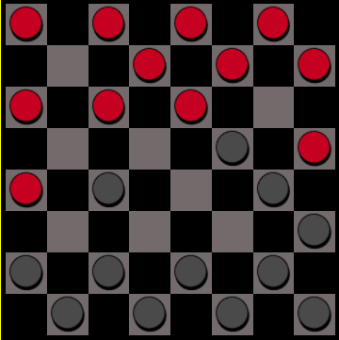
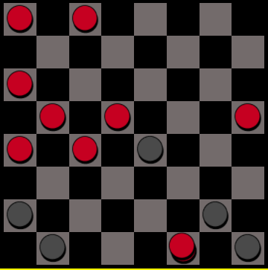
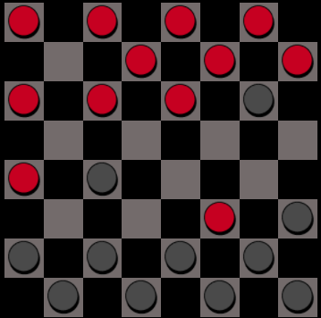
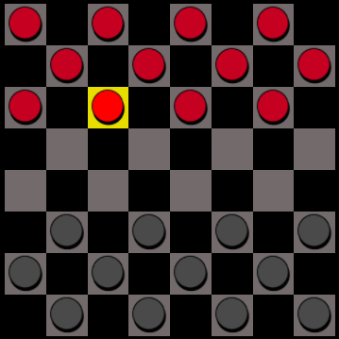

Slide 6
Content
Introduction - Daniel
Problems & Solutions - Henke
Some Code - Madde
Demo of Game - Daniel & Henke
Conclusions

Slide 7
Content
Introduction - Daniel
Problems & Solutions - Henke
Some Code - Madde
Demo of Game - Daniel & Henke
Conclusions

Slide 8
Content
Introduction - Daniel
Problems & Solutions - Henke
Some Code - Madde
Demo of Game - Daniel & Henke
Conclusions

Slide 9
Content
Introduction - Daniel
Problems & Solutions - Henke
Some Code - Madde
Demo of Game - Daniel & Henke
Conclusions

