Slide 1
Linear Feedback Shift Register (LFSR)
Elements of Applied Data Security
Alex Marchioni

Slide 2









LFSR
In an LFSR, the output from a standard shift register is fed back into its input in such a way as to cause the function to endlessly cycle through a sequence of patterns.
Linear
Feedback
$$p_{1}$$
$$p_{2}$$
$$p_{m−1}$$
$$p_{m}$$
Shift
Register
$$s_{m−1}$$
$$s_{m−2}$$
$$s_{1}$$
$$s_{0}$$
$$b$$
ck

Slide 3



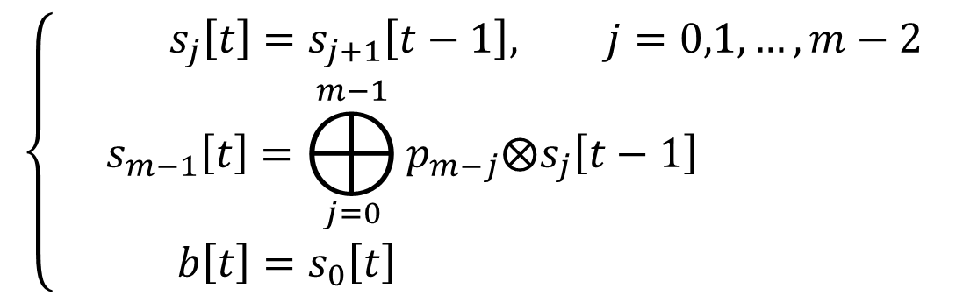





LFSR
From the block scheme:
$$\left\{\begin{aligned}{ s}_{j}\left[t\right]=s_{j+1}\left[t−1\right], j=0,1,…,m−2 \\ &s_{m−1}\left[t\right]=⨁_{j=0}^{m−1}{p_{m−j}⨂s_{j}\left[t−1\right]} \\ b\left[t\right]=s_{0}\left[t\right] \end{aligned}\right.$$
$$p_{1}$$
$$p_{2}$$
$$p_{m−1}$$
$$p_{m}$$
$$s_{m−1}$$
$$s_{m−2}$$
$$s_{1}$$
$$s_{0}$$
$$b$$
ck

Slide 4






















LFSR example
length = $3$
polynomial = $x^{3}+x+1$ ($p=0b1011$)
initial state $0b111$
$$s$$
$$b$$
$$fb$$
111 (7) 1 0
011 (3) 1 1
101 (5) 1 0
010 (2) 0 0
$$p_{1}=1$$
$$p_{2}=0$$
$$p_{3}=1$$
001 (1) 1 1
100 (4) 0 1
$$fb=1$$
$$fb=0$$
$$fb$$
$$s_{2}$$
$$s_{2}=1$$
$$s_{2}=0$$
$$s_{1}$$
$$s_{1}=1$$
$$s_{1}=0$$
$$s_{0}$$
$$s_{0}=1$$
$$s_{0}=0$$
$$b=1$$
$$b=0$$
$$b$$
110 (6) 0 1
ck
111 (7) 1 0

Slide 5
Task
Define a generator that implements an LFSR. Given a feedback polynomial and an initial state, it generates an infinite stream of bit.
Transform the LFSR generator in an iterator, so that it is possible to access to the internal state.
Compare the LFSR iterator with the one provided by the pylfsr Python package.
Define a function that implements the Berlekamp-Massey algorithm which finds the shortest LFSR that can generate the input bit stream.

Slide 6
Task 1: LFSR Generator

Slide 7
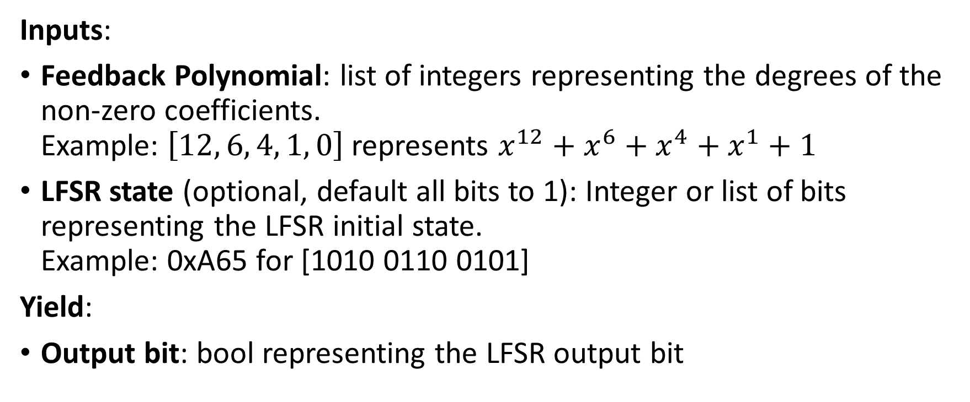
LFSR Generator
Inputs:
Feedback Polynomial: list of integers representing the degrees of the non-zero coefficients. Example: $\left[12, 6, 4, 1, 0\right]$ represents $x^{12}+x^{6}+x^{4}+x^{1}+1$
LFSR state (optional, default all bits to 1): Integer or list of bits representing the LFSR initial state. Example: 0xA65 for [1010 0110 0101]
Yield:
Output bit: bool representing the LFSR output bit

Slide 8
LFSR Generator
Template:
def lfsr_generator(poly, state=None):
''' generator docstring '''
# check inputs validity
# define variables storing the internal state
while True:
# LFSR iteration:
# - compute output from poly and state
# - update state
yield output

Slide 9
Infinite Iterables
To deal with iterables that counts an infinite number of elements, we can use the function islice from the built-in package itertools.
This function allows you to take a finite number of elements.
from itertools import islice
niter = ... # number of iterations
inputs = [...] # list of generator inputs
for b in islice(generator(*inputs), niter):
# do stuff
pass

Slide 10
Hints
There are many ways to implement a LFSR in Python.
The first choice to make is how to store the internal state and the polynomial. I suggest two types:
list of bool: it is the most straightforward choice as it directly maps the LFSR block scheme, but bit-wise logical operation may not be as easy.
integer: bit-wise logical operation, as well as bit-shift, are easy to perform on integers, while XOR of multiple bits or reversing the bit order are less straightforward.

Slide 11
Task 2: LFSR Iterator

Slide 12
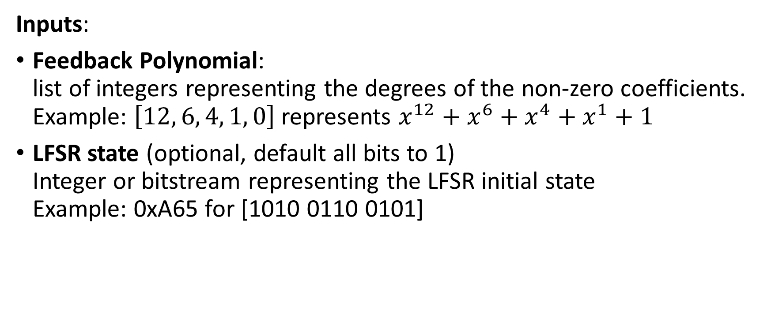
LFSR Iterator
Inputs:
Feedback Polynomial: list of integers representing the degrees of the non-zero coefficients. Example: $\left[12, 6, 4, 1, 0\right]$ represents $x^{12}+x^{6}+x^{4}+x^{1}+1$
LFSR state (optional, default all bits to 1) Integer or bitstream representing the LFSR initial state Example: 0xA65 for [1010 0110 0101]

Slide 13
LFSR Iterator
Attributes:
poly: list of the polynomial coefficients (list of int)
len: polynomial degree and length of the shift register (int)
state: LFSR state (int)
output: output bit (bool)
feedback: last feedback bit (bool)

Slide 14
LFSR Iterator
Methods:
__init__: class constructor;
__iter__: necessary to be an iterable;
__next__: update LFSR state and returns output bit;
cycle: returns a list of bool representing the full LFSR cycle ;
run_steps: execute N LFSR steps and returns the corresponding output list of bool (N is a input parameter, default N=1);
__str__: return a string describing the LFSR class instance.

Slide 15
LFSR Iterator
class LFSR(object):
''' class docstring '''
def __init__(self, poly, state=None):
''' constructor docstring '''
...
self.poly = ...
self.len = ...
self.state = ...
self.output = ...
self.feedback = ...
def __iter__(self):
return self
def __next__(self):
''' next docstring '''
...
return self.output
def run_steps(self, N=1):
''' run_steps docstring '''
...
return list_of_bool
def cycle(self, state=None):
''' cycle docstring '''
...
return list_of_bool

Slide 16
Task 3: Comparison with pylfsr

Slide 17
pylfsr
pylfsr implements a class LFSR similar to the one you are asked to implement. Here are some available methods:
LFSR.next(): run one cycle on LFSR with given feedback polynomial and update the state, feedback bit, and output bit.
LFSR.runKCycle(k): run k cycles and update all the Parameters.
LFSR.runFullCycle(): run full cycle ( = 2^M-1, where M is the poly degree)
LFSR.info(): display the information about LFSR
Try to implement an LFSR with both your class and the one in pylfsr and compare the generated streams of bits.

Slide 18
Task 4: Berlekamp-Massey Algorithm

Slide 19
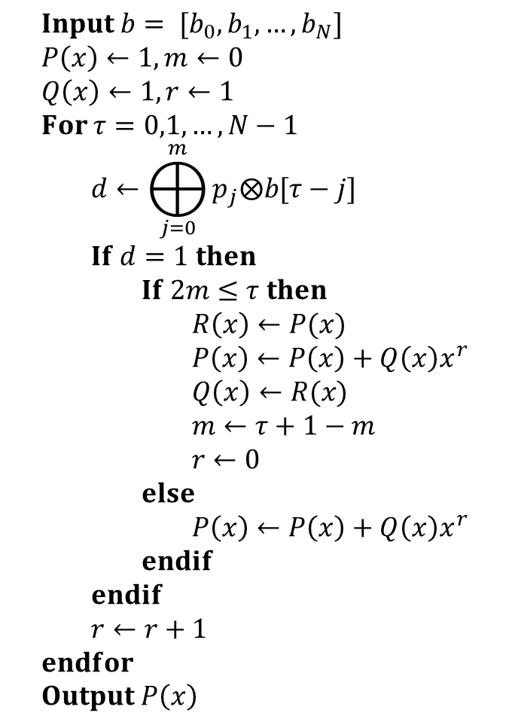
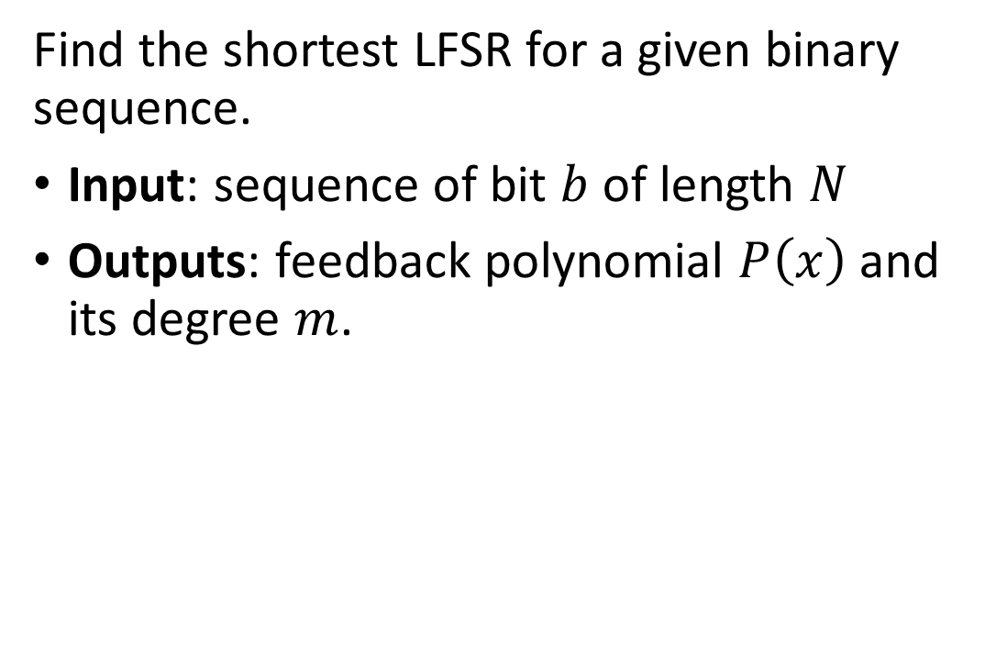
Berlekamp-Massey Algorithm
$$Input b= [b_{0}, b_{1}, …, b_{N}] \\ P\left(x\right)←1, m←0 \\ Q\left(x\right)←1, r←1 \\ For τ=0,1,…,N−1 \\ d←⨁_{j=0}^{m}{p_{j}⨂b[τ−j]} \\ If d=1 then \\ If 2m≤τ then \\ R\left(x\right)←P(x) \\ P\left(x\right)←P\left(x\right)+Q\left(x\right)x^{r} \\ Q\left(x\right)←R(x) \\ m←τ+1−m \\ r←0 \\ else \\ P\left(x\right)←P\left(x\right)+Q\left(x\right)x^{r} \\ endif \\ endif \\ r←r+1 \\ endfor \\ Output P\left(x\right)$$
Find the shortest LFSR for a given binary sequence.
Input: sequence of bit $b$ of length $N$
Outputs: feedback polynomial $P\left(x\right)$ and its degree $m$.
def berlekamp_massey(b):
''' function docstring '''
# algorithm implementation
return poly

Slide 20

























Berlekamp-Massey Algorithm
$$Input b= [b_{0}, b_{1}, …, b_{N}] \\ P\left(x\right)←1, m←0 \\ Q\left(x\right)←1, r←1 \\ For τ=0,1,…,N−1 \\ d←⨁_{j=0}^{m}{p_{j}⨂b[τ−j]} \\ If d=1 then \\ If 2m≤τ then \\ R\left(x\right)←P(x) \\ P\left(x\right)←P\left(x\right)+Q\left(x\right)x^{r} \\ Q\left(x\right)←R(x) \\ m←τ+1−m \\ r←0 \\ else \\ P\left(x\right)←P\left(x\right)+Q\left(x\right)x^{r} \\ endif \\ endif \\ r←r+1 \\ endfor \\ Output P\left(x\right)$$
$$τ$$
$$b_{τ}$$
$$d$$
$$P(x)$$
$$m$$
$$Q(x)$$
$$r$$
- - -
$$1$$
0
$$1$$
1
0 1 1 A
$$1+x$$
1
$$1$$
1
1 0 1 B
$$1$$
1
$$1$$
2
A
2 1 1 A
$$1+x^{2}$$
2
$$1$$
1
3 0 0
$$1+x^{2}$$
2
$$1$$
2
4 0 1 A
$$1$$
3
$$1+x^{2}$$
1
B
5 1 1 B
$$1+x+x^{3}$$
3
$$1+x^{2}$$
2
6 1 0
$$1+x+x^{3}$$
3
$$1+x^{2}$$
3
7 1 0
$$1+x+x^{3}$$
3
$$1+x^{2}$$
4

