Slide 1
Introduction to Python
Alex Marchioni

Slide 2
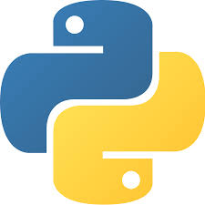
Python
Python is an Interpreted and Object-Oriented Programming Language.
WHY Python?
Simple syntax
Very flexible
Highly extensible
Cross-platform
Open-source with a huge community
Google says: Python where we can, C++ where we must

Slide 3
A bit of History
It is not so recent, since it was conceived in the late 1980s and implemented in 90s by Guido van Rossum.
Name is a tribute to Monty Python (a British surreal comedy group) in fact, as metasyntactic variables spam and eggs preferred to the traditional foo and bar
Python 2.0 released on Oct 2000, not supported since 01/2020
Python 3.0 released on Dec 2008
Last release is 3.8.2 on Feb 2020 (https://www.python.org/downloads/)

Slide 4
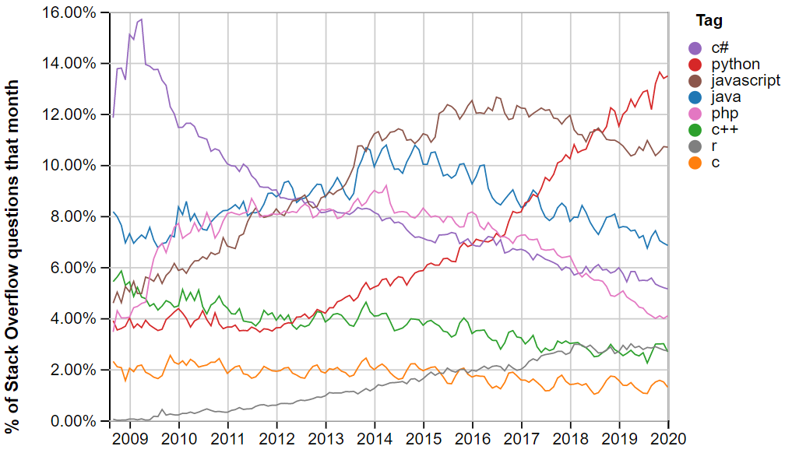
Popularity
According to StackOverflow's survey and trends Python among all programming languages is the:
1st most questioned
4th most used behind JavaScript, HTML/CSS, and SQL
2nd most loved behind Rust
1st most wanted developers who do not yet use it say they want to learn it

Slide 5
The Zen of Python (PEP 20)
Beautiful is better than ugly
Explicit is better than implicit
Simple is better than complex
Complex is better than complicated
Readability counts
P vs NP (… Pythonic vs Non-Pythonic)

Slide 6
Applications for Python
Web and Internet Development
Scientific and Numeric
Education
Desktop GUIs
Software Development
Business Applications
Basically everything -> It’s becoming as English for spoken languages

Slide 7
Scipy.org
Scipy.org = Python for math/science/engineering
Numpy: Numerical Python package (inspired by Matlab)
N-dimensional array capabilities and some linear algebra, Fourier analysis, random number capabilities, etc.
Scipy: Scientific Python
For Matlab users, it's very much like many of the core toolboxes.
Matplotlib: most popular plotting (data visualization) routine package for Python
Pandas: Data Science Python
high-performance, easy-to-use data structures and data analysis tools

Slide 8
IPython & Jupyter Notebook
Jupyter Notebook is a web-based interactive computational environment, that supports different languages (Python, R, Julia, C++)
IPython (Interactive Python) is the kernel that allows Python to be run on a Jupyter Notebook.

