Slide 1
Introduction to Python
Elements of Applied Data Security
Alex Marchioni

Slide 2
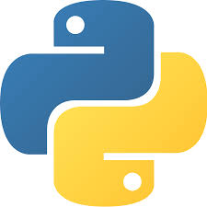
Python
Python is an Interpreted and Object-Oriented Programming Language.
WHY Python?
Simple syntax
Very flexible
Highly extensible
Cross-platform
Open-source with a huge community
Google says: Python where we can, C++ where we must

Slide 3
A bit of History
It is not so recent, since it was conceived in the late 1980s and implemented in 90s by Guido van Rossum.
Name is a tribute to Monty Python (a British surreal comedy group) in fact, as metasyntactic variables spam and eggs preferred to the traditional foo and bar
Python 2.0 released on Oct 2000, not supported since 01/2020
Python 3.0 released on Dec 2008
Last release is 3.8.2 on Feb 2020 (https://www.python.org/downloads/)

Slide 4
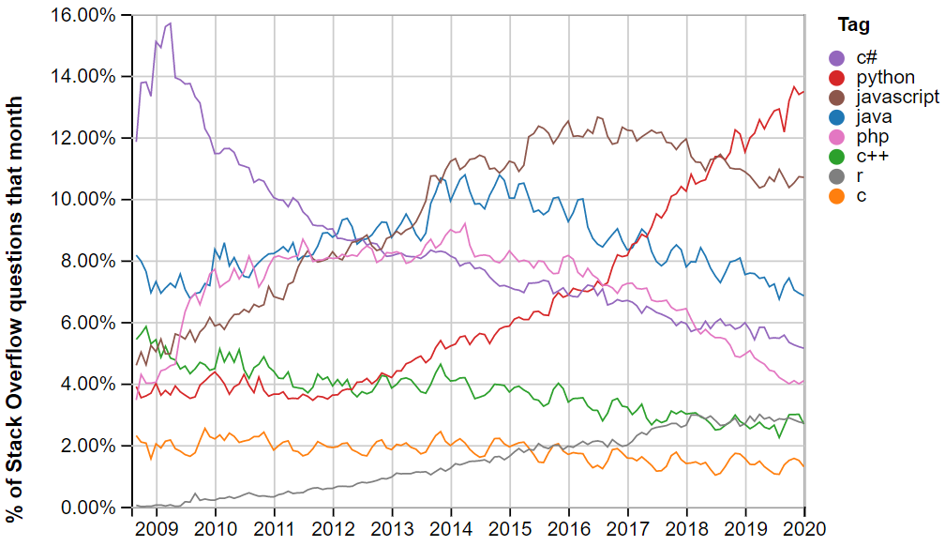
Popularity
According to StackOverflow's survey and trends Python among all programming languages is the:
1st most questioned
4th most used behind JavaScript, HTML/CSS, and SQL
2nd most loved behind Rust
1st most wanted developers who do not yet use it say they want to learn it

Slide 5
Applications for Python
Web and Internet Development
Scientific and Numeric
Education
Desktop GUIs
Software Development
Business Applications
Basically anything, like English for spoken languages

Slide 6
Scipy
Scipy.org = Python for math/science/engineering
Numpy: Numerical Python package (inspired by Matlab)
N-dimensional array capabilities and some linear algebra, Fourier analysis, random number capabilities, etc.
Scipy: Scientific Python
For Matlab users, it's very much like many of the core toolboxes.
Matplotlib: most popular data visualization package for Python
Inspired by Matlab plots, but then it has evolved into something more.
Pandas: Data Science Python
high-performance, easy-to-use data structures and data analysis tools

Slide 7
IPython & Jupyter Notebook
Jupyter Notebook is a web-based interactive computational environment, that supports different languages (Python, R, Julia, C++)
IPython (Interactive Python) is the kernel that allows Python to be run on a Jupyter Notebook.

Slide 8
Let’s start
We will get start with a short tutorial on Python.
Clone/download this repository: https://github.com/marchioa/data-security
There, in the folder 1.intro-to-python the file enviroment_setup.md lists all the instructions to set up the environment we will work on.
Once the environment is ready and Jupyter has started you can start opening the notebooks (.ipynb files) composing the tutorial. With great imagination, 1.LETS_START.ipynb is the first one.

