Slide 1
Stream Ciphers
Elements of Applied Data Security
Alex Marchioni

Slide 2






Stream Cipher
Symmetric key cipher where the plaintext is encrypted one digit at a time. Encryption is achieved by xoring the plaintext with a stream of pseudorandom bits obtained as an expansion of the key.
Alice
Bob
key
key expansion
key expansion
plaintext
$$s\left[t\right]$$
ciphertext
$$s\left[t\right]$$
plaintext
$$b\left[t\right]$$
$$e\left[t\right]$$
$$b\left[t\right]$$

Slide 3
Task
Define an object representing a Stream Cipher that, given a PRNG and a key, can encrypt and decrypt a message one bit at a time.
Define an iterator that implements a PRNG based on the A5/1 architecture and use it in the Stream Cipher object previously implemented to encrypt/decrypt a message.
Add to the StreamCipher class the possibility to encrypt/decrypt a message using bytes as digits instead of bits.
Define an iterator that implements a PRNG based on the RC4 architecture and use it in the new Stream Cipher object to encrypt/decrypt a message

Slide 4
Task 1: Stream Cipher

Slide 5
Stream Cipher
Inputs:
key: integer representing the shared secret key.
PRNG (optional, default None): Iterator implementing a PRNG that produce a pseudorandom bit stream starting from an initial seed. If None an LFSR is used as PRNG.
Methods:
encrypt: encrypts a plaintext (str, bytes) and returns the corresponding cyphertext (bytes);
decrypt: decrypts a cypertext (str, bytes) and returns the corresponding plaintext (bytes);

Slide 6
Stream Cipher
class StreamCipher(object):
''' class docstring '''
def __init__(self, key, prng=None):
''' constructor docstring '''
# do stuff
self.prng = ...
def encrypt(self, plaintext):
# do stuff
return ciphertext
def decrypt(self, ciphertext):
# do stuff
return plaintext
Template:

Slide 7
Stream Cipher Example
message = 'hello world!'
key = 0x0123456789ABCDEF
# define a function that create an instance of an LFSR
prng = lambda key: LFSR([64, 4, 3, 1, 0], state=key)
# create a StreamCipher instance for both Alice and Bob
alice = StreamCipher(key, prng=prng)
bob = StreamCipher(key, prng=prng)
plaintextA = message.encode('utf-8') # string to bytes
ciphertext = alice.encrypt(plaintextA) # encryption by Alice
plaintextB = bob.decrypt(ciphertext) # decryption by Bob
print(plaintextA) # -> b'hello world!'
print(ciphertext) # -> b'\x87\x02\xc7O\xa2e\xfen\x14\xfb\xafv'
print(plaintextB) # -> b'hello world!'

Slide 8
bitstring
bitstring is a pure Python module designed to help creation and analysis of binary data.
It implements the following classes:
BitArray: a container for binary data.
BitStream: adds a bit inserting and reading methods to treat the data as a stream.
Here is a Walkthrough to get started: https://pythonhosted.org/bitstring/walkthrough.html#

Slide 9
Task 2: A5/1

Slide 10
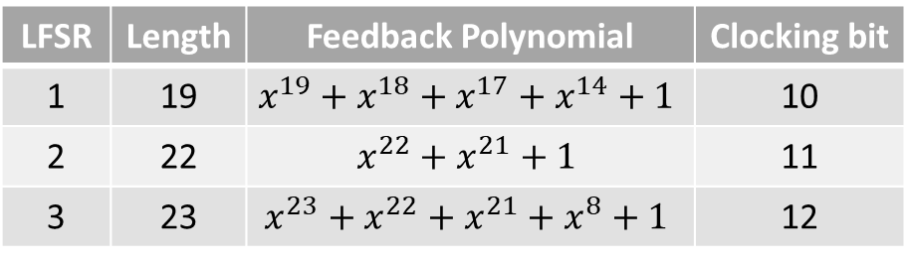
A5/1
The stream cipher used to provide privacy in the GSM cellular telephone standard.
Based on a combination of three LFSRs with irregular clocking.
At each cycle, the clocking bit of all three registers is examined and the majority bit is determined. A register is clocked if the clocking bit agrees with the majority bit.
LFSR | Length | Feedback Polynomial | Clocking bit
1 | 19 | $$x^{19}+x^{18}+x^{17}+x^{14}+1$$ | 10
2 | 22 | $$x^{22}+x^{21}+1$$ | 11
3 | 23 | $$x^{23}+x^{22}+x^{21}+x^{8}+1$$ | 12

Slide 11
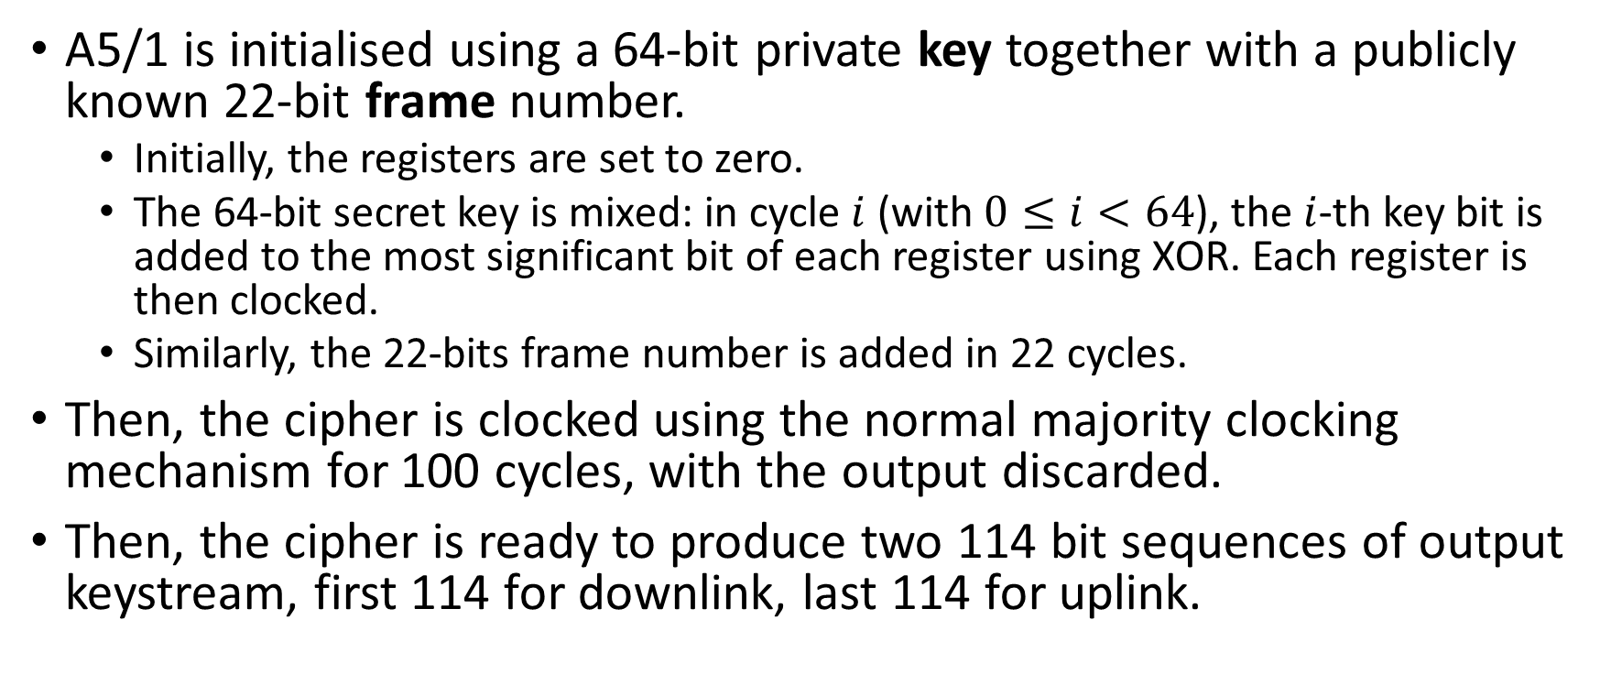
A5/1
A5/1 is initialised using a 64-bit private key together with a publicly known 22-bit frame number.
Initially, the registers are set to zero.
The 64-bit secret key is mixed: in cycle $i$ (with $0≤i<64$), the $i$-th key bit is added to the most significant bit of each register using XOR. Each register is then clocked.
Similarly, the 22-bits frame number is added in 22 cycles.
Then, the cipher is clocked using the normal majority clocking mechanism for 100 cycles, with the output discarded.
Then, the cipher is ready to produce two 114 bit sequences of output keystream, first 114 for downlink, last 114 for uplink.

Slide 12




A5/1
$$LFSR_{1}$$
14
17
18
19
18
17
16
15
14
13
12
11
10
9
8
7
6
5
4
3
2
1
0
$$LFSR_{2}$$
21
22
21
20
19
18
17
16
15
14
13
12
11
10
9
8
7
6
5
4
3
2
1
0
$$b$$
$$LFSR_{3}$$
8
21
22
23
22
21
20
19
18
17
16
15
14
13
12
11
10
9
8
7
6
5
4
3
2
1
0
M

Slide 13
A5/1
Define a Iterator that implements the A5/1 stream cipher.
Given a key and a frame number, encrypt and decrypt a message.
message = 'hello world!’
key, frame = 0x0123456789ABCDEF, 0x2F695A
# create a StreamCipher instance for both Alice and Bob
alice = StreamCipher(key, prng=A5_1, frame=frame)
bob = StreamCipher(key, prng=A5_1, frame=frame)
plaintextA = message.encode('utf-8’) # -> b'Hello world!'
ciphertext = alice.encrypt(plaintextA) # -> b'I\x04\x04\xe8E&\x89Vr_j\x9d'
plaintextB = bob.decrypt(ciphertext) # -> b'Hello world!'

Slide 14
A5/1 Key insertion
iter key LFSR1 LFSR2 LFSR3 out maj
1 1 40000 200000 400000 0 0
2 1 60000 300000 600000 0 0
3 1 70000 380000 700000 0 0
4 1 78000 3c0000 780000 0 0
5 0 3c000 1e0000 3c0000 0 0
6 1 5e000 2f0000 5e0000 0 0
7 1 6f000 378000 6f0000 0 0
8 1 77800 3bc000 778000 0 0
9 1 7bc00 3de000 3bc000 0 0
10 0 3de00 1ef000 5de000 0 0
11 1 5ef00 2f7800 2ef000 1 0
12 1 6f780 37bc00 177800 1 0
13 0 37bc0 1bde00 0bbc00 1 0
14 0 1bde0 0def00 45de00 1 0
15 1 0def0 26f780 22ef00 0 0
16 1 06f78 337bc0 117780 1 0
17 1 037bc 39bde0 48bbc0 1 0
18 1 41bde 3cdef0 245de0 1 0
19 0 20def 1e6f78 122ef0 1 1
20 1 506f7 2f37bc 491778 1 1
21 0 2837b 179bde 248bbc 0 1
iter key LFSR1 LFSR2 LFSR3 out maj
22 1 141bd 0bcdef 5245de 0 0
23 0 4a0de 05e6f7 2922ef 0 0
24 1 6506f 22f37b 149177 0 1
25 1 72837 3179bd 4a48bb 0 1
26 0 3941b 38bcde 25245d 1 0
27 0 1ca0d 3c5e6f 12922e 1 0
28 1 4e506 3e2f37 094917 1 0
29 0 27283 1f179b 44a48b 0 1
30 0 13941 0f8bcd 625245 1 1
31 0 49ca0 27c5e6 312922 0 0
32 1 24e50 13e2f3 189491 1 0
33 1 52728 29f179 4c4a48 0 1
34 1 29394 14f8bc 662524 0 0
35 1 149ca 2a7c5e 331292 1 0
36 0 4a4e5 353e2f 598949 1 1
37 0 65272 1a9f17 2cc4a4 0 1
38 1 72939 2d4f8b 566252 0 0
39 1 7949c 36a7c5 2b3129 1 0
40 0 7ca4e 3b53e2 559894 0 0
41 1 7e527 1da9f1 6acc4a 1 0
42 0 3f293 2ed4f8 356625 0 0
iter key LFSR1 LFSR2 LFSR3 out maj
43 1 5f949 376a7c 5ab312 1 1
44 0 6fca4 1bb53e 2d5989 1 1
45 0 37e52 2dda9f 56acc4 1 1
46 0 5bf29 16ed4f 2b5662 1 0
47 1 6df94 2b76a7 15ab31 0 0
48 0 76fca 15bb53 0ad598 1 1
49 1 3b7e5 2adda9 056acc 1 0
50 1 1dbf2 156ed4 02b566 1 0
51 0 0edf9 0ab76a 415ab3 1 0
52 0 076fc 255bb5 20ad59 1 0
53 0 03b7e 32adda 1056ac 1 0
54 1 01dbf 1956ed 082b56 0 0
55 0 00edf 2cab76 0415ab 1 0
56 0 4076f 3655bb 020ad5 0 1
57 1 603b7 3b2add 41056a 0 0
58 0 301db 3d956e 6082b5 0 0
59 0 180ed 3ecab7 70415a 0 0
60 0 4c076 1f655b 7820ad 0 0
61 0 6603b 0fb2ad 3c1056 0 0
62 0 7301d 27d956 1e082b 0 0
63 0 3980e 33ecab 0f0415 0 0
64 0 1cc07 19f655 07820a 0 0

Slide 15
A5/1 Frame number insertion
iter frame LFSR1 LFSR2 LFSR3 out maj
1 0 4e603 2cfb2a 03c105 1 0
2 1 67301 167d95 01e082 0 0
3 0 73980 2b3eca 00f041 1 1
4 1 79cc0 159f65 407820 1 1
5 1 7ce60 0acfb2 603c10 1 0
6 0 7e730 2567d9 301e08 1 1
7 1 3f398 12b3ec 580f04 0 0
8 0 1f9cc 0959f6 6c0782 0 0
9 1 0fce6 04acfb 3603c1 1 0
10 0 47e73 02567d 5b01e0 0 0
11 0 63f39 212b3e 2d80f0 1 1
12 1 71f9c 10959f 16c078 0 1
13 0 78fce 084acf 4b603c 1 1
14 1 7c7e7 242567 25b01e 1 0
15 1 7e3f3 3212b3 12d80f 0 1
16 0 7f1f9 190959 096c07 0 1
17 1 7f8fc 0c84ac 04b603 0 1
18 1 7fc7e 264256 025b01 1 1
19 1 3fe3f 13212b 012d80 0 0
20 1 5ff1f 299095 4096c0 1 0
21 0 6ff8f 34c84a 604b60 1 1
22 1 37fc7 1a6425 7025b0 0 0

Slide 16
A5/1 Key mixing (1)
iter LFSR1 LFSR2 LFSR3 out maj
1 37fc7 2d3212 3812d8 1 1
2 5bfe3 2d3212 1c096c 0 1
3 5bfe3 369909 4e04b6 1 0
4 6dff1 3b4c84 4e04b6 1 1
5 36ff8 1da642 4e04b6 0 0
6 36ff8 2ed321 27025b 0 0
7 36ff8 376990 13812d 1 1
8 5b7fc 1bb4c8 13812d 0 1
9 5b7fc 0dda64 49c096 1 0
10 2dbfe 06ed32 49c096 0 0
11 56dff 06ed32 64e04b 1 0
12 2b6ff 237699 64e04b 0 1
13 2b6ff 31bb4c 727025 1 0
14 15b7f 18dda6 393812 1 1
15 15b7f 2c6ed3 5c9c09 1 1
16 15b7f 163769 2e4e04 0 0
17 0adbf 2b1bb4 572702 1 1
18 056df 158dda 572702 1 1
19 42b6f 2ac6ed 572702 0 0
20 215b7 356376 6b9381 1 0
iter LFSR1 LFSR2 LFSR3 out maj
21 10adb 356376 35c9c0 0 1
22 0856d 3ab1bb 5ae4e0 0 0
23 0856d 1d58dd 6d7270 1 0
24 442b6 2eac6e 36b938 1 0
25 442b6 375637 5b5c9c 0 1
26 6215b 1bab1b 5b5c9c 1 0
27 6215b 0dd58d 6dae4e 0 0
28 310ad 26eac6 76d727 1 0
29 310ad 337563 3b6b93 0 1
30 58856 19bab1 1db5c9 1 0
31 58856 2cdd58 0edae4 1 0
32 58856 166eac 076d72 0 0
33 2c42b 166eac 43b6b9 1 0
34 56215 0b3756 21db5c 0 1
35 2b10a 259bab 21db5c 1 1
36 2b10a 12cdd5 10edae 0 1
37 55885 12cdd5 4876d7 1 1
38 55885 2966ea 643b6b 0 0
39 2ac42 34b375 643b6b 1 0
40 55621 34b375 321db5 1 1
iter LFSR1 LFSR2 LFSR3 out maj
41 2ab10 34b375 190eda 0 1
42 15588 3a59ba 4c876d 1 1
43 0aac4 3d2cdd 4c876d 0 0
44 45562 3d2cdd 6643b6 1 1
45 22ab1 3e966e 6643b6 0 1
46 11558 3f4b37 3321db 1 0
47 08aac 1fa59b 3321db 0 0
48 04556 0fd2cd 1990ed 1 0
49 022ab 0fd2cd 4cc876 0 0
50 41155 27e966 66643b 0 0
51 208aa 27e966 33321d 1 1
52 208aa 33f4b3 19990e 0 1
53 10455 19fa59 19990e 1 0
54 0822a 2cfd2c 4ccc87 0 1
55 04115 2cfd2c 266643 0 0
56 0208a 2cfd2c 133321 1 1
57 0208a 167e96 499990 1 0
58 0208a 2b3f4b 64ccc8 0 1
59 41045 2b3f4b 726664 0 0
60 20822 2b3f4b 793332 1 1

Slide 17
A5/1 Key mixing (2)
iter LFSR1 LFSR2 LFSR3 out maj
61 20822 159fa5 7c9999 1 0
62 20822 2acfd2 3e4ccc 0 0
63 10411 2acfd2 5f2666 1 1
64 48208 3567e9 5f2666 0 1
65 24104 3ab3f4 2f9333 0 1
66 52082 1d59fa 2f9333 1 1
67 52082 2eacfd 57c999 0 0
68 69041 2eacfd 2be4cc 0 0
69 74820 2eacfd 15f266 1 1
70 74820 37567e 4af933 0 1
71 7a410 3bab3f 4af933 1 0
72 3d208 1dd59f 657c99 0 0
73 1e904 0eeacf 657c99 1 0
74 1e904 077567 72be4c 0 1
75 4f482 03bab3 72be4c 1 1
76 67a41 01dd59 395f26 1 0
77 67a41 20eeac 1caf93 0 0
78 73d20 20eeac 4e57c9 1 1
79 79e90 107756 672be4 0 0
80 79e90 283bab 7395f2 1 1
iter LFSR1 LFSR2 LFSR3 out maj
81 3cf48 141dd5 39caf9 1 0
82 1e7a4 2a0eea 39caf9 1 1
83 0f3d2 350775 39caf9 0 0
84 479e9 3a83ba 1ce57c 0 1
85 23cf4 3d41dd 0e72be 1 1
86 11e7a 3d41dd 07395f 1 0
87 08f3d 3d41dd 439caf 1 1
88 4479e 3d41dd 21ce57 0 0
89 4479e 3ea0ee 10e72b 0 1
90 4479e 3f5077 487395 1 0
91 223cf 3f5077 2439ca 0 0
92 511e7 1fa83b 2439ca 1 0
93 511e7 0fd41d 521ce5 0 1
94 288f3 27ea0e 521ce5 1 0
95 288f3 33f507 290e72 0 0
96 54479 19fa83 548739 1 1
97 2a23c 0cfd41 548739 0 0
98 1511e 0cfd41 2a439c 0 1
99 0a88f 0cfd41 5521ce 0 0
100 45447 0cfd41 2a90e7 1 1

Slide 18
Task 3: Stream Cipher (2)

Slide 19
Stream Cipher (2)
Inputs:
key: integer representing the shared secret key.
PRNG (optional, default None): Iterator implementing a PRNG that produce a pseudorandom digit stream starting from an initial seed. A digit can be either a bit or a byte depending on the value of the digit parameter. If None an LFSR is used as PRNG with bit as digit.
digit: (optional, default “bit”) string to determine the type of digit “bit” or “byte”.
Methods: encrypt and decrypt as before

Slide 20
Stream Cipher
class StreamCipher(object):
''' class docstring '''
def __init__(self, key, prng=None, digit='bit'):
''' constructor docstring '''
# do stuff
self.prng = ...
def encrypt(self, plaintext):
# do stuff
return ciphertext
def decrypt(self, ciphertext):
# do stuff
return plaintext
Template:

Slide 21
Task 4: RC4

Slide 22
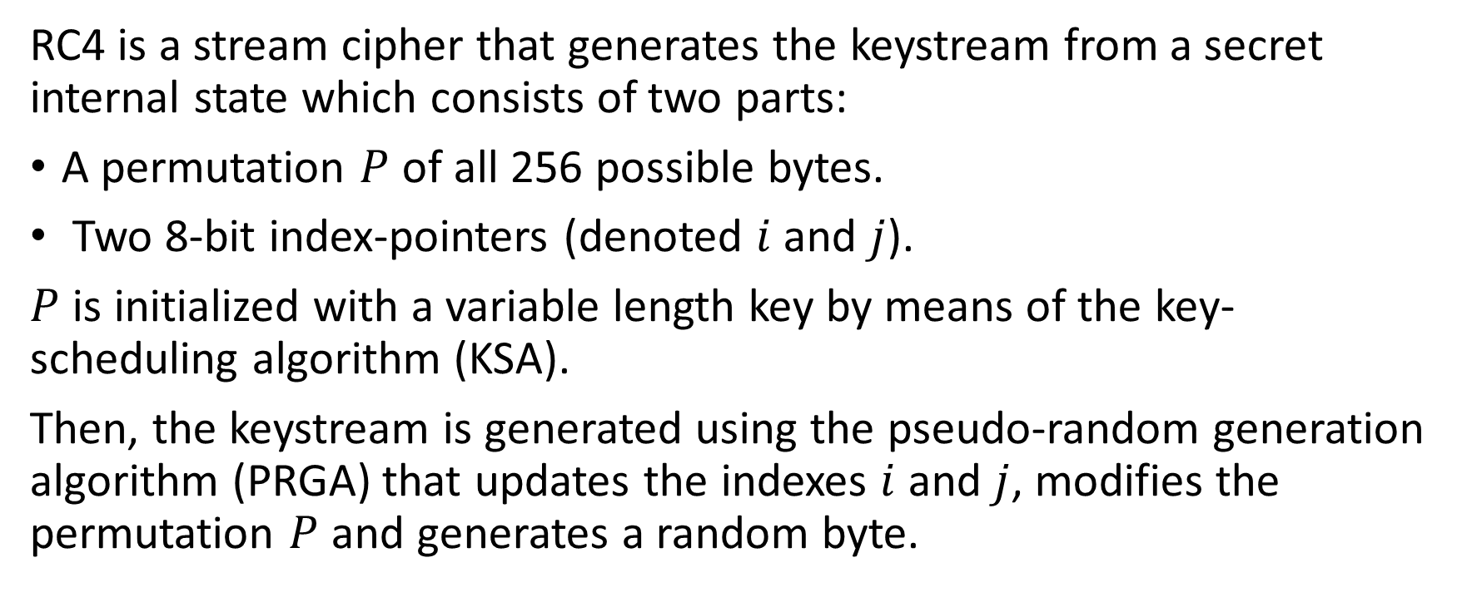
Rivest Cipher 4 (RC4)
RC4 is a stream cipher that generates the keystream from a secret internal state which consists of two parts:
A permutation $P$ of all 256 possible bytes.
Two 8-bit index-pointers (denoted $i$ and $j$).
$P$ is initialized with a variable length key by means of the key-scheduling algorithm (KSA).
Then, the keystream is generated using the pseudo-random generation algorithm (PRGA) that updates the indexes $i$ and $j$, modifies the permutation $P$ and generates a random byte.

Slide 23
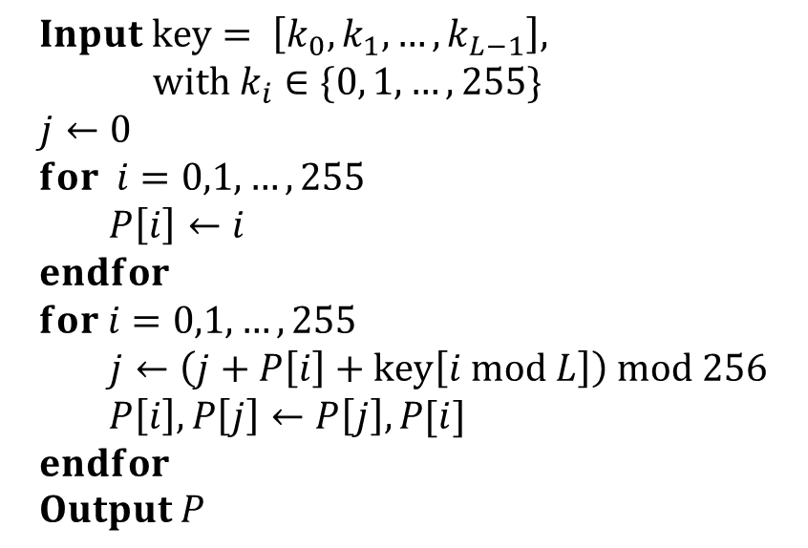
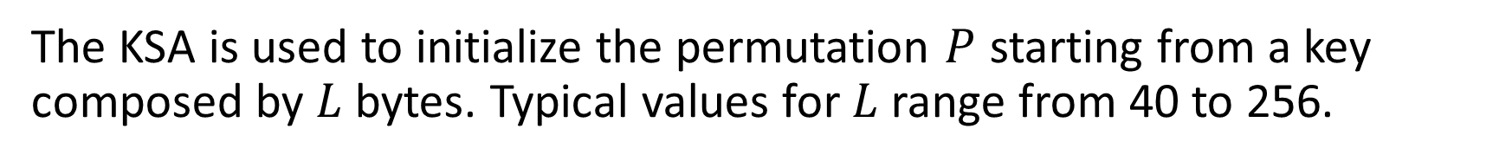
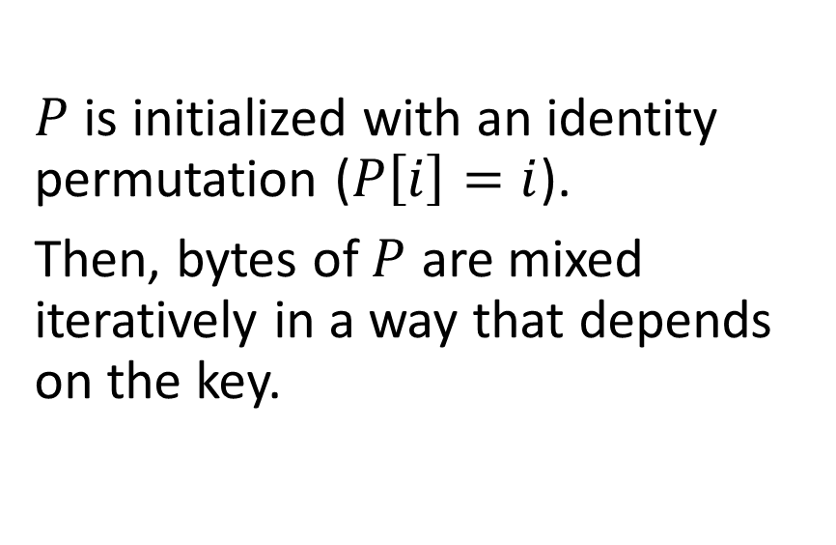
Key Scheduling Algorithm (KSA)
The KSA is used to initialize the permutation $P$ starting from a key composed by $L$ bytes. Typical values for $L$ range from 40 to 256.
$$Input key= \left[k_{0}, k_{1}, …, k_{L−1}\right], \\ with k_{i}∈\{0, 1,…,255\} \\ j←0 \\ for i=0,1,…,255 \\ P\left[i\right]←i \\ endfor \\ for i=0,1,…,255 \\ j←\left(j+P\left[i\right]+key\left[i mod L\right]\right) mod 256 \\ P\left[i\right], P\left[j\right]←P\left[j\right],P[i] \\ endfor \\ Output P$$
$P$ is initialized with an identity permutation ($P\left[i\right]=i$).
Then, bytes of $P$ are mixed iteratively in a way that depends on the key.

Slide 24
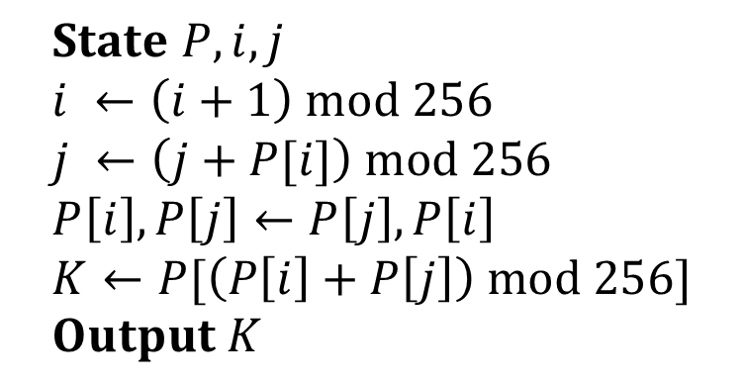
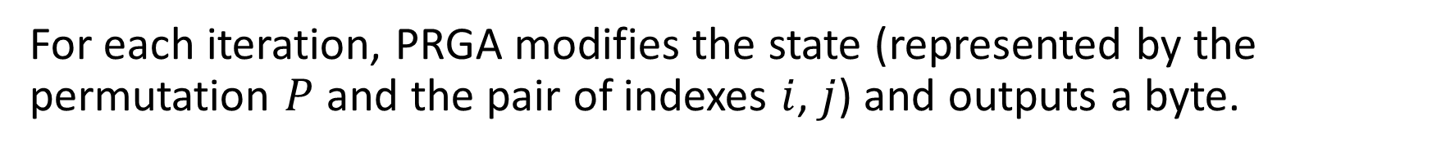
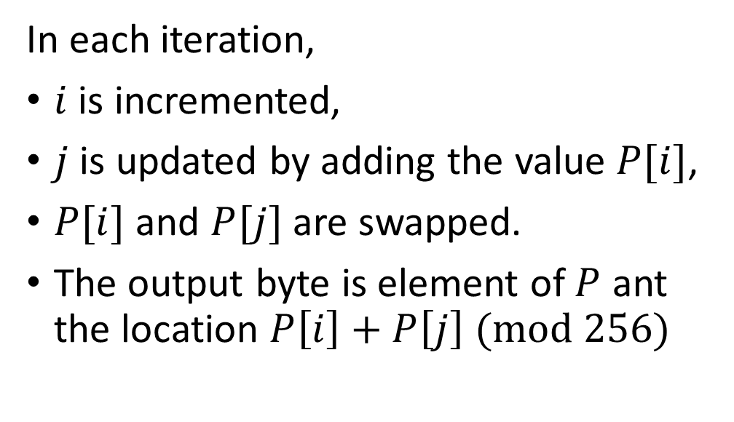
Pseudo-random generation Algorithm (PRGA)
For each iteration, PRGA modifies the state (represented by the permutation $P$ and the pair of indexes $i$, $j$) and outputs a byte.
In each iteration,
$i$ is incremented,
$j$ is updated by adding the value $P[i]$,
$P[i]$ and $P[j]$ are swapped.
The output byte is element of $P$ ant the location $P\left[i\right]+P\left[j\right] (mod 256)$
$$State P, i, j \\ i ←\left(i+1\right) mod 256 \\ j ←\left(j+P[i]\right) mod 256 \\ P\left[i\right], P\left[j\right]←P\left[j\right],P\left[i\right] \\ K←P[\left(P\left[i\right]+P\left[j\right]\right) mod 256] \\ Output K$$

Slide 25
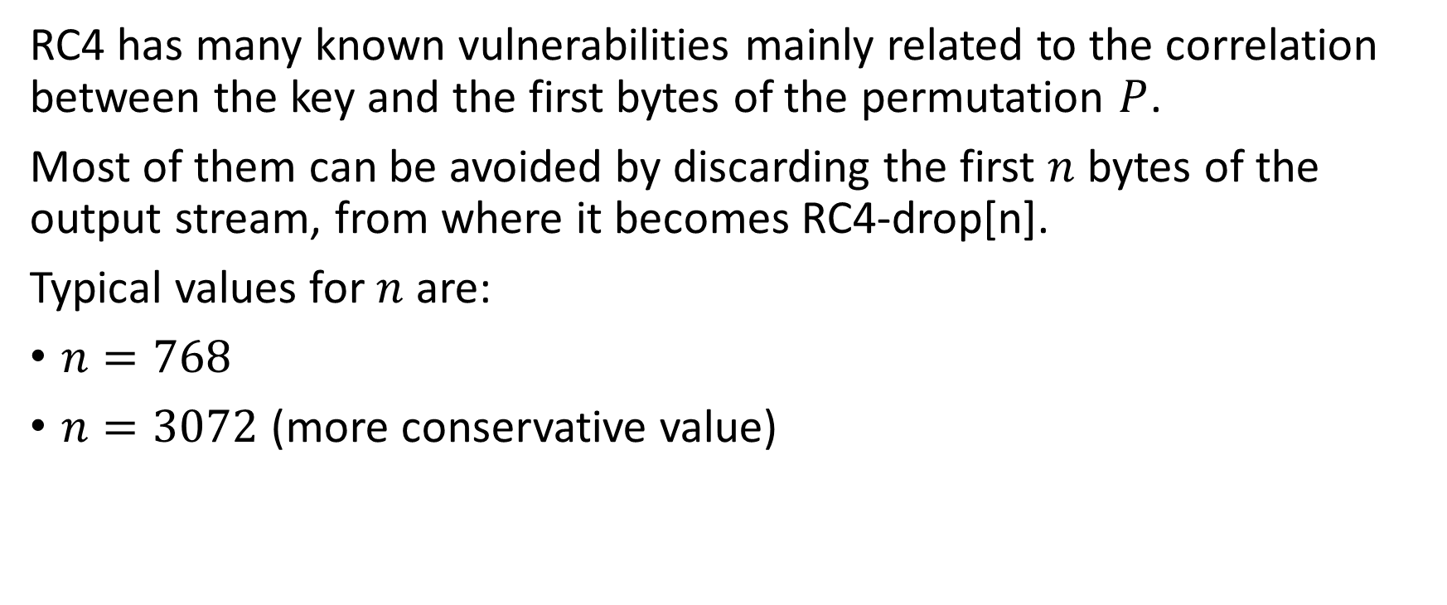
RC4-drop[n]
RC4 has many known vulnerabilities mainly related to the correlation between the key and the first bytes of the permutation $P$.
Most of them can be avoided by discarding the first $n$ bytes of the output stream, from where it becomes RC4-drop[n].
Typical values for $n$ are:
$n=768$
$n=3072$ (more conservative value)

Slide 26
RC4
Define a Iterator that implements the RC4 stream cipher.
Given a key and a drop number, encrypt and decrypt a message.
message = 'hello world!’
key = b'0123456789ABCDEF'
# create a StreamCipher instance for both Alice and Bob
alice = StreamCipher(key, digit='byte', prng=RC4, drop=10)
bob = StreamCipher(key, digit='byte', prng=RC4, drop=10)
plaintextA = message.encode('utf-8') # -> b'Hello world!'
ciphertext = alice.encrypt(plaintextA) # -> b'/\x9e\xf9\x83@\x81}\xa9\xd0\xd4\xd5\xf4'
plaintextB = bob.decrypt(ciphertext) # -> b'Hello world!'

Slide 27




$$LFSR_{1}$$
14
17
18
19
18
17
16
15
14
13
12
11
10
9
8
7
6
5
4
3
2
1
0
$$LFSR_{2}$$
21
22
21
20
19
18
17
16
15
14
13
12
11
10
9
8
7
6
5
4
3
2
1
0
$$b$$
$$LFSR_{3}$$
8
21
22
23
22
21
20
19
18
17
16
15
14
13
12
11
10
9
8
7
6
5
4
3
2
1
0
M

Slide 28





Alice
Bob
key
key expansion
key expansion
plaintext
$$s\left[t\right]$$
ciphertext
$$s\left[t\right]$$
plaintext
$$b\left[t\right]$$
$$e\left[t\right]$$
$$b\left[t\right]$$

