Slide 1
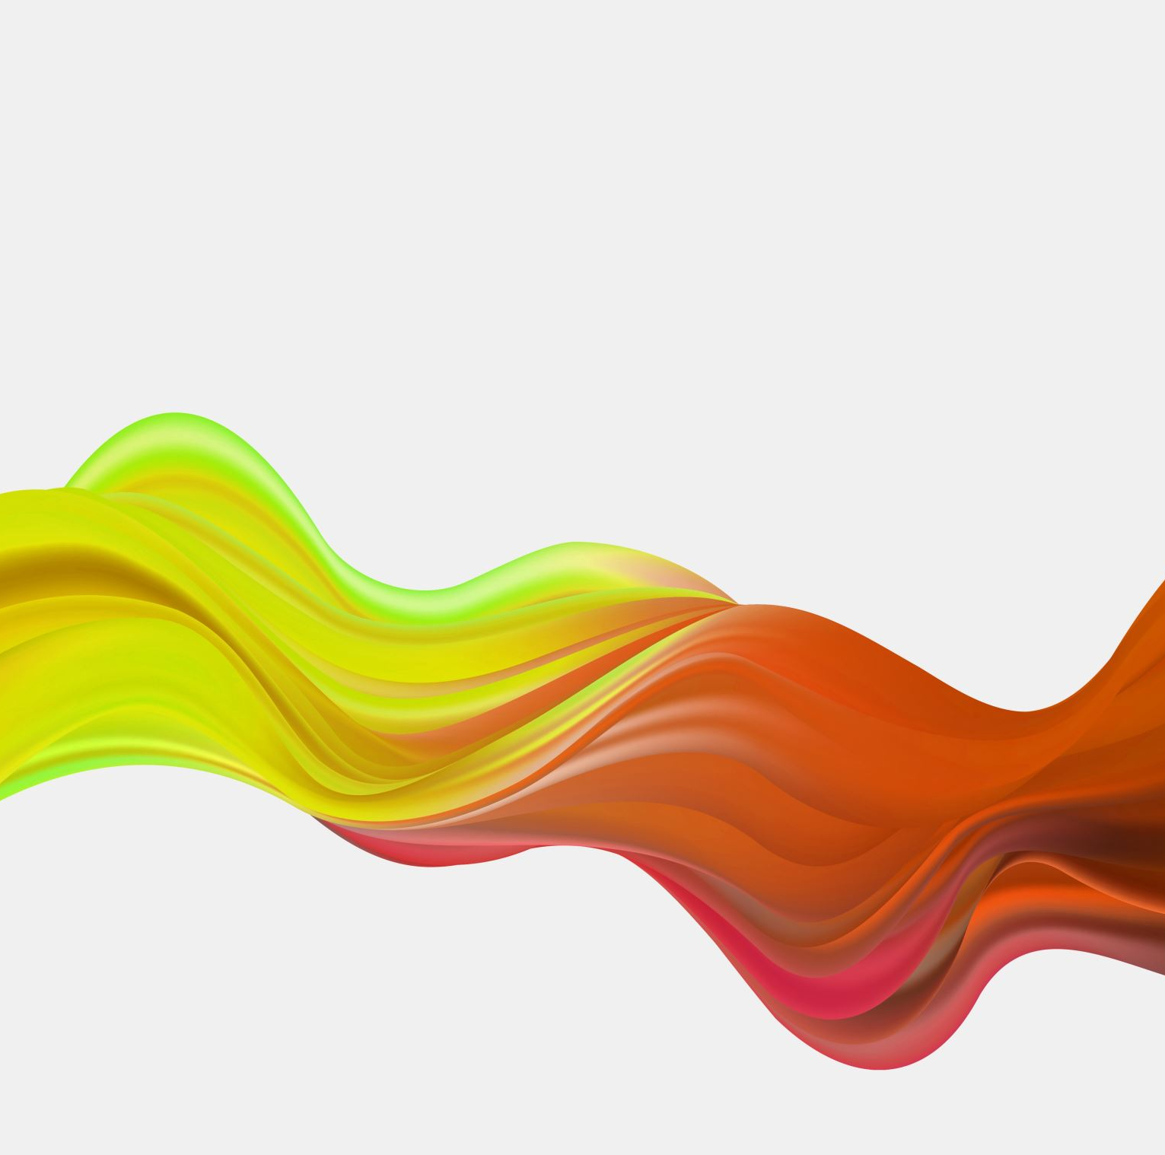
No Mesh? No Problem - openFoam meets PINNs
In Navier Stokes incompressible laminar flows
Mek4470
Henrik Haug

Slide 2
What are PINNs, and why use them?
Multilayer perceptron (MLP)
Meshless architecture
Datapoint validation
PDE residual is embedded directly into the loss function
Data Efficient (Does not need training data for solving the forward problem)
Perform well on inverse problems
openFoam | Pinn
Mesh | Collocation points
FVM discretizatrion | Automatic differentiation via JAX
PISO pressure-velocity coupling | continuity is enforced through loss function
Linear solver per timestep | Gradient descent over all time

Slide 3
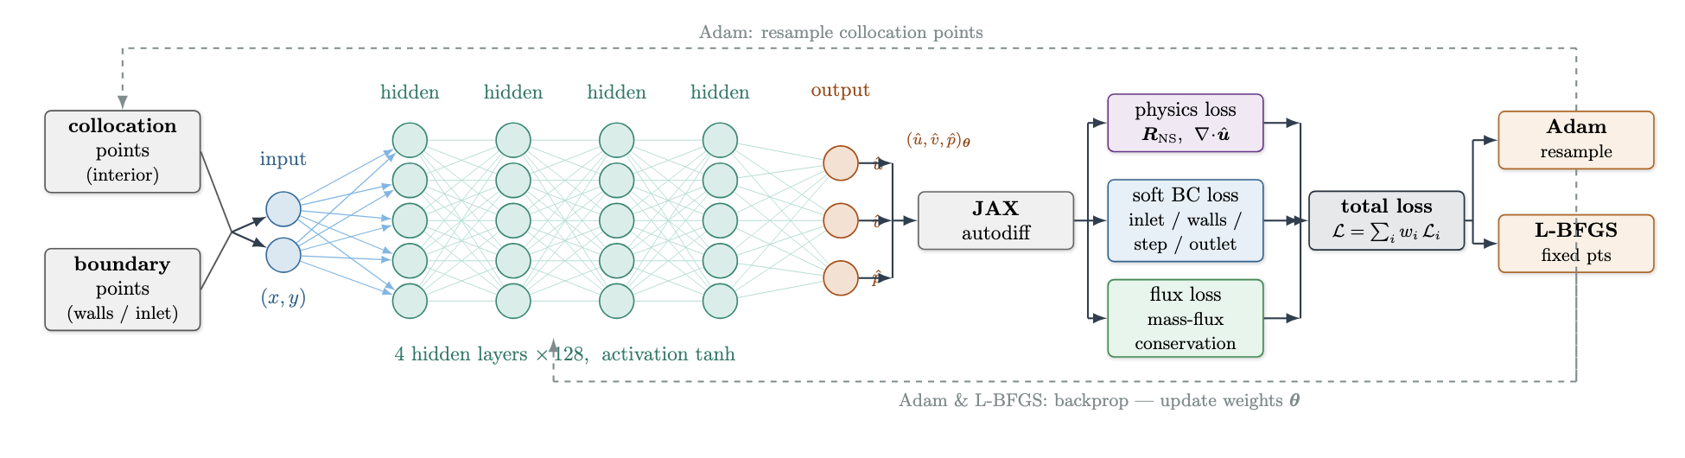

Solver 1: Physics-Informed Neural Networks
What are PINNs?
Incompressible Navier Stokes equation:
Momemtum equation:
$$ρ\left(\frac{∂u}{∂t}+u⋅∇u\right)=−∇p+μ∇^{2}u$$
Continuity equation:
$$∇⋅u=0$$
Network Architecture (MLP):
Inputs (x, y), outputs (u, v, p)
Fourier feature encoding
4 hidden layers with 128 neurons each using tanh activation
Two-phase training (Adam with cosine decay + L-BFGS)

Slide 4
Solver 2: OpenFoam
What is openFoam?
Transient, incompressible, laminar Navier-Stokes solver
icoFoam solver
PISO ALGO
Predict velocity:
Solve momentum equation with current pressure, guess p* to get u**
this satisfies momentum but not continuity (∇·u** ≠ 0).
First pressure correction:
Solve a Poisson equation with source ∇·u** to get p’
update p** = p* + p' and correct the velocity so it satisfies continuity
but momentum is only approximate since the neighbour coupling H was dropped.
Second pressure correction:
Use the momentum imbalance H(u** − u*)/d as a source for a second Poisson solve for p’’
giving a velocity and pressure that satisfy both continuity and momentum to much higher accuracy.
Advance: Set u* ← u***, p* ← p*** and move to the next time step. No outer iteration loop, unlike SIMPLE.

Slide 5
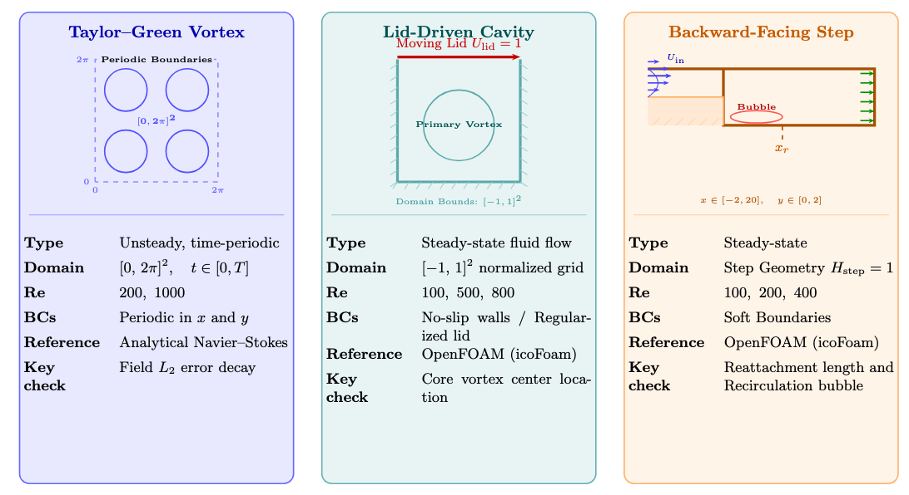
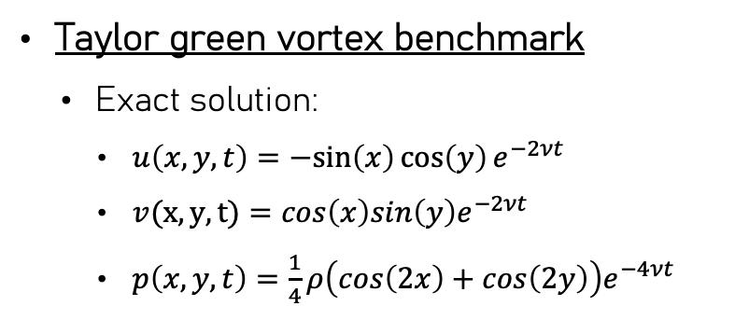
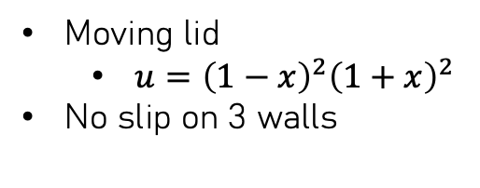
Test Cases Overview
Taylor green vortex benchmark
Exact solution:
$u\left(x,y,t\right)=−sin\left(x\right)\cos\left(y\right)e^{−2νt}$
$v(x, y, t)=cos\left(x\right)sin\left(y\right)e^{−2νt}$
$p\left(x,y,t\right)=\frac{1}{4}ρ\left(cos\left(2x\right)+cos\left(2y\right)\right)e^{−4νt}$
Lid Driven Cavity
Backward-Facing Step
Moving lid
$u={\left(1−x\right)}^{2}{\left(1+x\right)}^{2}$
No slip on 3 walls
Parabolic inlet velocity
No slip walls

Slide 6
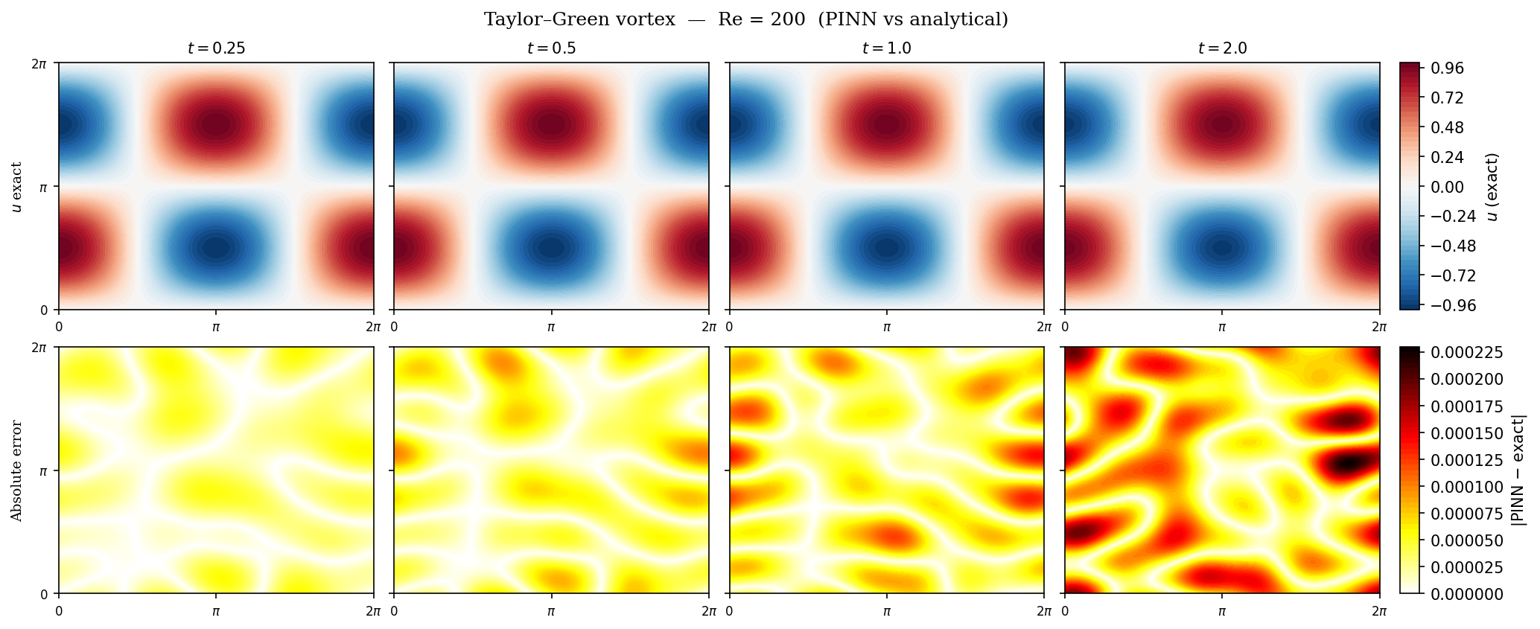
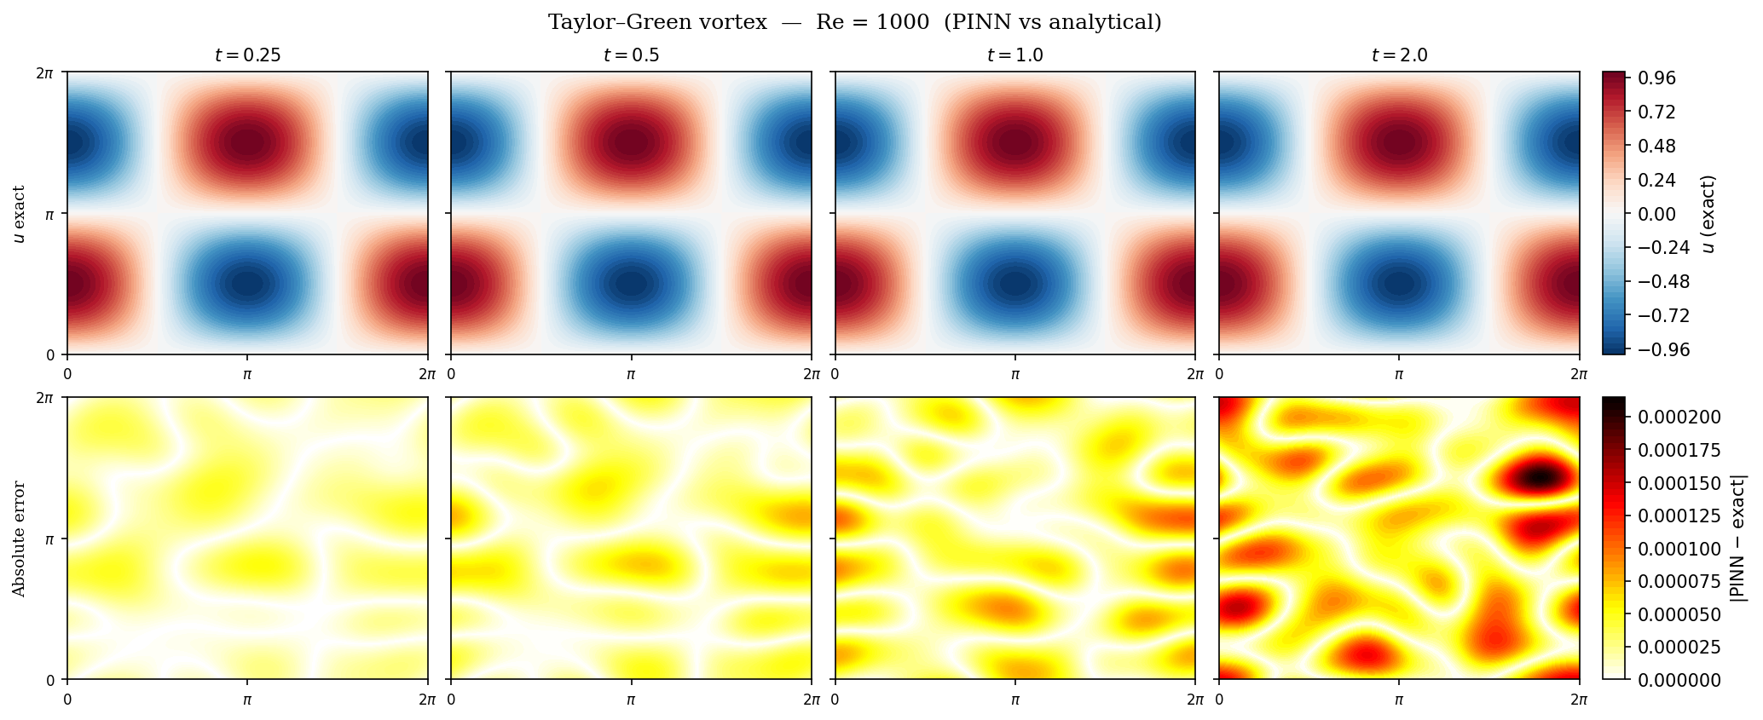
Taylor Green Vortex Benchmark

Slide 7
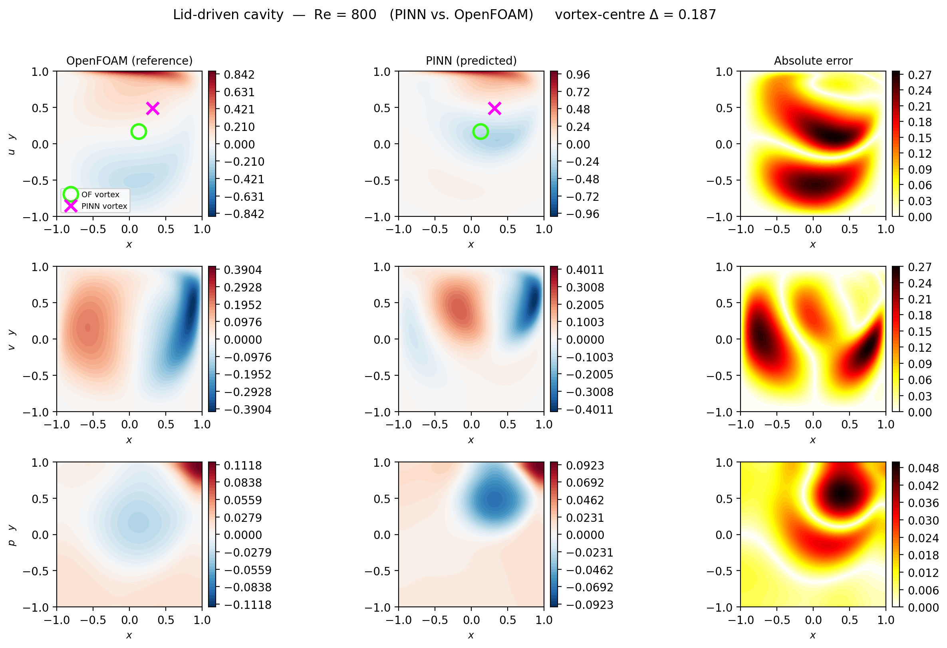
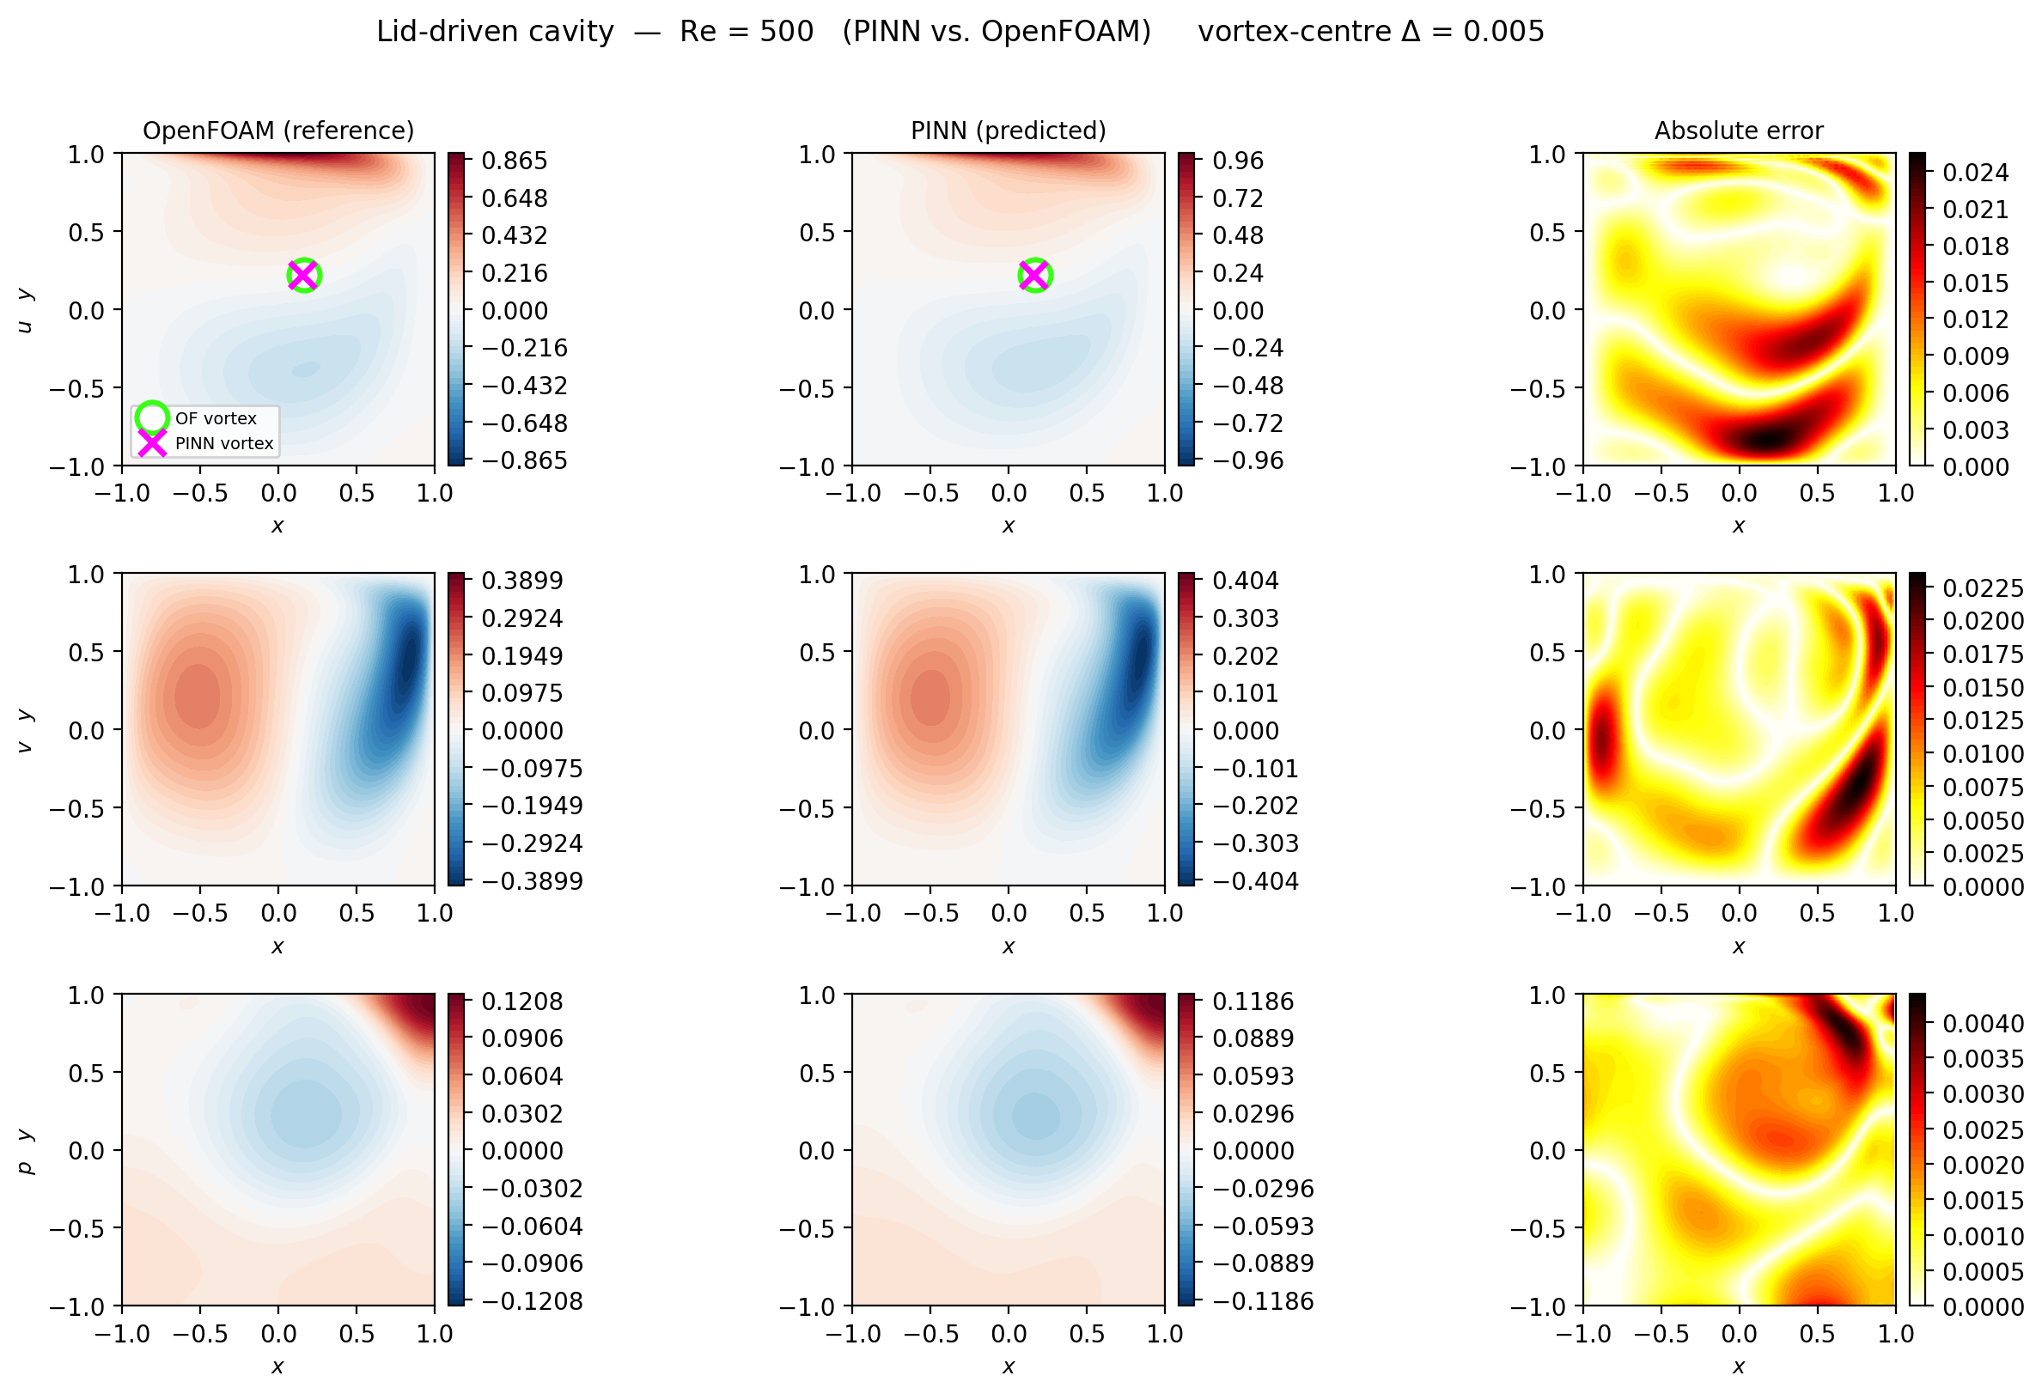
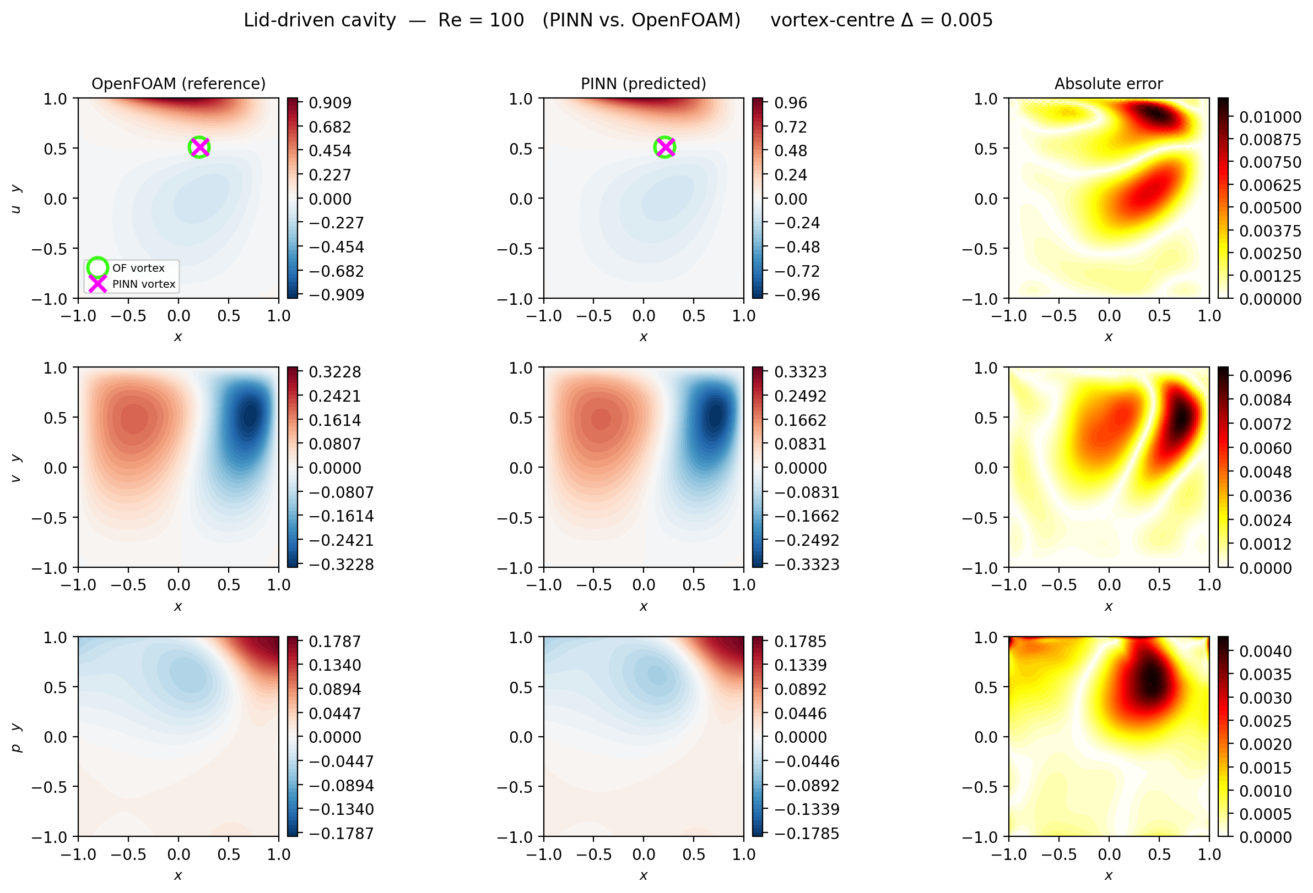
Lid Driven Cavity Results

Slide 8
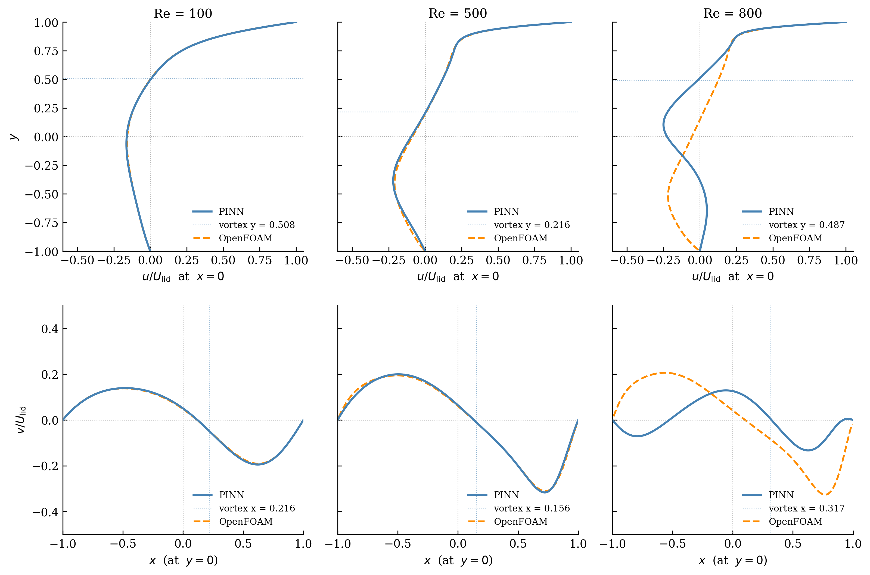
Lid Driven Cavity Results

Slide 9
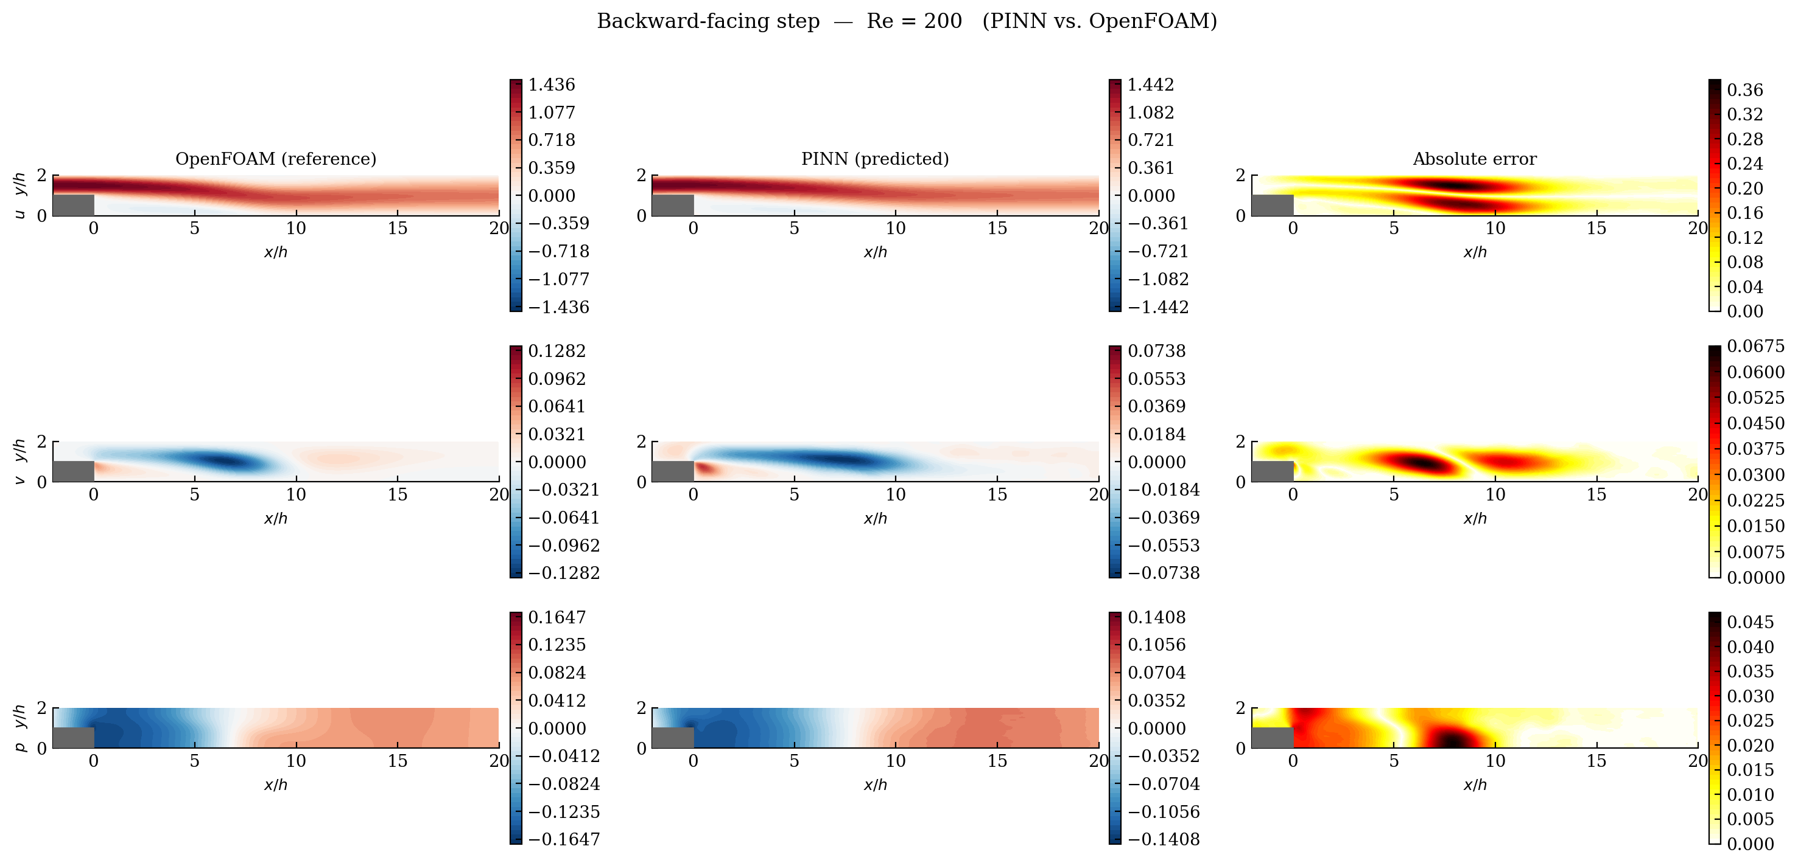
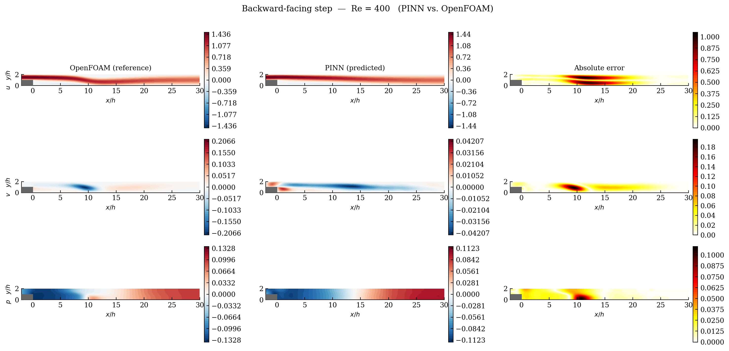
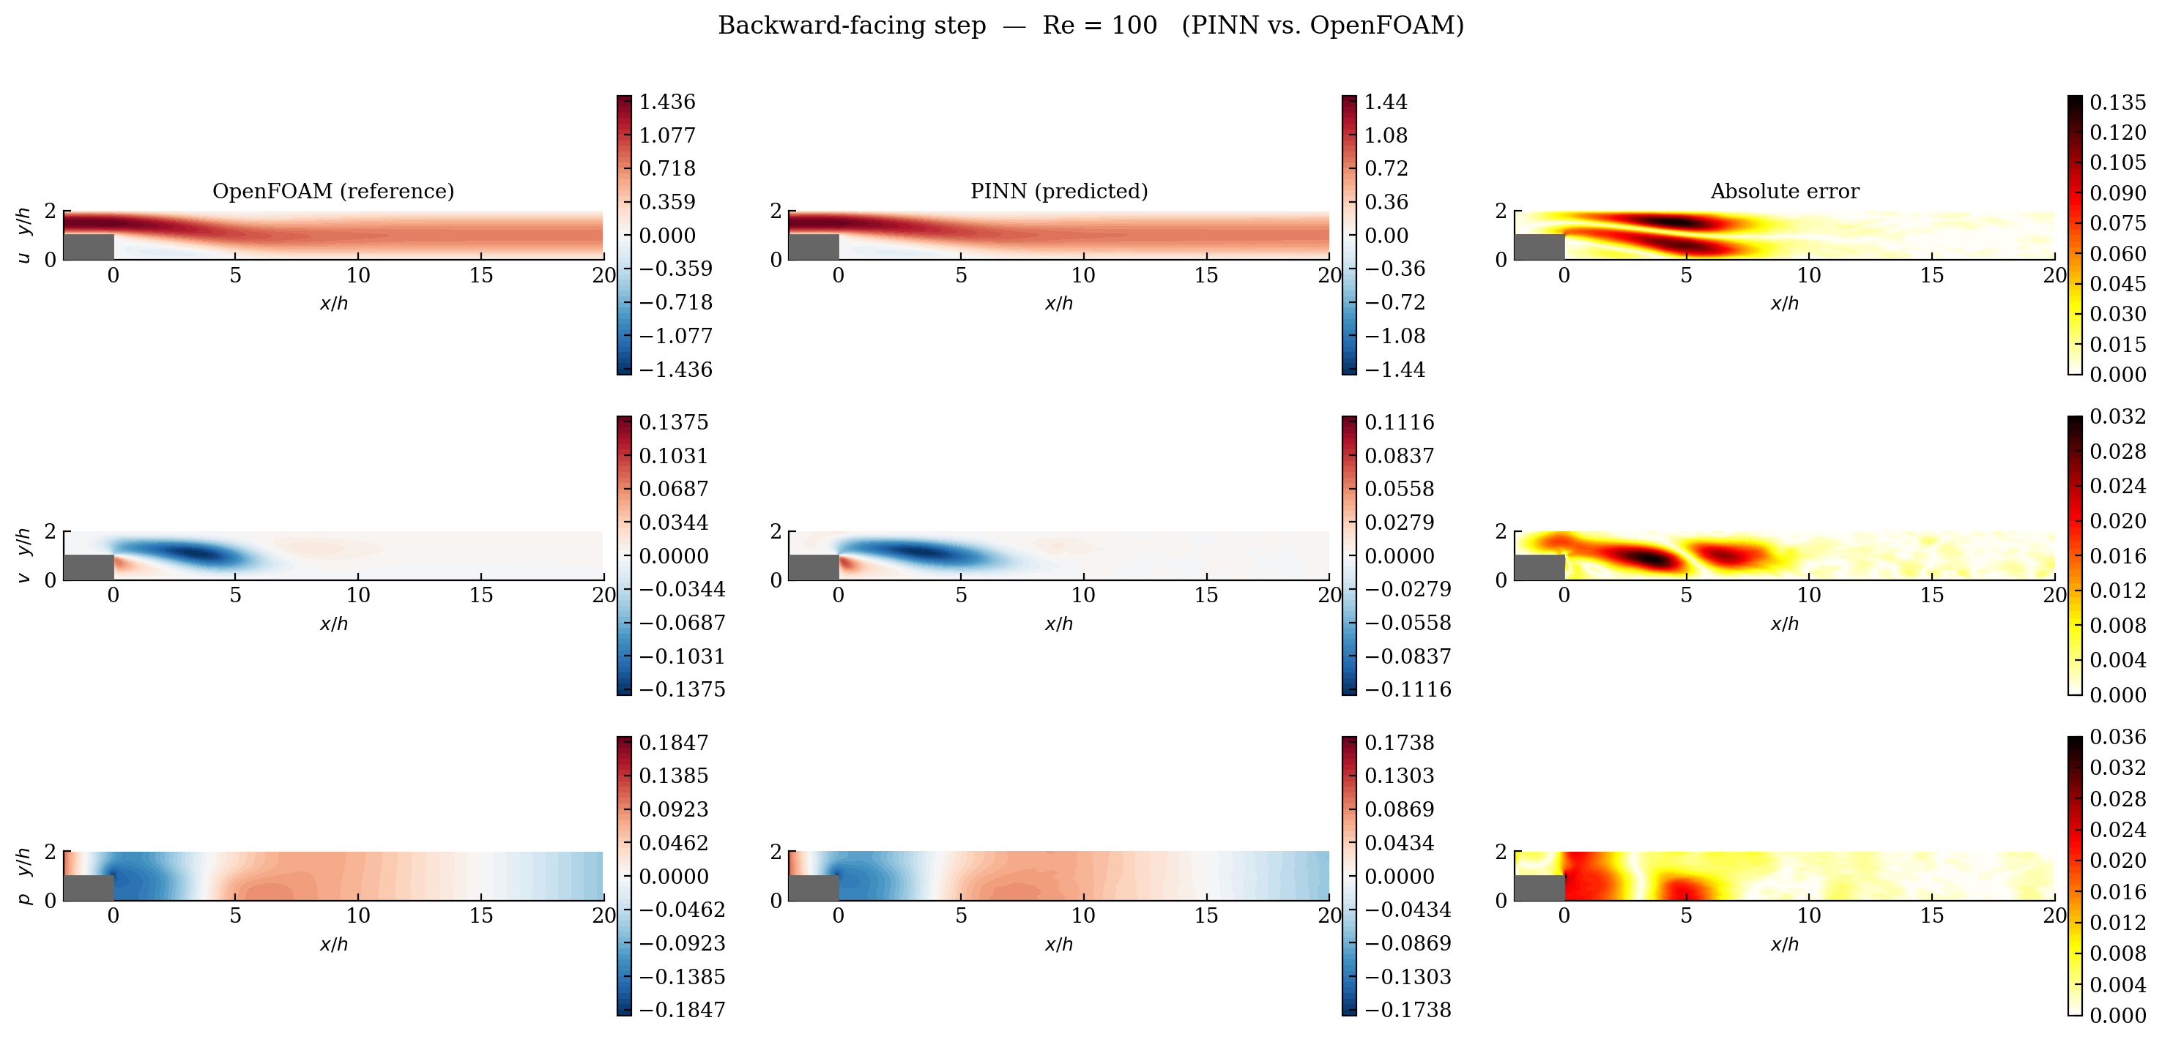
Backward-Facing Step Results

Slide 10
Backward-Facing Step Results

Slide 11
Limitations
Accuracy
Computationally expensive
Finding the correct network parameters and architecture

Slide 12
Where PINNs Have the Edge?
Inverse problem for the backward step setup:
X-axis scatter is inaccurate for visability reasons

Slide 13
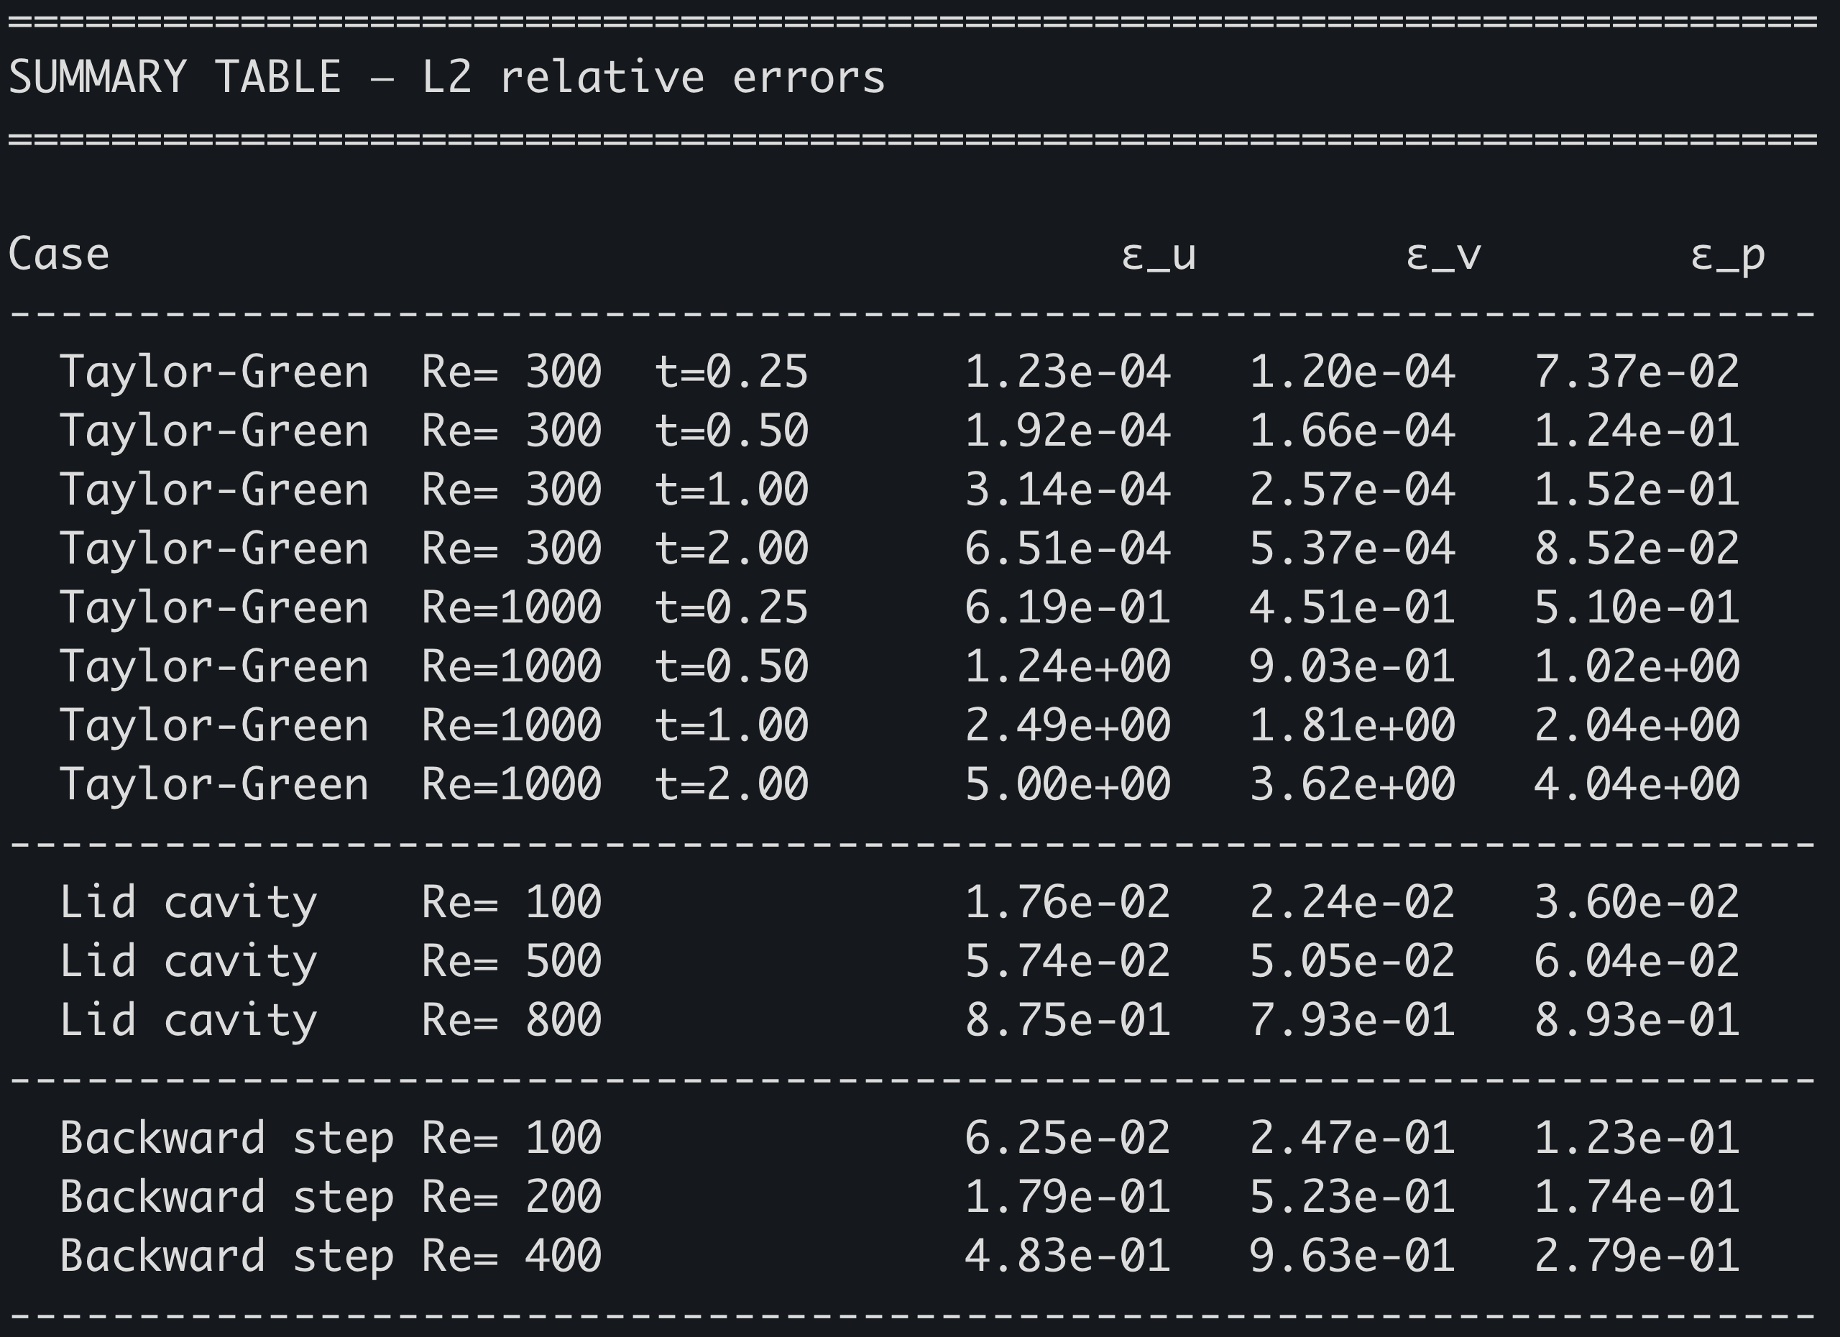
Conclusion
Does not replace traditional time stepping methods – rather an additional tool
PINN accuracy decreases as Re increases
PINNs perform better on a simple grid
PINNs struggle with sharp gradients

Slide 14
References
First PINN paper:
M. Raissi, P. Perdikaris, and G. E. Karniadakis, "Physics-informed neural networks: A deep learning framework for solving forward and inverse problems involving nonlinear partial differential equations," Journal of Computational Physics, vol. 378, pp. 686–707, 2019.
Article for training PINNS:
S. Wang, S. Sankaran, H. Wang, and P. Perdikaris, "An Expert's Guide to Training Physics-Informed Neural Networks," arXiv preprint arXiv:2308.08468, 2023.
CFD book:
H. K. Versteeg and W. Malalasekera, An Introduction to Computational Fluid Dynamics: The Finite Volume Method, 2nd ed. Harlow, England: Pearson Education Limited, 2007.

