Slide 1
Discussion
Comparison
Conclusion
Future Work
Notes:
Introduction
Rasmus Aaen
Comparison, MASSIVE vs C#, NetLogo, RoboCode
Conclusion, what did we create
Future Work, what could have been done different

Slide 2
Comparison
C#
Compiler, interpreter, & GUI is written in C#
Pros
No limits
Cons
No existing multi agent environment
Notes:
The compiler, interpreter, & GUI is coded in C#
Therefor, C# is a good language to compare with MASSIVE
Compare improvements
No limits, the user can do anything.
No base for a MAS, the user has to do everything.

Slide 3
Comparison
MASSIVE
Pros
Easy to implement a wargame
Premade multi agent environment
Build-in types and functions
Case insensitive language
Shorter initialization of objects
Cons
Limited to build-in functions
Notes:
MASSIVE
A base for a MAS
The user can go straight to the fun part, creating units etc.
The language is case insensitive, you will never be confused about variables which is spelled the same way but with a different casing
Shorter initialization of objects, billeder på de 2 næste slides.
Limited to build-in functions, the user cant build anything

Slide 4
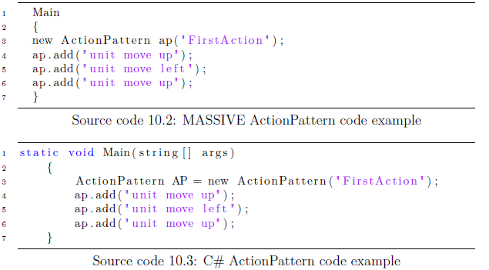
Comparison
Notes:
Differences
Shorter initialization
Difference in name, init and usage

Slide 5
Comparison
ActionPatterns vs NetLogo/RoboCode
Can be implemented
Before compiling, as NetLogo and RoboCode
After compiling, while running the wargame
The user can change tactic while simulating
Notes:
ActionPatterns, are much like the previous Agent Oriented Languages
NetLogo and RoboCode, requires the user to code everything before compiling
While the ActionPatterns can do it both before and after compiling.
The user has the freedom to change tactic while the wargame is running.

Slide 6
Conclusion
Created two languages
MASSIVE and the ActionPatterns
Created a compiler
MASSIVE
Created an interpreter
ActionPatterns
Optimized to Multi Agent Wargame scenarios
Notes:
We have created
Two languages, MASSIVE and the ActionPatterns
Both languages recieved its own translater
A compiler and an interpreter
As a whole the compiler and its GUI is optimized to create a Multi Agent Wargame simulation.
We would proboably have created it different if we were to do it again.

Slide 7
Future Work
Improvements
Modifying Agents, Teams etc. With foreach
Starting points on the battlefield
Expanding the action language
More options than move and encounter
Convert it to a ”scripting language”
Conditions
Loops
Notes:
Foreach loops making it possible to change Agents, Teams, Squads and ActionPatterns.
Giving the freedom to choose starting points of the units.
Expanding the action language;
More options like move and encounter, for example ??
Convert the action language to a scripting language, like NetLogo and RoboCode with Conditions and loops. Pic på næste slide

Slide 8
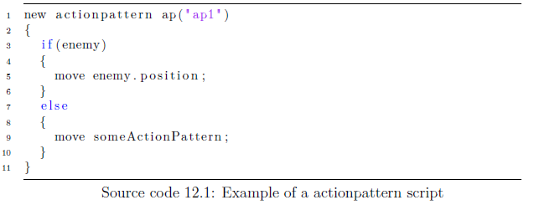
Future Work
Notes:
Would be converted to actions as in the current implementation.

Slide 9
Future Work
Improvements
Modifying Agents, Teams etc. With foreach
Starting points on the battlefield
Expanding the action language
More options than move and encounter
Convert it to a ”scripting language”
Conditions
Loops
Compiling directly to XML
Merging the Compiler and the Wargame
Multiplayer
Notes:
Compiling directly to XML instead of compiling to C# and afterwords to XML, runtime improvement
Merging the Compiler and the Wargame to one instance, would make the application more fluid.
On a long term basis, could a multiplayer version be interesting to implement.

