Slide 1
Language and compiler development
- A multi agent system wargame

Slide 2
Introduction
Notes:
2

Slide 3
Problem statement
How can we develop a programming language and compiler, optimized to control agents of a multi agent wargame?
Notes:
3

Slide 4
Multi Agent System
What is a Multi agent system?
Environment
Agents
What is the purpose of MAS?
Simulate scenarios
Notes:
4

Slide 5
Agent Oriented Languages
What is AOL?
Multi agent system
Multi agent system enviroment
Purpose of AOL
Enviroment
Functions
Limited
Notes:
5

Slide 6
Wargame scenario
Before launching the wargame
Express agents
Predefine agent behaviors
During the wargame
Use predefined agent behaviors
Take control over agents
Define close encounters
Notes:
6

Slide 7
Wargame scenario
Rules
The game is turn-based
The game is played on a grid
Each agent can move three grid-points in each turn
A higher ranked agent has a higher chance of winning
Agents fight when they are standing on the same grid-point
There is only one winner - Deathmatch
Notes:
7

Slide 8
Design of MASSIVE
Design Criteria
Grammar
Semantics

Slide 9
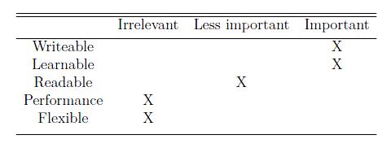
Design Criteria for MASSIVE
Should be easy to use
Similarities to popular languages
Simple

Slide 10


Grammar of MASSIVE
Blocks
{ Commands }
Simple datatypes
Bool, string and num
Statements
if, for, while

Slide 11
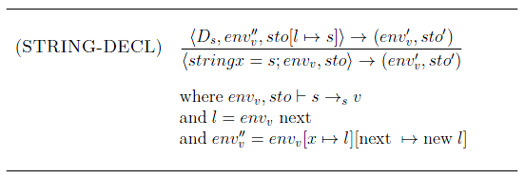
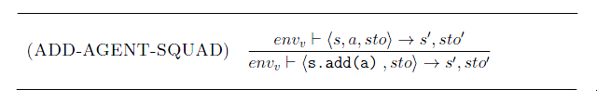
Semantics of MASSIVE

Slide 12
Compiler Components
Notes:
12

Slide 13
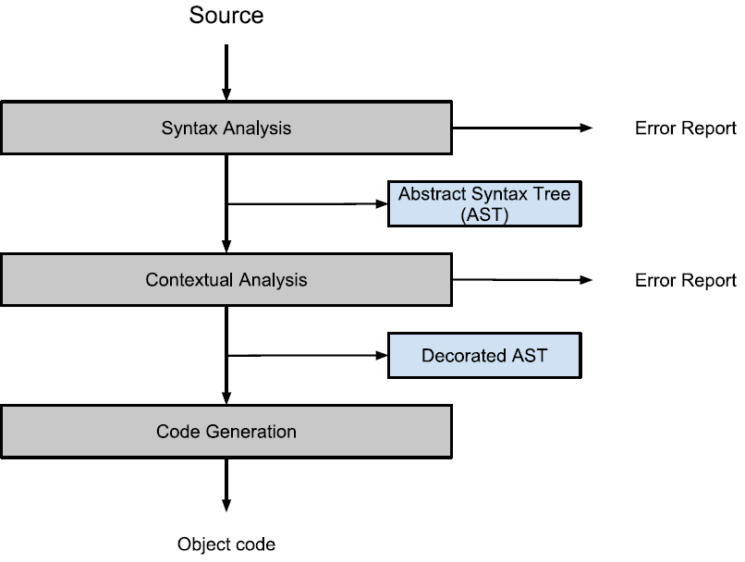
Compiler
The purpose of the compiler
MASSIVE to C#
Compiler components
Syntactic analysis
Contextual analysis
Code generation
Notes:
13

Slide 14
Syntactic analysis
Divided into two parts
Scanning
Recognizing tokens in input according to language keywords
Examples: “+” and “=” are operator tokens.
Parsing
Recognizing phrase structure of tokens
Building an abstract syntax tree
Notes:
14

Slide 15
Scanner implementation
The first method scans according to starters
If letter → identifier token
If number → number token
If operator → operator token
If the input is saved as an identifier:
Token class searches for matching keywords
If no match is found, input remains an identifier
If there is a match, the token class changes the input to the right token
Example: if the identifier spells “for”, the token class recognize it as a keyword, and changes it to a for-token
Notes:
15

Slide 16
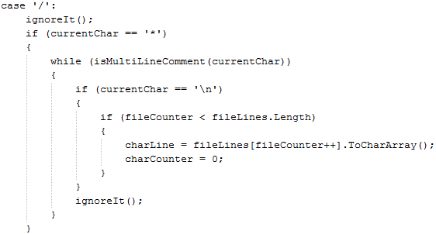
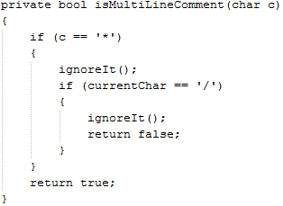
Scanner implementation
Comments, spaces, end-of-lines & indents
Not saved as tokens
Example: ignores multiline comments
Notes:
16

Slide 17
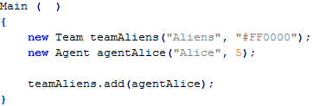
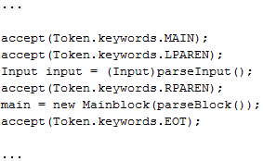
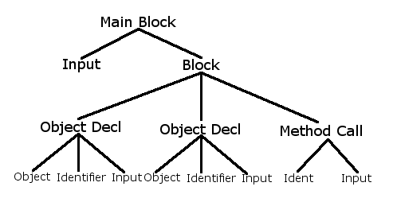
Parser implementation
Checks grammar and builds AST
Each token has a parsing method
Generates small subtrees and adds them to the AST
Example: parse main block method
Notes:
17

Slide 18
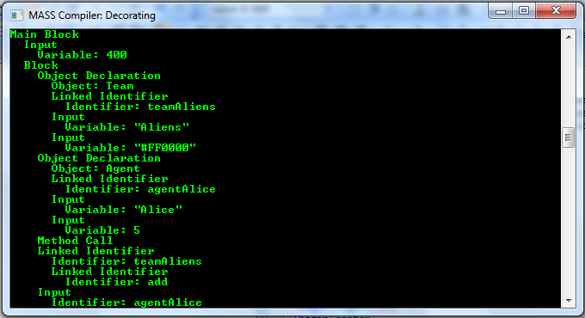
The abstract syntax tree
Convenient way of representing the phrases
Easy to traverse with visitors
Can be printed with a pretty-printer for good overview
Notes:
18

Slide 19
Implementing the compiler
Notes:
19

Slide 20
The visitor design pattern
Object Oriented Programming
Datastructure
Algorithm
Accept-method
Notes:
Visitor design pattern
Used in Object Oriented Programming
Used to seperate Object structure from Algorithm
Datastructure
Consists of objects
Objects have methods
Takes visitor-class as arguments
Visitor class do the real job
Algorithm
Traverses the tree
Knows about parents and children
Invokes all the accept-methods with it self as input

Slide 21
Decorating Visitors
Parses
TypeAndScopeVisitor
InputValidationVisitor
VariableVisitor
Usage of declared variables
Notes:
These are the visitors implemented by us
TypeAndScopeVisitor
Types and scopes
Type safety
Identification Table
Implemented as a class
List of declared variables
Current scope
Variables from a scope is deleted om exit from it
InputValidationVisitor
Check inputs of classes, methods, etc.
Hvordan fanden gør den det?!
VariableVisitor
Usage of declared variables
Throws expections when detecting an error
These are printed when the visitor is finished

Slide 22
Code Generation
CodeGenerationVisitor
Printing C# code
Uses Code template
Generation XML
Default ”skeleton”
MASSIVE content added later

Slide 23
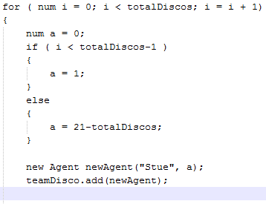
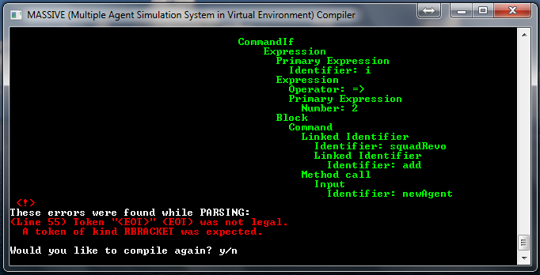
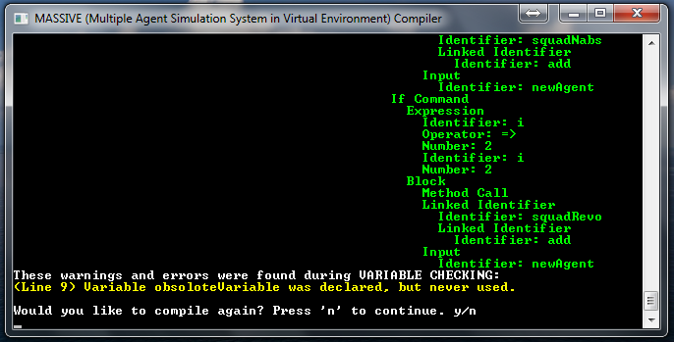

Error Handling
Parses throw exceptions
Finishes parse
Prints all exceptions
Parse-tree is marked with errors
Easy to re-compile

Slide 24
GUI and action language

Slide 25
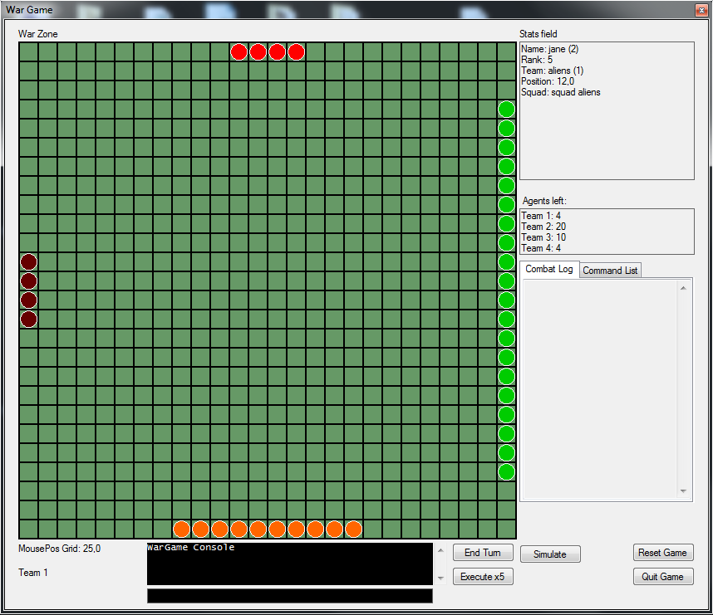
GUI
War Zone
Stats field
Control buttons
Wargame Console

Slide 26
Action Language
Validate commands
Execute commands
”team students jump down”
”team 2 move patrolLow”

Slide 27
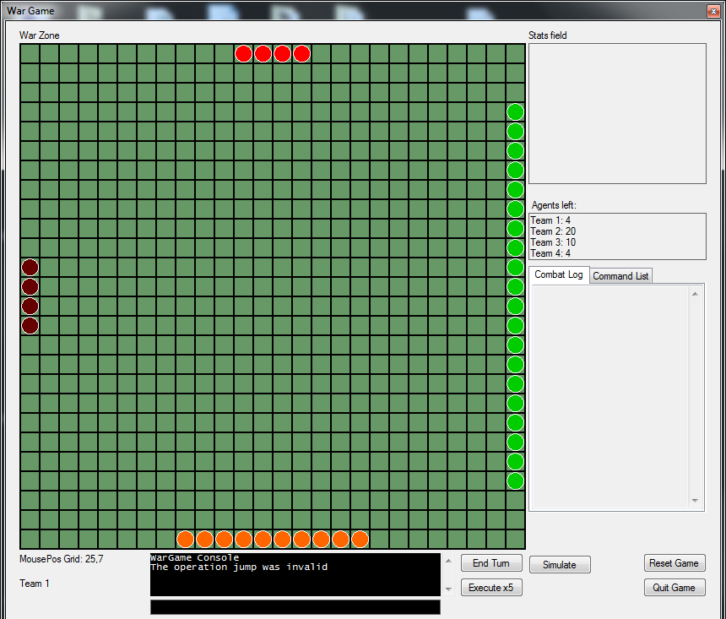
Demonstration - 1

Slide 28
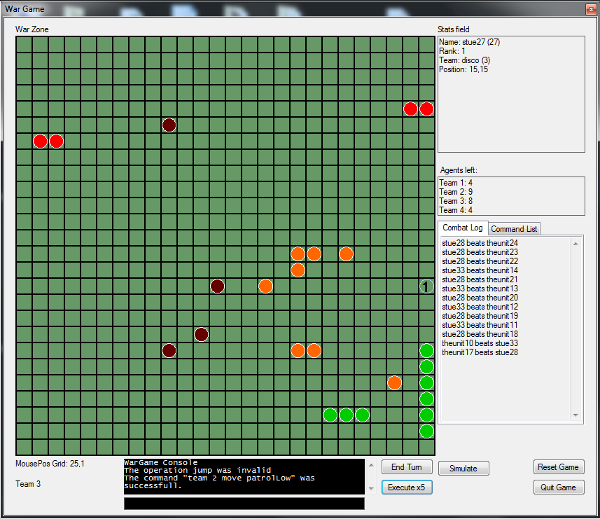
Demonstration - 2

Slide 29
Discussion
Comparison
Conclusion
Future Work

Slide 30
Comparison
C#
Compiler, interpreter, & GUI is written in C#
Pros
No limits
Cons
No existing multi agent environment
Notes:
The compiler, interpreter, & GUI is coded in C#
Therefor, C# is a good language to compare with MASSIVE
Compare improvements
No limits, the user can do anything.
No base for a MAS, the user has to do everything.

Slide 31
Comparison
MASSIVE
Pros
Easy to implement a wargame
Premade multi agent environment
Build-in types and functions
Case insensitive language
Shorter initialization of objects
Cons
Limited to build-in functions
Notes:
MASSIVE
A base for a MAS
The user can go straight to the fun part, creating units etc.
The language is case insensitive, you will never be confused about variables which is spelled the same way but with a different casing
Shorter initialization of objects, billeder på de 2 næste slides.
Limited to build-in functions, the user cant build anything

Slide 32
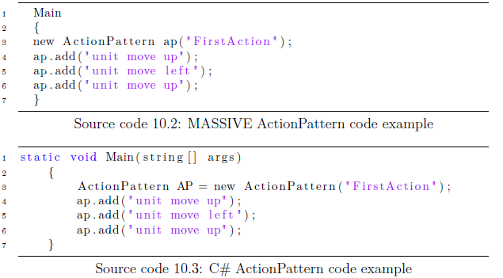
Comparison
Notes:
Differences
Shorter initialization
Difference in name, init and usage

Slide 33
Comparison
ActionPatterns vs NetLogo/RoboCode
Can be implemented
Before compiling, as NetLogo and RoboCode
After compiling, while running the wargame
The user can change tactic while simulating
Notes:
ActionPatterns, are much like the previous Agent Oriented Languages
NetLogo and RoboCode, requires the user to code everything before compiling
While the ActionPatterns can do it both before and after compiling.
The user has the freedom to change tactic while the wargame is running.

Slide 34
Conclusion
Created two languages
MASSIVE and the ActionPatterns
Created a compiler
MASSIVE
Created an interpreter
ActionPatterns
Optimized to Multi Agent Wargame scenarios
Notes:
We have created
Two languages, MASSIVE and the ActionPatterns
Both languages recieved its own translater
A compiler and an interpreter
As a whole the compiler and its GUI is optimized to create a Multi Agent Wargame simulation.
We would proboably have created it different if we were to do it again.

Slide 35
Future Work
Improvements
Modifying Agents, Teams etc. With foreach
Starting points on the battlefield
Expanding the action language
More options than move and encounter
Convert it to a ”scripting language”
Conditions
Loops
Notes:
Foreach loops making it possible to change Agents, Teams, Squads and ActionPatterns.
Giving the freedom to choose starting points of the units.
Expanding the action language;
More options like move and encounter, for example ??
Convert the action language to a scripting language, like NetLogo and RoboCode with Conditions and loops. Pic på næste slide

Slide 36
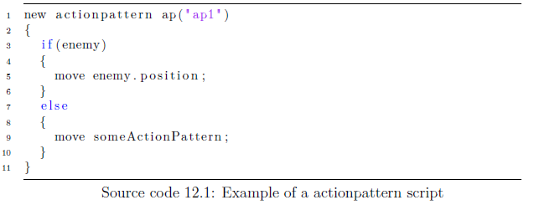
Future Work
Notes:
Would be converted to actions as in the current implementation.

Slide 37
Future Work
Improvements
Modifying Agents, Teams etc. With foreach
Starting points on the battlefield
Expanding the action language
More options than move and encounter
Convert it to a ”scripting language”
Conditions
Loops
Compiling directly to XML
Merging the Compiler and the Wargame
Multiplayer
Notes:
Compiling directly to XML instead of compiling to C# and afterwords to XML, runtime improvement
Merging the Compiler and the Wargame to one instance, would make the application more fluid.
On a long term basis, could a multiplayer version be interesting to implement.

