Slide 1
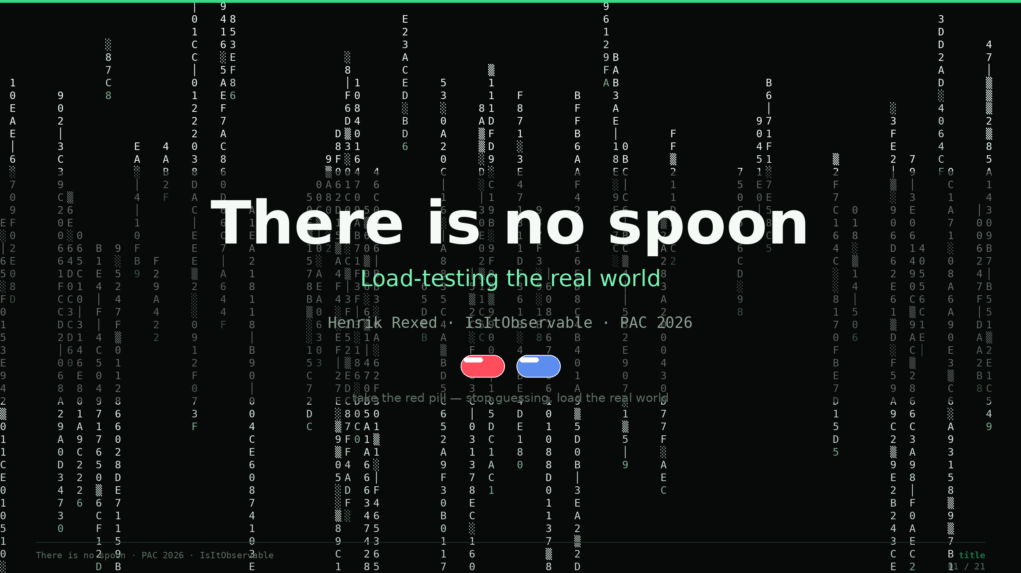
Notes:
Slide 1 — Title (0:00–0:30)
Hi — I'm Henrik Rexed, from IsItObservable. The title of this talk is *There is no spoon*, and by the end I want you to agree with it. Because almost every load test I've ever seen tries to bend the spoon — tries to make the system pass the test — when the real job is the opposite: bend the test until it matches reality. Thirty minutes, three places where I'm going to stop and make *you* argue with me, one live demo, and one number — one-point-two-seven — that I'll earn before I use it.

Slide 2
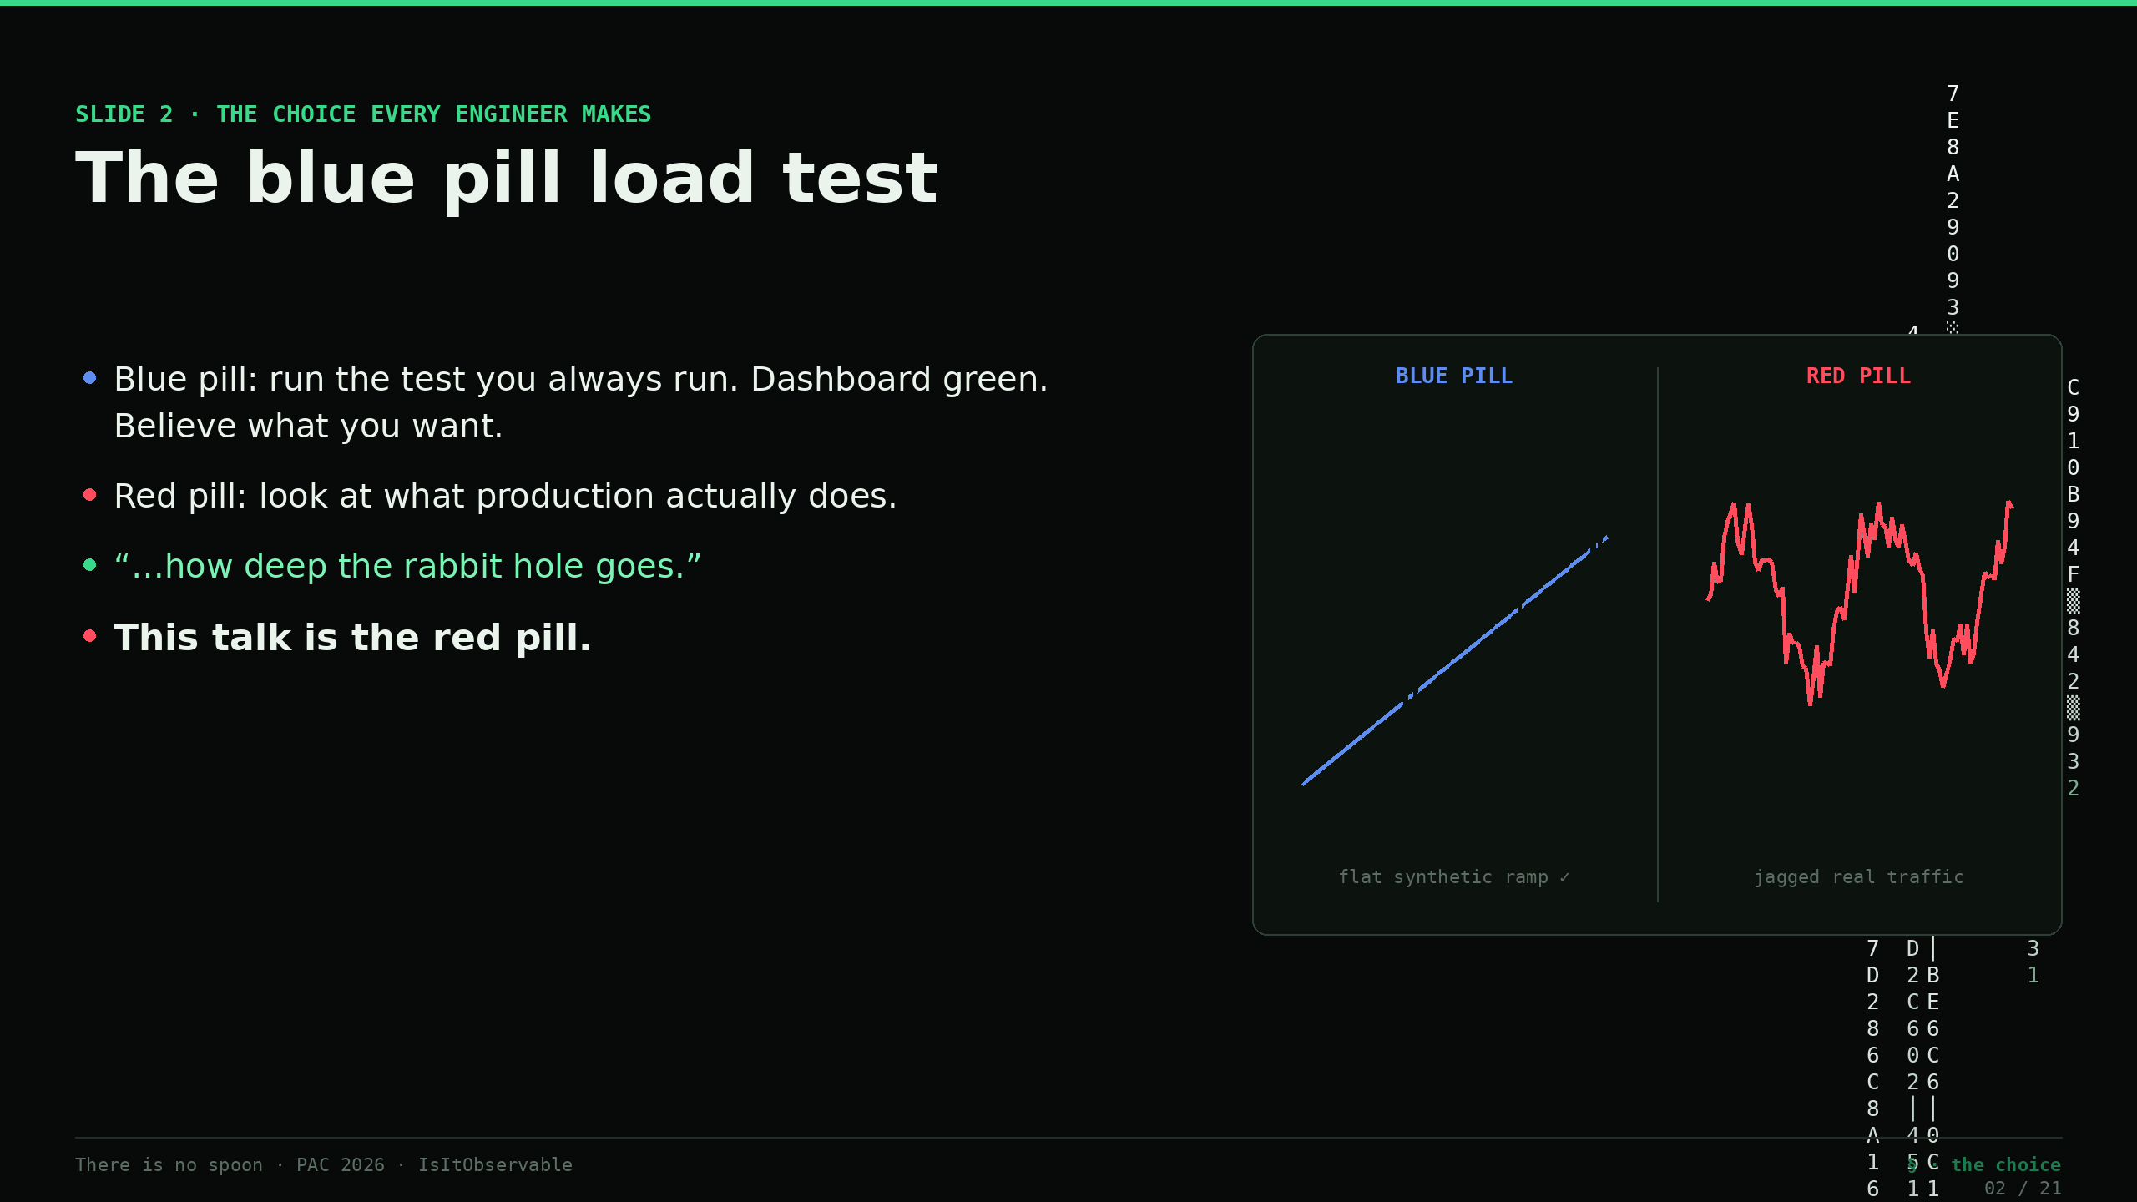
Notes:
Slide 2 — The blue pill load test (0:30–2:00)
Here's the choice every performance engineer makes, usually without noticing. *(Morpheus line on screen.)* The blue pill: you run the test you've always run, the dashboard goes green, you wake up and believe whatever you want to believe. The red pill: you look at what production is *actually* doing, and you follow that rabbit hole all the way down — even when it tells you your test has been fiction for three years. This whole talk is the red pill. We're going to see the real world as it is, build a faithful projection of it, load that projection on demand — and never, ever cheat it to pass.

Slide 3
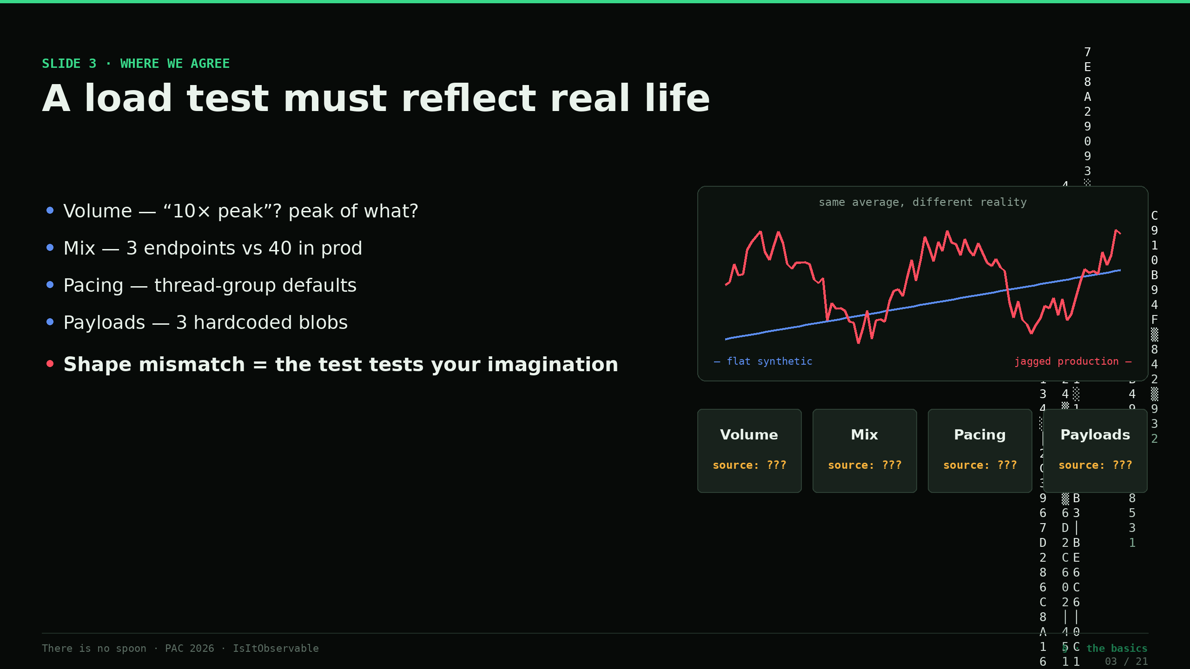
Notes:
Slide 3 — The basics: a load test must reflect real life (2:00–4:00)
Let's start where we agree. A load test is only worth running if it reproduces production *shape* — not just an average number. Open a typical k6 or JMeter script and ask four questions. Volume: where did the RPS come from? Usually "ten times peak" — peak of what, measured when? Mix: three endpoints in the script, forty in production. Pacing: whatever the thread-group default happened to be. Payloads: three hardcoded JSON blobs. Each one is a guess, and they multiply. And here's the failure mode that costs money: the run passes, production still burns, because a flat synthetic ramp against a jagged, bursty, seasonal real curve — same average, completely different reality — exercises your system in a state it never actually occupies. A test that doesn't match shape doesn't test your system. It tests your imagination. Which brings me to my first question for you.

Slide 4
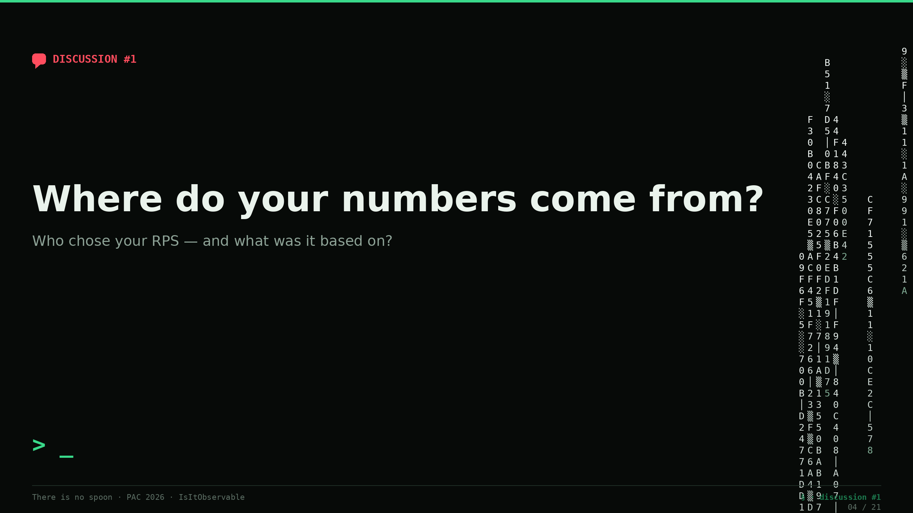
Notes:
💬 Slide 4 — Discussion #1 (4:00–5:30)
So — honestly — where do *your* numbers come from? Show of hands, or shout it out: who chose the RPS in your main load test, and what was it based on? *(Collect 3–4 answers. Expect: "last year's number," "double the record," "the SLO," "marketing's traffic forecast.")* I'm collecting folklore here, and I'm going to come back to every one of these. Hold that thought — because the rest of this talk is about replacing every one of those answers with a trace.

Slide 5
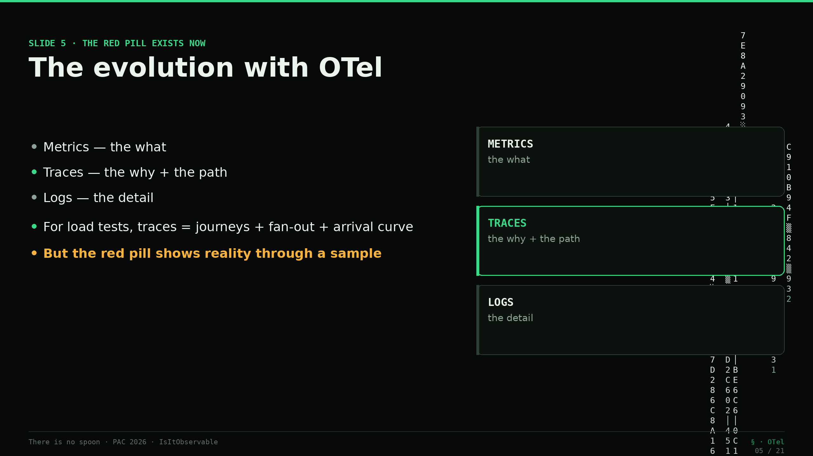
Notes:
Slide 5 — The evolution with OTel (5:30–7:30)
What changed is that the red pill actually exists now. Ten years ago, "production reality" was a guess dressed up as a metric. Today, with OpenTelemetry, we have three correlated signals — metrics for the *what*, traces for the *why and the path*, logs for the *detail* — and for a load test, traces are the gift: they give you the actual journeys, the fan-out across the service graph, the real per-operation latency, and the arrival curve at one-minute resolution. This is the red pill. The catch — and it's the whole middle of this talk — is that the red pill shows you reality *through a sample*. And a sample lies to you in a very specific, very dangerous way.

Slide 6
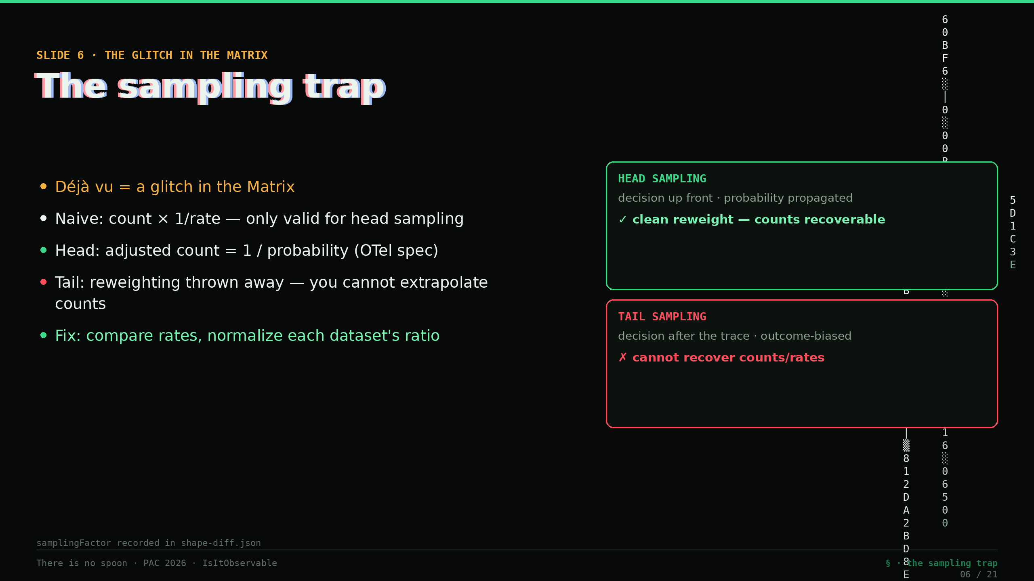
Notes:
Slide 6 — The sampling trap (7:30–10:00)
This is the glitch in the Matrix. *(Trinity quote on screen.)* Déjà vu — you see the same cat twice — means they changed something. In telemetry, the thing that "changed" is that you're not seeing every request; you're seeing a sample. And here's the trap that bites every performance engineer: you take your sampled trace count and multiply by one-over-the-rate to "extrapolate" back to production volume. That works for exactly one kind of sampling. **Head sampling** — the decision is made up front, probabilistically — you can recover the real count, *if* the probability is propagated. OpenTelemetry's own spec gives you the math: the *adjusted count* of a sampled span is the reciprocal of its sampling probability. One over the rate. That's sanctioned. But **tail sampling** — keep the errors, keep the slow ones, decide *after* the trace finishes — is biased by construction and throws the reweighting factor away. You cannot extrapolate counts from tail-sampled data. Full stop. A respected OTel engineer, Goutham, put it bluntly: there is no way to generate accurate metrics from tail-sampled data — the metrics have to be generated *before* the sampling happens. So the fix, the rule we bake into the methodology: compare *rates*, not raw counts, and normalize every dataset by its own sampling ratio before you compare. Mismatched, unrecorded sampling is the number-one cause of a false "out of tolerance" verdict. And hold onto that *discipline* — reconcile your sources, record the factor — because in a minute I'll show you the same trap bite us on an **un-sampled** tenant, where nothing was sampled away and a second source *still* only saw part of the picture. That's a different glitch with the same cure. Remember the number one-point-two-seven.

Slide 7
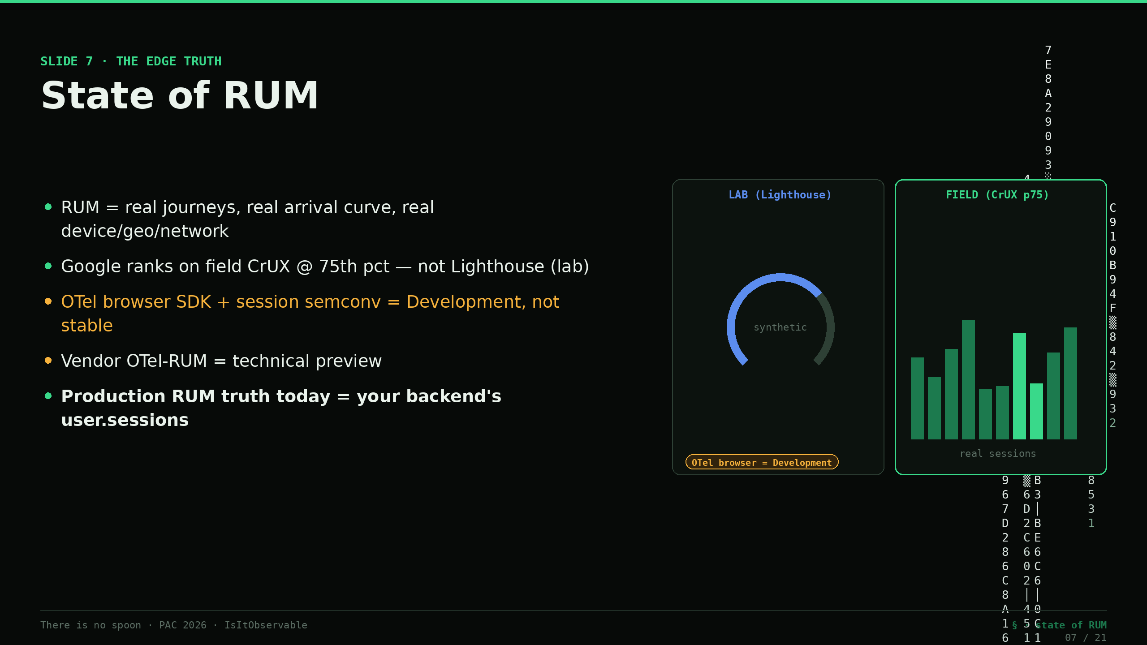
Notes:
Slide 7 — State of RUM (10:00–12:00)
There's a second source of truth the trace stream doesn't have, and it's the one closest to your user: RUM. Real User Monitoring sits in the browser and the mobile app and records what *actually* happened to real people — the real journeys, the real arrival curve, the real device, geography, and network mix. Here's the proof point I like for this room: Google doesn't rank your site on Lighthouse — a lab test, synthetic. It ranks on *field* Core Web Vitals, from the Chrome User Experience Report, at the seventy-fifth percentile of real sessions. A page can ace the lab and fail the field. That gap — lab versus field — is exactly the gap between a synthetic load test and production. Now, the honest part, because you'll ask: OpenTelemetry *can* do RUM in the browser today, but the browser SDK and the session semantic conventions are still marked "Development" — not stable — and the vendor implementations ship as technical preview. So the production-grade RUM truth today still lives in your observability backend. In our case, that's two specific objects. Which is my second question.

Slide 8
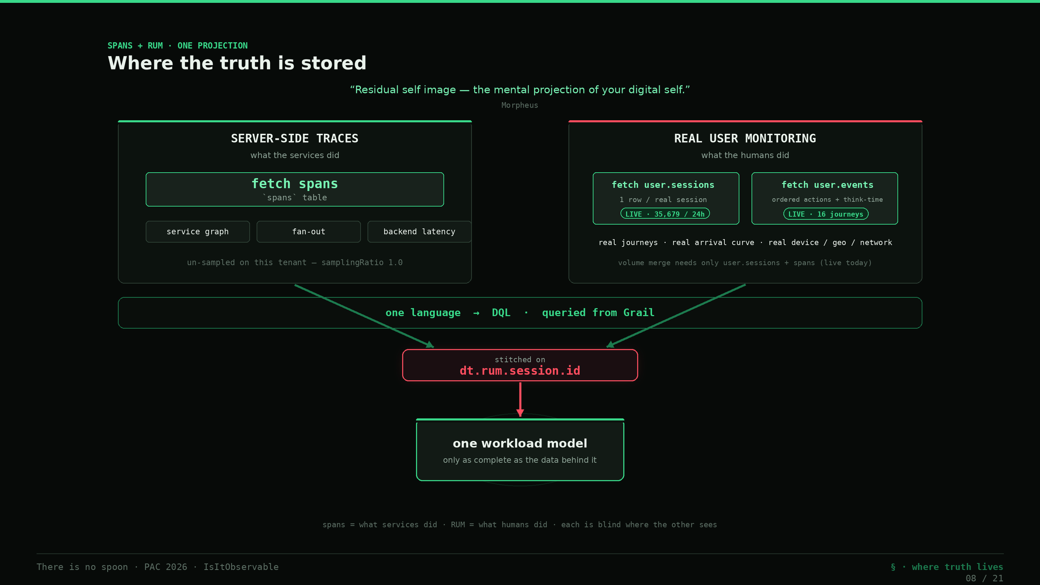
Notes:
Slide 8 — Where the truth is stored: spans + RUM (12:00–14:00)
*(This is the "residual self image" slide.)* Here's the key mental model. Everything we build is a *projection* of reality — and like Neo's residual self image in the Construct, it's only as complete as the data behind it. Two stores feed the projection. Server-side traces live in **spans** — the service graph, fan-out, backend latency. The real user truth lives in **RUM** — and in our backend that's two DQL objects: `user.sessions`, one row per real session, and `user.events`, the ordered actions *inside* a session. Both keyed by `dt.rum.session.id`. Spans tell you what the services did; RUM tells you what the humans did. You need both, because each is blind where the other sees.

Slide 9
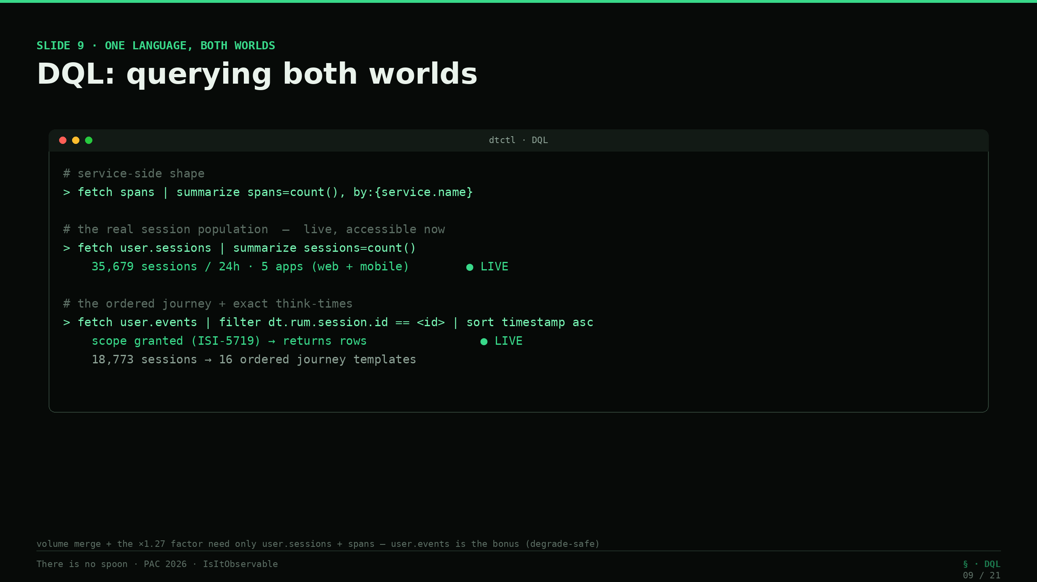
Notes:
Slide 9 — DQL: querying both worlds (14:00–16:00)
And you query both with one language — DQL. *(Show the three snippets.)* `fetch spans` for the service-side shape. `fetch user.sessions` for the real session population — live, that's thirty-five thousand sessions a day across five apps, web and mobile, and it's accessible right now. And `fetch user.events`, filtered by the session id, for the ordered journey and the exact think-times between actions — which, as of this week, is live too: that storage scope was just granted, so on Astroshop that's eighteen thousand sessions resolving into sixteen ordered journey templates with real per-view think-times. One honest note, and it matters for what comes next: the request-volume merge and that one-point-two-seven factor need only `user.sessions` plus spans — they never depended on `user.events` — so the whole pipeline degrades gracefully if that scope ever goes away. Which is where I earn the number.

Slide 10
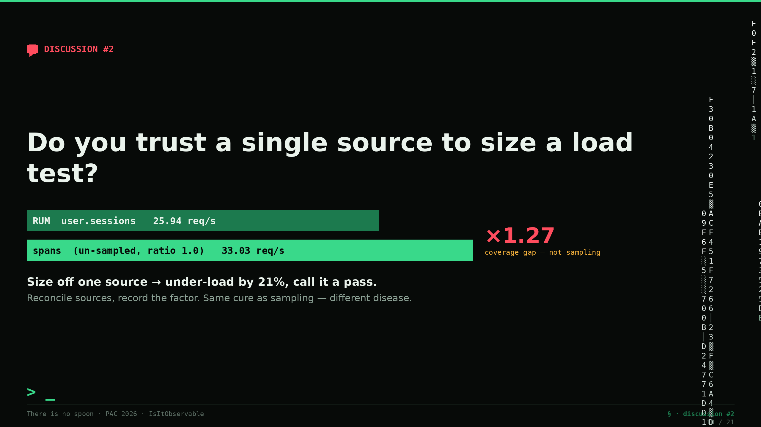
Notes:
💬 Slide 10 — Discussion #2 (16:00–17:30)
Second question, and this is the one I actually want to fight about. Do you trust a *single* source to size a load test? *(Let the room go. Expect a split. Push both sides.)* Here's my position, and you just saw the receipts. On Astroshop the spans are **un-sampled** — sampling ratio one-point-zero — so you'd think I'm safe from everything I just warned you about. But my richest journey source, RUM, only saw twenty-six requests a second where the spans saw thirty-three. That's a one-point-two-seven gap — RUM captured seventy-nine percent of the real traffic — and *not because anything was sampled away*. RUM and spans simply capture different slices of reality. If I'd sized the test off RUM counts alone, I'd have under-loaded the system by twenty-one percent and called it a pass. *That's* the glitch in the Matrix — not that a source was sampled, but that I believed one source. Reconcile them, record the factor — one-point-two-seven — and move on. Same cure as the sampling slide, different disease.

Slide 11
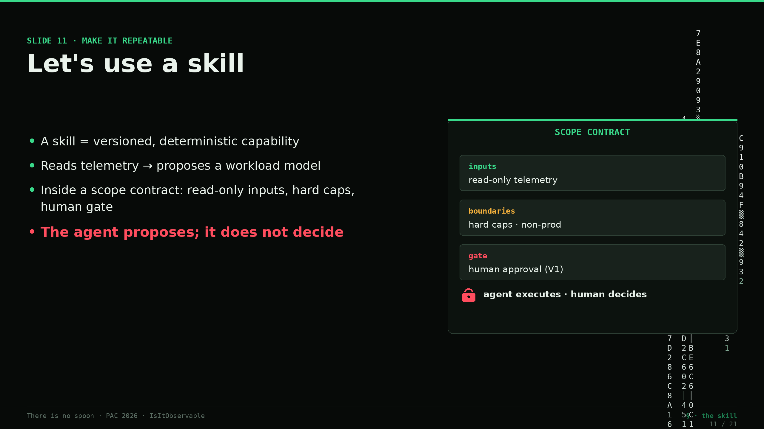
Notes:
Slide 11 — Let's use a skill (17:30–19:00)
So how do we make this repeatable instead of a one-off heroics project? We give an agent a *skill* — a versioned, deterministic capability — and a scope contract. The skill reads the telemetry and proposes a workload model: the journeys, their weights, the arrival shape, the think-times, the dataset sizing. The agent does the boring, mechanical extraction. But — and this is the spine of the whole method — the agent proposes; it does not decide. It operates inside a written contract: what it may read, hard caps, and a human gate before anything runs. Telemetry proposes. You dispose.

Slide 12
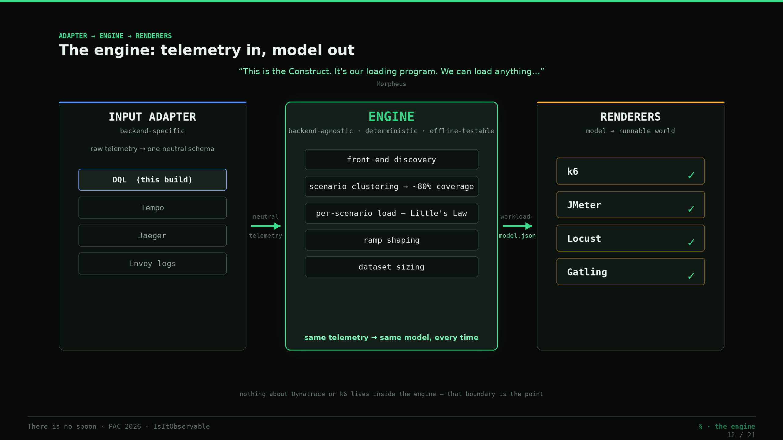
Notes:
Slide 12 — The engine: telemetry in, model out (19:00–21:00)
*(The Construct slide.)* "This is the Construct. It's our loading program. We can load anything." That's the engine. It's three layers, and the split is deliberate. A backend-specific **input adapter** pulls the raw telemetry — DQL for us, but it could be Tempo, Jaeger, Envoy logs — and normalizes it into one neutral schema. Then the **engine** — completely backend-agnostic, deterministic, offline-testable — turns that neutral telemetry into a workload model: front-end discovery, scenario clustering to about eighty percent coverage, per-scenario load via Little's Law, ramp shaping, dataset sizing. Telemetry in, model out, nothing about Dynatrace or k6 inside it. That determinism is the point — same telemetry, same model, every time.

Slide 13
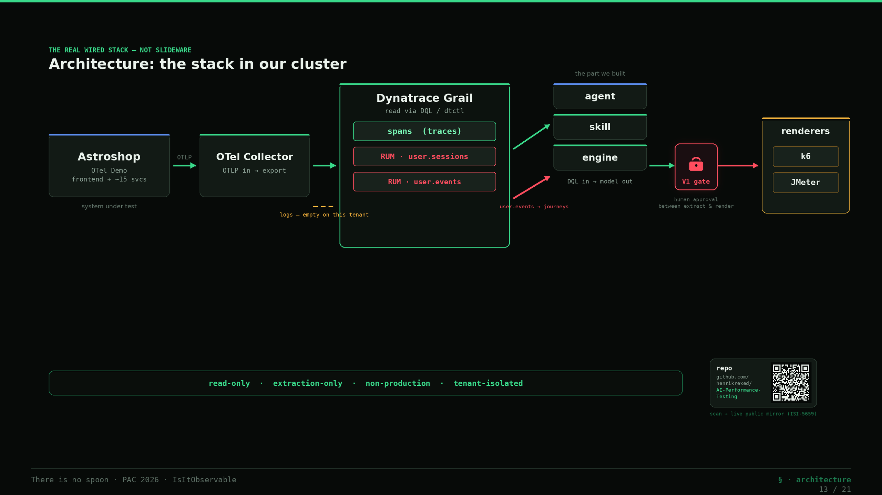
Notes:
Slide 13 — Architecture: the stack in our cluster (21:00–21:45)
Before I run it, thirty seconds on what's actually wired up — because none of this is a slideware diagram, it's running in our cluster right now. *(Walk the arrows.)* The system under test is the **OpenTelemetry Demo** — Astroshop, a frontend and about fifteen microservices, instrumented with OTel. Its telemetry flows out over OTLP to an **OpenTelemetry Collector**, and the Collector ships it to **Dynatrace Grail**. Grail is where the two truths live: the **`spans`** table — the traces — and **RUM**, in `user.sessions` and `user.events`. On top of that sits the part we built: an **agent** that drives a versioned **skill**, which runs the **engine** — DQL in, workload model out — and then the **renderers** that materialize the model into k6 and JMeter. One honest annotation on this diagram, because this room will look for it: the **logs** leg is drawn dashed — on this tenant the access-log probe comes back empty, so we're spans-and-RUM here, not logs. The `user.events` feed next to it is drawn **solid** — that scope was gated until this week and it's now granted, so the ordered-journey table flows live and feeds `rum-journey-model.json` downstream. Everything on the read path is **read-only, extraction-only, non-production**. All of this — the engine, the renderers, this exact demo — is in the repo; links are on screen and on the last slide.

Slide 14
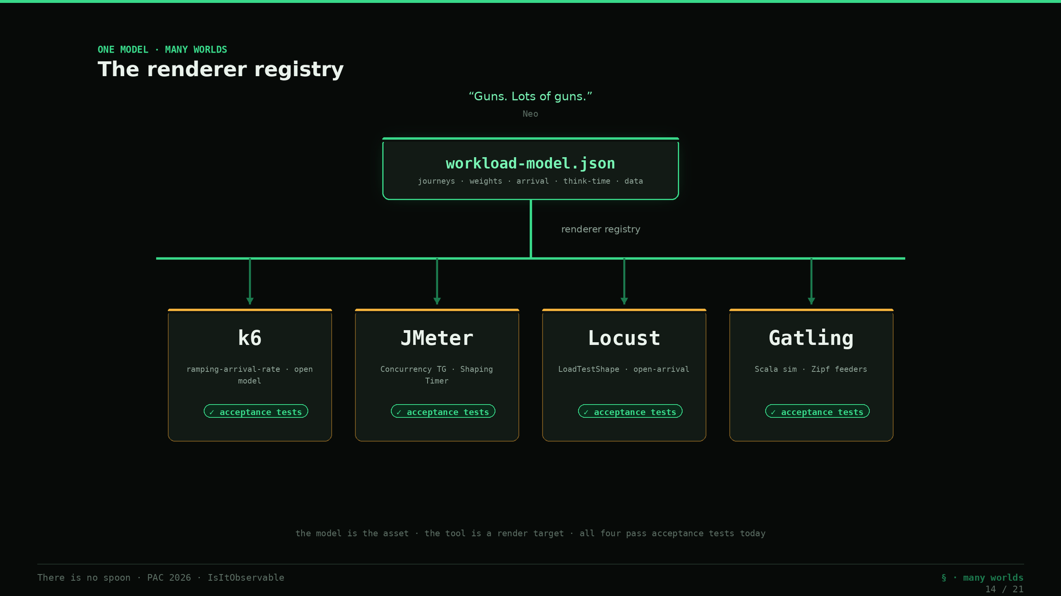
Notes:
Slide 14 — One model, many worlds (21:45–22:45)
And once you have the model, here's the "guns, lots of guns" moment. *(Neo quote.)* One `workload-model.json`, and a registry of **renderers** materializes it into whatever tool you run: k6, JMeter, Locust, Gatling — all four exist today and all four pass their acceptance tests. Same model, same shape, four weapons. The tool stops being the thing you argue about. The *model* is the asset; the tool is a render target. And I'm not going to tell you it works — I'm going to do it, live, right now.

Slide 15
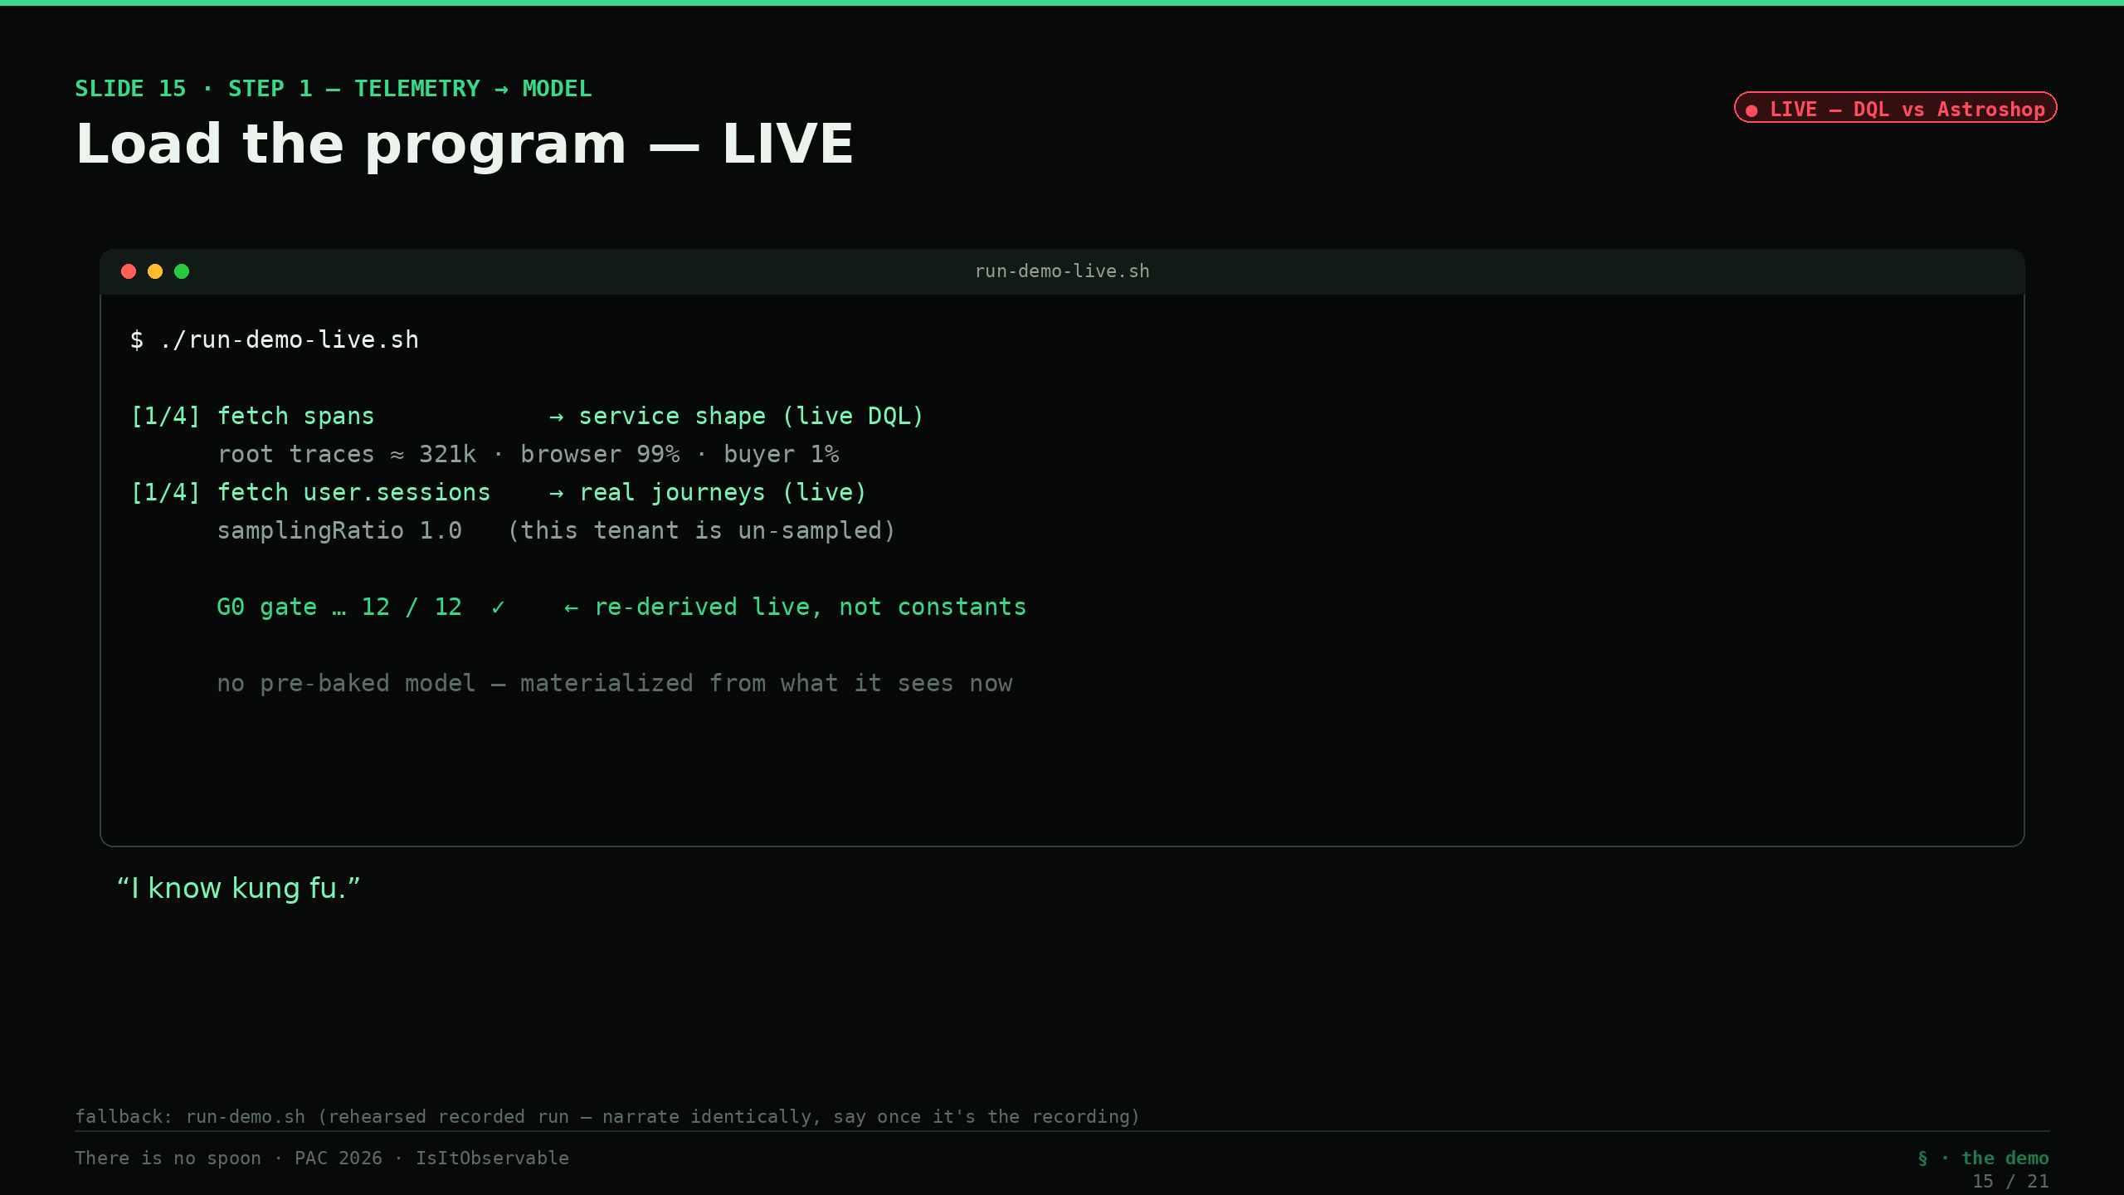
Notes:
Slides 15–18 — DEMO: load the program, LIVE (22:45–27:30) — *narration; artifacts owned by C*
This is the part where I don't trust the demo either — so we build it from scratch, on stage, against the live system. *(Step 0 — one command, `run-demo-live.sh`.)* *"I know kung fu."* *(Step 1 — telemetry → model, live.)* This isn't a model I saved yesterday. Right now it's running DQL against the live Astroshop — `fetch spans` for the service shape, `fetch user.sessions` for the real journeys — and materializing the model from what it sees this second. Watch the numbers land: three hundred thousand-plus frontend root traces, the order split coming out at roughly ninety-nine percent browsers and one percent buyers — *re-derived live, not a constant I typed in* — and sampling ratio one-point-zero, because this tenant is unsampled. The G0 gate runs on those fresh numbers: twelve of twelve, green. *(Step 1 — the wall came down.)* And watch this line scroll by — `fetch user.events`. Until this week that query came back **four-oh-three, not authorized**: the ordered-journey table was behind a storage scope we'd asked for and hadn't been granted. That scope landed this week — so now it *returns rows*. Eighteen thousand sessions resolve into sixteen ordered journey templates with real think-times between actions. Here's the honesty move, though, and it's the important one: **the model you're watching build did not need that table.** It's sized from spans plus `user.sessions`, and the extractor is written to degrade cleanly to exactly those two if `user.events` is ever gone — so the ordered journeys are a *bonus* the model now flows, not a dependency it breaks on. Trust the trace, not the demo: I'll take the richer data when it's there and lose nothing when it isn't. *(The gate.)* Now the engine stops and asks a human — me — to approve what it just observed. *(Temet Nosce foreshadow.)* It will not synthesize a single request until I do. I approve. *(Step 2 — model → k6.)* *"Show me."* One command, and out of that one approved model comes a k6 project: ramping-arrival-rate executor — an open model — stages scaled straight off the weights, and `synthetic=true` in baggage on every request so I can find my own load later. V2a checks pass. *(Step 3 — model → JMeter.)* Same model, different gun: out comes a `.jmx` — Concurrency Thread Group, Throughput Shaping Timer, CSV data sets for cache-busting. Static checks pass. *(Step 4 — diff.)* Side by side: same journeys, same weights, same arrival envelope, same synthetic baggage — two completely different engines, zero hand-authoring. Guns, lots of guns. The model is the program; the renderer is just the compiler back-end. *(Fallback note for Henrik: if Step 0 reports the tenant unreachable, `run-demo-live.sh` tells you to switch to `run-demo.sh` — a rehearsed recorded run of this identical flow. Narrate it the same way; say once that it's the recorded fallback. If time is short, narrate steps 1, 2, 4 and drop the JMeter detail.)*

Slide 16
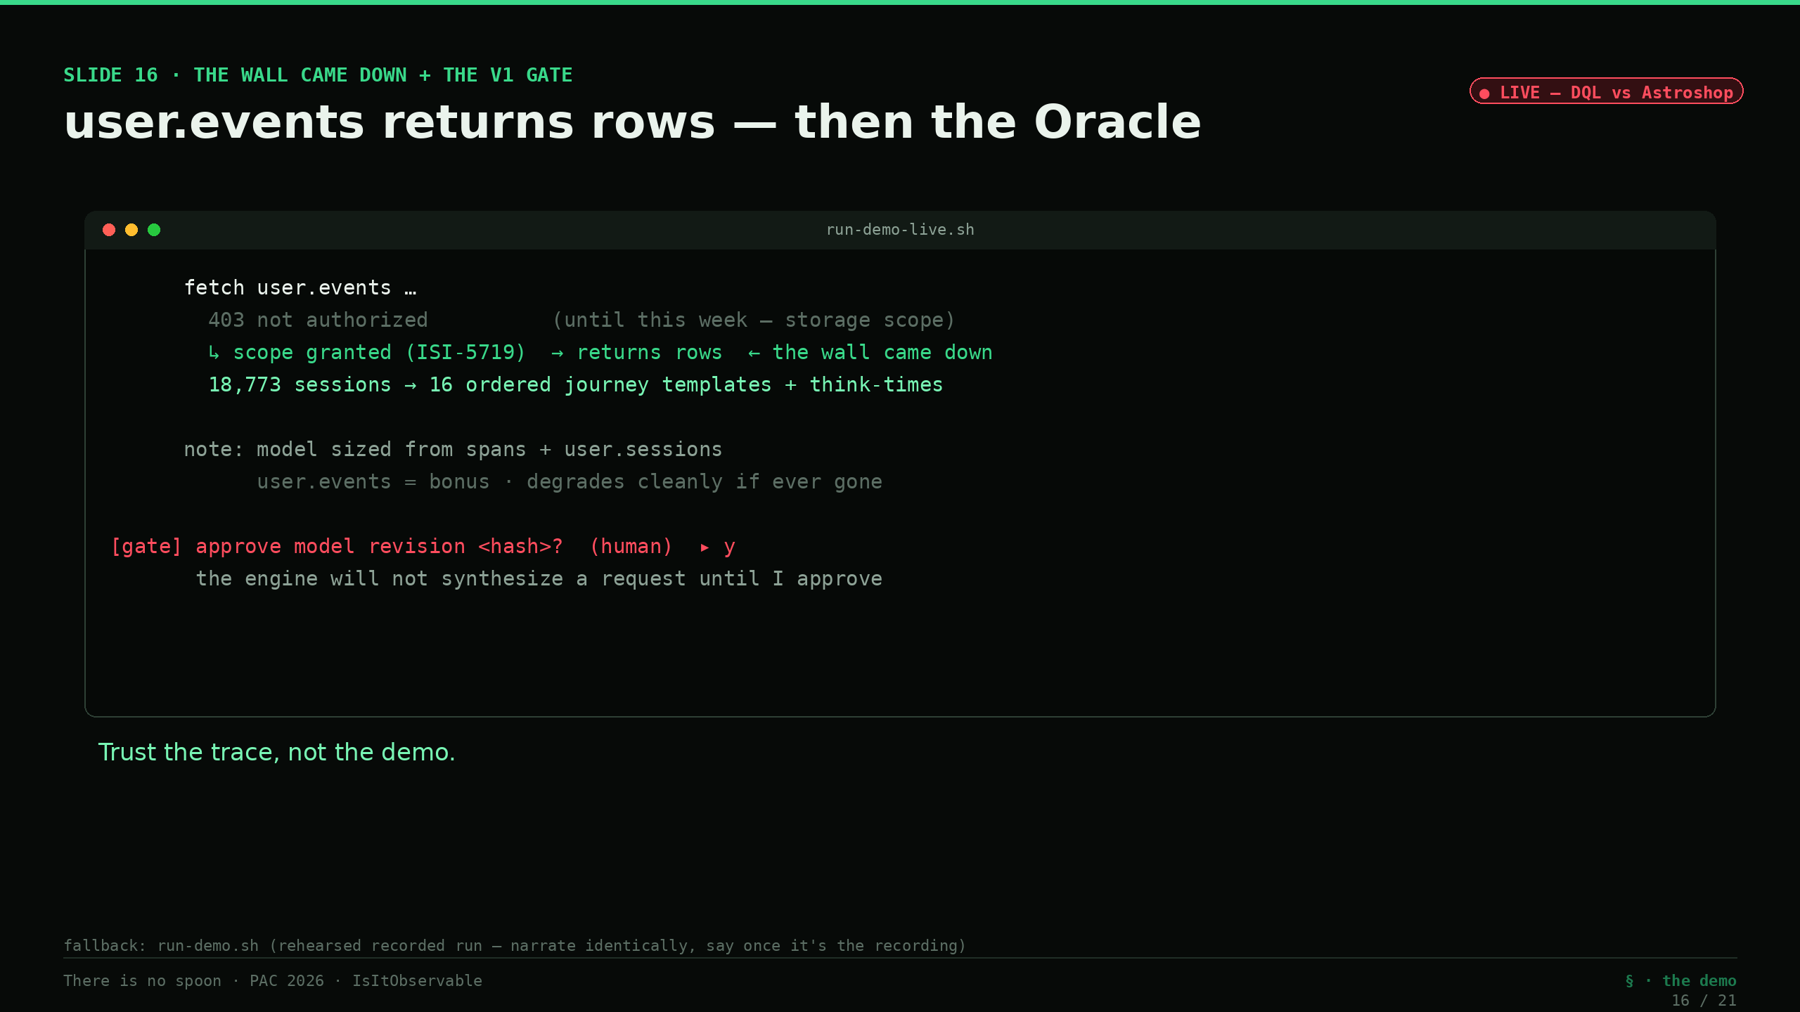
Notes:
Slides 15–18 — DEMO: load the program, LIVE (22:45–27:30) — *narration; artifacts owned by C*
This is the part where I don't trust the demo either — so we build it from scratch, on stage, against the live system. *(Step 0 — one command, `run-demo-live.sh`.)* *"I know kung fu."* *(Step 1 — telemetry → model, live.)* This isn't a model I saved yesterday. Right now it's running DQL against the live Astroshop — `fetch spans` for the service shape, `fetch user.sessions` for the real journeys — and materializing the model from what it sees this second. Watch the numbers land: three hundred thousand-plus frontend root traces, the order split coming out at roughly ninety-nine percent browsers and one percent buyers — *re-derived live, not a constant I typed in* — and sampling ratio one-point-zero, because this tenant is unsampled. The G0 gate runs on those fresh numbers: twelve of twelve, green. *(Step 1 — the wall came down.)* And watch this line scroll by — `fetch user.events`. Until this week that query came back **four-oh-three, not authorized**: the ordered-journey table was behind a storage scope we'd asked for and hadn't been granted. That scope landed this week — so now it *returns rows*. Eighteen thousand sessions resolve into sixteen ordered journey templates with real think-times between actions. Here's the honesty move, though, and it's the important one: **the model you're watching build did not need that table.** It's sized from spans plus `user.sessions`, and the extractor is written to degrade cleanly to exactly those two if `user.events` is ever gone — so the ordered journeys are a *bonus* the model now flows, not a dependency it breaks on. Trust the trace, not the demo: I'll take the richer data when it's there and lose nothing when it isn't. *(The gate.)* Now the engine stops and asks a human — me — to approve what it just observed. *(Temet Nosce foreshadow.)* It will not synthesize a single request until I do. I approve. *(Step 2 — model → k6.)* *"Show me."* One command, and out of that one approved model comes a k6 project: ramping-arrival-rate executor — an open model — stages scaled straight off the weights, and `synthetic=true` in baggage on every request so I can find my own load later. V2a checks pass. *(Step 3 — model → JMeter.)* Same model, different gun: out comes a `.jmx` — Concurrency Thread Group, Throughput Shaping Timer, CSV data sets for cache-busting. Static checks pass. *(Step 4 — diff.)* Side by side: same journeys, same weights, same arrival envelope, same synthetic baggage — two completely different engines, zero hand-authoring. Guns, lots of guns. The model is the program; the renderer is just the compiler back-end. *(Fallback note for Henrik: if Step 0 reports the tenant unreachable, `run-demo-live.sh` tells you to switch to `run-demo.sh` — a rehearsed recorded run of this identical flow. Narrate it the same way; say once that it's the recorded fallback. If time is short, narrate steps 1, 2, 4 and drop the JMeter detail.)*

Slide 17
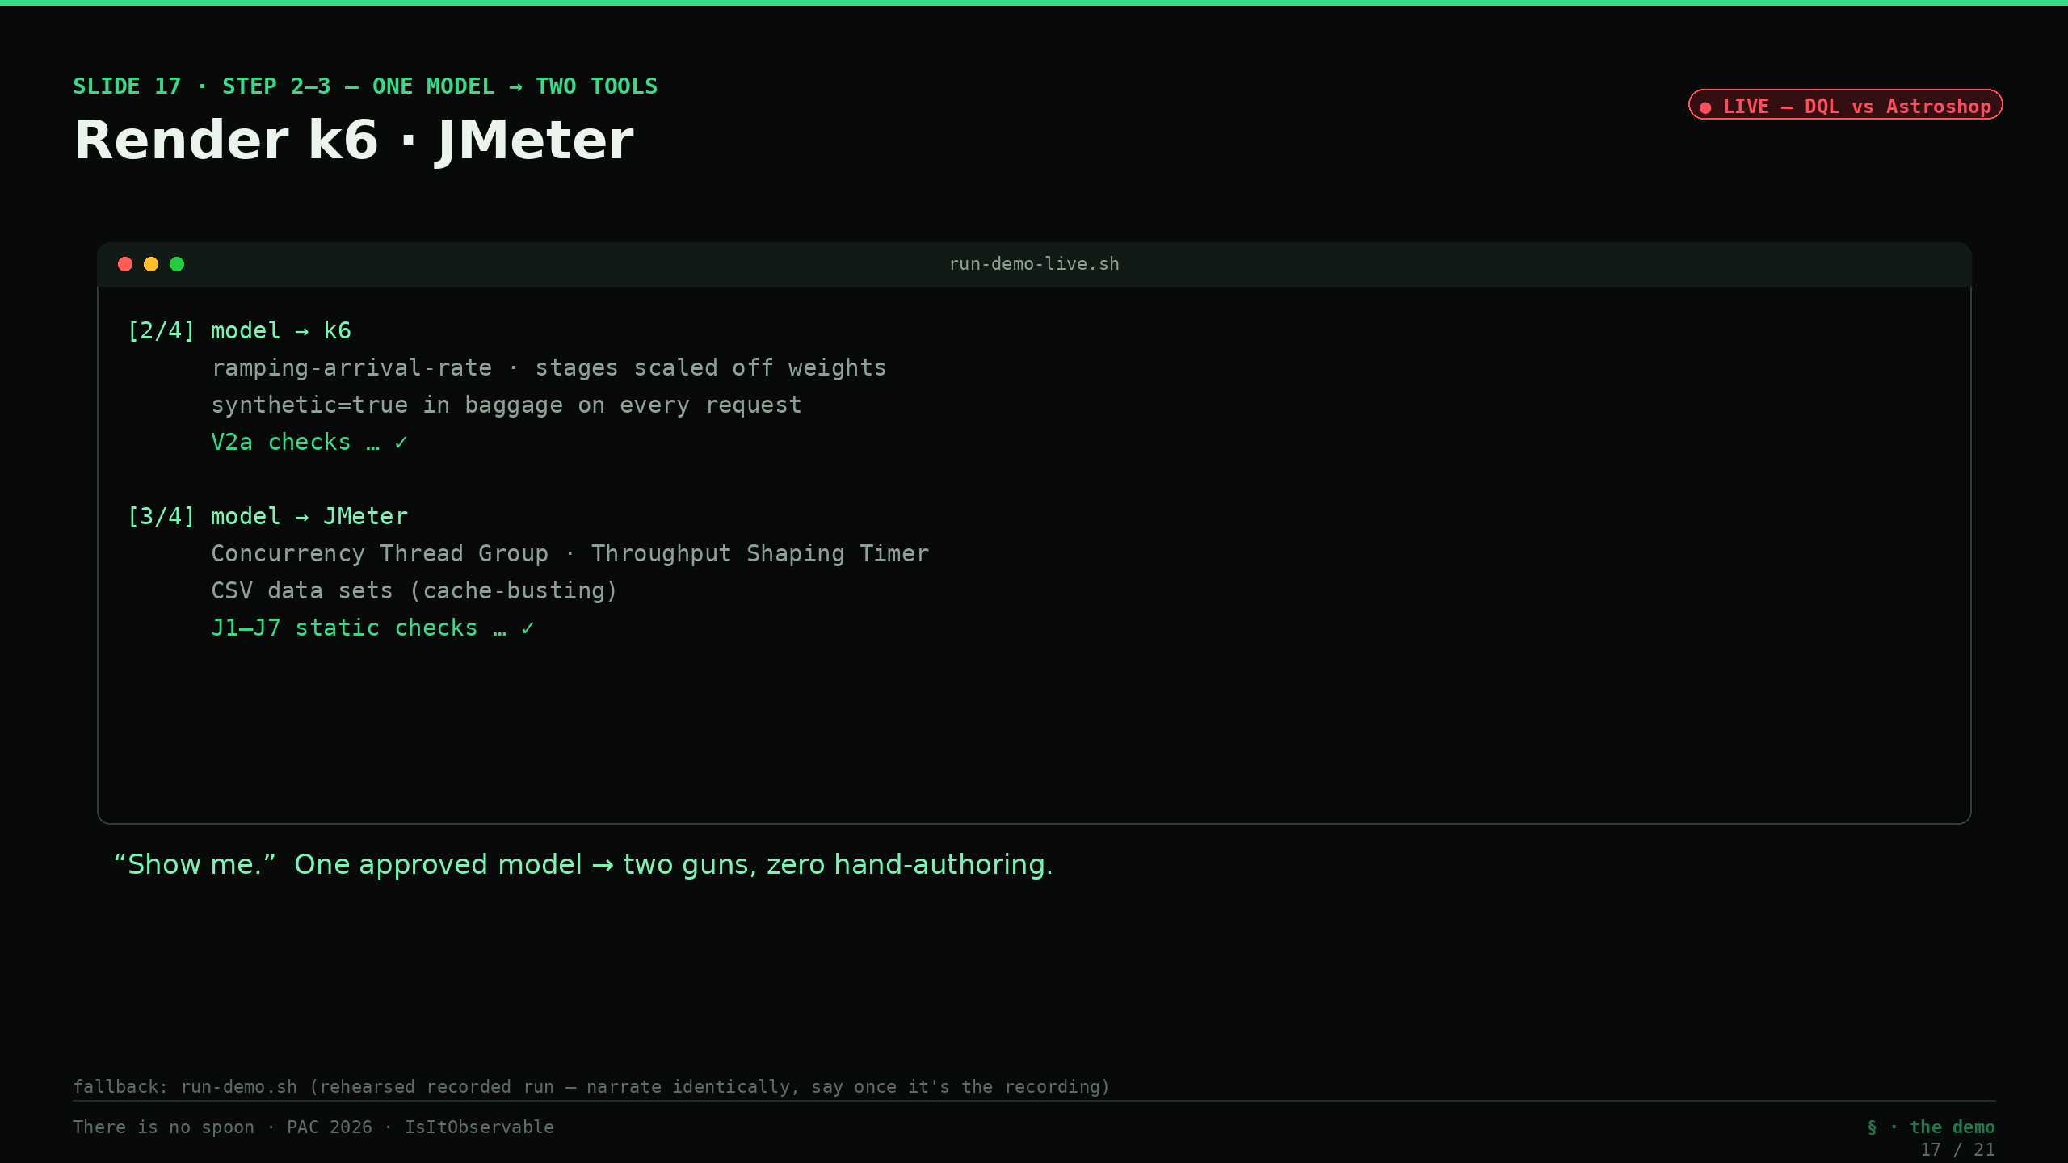
Notes:
Slides 15–18 — DEMO: load the program, LIVE (22:45–27:30) — *narration; artifacts owned by C*
This is the part where I don't trust the demo either — so we build it from scratch, on stage, against the live system. *(Step 0 — one command, `run-demo-live.sh`.)* *"I know kung fu."* *(Step 1 — telemetry → model, live.)* This isn't a model I saved yesterday. Right now it's running DQL against the live Astroshop — `fetch spans` for the service shape, `fetch user.sessions` for the real journeys — and materializing the model from what it sees this second. Watch the numbers land: three hundred thousand-plus frontend root traces, the order split coming out at roughly ninety-nine percent browsers and one percent buyers — *re-derived live, not a constant I typed in* — and sampling ratio one-point-zero, because this tenant is unsampled. The G0 gate runs on those fresh numbers: twelve of twelve, green. *(Step 1 — the wall came down.)* And watch this line scroll by — `fetch user.events`. Until this week that query came back **four-oh-three, not authorized**: the ordered-journey table was behind a storage scope we'd asked for and hadn't been granted. That scope landed this week — so now it *returns rows*. Eighteen thousand sessions resolve into sixteen ordered journey templates with real think-times between actions. Here's the honesty move, though, and it's the important one: **the model you're watching build did not need that table.** It's sized from spans plus `user.sessions`, and the extractor is written to degrade cleanly to exactly those two if `user.events` is ever gone — so the ordered journeys are a *bonus* the model now flows, not a dependency it breaks on. Trust the trace, not the demo: I'll take the richer data when it's there and lose nothing when it isn't. *(The gate.)* Now the engine stops and asks a human — me — to approve what it just observed. *(Temet Nosce foreshadow.)* It will not synthesize a single request until I do. I approve. *(Step 2 — model → k6.)* *"Show me."* One command, and out of that one approved model comes a k6 project: ramping-arrival-rate executor — an open model — stages scaled straight off the weights, and `synthetic=true` in baggage on every request so I can find my own load later. V2a checks pass. *(Step 3 — model → JMeter.)* Same model, different gun: out comes a `.jmx` — Concurrency Thread Group, Throughput Shaping Timer, CSV data sets for cache-busting. Static checks pass. *(Step 4 — diff.)* Side by side: same journeys, same weights, same arrival envelope, same synthetic baggage — two completely different engines, zero hand-authoring. Guns, lots of guns. The model is the program; the renderer is just the compiler back-end. *(Fallback note for Henrik: if Step 0 reports the tenant unreachable, `run-demo-live.sh` tells you to switch to `run-demo.sh` — a rehearsed recorded run of this identical flow. Narrate it the same way; say once that it's the recorded fallback. If time is short, narrate steps 1, 2, 4 and drop the JMeter detail.)*

Slide 18
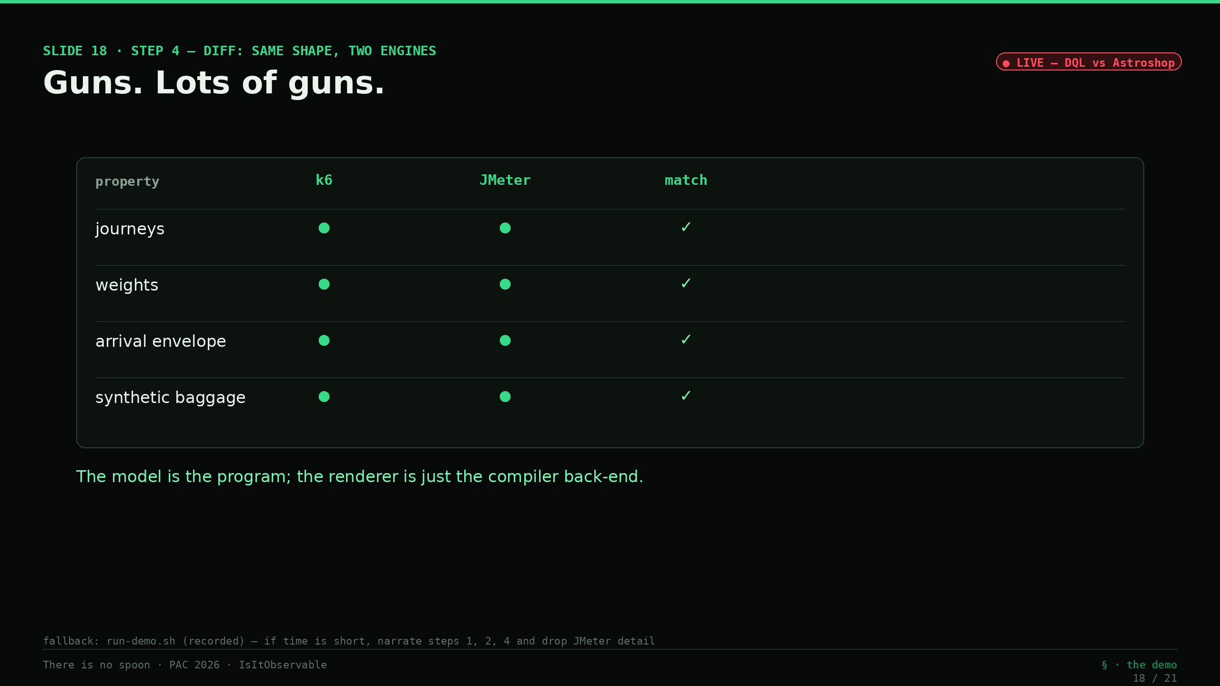
Notes:
Slides 15–18 — DEMO: load the program, LIVE (22:45–27:30) — *narration; artifacts owned by C*
This is the part where I don't trust the demo either — so we build it from scratch, on stage, against the live system. *(Step 0 — one command, `run-demo-live.sh`.)* *"I know kung fu."* *(Step 1 — telemetry → model, live.)* This isn't a model I saved yesterday. Right now it's running DQL against the live Astroshop — `fetch spans` for the service shape, `fetch user.sessions` for the real journeys — and materializing the model from what it sees this second. Watch the numbers land: three hundred thousand-plus frontend root traces, the order split coming out at roughly ninety-nine percent browsers and one percent buyers — *re-derived live, not a constant I typed in* — and sampling ratio one-point-zero, because this tenant is unsampled. The G0 gate runs on those fresh numbers: twelve of twelve, green. *(Step 1 — the wall came down.)* And watch this line scroll by — `fetch user.events`. Until this week that query came back **four-oh-three, not authorized**: the ordered-journey table was behind a storage scope we'd asked for and hadn't been granted. That scope landed this week — so now it *returns rows*. Eighteen thousand sessions resolve into sixteen ordered journey templates with real think-times between actions. Here's the honesty move, though, and it's the important one: **the model you're watching build did not need that table.** It's sized from spans plus `user.sessions`, and the extractor is written to degrade cleanly to exactly those two if `user.events` is ever gone — so the ordered journeys are a *bonus* the model now flows, not a dependency it breaks on. Trust the trace, not the demo: I'll take the richer data when it's there and lose nothing when it isn't. *(The gate.)* Now the engine stops and asks a human — me — to approve what it just observed. *(Temet Nosce foreshadow.)* It will not synthesize a single request until I do. I approve. *(Step 2 — model → k6.)* *"Show me."* One command, and out of that one approved model comes a k6 project: ramping-arrival-rate executor — an open model — stages scaled straight off the weights, and `synthetic=true` in baggage on every request so I can find my own load later. V2a checks pass. *(Step 3 — model → JMeter.)* Same model, different gun: out comes a `.jmx` — Concurrency Thread Group, Throughput Shaping Timer, CSV data sets for cache-busting. Static checks pass. *(Step 4 — diff.)* Side by side: same journeys, same weights, same arrival envelope, same synthetic baggage — two completely different engines, zero hand-authoring. Guns, lots of guns. The model is the program; the renderer is just the compiler back-end. *(Fallback note for Henrik: if Step 0 reports the tenant unreachable, `run-demo-live.sh` tells you to switch to `run-demo.sh` — a rehearsed recorded run of this identical flow. Narrate it the same way; say once that it's the recorded fallback. If time is short, narrate steps 1, 2, 4 and drop the JMeter detail.)*

Slide 19
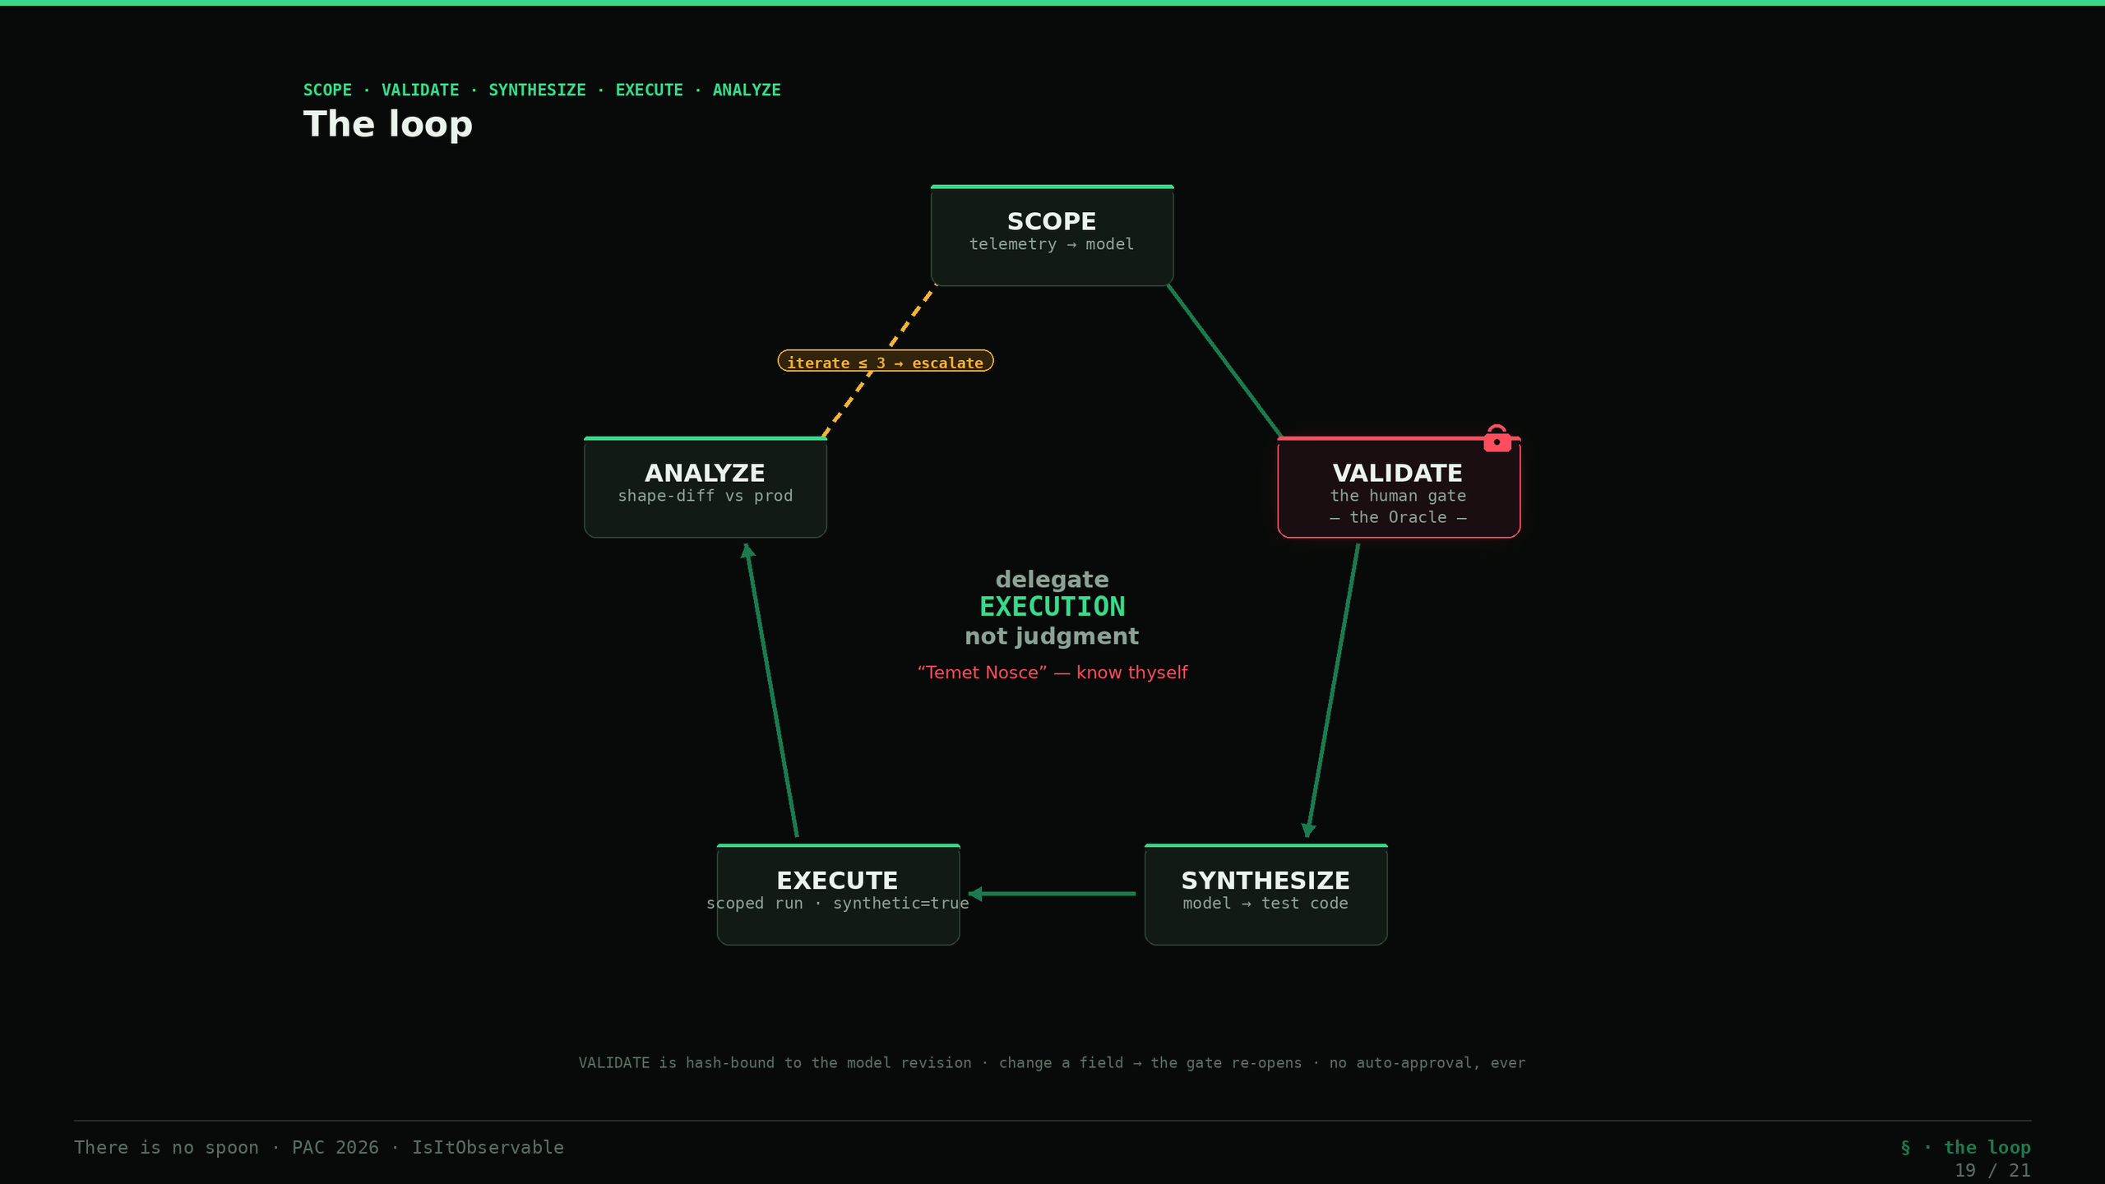
Notes:
Slide 19 — The loop + the Oracle (27:30–29:00)
Zoom out: the whole thing is a five-stage loop. SCOPE — telemetry to model. VALIDATE — the human gate. SYNTHESIZE — model to test code. EXECUTE — the scoped run, tagged synthetic. ANALYZE — shape-diff against production, and iterate at most three times before it escalates to a human. And VALIDATE is the Oracle — you just watched it fire, mid-demo, when the engine made me approve the model before it would render anything. *(Temet Nosce — "know thyself" — on screen.)* The agent can model, generate, run, and diff all day long. But whether *this* scenario is the right thing to test is a human judgment, bound by a hash to the exact model revision — change one field and the approval is void and the gate re-opens. No auto-approval, ever. Not on confidence, not on a similarity score, not on a deadline. That's what "delegate execution, not judgment" means in practice.

Slide 20
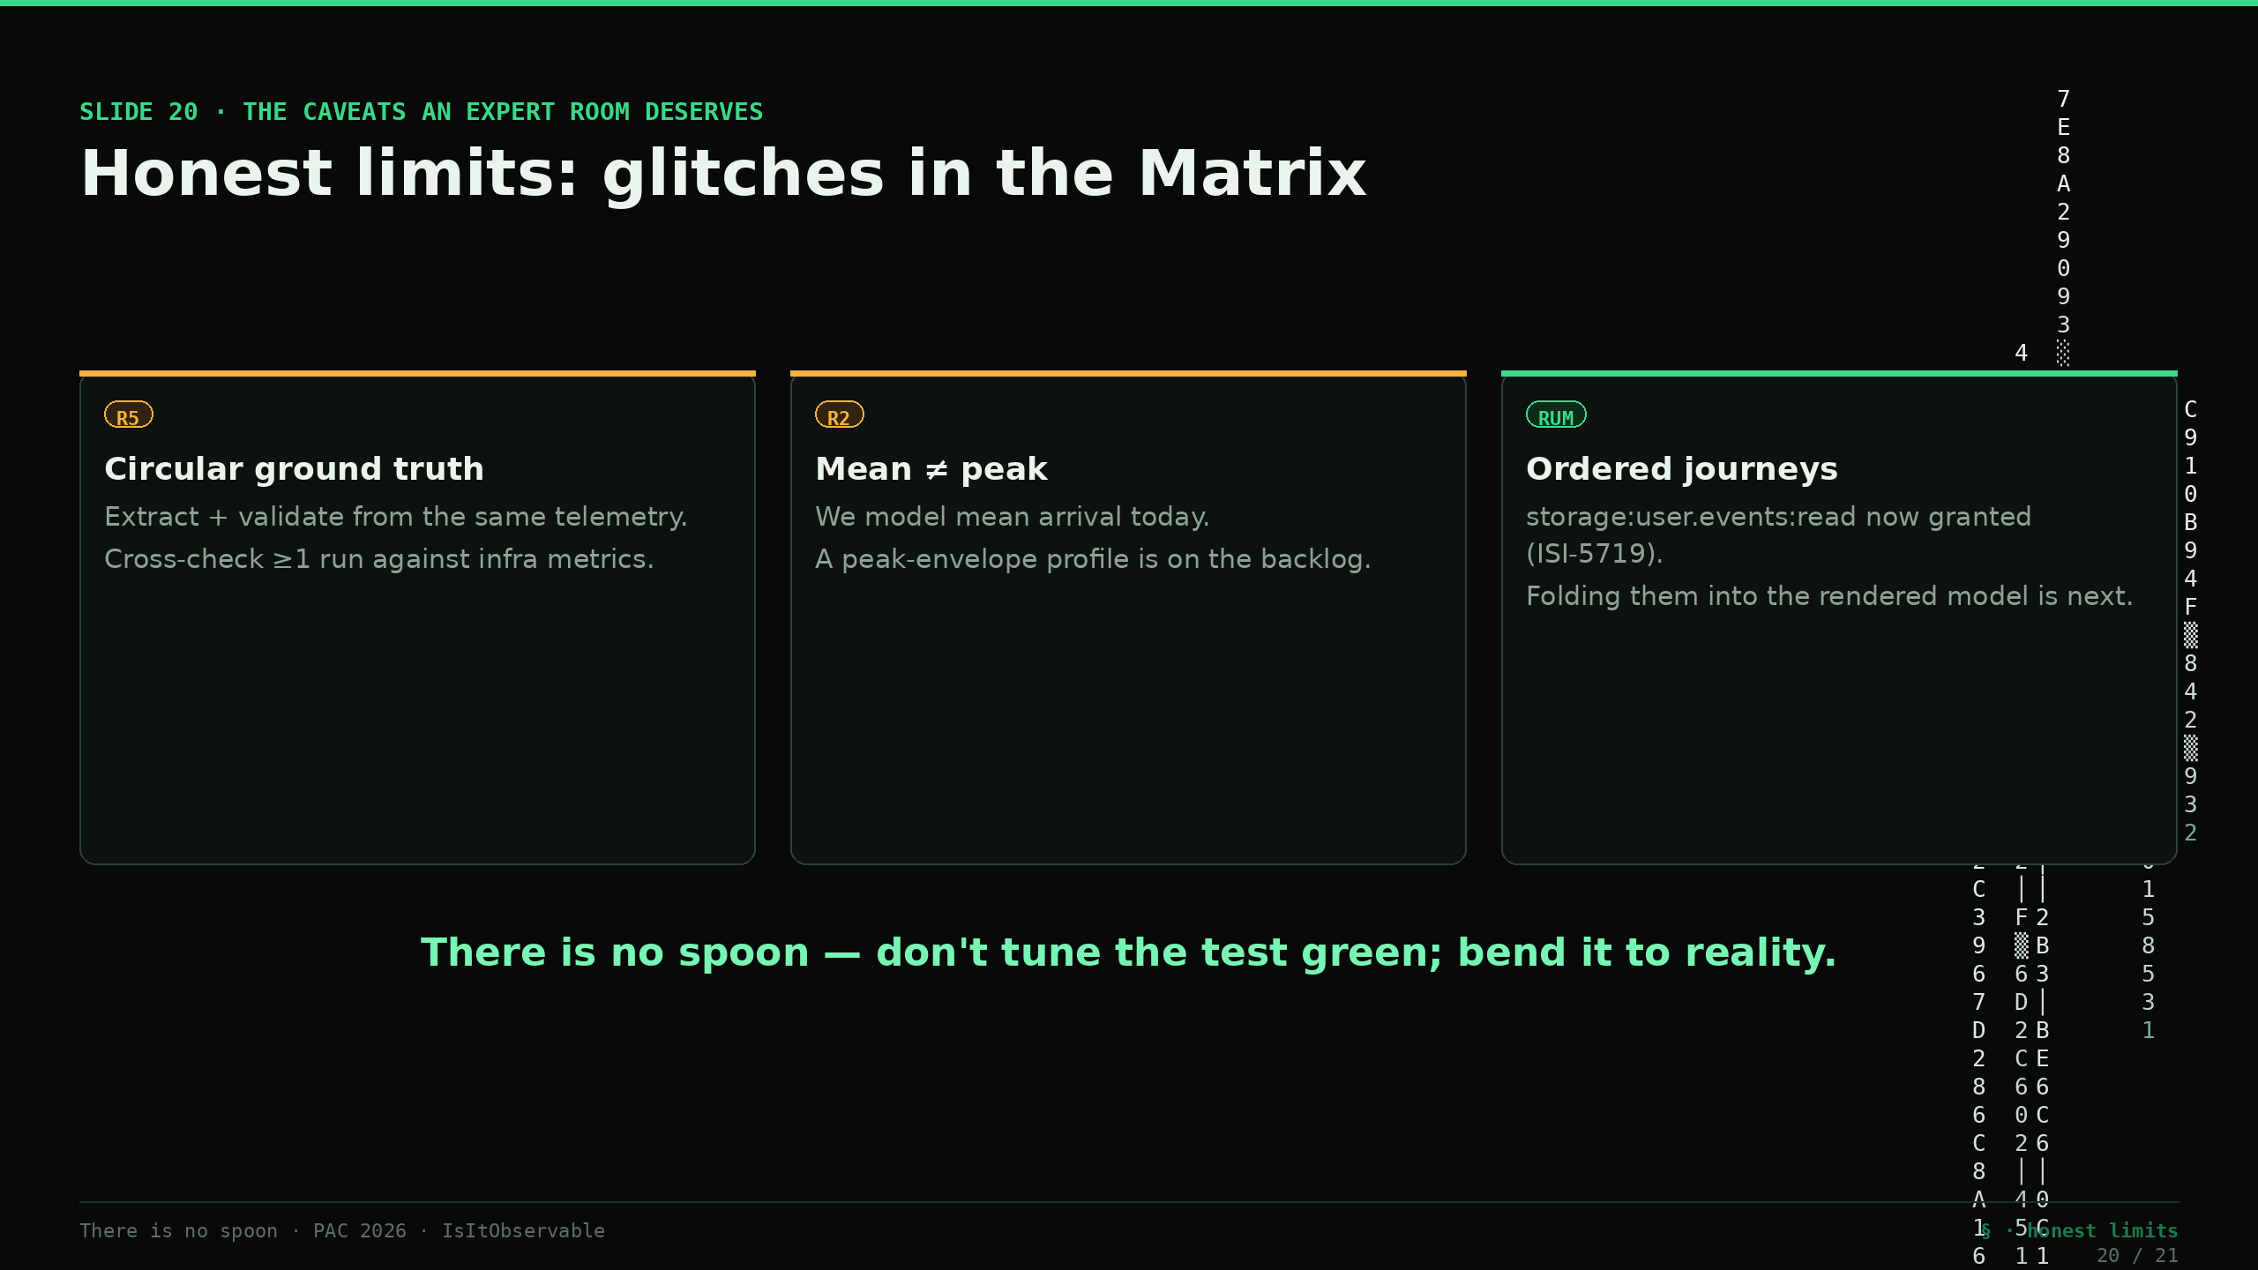
Notes:
Slide 20 — Honest limits: glitches in the Matrix (29:00–30:00) [FLEX]
Before I open it up — the glitches I haven't fixed, because an expert room deserves the caveats. One: we extract *and* validate from the same telemetry, so a shared blind spot — async fan-out, websockets, fire-and-forget — is invisible on both sides. We cross-check at least one run against infra metrics, not telemetry alone. Two: mean is not peak; we model mean arrival today and a peak-envelope profile is still on the backlog. Three: the ordered-journey RUM piece — the one that was four-oh-three until this week — just got its storage scope granted, so the ordered journeys and think-times are now extractable; folding them into the rendered model, beyond the volume-and-shape sizing we already do, is the next piece of work. And the deepest one — there is no spoon. The temptation, always, is to tune the test until the diff turns green. We cap iterations at three and escalate with evidence precisely so we bend the test toward reality, not toward passing.

Slide 21
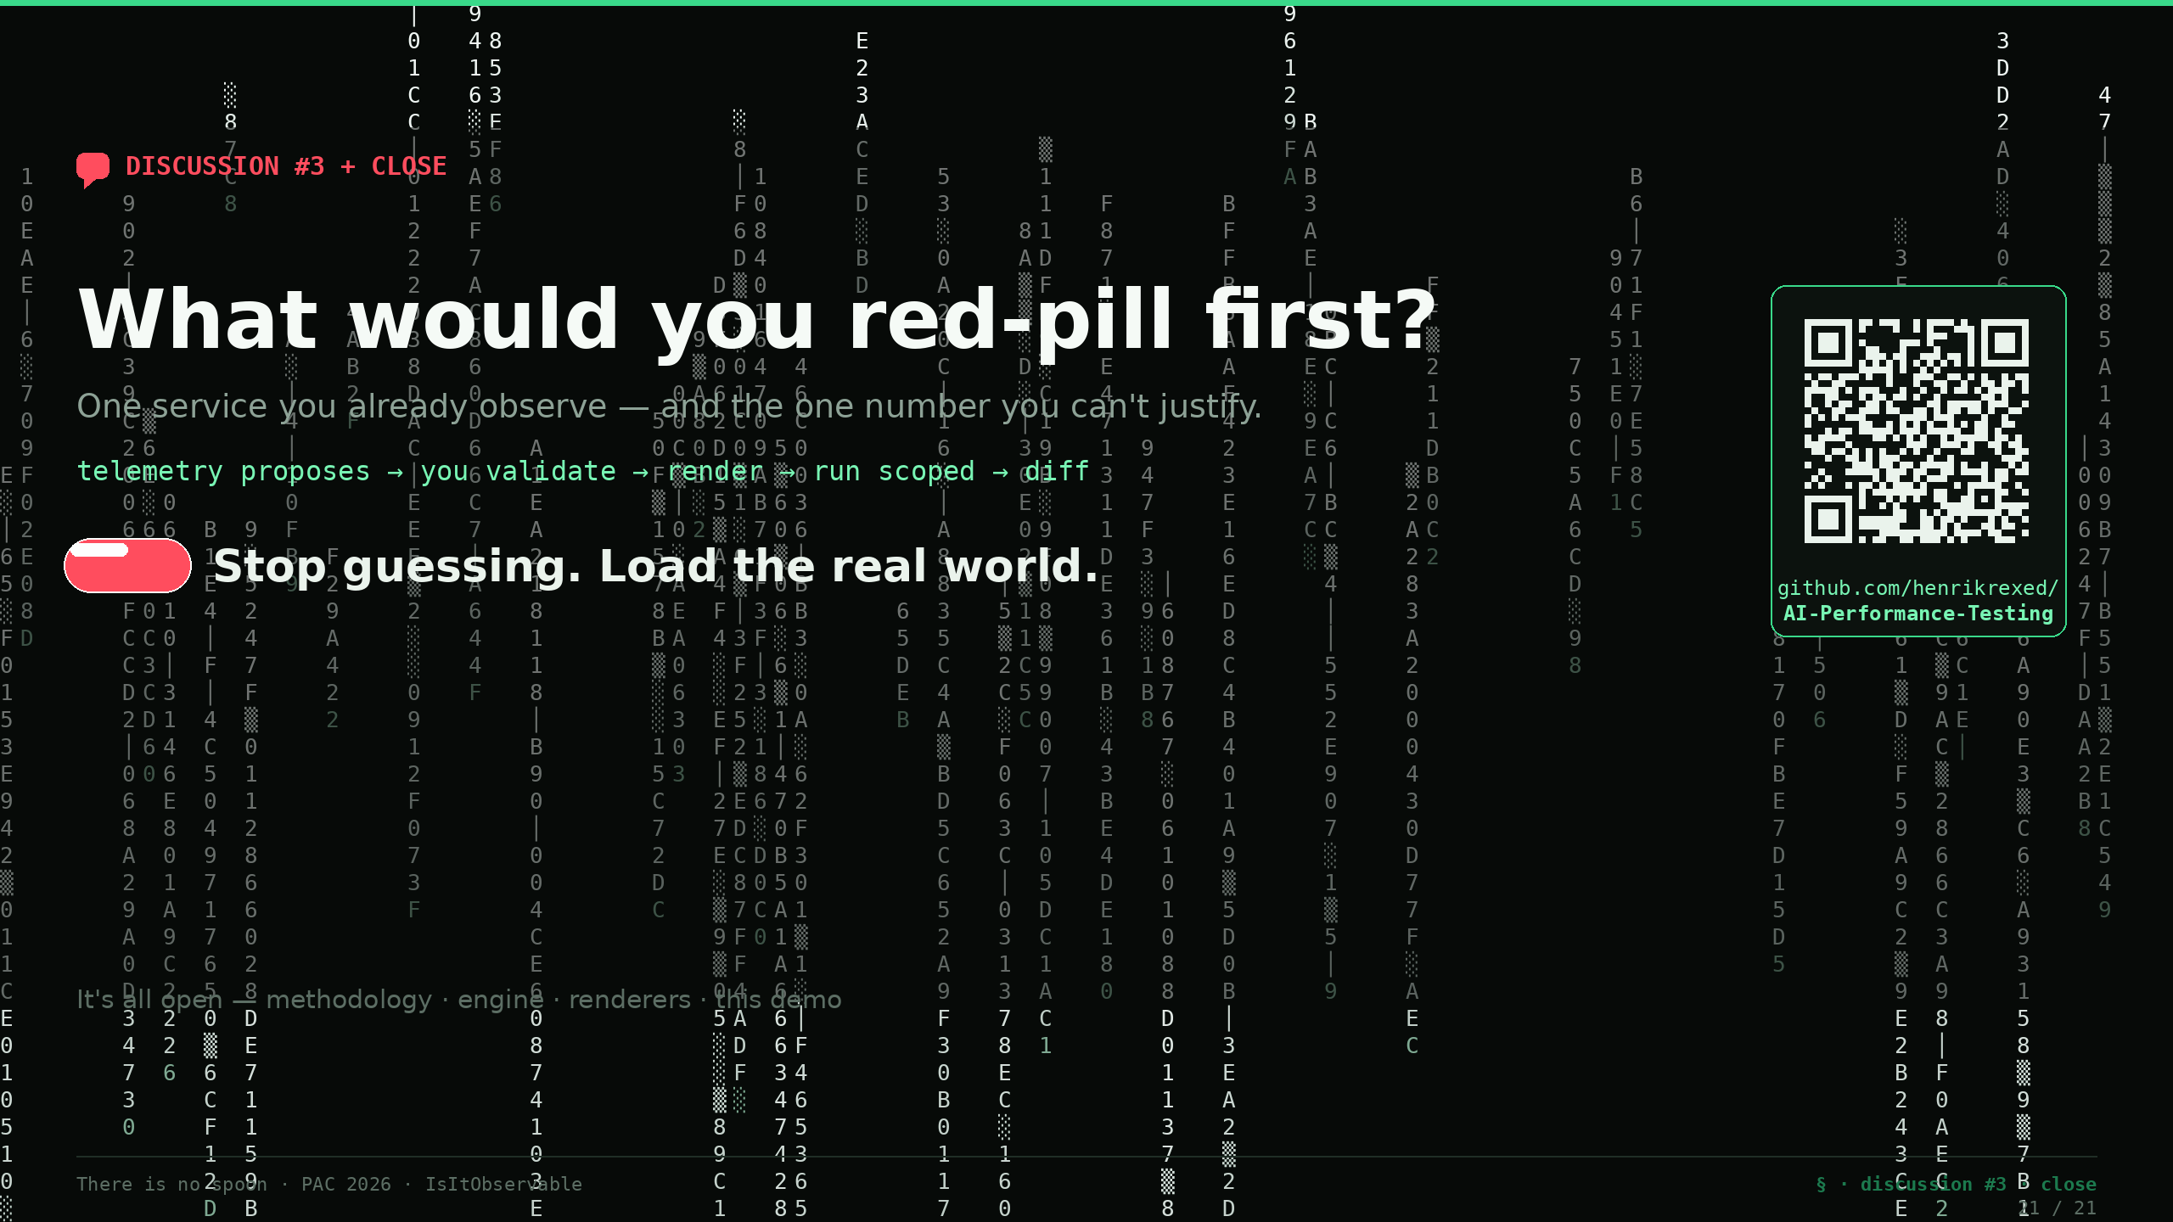
Notes:
💬 Slide 21 — Discussion #3 + close (30:00 → into Q&A)
So here's my last question, and then the floor is yours. If you walked out of here and took the red pill on exactly one service — one service you already observe well — which one would you red-pill first, and what's the one number in your current test for it that you've never been able to justify? *(Collect answers; tie back to the folklore from Discussion #1.)* That's the ask. Not "rebuild all your load testing." Pick one service, let the telemetry propose the model, you validate it, render it, run it scoped, diff the shape. One service. Everything you just watched — the engine, the renderers, this live demo — is open; the repo and the asset links are on the screen behind me. Stop guessing. Load the real world. Thank you.
---

