Slide 1
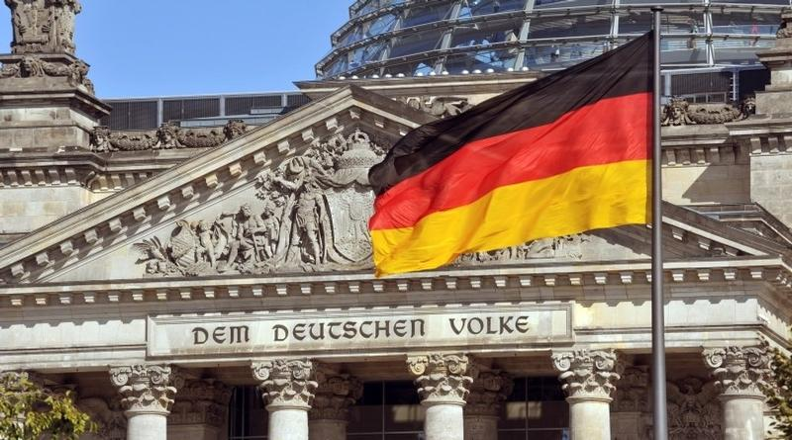
G
E
R
M
A
N
Y
A brief
PEST Analysis

Slide 2
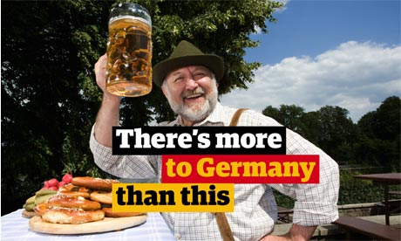
HENRY KPANO
TEAM DEUTSCHLAND
CATHERINE KIMANI
HENRY MASCOT

Slide 3
WE WILL BE SHARING
a. Cultural dimensions
b. Cultural etiquette
c. Level of Tech Adoption
d. Major events

Slide 4
CULTURAL DIMENSIONS

Slide 5
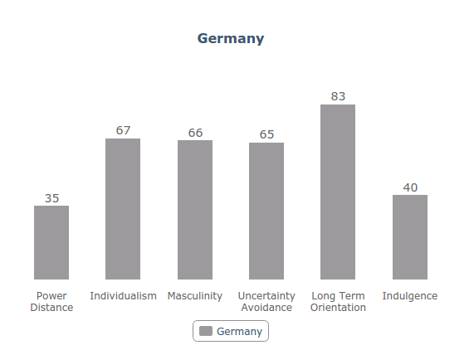
67
67
67
66
65
67
35
Power
Distance
Individualism
Masculinity
Uncertainty
Avoidance
Long Term
Orientation
Indulgence

Slide 6
CULTURAL PRACTICES
AND ETIQUETTE

Slide 7



Slide 8
LEVEL OF TECHNOLOGY
ADOPTION

Slide 9
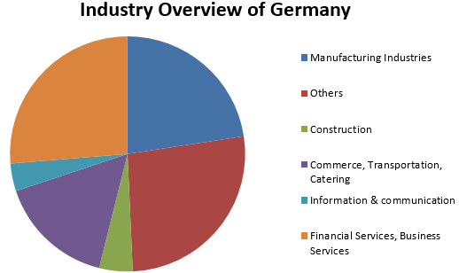




Internet users:
total: 70.3 million
mobile cellular:
total: 99.5 million
berlin

Slide 10
DANKE
Sources:
1. The Hofstede Center: http://geert-hofstede.com/countries.html
2. https://www.easyuni.com/advice/economic-outlay-of-germany-317
3. http://etiquette.wanderbat.com/
4. http://www.indexmundi.com/germany/economy_profile.html
5. http://www.businessinsider.sg/the-best-tech-startups-in-germany-2015-5/
6. http://www.uni-frankfurt.de/46329991/Guide-to-German-culture_and-etiquette.pdf?
7. http://www.young-germany.de/topic/live/settle-in-adjust/a-guide-to-german-etiquette

