Slide 1




React JS + Meteor = GroceryCentrica
September 29nd , 2016
Notes:
Guys Good afternoon,
Thank you for comming in this afternoon and spend your time with me!
I’m happy to share this idea and technology with you.
Before starting, just a point.
As you can list and make fun about it, english isn’t my mother language.
1-If you don’t undestand what Iḿ saying, please raise your hand or make any noise! I’ll stop and say it again.
2-If you still don’t undestand stop me again! I’ll use another words and explain again in a different way.

Slide 2
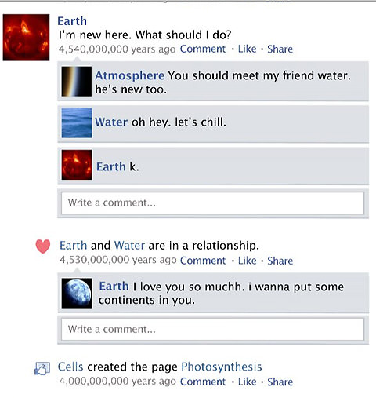

REACT
Created by Facebook ( Jordan Walke)
March 2011, using for Facebook’s newsfeed and Instagram
Notes:
Sigh. Yes, Angular is a framework, React is a library. Some say this difference makes comparing them illogical. Not at all!

Slide 3
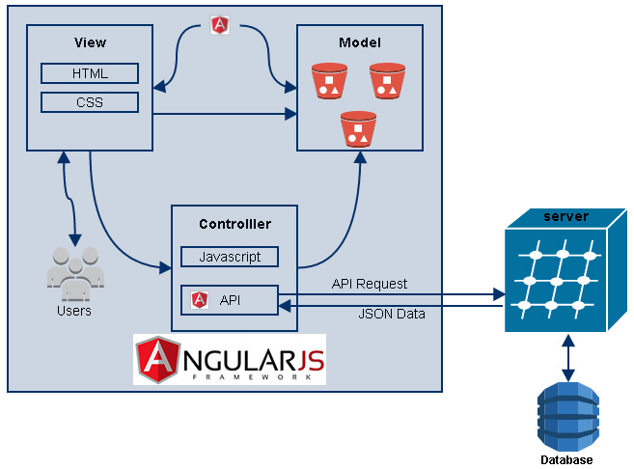
REACT
It’s Open Source since 2013, March
React isn’t an MVC FrameWork
Angular.js
Ember.js
Batman.js
React doesn’t use templates
Views
Notes:
Sigh. Yes, Angular is a framework, React is a library. Some say this difference makes comparing them illogical. Not at all!

Slide 4

Let’s make React

Slide 5
World vision
Please Welcome Neil

Slide 6
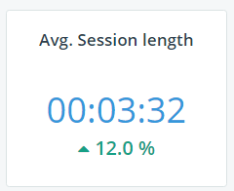
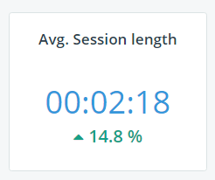
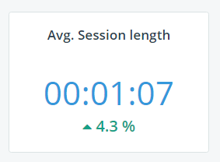
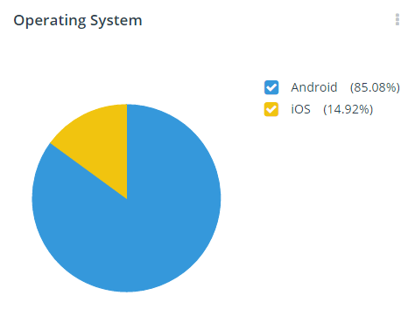
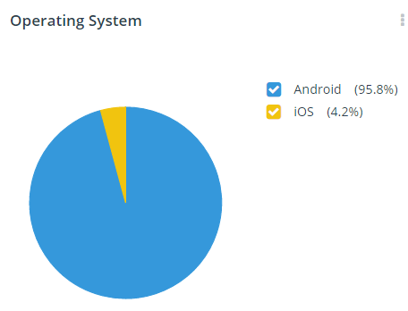
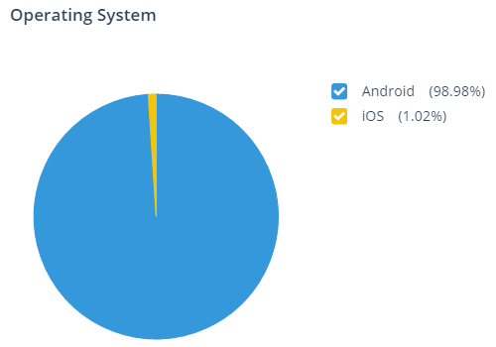
Mobile Maintenance
Mobile Inspections
Mobile Assignments

Slide 7
Mobile Maintenance
Mobile Inspections
Mobile Assignments
{
"readyState": 4,
"responseText":
"{\"Message\":\"An error has occurred.\"}", "status": 500, "statusText": "Internal Server Error"}
requestData={
"WRID": 942588, "StatusDate": "2016-06-14T19:59:44", "StatusID": 3, "ServiceTypeID": 1, "RepairID": 13, "EmployeeID": 28995, "RegularMinutes": null, "OvertimeMinutes": 0.05, "TravelMinutes": null, "Regular1WagePremiumID": null, "Regular2WagePremiumID": null, "Overtime1WagePremiumID": null, "Overtime2WagePremiumID": null, "Notes": "Light switch was turned off", "UserName": "mjdawson@gsmc.org"}

Slide 8
Automate testing
Telerik Test Studio
JavaScript frameworks
Jasmine
Karma

Slide 9
Questions? Comments? Concerns?

