Slide 1

Reinforcement Learning
Reinforcement Learning FEUP-M.EIC009-2022/2023-2S
Training Gym’s LunarLander with different scenarios and models
Group B
Diogo Costa - up201906731 Francisco Colino - up201905405
Henrique Sousa - up201906681

Slide 2
Proposal
We want to explore:
Stable baselines models and capacities.
Gym API and environments.
Reinforcement Learning.
Approach:
Choose a base environment.
Test different models.
Test different environments.

Slide 3
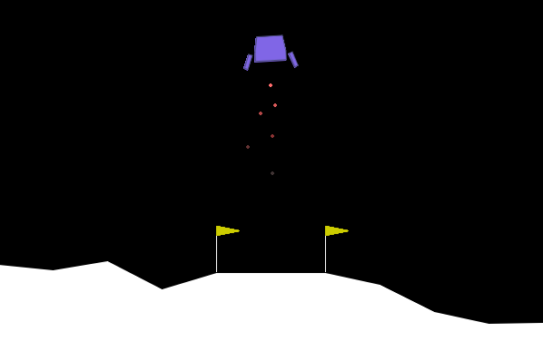
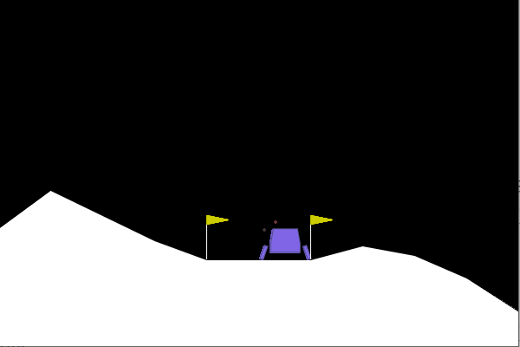
Environment - Lunar Lander V2
Action space -> Box(-1,1,(2,))
Two floats between -1 and 1
Main engine(fires if value > 0.5)
Side engines (left fires if value > 0.5, right fires if value < 0.5)
Observation space -> (8,)
Lander coordinates, and velocity
Lander angle and angular velocity
If the legs contact the ground or not
State:
Initial: Center of screen, with a random velocity
During: observation
Done:
Lander crashes
Lander disappears
Lander at rest
Rewards
Negative:
Firing engines
Moving away from landing pad
Crashing
Positive
Moving in the direction of the landing pad
Finishing at rest

Slide 4
Algorithms applied
Environments used
Training
A2C - Advantage Actor-Critic
DDPG - Deep Deterministic Policy Gradient
PPO - Proximal Policy Optimization
SAC - Soft Actor-Critic
Max thrust = 75%
Wind power = 5
Wind power = 10
Wind power = 15
Failure Rate = 5%
Failure Rate = 10%
Failure Rate = 25%
Failure Rate = 50%
Byzantine Rate = 25%
Byzantine Rate = 50%
Per model per environment
15 episodes of 10k iterations
150k iterations

Slide 5
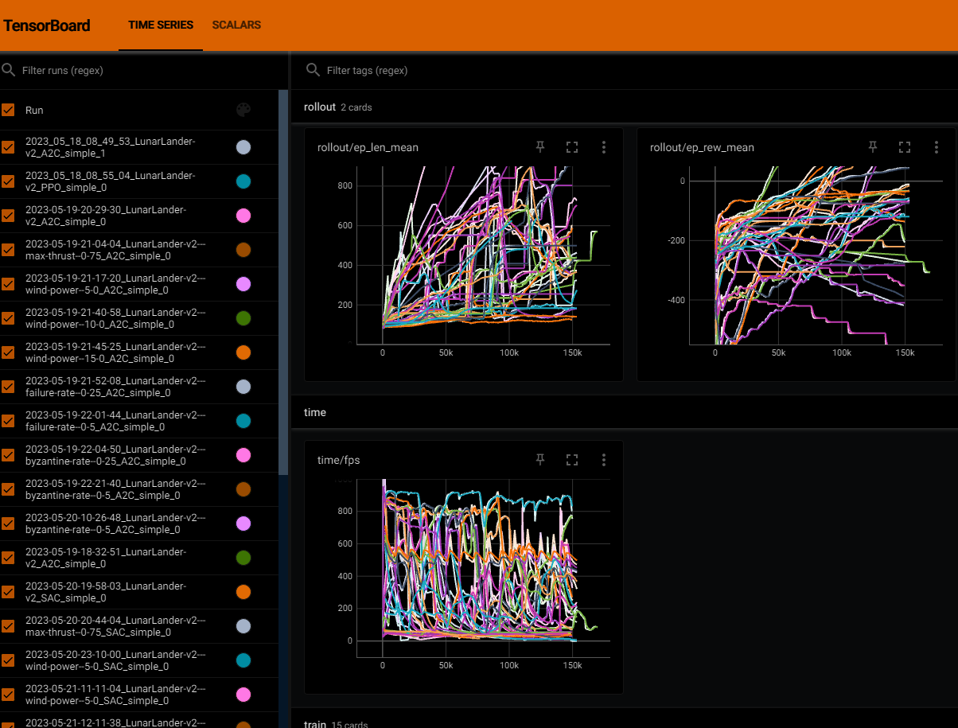
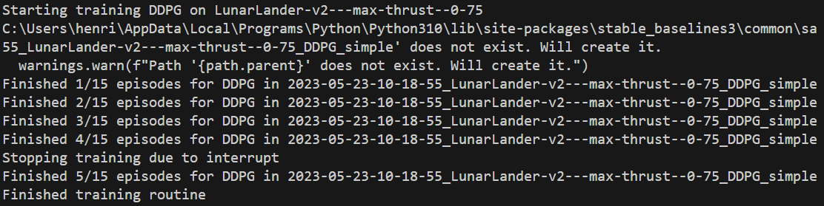
Visualization during and after training
Models have a verbose option:
Too many prints cluttering the terminal.
Implemented our own mechanisms:
Training by episode:
Variable number of episodes and iterations per episode.
Episode conclusion is displayed.
Tensorboard:
Real time logging.
After the fact visualization.
Using models:
Validating learning.

Slide 6
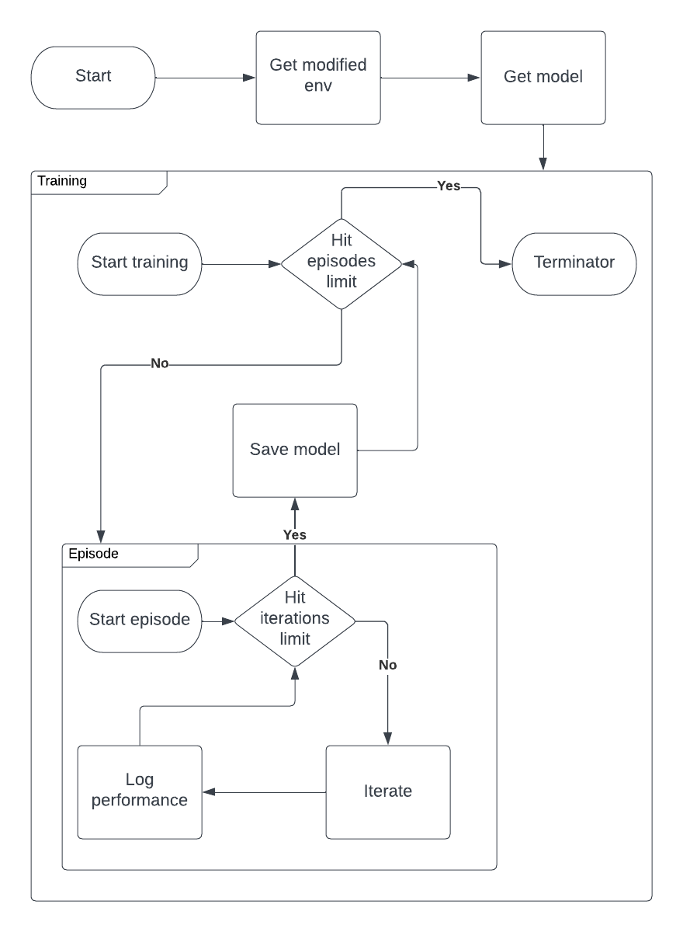
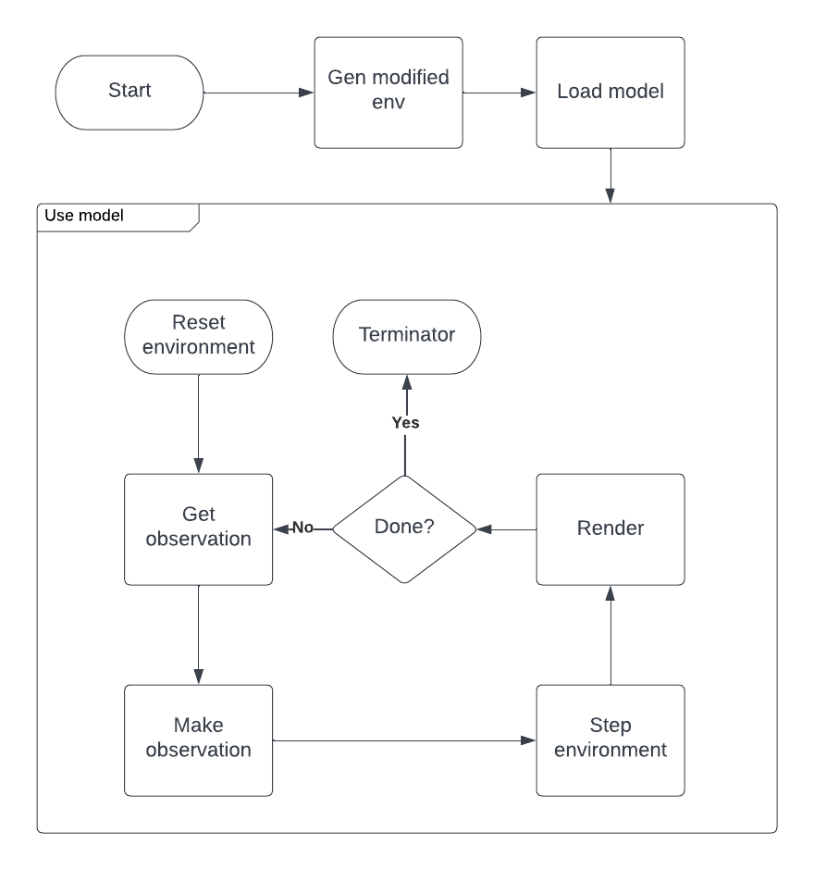
Pipeline

Slide 7
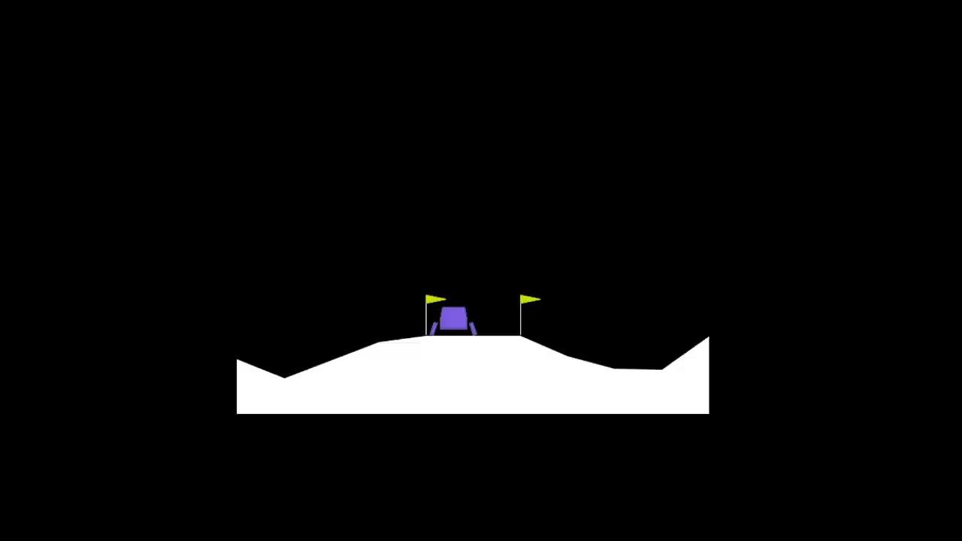
Demo
SAC with wind power 15.0

Slide 8
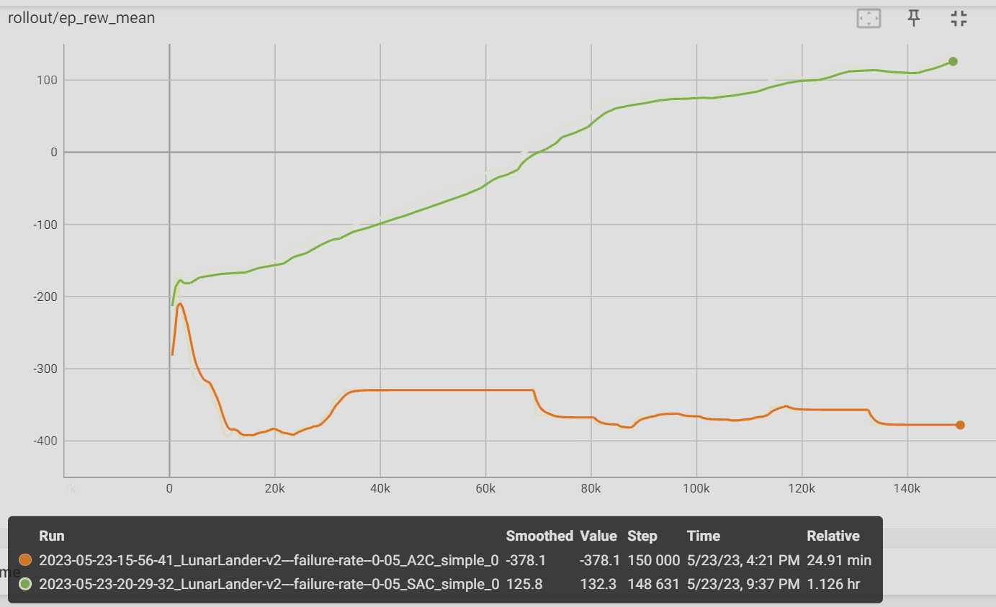
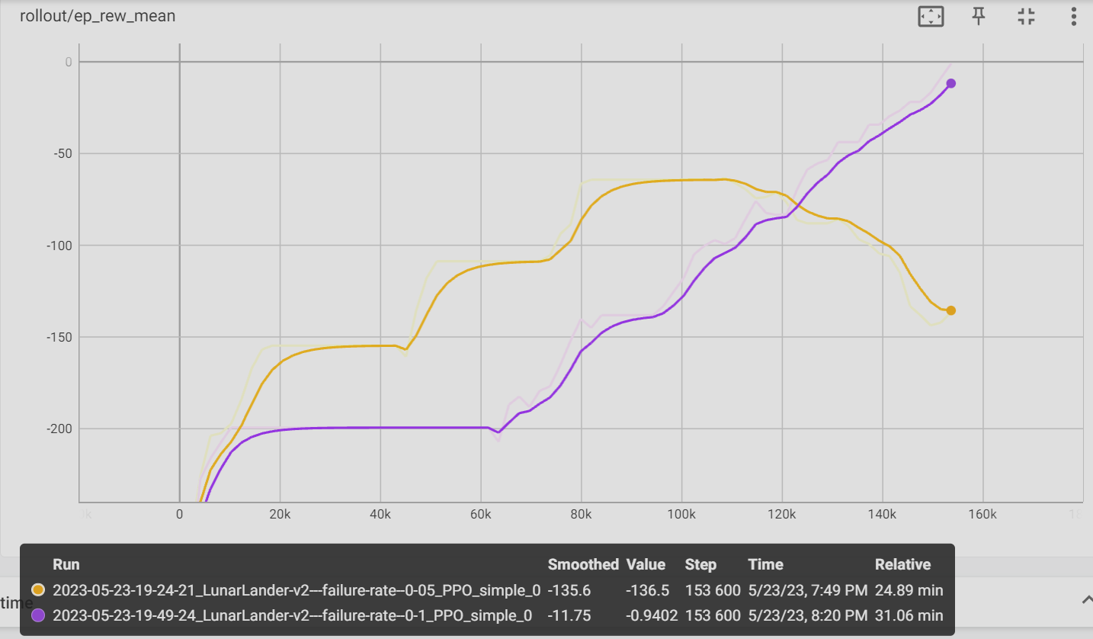
Analysis
Comparing some models considering a failure rate in the environment:
Orange: A2C Failure rate 0.05
Green: SAC Failure rate 0.05
Orange: PPO Failure rate 0.05
Purple: PPO Failure rate 0.1

Slide 9
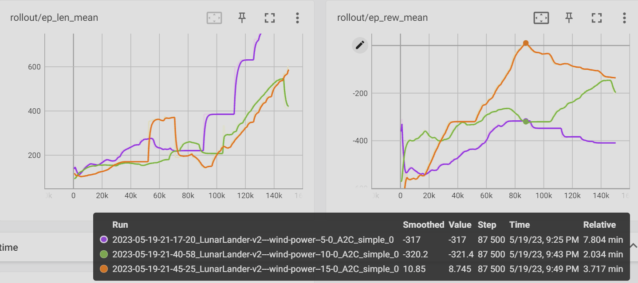
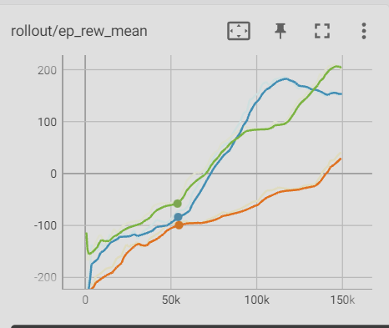
Analysis
Comparing episode length
Comparing models
Purple: A2C Wind power 5.0
Green: A2C Wind power 10.0
Orange: A2C Wind power 15.0
3 version of SAC
Notes:
Note: ep_len is that of the environment episode. not the training episode

Slide 10
Conclusion and future work
There are libraries that make it incredibly easy to experiment with Reinforcement Learning:
It is even possible to get decent to good results on simple tasks.
An adequate methodology can lead to better results and faster development.
Training models can take a long time.
Not all models are created equal:
There is enough randomization that the same conditions may lead to slightly different results.
Future work:
Obtain positive result for every environment - is that even possible?
Find ways to speed up training or prevent local optima - adjust reward?

Slide 11
Annexes
Note: The README.md in the code has instructions, other details on running, and the available features.

Slide 12
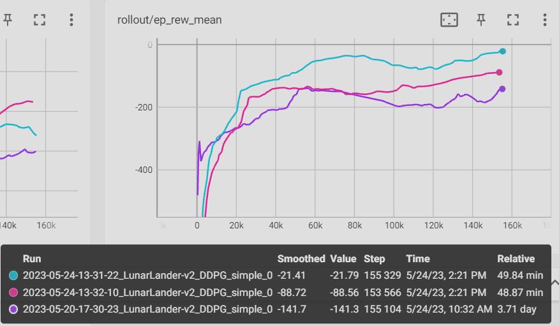
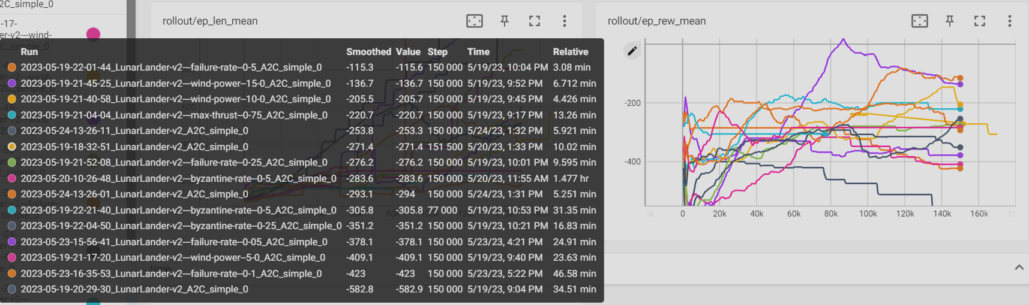
Other results
Reward graphs per model

Slide 13
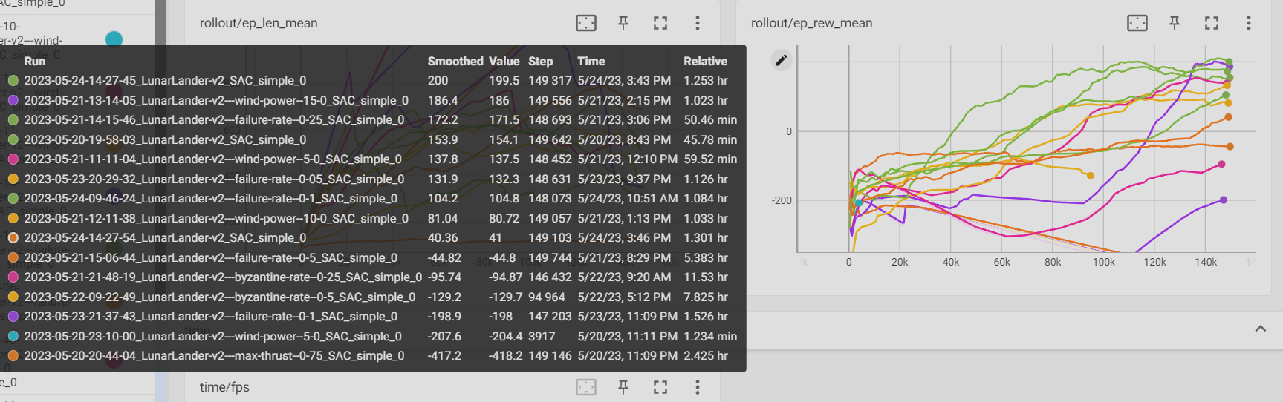
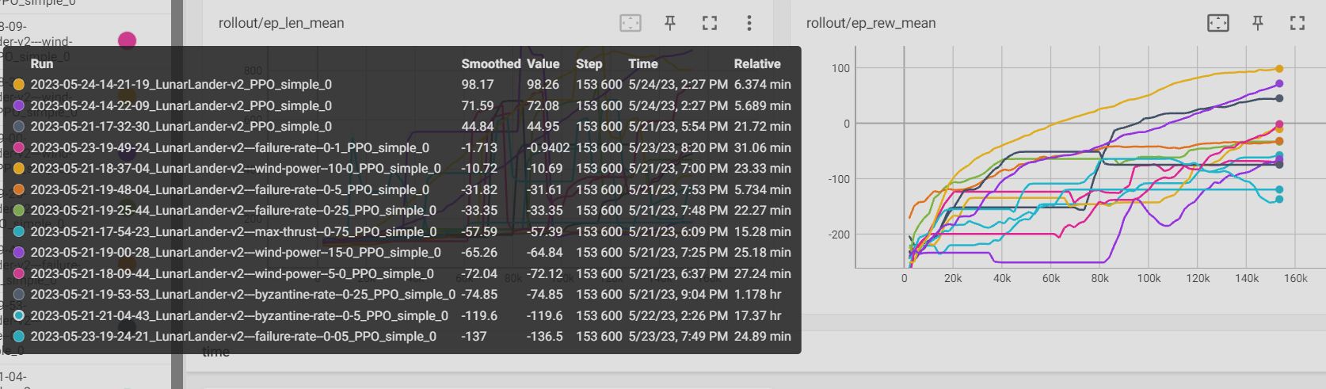

Slide 14
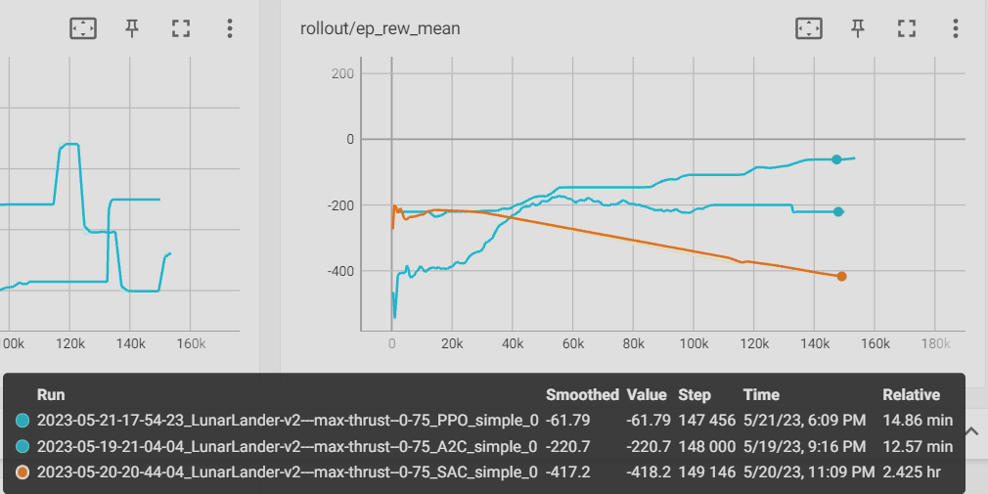
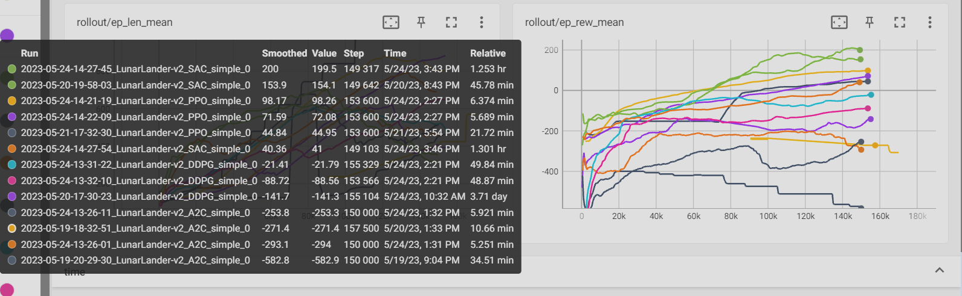
Other results
Reward graphs per environment

Slide 15
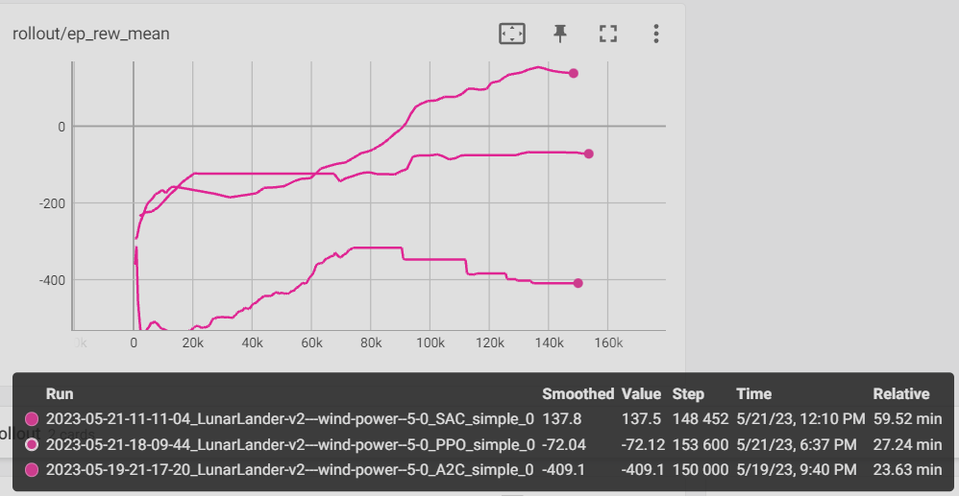
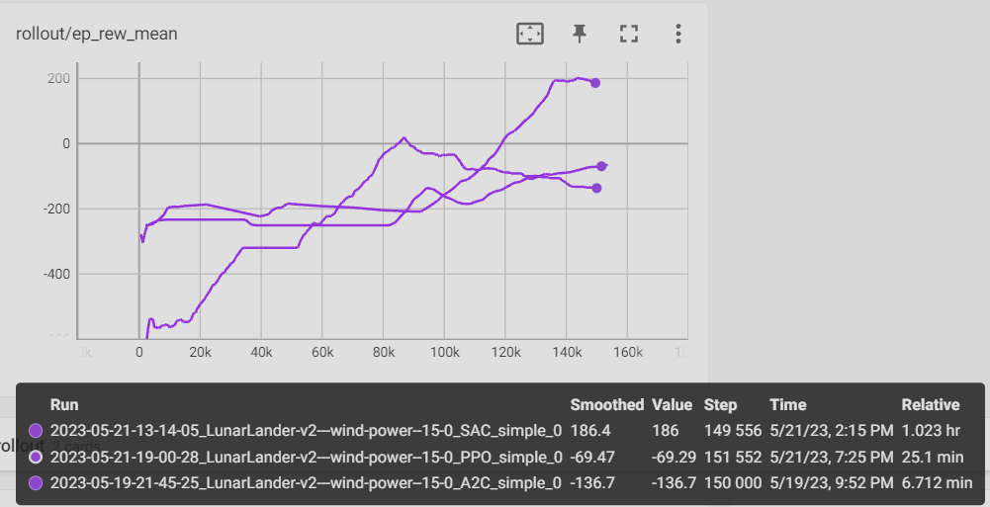
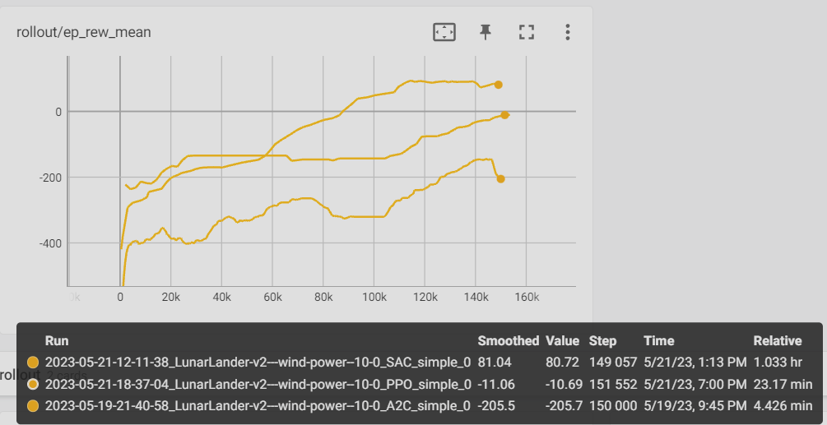

Slide 16
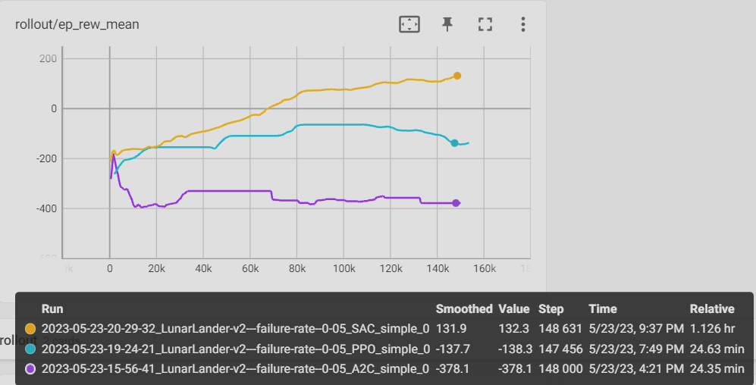
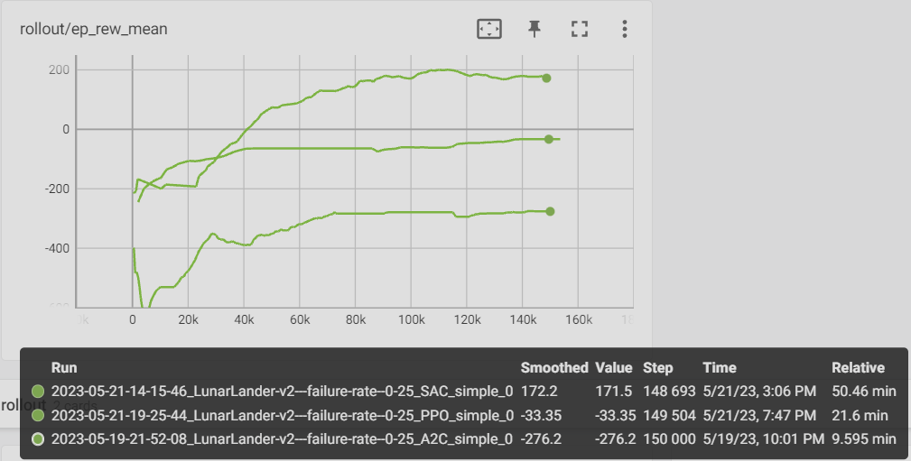
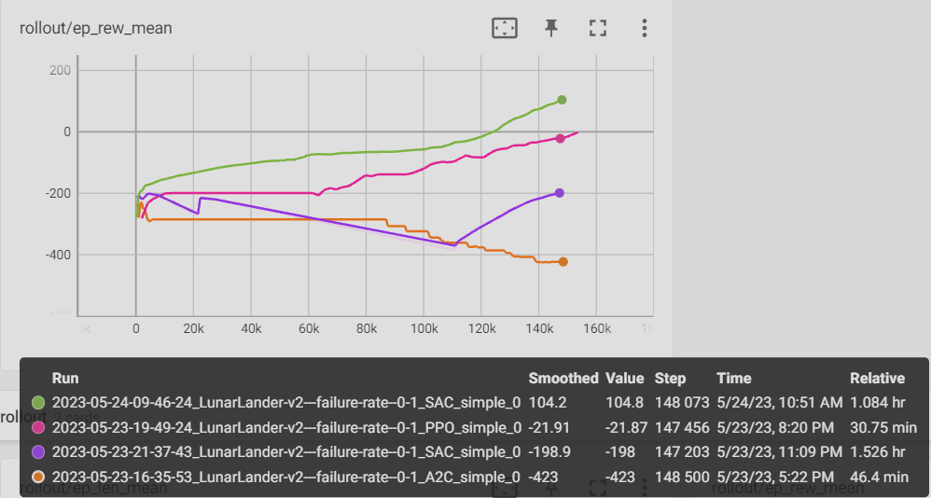
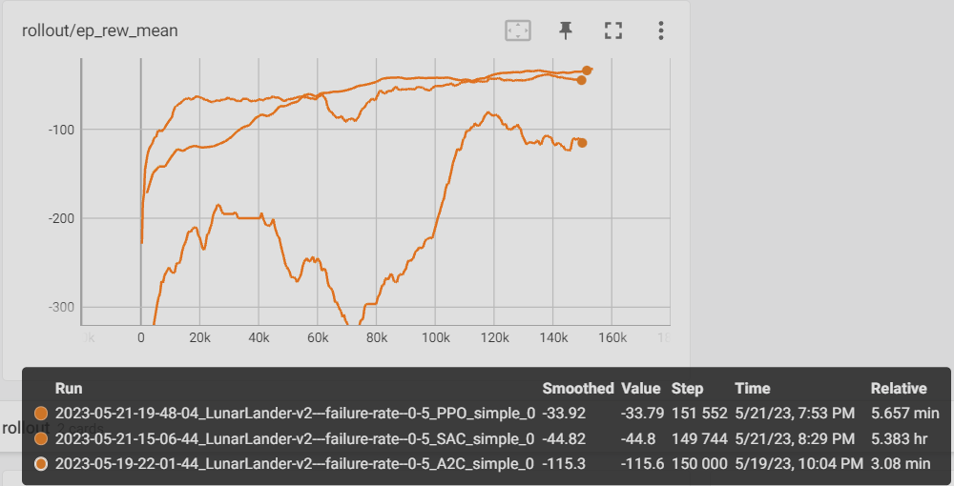

Slide 17
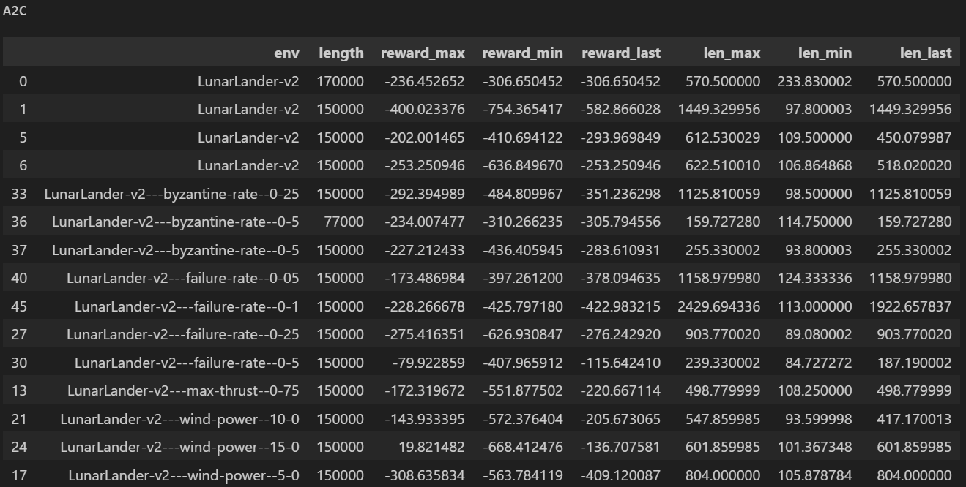
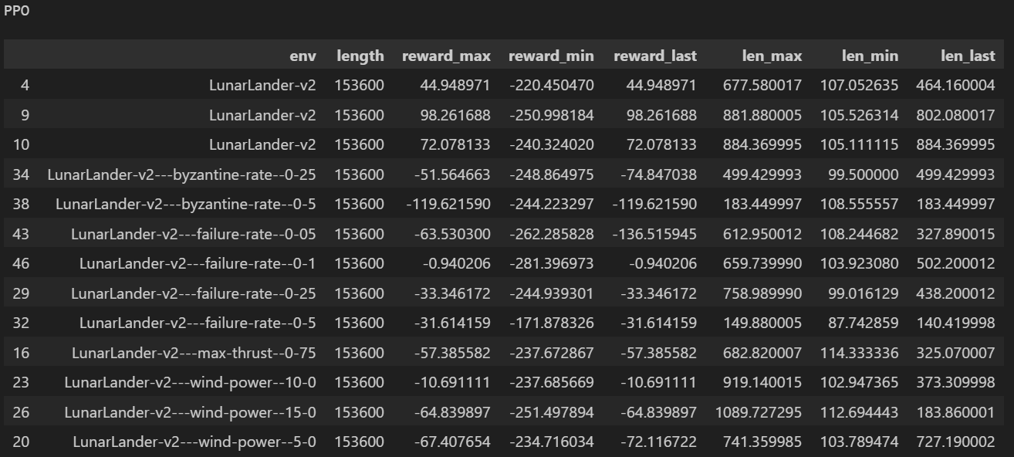
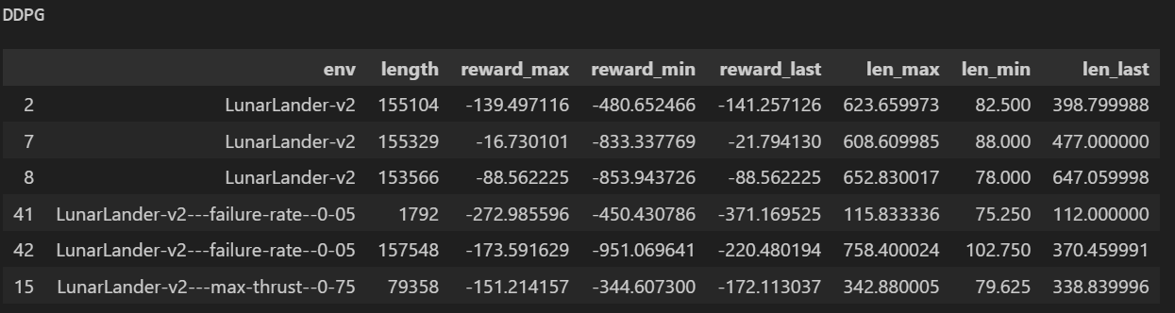
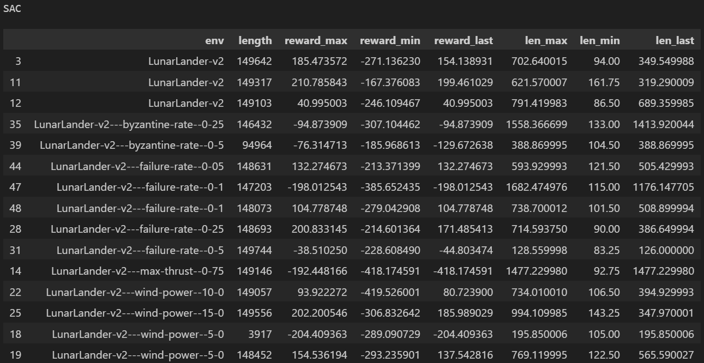
Detailed data - By model

Slide 18
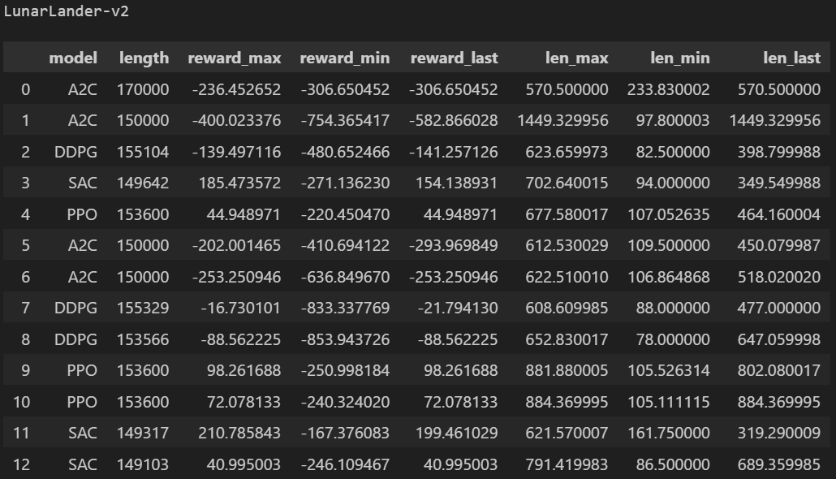
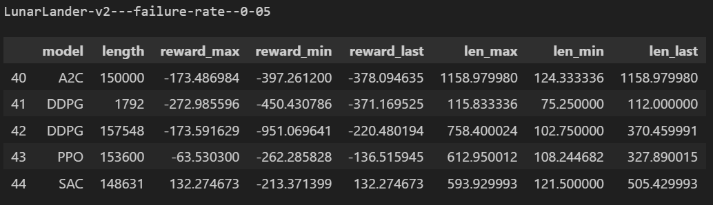
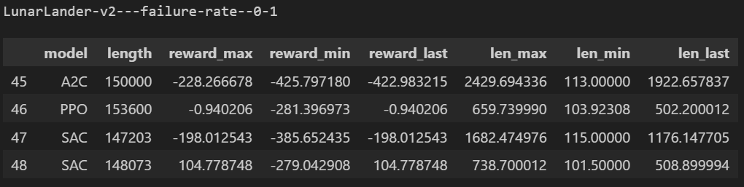
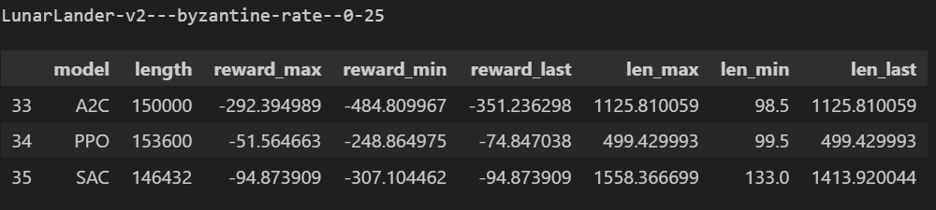
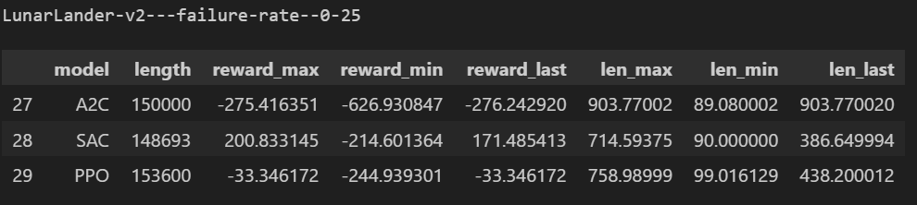
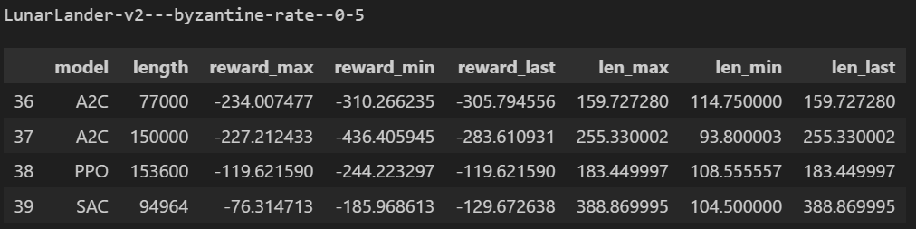
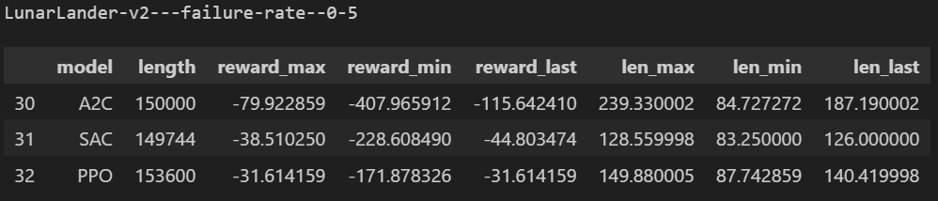
Detailed data - By environment

Slide 19
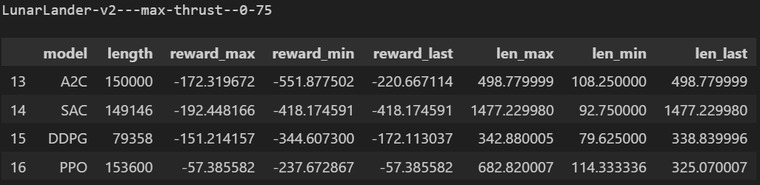
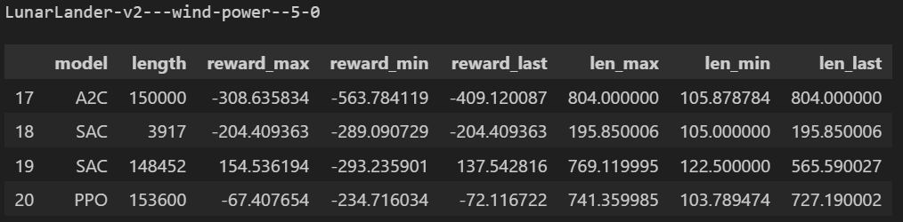
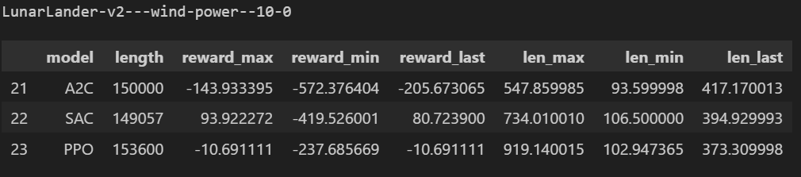
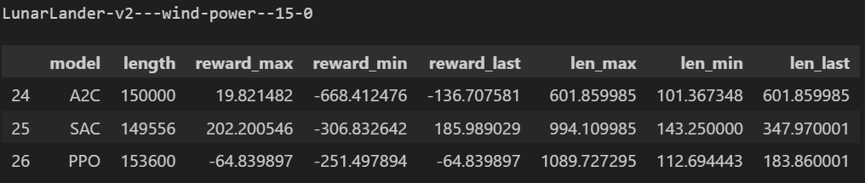
Detailed data - By environment

Slide 20
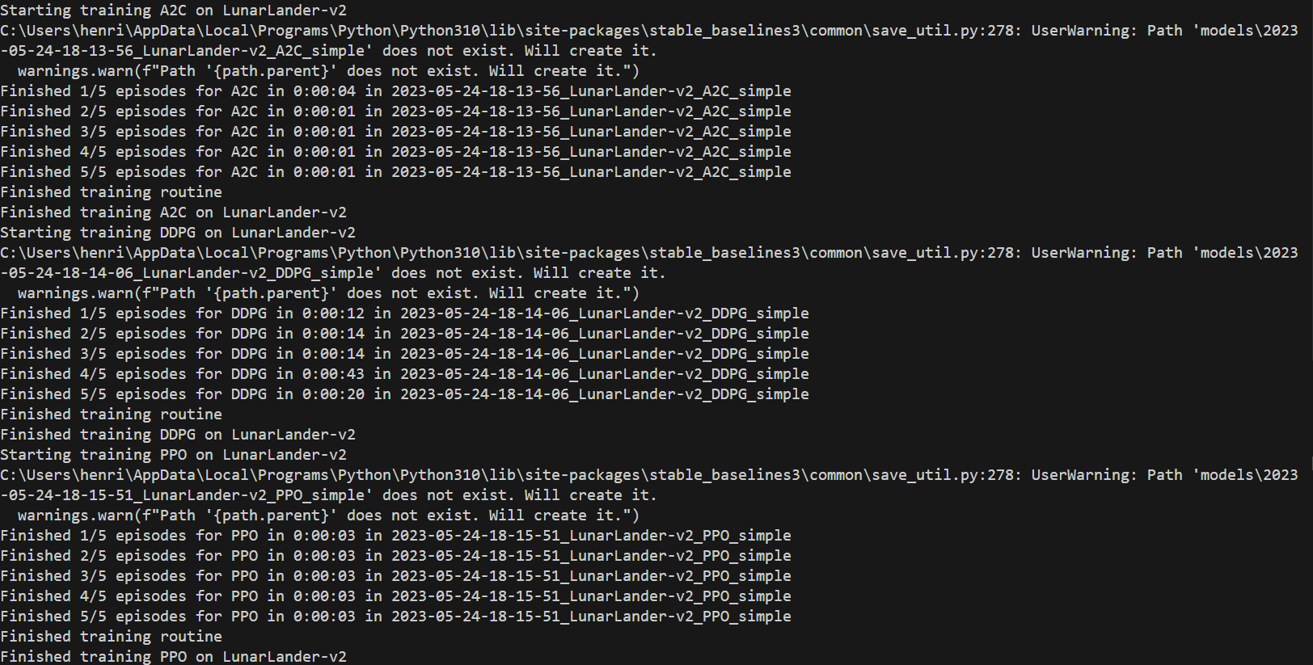
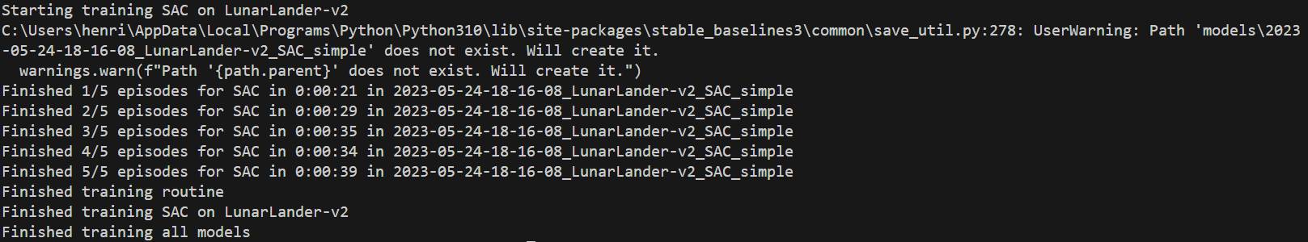
Running all models

