Slide 1
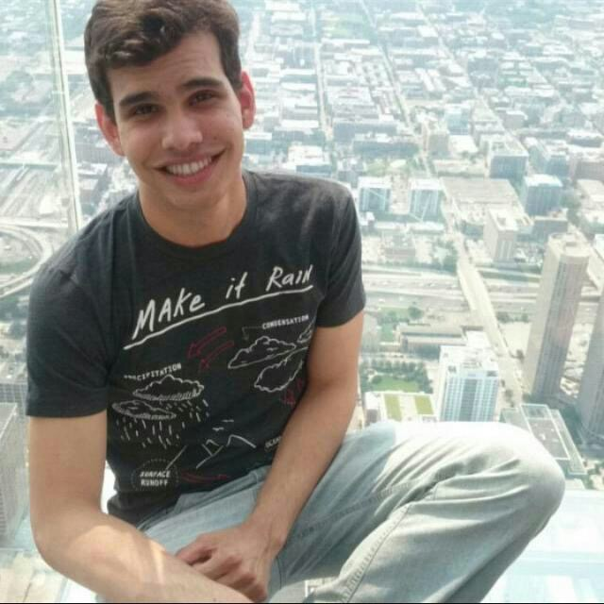
Antonio Vitor de Souza Matos
Characteristics
Leader
Concentrated person
Great sense of organization
Communicative
Goals
Study at a good American university
Have a successful career
Work at Boeing
International Student
Male
22 years old
He is from Salvador (Brazil)
Married

Slide 2
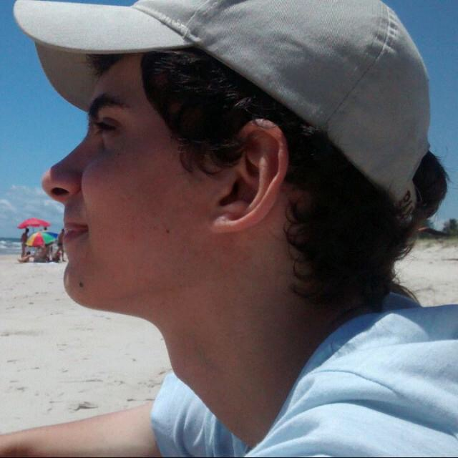
Juliano Santa Ines de Andrade Marques
Characteristics
Responsable
Helpful person
Dedicated
Hardworking
Goals
Tranfer to a respected university in USA
Have a peaceful life
Work at Odebrecht
Transfer Student
Male
22 years old
He is from San Francisco (CA)
Single

Slide 3
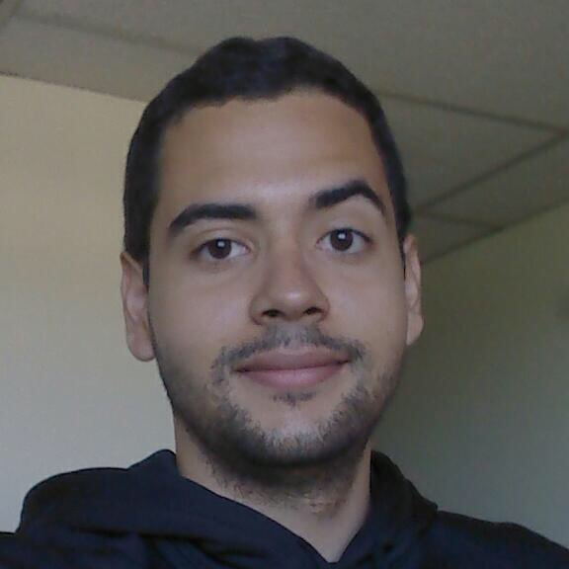
Caio dos Santos Magalhaes
Characteristics
Genius
Hardworking
Optimist person
Calm and equlibrated
Goals
Learn a lot at the new university he is looking for
Have a successful career
Work at NASA
Freshman Student
Male
23 years old
He is from Atlanta (GA)
Single

