Slide 1
ACL/EMNLP 2009 survey
By Danushka Bollegala

Slide 2
Co-located Conferences
Annual General Meeting of the Association for Computational Linguistics (ACL)
International Joint Conferences on Natural Language Processing (IJCNLP)
Empirical Methods in Natural Language Processing (EMNLP)

Slide 3

Suntec - Singapore

Slide 4
Interesting Papers
Latent Variable Models of Concept-Attribute Attachment, Joseph Reisinger & Marius Pasca, Google. (EMNLP)
Unsupervised Semantic Parsing, Hoifung Poon and Pedro Domingos, University of Washington. (EMNLP Best Paper)
A Novel Discourse Parser Based on Support Vector Machine Classification, David duVerle, Helmut Prendinger, NII (ACL)
Automatic set instance extraction using the web, Wang & Cohen, CMU (ACL)

Slide 5
Latent Variable Models of Concept-Attribute Attachment
Motivation:
Attach attributes to WordNet concepts
Use Bayesian topic models (i.e. Latent Dirichlet Allocation (LDA)) to find which attributes are specific for a particular WordNet concept.
Extends Pasca’s previous work on attribute extraction using search engine query logs (WWW 2007)

Slide 6
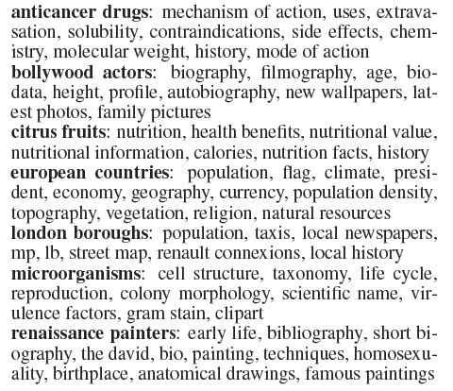
Method
INPUT:
Labeled sets of attributes

Slide 7
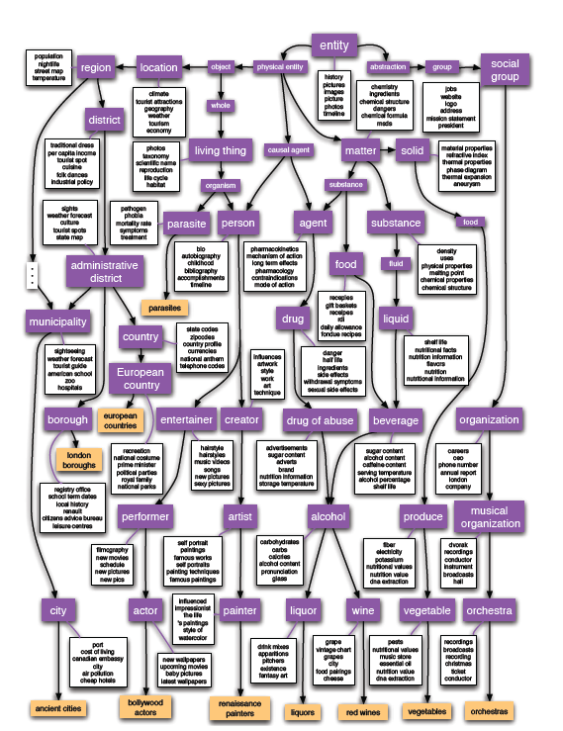
Method
OUTPUT:
WordNet
concepts
Annotated
With attributes.

Slide 8
Creating labeled attribute sets
To obtain class instances, cluster noun phrases using distributional similarity
Lin & Pantel 2002 (DIRT)
To label classes use such-as patterns
Renaissance painters such as Hironymous Bosch
Use query logs to find attributes for classes
Bosch painting style
Rank attributes according to their weighted Jaccard similarity with manually provided 5 seeds for the class.

Slide 9
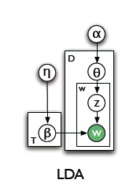
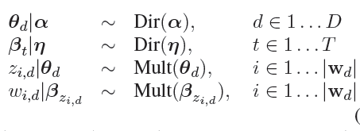
Latent Dirichlet Allocation (LDA)
Topic Models vs. Current Work
Words → Attributes
Documents → Attribute Sets

Slide 10
Fixed Structure LDA
For each attribute set find the leaf WordNet concept which has the minimum edit distance with attribute set label.
Consider all nodes that connects this leaf node to the root of WordNet via IS-A relations.
Introduce a distribution over candidate nodes in addition to topics.

Slide 11
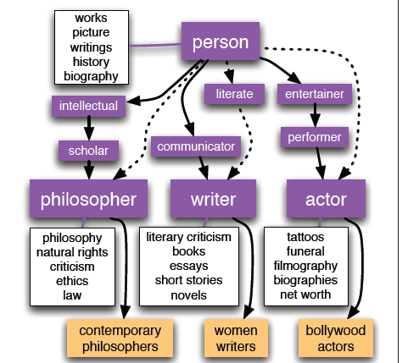
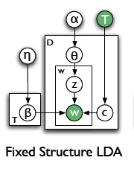
Fixed Structure LDA

Slide 12

Sense Selective LDA
A single class label can be found in multiple synsets
e.g. bollywood actor: thespian or doer
Place a prior distribution over leaf nodes that matches the class label according to the frequency of the concepts.

Slide 13
Chinese Restaurant Process (CRP)
A Bayesian flat clustering method
A discrete stochastic process
Infinite number of circular tables
Infinite number of customers can sit at a table
A customer coming at t=n+1 has two options
Sit at a new table with probability 1/(n+1)
Sit at a table with k others k/(n+1)
Formally,
Defines a probability distribution over partitions of the set {1,2,…,n}
Customers → documents
Tables → Clusters

Slide 14
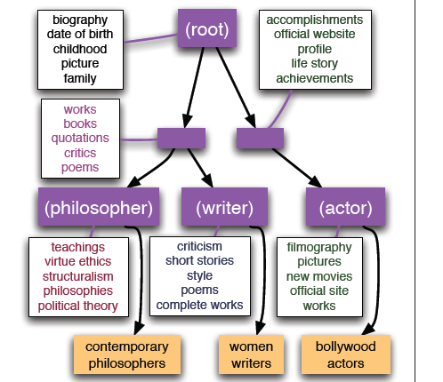
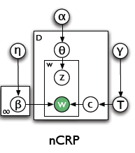
Nested CRP
A hierarchical Bayesian clustering method
Each node defines a Dirichlet distribution over its child nodes.

Slide 15

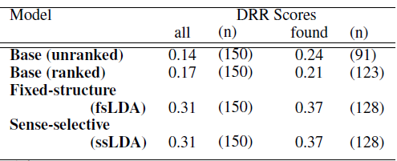
Experiments and Results
Ask human annotators to rank WordNet concepts for attribute sets.
Use a modified version of MRR for evaluation (DRR)

Slide 16
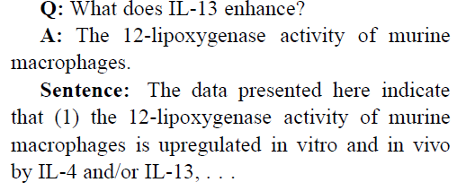
2. Unsupervised Semantic Parsing
EMNLP 2009 Best Paper
First ever unsupervised semantic parser
INPUT: A dependency tree of a sentence
OUTPUT: clustered quasi logical forms
Based upon: Markov Logic Networks (MLN)
Applications:
QA systems

Slide 17
Semantic Parsing
INPUT: Utah borders Idaho.
Problems:
Syntactic variations: active/passive voices
Build on top of a dependency parser
Paraphrases:
Use clustering to identify semantically related paraphrases
Cf. DIRT (Lin & Pantel, 2002)
Representation:
Markov Logic

Slide 18
Markov Logic
Weighted first-order logic
Markov Logic Network (MLN)
One node per ground atom
One feature per ground clause
The weight of a feature is the weight of the first-order clause that originated it

Slide 19
MLN Example: Friends & Smokers
Two constants: Anna (A) and Bob (B)
Friends(A,B)
Friends(A,A)
Smokes(A)
Smokes(B)
Friends(B,B)
Cancer(A)
Cancer(B)
Friends(B,A)

Slide 20
Markov Logic Networks
MLN is template for ground Markov nets
Probability of a world x:
Typed variables and constants greatly reduce size of ground Markov net
Functions, existential quantifiers, etc.
Infinite and continuous domains
Weight of formula i
No. of true groundings of formula i in x

Slide 21
Quasi Logical Form
Replace each node in the dependency tree by a unary atom with predicate being the lemma+POS, and each edge by a binary atom with predicate being the dependency label.
Utah borders Idaho.
borders(n₁)∧Utah(n₂) ∧Idaho(n₃) ∧nsubj(n₁,n₂) ∧dobj(n₁,n₃)
Skolem constants are used to remove quantifiers
Utah
(NOUN)
borders
(VERB)
Idaho
(NOUN)
subj
dobj

Slide 22
Lambda forms
For each subformula F of a QLF, corresponding lambda form is derived by replacing every skolem constant n that does not appear in any unary atom in F.
borders(n₁) ∧nsubj(n₁,n₂) ∧dobj(n₁,n₃)
λx₂λx₃.borders(n₁) ∧nsubj(n₁,x₂) ∧dobj(n₁,x₃)
lambda form cluster
A set of semantically interchangeable lambda forms
core form
does not contain any lambda variable. borders(n₁)
argument forms
contain a single lambda variable. λx₂.nsubj(n₁,x₂)

Slide 23
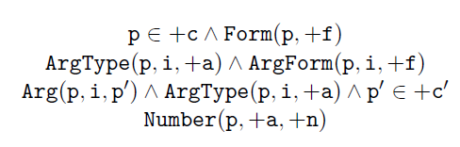
Semantic Parsing
Sentence
Parse
Tree
QLF (Q)
dependency
parsing
Further identify
The core form and
Argument forms.
Each argument form
Is assigned to an
Argument type in c
P(L|Q)
p₁
p₂
p₃
…
p_{n}
c₁
c₂
c₃
…
c_{n}

Slide 24
3. A Novel Discourse Parser Based on Support Vector Machine Classification
Problem: Given a text, annotate discourse according to Rhetorical Structure Theory (RST)
Two-step approach
Given a text, segment into elementary discourse units (EDUs).
Generate an RST tree (edges=RST relations, nodes=edus)

Slide 25
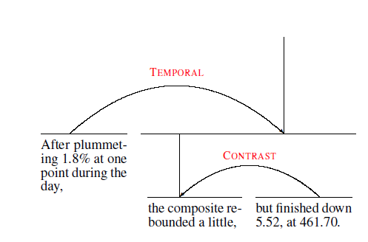
Example
The paper focuses only on the second (RST tree building) step, and use
existing methods (SPADE) to segment a given text into edus.
Current state-of-the-art F scores: segmentation 90.2%, parsing 70.1%
A reduced set of 18 relations used (original 75 relations are partitioned into 18 classes according to discourse similarity)
n-ary relations are converted to nested binary relations. The Principle of Sequentiality is used to reduce the number of relations during tree building.

Slide 26
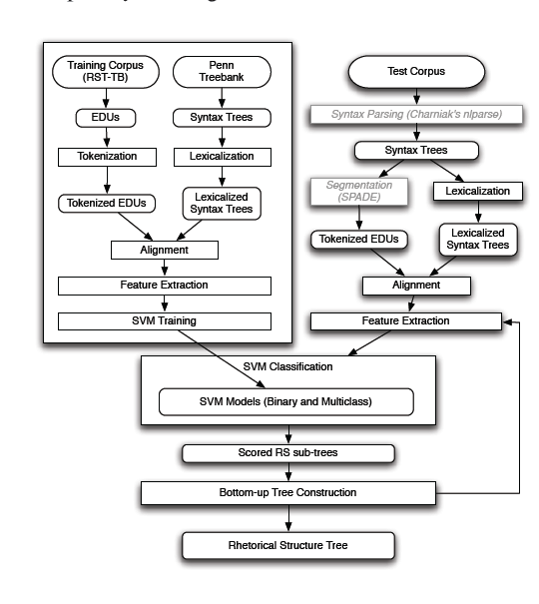
System Workflow

Slide 27
Two classifiers
S: Binary Classifer
Given to edus whether there exist an RST relation between those edus.
L: Multiclass Classifier
Given two edus between which there exist some RST relation (S=True), what is it?
41 classes

Slide 28
Features
Textual Organization
Belongs to the same sentence, same paragraph, no. of sentence boundaries, no. of paragraph boundaries
Lexical clues (cue words), punctuation
POS tags
Dominance sets (useful in identifying inter-sentential attribution relation)
Attribution = reported speech. ~said that~

Slide 29
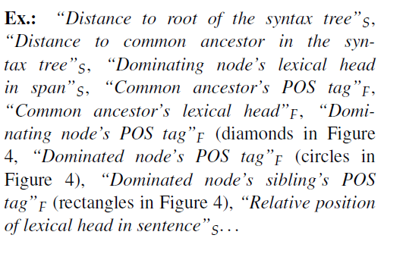
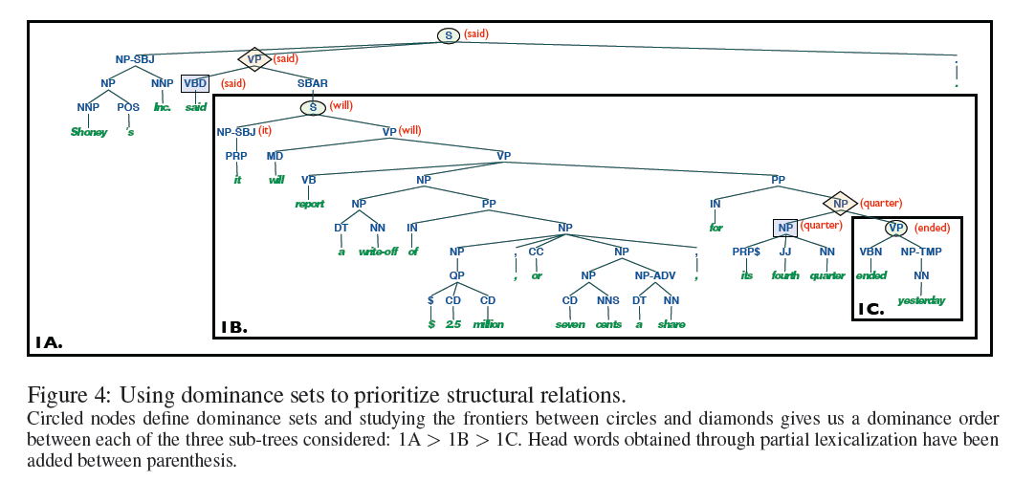
Dominance Sets

Slide 30
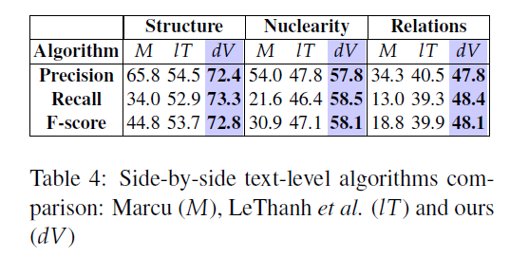
Results
S: blank tree structure
N: tree structure with nuclearity
R: tree structure with nuclearity and relations

Slide 31
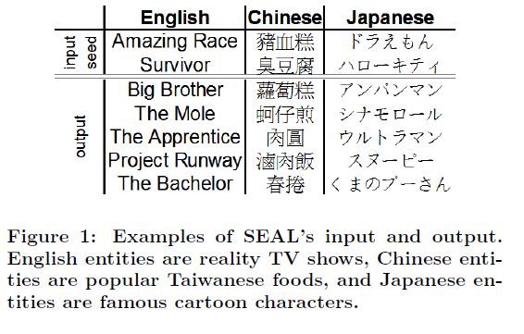
4. Automatic set instance extraction using the web
Problem: Given a semantic class (e.g. fruits) and some seeds (e.g. apple, orange), iterate all instances of the class.

Slide 32
AISA: Automatic Set Instance Acquirer
The proposed method has 3 components
Noisy instance provider
Noisy instance expander
Bootstrapper
Noisy instance provider
Use Heart patterns (hyponym patterns) with the given class name to find some noisy instances (seeds)
Lexical patterns only, no POS or parsing

Slide 33
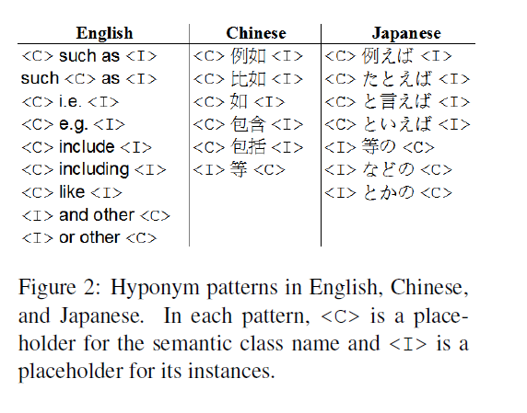
Noisy instance provider
Search Google and Yahoo! using those queries and download snippets. Further split each snippet into excerpts. Chunk the excerpts (beginning, end of an excerpts, punctuation)

Slide 34


Initial (seed) ranking
Rank the initial seeds using their frequency in snippets, excerpts and chunks.
Higher the frequency, the better
Shorter the chunk the better

Slide 35
Noisy instance expander
Use SEAL (Set Expander for Any Language) Previous work by the authors.
Download web pages for the concatenated query of all seeds
Create page specific wrappers
Maximally long left and right contexts of instances in the page (2 chars)
~社長<I>様～ 「楽天社長三木谷様」
Use those wrappers to extract more candidates from the same page.
Rank the candidates using PageRank

Slide 36
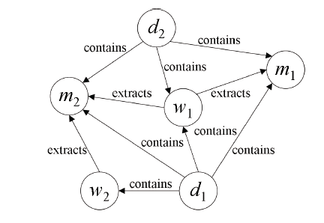
Candidate Ranking in SEAL
Start with initial seeds.
Perform a random walk on the graph.
Select instances with score greater than k (set to 0.4 using a development dataset)
Use the candidates with score greater than k AND appear in the initial seeds for the next iteration
Stop when candidates at steps i and (i-1) are the same.

Slide 37
Bootstrapper
Use ones own output as the input to itself.
For each 3 combinations of instances provided by SEAL, concatenate those three instances and download 25 web pages.
Extract instances from those pages as well.
Stop when all combinations are explored or after 5 iterations.
Aggregate statistics and create a single graph.
Rank the candidates using PageRank.

Slide 38
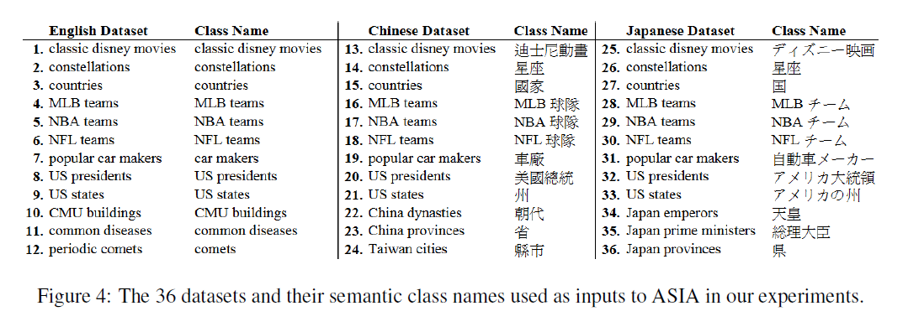
Datasets

Slide 39
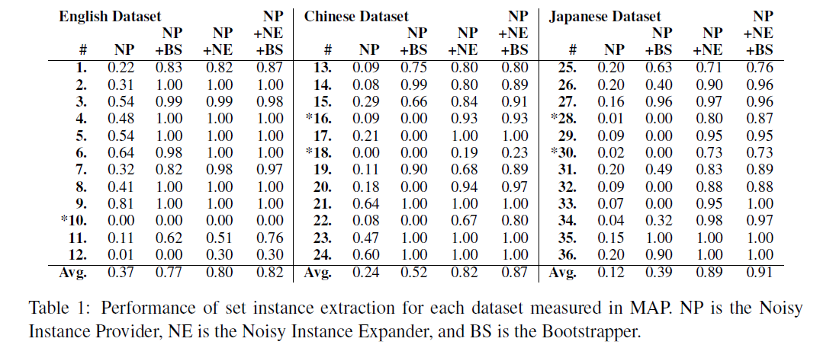
Results

Slide 40
Trends in NLP
Lots of papers on discourse parsing
Penn Discourse Tree Bank (PDTB)
Easier than RST
No trees
5 relation types (top level)
3 levels
Key note speech on Discourse parsing
Bonnie Webber, University of Edinburgh, UK
Semantic parsing
Best paper in ACL
Active Learning, Graphical Models
Lots of new datasets, difficulty in comparison
Improvement due to new features OR novel learning algorithms?
ACL 2010: Uppasala, Sweden.

