Slide 1

Continuous Performance Engineering (CPE)
Step by Step.
Anshu Jain| Henrique Amaral Maran
CTO - Performance Engineering & Testing Services
April 2024

Slide 2

Agenda
Continuous Performance Engineering (CPE)
Software Performance – why bother?
Service level testing with JMeter
Types of performance testing
Lab activity - JMeter Scripting
Basic Gitlab CI/CD concepts
Lab activity - Create your own Gitlab Pipeline + Jmeter
Lab activity - Triggering the pipeline
CPE pipeline – Architecture and tools overview
How to Create (fast)visualizations from CPE data

Slide 3
Performance Engineering – backend performance
Software Performance testing– why bother in the first place? Why we do what we do?
What tools can we use?
Notes:
ANSHU

Slide 4

Backend performance
Lab activity
Service level testing with Jmeter
NEUXS REPO link(in this slide)

Slide 5
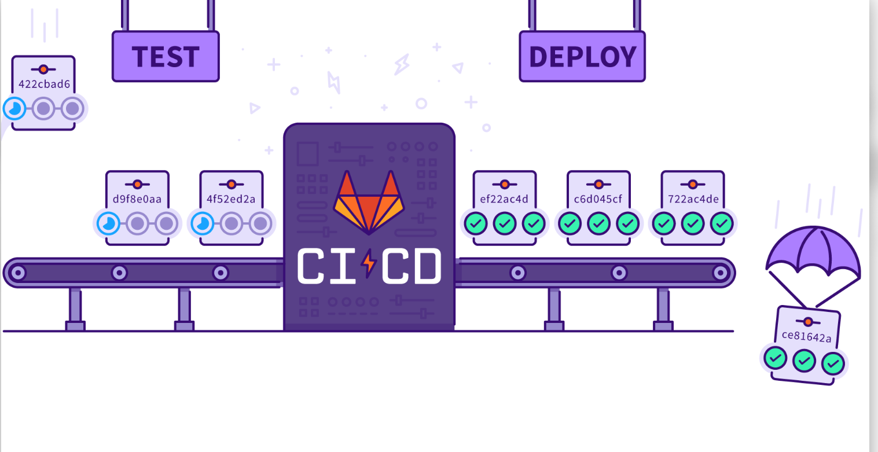
Basic Gitlab CI/CD concepts
What are Gitlab pipelines and how they work?
Jobs
Stages
Runners
Notes:
Source:
https://blog.42mate.com/gitlab-ci-cd-pipelines

Slide 6

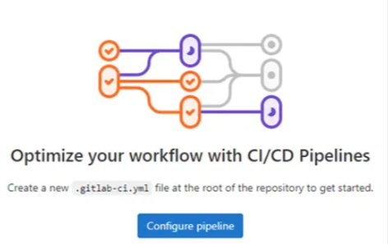
Basic Gitlab CI/CD concepts
Lab activity
Create a pipeline from Scratch
! Prerequisite: You need access to GitLab and the developer role assigned to you
If not > (goto/devcloud-developers/)

Slide 7
Create a pipeline from Scratch – Lab activity
Creating a Project in GitLab from Scratch:
To create a new project in GitLab, follow these steps:
Log in to your GitLab account.(goto/devcloud/)
On the left-top sidebar, use the plus (+) icon in the navigation bar and then “New project/repository”
Next, choose to create a blank project
Project name: Provide a name for your project.
Project URL: Select “Pick a group or namescape, scroll all the way down until you find your user and select it.
Set the project’s visibility level as “Internal”
Ensure you have runners available
In GitLab, runners are agents that run CI/CD tasks. To see available runners, from your project, click Settings > CI/CD > Runners, And if not enabled, toggle “enable shared runners for this project”
Once your project is created, follow these steps:
Navigate to your project.
Click on “Build>Pipelines” in the left sidebar.
Look for the “Try Test Template” and click on it. This will open the pipeline editor.
Take some time to read through the pipeline contents and try to understand its structure.
At the end of the screen, click on “commit changes”.
Click on “Build>Pipelines” in the left sidebar.
Your pipeline should have run automatically. To check your pipeline status in real-time, click on the number followed by the symbol “#”. This is the pipeline ID

Slide 8
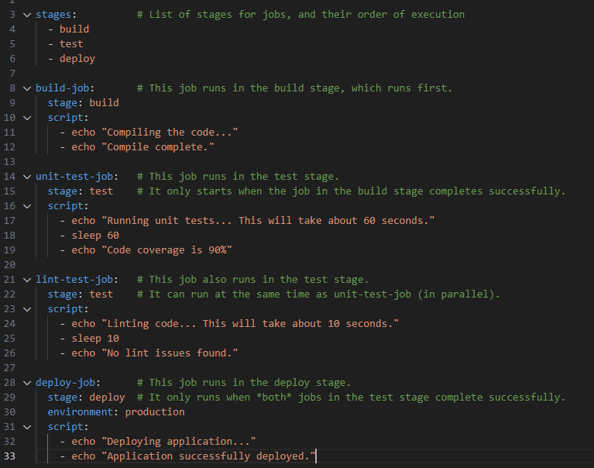
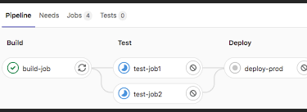
Gitlab pipeline file – basic structure
Link of possible keywords official gitlab docs/
https://docs.gitlab.com/ee/ci/quick_start/index.html

Slide 9
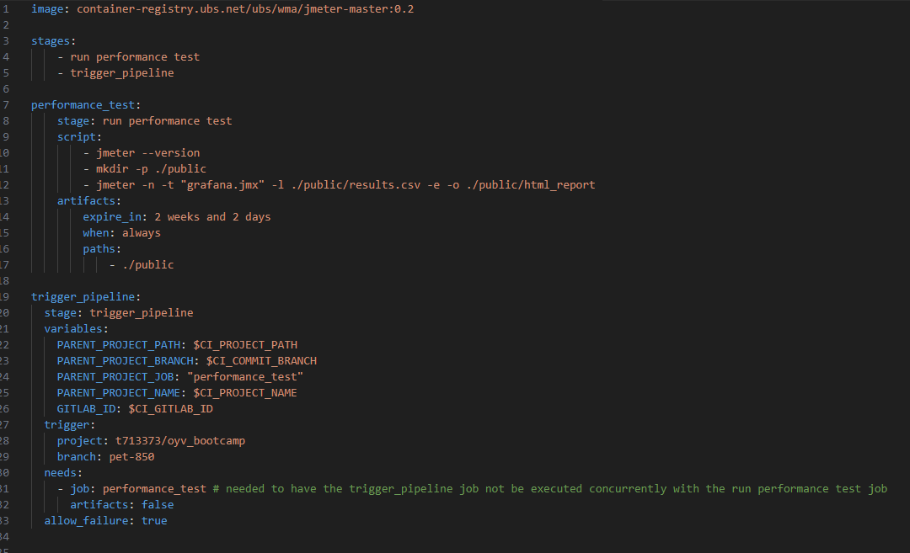
Performance Engineering –
Original project by Jagath Sathy:
https://devcloud.ubs.net/t660094/jmeterpeformancetest-gitlab-ci-template

Slide 10
Gitlab pipeline + Jmeter
Lab activity
Run a performance test using your pipeline
Notes:
Nem todos vao conseguir seguir os lab activities,, ou querer. devido a natureza da sessao na fazia sentido mandar email… Mas nao se preocupe, esse video estara gravado
E caso vc nao tenha acesso ou NIVEL de acesso necessario Neese momento, pode sempre voltar aqui no video e refazer junto comigo. O iportnate agora é que vc preste atencao
No que est asendo feito, mais do que fazer em si.

Slide 11
Gitlab pipeline + Jmeter – Lab activity
Creating a Project in GitLab from Scratch:
To Run a performance test programatically, follow these steps:
Log in to your GitLab account.(goto/devcloud/)
Choose the project you created in the previous lab
Upload the jmx file generated by Jmeter in the first lab (In case you don’t have it, a copy can be found at:
Go to https://devcloud.ubs.net/t713373/jmeterlab/
Click on the “Grafana.jmx” file
Click on the download button
Upload it to your project, by clicking on the plus(+) sign right next to your project’s name.
Click on the .gitlab-ci.yml file
Click on the button Edit>Edit with pipeline editor
If it fails, go back and select Edit>Edit single file
Replace all the content with the one that can be found at:
https://devcloud.ubs.net/t713373/jmeterlab/
Change the “Grafana.jxm” name to the name of your script.
At the end of the screen, click on “commit changes”.
Click on “Build>Pipelines” in the left sidebar, and then click on “run pipeline”
Take some time explore through the pipeline contents and try to understand how it ran.

Slide 12






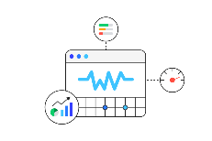
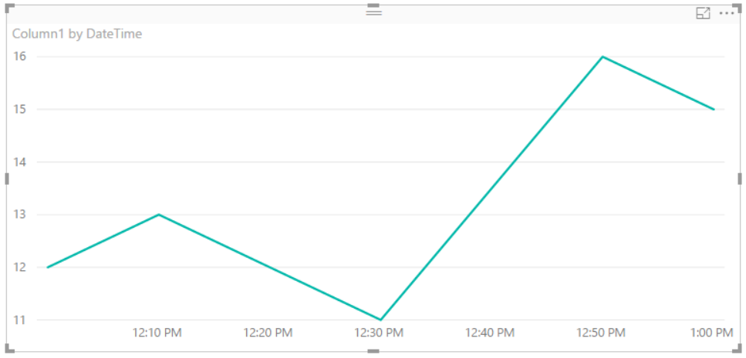








CPE pipeline – how it works
App
main
Repo
(configured)
CPE
Pipeline
Telemetry Hub
(Azure Cosmos DB)
GitLab
Backend
/frontend
New version
Gitlab Runners
(WIP)
(Wip)
Test Environment
APPLICATIONS

Slide 13
Continuous Performance Engineering Definition
Trigger explain

Slide 14


Performance engineering tools
Performance and Load testing
Web page analysis
Web vitals

Slide 15
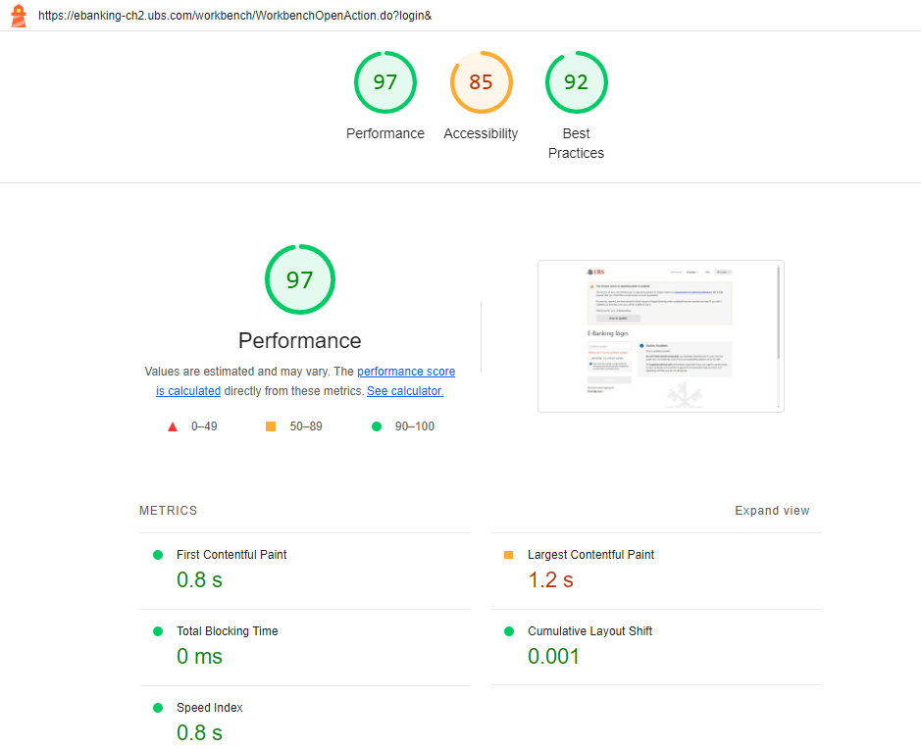
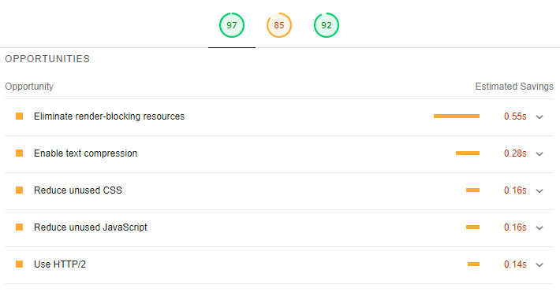
Example of Google Lighthouse report

Slide 16
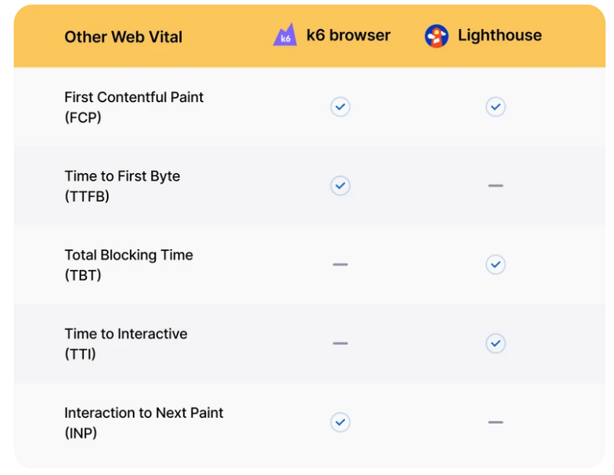
Performance Engineering – Front end performance
Google lighthouse and webvitals – why both?
https://k6.io/blog/comparing-k6-and-google-lighthouse-for-web-performance/

Slide 17
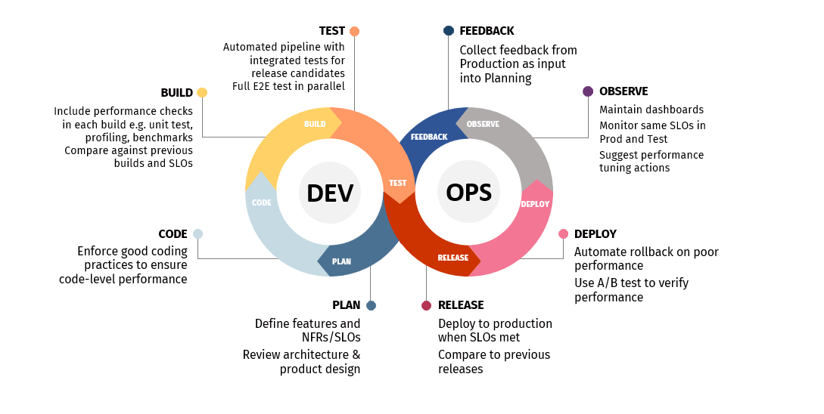
Continuous Performance Engineering Definition
CPE is the practice covering all performance-related activities throughout the lifecycle.
Notes:
CPE is the practice covering all performance-related activities throughout the lifecycle, including:
Code-level analysis
Early performance testing during development
Front-end performance analysis during development
Performance requirements analysis and SLO validation
Monitoring and feedback to the design process
“SHIFT LEFT AND SHIFT RIGHT PERFORMANCE”

Slide 18
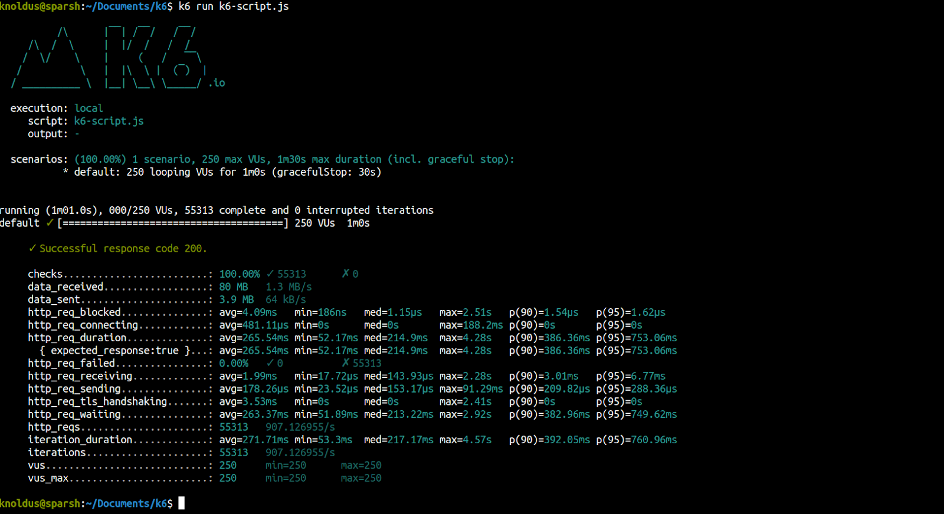
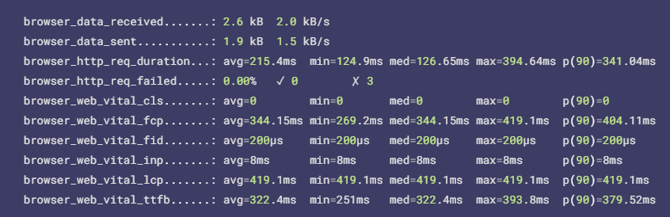
Example of K6/Web Vitals report

Slide 19

CPE pipeline – how it works
App
main
Repo
(configured)
CPE
Pipeline
Telemetry Hub
(Azure Cosmos DB)
GitLab
Backend
/frontend
New version
Gitlab Runners
(WIP)
Test Environment
APPLICATIONS

Slide 20
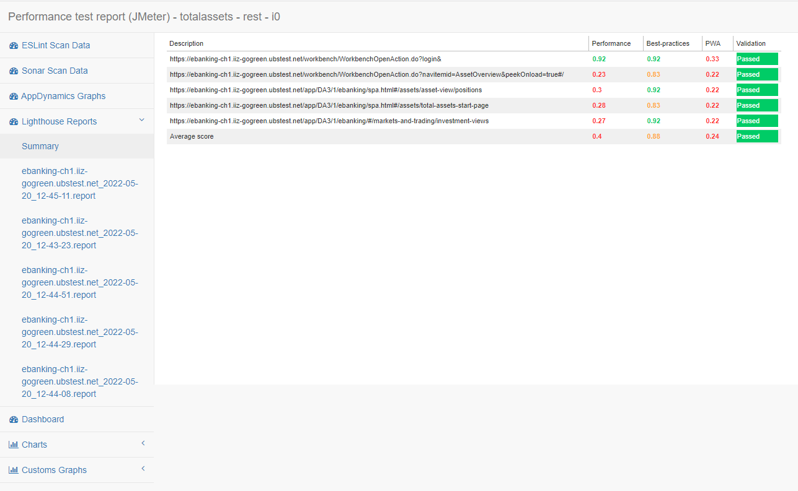
Report Example (4/6) – Lighthouse Summary Data

Slide 21
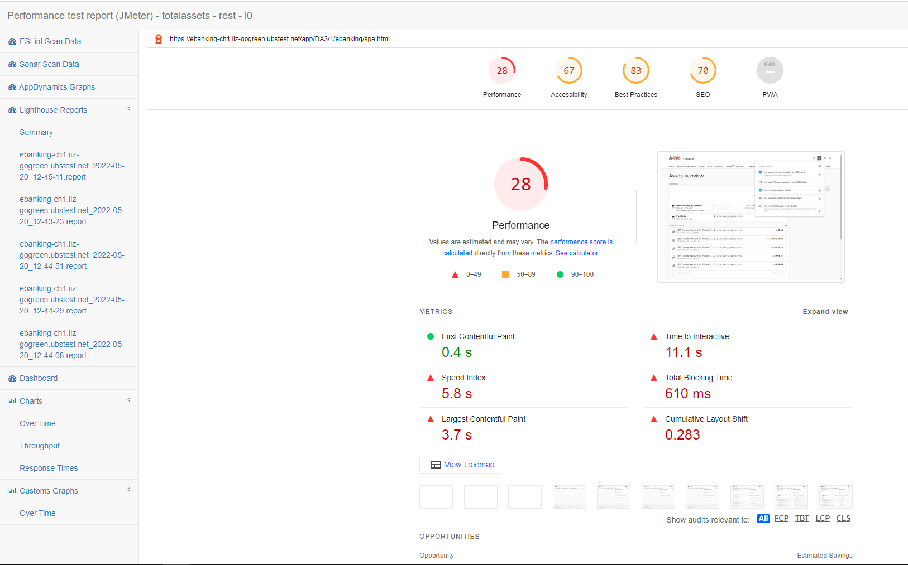
Report Example (5/6) – Lighthouse Detailed Report

Slide 22
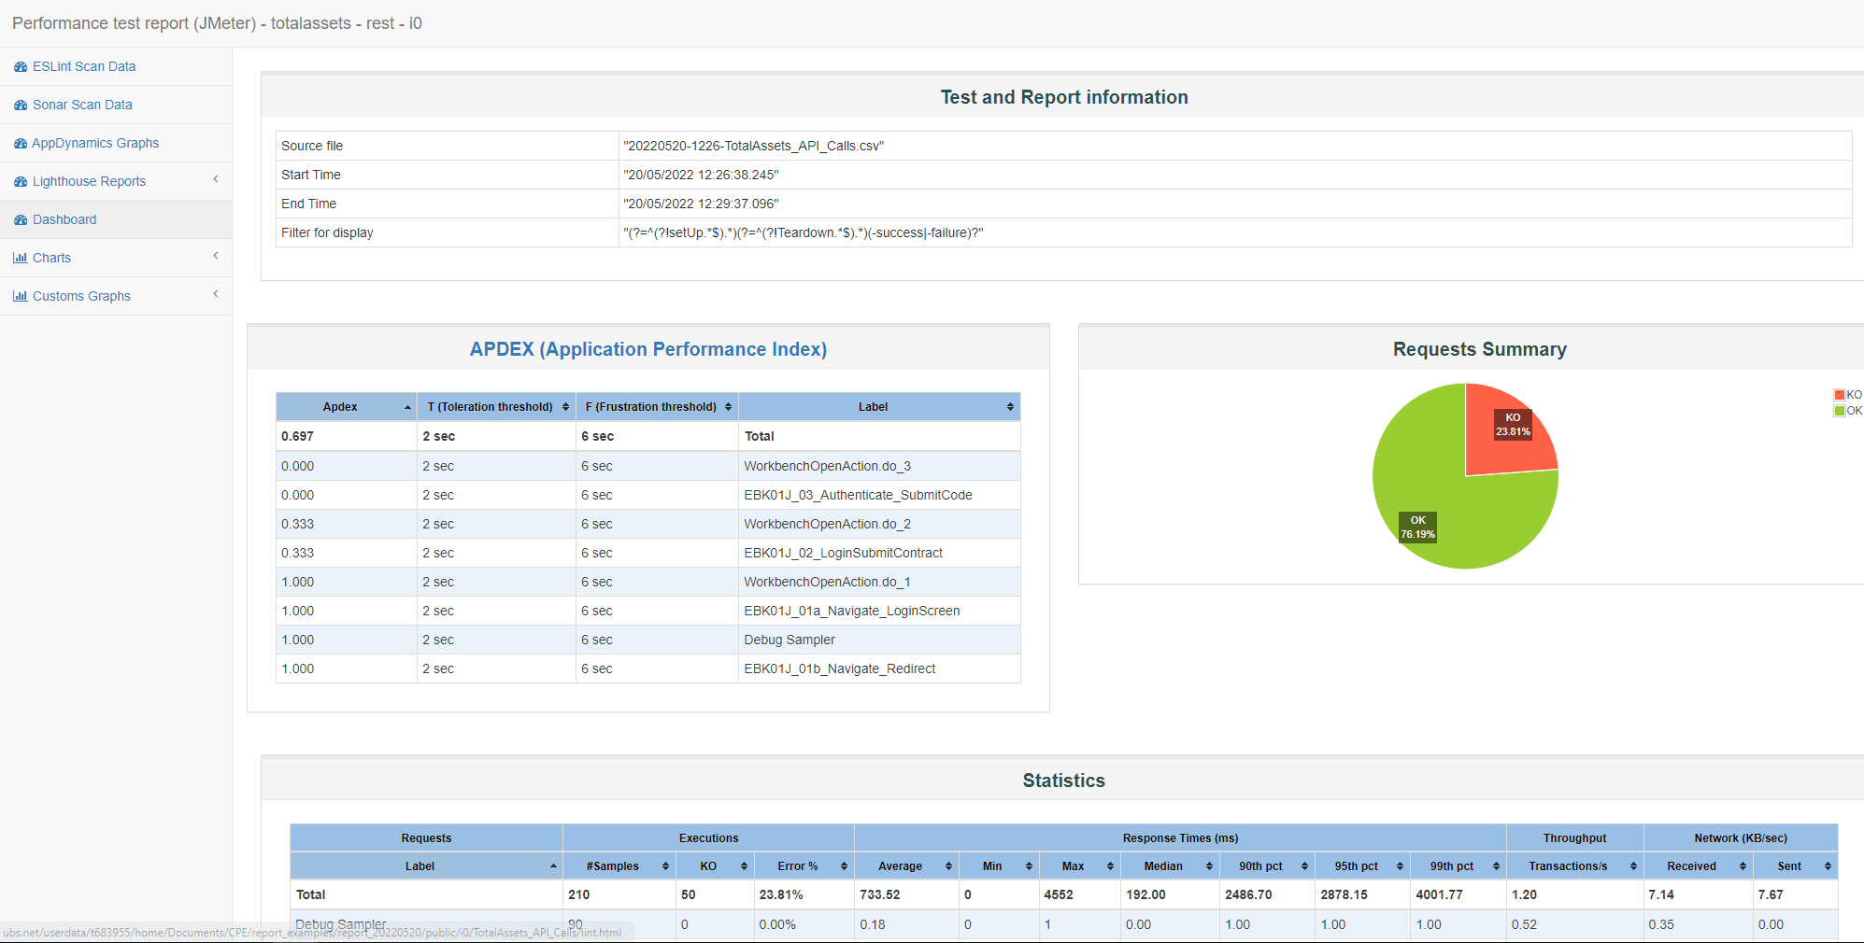
Report Example (6/6) – JMeter Report

Slide 23
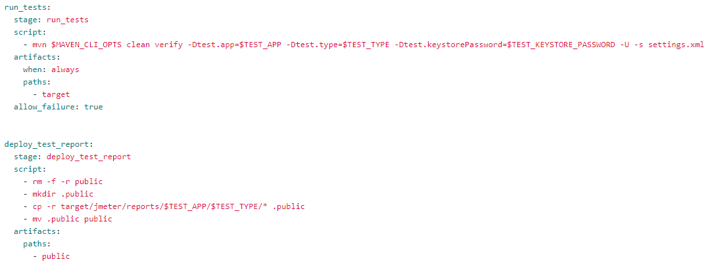
How to use the CPE resources
The TAF team provides several resources for use in your project’s CI/CD pipeline in GitLab.
You can customise the pipeline to choose which features are useful for you using GitLab variables.
You can check different implementation examples at this repository
GitLab CI jobs from TAF’s performance archetype

Slide 24

Collaboration & Enabling
Closer interaction and collaboration within Touchpoint and with our client stream partners…
Bootcamps & Webinars
PE Bootcamp
Performance Introduction
Performance Requirements
Types of Performance Test
Performance Test Process Overview
Performance Test Scripts
Performance Results and Analysis
JMeter Load Test Bootcamp
Introduction to load testing
How to install and start using Apache JMeter?
Create your first JMeter script.
Run your first test and analyze the JMeter report.
How to integrate JMeter tests in your pipeline?
What other performance testing tools are available at UBS?
AppDynamics Bootcamp
Introduction to APM and Observability
AppDynamics Overview
What other monitoring tools are available at UBS?
What information / metrics is the Pod most interested in?
How to use the EUM for SPA Typescript package (React Roundtable)
Plan the implementation steps for a Product Dashboard
Splunk Bootcamp
Learn what are the key features of Splunk
What are you allowed to see in Splunk as Developer?
How to log your application
Create and execute Splunk queries
How to create dashboards in Splunk
How to use the Splunk API
Ready to delve into the next sessions or seeking expert guidance on Performance Engineering? Don't hesitate to reach out to us: emidio.romandini@ubs.com and michael.blatt@ubs.com.
Notes:
I have changed the XYZ Monitoring Requirements to XYZ Requirements (in 1. Req Analysis)

Slide 25
WMPC Performance Engineering & Testing Services
Link: goto/pets
Link to the CPE documentation/implementation guide
Henrique Amaral Maran WMPC Technology
CTO - Performance Engineering & Testing Services
Touchpoint - Site Reliability and Cloud Adoption
Phone +41 78 230 60 97
Henrique.maran@ubs.com

