Slide 1

Continuous Performance Engineering (CPE)
Step by Step Setup
Anshu Jain| Henrique Amaral Maran
CTO - Performance Engineering & Testing Services
April 2024

Slide 2

Agenda
Continuous Performance Engineering (CPE)
Software Performance – why bother?
Types of performance testing
Service level testing with JMeter
Lab activity - JMeter Scripting
Basic Gitlab CI/CD concepts
Lab activity - Create your own Gitlab Pipeline + Jmeter
Lab activity - Triggering the pipeline
CPE pipeline – Architecture and tools overview
How to Create (fast)visualizations from CPE data

Slide 3
Performance Engineering – backend performance
Anshu
Notes:
ANSHU

Slide 4

Backend performance
Lab activity
Service level testing with Jmeter
NEUXS REPO link(in this slide)

Slide 5
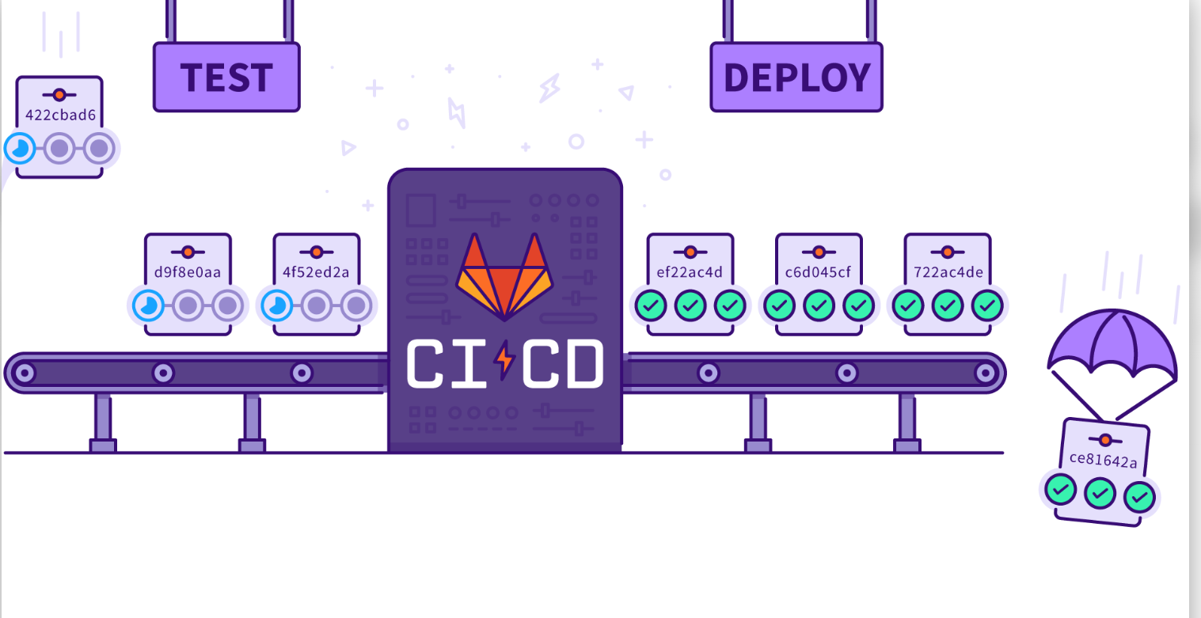
Basic Gitlab CI/CD concepts
What are Gitlab pipelines and how they work?
Jobs
Stages
Runners
Notes:
Source:
https://blog.42mate.com/gitlab-ci-cd-pipelines

Slide 6

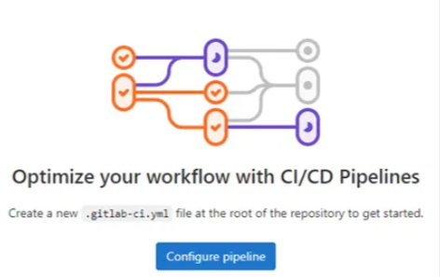
Basic Gitlab CI/CD concepts
Lab activity
Create a pipeline from Scratch
! Prerequisite: You need access to GitLab and the developer role assigned to you
If not > (goto/devcloud-developers/)

Slide 7
Create a pipeline from Scratch – Lab activity
Creating a Project in GitLab from Scratch:
To create a new project in GitLab, follow these steps:
Log in to your GitLab account.(goto/devcloud/)
On the left-top sidebar, use the plus (+) icon in the navigation bar and then “New project/repository”
Next, choose to create a blank project
Project name: Provide a name for your project.
Project URL: Select “Pick a group or namescape, scroll all the way down until you find your user and select it.
Set the project’s visibility level as “Internal”
Ensure you have runners available
In GitLab, runners are agents that run CI/CD tasks. To see available runners, from your project, click Settings > CI/CD > Runners, And if not enabled, toggle “enable shared runners for this project”
Once your project is created, follow these steps:
Navigate to your project.
Click on “Build>Pipelines” in the left sidebar.
Look for the “Try Test Template” and click on it. This will open the pipeline editor.
Take some time to read through the pipeline contents and try to understand its structure.
At the end of the screen, click on “commit changes”.
Click on “Build>Pipelines” in the left sidebar.
Your pipeline should have run automatically. To check your pipeline status in real-time, click on the number followed by the symbol “#”. This is the pipeline ID

Slide 8
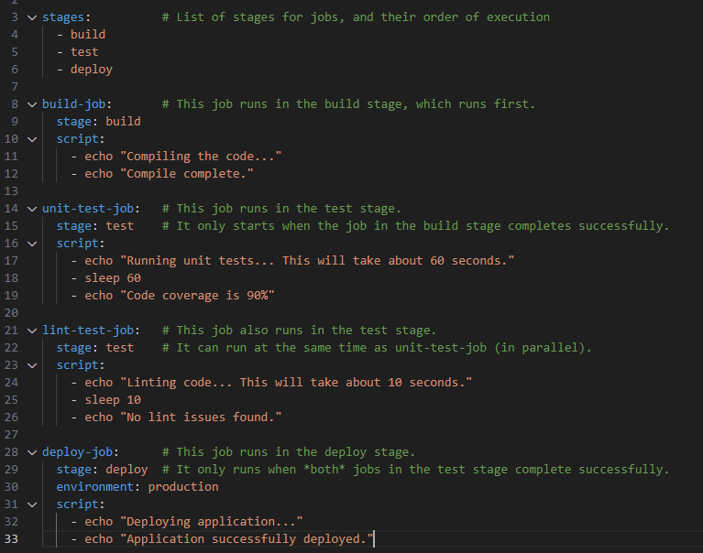
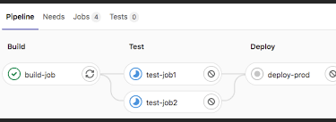
Gitlab pipeline file – basic structure
Link of possible keywords official gitlab docs/
https://docs.gitlab.com/ee/ci/quick_start/index.html

Slide 9
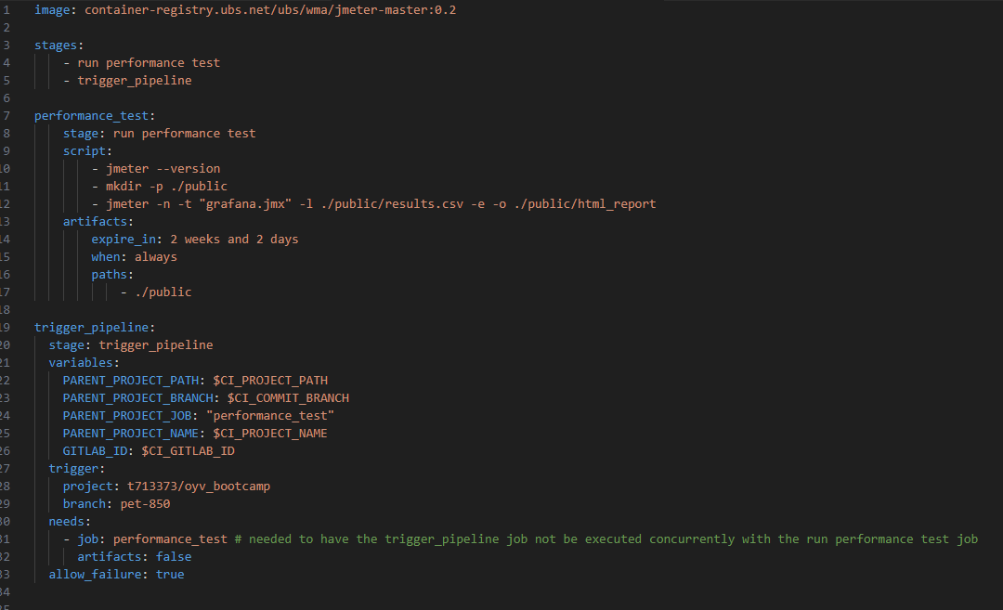
Gitlab pipeline + Jmeter
Original project by Jagath Sathy (gitlab-ci.yml)

Slide 10
Gitlab pipeline + Jmeter
Lab activity
Run a performance test using your pipeline

Slide 11
Gitlab pipeline + Jmeter – Lab activity
Creating a Project in GitLab from Scratch:
To Run a performance test programatically, follow these steps:
Log in to your GitLab account.(goto/devcloud/)
Choose the project you created in the previous lab
Upload the jmx file generated by Jmeter in the first lab (In case you don’t have it, a copy can be found at:
Go to https://devcloud.ubs.net/t713373/jmeterlab/
Click on the “example.jmx” file
Click on the download button
Upload it to your project, by clicking on the plus(+) sign right next to your project’s name.
5. Click on the .gitlab-ci.yml file
6. Click on the button Edit>Edit with pipeline editor
If it fails, go back and select Edit>Edit single file
7. Replace all the content with the one that can be found at:
https://devcloud.ubs.net/t713373/jmeterlab/
Change the “example.jmx” name to the name of your script.
8. At the end of the screen, click on “commit changes”.
9. Click on “Build>Pipelines” in the left sidebar, and then click on “run pipeline”
10. Take some time to explore the pipeline contents and try to understand how it ran and get familiar with the interface.

Slide 12
Gitlab pipeline – trigger and sharing artifacts

Slide 13




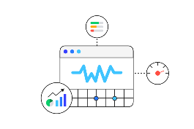

CPE pipeline tools
Static code analysis
Performance and Load testing
Web page analysis
Web vitals

Slide 14







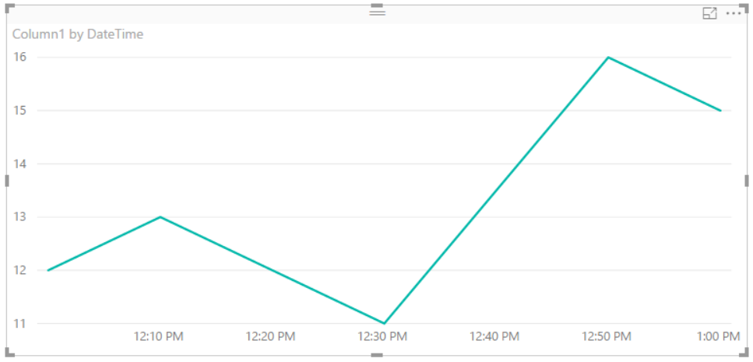





CPE pipeline – how it works
App
main
Repo
(configured)
CPE
Pipeline
Telemetry Hub
(Azure Cosmos DB)
GitLab
Backend
/frontend
New version
Gitlab Runners
(WIP)
(Wip)
Test Environment
APPLICATIONS

Slide 15
Data storage and Visualization – How to get access
Cosmos DB:
- Via Public key
-Always update on goto/testsdk/ > CPE > CPE implementation guide
Power BI:
To install power BI desktop:
https://myhub.ubs.net/myhub/assist/articles/325724?src=ais
To publish dashboards:
https://myhub.ubs.net/myhub/assist/articles/297488
Telemetry Hub
(Azure Cosmos DB)

Slide 16
Demo
Telemetry Hub
(Azure Cosmos DB)
Building visualizations from our Telemetry HUB (cosmos DB)

Slide 17

Collaboration & Enabling
Closer interaction and collaboration within Touchpoint and with our client stream partners…
Bootcamps & Webinars
PE Bootcamp
Performance Introduction
Performance Requirements
Types of Performance Test
Performance Test Process Overview
Performance Test Scripts
Performance Results and Analysis
JMeter Load Test Bootcamp
Introduction to load testing
How to install and start using Apache JMeter?
Create your first JMeter script.
Run your first test and analyze the JMeter report.
How to integrate JMeter tests in your pipeline?
What other performance testing tools are available at UBS?
AppDynamics Bootcamp
Introduction to APM and Observability
AppDynamics Overview
What other monitoring tools are available at UBS?
What information / metrics is the Pod most interested in?
How to use the EUM for SPA Typescript package (React Roundtable)
Plan the implementation steps for a Product Dashboard
Splunk Bootcamp
Learn what are the key features of Splunk
What are you allowed to see in Splunk as Developer?
How to log your application
Create and execute Splunk queries
How to create dashboards in Splunk
How to use the Splunk API
Ready to delve into the next sessions or seeking expert guidance on Performance Engineering? Don't hesitate to reach out to us: emidio.romandini@ubs.com and michael.blatt@ubs.com.
Notes:
I have changed the XYZ Monitoring Requirements to XYZ Requirements (in 1. Req Analysis)

Slide 18
WMPC Performance Engineering & Testing Services
Link: goto/pets
Link to the CPE documentation/implementation guide
Henrique Amaral Maran WMPC Technology
CTO - Performance Engineering & Testing Services
Touchpoint - Site Reliability and Cloud Adoption
Phone +41 78 230 60 97
Henrique.maran@ubs.com

