Slide 1
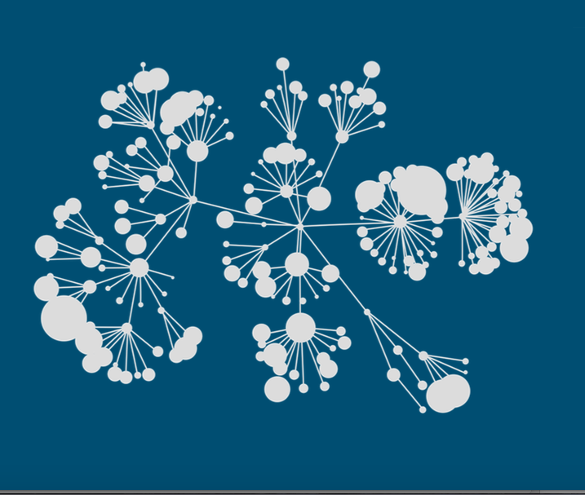

Kaggle Humpback Whale Identification Challenge 2nd Place Solution

Slide 2
Agenda
Background
Summary
Pre-processing
Model Design

Slide 3
Background
Prior Experience
I have participated in some competitions in Kaggle and some other platforms in China.
Currently, I focus on face recognition and person ReID tasks based on deep learning.
These experience helps me a lot in this competition!

Slide 4
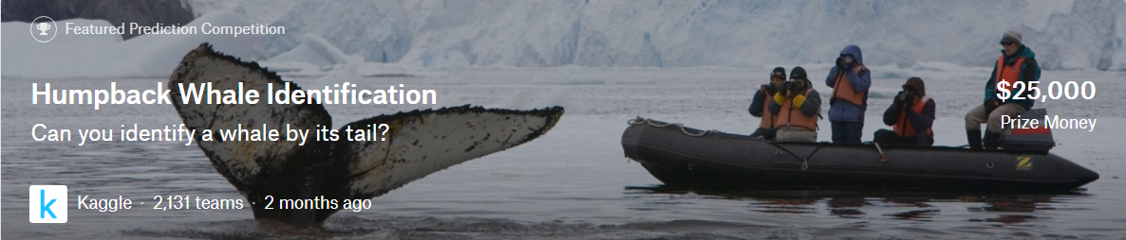
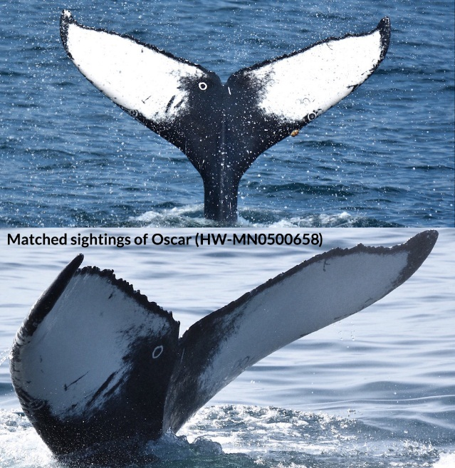
Background
Identify a whale by its tail
Identify a person by his/her face -> face recognition
Identify a person by his/her body -> person re-id

Slide 5
Summary
Keypoints of my solution:
Horizontal flip to create more ids->5004*2
I utilize three backbones ->
resnet101, seresnet101, seresnext101
End to end training with arcface loss + triplet loss + focal loss
Used Pytorch

Slide 6
Model Design
Data augmentation
Model structure
Model Ensemble

Slide 7
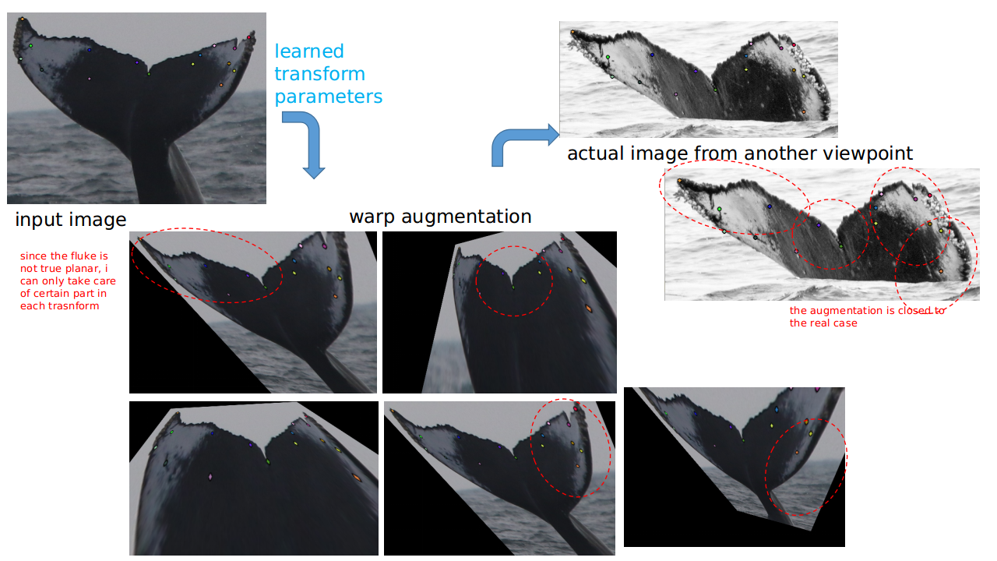
Model Design
Data augmentation
256*512 or 512*512 cropped images as input
Randomly do blur, grayscale, noise, shear, rotate, perspective transform

Slide 8
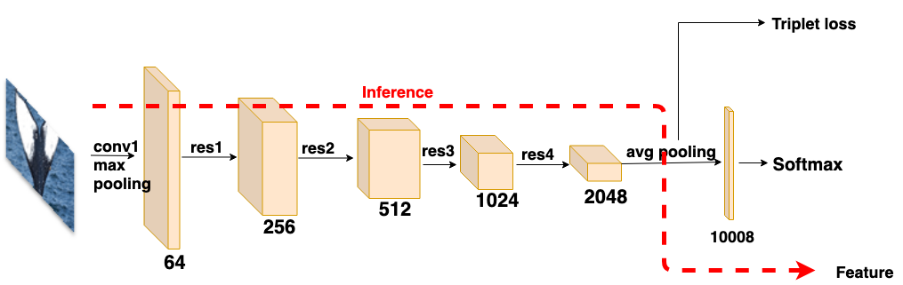
Model Design
Baseline Model Structure
Data: 5004 ids
Loss: triplet loss + softmax
The cosine similarity of train test set features vectors was used as the measure of similarity.
single model 256*512 resnet101: ~0.920

Slide 9

Model Design
Improved Model Structure
Data: 5004 ids
Loss: triplet loss + arcface
single model 256*512 resnet101: ~0.945
ArcFace: Additive Angular Margin Loss for Deep Face Recognition[J]. 2018. Deng J , Guo J , Zafeiriou S .

Slide 10
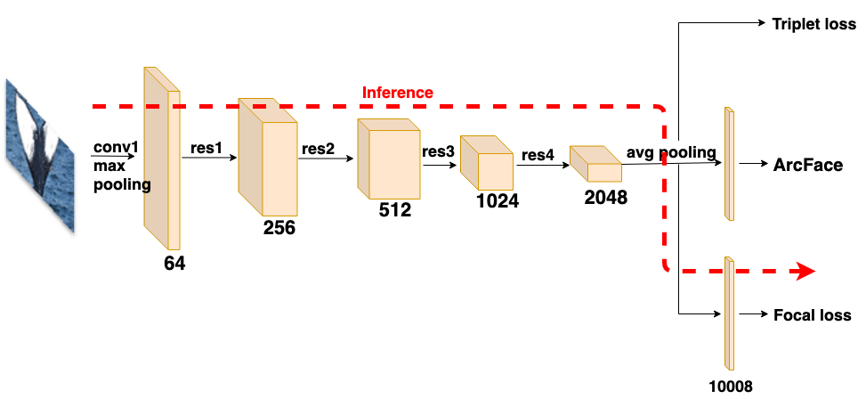
Model Design
Final Model Structure
Data: 5004 ids + newwhales
Backbone: resnet101, se-resnet101, se-resnext101
Loss: arcface loss + triplet loss + focal loss
single model 256*512 resnet101: ~0.960+
Class-Balanced Loss Based on Effective Number of Samples[J]. 2019.Cui Y , Jia M , Lin T Y , et al.

Slide 11
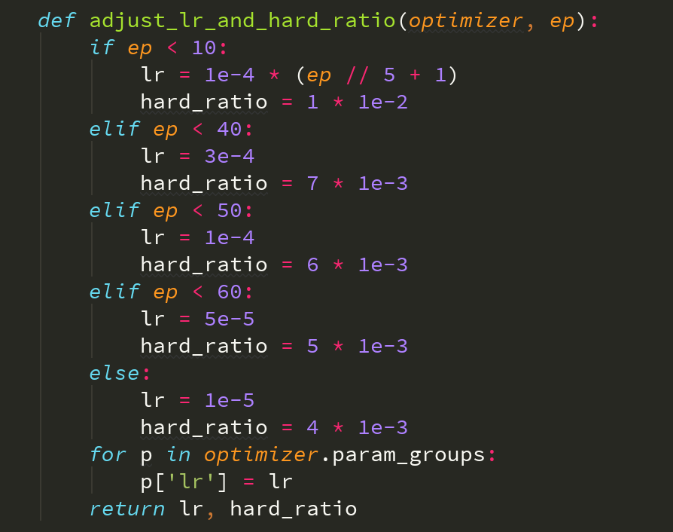
Optimizer: adam optimizer
LR schedule: warm up lr strategy
Training Methods

Slide 12
Model Design
Single model Performance

Slide 13
Model
Ensemble
Weighted average is used as our ensemble strategy.
The final submission is the weight average result of 10ckpts

Slide 14


