Slide 1


GO
Nick Pawsey & Henrique Teazis da Silva

Slide 2
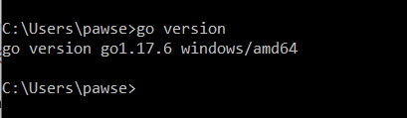
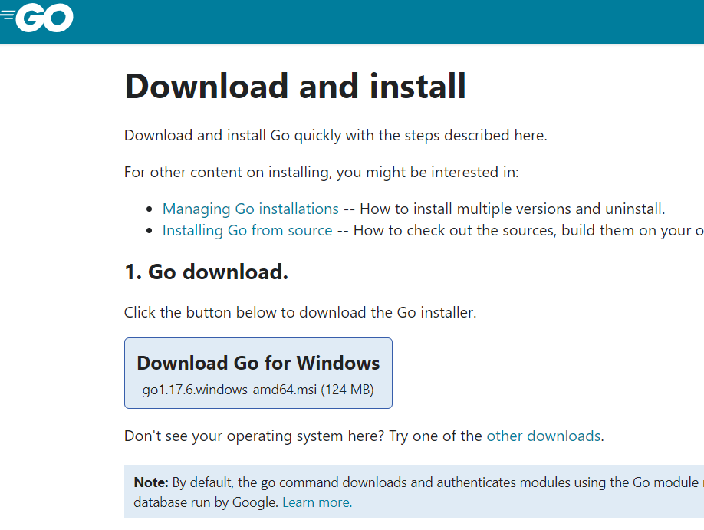
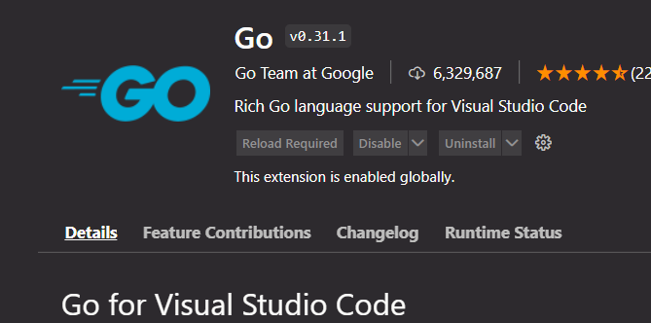
Download Go & Extension in VS Code
https://go.dev/doc/install

Slide 3
Go Introduction
Go was created by a small team within Google.
The team comprised of Robert Grisemar, Rob Pike and Ken Thompson. The language first appeared on November 10, 2009.
Is a procedural programming language.
It is an open-source language.

Slide 4
Why Go Was Created 1.1
One of Googles problems is compile time. Google’s projects are so large that it takes several hours for compiling.
Go was designed for quick compilation without the need for dependency checking so it fixes this issue.
Another problem Google had was string processing. Google is always reading and writing, analyzes webpages. They try to be efficient with string manipulation.
Google built a library of string functions into Go so that things like garbage collection is a lot simpler than other libraries. (C++).
At the time Python, Java and C/C++ lanageus were created during a time when multi threaded applications were rare.

Slide 5
Why Go Was Created 1.2
Almost every application that was created had to focus on single thread at a time. Concurrency patterns were patched in.
Since Google was used to working with highly parallel, highly concurrent apps caused challenges when working with these languages.

Slide 6
Go (golang) - Main Features
It is a Strong and Statically typed language. It inherits similar features from languages such as Java and C++.
Strong typing – is when the variable cannot change over time.
Static typing – variables must be defined at compile time.
Excellent community

Slide 7
Go Key Features
Simplicity
Fast compile times
Garbage collection
Built-in concurrency
Compile to standalone binaries

Slide 8
Key Aspects of a Go program
For any Go program you need to include the statement package main. Every go application is structured into packages.
main is a special package, because every one of your applications will need this as an entry point.
Right below the package main we have an import statement. “fmt” library. In the Go community often called “thumped”.
Once we import this package we will be able to format strings. In this example we will make use of fmt’s Println function by passing in an argument “Hello, World!”.
func main() {
Fmt.Println(“Hello, World!”)
}

Slide 9
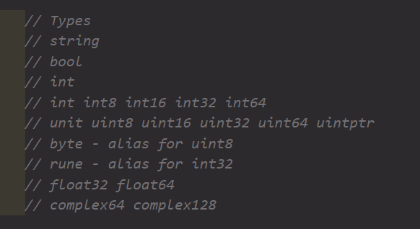
Types
Go has types such has string,
Bool, int and floats.
It supports types like maps,
Slices and arrays.
Composite types are made
By combining other built-in types.

Slide 10
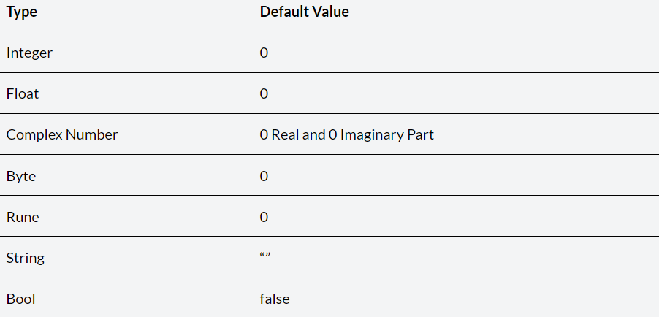
Default Types

Slide 11
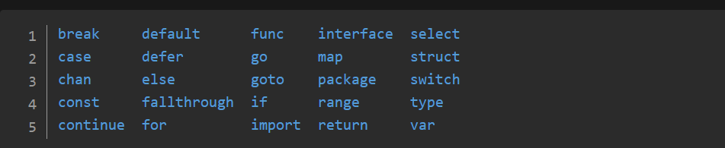
Keywords

Slide 12
Formatted I/O – Format Verbs
Next Slide….

Slide 13
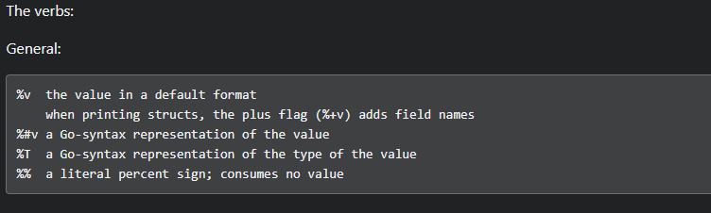
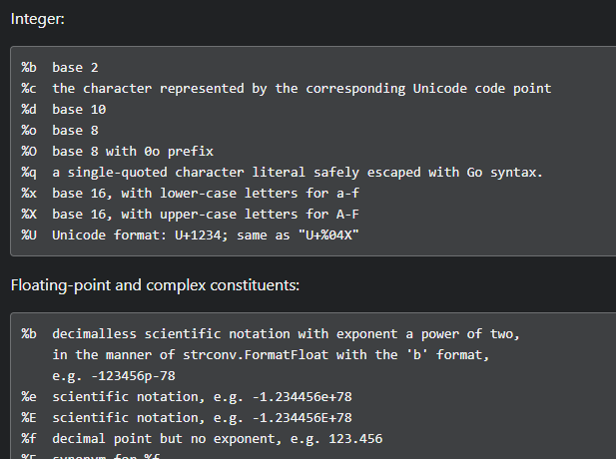


Slide 14
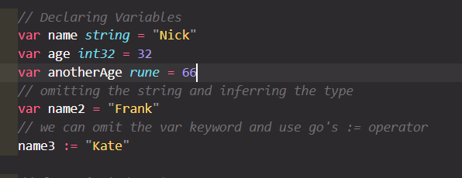
Variables - Declaring
There are 3 ways of declaring a variable:
var x int
x = 5
var x int = 5
x := 5
Declare constant:
const x int = 5

Slide 15
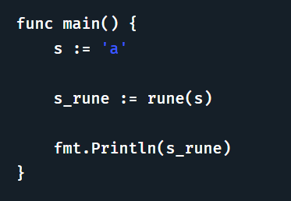
Rune
Strings are created of bytes.
They can contain valid characters represented as a rune.
Using the rune() function to convert a string to an array of runes.
ASCII characters, will be the same as the byte values.
In Go, strings are made up of bytes. Go uses UTF-8 encoding, so that any valid character can be represented in a Unicode code point.
So, what is a Rune?
A rune is an alias of an int32. Since go uses UTF-8 encoding, a character can also be defined.

Slide 16
Operators
a := 10
b := 5
Add: a + b 15
Subtract: a – b 5
Multiply: a * b 50
Divide: a / b 2
Remainder: a % b 0
< less than
> greater than
== equal to
!= different than
<= less than or equal to
>= greater than or equal to

Slide 17
Control Structures
x := 10
y := 20
if x < y {
fmt.Println("True")
} else {
fmt.Println(“False”)
}
Looping
Note: Only the for statement exists in Go.
for i := 0; i < 5; i++ {
fmt.Println(i)
}

Slide 18
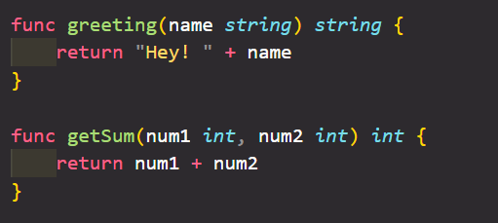
Functions
Example:
func main() {
displayMsg("Hello")
sum(1, 2, 3, 4, 5)
}
func displayMsg(msg string) {
fmt.Println(msg)
}
func sum(values ...int){
result := 0
for _, v := range values {
result += v
}
fmt.Println("The sum is ", result)
}

Slide 19
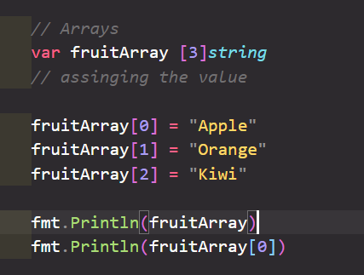
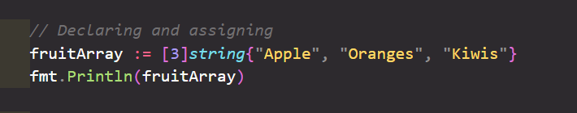
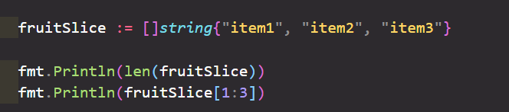
Array / Slices

Slide 20
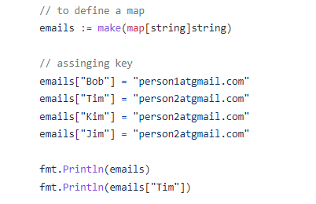
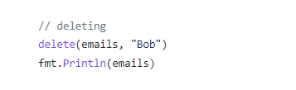
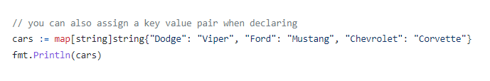
Maps

Slide 21
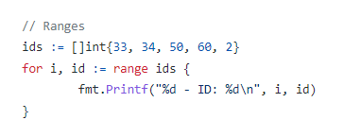
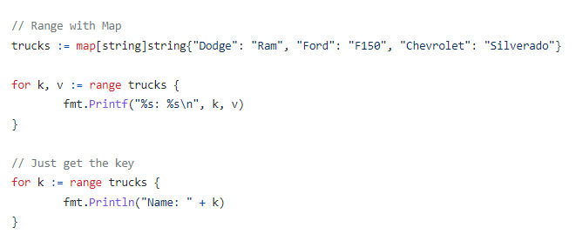
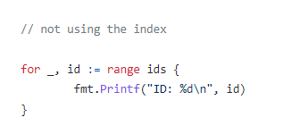
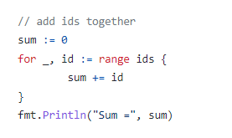
Ranges

Slide 22
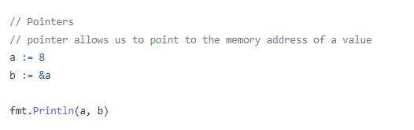
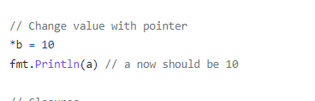

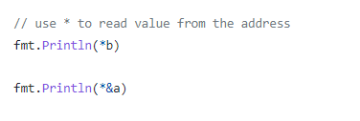
Pointers

Slide 23
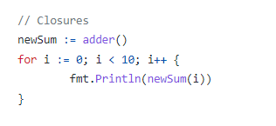
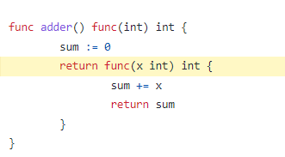
Closures
← Outside of main

Slide 24
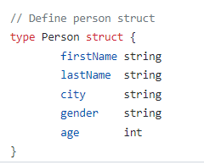
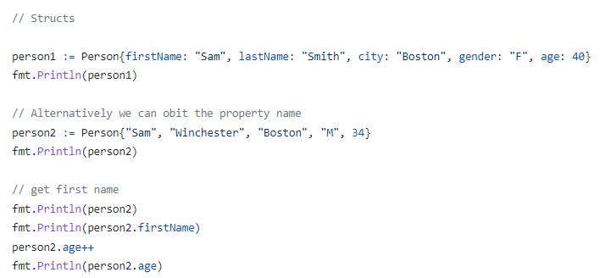
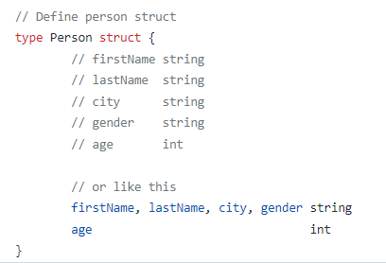
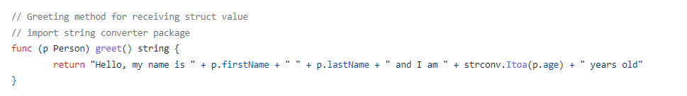
Structs

Slide 25
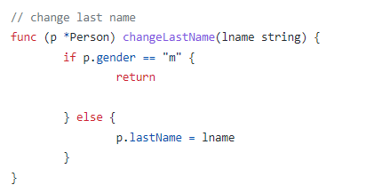
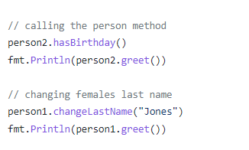
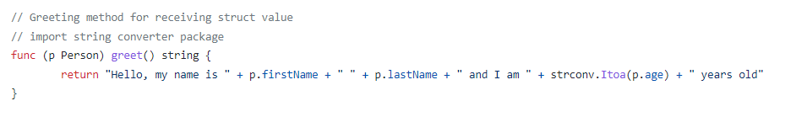
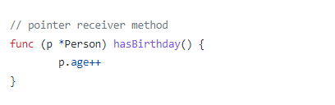
Structs

Slide 26
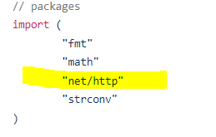
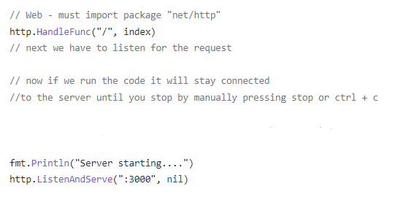

Web – “net/http”

Slide 27
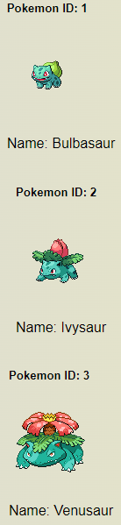
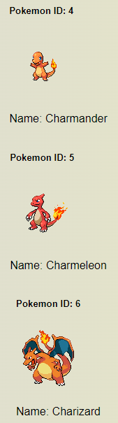
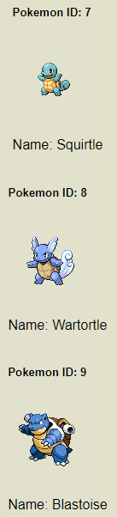
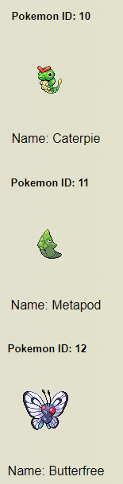
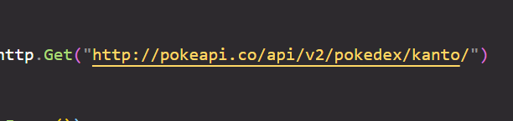
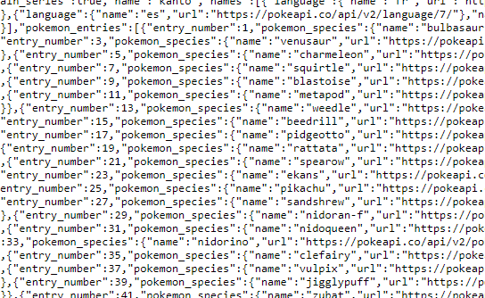
Pokedex Demo – Using Pokeapi

Slide 28
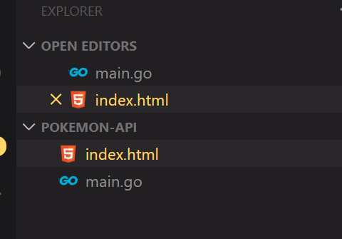
Step 1
Create a new folder
Add 2 files – index.html and main.go
Open in VS Code.

Slide 29
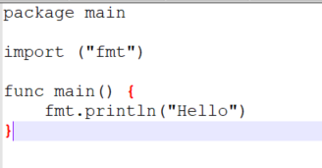
Step 2
In the main.go file
Add code below:

Slide 30
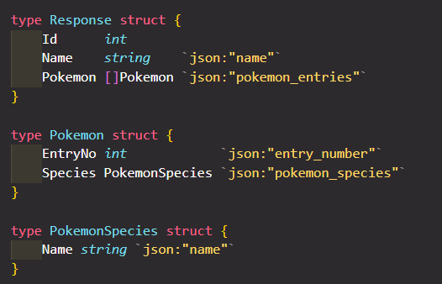
Step 3 – Code the struct

Slide 31
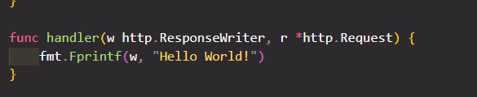
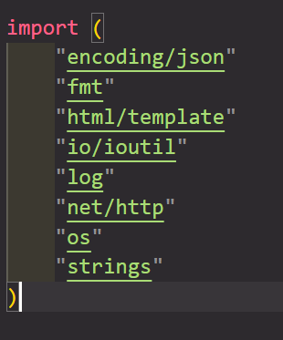
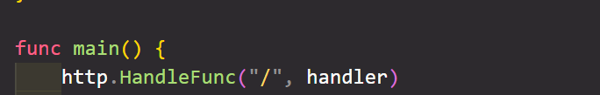

Step 4 – Testing index.html
In the terminal type: go run main.go

Slide 32
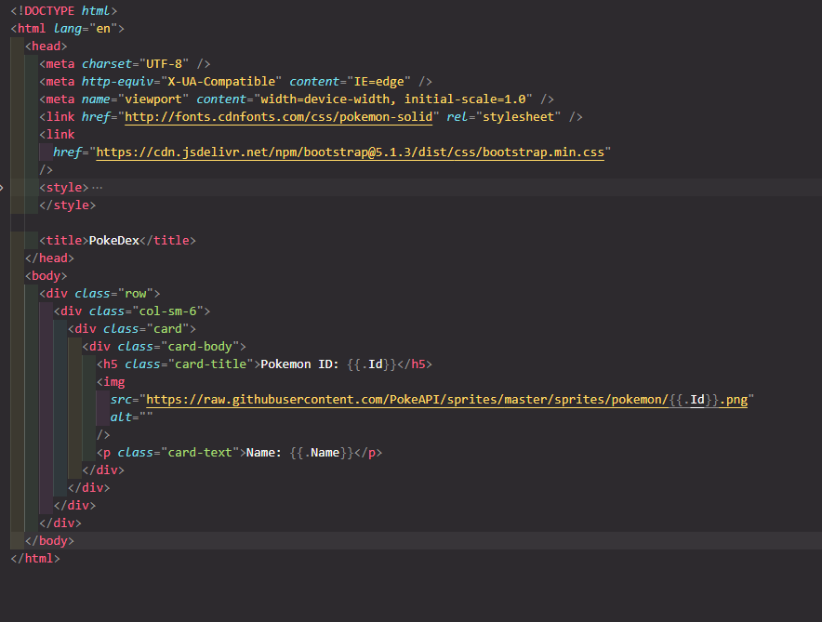
Step 5 – Index.html
To save time, we will just give you this code.

Slide 33
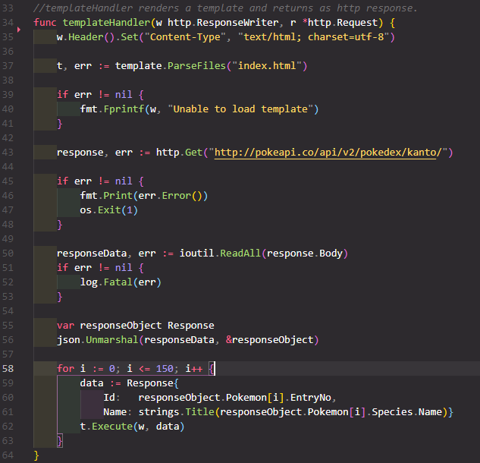

Step 6 – main.go

Slide 34
Resources and References
THE WAY TO GO – A Thorough Introduction to the Go Programming Language
Learn Go Programming - Golang Tutorial for Beginners – (Slide 3-6)
Learn Go Programming - Golang Tutorial for Beginners – YouTube
Go Fundamentals – In class example
https://www.youtube.com/watch?v=SqrbIlUwR0U
Consuming API
https://tutorialedge.net/golang/consuming-restful-api-with-go/
HTML templates - Go Lang Practical Programming Tutorial p.16 https://www.youtube.com/watch?v=Uo9MSE2Gbzs&t=325s
Keywords https://go101.org/article/keywords-and-identifiers.html
I/O Format Verbs https://pkg.go.dev/fmt
API https://pokeapi.co/docs/v2#pokemon-section
Default Types https://golangbyexample.com/go-default-zero-value-all-types/
Runes https://golangdocs.com/rune-in-golang https://zetcode.com/golang/rune/

