Slide 1

Bosch Assesment Data Engineer
Henrique Silva

Slide 2
Main Objectives
1.Extract, clean, transform, and load data from public sources related to the automotive industry;
Suggest an automation for the data pipeline with a chosen schedule interval;
Document all decisions made during the data processing and transformation steps;
Address any challenges faced during the exercise.

Slide 3
Index
Script Developed (Slides 4-5)
Vehicle Complaints Dataset (Slides 6-10)
Alternative Fuel Stations Dataset (Slides 11-14)
Vehicle Fuel Economy Information Dataset (Slide 15-16)
Data Loading (Slide 17-18)
Automation Suggestion (Slide 19)
Conclusion (Slide 20)

Slide 4
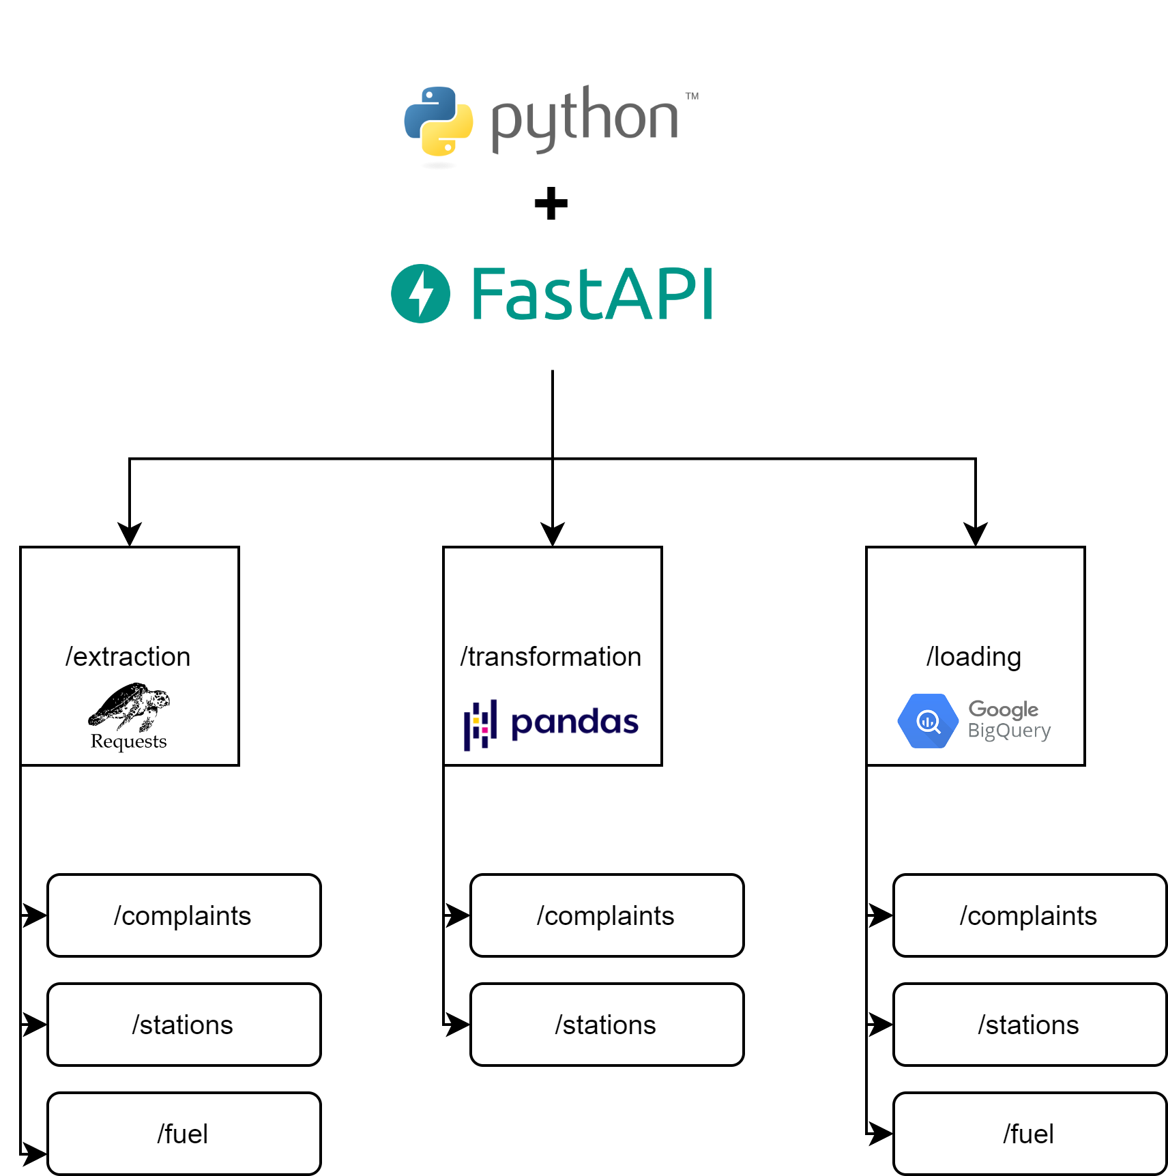
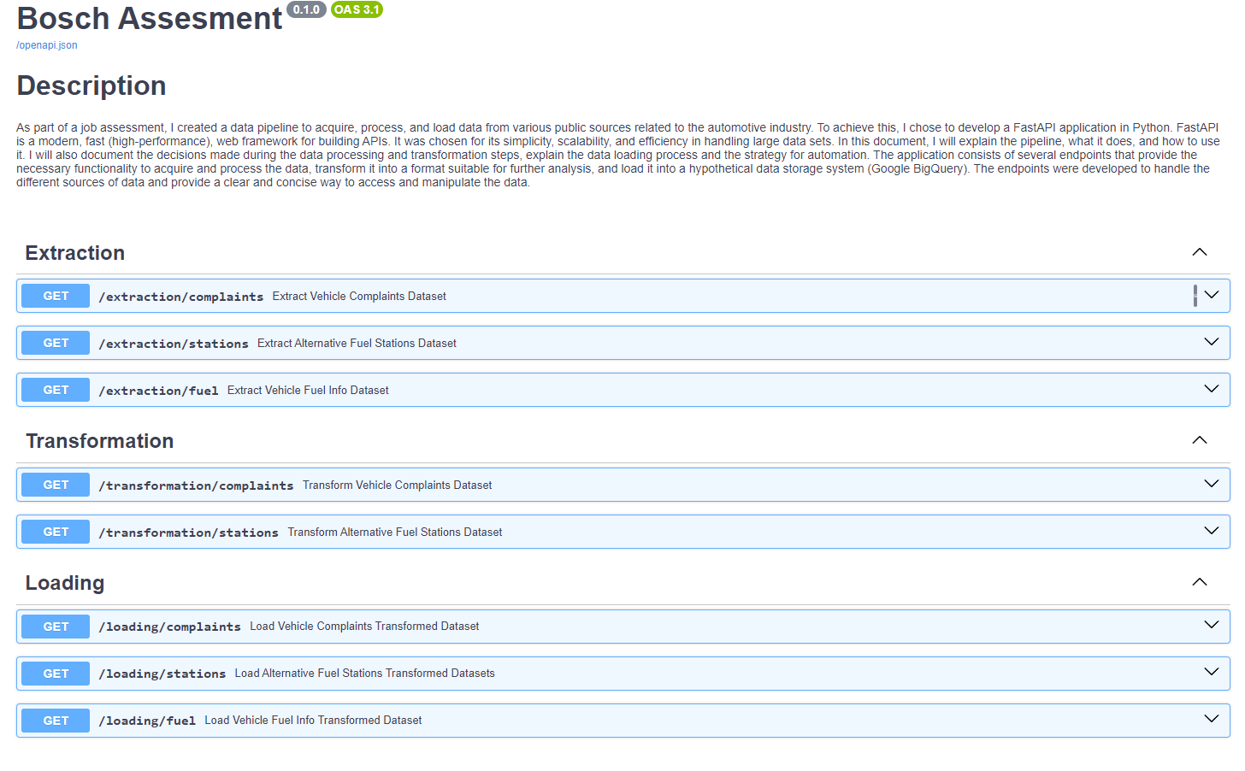
1 - Script Developed
How To Launch:
1. Clone GitHub repository;
2. Install ‘requirements.txt’ libs;
3. Open terminal inside ‘app/’ and type: ‘uvicorn main:app --reload’;
4. Access documentation on browser using http://localhost:8000/docs:
Project Infrastructure
Project FastAPI docs

Slide 5
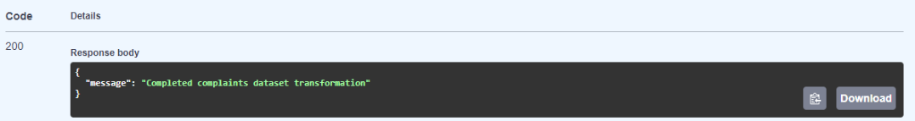
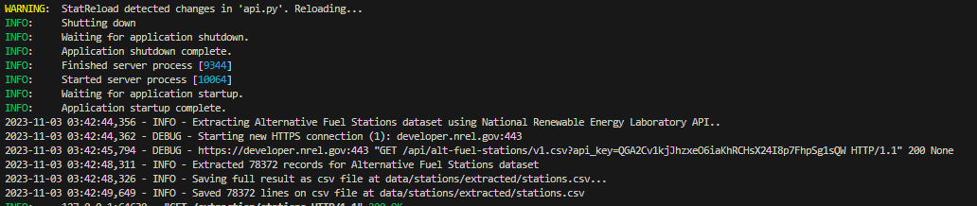
1.1 - How To Run
FastAPI docs provide an interactive interface can be used to send requests to the app;
To test an endpoint, expand the endpoint in the sidebar and click on the "Try it out" button;
Once the parameters are entered, the "Execute" button can be clicked to send the request to execute the endpoint defined function. The response will be displayed below the form:
When executed, the logs of the app can also be seen in the console:
FastAPI response example
Console logs example

Slide 6
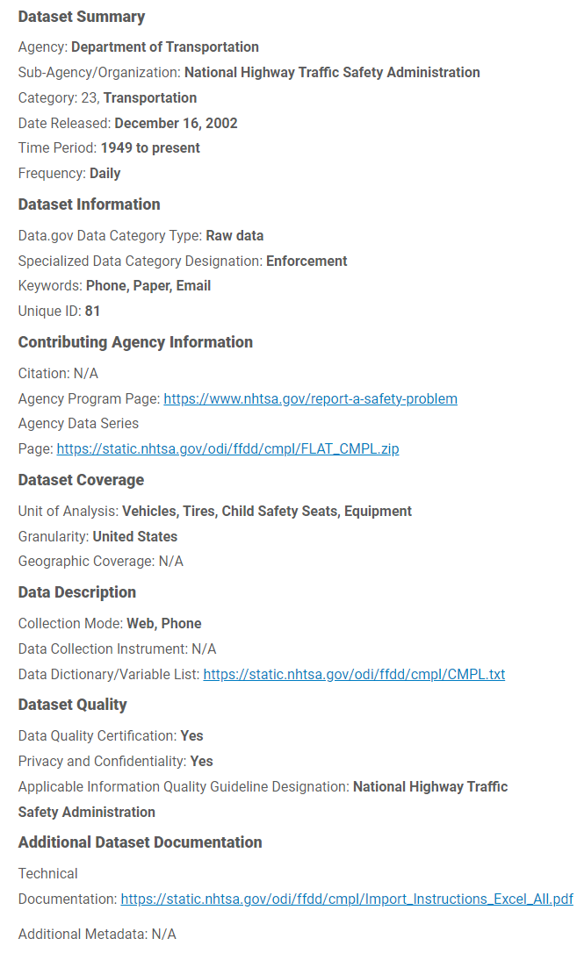
2 - Vehicle Complaints Dataset
The U.S. Department of Transportation Vehicle Complaints dataset includes complaints about safety concerns related to vehicles, such as brakes, steering, and airbags, as well as general issues like electrical problems and engine failures;
Received by the National Highway Traffic Safety Administration (NHTSA) or through the Office of Defects Investigation (ODI);
NHTSA provides an API that can be used to retrieve information on vehicle complaints.
Complaints dataset metadata

Slide 7
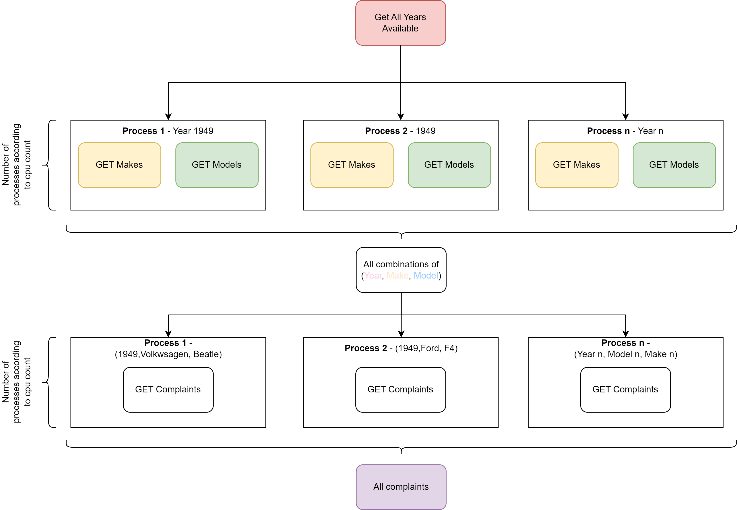
2.1 - Vehicle Complaints: Extraction
Use multiprocessing to create a pool of worker processes and the starmap() function to create a list of all possible combinations between the model years, makes, and models that have received complaints;
Use multiprocessing to create a pool of worker processes and the starmap() function to extract all complaints for each combination of make, model, and model year in parallel;
Concatenate the resulting dataframes into a single dataframe and save it as a CSV.
Complaints extraction method

Slide 8
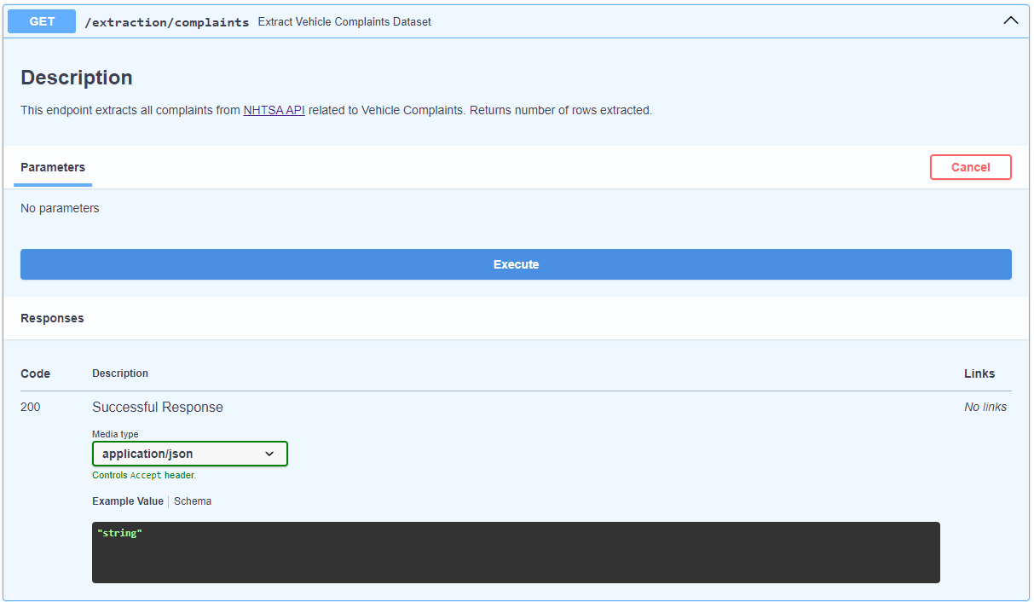
2.1 - Vehicle Complaints: Extraction
Extraction can be accessed by making a GET request to the ‘/extraction/complaints’ route:
Complaints extraction FastAPI UI

Slide 9
2.2 - Vehicle Complaints: Transformation
Main Transformations on Data
Load the CSV file and remove irrelevant columns;
Fix the date format and capitalization of certain columns;
Create a new column for the year of the complaint and convert certain columns to datetime or integer format;
Reorder the columns and assign a unique ID to each row;
Save the processed dataframe as a CSV file;
The final processed dataframe is returned.

Slide 10
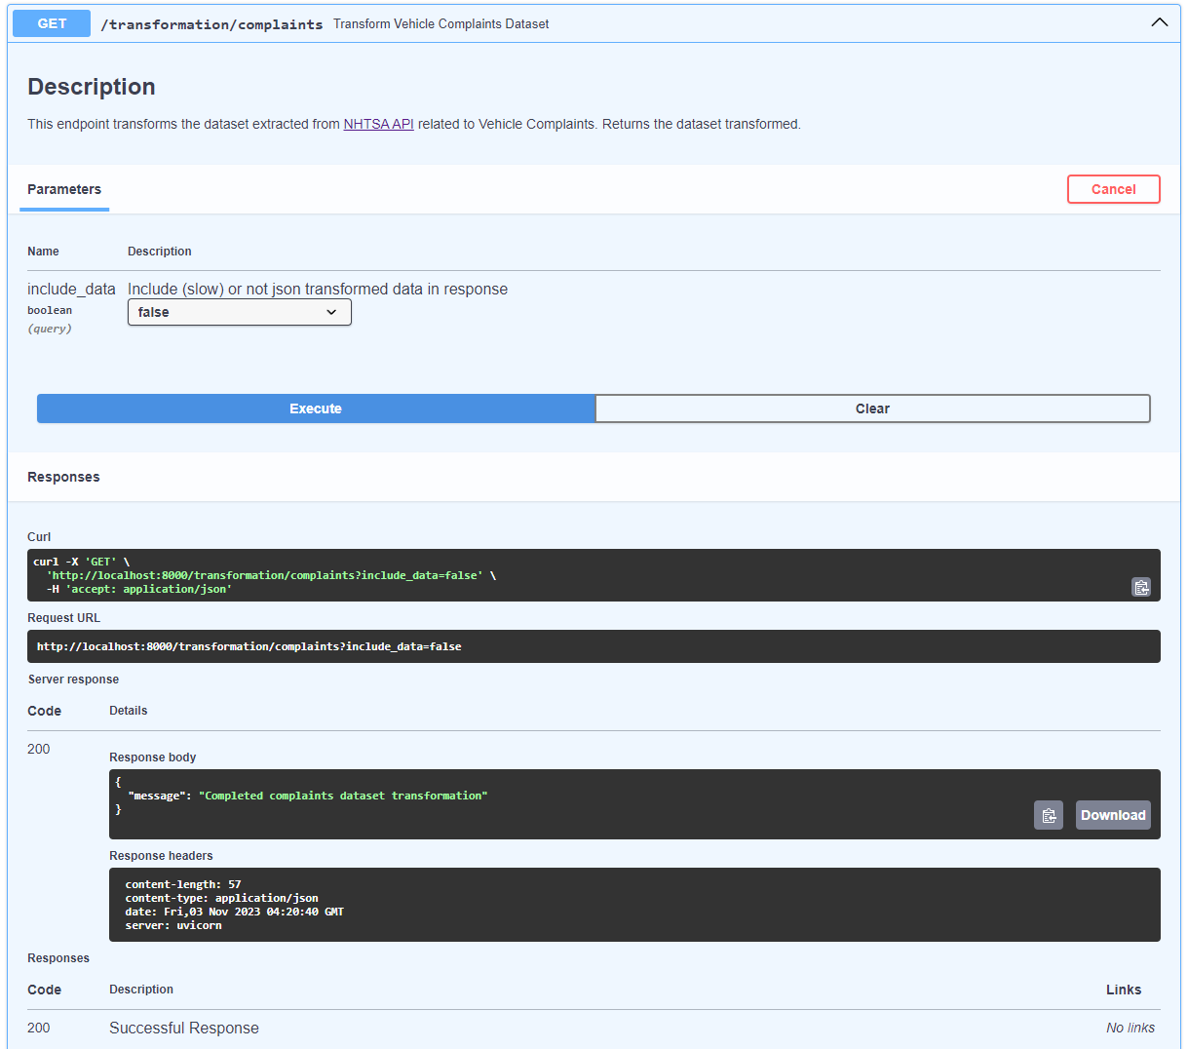
2.2 - Vehicle Complaints: Transformation
Transformation can be accessed by making a GET request to the ‘/transformation/complaints’ route:
‘http://localhost:8000/transformation/complaints?include_data=true’ - Includes transformed data in the response.
‘http://localhost:8000/transformation/complaints?include_data=false’ - Excludes transformed data from the response.
Complaints transformation FastAPI UI

Slide 11
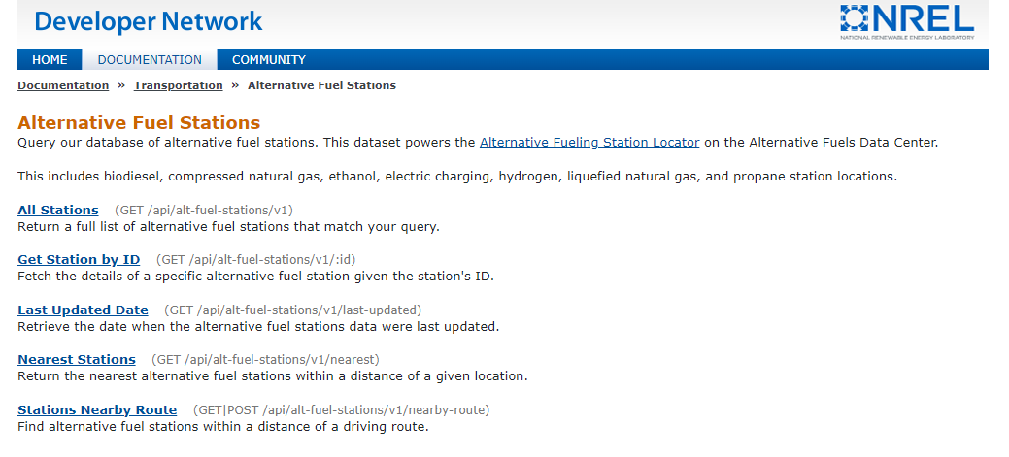
3 - Alternative Fuel Stations Dataset
The Alternative Fuel Stations dataset is maintained by the National Renewable Energy Laboratory;
Contains information on alternative fuel stations across the United States;
Provides valuable information on the locations and types of alternative fuel stations available;
Data can be extracted using the NREL API.
NREL API webpage

Slide 12
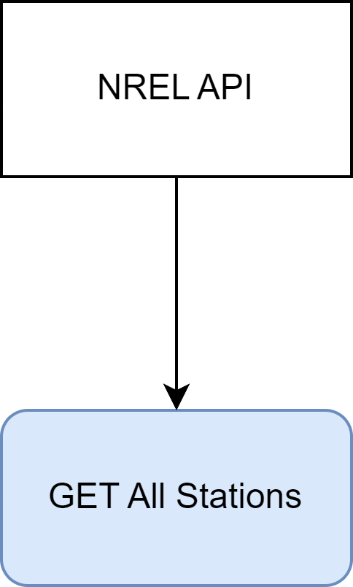
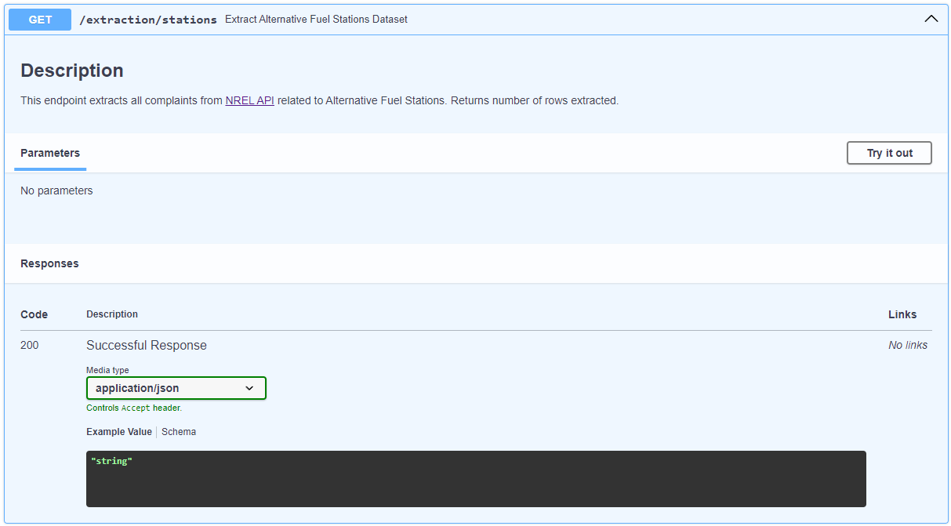
3.1 - Alternative Fuel Stations: Extraction
Steps:
Define the URL for the NREL API endpoint;
Extract the data from the response;
Save the resulting dataframe containing information about the alternative fuel stations as a CSV;
Extraction can be accessed by making a GET request to the ‘/extraction/stations’ route.
Stations extraction method
Stations extraction FastAPI UI

Slide 13
3.2 - Alternative Fuel Stations: Transformation
Main Transformations on Data
Load the CSV file and fix the column names;
Remove deprecated and irrelevant columns;
Map values of certain columns to new columns and create new address and point columns;
Remove rows where the ‘station_name’ column is null and clean null values in string columns;
Convert the ‘updated_at’ column to datetime format and reorder the columns in the dataframe;
Assign a unique ID to each row and split the dataframe into multiple dataframes based on fuel type;
For each fuel type-specific dataframe, perform additional cleaning, manipulation, and conversion tasks as necessary;
Save each fuel type-specific dataframe as a separate CSV file;
Return the all tables concatenated in JSON format using FastAPI.

Slide 14
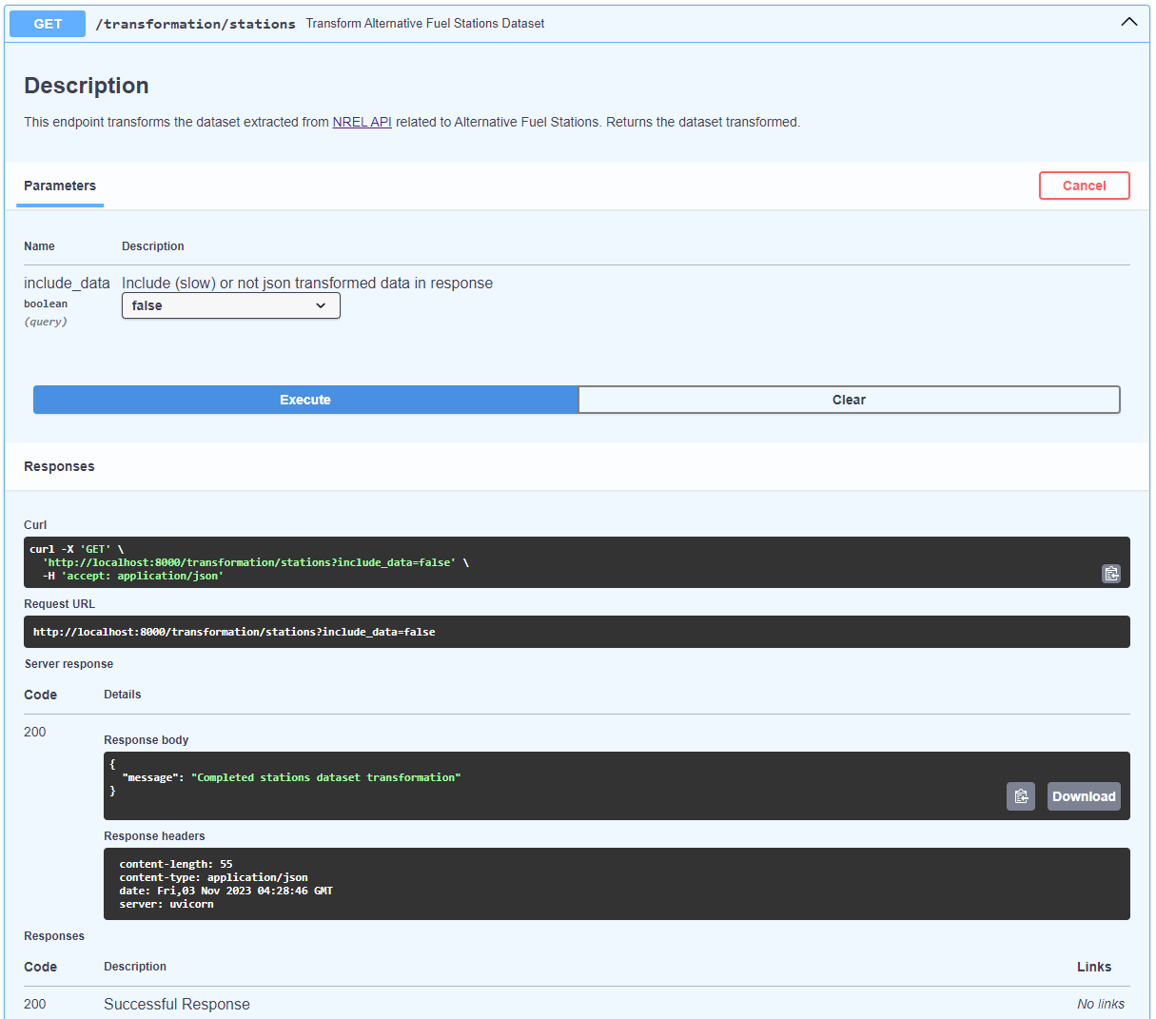
3.2 - Alternative Fuel Stations: Transformation
Transformation can be accessed by making a GET request to the ‘/transformation/stations’ route:
‘http://localhost:8000/transformation/stations?include_data=true’ - Includes transformed data in the response.
‘http://localhost:8000/transformation/stations?include_data=false’ - Excludes transformed data from the response.
Stations transformation FastAPI UI

Slide 15
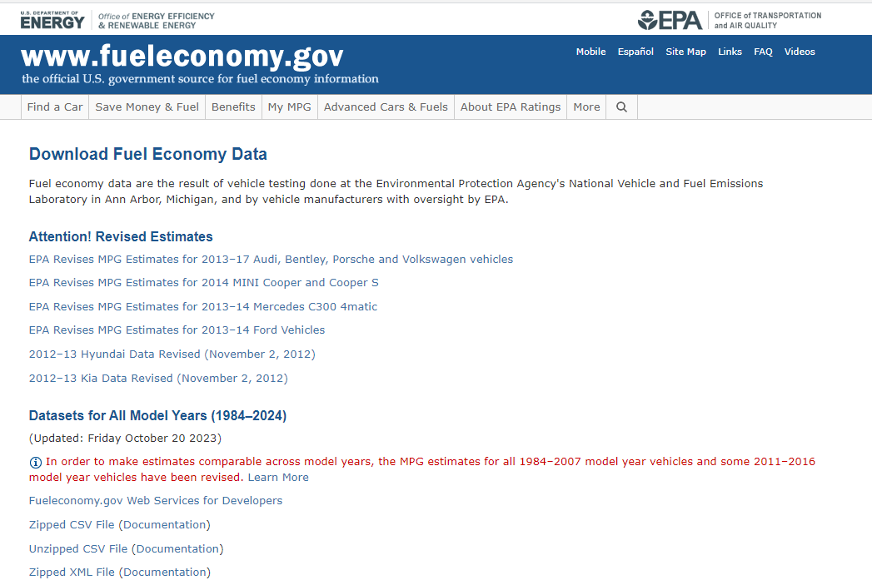
4 - Vehicle Fuel Economy Information Dataset
Vehicle Fuel Economy Information dataset provides information on fuel economy and emissions for cars and trucks;
Dataset is maintained by US Department of Energy and Environmental Protection Agency;
Includes information on make, model, year, fuel type, and fuel efficiency for each vehicle;
Used to inform consumers and policymakers about fuel economy and emissions of different vehicles.
Fuel dataset webpage

Slide 16
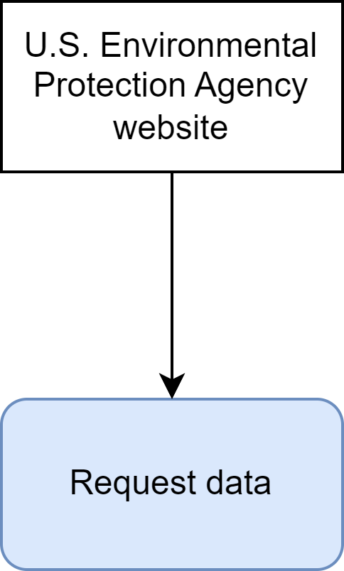
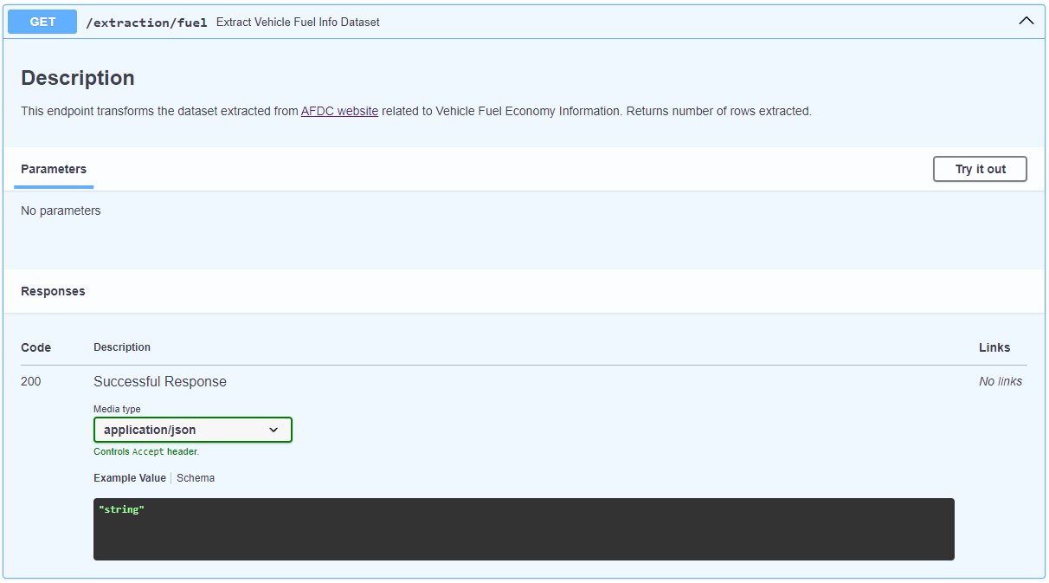
4.1 - Vehicle Fuel Economy Information: Extraction
Steps:
Download data using link from U.S. Environmental Protection Agency via request;
Save the resulting information about the alternative fuel economy as a CSV;
Extraction can be accessed by making a GET request to the ‘/extraction/fuel’ route.
Fuel extraction method
Fuel extraction FastAPI UI

Slide 17
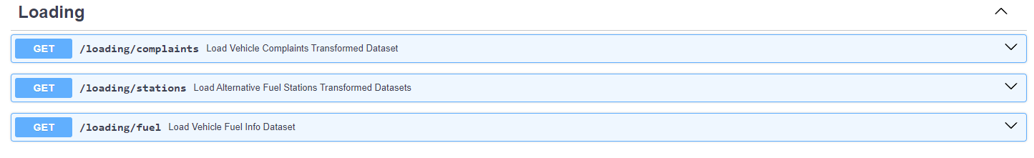
5 – Data Loading
To send transformed datasets to Google BigQuery:
Create a BigQuery engine using ‘database.SessionBigQuery()’ function;
Use ‘loader.df_to_gcp()’ function to send a single DataFrame directly to BigQuery and ‘loader.dict_df_to_gcp()’ to send dicts of DataFrames like the case of transformed Vehicle Complaints datasets;
‘Loading’ tagged endpoints can be used directly to perform transformation and then loading.
‘Loading’ tagged endpoints
Notes:
Sending dataframes directly is safer than saving as CSV files and reopening;
Google BigQuery has built-in GIS capabilities to work with spatial data like the Point() column created in Alternative Fuel Stations transformed datasets;

Slide 18
5.1 - Why Google Bigquery?
Scalability: can handle datasets of any size, from gigabytes to petabytes.
Speed: can process queries on large datasets in seconds or minutes.
Cost-effectiveness: offers a pay-as-you-go pricing model.
Security: BigQuery provides robust security features, including data encryption, access controls, and audit logging.
Integration: BigQuery has native integrations with a wide range of data sources and dashboarding tools, including Google Data Studio, Grafana, and PowerBI.

Slide 19
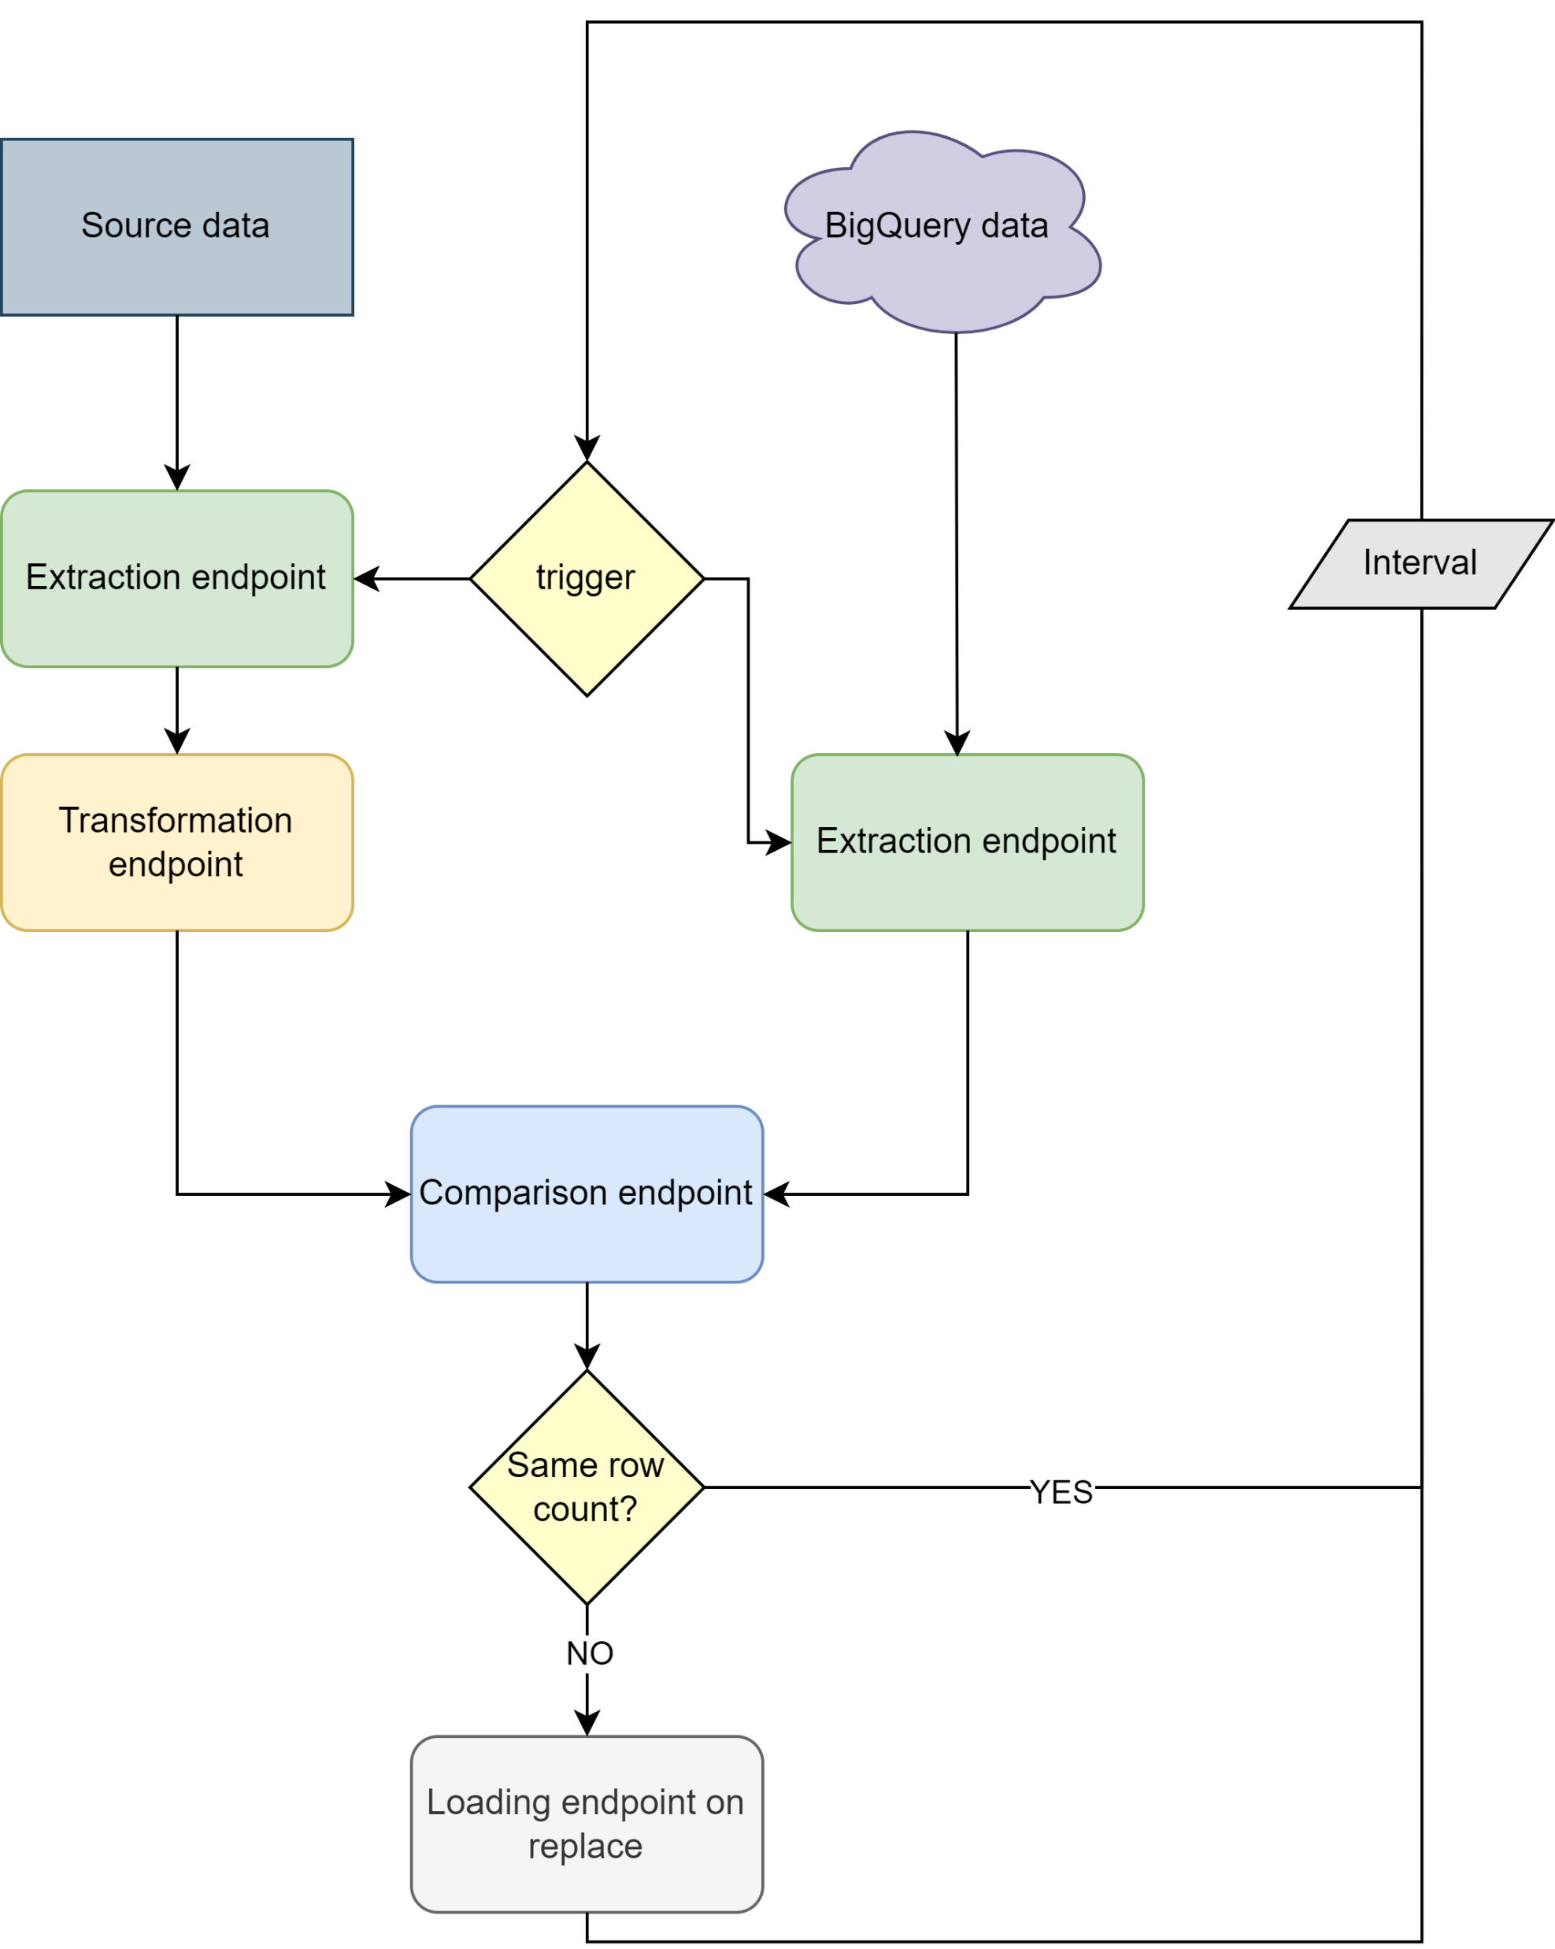
6 - Automation Suggestion
According to a interval, extract, transform, and update datasets in BigQuery by comparing the data in cloud with the source;
Use tool such as crontab to schedule script to run regularly and FastAPI to create urls that can be curled for scheduling script;
For each dataset, download latest version from source, process it, and compare it to the version extracted from BigQuery;
If row count is different, replace contents of corresponding BigQuery table with newly extracted and transformed dataframe;
If row count is the same, do nothing;
Set up a cron job to run at a scheduled interval to trigger the FastAPI endpoints;
Make sure interval is aligned with dashboard development or other services that rely on this info.
Automation suggestion

Slide 20
7 - Conclusion
What were the biggest challenges faced during the project, and how were they overcome?
What were the most successful strategies or approaches used during the project, and how might they be applied in other contexts?
How might the project's results be used to inform policy, decision-making, or future research in the field?

