Slide 1
Objectives
STTUNER BASIC USAGE
&
OPTIONS
Version :1.0

Slide 2
STTUNER - Introduction
The Tuner Driver API provides a generic interface to a Front End decoder device for receiving a digital transport stream via Satellite, Cable or Terrestrial transmission
The driver is designed to be used with other STAPI components* like STI2C, STEVT etc for layered communications with the target Front End decoder device (e.g., STI2C for communications with the STV0288 demodulator)
The main API calls are designed to be non-blocking to allow a scan to be initiated by a single function call, with asynchronous notification of a “signal lock” via a callback mechanism. This is intended to maximize the throughput of the underlying “signal lock” search algorithm
All driver events are also exported to a nominated Event Handler driver
*for details refer release note document.

Slide 3


Basic Interface Diagram
58-862 MHz
CABLE
STV0297,STV0297j,STV0297E
I2C
SATELLITE
STV0299,0399,0288,0899
DVB/DirecTV TS Interface
ST BACK END
with STAPI s/w
component on OS20/21
950-2150 MHz
Serial/Parallel may be selected through Init Param
TERRESTRIAL
STV036x,
STV037x
452-868 MHz
FRONT END
Required Front End(s) selected through appropriate
Build Options and Init Params.
More than One of Same/Different types can be used simultaneously.
Required FE may be selected

Slide 4
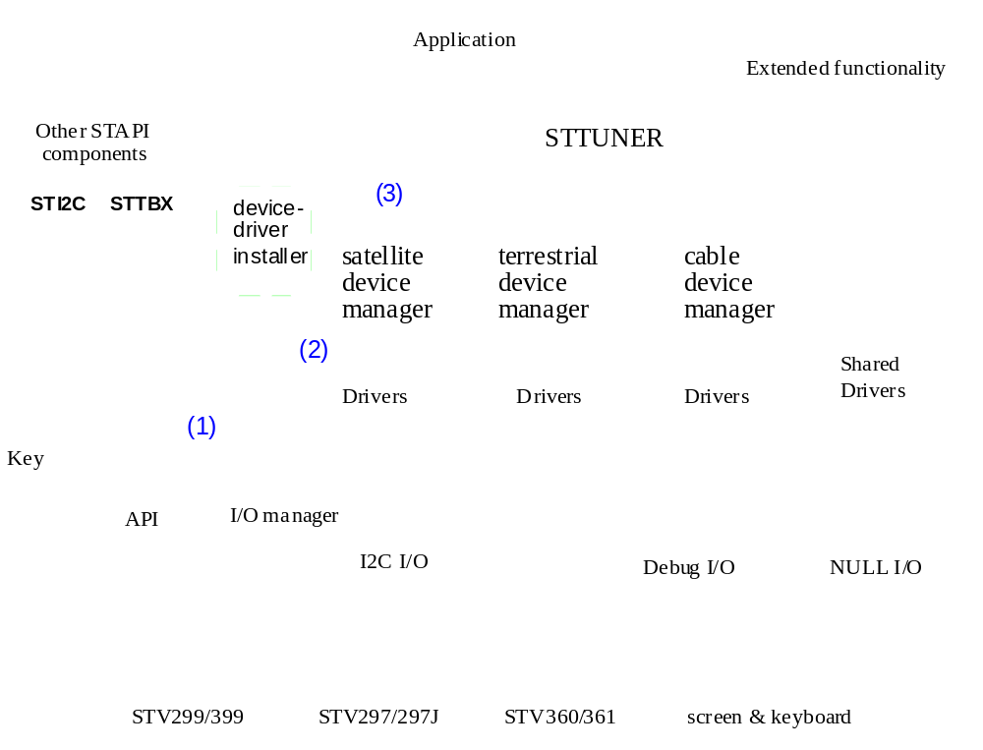
Layered architecture of sttuner driver
STV299,399, STV288,899
STV360,361, 370

Slide 5
EVENTS
STATE MACHINE: the API encapsulates a state machine, where the driver may be in One of the several states:
SCANNING
LOCKED
SCANNING: driver is scanning for a particular frequency or across a specified range of frequencies i.e. the user has called STTUNER_Scan() or STTUNER_SetFrequency()
LOCKED: driver is locked (and tracking) a specific frequency
UNLOCKED: driver has either lost lock (tracking failure) or the lock was forcibly terminated by the caller i.e. via a call to STTUNER_Unlock()
NOT FOUND: scanning process has completed and failed to lock to a particular frequency
NOT FOUND
UNLOCKED
Main events Notified by sttuner:
STTUNER_EV_LOCKED: Tuner is Locked
STTUNER_EV_UNLOCKED: initially locksbut then unlocks; may be due to removal of feed, degradation in signal, etc.
STTUNER_EV_SCAN_FAILED: frequency scan fails
STTUNER_EV_TIMEOUT: takes more than specified time
STTUNER_EV_SIGNAL_CHANGE: signal degraded but tuner still locked.
STTUNER_EV_LNB_FAILURE: overload or shortcircuit reported by LNB driver.
For event usage examples refer to test application Sat_test.c in sttuner.

Slide 6
STTUNER – Important API’s
STTUNER_Init() Install device driver, allocate memory for instance dataBase and initialise I/O (I2C) handle.
STTUNER_Open() Setup the front driver (Tuner and demod, etc.) at default configuration and returns a handle to the application.
  STTUNER_OpenParams_t a callback routine may be specified for receiving notification of events
  The user may now call STTUNER_Scan() or STTUNER_SetFrequency() API.
STTUNER_Scan()to scan a range of frequency band. BandList and ScanList parameters must be set in the application and the API must be called after calling Sttuner_SetBandList() and Stuner_SetScanList();
STTUNER_SetFrequency() Scanning parameters must be filled in Sttuner_Scan_t and the API must be called after Sttuner_SetBandList() to lock to a signal of specified frequency, symbol rate, polarization and puncture rate.
When a lock is obtained the user is notified via the NotifyFunction in the STTUNER_OpenParams_t and the user may optionally choose to subscribe to this event using the Event Handler API, in which case it is advised that the NotifyFunction is set to NULL.
STTUNER_GetTunerInfo(): This provides information such as the signal quality, BER and AGC value.
STTUNER_Close(): forcibly unlock the tuner and invalidate the caller’s handle.
STTUNER_Term(): terminates the driver after a call to STTUNER_Close().(free the handle)
Note: for full details and sample usage refer to the document Sttuner.fm
Notes:
STTUNER_GetTunerInfo(): Returns the current tuner info at lock.
STTUNER_GetTunerInfo(): Returns the current tuner info at lock.

Slide 7
Basic BUILD OPTIONS
Sat DVD_STTUNER_USE_SAT=YES DVD_STTUNER_DRV_SAT_STV0xxx=YES DVD_STTUNER_DRV_TUNER_xxx=YES (for299/899/288) |  |  | Ter DVD_STTUNER_USE_TER=YES (for STV036x) DVD_STTUNER_USE_ATSC_VSB=YES (for STV037x) DVD_STTUNER_DRV_TER_STV0***=YES DVD_STTUNER_DRV_TUNER_xxx=YES |  | Cab DVD_STTUNER_USE_CAB=YES DVD_STTUNER_DRV_CAB_STV0***=YES DVD_STTUNER_DRV_CAB_EXTTUNERS=YES set DVD_STTUNER_TUNER_xxx=YES
Demod (xxx=) | LNB | SCR | Demod (***=) | Tuner | Demod | Tuner
299 | LNBP21/LNBH21 DVD_STTUNER_DRV_SAT_LNB21/LNBH21=YES No option required for LNB10/15 series LNBs. | DVD_STTUNER_DRV_SAT_SCR=YES | 360 | DTT7592,DTT7600,TDQD3 Corresponding build option for the tuner to be set. | 297 | Corresponding build option for the tuner to be set
399 |  |  | 361 |  | 297j
288 |  |  | 370 |  | 297E 370,371 QAM
899
There are other options for configuring DiSEqC driver Mini 299,399E driver options. Please refer to the application note Tuneran09.pdf |  |  | Please refer to the application note Tuneran09.pdf for more details and more options
Notes:
If LNB10/15 series default option

Slide 8
BUILD OPTIONS EXAMPLE:
288 driver
Example- Building 288 driver with optimized code/data size
set DVD_STTUNER_USE_SAT=YES
set DVD_STTUNER_DRV_SAT_STX0288=YES
set DVD_STTUNER_DRV_SAT_LNBH21=YES
set DVD_STTUNER_TUNER_STB6000=YES
set LNBH_21=YES (sat_test options)
set C_BAND_TESTING=YES (sat_test options)
set STTUNER_SAT_TEST_TUNER_TYPE=STTUNER_TUNER_STB6100(sat_test options)

Slide 9
BUILD OPTIONS EXAMPLE:
Terrestrial 36X,37X driver
Terrestrial COFDM(36x)
set DVD_STTUNER_USE_TER=YES
set DVD_STTUNER_DRV_TER_STV036X=YES
set DVD_STTUNER_TUNER_XXX=YES
set TUNER_362=YES (ter_test.c option)
set TEST_NOIDA_DTT_TRANSMISSION=YES (ter_test.c option)
set TEST_TUNER_TYPE=DTT7300X (ter_test.c option)
Terrestrial VSB (37x)
set DVD_STTUNER_USE_ATSC_VSB=YES
set DVD_STTUNER_DRV_TER_STV037x=YES
set DVD_STTUNER_TUNER_XXX=YES
set TUNER_370VSB=YES (ter_test.c option)
set TEST_NOIDA_DTT_TRANSMISSION=YES (ter_test.c option)
Set TEST_TUNER_TYPE=DTT7600(ter_test.c option)
(Incase of using shared tuner shared tuner option should be set)

Slide 10
BUILD OPTIONS EXAMPLE:
Cable 297X
Cable
set DVD_STTUNER_USE_CAB=YES
set DVD_STTUNER_DRV_CAB_STV0XXX=YES
set DVD_STTUNER_DRV_CAB_EXTTUNERS=YES
set DVD_STTUNER_TUNER_XXX=YES
set DVD_TUNER=STV0297 (cab_test.c option)
set TEST_TUNER_TYPE=MT2060 (cab_test.c option)

