Slide 1
Q3 BUSINESS REVIEW
ACME FOODS
Jane Doe, Client Lead
OCTOBER 2026

Slide 2
AGENDA
What we will cover today
Q3 performance highlights
How we delivered: our execution model
Your team
What we will measure in Q4
Next steps

Slide 3
Q3 PERFORMANCE
SECTION 01

Slide 4
Q3 RESULTS AT A GLANCE
Across 1,240 stores in modern and traditional trade
AVAILABILITY
SHARE OF SHELF
COMPLIANCE
96%
31%
92%
On-shelf availability, up 4 points on Q2.
Share of shelf in core categories.
Planogram compliance across key accounts.
Source: Smollan store audits, Jul-Sep
Target 30%
Up from 85% in Q1

Slide 5
SELL-OUT GROWTH BY MONTH
VALUE SALES, R MILLION

Slide 6

PERFORMANCE BY KEY ACCOUNT
Q3 actuals vs. target
ACCOUNT | OSA | SHARE OF SHELF | COMPLIANCE | PROMO EXECUTION
Retailer A | 97% | 33% | 94% | ✓
Retailer B | 95% | 30% | 91% | ✓
Retailer C | 94% | 29% | 90%
Retailer D | 96% | 32% | 93% | ✓

Slide 7
HOW WE DELIVERED
SECTION 02

Slide 8
OUR EXECUTION MODEL
FROM INSIGHT TO SHELF
A weekly rhythm that turns store data into action within 48 hours.
PLAN
EXECUTE
MEASURE
ANALYSE
ACT
Route plans
Store priorities
Merchandising
Promo set-up
Photo audits
OSA checks
Dashboards
Exception alerts
Fix gaps
Share wins
Every Monday
Daily
Each visit
Within 24h
Within 48h

Slide 9
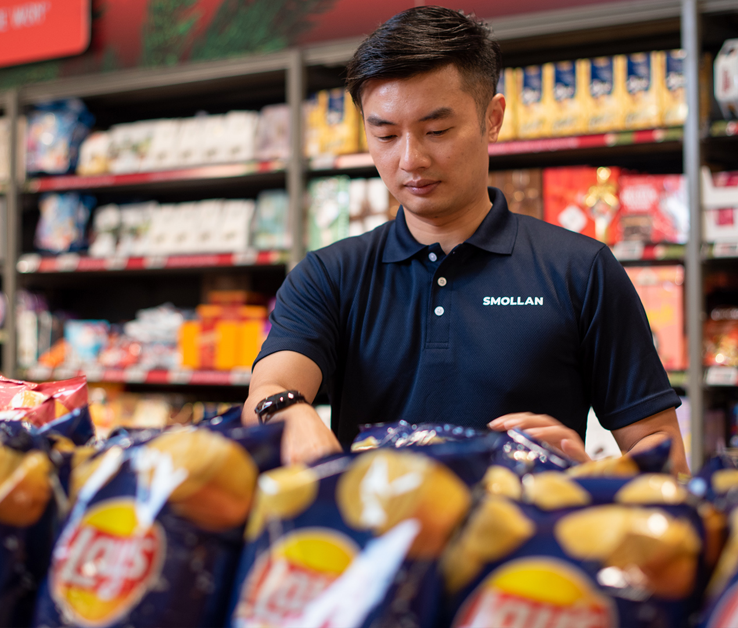
ONE NUMBER THAT MATTERS
Out-of-stocks resolved within 48 hours
89%
RESOLVED IN 48H
Exception alerts route straight to the field team on the day.
Q3 2026, all regions

Slide 10
YOUR ACME FOODS TEAM
JANE DOE
Client Lead
SIPHO DLAMINI
Field Manager - Inland
MARIA SILVA
Field Manager - Coastal
KEN OTIENO
Insights Lead
ANN LEE
Team Leader
RAJ PATEL
Team Leader
TOM BERG
Team Leader
LEA ROUX
Team Leader
OLA ADE
Analyst

Slide 11
Q4 KPIs
OSA
On-shelf availability at or above 96% in all key accounts
SHARE OF SHELF
Maintain 31%+ share of shelf in core categories
Co-created with Acme Foods, reviewed monthly.
COMPLIANCE
Planogram compliance of 93% or higher
PROMO
100% of promotions live on day one
RESPONSE
Out-of-stocks resolved within 48 hours

Slide 12
WHAT MAKES SMOLLAN UNIQUE?
WINNING AT THE POINT OF PURCHASE
AN EXCEPTIONAL OFFER
A GLOBAL
BUSINESS
AN ADVANCED OPERATING MODEL
A GREAT PLACE
TO WORK
A broad range of services and integrated solutions
We can work locally, regionally and globally
Agility, pace, precision and insight
Highly engaged people to drive performance

Slide 13
THANK YOU
FOR THE OPPORTUNITY
Thank you for a strong quarter together. We look forward to an even better Q4.
NEXT STEPS
Agree Q4 KPI targets by 31 October
Monthly performance reviews
Q4 review in January

