Slide 1
Global Variables
home-when
workplace-when
commute-when
alarm-reset-when
contact_rate_bus
contact_rate_car
contact_rate_walk
contact_rate_tube
contact_rate_train
contact_rate_big_workplace
contact_rate_mid_workplace
contact_rate_small_workplace
infection_rate_ymask_ycardio
infection_rate_nmask_ncardio
infection_rate_ymask_ncardio
infection_rate_nmask_ycardio
cumulative_sick
cumulative_susceptible
cumulative_immune
cumulative_vaccinated
transportation_list
company_list
high_popular_company_list
mid_popular_company_list
low_popular_company_list
cardiovascular_disease_list
mask_list
phase
days
days-track
hour-counter
cumulative-hour-counter
Patch
Turtle
Turtle Variables
Patch Variables
sick?
immune?
susceptible?
vaccinated?
mask?
cardiovascular-disease?
sick-count
natural-immune-count
vaccination-immune-count
transportation
company
sick-population
total-population

Slide 2
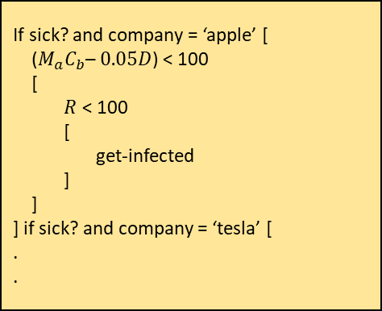
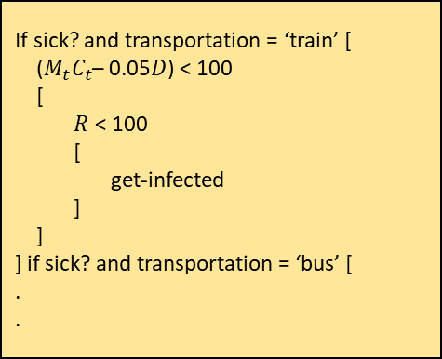
Check Status
If sick
If immune
If vaccinated
If sick-count > infectious period, become immune.
If sick-count < infectious period, stay sick
If vaccine-immune-count > immunity-period, become immune.
If vaccine-immune-count < immunity-period, stay vaccinated
If natural-immune-count > immunity-period, become susceptible
If natural-immune-count < immunity-period, stay immune
If susceptible
Infect
if sick-population > 0 and phase = ‘commute-hour’
if sick-population > 0 and phase = ‘work-hour’
If sick? and transportation = ‘train’ [
($M_{t}C_{t}$– 0.05$D$) < 100
[
$R$ < 100
[
get-infected
]
]
] if sick? and transportation = ‘bus’ [
.
.
If sick? and company = ‘apple’ [
($M_{a}C_{b}$– $0.05D$) < 100
[
$R$ < 100
[
get-infected
]
]
] if sick? and company = ‘tesla’ [
.
.
Move

Slide 3
Vaccinated
Susceptible
Recovered
Infected

Slide 4
2 hours
Commute-hour
12 hours
8 hours
Home-hour
Work-hour
2 hours
Commute-hour
1 hour = 1 tick
1 day = 24 ticks
1 year = 8760 ticks

Slide 5
Global Variables
home-when
workplace-when
commute-when
alarm-reset-when
contact_rate_bus
contact_rate_car
contact_rate_walk
contact_rate_tube
contact_rate_train
contact_rate_big_workplace
contact_rate_mid_workplace
contact_rate_small_workplace
infection_rate_ymask_ycardio
infection_rate_nmask_ncardio
infection_rate_ymask_ncardio
infection_rate_nmask_ycardio
cumulative_sick
cumulative_susceptible
cumulative_immune
cumulative_vaccinated
transportation_list
company_list
high_popular_company_list
mid_popular_company_list
low_popular_company_list
cardiovascular_disease_list
mask_list
phase
days
days-track
hour-counter
cumulative-hour-counter
Patch
Turtle
Turtle Variables
Patch Variables
sick?
immune?
susceptible?
vaccinated?
mask?
cardiovascular-disease?
sick-count
natural-immune-count
vaccination-immune-count
transportation
company
sick-population
total-population

