Slide 1
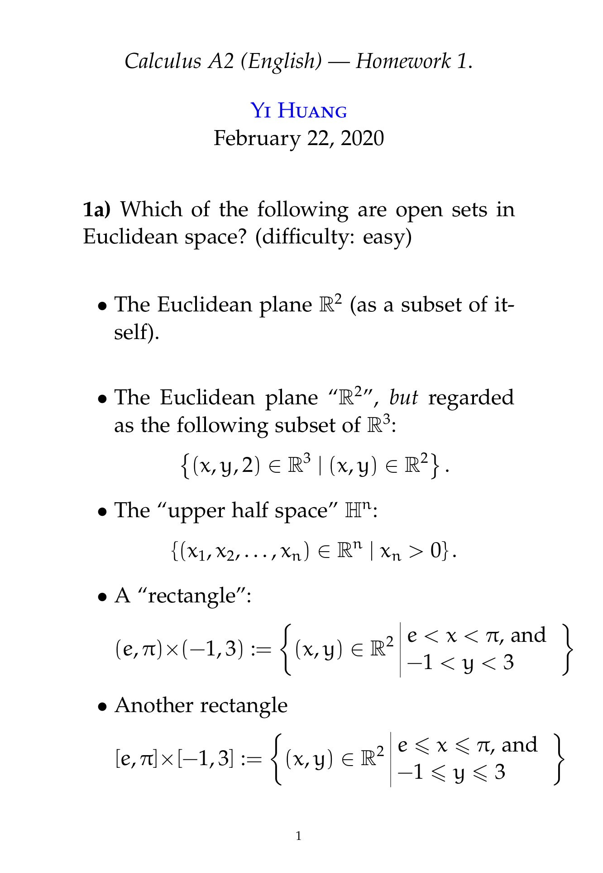

Multiple Choice(multiple)
Remark
Points: 1
Remark
A is open, given an arbitrary point, take any ball around it…it has to be a subset of R².
C is open, you can construct open balls around (x₁,…,x_{n}) of radius less than x_{n}.
D is open, and the argument for this is more-or-less the same as for question 3i.
A
B
C
D
E
Submit
Text\Image\Formula are allowed and all the content should be placed in this area

Slide 2
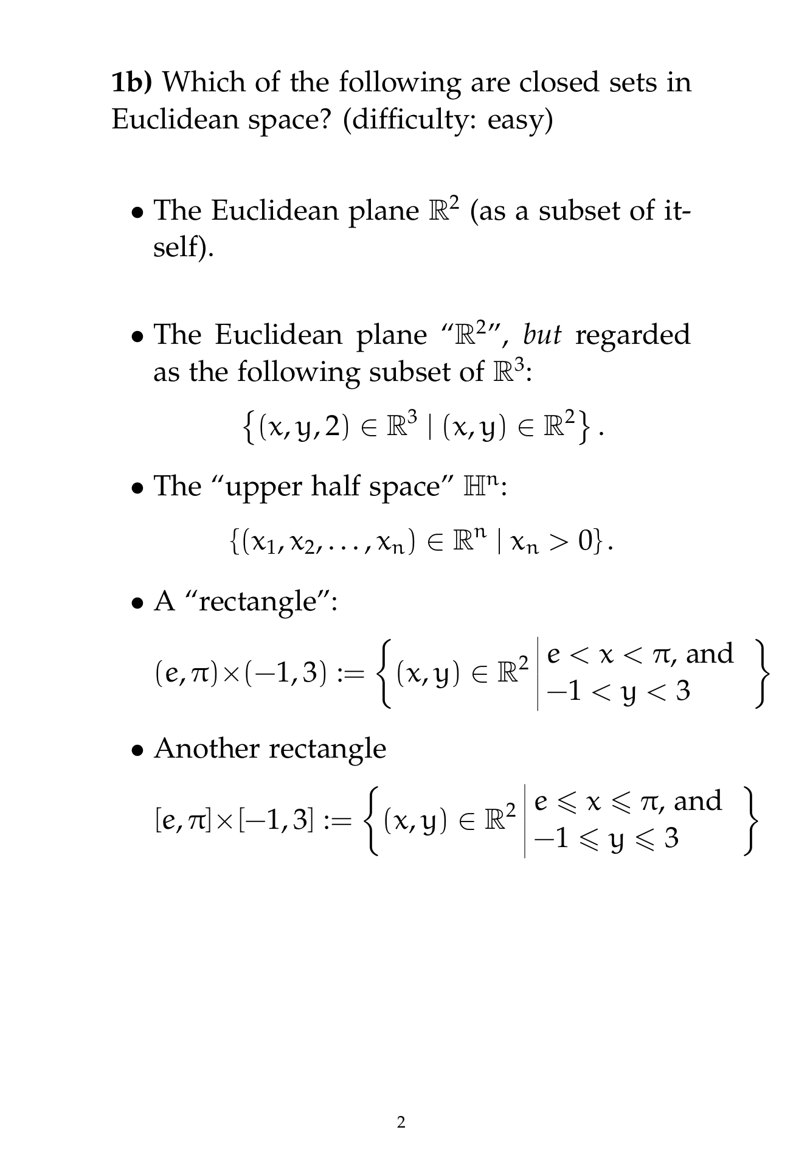
Multiple Choice(multiple)
Remark
Points: 1
Remark
A R² is closed because its complement, the empty set, is trivially open.
B this is also closed. In fact, its complement consists of two sets which are more-or-less just rotations of the upper half space for n=3.
E this is closed. It is fairly straight-forward to show that it has to contain all of its adherent points if one uses Lemma 2.5 from class. Then, Theorem 2.7 ensures that it is closed.
A
B
C
D
E
Submit
Text\Image\Formula are allowed and all the content should be placed in this area

Slide 3
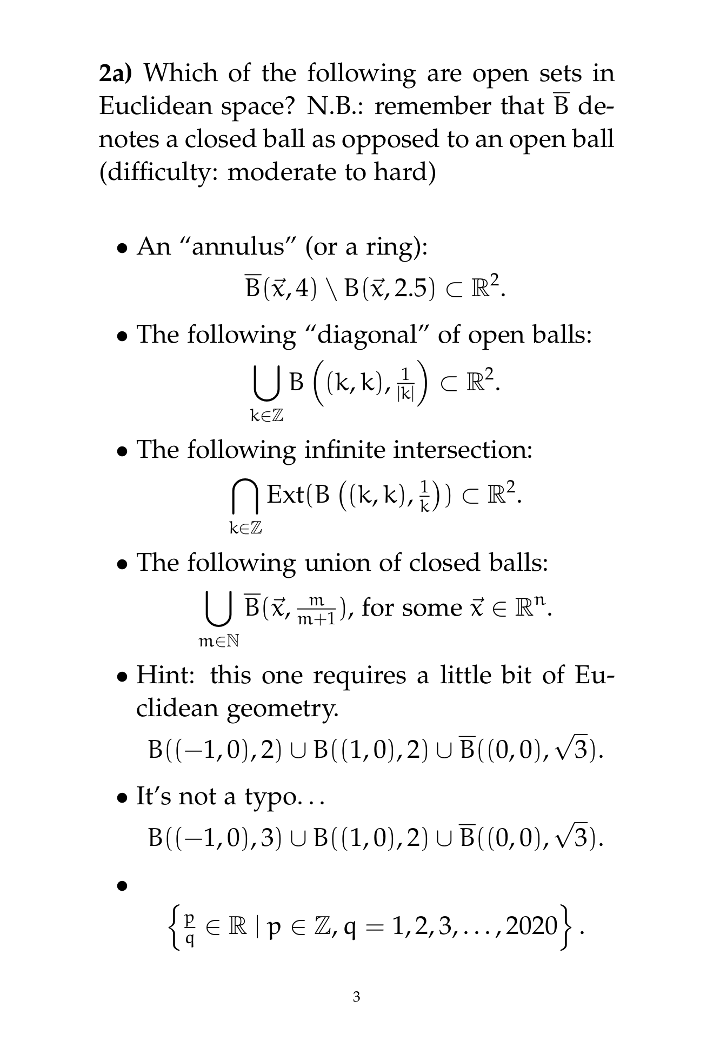
Multiple Choice(multiple)
Remark
Points: 1
Remark
B is open because it is the union of open balls.
C is open despite being an infinite intersection of open sets.
D is open despite being an infinite union of closed sets.
F is open because the closed ball is a subset of the union of the two open balls.
A
B
C
D
E
F
G
Submit
Text\Image\Formula are allowed and all the content should be placed in this area

Slide 4
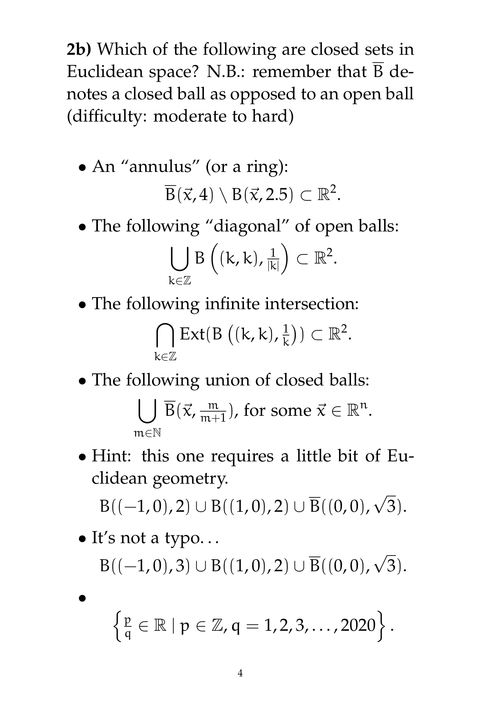
Multiple Choice(multiple)
Remark
Points: 1
Remark
A is closed, in fact generally speaking, if you remove an open set from a closed set you always get a closed set. And if you remove a closed set from an open set you always get an open set.
E is neither open nor close. It is “almost” open, but fails to be because it contains two very special boundary points (0,2) and (0,-2).
G is closed. In fact, it is a finite collection of points on every bounded subset of the real numbers.
A
B
C
D
E
F
G
Submit
Text\Image\Formula are allowed and all the content should be placed in this area

Slide 5
Open Question
Points: 10
The rest of the questions are computation/proof type questions and you will need to write up actual answers to submit either via this page (as images) or to my email
yihuangmath@tsinghua.edu.cn
or possibly through wechat.
Please try to set up Zoom/wechat groups with each other to discuss these questions in your randomly allocated small groups if you can!
Open Question is only supported on Version 2.0 or newer.
Answer

Slide 6
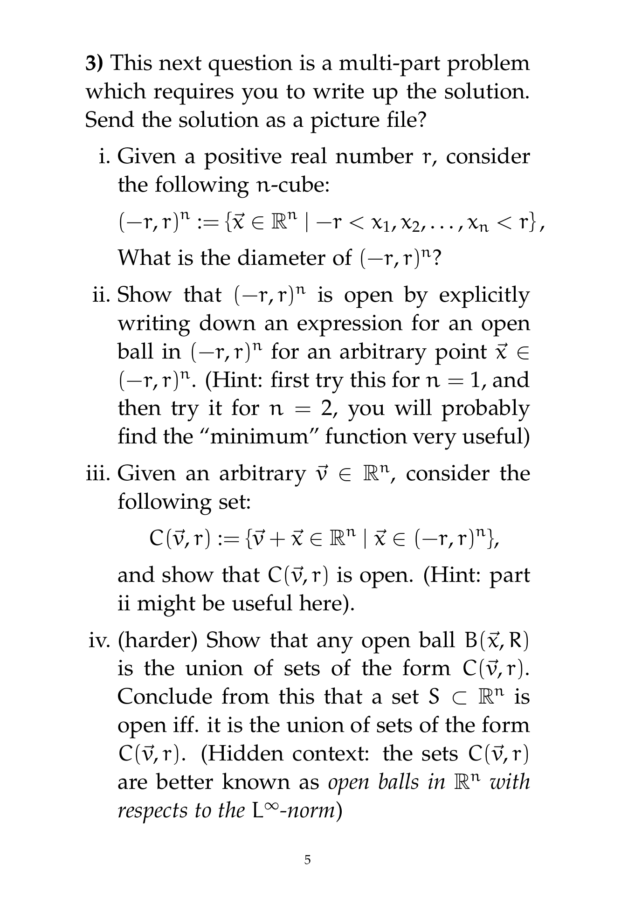

Slide 7
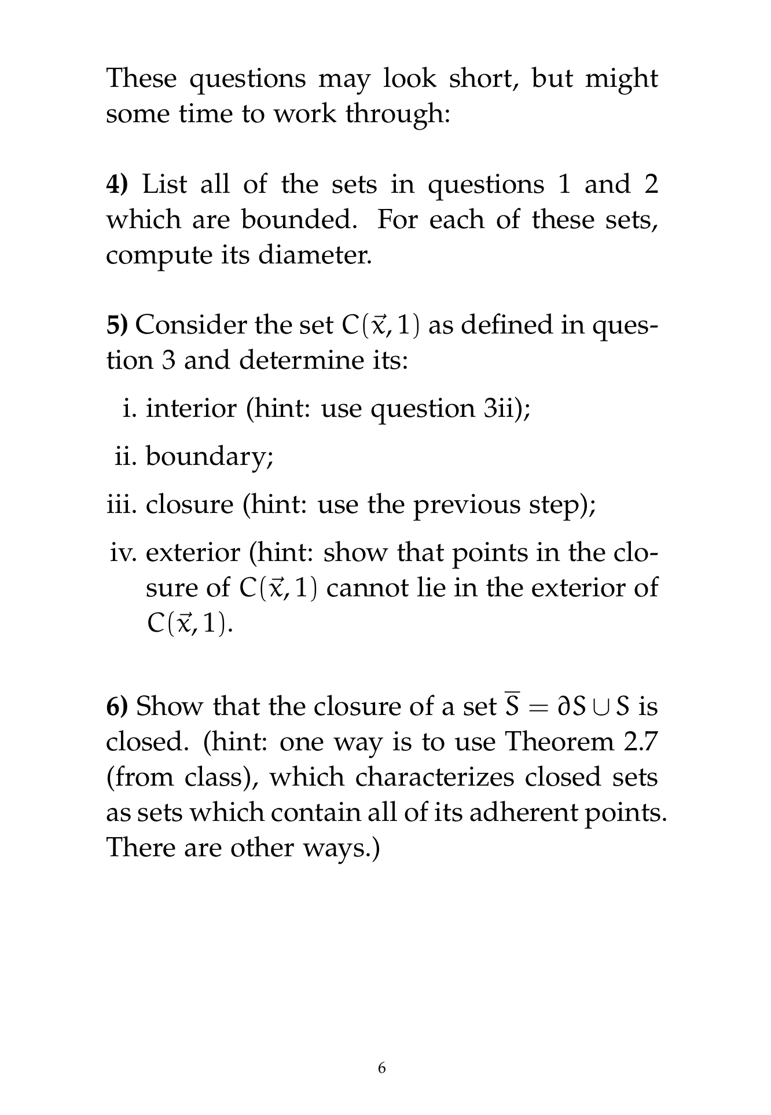

Slide 8
