Slide 1

Speaker-Targeted Speech Recognition
Han-Yun Yeh, Haopeng Gao

Slide 2
Introduction
Current ASR has competitive performance in clean environments (WER <5%)
For multi-speaker ASR, there is still a long way to go
Speech separation BEFORE recognition
deep clustering, non-negative matrix factorization,…
Our approach focus on targeting the speaker WHILE recognition
Appending robust speaker embedding to acoustic feature vector
Notes:
cocktail party problem is an example

Slide 3
Literature survey
Speech separation approach
computational auditory scene analysis
Non-negative matrix factorization
Graphical modeling
Spectral clustering
Deep clustering
Speaker embedding
I-vector (GMM-UBM)
X-vector (DNN)
Notes:
Gaussian Mixture Model - Universal Background Model.

Slide 4
Baseline system
Environments:
ESPnet 0.10.4a1
Python 3.8.10 [GCC 9.4.0]
Pytorch 1.10.0+cu113
WSJ recipe, pre-trained model: kamo-naoyuki/wsj_transformer2
Dataset:
WSJ0/1 for baseline train/dev/eval (16kHz)
WSJ0-2mix for evaluation of overlapped speech (16kHz)
Generated from WSJ0, randomly mix speech utterances of 2 speakers
101 speakers in train/dev, 19 other speakers in eval sets
46, 11, 7 hours of train/dev/eval sets.

Slide 5
Baseline performance – Clean speech
WSJ dataset
WER:
CER:
 | Snt | Srd | Corr | Sub | Del | Ins | Err | S.Err
test_dev93 | 503 | 8234 | 94.6 | 4.7 | 0.7 | 0.8 | 6.1 | 50.9
test_eval92 | 333 | 5643 | 96.8 | 2.9 | 0.3 | 0.8 | 4 | 35.4
 | Snt | Srd | Corr | Sub | Del | Ins | Err | S.Err
test_dev93 | 503 | 48634 | 97.8 | 1 | 1.2 | 0.5 | 2.7 | 57.7
test_eval92 | 333 | 33341 | 98.7 | 0.6 | 0.7 | 0.4 | 1.7 | 44.1

Slide 6
Baseline performance – Overlapped speech
WSJ0-2mix dataset (still running)
WER:
Expect > 80% according to previous paper
CER:
Expect > 80%

Slide 7
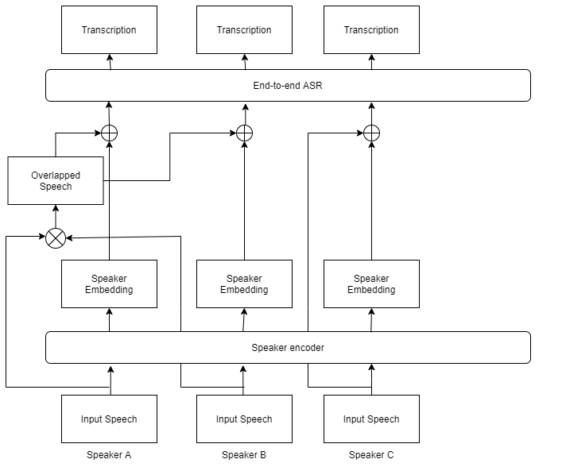
Proposed method (from previous work)
Training the end-to-end ASR by overlapped speech acoustic feature vector concatenating with speaker embedding

Slide 8
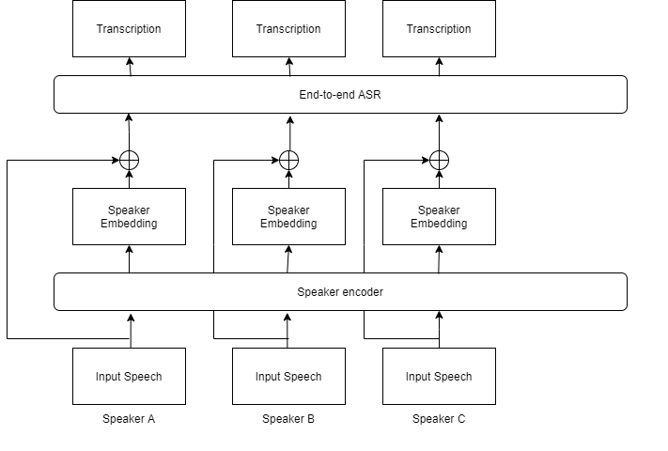
Proposed method
Training the end-to-end ASR by clean speech acoustic feature vector concatenating with speaker embedding

Slide 9
Proposed method
Enhance speaker embedding with denoising autoencoder (DAE) to adapt with noisy environment.
(Assume that the overlapped speech is a noisy signals)

Slide 10
Reference
Dehak, Najim, et al. "Front-end factor analysis for speaker verification." IEEE Transactions on Audio, Speech, and Language Processing 19.4 (2010): 788-798.
Snyder, David, et al. "X-vectors: Robust dnn embeddings for speaker recognition." 2018 IEEE International Conference on Acoustics, Speech and Signal Processing (ICASSP). IEEE, 2018.
Alam, Md Jahangir, et al. "Speech recognition in reverberant and noisy environments employing multiple feature extractors and i-vector speaker adaptation." EURASIP Journal on Advances in Signal Processing 2015.1 (2015): 1-13.
Garimella, Sri, et al. "Robust i-vector based adaptation of DNN acoustic model for speech recognition." Sixteenth Annual Conference of the International Speech Communication Associa
Chuang, Fu-Kai, et al. "Speaker-Aware Deep Denoising Autoencoder with Embedded Speaker Identity for Speech Enhancement." Interspeech. 2019.tion. 2015.
Denisov, Pavel, and Ngoc Thang Vu. "End-to-end multi-speaker speech recognition using speaker embeddings and transfer learning." arXiv preprint arXiv:1908.04737 (2019).

Slide 11
Wang, DeLiang, and Guy J. Brown. Computational auditory scene analysis: Principles, algorithms, and applications. Wiley-IEEE press, 2006.
Schmidt, Mikkel N., and Rasmus Kongsgaard Olsson. "Single-channel speech separation using sparse non-negative matrix factorization." Interspeech. Vol. 2. 2006.
Hershey, John R., et al. "Super-human multi-talker speech recognition: A graphical modeling approach." Computer Speech & Language 24.1 (2010): 45-66.
Hershey, John R., et al. "Deep clustering: Discriminative embeddings for segmentation and separation." 2016 IEEE International Conference on Acoustics, Speech and Signal Processing (ICASSP). IEEE, 2016.

Slide 12
Thanks

