Slide 1
One-dimensional Electromagnetic Particle Code
Yoshiharu Omura
RISH, Kyoto University
omura@rish.kyoto-u.ac.jp

Slide 2
TERRAPUB e-Library
http://www.terrapub.co.jp/e-library/
Computer Space Plasma Physics:
Simulation Technique and Software
Edited by H. Matsumoto and Y. Omura
Advanced Methods for Space Simulations
Edited by H. Usui and Y. Omura
Computer Simulation of Space Plasmas
Edited by H. Matsumoto and T. Sato

Slide 3
Classification of Simulation Codes
Fluid code (MHD, Multi-fluid)
B(X, t), V(X, t), ρ(X, t) : Eulerian variables
Particle code
x(t), v(t): Lagrangian variables
E(x, t), B(x, t), J(x, t) : Eulerian variables
Hybrid code
(typically) Ions: particles, Electrons: fluid
(ex) Hot electrons: particles, Cold electrons: fluid
Vlasov code
f(X, V, t) : Particle distribution function
E(x, t), B(x, t), J(x, t) : Eulerian variables

Slide 4
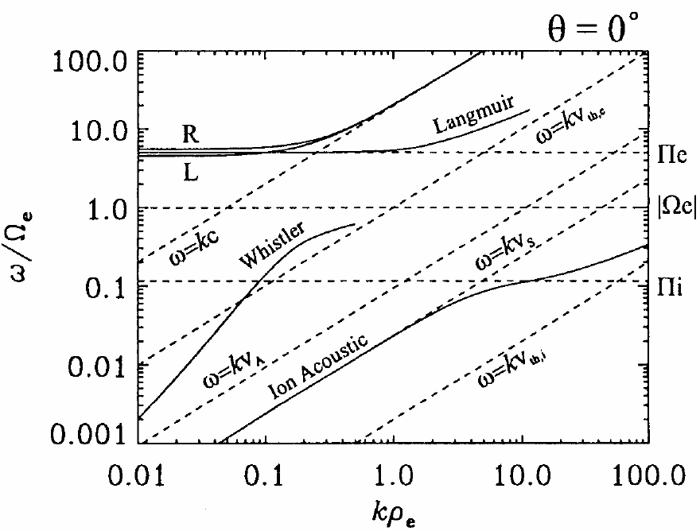
Waves in Plasmas (Parallel Propagation)

Slide 5
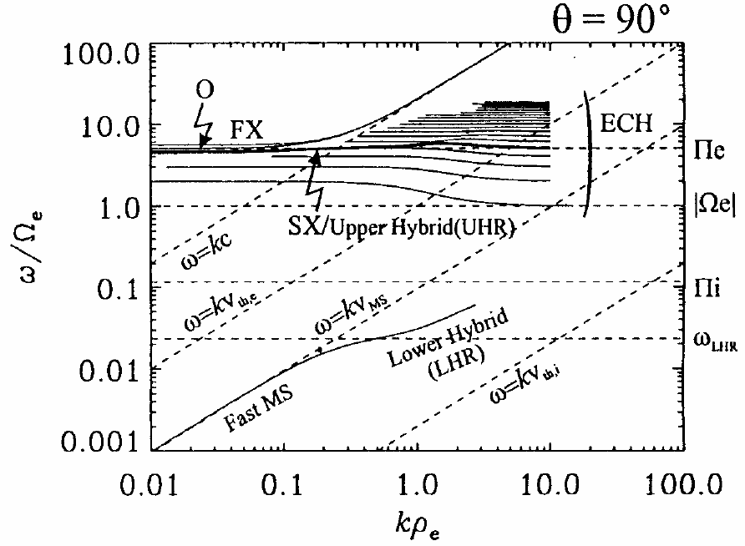
Waves in Plasmas (Perpendicular Propagation)

Slide 6



PIC code for Space Plasmas
Space Plasmas: Collisionless
Particle-In-Cell Code
Particles: x(t), v(t)
Fields: E(t, X), B(t, X)
E and B are defined on grid points, and calculated from ρand Ｊ. The electrostatic force between two particles in the same cell disappears.

Slide 7
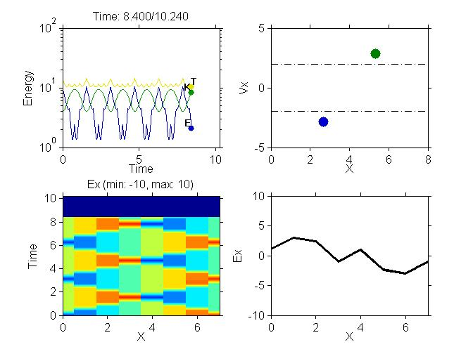
KEMPO1

Slide 8
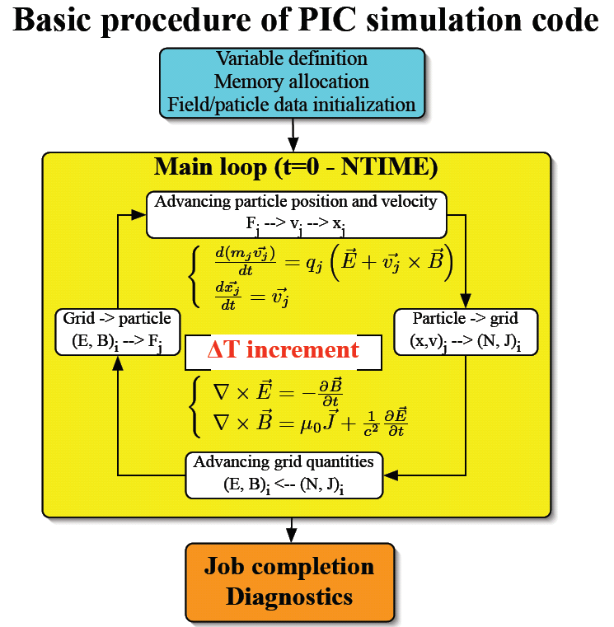
Δt increment

Slide 9
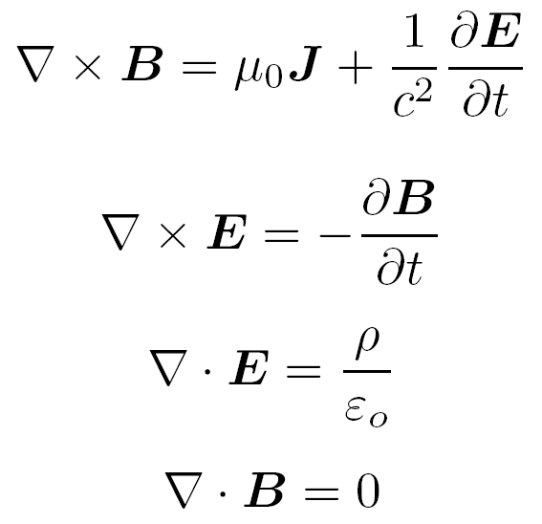
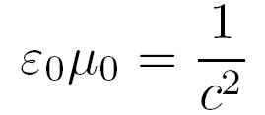
Maxwell’s Equations
where

Slide 10























Grid Assignment
i-1/2
i
i+1/2
i+1

Slide 11
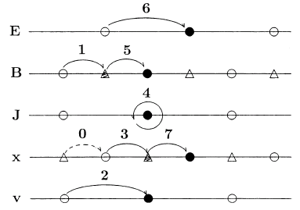
Time Step Chart

Slide 12
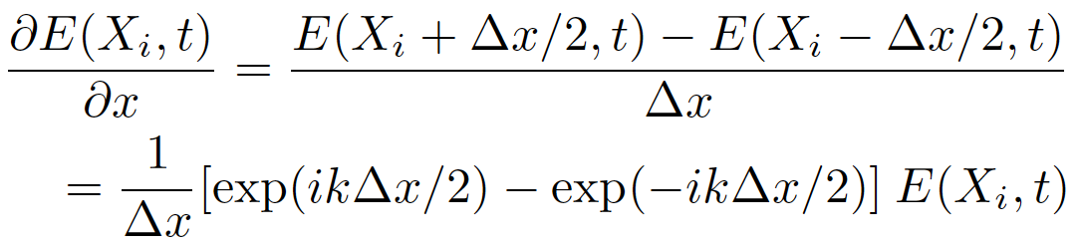
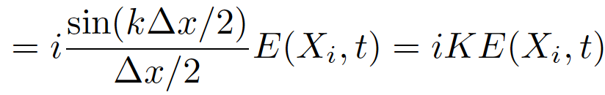
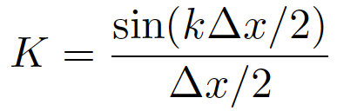
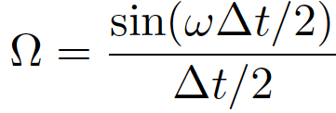
Centered Difference Scheme

Slide 13


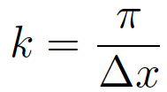
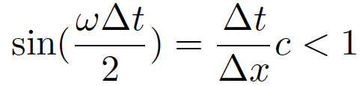
Courant Condition
Electromagnetic modes in vacuum
Centered Difference Scheme in space and time
For
we have
Courant Condition

Slide 14
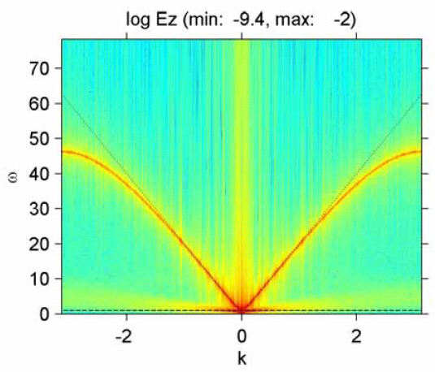


Dispersion Relation of Light Mode

Slide 15
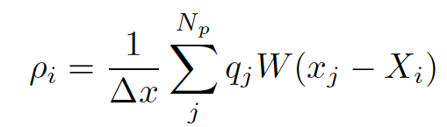
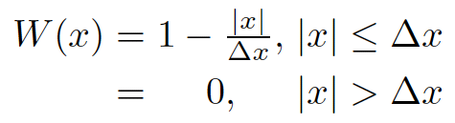
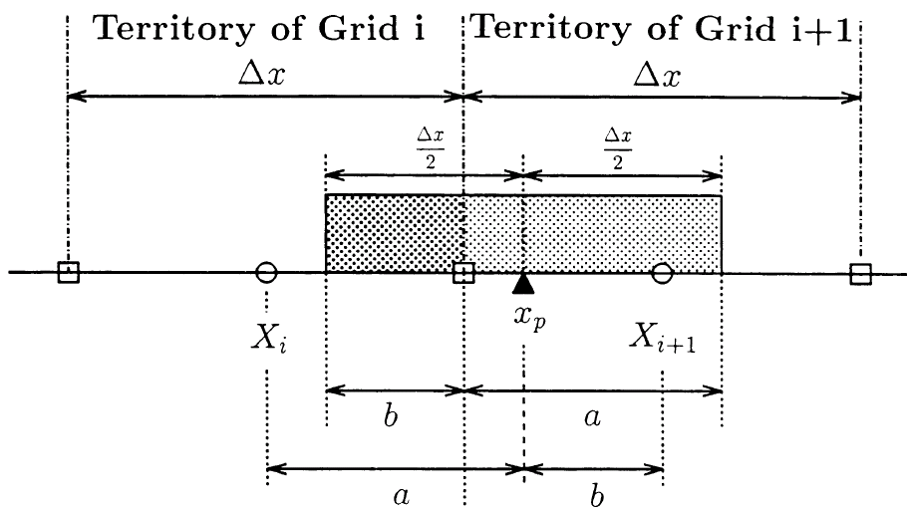


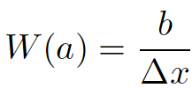

Charge Density
Shape Function
Np: Number of Particles

Slide 16
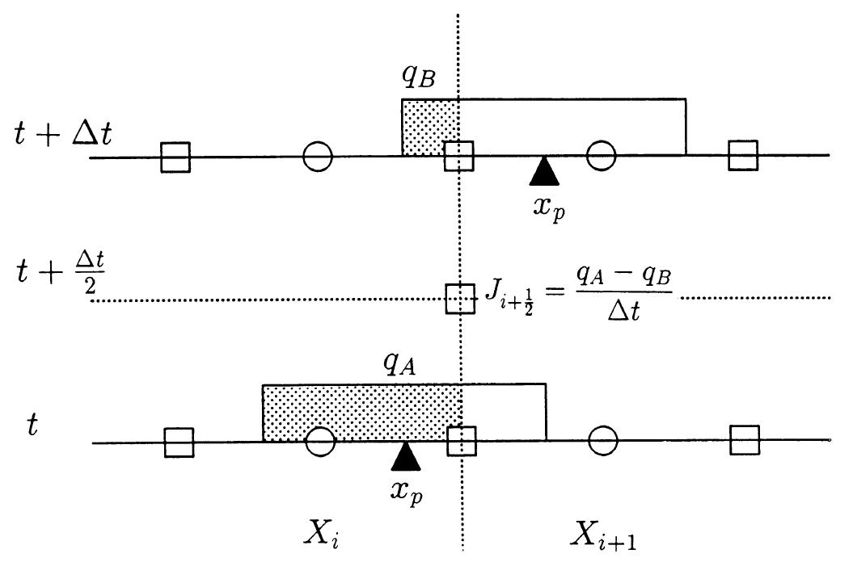

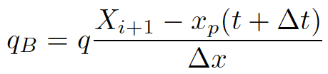
Current Density J_{x}: Case 1

Slide 17
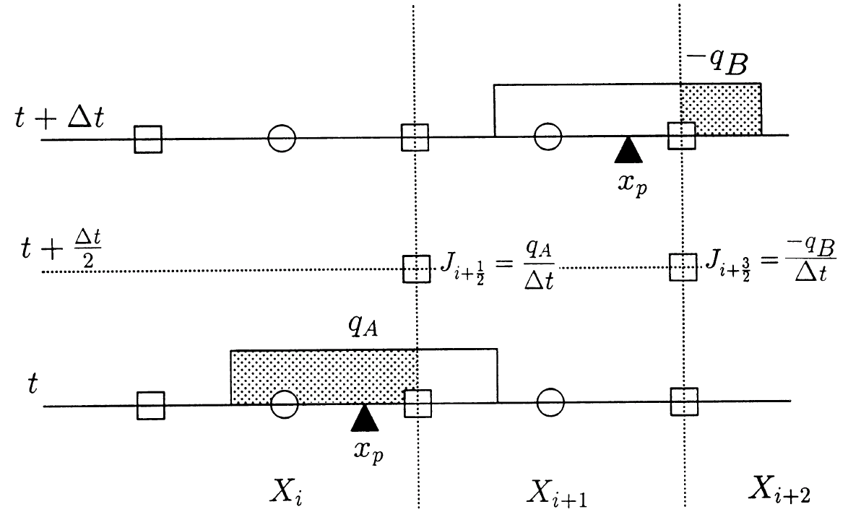
Current Density J_{x}: Case 2

Slide 18
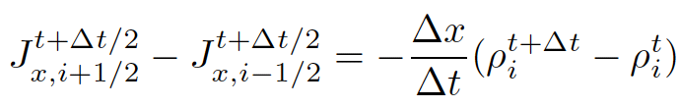

Program for Current Density Computation
for m = (n1+1):n2
%-- charge conservation method --
qhs = qh * sign(vx(m));
avx = abs(vx(m));
x1 = x(m) + 2.0 -avx;
x2 = x(m) + 2.0 +avx;
i1 = floor(x1);
i2 = floor(x2);
ajx(i1) = ajx(i1) + (i2 - x1)*qhs;
ajx(i2) = ajx(i2) + (x2 - i2)*qhs;
end
Only valid for particles satisfying
which is automatically satisfied in the relativistic code.

Slide 19
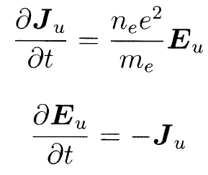
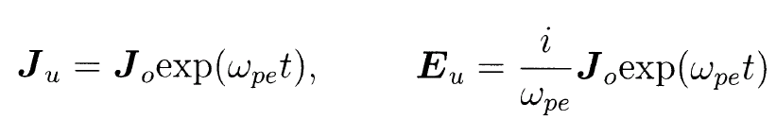
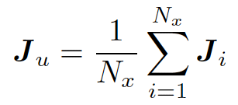

Cancellation of Uniform Current
The uniform component must be subtracted.

Slide 20
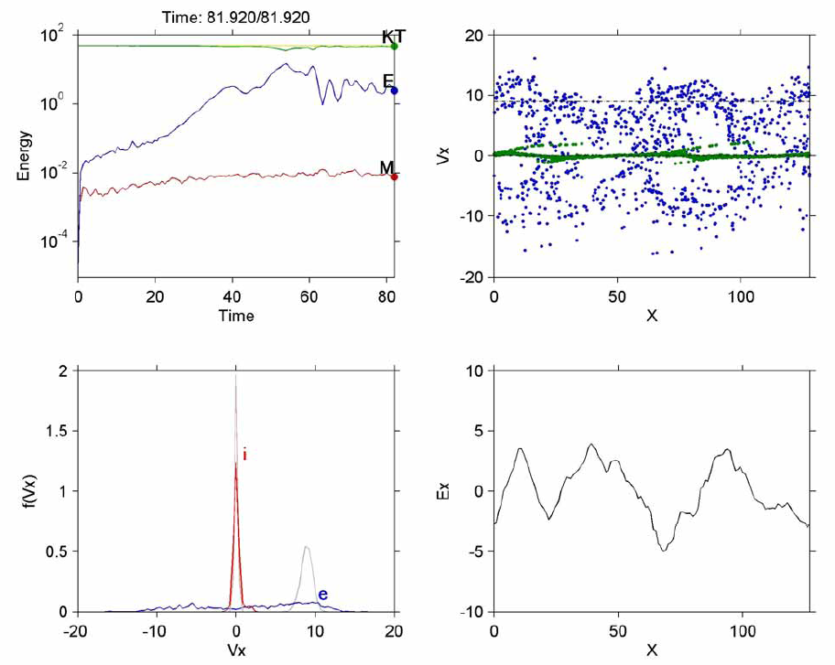
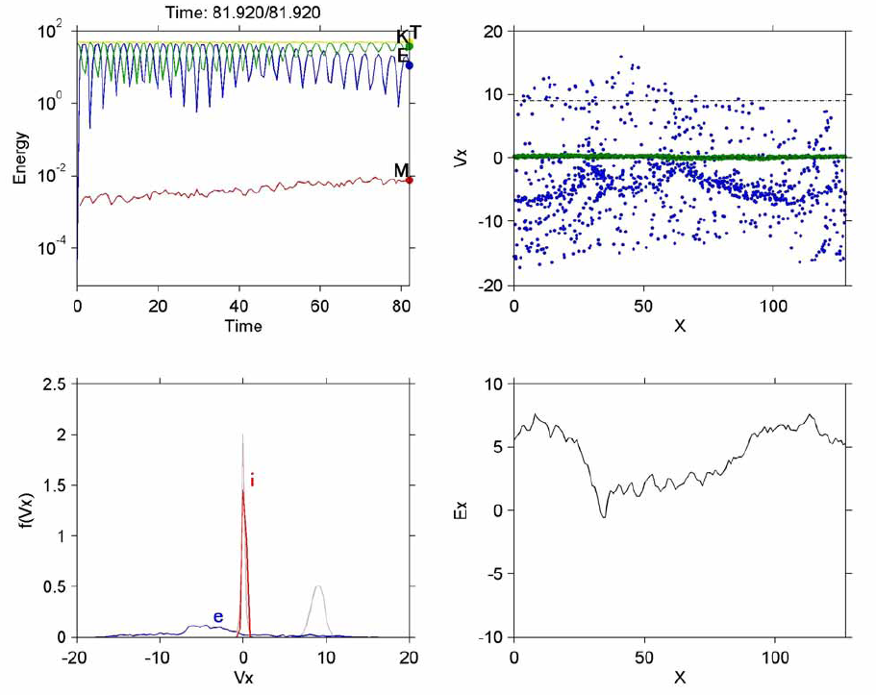
KEMPO1
Without Uniform Current
With Uniform Current
Notes:
Set AJAMP to a nonzero value in Buneman inst.

Slide 21
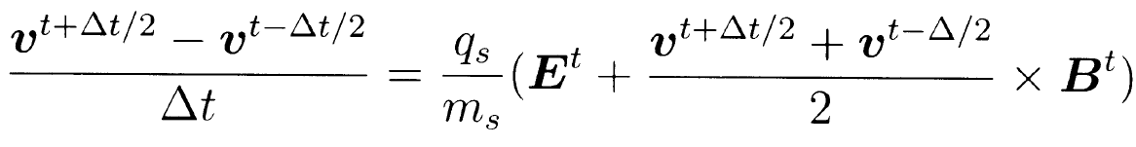
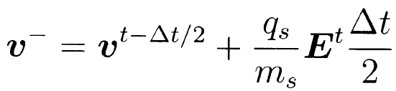
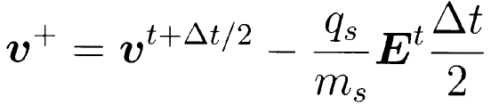
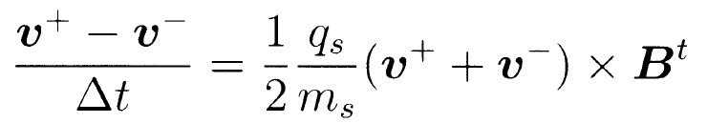
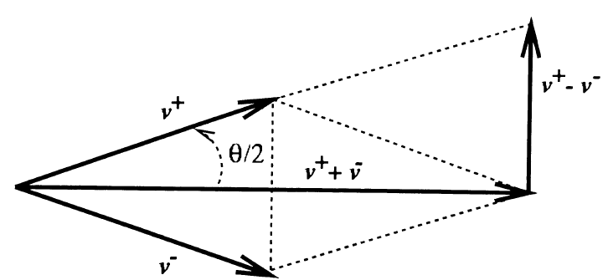

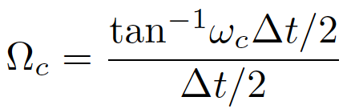
Buneman-Boris Method
Kinetic Energy Conservation
Small Phase Delay

Slide 22


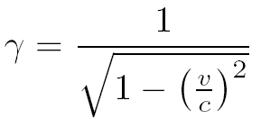
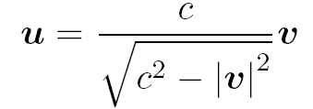
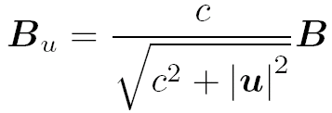

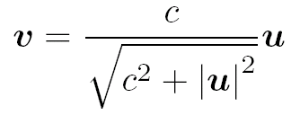
Relativistic Equation of Motion

Slide 23
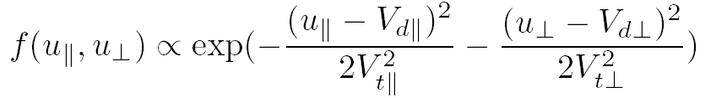
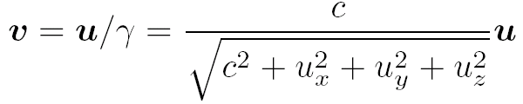



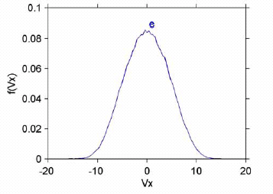
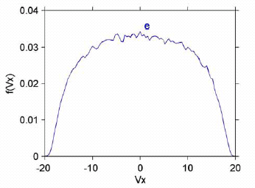
Initial Velocity Distribution Function

Slide 24
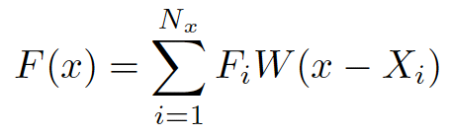
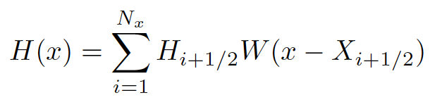
Field Interpolation to Particle Position
H(x)
Linear Interpolation
F(x)
i-1/2
i
i+1/2
i+1

Slide 25
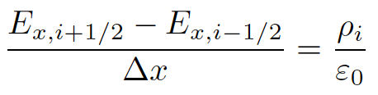
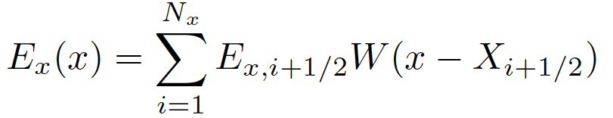
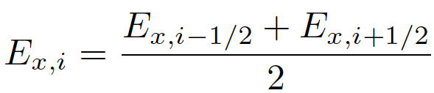
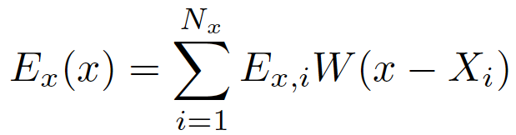
Electrostatic Self-force Cancellation
Self-force
Relocation
No Self-force

Slide 26

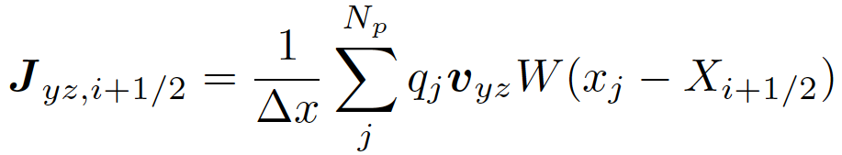
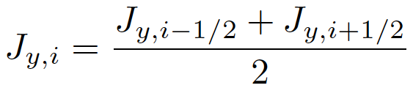
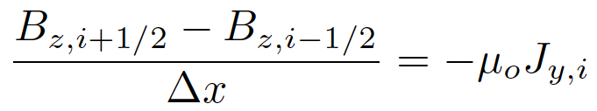


Magnetostatic Self-force Cancellation
Magnetostatic equation (Ampere’s Law)
Source Relocation
Field Relocation

Slide 27





Relative Unit System
We assume in KEMPO1
Reference Values for Space and Time
Speed of light: c
Characteristic frequency: ω max (ω_{ｐ} , ω_{ｃ} )
We choose Δｔ so that
We choose Δｔ so that

Slide 28




Charge Neutrality Condition
Number Density
Nx: Number of Grid Points
Particle Charge
is an arbitrary value.
For simplicity, -1 for electrons.
0.01, 0.001 or 1/1836 for protons.

Slide 29






Enhanced Thermal Fluctuation
Electrostatic Field Energy Density
Thermal Energy Density
Normalized Thermal Fluctuation

Slide 30







Debye Length / Grid Spacing
Density Perturbation with a small potential
Inserting into Poisson’s Equation,
Fourier transformation
Replacing k with K

Slide 31

GUI for Input Parameters

Slide 32

Renormalization
Simulation Unit System
Relative Unit System

Slide 33

Normal Modes in the Parallel Direction

Slide 34

Normal Modes in the Perpendicular Direction

Slide 35

Whistler Mode Wave Radiation

Slide 36

Circularly Polarized Wave

Slide 37

Electron Two-stream Instability

Slide 38

Electrostatic Solitary Waves

Slide 39


Electrostatic and Whistler Instabilities

Slide 40


Electrostatic Cyclotron Wave Instability

Slide 41


KEMPO1
Kyoto university ElectroMagnetic Particle cOde: 1D
Let’s have exercises!

