Slide 1
Dynamic Programming (DP)
Like divide-and-conquer, solve problem by combining the solutions to sub-problems.
Differences between divide-and-conquer and DP:
  Independent sub-problems, solve sub-problems independently and recursively, (so same sub(sub)problems solved repeatedly)
  Sub-problems are dependent, i.e., sub-problems share sub-sub-problems, every sub(sub)problem solved just once, solutions to sub(sub)problems are stored in a table and used for solving higher level sub-problems.

Slide 2
Application domain of DP
Optimization problem: find a solution with optimal (maximum or minimum) value.
An optimal solution, not the optimal solution, since may more than one optimal solution, any one is OK.

Slide 3
Typical steps of DP
Characterize the structure of an optimal solution.
Recursively define the value of an optimal solution.
Compute the value of an optimal solution in a bottom-up fashion.
Compute an optimal solution from computed/stored information.

Slide 4
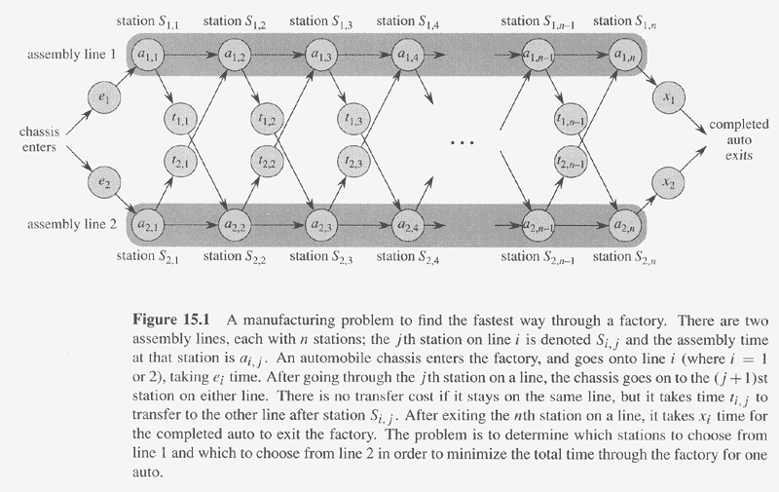
DP Example – Assembly Line Scheduling (ALS)

Slide 5
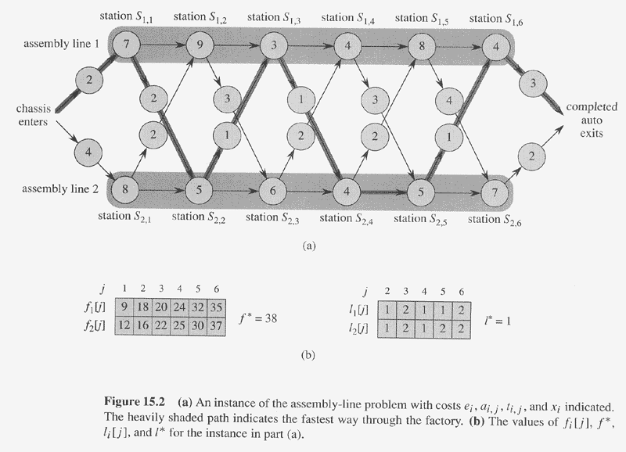
Concrete Instance of ALS

Slide 6
Brute Force Solution
  List all possible sequences,
  For each sequence of n stations, compute the passing time. (the computation takes Θ(n) time.)
  Record the sequence with smaller passing time.
  However, there are total 2^{n} possible sequences.

Slide 7
ALS --DP steps: Step 1
Step 1: find the structure of the fastest way through factory
  Consider the fastest way from starting point through station S_{1,j} (same for S_{2,j})
    j=1, only one possibility
    j=2,3,…,n, two possibilities: from S_{1,j-1} or S_{2,j-1}
      from S_{1,j-1}, additional time a_{1,j}
      from S_{2,j-1}, additional time t_{2,j-1} + a_{1,j}
    suppose the fastest way through S_{1,j} is through S_{1,j-1}, then the chassis must have taken a fastest way from starting point through S_{1,j-1}. Why???
    Similarly for S_{2,j-1}.

Slide 8
DP step 1: Find Optimal Structure
An optimal solution to a problem contains within it an optimal solution to subproblems.
the fastest way through station S_{i,j} contains within it the fastest way through station S_{1,j-1} or S_{2,j-1 .}
Thus can construct an optimal solution to a problem from the optimal solutions to subproblems.

Slide 9
ALS --DP steps: Step 2
Step 2: A recursive solution
Let f_{i}[j] (i=1,2 and j=1,2,…, n) denote the fastest possible time to get a chassis from starting point through S_{i,j}.
Let f* denote the fastest time for a chassis all the way through the factory. Then
f* = min(f₁[n] +x₁, f₂[n] +x₂)
f₁[1]=e₁+a_{1,1}, fastest time to get through S_{1,1}
f₁[j]=min(f₁[j-1]+a_{1,j}, f₂[j-1]+ t_{2,j-1}+ a_{1,j})
Similarly to f₂[j].

Slide 10
ALS --DP steps: Step 2
Recursive solution:
  f* = min(f₁[n] +x₁, f₂[n] +x₂)
  f₁[j]= e₁+a1,1 if j=1
  min(f₁[j-1]+a_{1,j}, f₂[j-1]+ t_{2,j-1}+ a_{1,j}) _{if j>1}
  f₂[j]= e₂+a2,1 if j=1
  min(f₂[j-1]+a_{2,j}, f₁[j-1]+ t_{1,j-1}+ a_{2,j}) _{if j>1}
f_{i}[j] (i=1,2; j=1,2,…,n) records optimal values to the subproblems.
To keep the track of the fastest way, introduce l_{i}[j] to record the line number (1 or 2), whose station j-1 is used in a fastest way through S_{i,j}.
Introduce l* to be the line whose station n is used in a fastest way through the factory.

Slide 11
ALS --DP steps: Step 3
Step 3: Computing the fastest time
  One option: a recursive algorithm.
    Let r_{i}(j) be the number of references made to f_{i}[j]
      r₁(n) = r₂(n) = 1
      r₁(j) = r₂(j) = r₁(j+1)+ r₂(j+1)
      r_{i} (j) = 2^{n-j}.
      So f₁[1] is referred to 2^{n-1} times.
      Total references to all f_{i}[j] is Θ(2^{n}).
    Thus, the running time is exponential.
  Non-recursive algorithm.

Slide 12
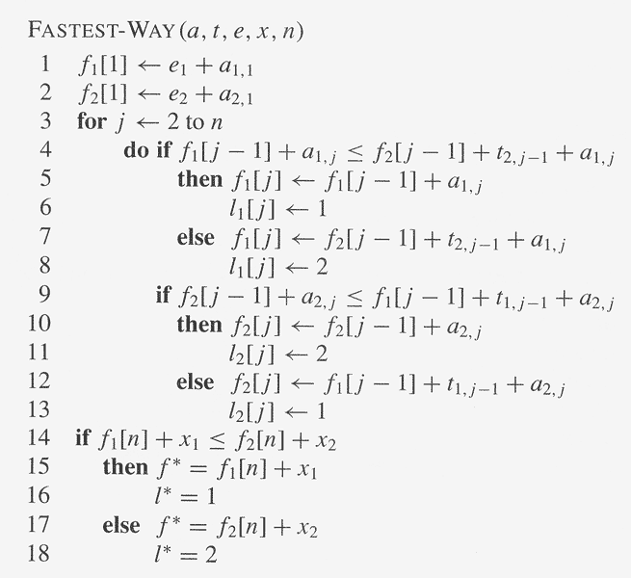
ALS FAST-WAY algorithm
Running time: O(n).

Slide 13
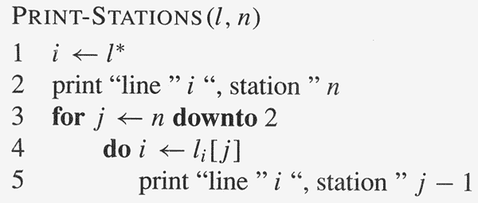
ALS --DP steps: Step 4
Step 4: Construct the fastest way through the factory

Slide 14
Matrix-chain multiplication (MCM) -DP
Problem: given <A₁, A₂, …,A_{n}>, compute the product: A₁×A₂×…×A_{n} , find the fastest way (i.e., minimum number of multiplications) to compute it.
Suppose two matrices A(p,q) and B(q,r), compute their product C(p,r) in p × q × r multiplications
  for i=1 to p for j=1 to r C[i,j]=0
  for i=1 to p
    for j=1 to r
      for k=1 to q C[i,j] = C[i,j]+ A[i,k]B[k,j]

Slide 15
Matrix-chain multiplication -DP
Different parenthesizations will have different number of multiplications for product of multiple matrices
Example: A(10,100), B(100,5), C(5,50)
  If ((A ×B) ×C), 10 ×100 ×5 +10 ×5 ×50 =7500
  If (A ×(B ×C)), 10 ×100 ×50+100 ×5 ×50=75000
The first way is ten times faster than the second !!!
Denote <A₁, A₂, …,A_{n}> by < p₀,p₁,p₂,…,p_{n}>
  i.e, A₁(p₀,p₁), A₂(p₁,p₂), …, A_{i}(p_{i-1},p_{i}),… A_{n}(p_{n-1},p_{n})

Slide 16
Matrix-chain multiplication –MCM DP
Intuitive brute-force solution: Counting the number of parenthesizations by exhaustively checking all possible parenthesizations.
Let P(n) denote the number of alternative parenthesizations of a sequence of n matrices:
  P(n) = 1 if n=1
  ∑_{k=1}^{n-1} P(k)P(n-k) if n≥2
The solution to the recursion is Ω(2^{n}).
So brute-force will not work.

Slide 17
MCP DP Steps
Step 1: structure of an optimal parenthesization
  Let A_{i..j} (i≤j) denote the matrix resulting from A_{i}×A_{i+1}×…×A_{j}
  Any parenthesization of A_{i}×A_{i+1}×…×A_{j} must split the product between A_{k} and A_{k+1} for some k, (i≤k<j). The cost = # of computing A_{i..k} + # of computing A_{k+1..j} + # A_{i..k} × A_{k+1..j.}
  If k is the position for an optimal parenthesization, the parenthesization of “prefix” subchain A_{i}×A_{i+1}×…×A_{k} within this optimal parenthesization of A_{i}×A_{i+1}×…×A_{j} must be an optimal parenthesization of A_{i}×A_{i+1}×…×A_{k.}
  A_{i}×A_{i+1}×…×A_{k} × A_{k+1}×…×A_{j}

Slide 18
MCP DP Steps
Step 2: a recursive relation
  Let m[i,j] be the minimum number of multiplications for A_{i}×A_{i+1}×…×A_{j}
  m[1,n] will be the answer
  m[i,j] = 0 if i = j
  min {m[i,k] + m[k+1,j] +p_{i-1}p_{k}p_{j} } if i<j
i≤k<j

Slide 19
MCM DP Steps
Step 3, Computing the optimal cost
  If by recursive algorithm, exponential time Ω(2^{n}) (ref. to P.346 for the proof.), no better than brute-force.
  Total number of subproblems: +n = Θ(n²)
  Recursive algorithm will encounter the same subproblem many times.
  If tabling the answers for subproblems, each subproblem is only solved once.
  The second hallmark of DP: overlapping subproblems and solve every subproblem just once.
2
( )
n

Slide 20
MCM DP Steps
Step 3, Algorithm,
  array m[1..n,1..n], with m[i,j] records the optimal cost for A_{i}×A_{i+1}×…×A_{j .}
  array s[1..n,1..n], s[i,j] records index k which achieved the optimal cost when computing m[i,j].
  Suppose the input to the algorithm is p=< p₀ , p₁ ,…, p_{n} >.

Slide 21
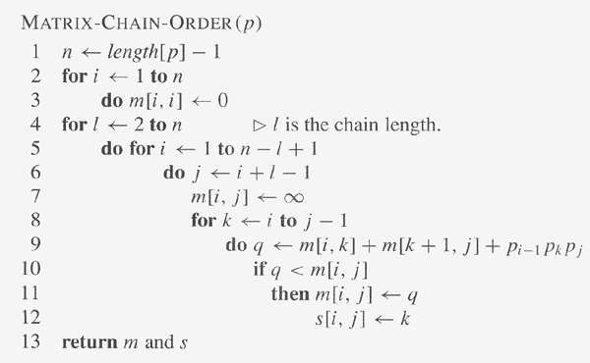
MCM DP Steps

Slide 22
MCM DP—order of matrix computations
m(1,1) m(1,2) m(1,3) m(1,4) m(1,5) m(1,6)
m(2,2) m(2,3) m(2,4) m(2,5) m(2,6)
m(3,3) m(3,4) m(3,5) m(3,6)
m(4,4) m(4,5) m(4,6)
m(5,5) m(5,6)
m(6,6)

Slide 23
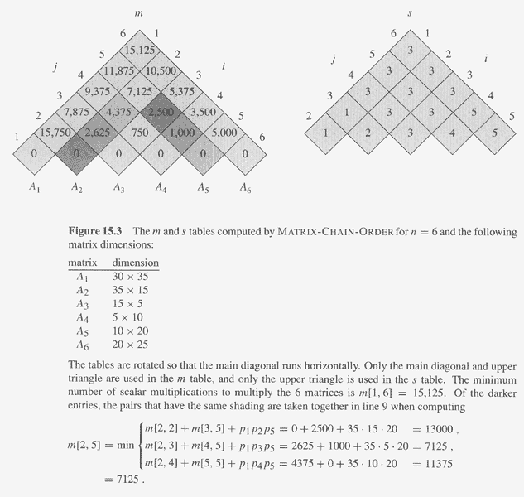
MCM DP Example

Slide 24
MCM DP Steps
Step 4, constructing a parenthesization order for the optimal solution.
  Since s[1..n,1..n] is computed, and s[i,j] is the split position for A_{i}A_{i+1}…A_{j} , i.e, A_{i}…A_{s[i,j]} and A_{s[i,j] +1}…A_{j} , thus, the parenthesization order can be obtained from s[1..n,1..n] recursively, beginning from s[1,n].

Slide 25
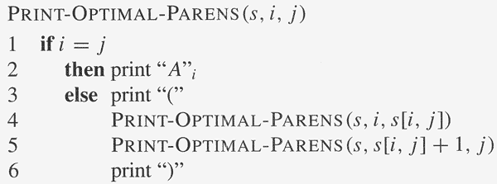
MCM DP Steps
Step 4, algorithm

Slide 26
Elements of DP
Optimal (sub)structure
  An optimal solution to the problem contains within it optimal solutions to subproblems.
Overlapping subproblems
  The space of subproblems is “small” in that a recursive algorithm for the problem solves the same subproblems over and over. Total number of distinct subproblems is typically polynomial in input size.
(Reconstruction an optimal solution)

Slide 27
Finding Optimal substructures
Show a solution to the problem consists of making a choice, which results in one or more subproblems to be solved.
Suppose you are given a choice leading to an optimal solution.
  Determine which subproblems follows and how to characterize the resulting space of subproblems.
Show the solution to the subproblems used within the optimal solution to the problem must themselves be optimal by cut-and-paste technique.

Slide 28
Characterize Subproblem Space
Try to keep the space as simple as possible.
In assembly-line schedule, S_{1,j} and S_{2,j} is good for subproblem space, no need for other more general space
In matrix-chain multiplication, subproblem space A₁A₂…A_{j} will not work. Instead, A_{i}A_{i+1}…A_{j} (vary at both ends) works.

Slide 29
A Recursive Algorithm for Matrix-Chain Multiplication
RECURSIVE-MATRIX-CHAIN(p,i,j) (called with(p,1,n))
if i=j then return 0
m[i,j]←∞
for k←i to j-1
do q← RECURSIVE-MATRIX-CHAIN(p,i,k)+ RECURSIVE-MATRIX-CHAIN(p,k+1,j)+p_{i-1}p_{k}p_{j}
if q< m[i,j] then m[i,j] ←q
return m[i,j]
The running time of the algorithm is O(2^{n}). Ref. to page 346 for proof.

Slide 30
Recursion tree for the computation of RECURSIVE-MATRIX-CHAIN(p,1,4)
1..4
1..1
2..4
1..2
3..4
1..3
4..4
2..2
3..4
2..3
4..4
1..1
2..2
3..3
4..4
1..1
2..3
1..2
3..3
3..3
4..4
2..2
3..3
2..2
3..3
1..1
2..2
This divide-and-conquer recursive algorithm solves the overlapping problems over and over.
In contrast, DP solves the same (overlapping) subproblems only once (at the first time),
then store the result in a table, when the same subproblem is encountered later, just look up
the table to get the result.
The computations in green color are replaced by table loop up in MEMOIZED-MATRIX-CHAIN(p,1,4)
The divide-and-conquer is better for the problem which generates brand-new problems at
each step of recursion.

Slide 31
Optimal Substructure Varies in Two Ways
How many subproblems
  In assembly-line schedule, one subproblem
  In matrix-chain multiplication: two subproblems
How many choices
  In assembly-line schedule, two choices
  In matrix-chain multiplication: j-i choices
DP solve the problem in bottom-up manner.

Slide 32
Running Time for DP Programs
#overall subproblems × #choices.
  In assembly-line scheduling, O(n) × O(1)= O(n) .
  In matrix-chain multiplication, O(n²) × O(n) = O(n³)
The cost =costs of solving subproblems + cost of making choice.
  In assembly-line scheduling, choice cost is
    a_{i,j} if stay in the same line, t_{i’,j-1}+a_{i,j} (i′≠i) otherwise.
  In matrix-chain multiplication, choice cost is p_{i-1}p_{k}p_{j}.

Slide 33
Subtleties when Determining Optimal Structure
Take care that optimal structure does not apply even it looks like to be in first sight.
Unweighted shortest path:
  Find a path from u to v consisting of fewest edges.
  Can be proved to have optimal substructures.
Unweighted longest simple path:
  Find a simple path from u to v consisting of most edges.
  Figure 15.4 shows it does not satisfy optimal substructure.
Independence (no share of resources) among subproblems if a problem has optimal structure.
q
r
q→ r → t is the longest simple path from q to t.
But q→ r is not the longest simple path from q to r.
s
t

Slide 34
Reconstructing an Optimal Solution
An auxiliary table:
  Store the choice of the subproblem in each step
  reconstructing the optimal steps from the table.
The table may be deleted without affecting performance
  Assembly-line scheduling, l₁[n] and l₂[n] can be easily removed. Reconstructing optimal solution from f₁[n] and f₂[n] will be efficient.
  But MCM, if s[1..n,1..n] is removed, reconstructing optimal solution from m[1..n,1..n] will be inefficient.

Slide 35
Memoization
A variation of DP
Keep the same efficiency as DP
But in a top-down manner.
Idea:
  Each entry in table initially contains a value indicating the entry has yet to be filled in.
  When a subproblem is first encountered, its solution needs to be solved and then is stored in the corresponding entry of the table.
  If the subproblem is encountered again in the future, just look up the table to take the value.

Slide 36
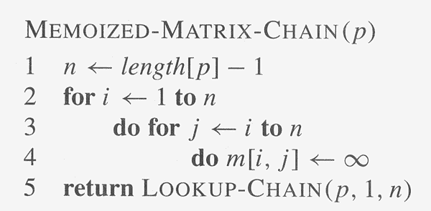
Memoized Matrix Chain
LOOKUP-CHAIN(p,i,j)
if m[i,j]<∞ then return m[i,j]
if i=j then m[i,j] ←0
else for k←i to j-1
do q← LOOKUP-CHAIN(p,i,k)+
LOOKUP-CHAIN(p,k+1,j)+p_{i-1}p_{k}p_{j}
if q< m[i,j] then m[i,j] ←q
return m[i,j]

Slide 37
DP VS. Memoization
MCM can be solved by DP or Memoized algorithm, both in O(n³).
  Total Θ(n²) subproblems, with O(n) for each.
If all subproblems must be solved at least once, DP is better by a constant factor due to no recursive involvement as in Memoized algorithm.
If some subproblems may not need to be solved, Memoized algorithm may be more efficient, since it only solve these subproblems which are definitely required.

Slide 38
Longest Common Subsequence (LCS)
DNA analysis, two DNA string comparison.
DNA string: a sequence of symbols A,C,G,T.
  S=ACCGGTCGAGCTTCGAAT
Subsequence (of X): is X with some symbols left out.
  Z=CGTC is a subsequence of X=ACGCTAC.
Common subsequence Z (of X and Y): a subsequence of X and also a subsequence of Y.
  Z=CGA is a common subsequence of both X=ACGCTAC and Y=CTGACA.
Longest Common Subsequence (LCS): the longest one of common subsequences.
  Z' =CGCA is the LCS of the above X and Y.
LCS problem: given X=<x₁, x₂,…, x_{m}> and Y=<y₁, y₂,…, y_{n}>, find their LCS.

Slide 39
LCS Intuitive Solution –brute force
List all possible subsequences of X, check whether they are also subsequences of Y, keep the longer one each time.
Each subsequence corresponds to a subset of the indices {1,2,…,m}, there are 2^{m}. So exponential.

Slide 40
LCS DP –step 1: Optimal Substructure
Characterize optimal substructure of LCS.
Theorem 15.1: Let X=<x₁, x₂,…, x_{m}> (= X_{m}) and Y=<y₁, y₂,…,y_{n}> (= Y_{n}) and Z=<z₁, z₂,…, z_{k}> (= Z_{k}) be any LCS of X and Y,
  1. if x_{m}= y_{n}, then z_{k}= x_{m}= y_{n}, and Z_{k-1} is the LCS of X_{m-1} and Y_{n-1}.
  2. if x_{m}≠ y_{n}, then z_{k} ≠ x_{m} implies Z is the LCS of X_{m-1} and Y_{n}.
  3. if x_{m}≠ y_{n}, then z_{k} ≠ y_{n} implies Z is the LCS of X_{m} and Y_{n-1}.

Slide 41
LCS DP –step 2:Recursive Solution
What the theorem says:
  If x_{m}= y_{n,} find LCS of X_{m-1} and Y_{n-1}, then append x_{m}.
  If x_{m} ≠ y_{n,} find LCS of X_{m-1} and Y_{n} and LCS of X_{m} and Y_{n-1}, take which one is longer.
Overlapping substructure:
  Both LCS of X_{m-1} and Y_{n} and LCS of X_{m} and Y_{n-1} will need to solve LCS of X_{m-1} and Y_{n-1}.
c[i,j] is the length of LCS of X_{i} and Y_{j} .
c[i,j]= 0 if i=0, or j=0
c[i-1,j-1]+1 if i,j>0 and x_{i}= y_{j,}
max{c[i-1,j], c[i,j-1]} if i,j>0 and x_{i} ≠ y_{j,}

Slide 42
LCS DP-- step 3:Computing the Length of LCS
c[0..m,0..n], where c[i,j] is defined as above.
  c[m,n] is the answer (length of LCS).
b[1..m,1..n], where b[i,j] points to the table entry corresponding to the optimal subproblem solution chosen when computing c[i,j].
  From b[m,n] backward to find the LCS.

Slide 43
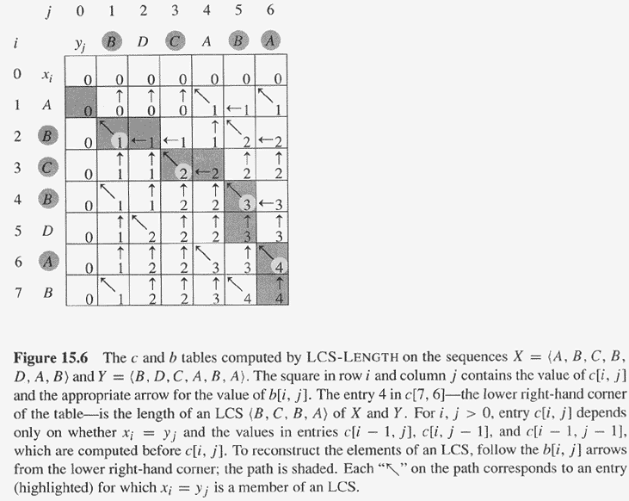
LCS computation example

Slide 44
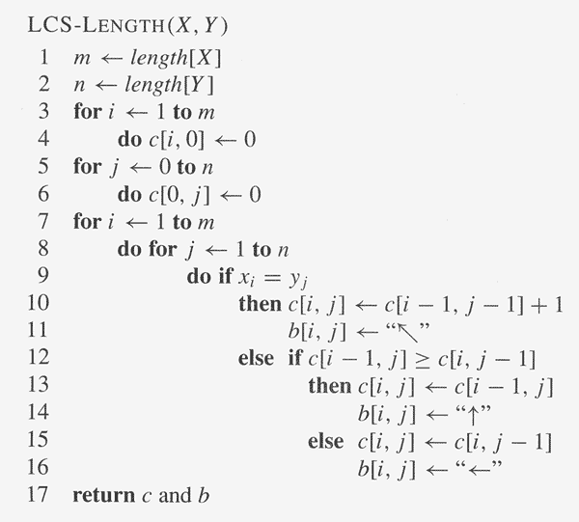
LCS DP Algorithm

Slide 45
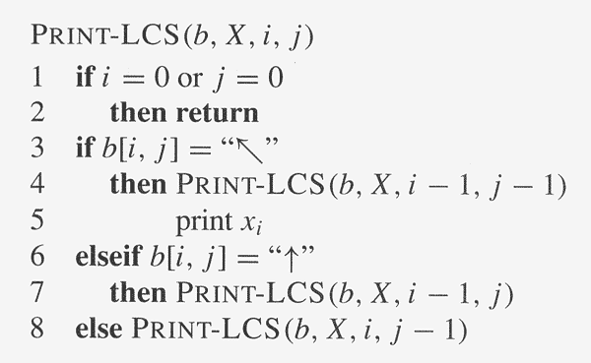
LCS DP –step 4: Constructing LCS

Slide 46
LCS space saving version
Remove array b.
Print_LCS_without_b(c,X,i,j){
  If (i=0 or j=0) return;
  If (c[i,j]==c[i-1,j-1]+1)
    {Print_LCS_without_b(c,X,i-1,j-1); print x_{i}}
  else if(c[i,j]==c[i-1,j])
    {Print_LCS_without_b(c,X,i-1,j);}
  else
    {Print_LCS_without_b(c,X,i,j-1);}
}
Can We do better?
  2*min{m,n} space, or even min{m,n}+1 space for just LCS value.

Slide 47
Summary
DP two important properties
Four steps of DP.
Differences among divide-and-conquer algorithms, DP algorithms, and Memoized algorithm.
Writing DP programs and analyze their running time and space requirement.
Modify the discussed DP algorithms.

