Slide 1

Captone project 1 Industry turnover
Henry Wong

Slide 2
Data
Census.gov
Data: collected between 1991 to 2017
Data size: 80 columns, 235000 rows

Slide 3
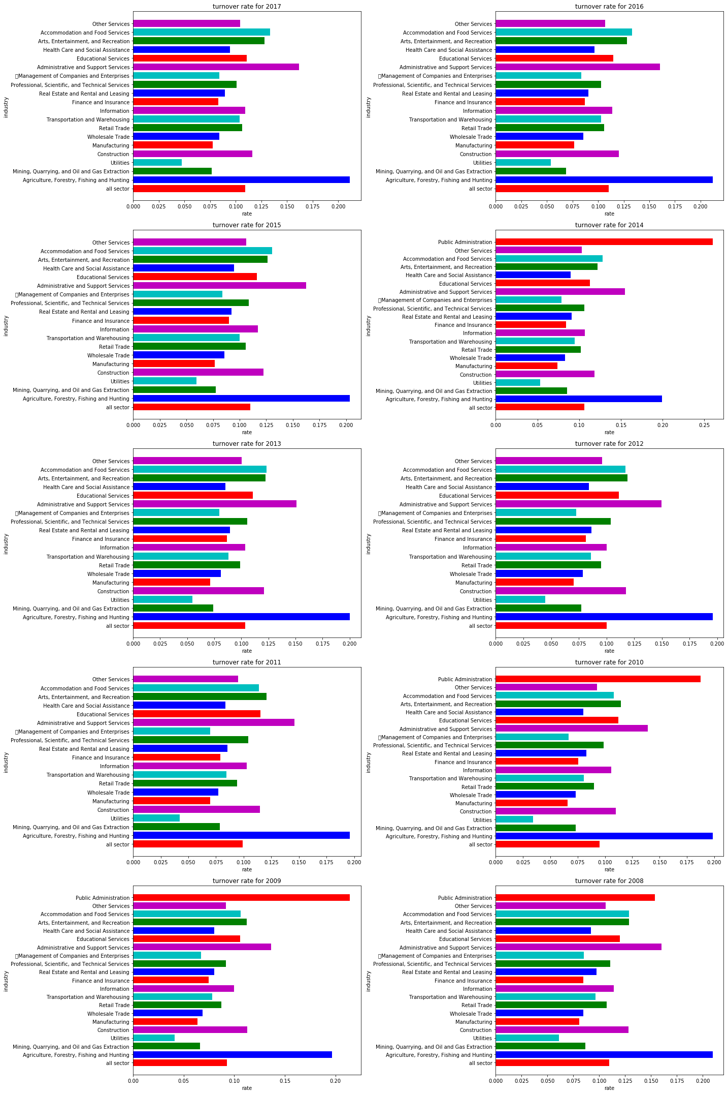
turnover rate between different industry from 2008 to 2017

Slide 4
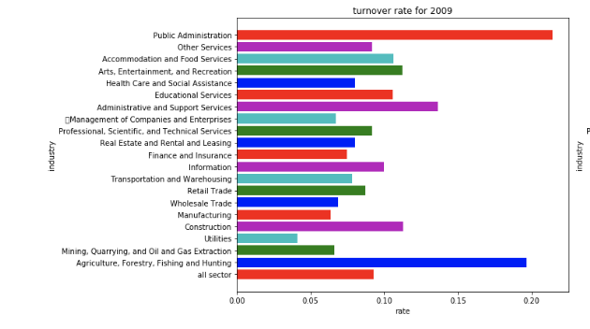
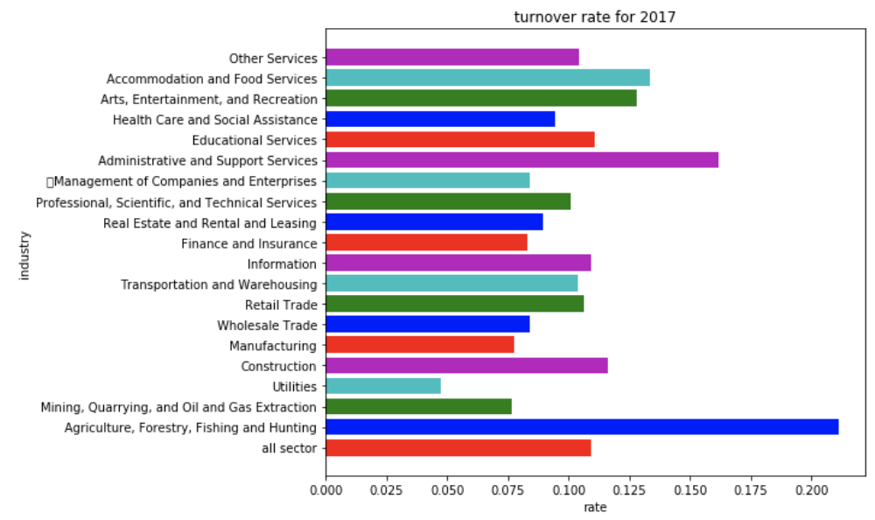

Slide 5
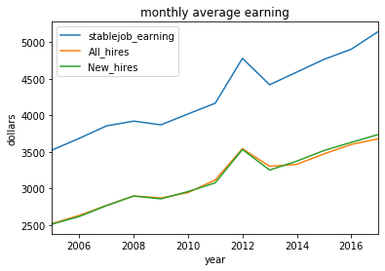
Monthly earning

Slide 6
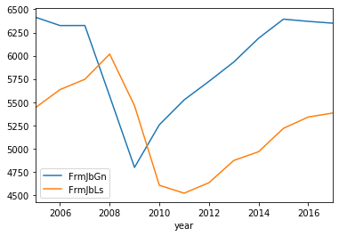
Job gain and job lost and between 2005 to 2017

Slide 7
Hypothesis testing 1: In 2017, finance, insurance industry and real estate industry turnover rate
Null hypothesis: both industry turnover rate are the same.
Alternative hypothesis: one of the industry turnover rate is higher than the other.
Alpha = 0.05
Welch’s T-test: p-value = 0.0208
U-test: p-value = 7.815211845647882e-07

Slide 8
Conclusion for hypothesis testing1
We have enough evidence to reject the null hypothesis
Real Estate industry turnover rate is higher than Finance and Insurance in 2017

Slide 9
Hypothesis testing 2: compare finance and insurance industry turnover rate between 2009 and 2017
Null hypothesis: finance and insurance industry turnover rate are the same in 2009 and 2017
Alternative hypothesis: one of the industry turnover rate is higher than the other.
Alpha = 0.05
Welch’s T-test: p-value = 0.0003824
U-test: p-value = 0.00484

Slide 10
Conclusion for hypothesis testing 2
We have enough evidence to reject the null hypothesis.
2017 turnover rate is higher than 2009 in finance and insurance industry.

Slide 11
Thank you

