Slide 1

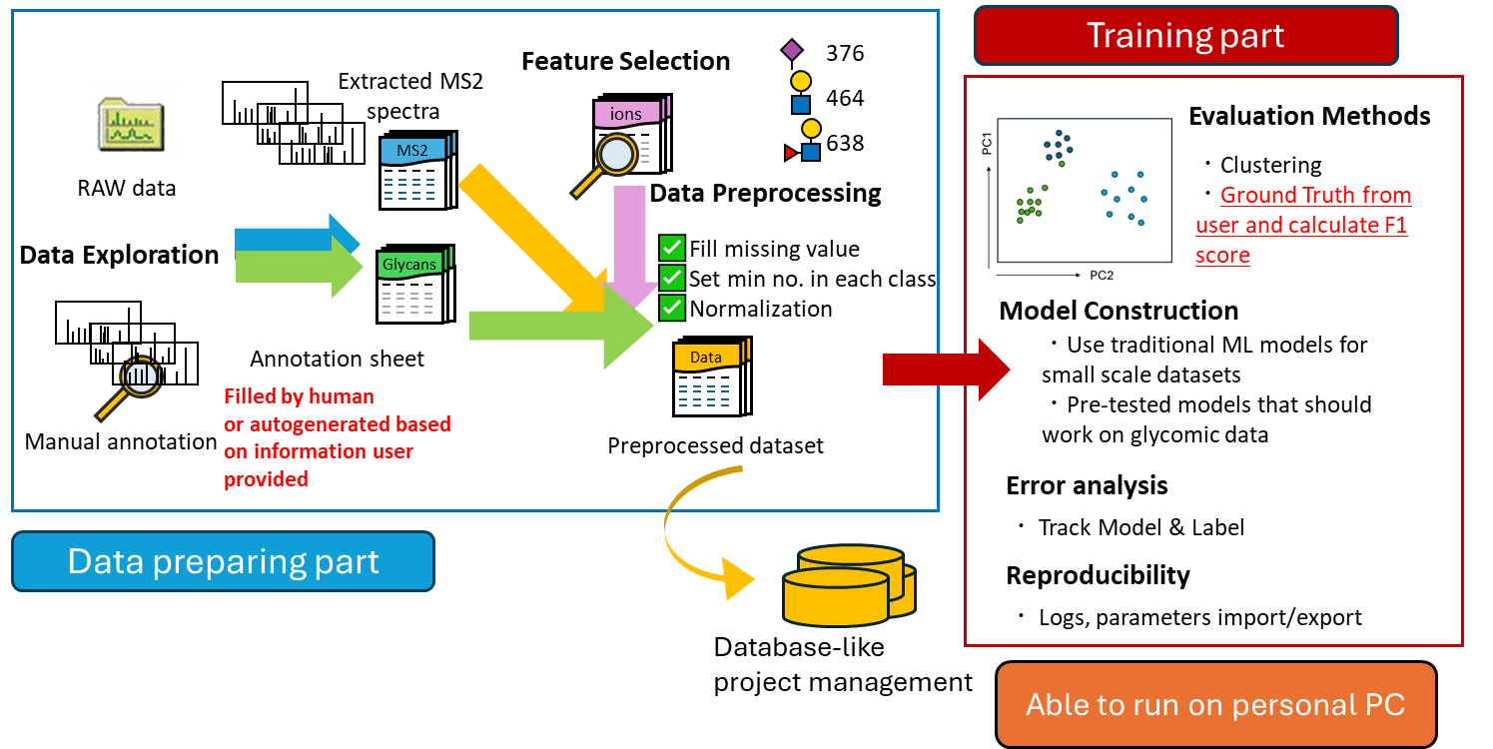
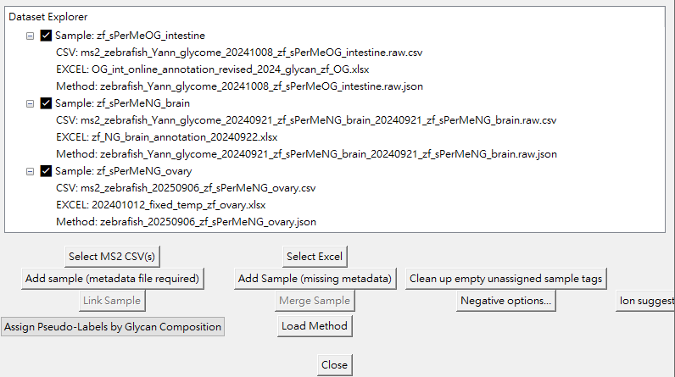
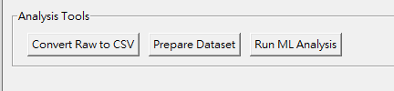
GlycoMSParser:
A GUI/CLI Tool of building high-quality annotation glycomic data for adjustable machine-learning approach
Nakai Lab (FAiS, IMS, UTokyo)
CBMS D4, GSFS, The University of Tokyo
TSENG Huan Chuan (曾煥權)
2025/9/9

Slide 2
Feature overview
Data preprocessing
Generate ML-friendly formatted csv (tsv)
Generate metadata for further tracking
Dataset preparation
Manual annotation OR
Pseudo-labeling
Validate data formatting
Critical fragmentation ion mining
Save/load operation history and workspace
Build ML model
Adjustable parameters
Able to read trained models for prediction

Slide 3
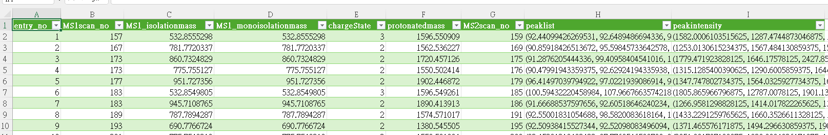
Features in Data preprocessing
  Generate ML-friendly formatted csv (tsv)
  Indexing by MS2 scan and saving spectral data with essential information
  The csv will be served as source data in the whole analysis pipeline
Metadata of MS2 spectra
MS2 spectra peak list
MS2 scan number as index (unique key)
Each row represents 1 MS2 spectrum

Slide 4

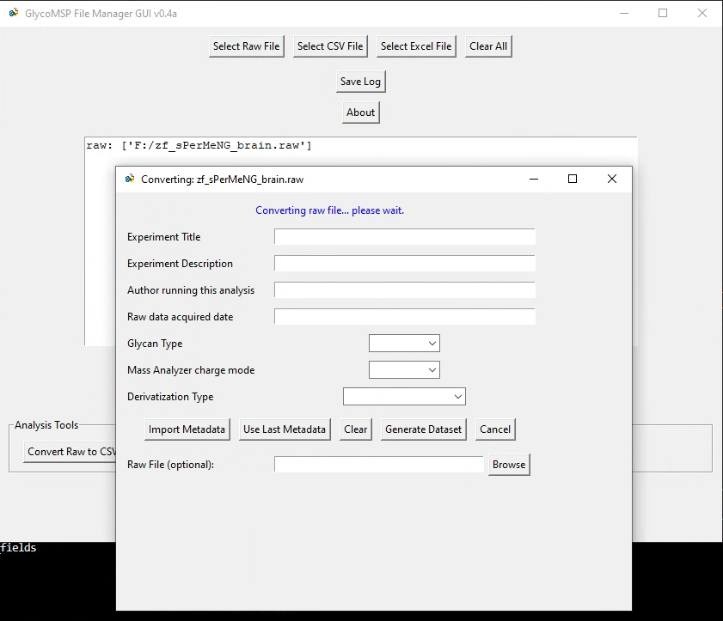
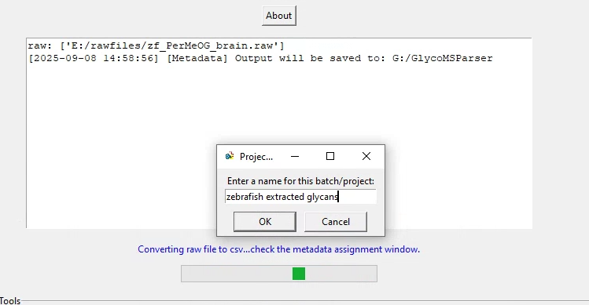
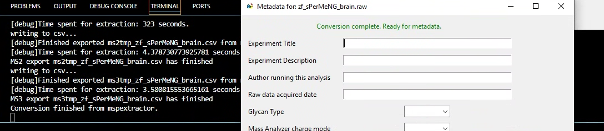
Converting raw files to csv files
  Support conversion from .raw file (ThermoFisher Scientific ©)
    (Windows only)Need Thermo Foundation, Xcalibur and raw file reader library installed
  Convert from generic .mzML(xml like format) file*
    The containers might change if the conversion setting differs. Need more datasets from different labs to confirm if the method works stably
    [dev] Currently only can run in CLI (command line interface) mzML -> csv
  Generate metadata for further tracking
    Also include glycan basic information
    which can be imported for later analysis
Information printed in CLI (terminal) Will be integrated to GUI main log window

Slide 5
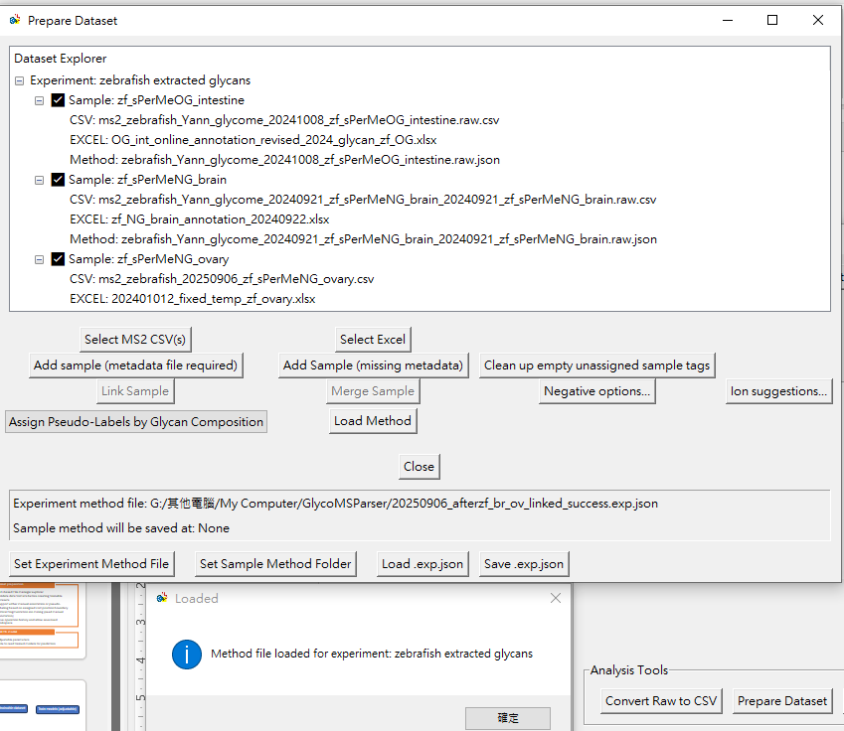
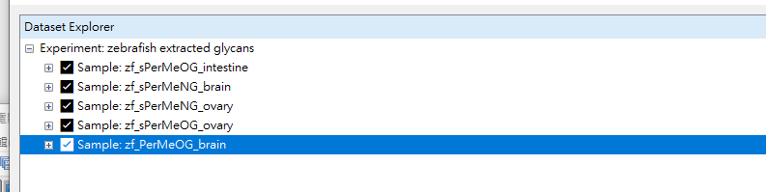
Dataset preparation overview
Still in development, the layout and buttons may change
  Experiment management
  Independent operation on each sample
  Save and load the workspace
  Validate files (formatting, contents) before creating trainable datasets
  Two approach of adding labels:
  Use manual annotation
  Use pseudo-labels by assigning glycan composition and restraints

Slide 6
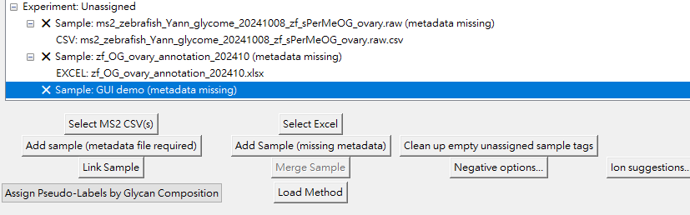
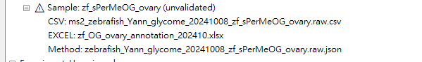
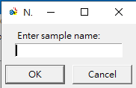
Experiment management
  Main components:
    Converted csv file: storing spectral information
    Manual annotation excel (optional): storing feature and annotations for training
    Metadata: storing sample information
  Current workspace can be saved and loaded in another session
Manual annotation data operation panel
Link: validate the csv and excel
Negative options: set non-glycans from spectral data
Ion suggestions: find and generate probably critical ions list (feature mining)
Pseudo-labeling approach by assigning glycan composition and restraints

Slide 7
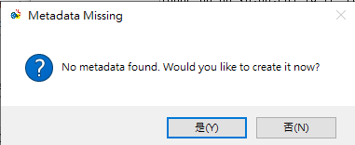
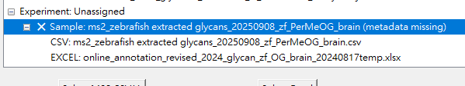
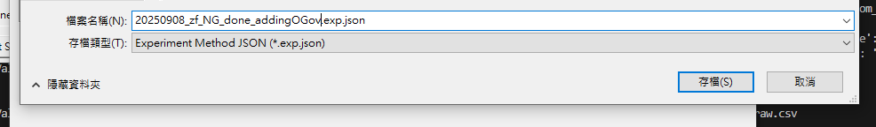
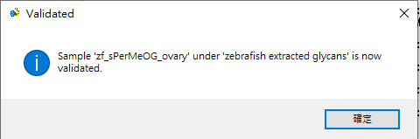

Validate and generate trainable csv
(manual annotation approach)
  After linking sample successful:
    Ask users to save current link status
    Workspace will be updated
  Now the sample can be merged for training
    Users can…
    Add more MS2 annotations before training
    Try to find more critical fragmentation ions and append them to training feature
Link without metadata will force user to create metadata before proceeding
Information printed in CLI (terminal)
Will be integrated to GUI main log window

Slide 8
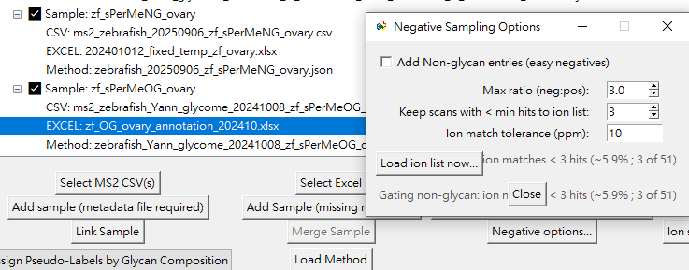
Feature: adding non-glycan automatically
  Users can add “Non-glycan” MS2 in the annotation data
    Bias from human may occur
    Take time for human to see “Non-glycan” spectra, which is out of our interest
  Easy way (automatically) to add Non-glycan MS2 from linked sample
    Requires fragmentation ions as feature to filter the Non-glycan spectra
Check to add Non-glycan
spectra
Feature related settings
Information printed in CLI (terminal)
Will be integrated to GUI main log window
In this sample we have 189 annotated MS2
3x -> 567 Non-glycans spectra will be appended

Slide 9
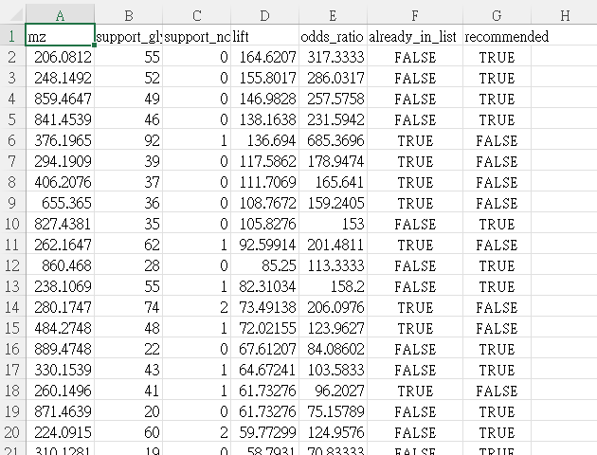
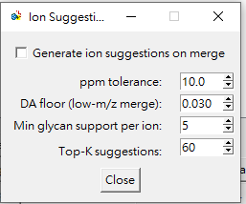
Feature: ion mining (traditional probability method)
  Search relatively important (high frequency) fragmentation ions from labeled data
    Find those top-K (default as 60) ions presenting in those spectra labeled as glycan
    Consider both glycan and non-glycan label and calculate the score
    Finally gate the presence of ions in glycan-labeled spectra (default as 5)
    Will tell you if the ion already exists in ion_list
  Need human/expert validation of the fragmentation ion
    This method doesn’t resolve the ions,
    these are just “probably important” ions
Already in ion_list
Check to add ion mining feature
Information printed in CLI (terminal)
Will be integrated to GUI main log window

Slide 10
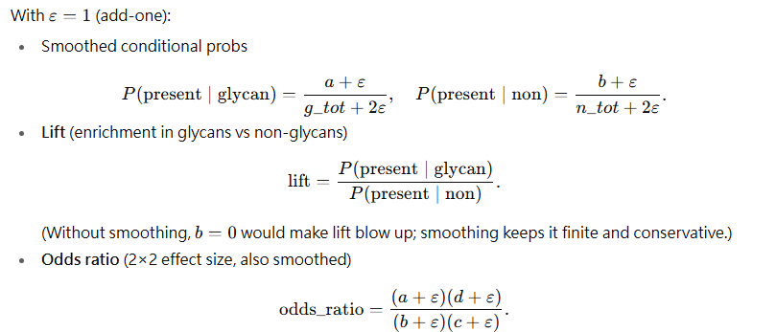
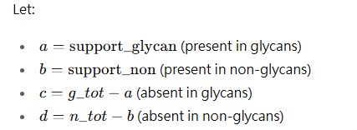
Feature: ion feature mining
  Step 1: concatenate all peaks from glycan spectra
  Step 2: cluster the peaks using hybrid tolerance and find more than 3 peaks in one mass bin (0.03 | 10 ppm) -> centered(centroid?) peak mass
  Step 3: Scan through all spectra and count the presence/absence
  Step 4:
  Step 5: ions need to present in more than min glycan spectra -> output
  Non-glycans currently come from: capped (pseudo) or man annotation
g_tot
n_tot

Slide 11
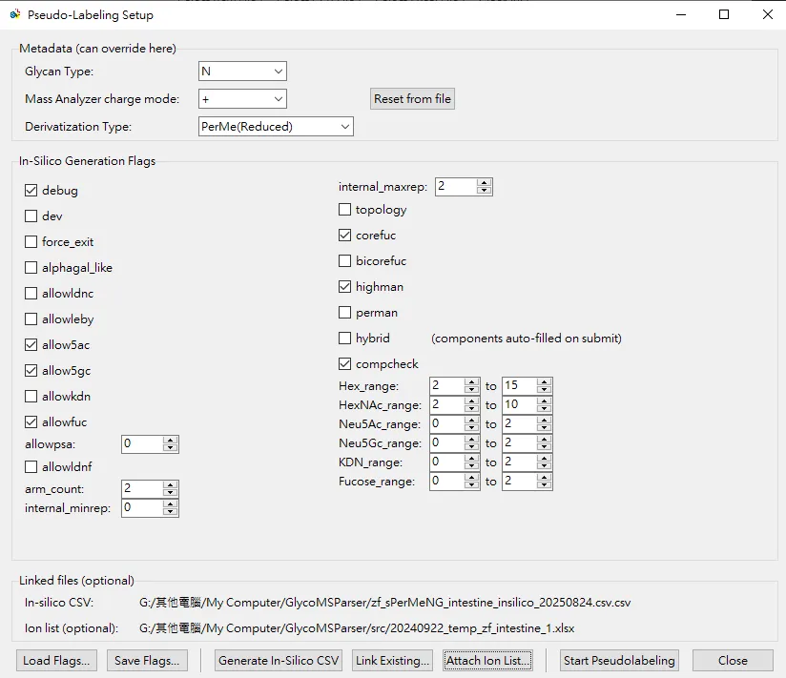
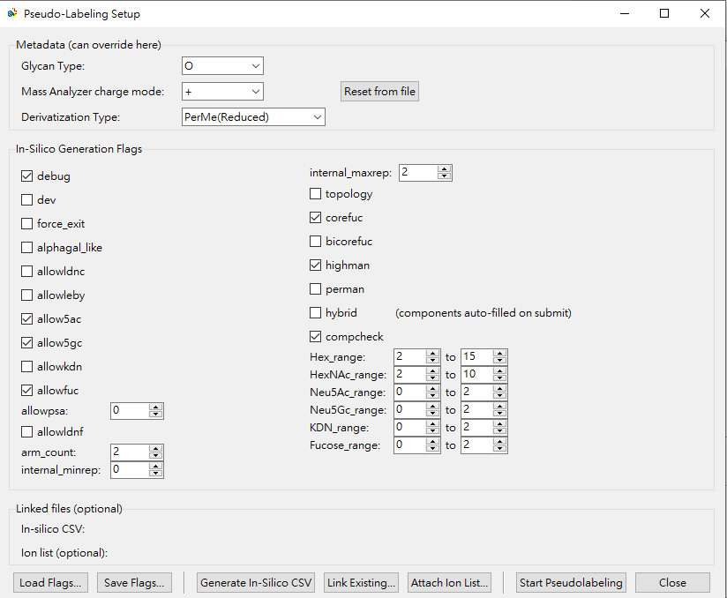
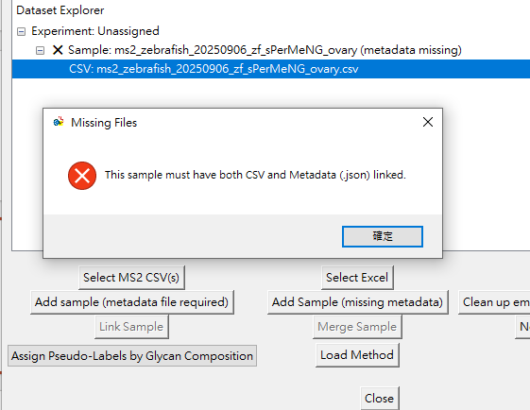
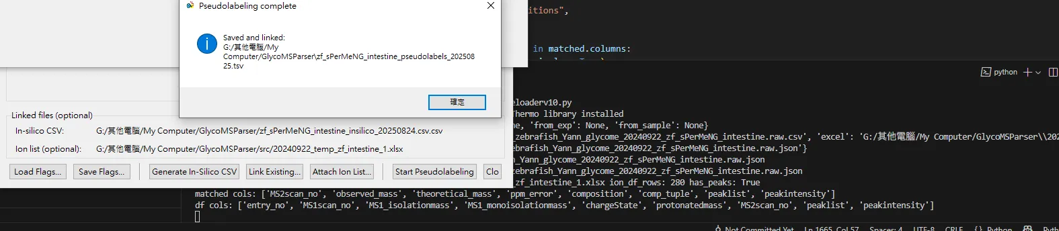
Generating trainable csv without manual annotation
(pseudo-labeling approach)
  Requires converted csv and metadata
  Ask for “glycotopes” instead of “glycosyltransferase”
  (avoid unclear function, regulation before human completely resolve them)
Generate a “in silico composition list csv” based on the configurations
Imported from metadata
Missing metadata will raise error message

Slide 12






Pseudo-labeling approach
First ion filter to reduce spectra number for users to review
  They can generate annotation sheet using the filtered list (Reduce by 70~90%)
Labeled spectra can be trained as well as manual annotation approach
How many arms?
2
Need glycobiology knowledge to set the upper/lower limits
Special structure allowed? (species-specific)
Yes
Asn
Total sugar unit limits
3
3~7
Asn
Match the spectra by mass / ions
2~4
csv
csv
0~2
PseudoResult.csv
In silico glycan list.csv

Slide 13
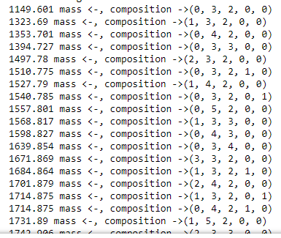
auto-generate proper pseudo-labels progress
Include in silico glycan list generation (w/ smarter design), this slide and fit composition part
Previous version: (brutal) expand the glycan list based on composition
3
(F, H, N, S, G)
3~7
2~4
Time spent < 0.1s
>1k entities
0~2
Current version: incorporate glycan synthesis restraints
How many arms?
Etc…
Special structure allowed? (species-specific)
Time spent can be ignored
Reduce by 30%~70% impossible combinations
Total sugar unit limits

Slide 14



Adapted in silico glycan list generation flow (N-glycan)
Confidential
G_n=
(t1, t2…tm)
Terminal permutations
Flags (driven by gene expression OR observation)
G_i=
(i1,i2…in)
Internal permutations
Flag and repeat number
G_n x G_i
(mxn combinations)
n
(remove topological info before core additions or you’ll get mn^{arm})
Set maximum arm numbers to add terminal and internal glycotopes
Apply to arms
Sugar unit limits filter
Finish building glycan sets
Add out-of-rules glycans
(less and varieties are limited)
Core additions and exceptions
(optional)

Slide 15
Adapted in silico glycan list generation flow (O-glycan)
Confidential
G_n=
(t1, t2…tm)
Terminal permutations
Flags (driven by gene expression OR observation)
G_i=
(i1,i2…in)
Internal permutations
Flag and repeat number
G_n x G_i
(mxn combinations)
n
(remove topological info before core additions or you’ll get mn^{arm})
Based on core types to assign proper permutation sets based on the restraints
Core combinations
?
Finish building glycan sets
Add out-of-rules glycans
(less and varieties are limited)
Sugar unit limits filter
(optional)

Slide 16
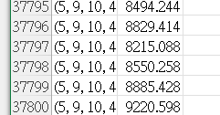
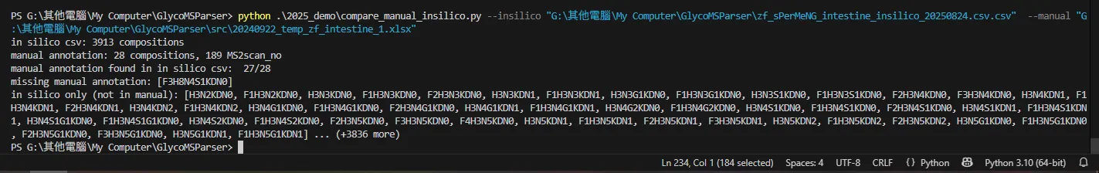
Comparing with manual annotation
In silico: 3913
Manual:
28
Reduce the in silico glycans from (brutal expansion) ~38k to 3.9k (reduced by 88%)
By turning on/off flags, in silico glycans can vary from ~1k - ~10k
Estimated type of N-glycans in one sample is around ~100
1
Not overlapped: 1
Reason: out of configured constraints

Slide 17
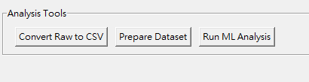
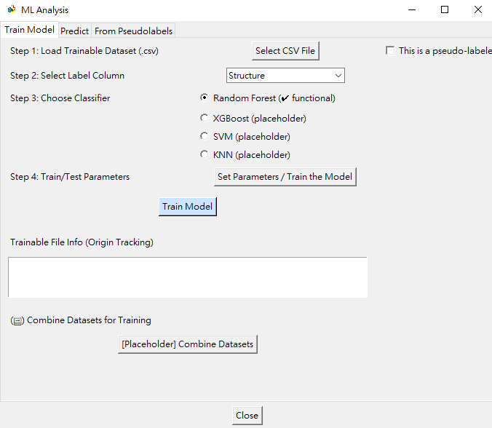
Features in ML analysis
  Train model
    Require trainable csv
    Select Label column (as classes being trained)
    Random Forest available
    XGBoost (CLI, not optimized)
    SVM and KNN are not implemented
  Possible to adjust the parameters
  (see next slide)
  Combine multiple trainable datasets
  into one single dataset

Slide 18
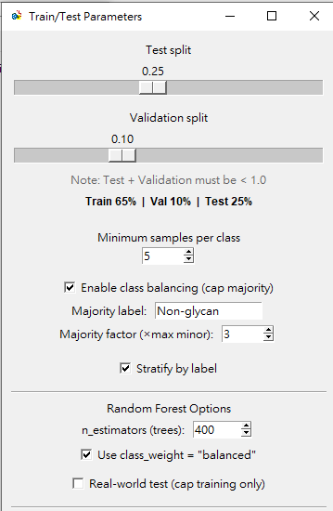
Random forest train parameters
Test (0.05-0.50, +0.05 per level, default 0.25)
Validation (0.00-0.30, +0.05 per level, default 0.1)
Train (remaining, max 0.95, min 0.2)
Minimal count for each class (default 5)
Cap majority (prevent Non-glycan flooding)
Stratify (keep per-class proportions across Tr/Va/Te
Trees numbers (estimators): 0~800
State = 42 for current study
Balance the class
Cap non-glycans only during training

Slide 19
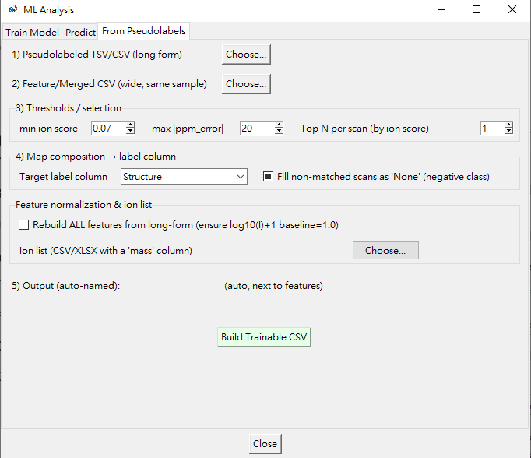
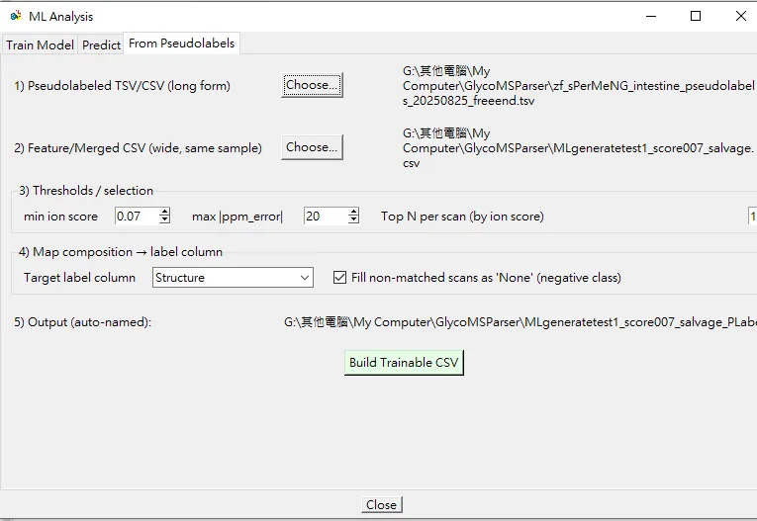
Filtering pseudo-labeling datasets for training
Further filter the spectra labeled with composition using the feature scoring (presenting ion feature count/ total ion feature count)
(Working) Add pre-filtering (GUI only, CLI has been implemented) options
which generates feature/merged CSV
(Future function)Top N will pick the highest score of assigned composition
  Need another combination score that is sensitive to composition/structure
Rebuild and add Non-glycan back

Slide 20
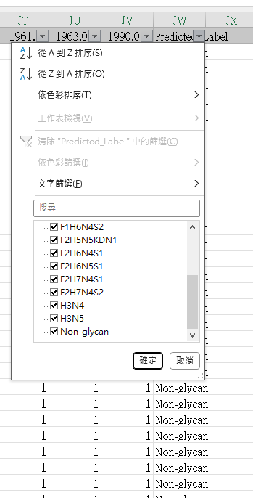
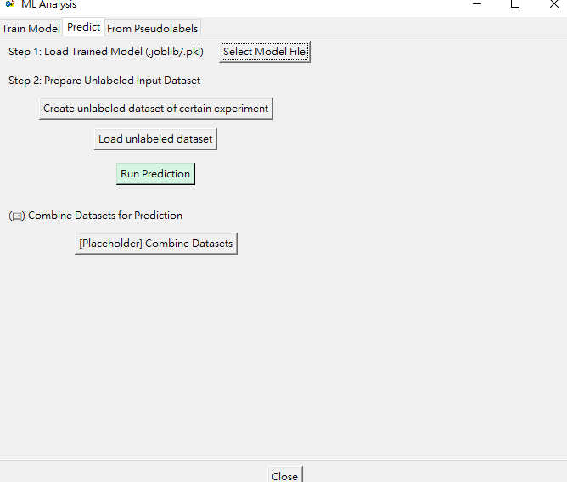
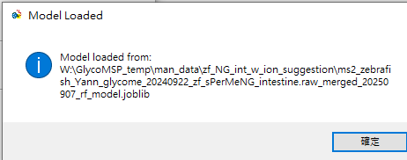
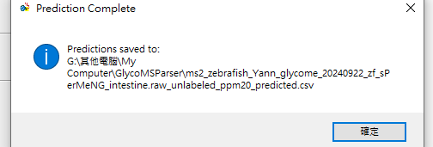
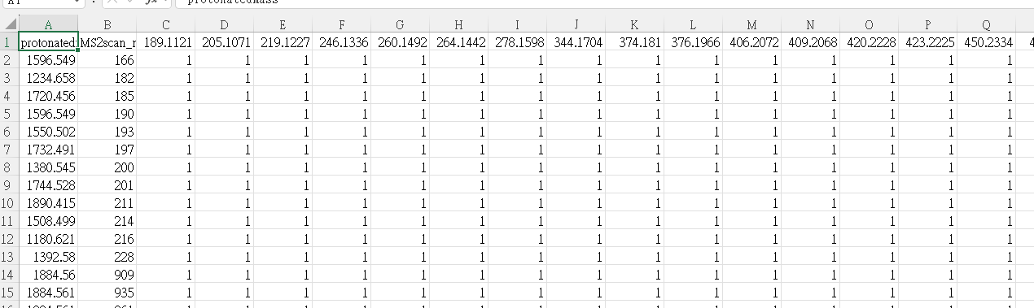
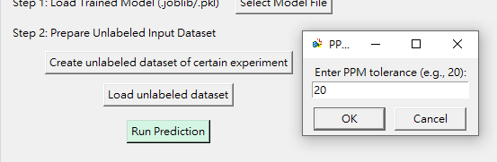
Features in ML analysis
  Prediction tab
  Requires raw converted csv and feature (ion list)
  Will flatten the peak list and intensity into ML-compatible csv
  (Working) Statistics on prediction results
Need experiment json to automatically retrieve feature (from Excel) and raw csv

Slide 21
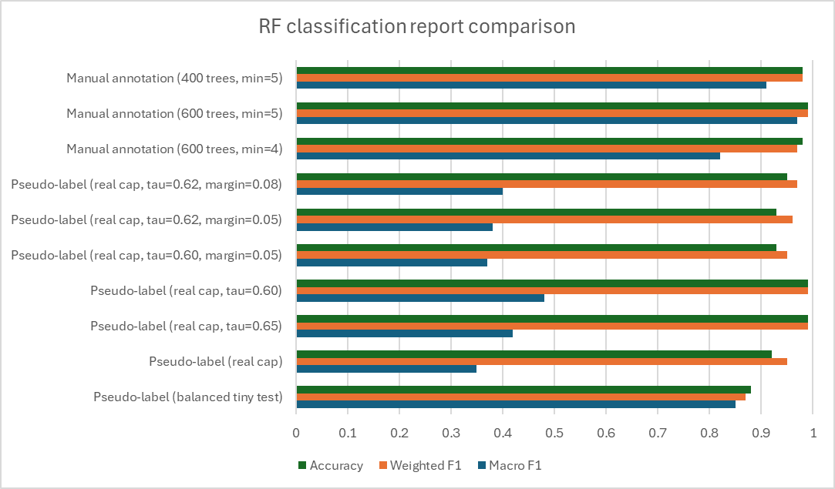
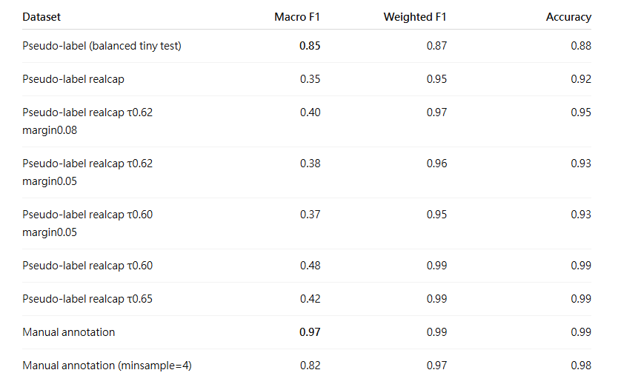
Quick comparison of train results
Low macro F1 -> underperforms on less frequent glycan classes
despite strong overall accuracy, reflecting class-imbalance and confusion among rare subclasses.” * Test set dominated by Non-glycan
test 0.2, val0.0, min count=15, cap 3x, stratify on, balanced, 400 trees
test 0.2, val0.0, min count=15, cap train 3x, stratify on, balanced, 400 trees
test 0.2, val0.0, min count=15, cap train 3x, stratify on, balanced, 400 trees, tau = 0.62, margin = 0.08
test 0.2, val0.0, min count=15, cap train 3x, stratify on, balanced, 400 trees, tau = 0.62, margin = 0.05
test 0.2, val0.0, min count=15, cap train 3x, stratify on, balanced, 400 trees, tau = 0.6, margin = 0.05
test 0.2, val0.0, min count=15, cap train 3x, stratify on, balanced, 400 trees, tau = 0.6
test 0.2, val0.0, min count=15, cap train 3x, stratify on, balanced, 400 trees, tau = 0.65
test 0.2, val0.0, min count=5, cap train 3x, stratify on, balanced, 600 trees, tau = 0.6
Notes:
F1 (per class) = harmonic mean of precision and recall for that one class.
Macro F1 = the simple average of all per-class F1s (each class counts equally, no matter how many samples it has).
Weighted F1 = average of per-class F1s weighted by class size (big classes dominate).
Accuracy = fraction of all correct predictions (heavily swayed by majority classes).
So, when you see high Accuracy / high Weighted F1 but low Macro F1, it means:
The model is doing great on the majority class(es) (here: Non-glycan) and a few common glycans.
It’s doing poorly on several minority glycan classes—often with F1 near zero (e.g., never predicted, or predicted with very low precision).
Because Macro F1 gives every glycan type equal weight, a handful of weak/zero-F1 classes pull the macro average down, even though the big classes look excellent.

Slide 22
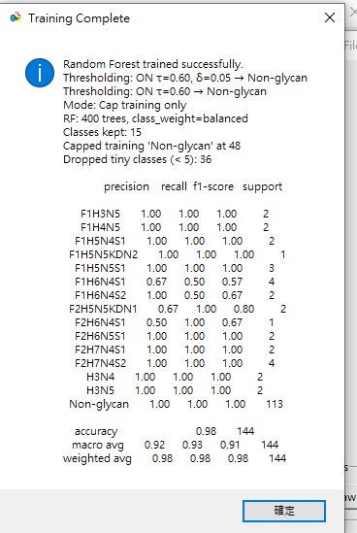
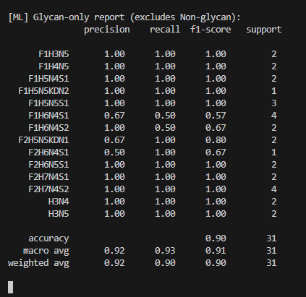
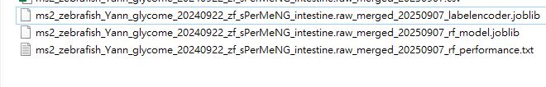
A quick glance at classification report

Slide 23
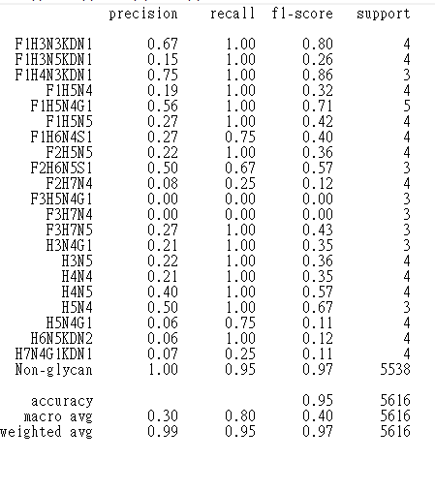
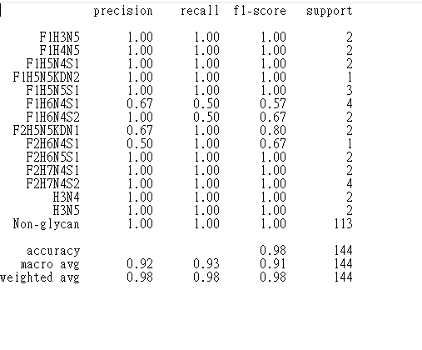
Quick summary: pseudo-label gives different classes of glycans with relatively low F1 score
Good tools for distinguishing glycans, but not the final annotation
Pseudo-labeled
Manually-labeled
test 0.2, val0.0, min count=15, cap train 3x, stratify on, balanced, 400 trees, tau = 0.62, margin = 0.08
test 0.2, val0.0, min count=5, cap train 3x, stratify on, balanced, 400 trees

Slide 24
Pseudo-label (real cap, τ=0.62, margin=0.08) — n_estimators=400, min_samples=15
Manual annotation — n_estimators=400, min_samples=5
Accuracy: 0.95
Macro F1: 0.40
Weighted F1: 0.97
Accuracy: 0.98
Macro F1: 0.91
Weighted F1: 0.98
Class | Support | Precision | Recall | F1
F1H5N4G1 | 5 | 0.56 | 1.00 | 0.71
H5N4G1 | 4 | 0.06 | 0.75 | 0.11
H7N4G1KDN1 | 4 | 0.07 | 0.25 | 0.11
F3H5N4G1 | 3 | 0.00 | 0.00 | 0.00
F3H7N4 | 3 | 0.00 | 0.00 | 0.00
H3N4G1 | 3 | 0.21 | 1.00 | 0.35
Class | Support | Precision | Recall | F1
F1H6N4S1 | 4 | 0.67 | 0.50 | 0.57
F2H7N4S2 | 4 | 1.00 | 1.00 | 1.00
F1H5N5S1 | 3 | 1.00 | 1.00 | 1.00
F2H6N4S1 | 1 | 0.50 | 1.00 | 0.67
F1H5N5KDN2 | 1 | 1.00 | 1.00 | 1.00
F1H6N4S2 | 2 | 1.00 | 0.50 | 0.67

Slide 25
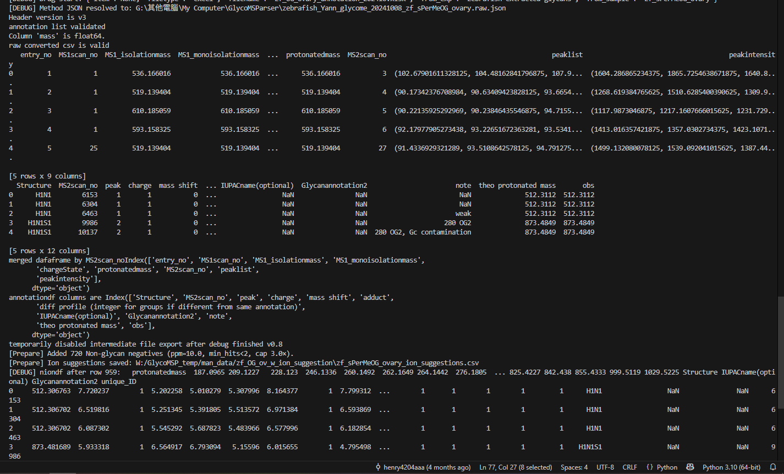
Debug prints in console (202509)

Slide 26
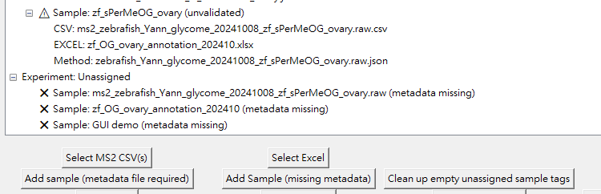
Dev issues in file management workflow
  Can’t clean the empty tags itself
  The experiment, method and metadata json files are mixed (the duties are ambiguous)
  Json files are not updated in real time and if files are moved, or user attempting running on another device, the integrity of json will break and causing error (file not found errors), need a path validation or HASH value validation to confirm users are using “same file”
  UI, button positions and functions are not straightforward

Slide 27
Dev issues in file management workflow (2)
  Ion suggestion should be able to perform out of merging process (since merging itself catches features and fixes them, adding new features will result in another file adjustment)
  Using whole negative sample instead of capped negative one

Slide 28
Recap
Data preprocessing
Generate ML-friendly formatted csv (tsv)
Convert from .raw file (ThermoFisher Scientific ©)
Convert from generic .mzML(xml like format) file
Generate metadata for further tracking
Dataset preparation
GUI-based File manager explorer
Validate data formats before creating trainable datasets
Support either manual annotation or pseudo-labeling based on assigned composition boundary
Critical fragmentation ion mining (need manual annotation)
Save operation history and allow save/read workspace
Build ML model
Adjustable parameters
Able to read trained models for prediction

Slide 29

Prepare trainable dataset
Train models (adjustable)
ThermoFisher RAW
MS2
Data preprocessing

Slide 30
Fig 1. Pipeline of GlycoMSParser
Glycans
Glycotope
ThermoFisher RAW
In silico glycan composition + mass list
Glycogenes & Glycotopes
expression in certain species
A. Enumerate with
in silico composition + known fragments
Assign composition based on mass
Examines if the composition and fragments in spectrum is reasonable based on possible glycotope combinations
Threshold = a
Enumerate glycotopes to build glycans
👀
MS2
Calculate mass in [H+] form
MS2
Score the spectra
MS2
MS2
Glycan fragments
Extracted MS2 data list
MS2 list + composition
Filtered MS2 list
Enumerated MS2 list + composition
B. Try to learn features
Models assigning spectra as certain annotations
Developing
Glycotope statistics
MS2
Learn patterns from annotated dataset
annotation
a b c d
Summarize
Glycan A
1 2 3 4
Glycan B
fragments
Glycan C
Combined w/ manually annotated data

