Slide 1
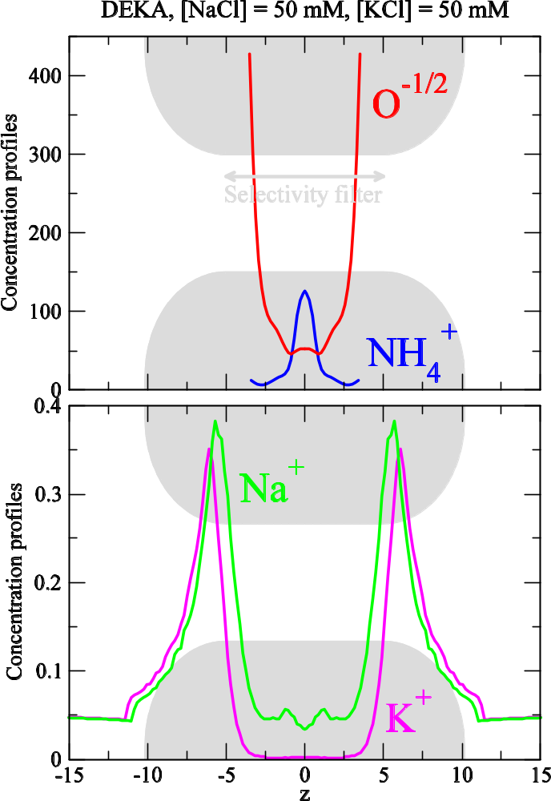
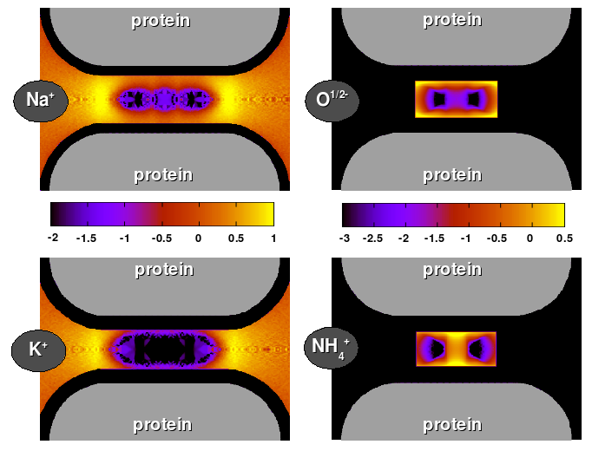
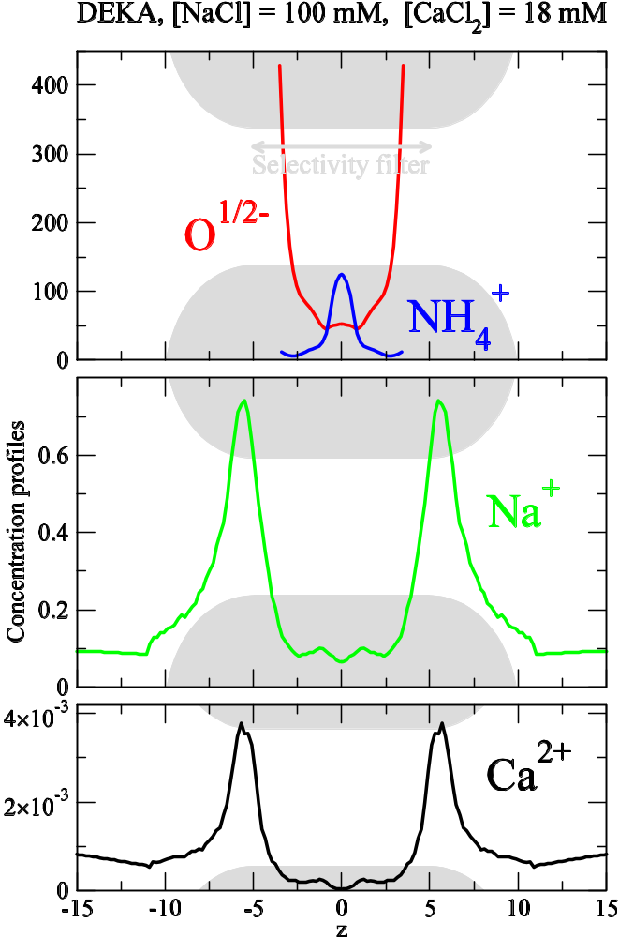
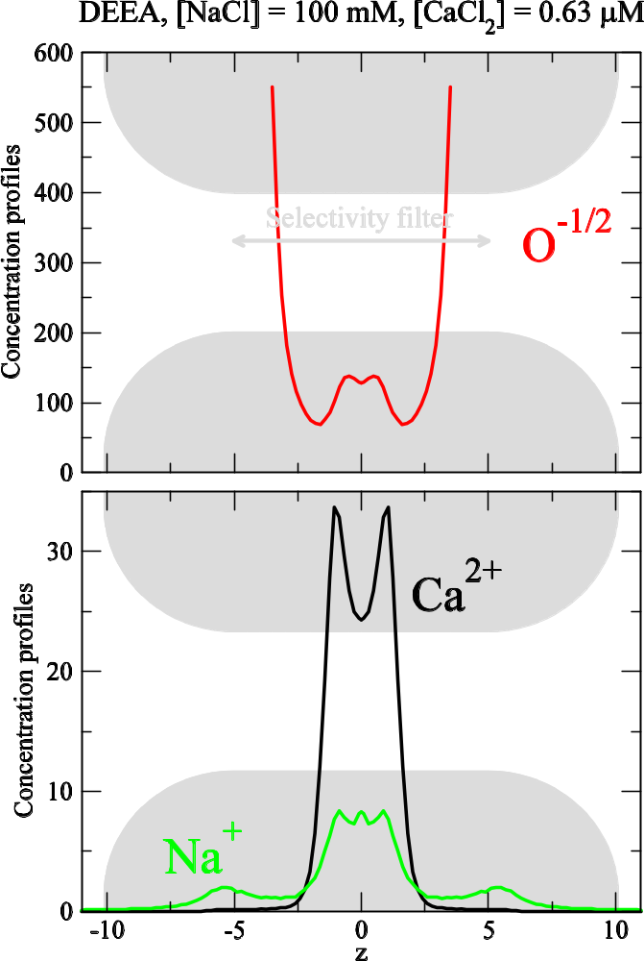
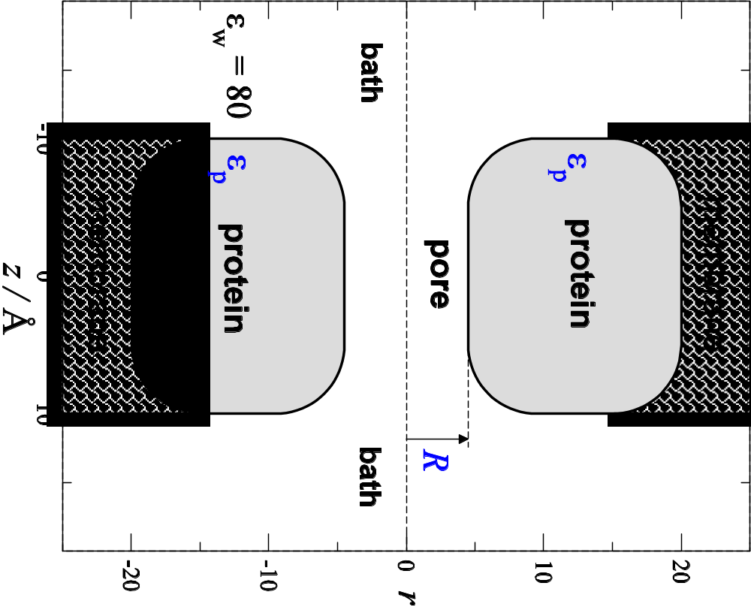
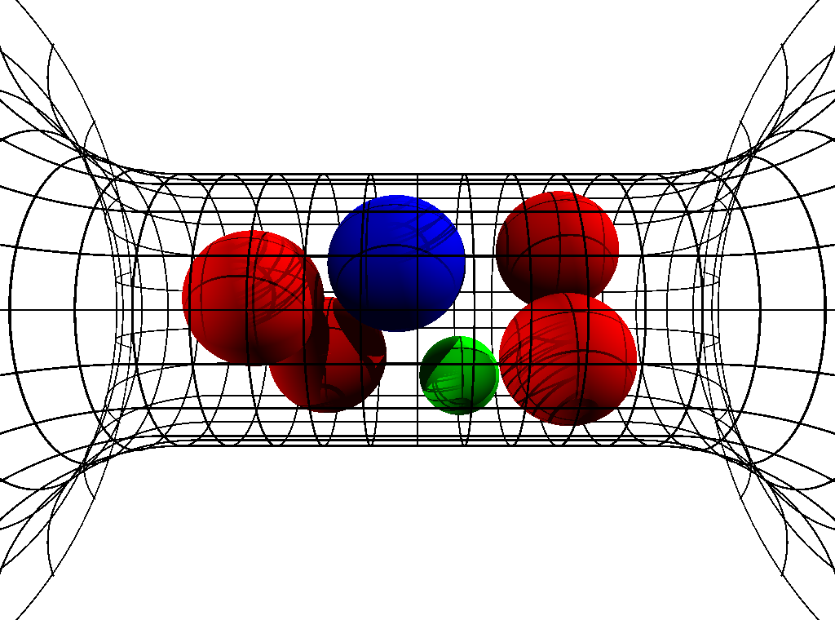
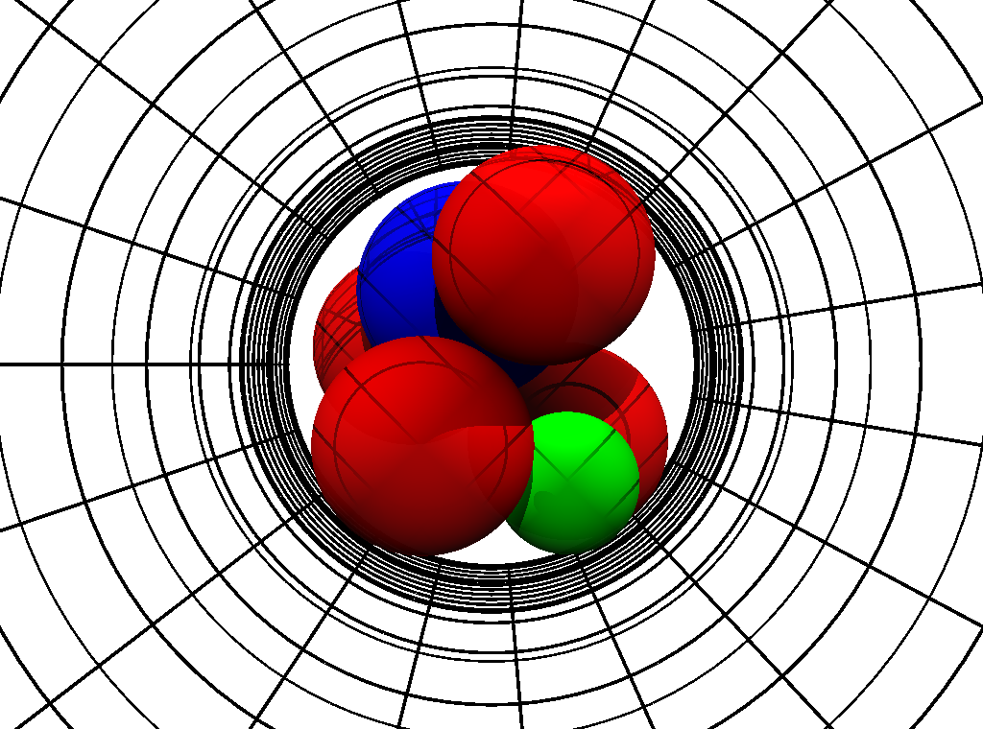
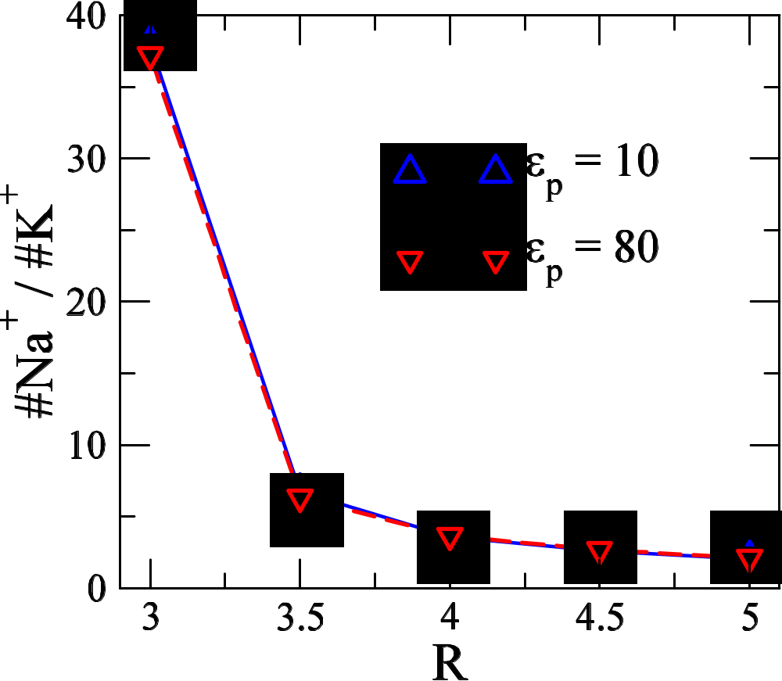
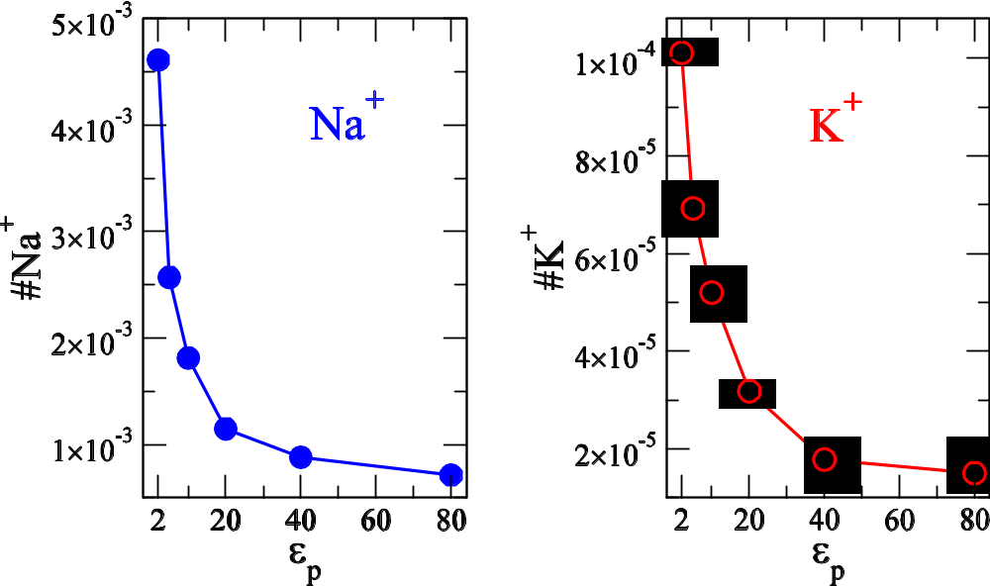
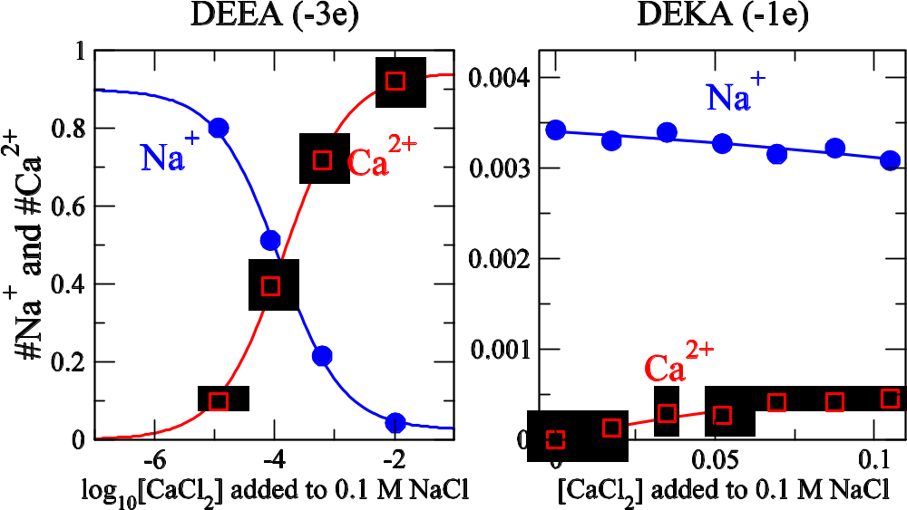
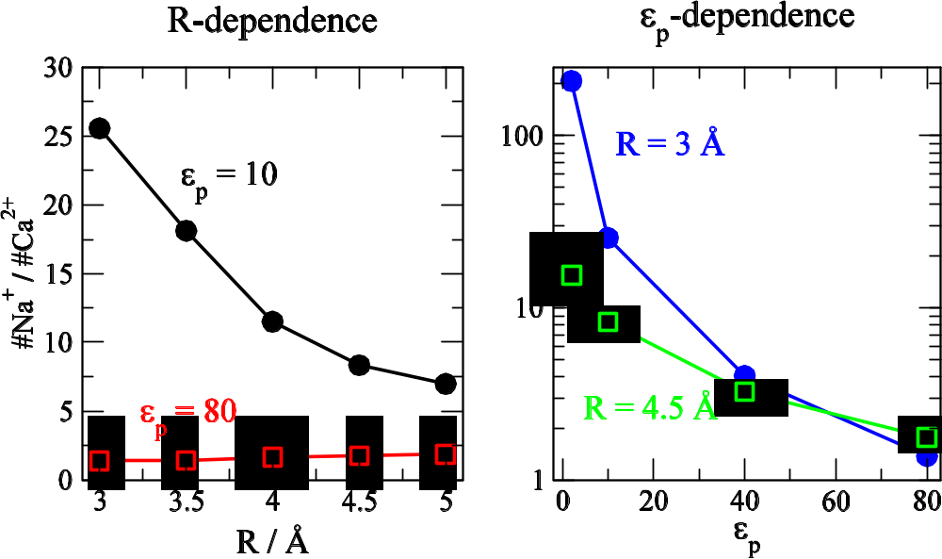
The effect of the protein dielectric coefficient and pore radius on the Na⁺ affinity of a model sodium channel
Dezső Boda^{1,2}, Mónika Valiskó², Bob Eisenberg¹, Wolfgang Nonner³, Douglas Henderson⁴, Dirk Gillespie¹
¹ Rush University Medical Center, Chicago, IL; ² University of Pannonia, Veszprém, Hungary; ³ Brigham Young University, Provo, UT; ⁴ University of Miami School of Medicine, Miami, FL
Abstract
Na⁺ vs. Ca²⁺ selectivity
Na⁺ vs. K⁺ selectivity
Na channels that produce the action potentials of nerves and muscles include a selectivity filter formed by both positively and negatively charged amino acid residues. We study equilibrium ion accumulation of various ions in the filter for different compositions of the bath electrolyte using Monte Carlo simulations. We use a reduced model of the channel by allowing the protein to have a different dielectric coefficient from the solution. Ions and tethered carboxylate and amino groups (that are restricted to the filter) are treated as charged hard spheres. We find that (1) decreasing the dielectric coefficient of the protein improves the Na⁺ vs. Ca²⁺ affinity of the filter; and that (2) decreasing the radius of the filter improves Na⁺ vs. K⁺ affinity of the filter. Electrostatic effects play the dominant role in (1), the effect of dielectric constant; while excluded volume effects play the dominant role in (2), the effect of radius.
Mutating a Na channel (DEKA) into a Ca channel (DEEA)
K⁺ ions excluded from the center of the crowded filter
DEKA: 4 O^{1/2-} and 1 NH₄⁺ (-1e charge) DEEA: 6 O^{1/2-} (-3e charge)
Mutation K→E
Model of channel and electrolyte
 | O^{1/2-} | d = 2.8 Å
 | NH₄⁺ | d = 3.0 Å
 | Na⁺ | d = 2.0 Å
 | Ca²⁺ | d = 1.98 Å
 | K⁺ | d = 2.66 Å
 | Cl⁻ | d = 3.62 Å
The most selective region of the filter is its center. Na⁺ vs. K⁺ selectivity works on the basis of exclusion, not binding. The binding sites (defined as high concentration spots) are not selective.
Ca²⁺ is excluded from the middle of the filter more: Na channel
Ca²⁺ is attracted to the middle of the filter more: Ca channel
Channel: is a doughnut shaped object with a pore in the middle.
Its relevant parameters: dielectric coefficient (ε_{p}) and pore radius (R).
It is embedded in a membrane that separates two baths.
Ions: charged hard spheres, solvent: continuum dielectric (ε_{w} = 80)
Selectivity filter: central pore containing characteristic amino acid side chains
Side chains: hard sphere ions model the end groups of the side chains:
    D or E: two half charged oxygens (O^{1/2-})
    K: a positive ammonium ion (NH₄⁺)
Method: Equilibrium Monte Carlo Simulations (Grand Canonical Ensemble)
R = 3 Å and ε_{p} = 10 (if not stated otherwise)
Occupancy: average number of various ions (#Na⁺, #Ca²⁺, or #K⁺) in the central 5 Å portion of the selectivity filter.
Decreasing protein dielectric coefficient: increases the electrostatic penalty for Ca²⁺
Decreasing pore radius: makes the filter more crowded → increases the excluded volume penalty
Both amplify the effect of electrostatics → a better Na channel is obtained
________________________
Balance of electrostatic and entropic forces produces a rich selectivity behavior.
Decreasing pore radius: improves Na⁺ vs. K⁺ selectivity
Decreasing protein dielectric coefficient: increases occupancy, but not #Na⁺ / #K⁺ ratio
Conclusions
On the basis of a reduced model using known structural information (amino acid sequences of the selectivity filter) we can explain the selectivity properties of Na and Ca channel in a wide range of conditions.
The mechanism works on the basis of a competition between electrostatic and excluded volume effects: ions compete for space in the crowded selectivity filter.
The degree of selectivity can be tuned by the engineering variables of the reduced model (R, ε_{p}, and amino acid side chains) – these variables can be controlled by protein structure, e. g., the genetic code.
Only basic physical forces (electrostatic and excluded volume) were used to develop this mechanism: no specific chemical binding forces were assumed.
Structural charges (O^{1/2-} and NH₄⁺) are mobile. The filter contains a high density liquid-like structure that distribute according to minimal free energy: this structure is an output of the simulation and depends on conditions.
References
Nonner et al, Binding and selectivity in L-type calcium channels: A mean spherical approximation Biophys. J, 79, 1976 (2000).
Boda et al, Monte Carlo simulations of the mechanism for channel selectivity: The competition between volume exclusion and charge neutrality J. Phys. Chem. B 104, 8903 (2000).
Boda et al, The effect of protein dielectric coefficient on the ionic selectivity of a calcium channel J. Chem. Phys. 125, 034901 (2006).
NIH (Grant GM076013), Hungarian National Research Fund (Grant OTKA K63322), NATO Grant No. PST.CLG.980366, the Rush University Committee on Research the Ira and Marylou Fulton Supercomputing Center of BYU is gratefully acknowledged.

