Slide 1
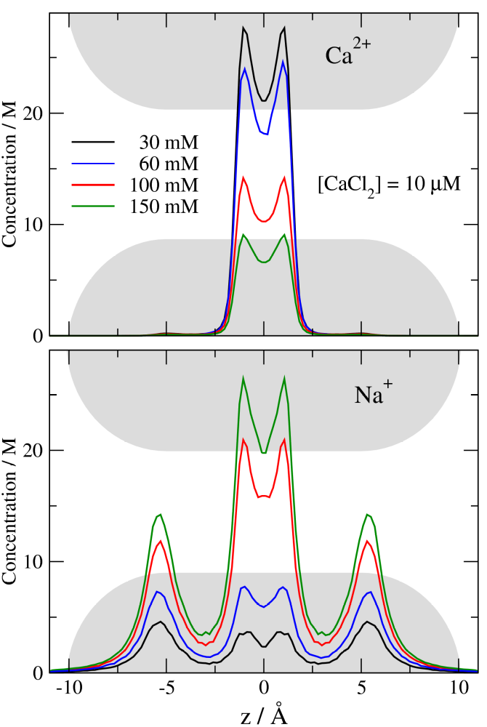
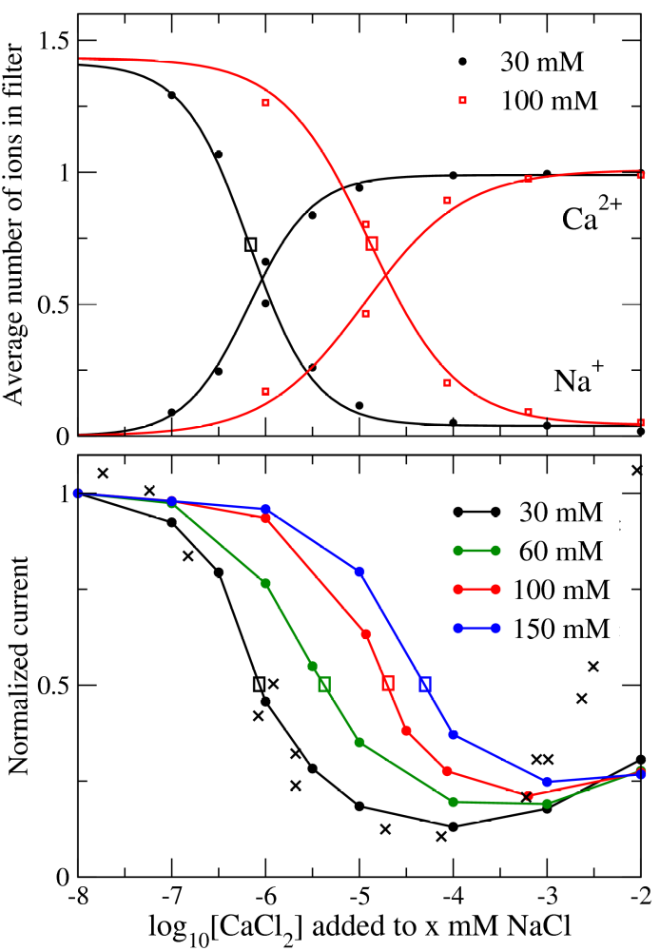
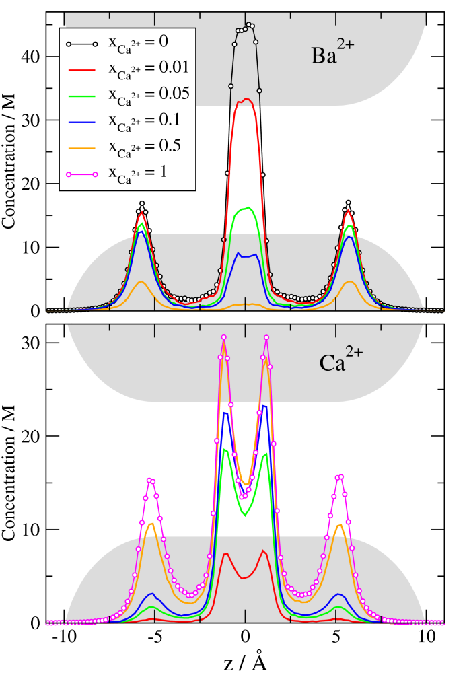
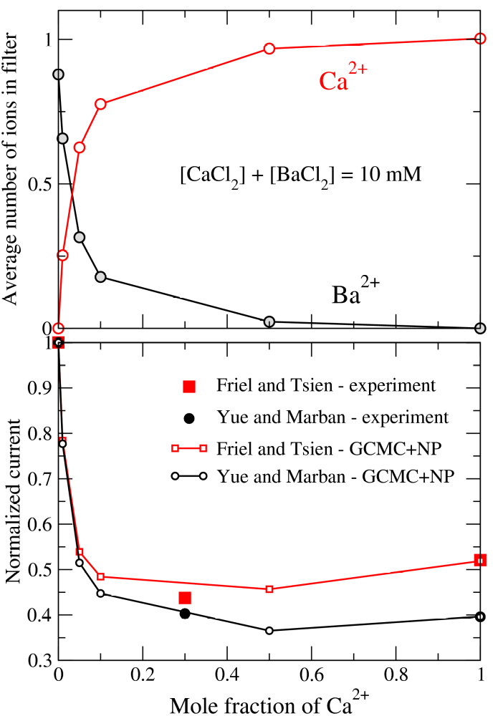
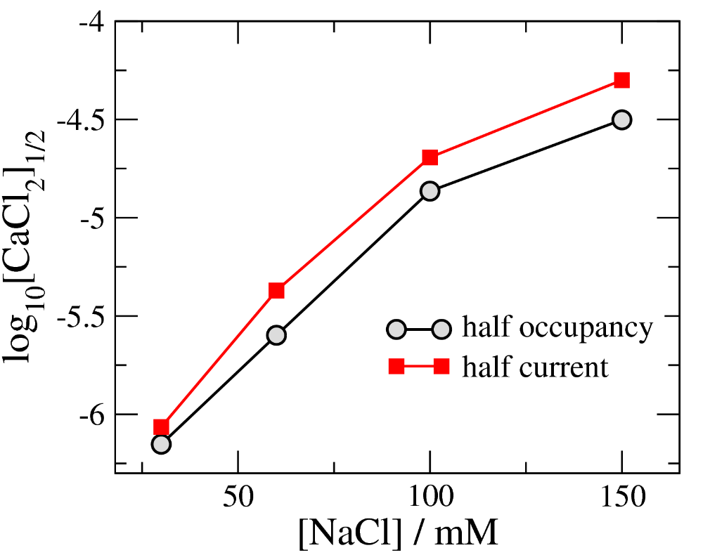
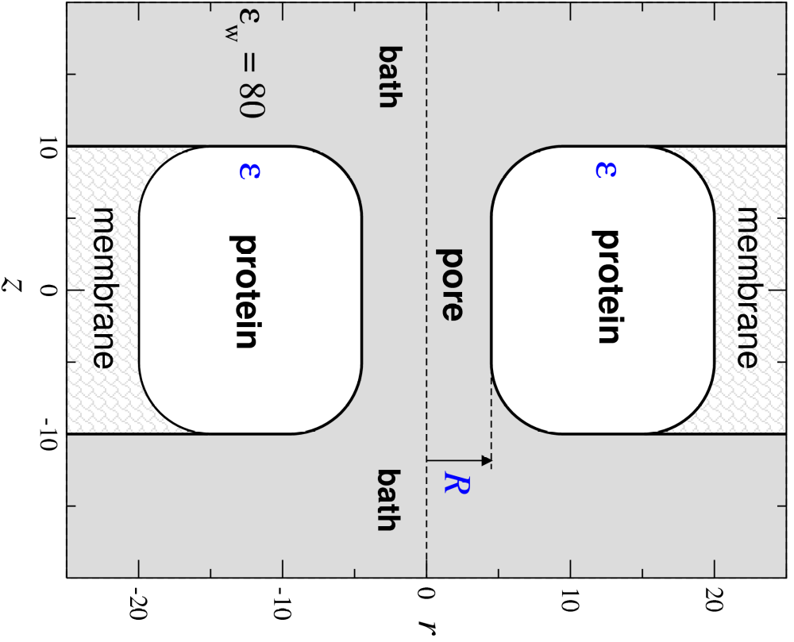
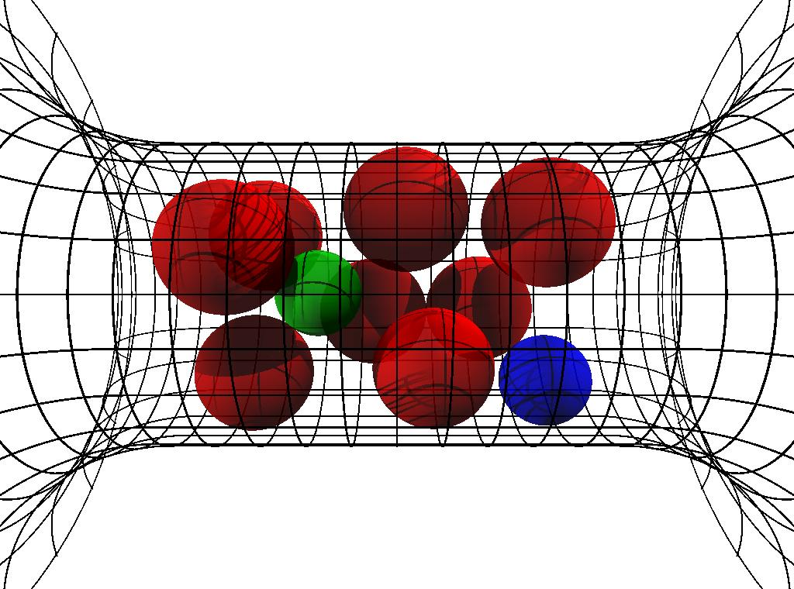
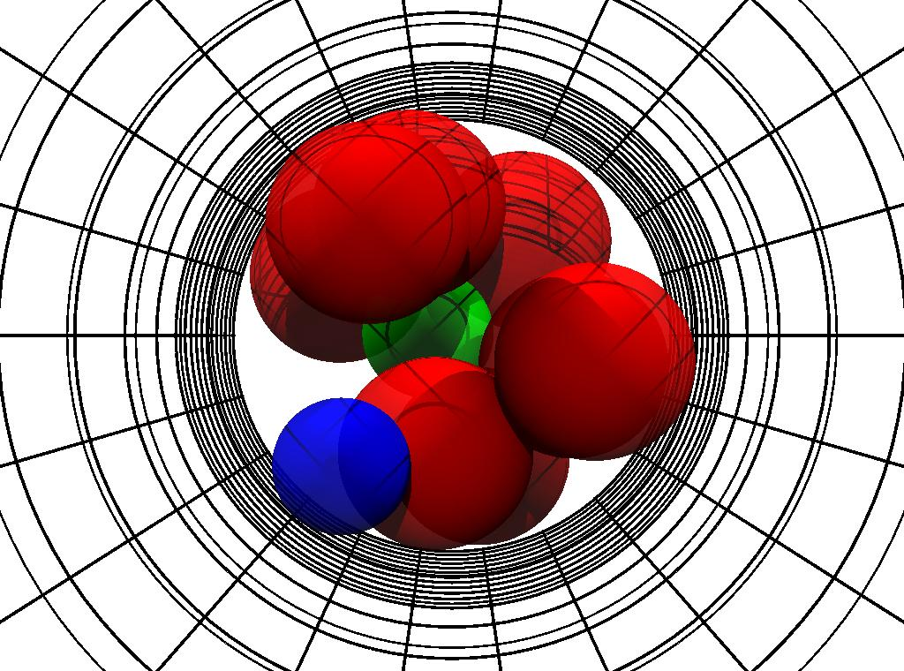
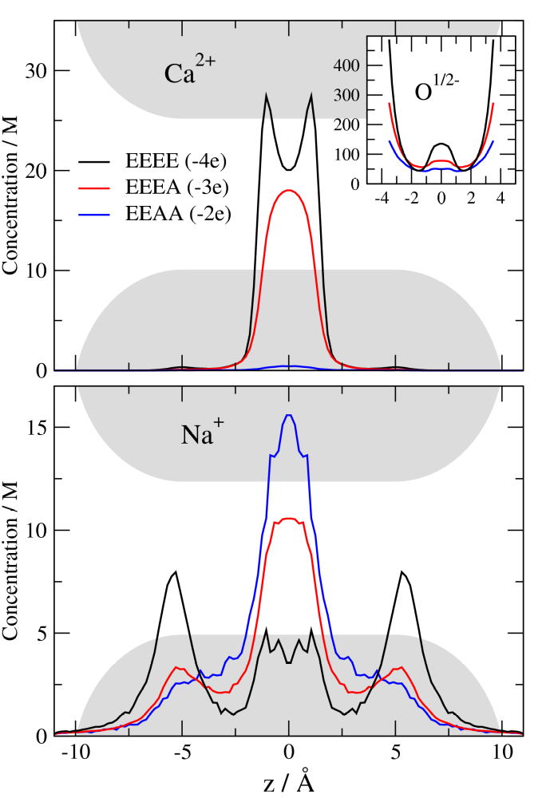
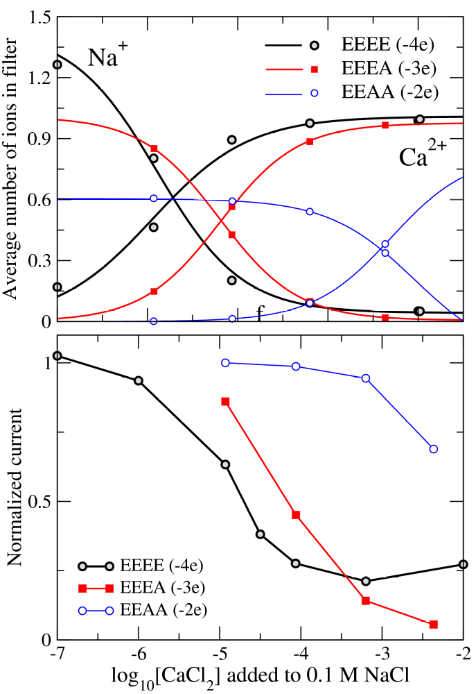
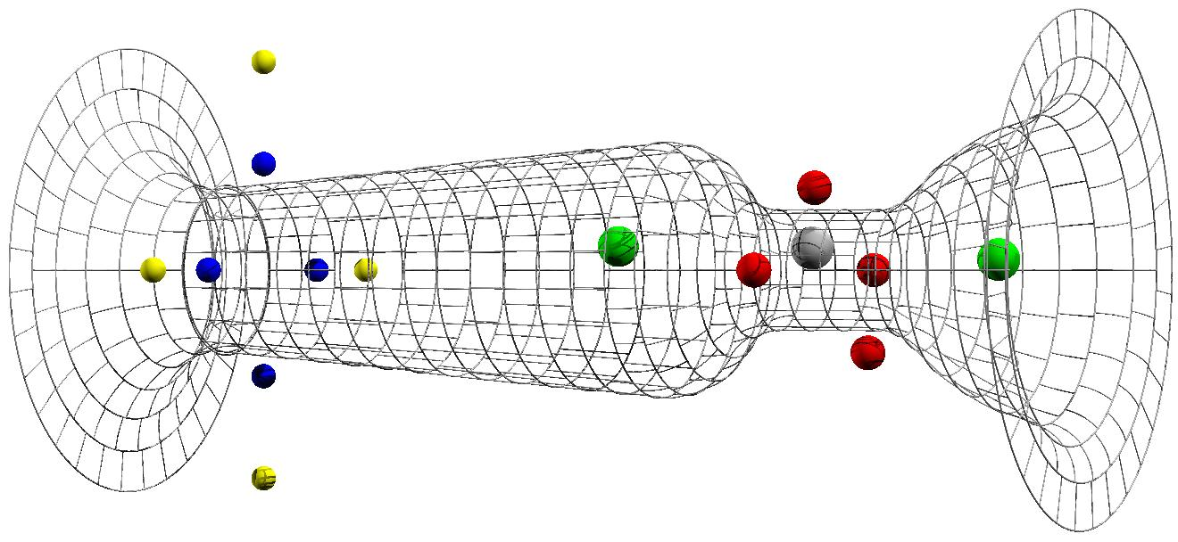
Competition of Steric Repulsion and Electrostatic Attraction in Model Calcium Channels
Dezső Boda^{1,2}, Wolfgang Nonner³, Mónika Valiskó², Douglas Henderson⁴, Bob Eisenberg¹, Dirk Gillespie¹
¹Rush University Medical Center, Chicago, IL; ²University of Pannonia, Veszprém, Hungary; ³Miller School of Medicine University of Miami, Miami, FL; ⁴Brigham Young University, Provo, UT
Abstract
CSC model has micromolar Ca²⁺ selectivity
Size selectivity: Ca²⁺ vs. Ba²⁺ AMFE
Calcium channels conduct Na ions in the absence of Ca²⁺, but they selectively conduct Ca²⁺ ions when Ca²⁺ ions are present at physiological concentrations. In the anomalous mole fraction effect (AMFE), even a micromolar amount of Ca²⁺ ions effectively blocks Na current. Many attempts have been made to explain the mechanism behind these phenomena. In our model of the selectivity filter of Ca channels, the end-groups of the side chains of amino acids - four glutamates - in the selectivity filter are represented as mobile ions that are restricted so they move inside the filter. These structural ions form a liquid-like self-adjusting environment for the passing ions so that the system assumes minimum free energy. They also fill part of the pore so the counterions have to compete for space in the crowded selectivity filter. In this picture electrostatic attraction and repulsive entropic excluded volume effects compete with each other to determine which ions can enter the selectivity filter. We argue that this competition is crucial in explaining the selectivity mechanism of Ca channels. We show Monte Carlo simulation results for competition between ions of different valence and diameter. We predict that Ca²⁺-selectivity depends on the background concentration of NaCl. We show that our model can explain the micromolar Ca²⁺-selectivity observed in the L-type Ca channel. We also show results for an alternative model of Ca²⁺ channels developed by Corry et al. In this model, the structural ions are placed in fixed positions behind the protein wall. We show that this rigid model cannot reproduce the micromolar selectivity of the L-type Ca channel.
Ca²⁺-selectivity depends on NaCl concentration:
As [NaCl] increases, Ca²⁺-affinity decreases.
D_{Ca}/D_{Na} ratios adjusted to experi- mental values at x_{Ca}=1.
Experiments:
Friel and Tsien,PNAS, 1989, 86:
5107. D_{Ca}/D_{Na}=0.280
Yue and Marban, JGP,1990, 95:
911. D_{Ca}/D_{Na}=0.214
AMFE is a result of different concentration dependence in the high affinity central region of the filter (-2.5 < z < 2.5) and in the depletion regions (2.5 < |z| < 5).
For details, see neighboring poster 2221-POS/B336.
The CSC model
The Charge Space Competition (CSC) model states that cations are attracted into the selectivity filter by charged amino acids making for a very crowded filter where it is difficult for ions to find space. This competition of energy and entropy favors small and/or divalent ions in the crowded filter because they provide more charge in less space to balance the charge of the structural ions of the selectivity filter.
Theory vs. Experiments
Concentration profiles of Ca²⁺ and Na⁺ along the pore for various [NaCl]. In the CSC model there is lots of Ca²⁺ in the selectivity filter at micromolar [CaCl₂].
Occupancy curves of Ca²⁺ and Na⁺ and normalized currents for various [NaCl]. X symbols are the experimental data of Almers et al. (J. Physiol. 353: 565) for 32 mM NaCl.
Occupancy of Na⁺ in the selectivity filter is a measure of the Ca²⁺-block of Na⁺ current because they are strongly correlated.
Concentration profiles of Ca²⁺ and Ba²⁺ along the pore for various Ca²⁺ mole fractions x_{Ca}=[Ca²⁺]/c_{total}., where the total concentration is kept fixed at c_{total}=10 mM.
Occupancy curves of Ca²⁺ and Ba²⁺ and normalized currents for two experiments. One group found an AMFE, one group did not. We reproduce both results.
Channel: a doughnut shaped object
with a pore in the middle with protein
dielectric coefficient ε=10 and
pore radius R=3.5Å.
It is embedded in a membrane that
separates two baths.
Ions: charged hard spheres, solvent:
continuum dielectric (ε_{w} = 80)‏
Selectivity filter: central pore
containing characteristic amino acid
side chains: hard sphere ions model
the terminal groups of the side
chains: E: two half charged oxygens
(O^{1/2-}, red balls in figures to the left).
The Ca channel model of Corry et al. is only weakly Ca²⁺-selective
Loss of Ca²⁺ selectivity in E A mutations
Squares and solid lines: results of direct
Brownian Dynamics simulations
Dashed and dotted lines: results of
extrapolations
X: Experimental data of Almers et al.
Concentration profiles of Ca²⁺ and Na⁺ along the pore for mutations for
[CaCl₂] = 86 μM and [NaCl] = 100 mM.
They simulated >18 mM Ca²⁺, and extrapolated four orders of magnitude to micromolar concentrations.
We directly simulated micromolar Ca²⁺ concentrations and showed that the Corry et al. model has >100 μM Ca²⁺-affinity, not 1 μM.
We showed that placing structural ions in the selectivity filter of the Corry et al. model, micromolar Ca²⁺ selectivity is restored.
This indicates that the excluded volume of the ions is important.
Occupancy curves of Ca²⁺ and Na²⁺ and normalized currents for various mutations.
The Ca channel model of Corry et al. (Biophys. J. 2001, 80: 195)‏
Mutating the negatively charged E into the neutral and small A, the Ca²⁺-affinity of the channel decreases.
The Ca²⁺ block of Na⁺ currents occurs at higher Ca²⁺ concentration for EEEA.
In the weakly charged filter (EEAA) there is no Ca²⁺ block because no depletions regions for Ca²⁺ form.
The Corry et al. model contains
a narrow selectivity filter surrounded by
structural charges in fixed positions behind the
wall (red balls in the figure),
a large cavity that imposes a dielectric barrier,
dipoles at the intracellular entrance (yellow and
blue balls in the figure)‏
Axial distributions of Ca²⁺ and Na⁺ along the pore for different Ca²⁺ concentrations. In the Corry et al. model there is almost no Ca²⁺ in the filter at micromolar Ca²⁺ concentration.
Upper panel: the extrapolated results of Corry et al. Bottom panel: Occupancy curves of Ca²⁺ and Na⁺ as obtained from GCMC simulations.
Methods
Equilibrium profiles are computed with Grand Canonical Monte Carlo simulations
(micromolar Ca²⁺ concentrations can be simulated directly).
Normalized currents are computed by substituting these profiles into the integrated Nernst-
Planck equation with the assumptions that the electrolytes are symmetric on the two sides of
the membrane, voltage is small, and that flux is limited in the selectivity filter.
The adjustable parameter of this calculation is the ratio of the diffusion coefficients of the two
ions (for example, D_{Ca}/D_{Na}=0.1 was used here).
For details, see neighboring poster 2221-POS/B336.
Conclusions
References
Selectivity is a result of the balance of electrostatic forces (energy) and excluded volume of ions (entropy).
The mobile terminal groups of protein side chains have a close interaction with ions: they form a liquid-like
flexible environment that is more similar to an ionic liquid than to a dilute electrolyte solution.
The CSC model reproduces experimental results and makes predictions (experiments are needed).
A large range of phenomena is explained using only basic physical forces and robust, reproducible methods.
CSC model: Nonner, W., Catacuzzeno, L., and B. Eisenberg. 2000. Biophys. J. 79:1976.
Effect of protein dielectric coefficient and pore radius: Boda et al., 2006, J. Chem. Phys. 125: 034901;
Boda et al., 2007. Phys. Rev. Lett. 98:168102.
Application to Na channels: Boda et al. 2007, Biophys. J. 93: 1960.
Application to the model of Corry et al.: Boda et al. 2008, Biophys. J. in press, doi:10.1529/biophysj.107.122796

