Slide 1


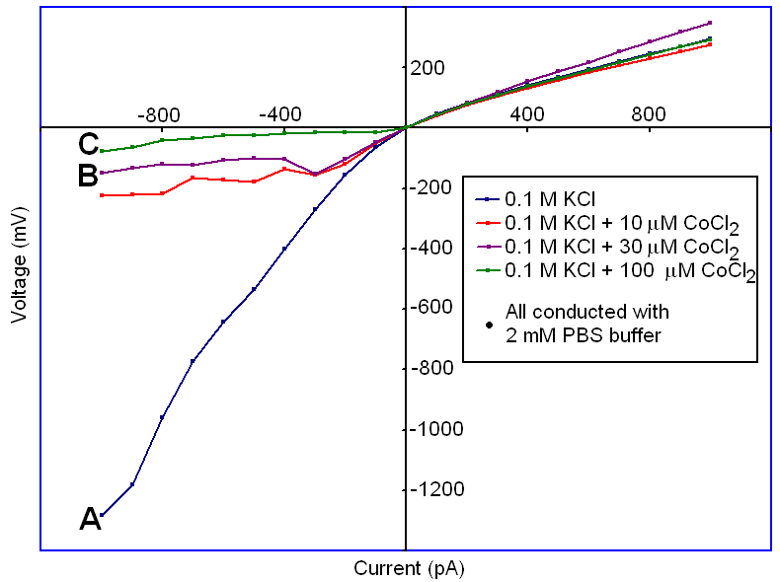
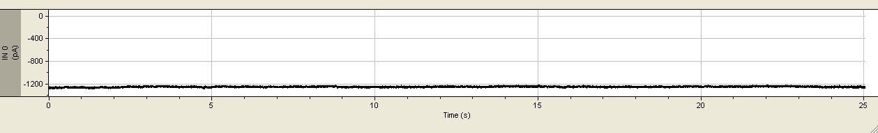
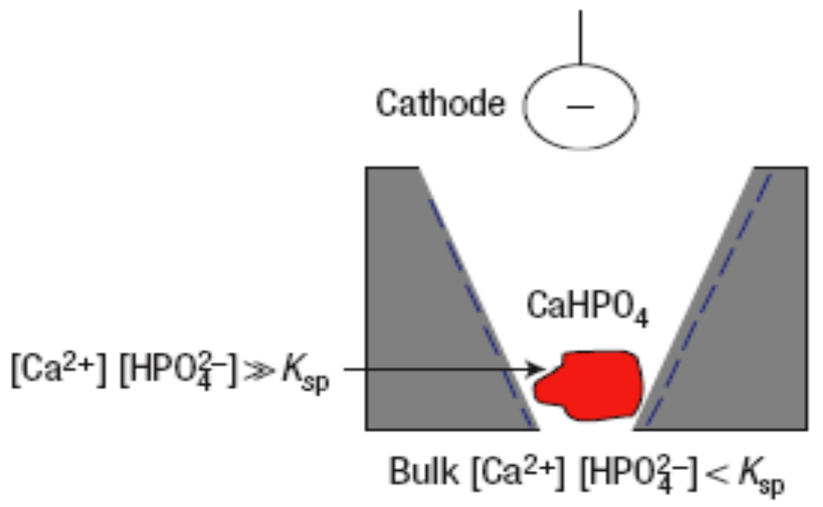

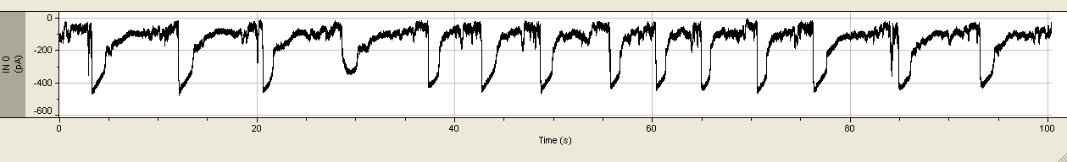

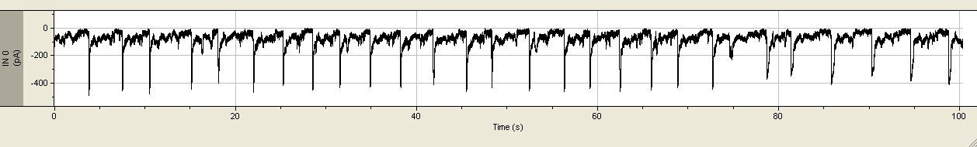
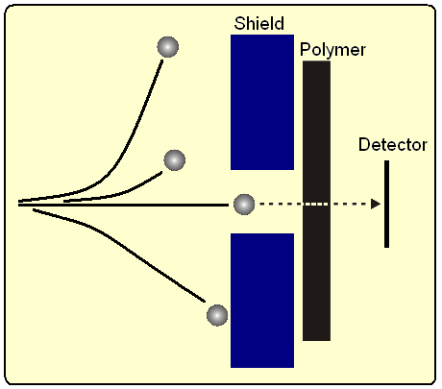
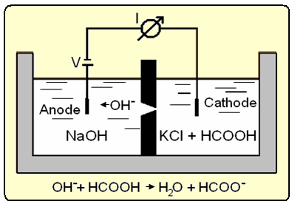
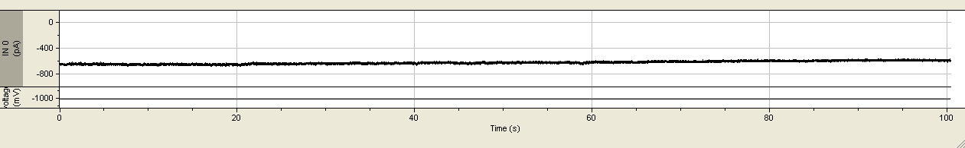
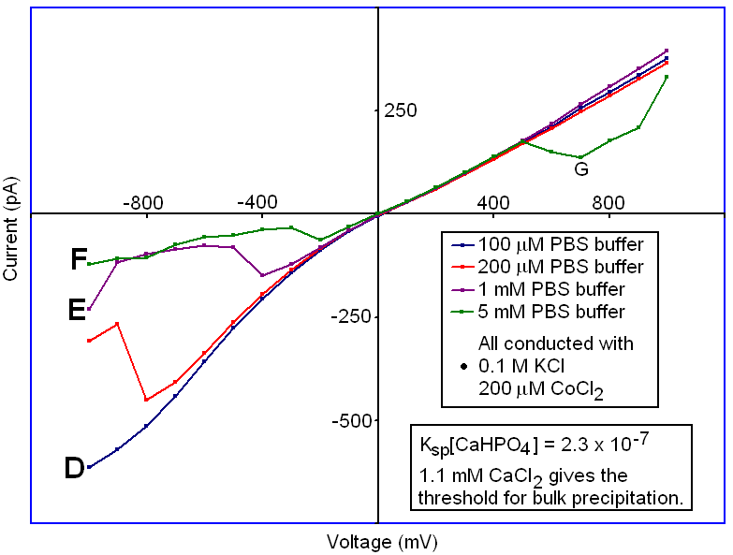
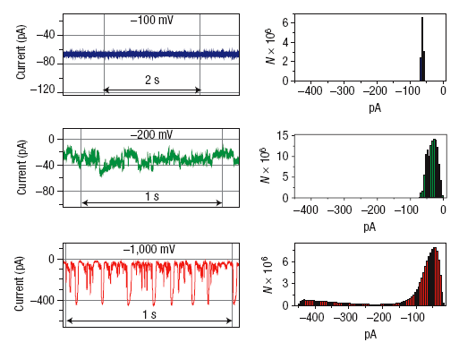
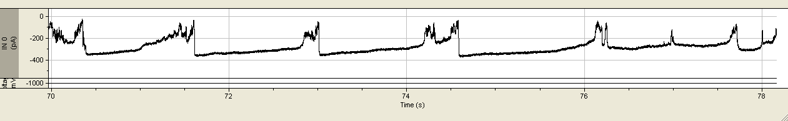
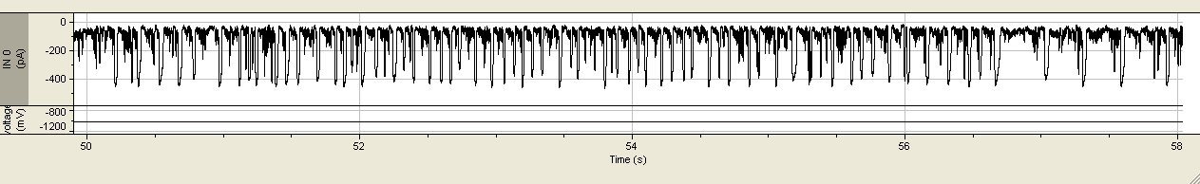

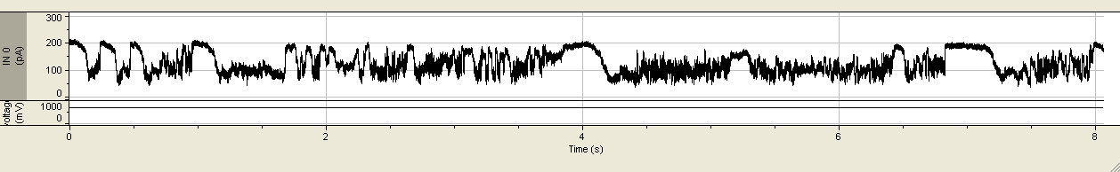
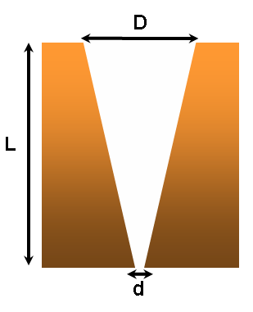
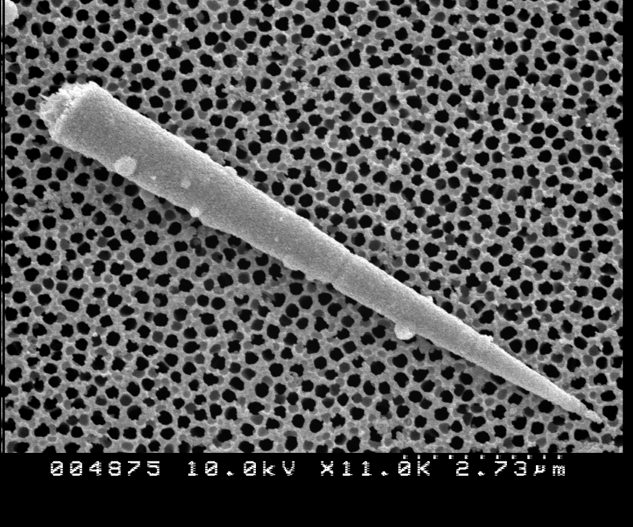
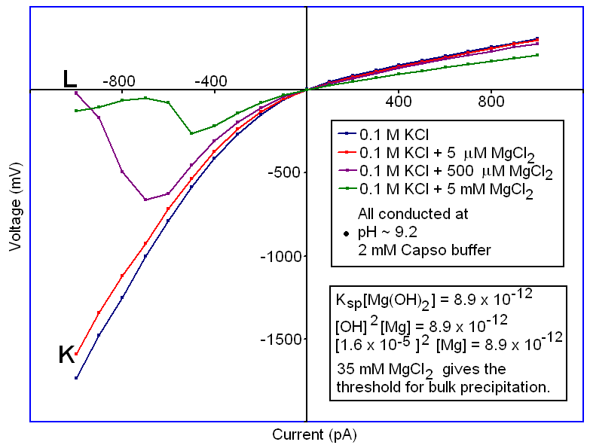

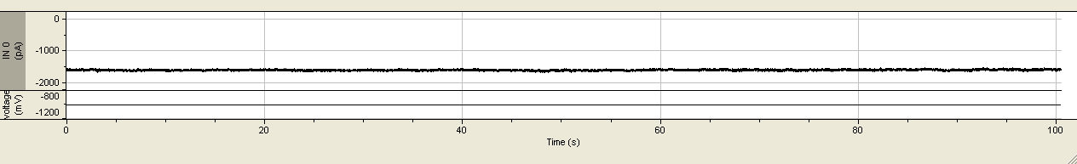
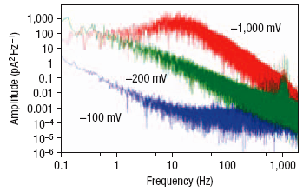
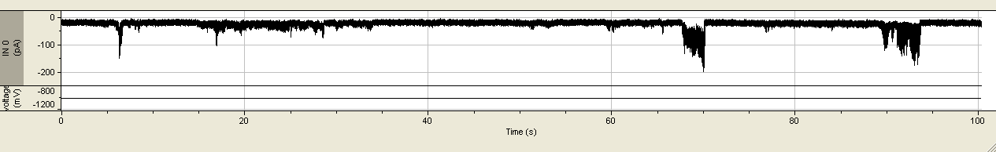
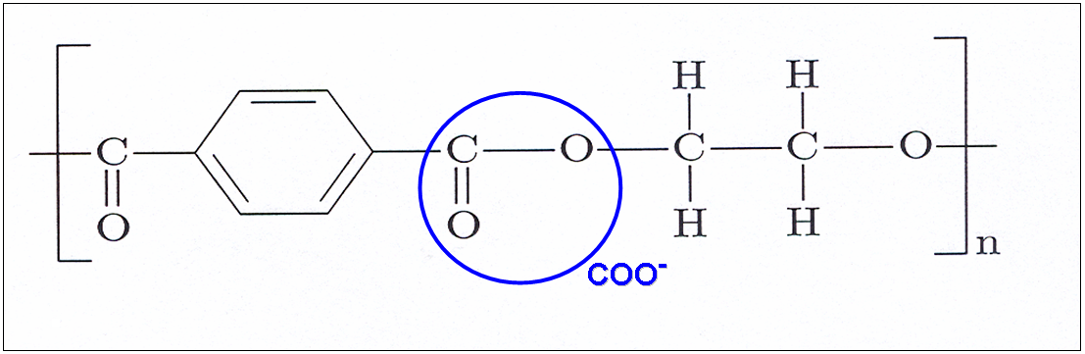
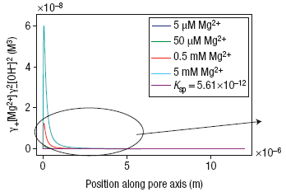
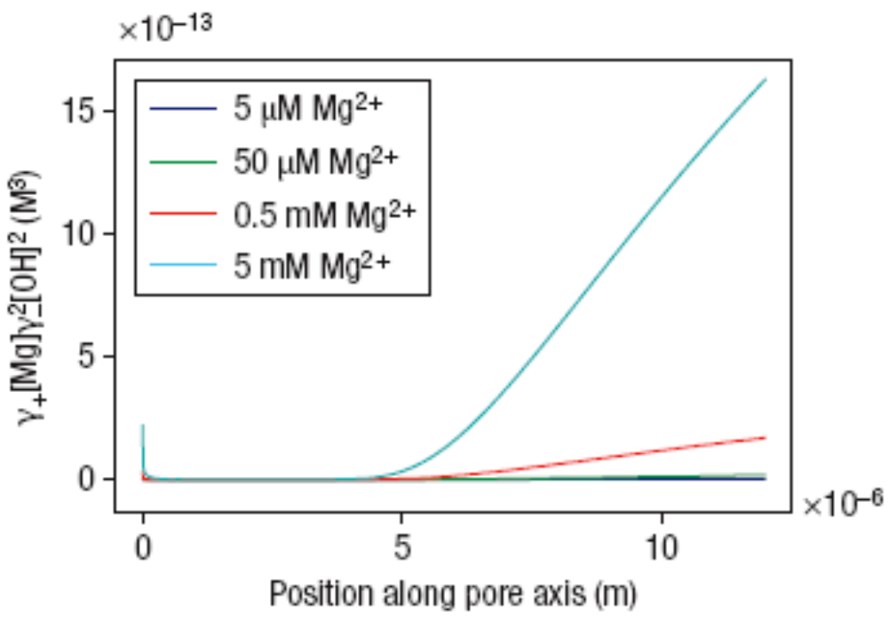
Ion Current Oscillations Caused by Femtoliter Volume Precipitation in a Nanopore
MATTHEW R. POWELL¹, MICHAEL SULLIVAN¹, IVAN VLASSIOUK¹, DRAGOS CONSTANTIN¹, OLIVIER SUDRE², CRAIG C. MARTENS³, ROBERT S. EISENBERG⁴, AND ZUZANNA S. SIWY¹*
¹Department of Physics and Astronomy, University of California, Irvine, California 92697, USA ²Teledyne Scientific Co., 1049 Camino Dos Rios, Thousand Oaks, California 91360, USA
³Department of Chemistry, University of California, Irvine, California 92697, USA ⁴Rush Medical College, Department of Molecular Biophysics & Physiology, Chicago, Illinois 60612, USA *e-mail: zsiwy@uci.edu
Abstract
Cobalt Induced Oscillations with PBS Buffer
The fixed negative surface charges inside single conical polymer nanopores result in transport properties not encountered in micrometer-scale counterparts. A notable example of an effect caused by these permanent negative charges is the enhancement of ionic concentration inside the pore when compared to the bulk solution. The nanopores described here are created with the track etching technique resulting in a conical geometry having a large opening of hundreds of nanometers and a small opening of several nanometers. A new phenomenon is presented detailing an oscillating ionic current through our conical nanopore when a small amount of a divalent cation is added to a buffered monovalent ionic solution. An ionic current enhancement brought on by the superposition of the electric field from the fixed negative surface charges and the externally applied electric field causes a formation and redissolution of nanoprecipitates that temporarily block the ionic current through the pore. The frequency and character of these ionic current oscillations is regulated by the transmembrane potential and the chemistry of the nanoprecipitate. This oscillating system could be used as a model for studying nonlinear electrochemical processes and early stages of crystallization.
Control recording, 0.1 M KCl
Nanopore Fabrication
When the negatively biased electrode (cathode) is at the larger opening of a conical nanopore, cations will move from the narrow opening towards the larger opening of the cone. The activities of Ca²⁺ and HPO₄²⁻ ions inside the nanopore then rise above the solubility product K_{sp} of CaHPO4, allowing nanoprecipitation to occur.
Heavy Ion Irradiation
Chemical Etching
PBS Buffer Dependence on Calcium Induced Oscillations
A high energy single heavy ion creates a damage track through the polymer film.
Sodium hydroxide etches along the damage track until breakthrough occurs and the etching is stopped.
Single Conical Nanopore Dimensions
Magnesium Hydroxide Precipitation
Ion current time series along with current histograms for various applied voltages as indicated, with 0.1 M KCl, 0.2 mM CaCl² and 5 mM PBS.
L = 12 micrometers
D ~ 450 nanometers
d ~ 3 nanometers
A gold electroless deposition “negative” of a conical PET nanopore. (Univ. of Florida)
Pore Wall Surface Charge
Modeling of the Theoretical Concentration for the Magnesium Hydroxide Precipitation
Power spectra of the ion current recordings above. The peak between 10 Hz and 20 Hz for the -1,000 mV time series corresponds to oscillations of that frequency, which can be clearly seen from the time series.
-1000 mV
+1000 mV
Theoretical results from the one-dimensional Poisson–Nernst–Planck model mapping the products of the magnesium and hydroxide activities for -1,000 mV (left), +1,000 mV (right), along the pore axis. Position 0 corresponds to the tip of the pore. The modelling confirms that the ionic concentrations in the pore are very different for the two voltage polarities, allowing the nanoprecipitates to form for negative voltages.
Acknowledgements:
Irradiation with swift heavy ions was performed at the Gesellschaft fur Schwerionenforschung (GSI), Darmstadt, Germany. We thank the Alfred P. Sloan Foundation, the Institute for Surface and Interface Science and the Institute for Complex Adaptive Matter for financial support.
Etching PET with NaOH produces carboxyl groups on the polymer surface. Surface density of these groups is estimated at ~1.5 per nm².

