Slide 1
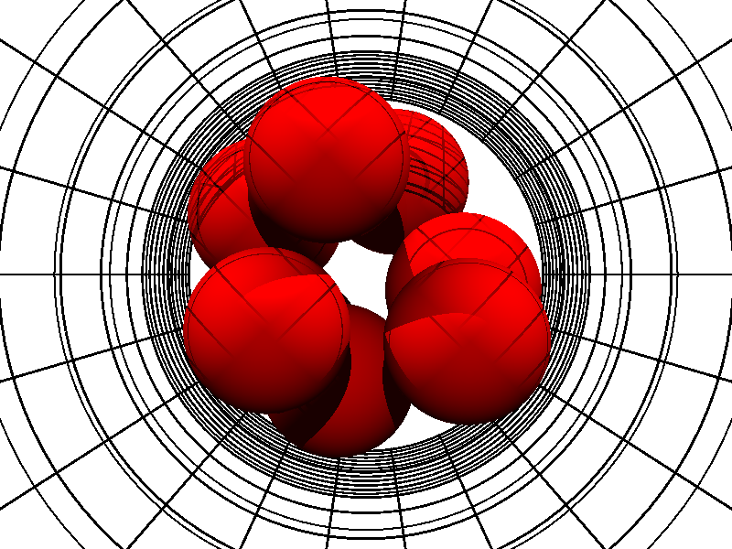
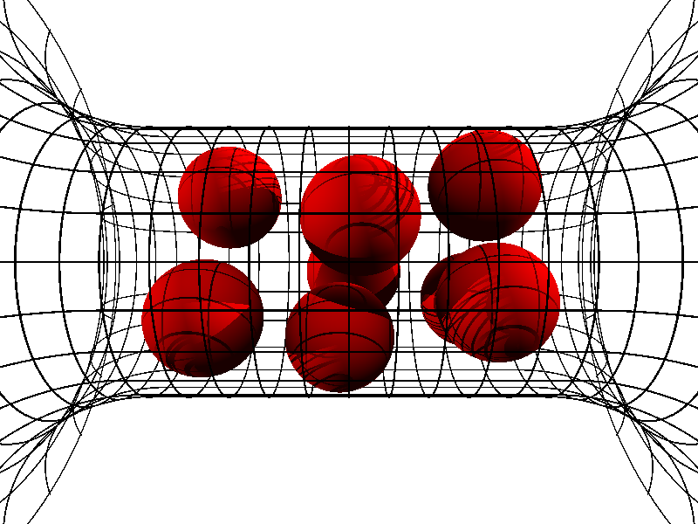
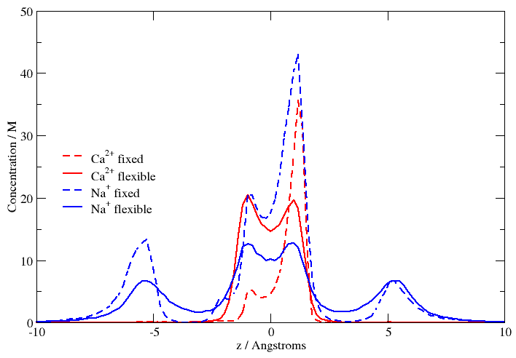
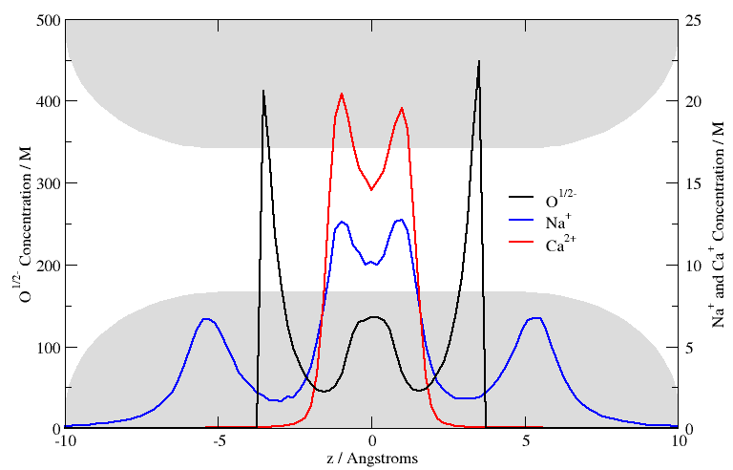
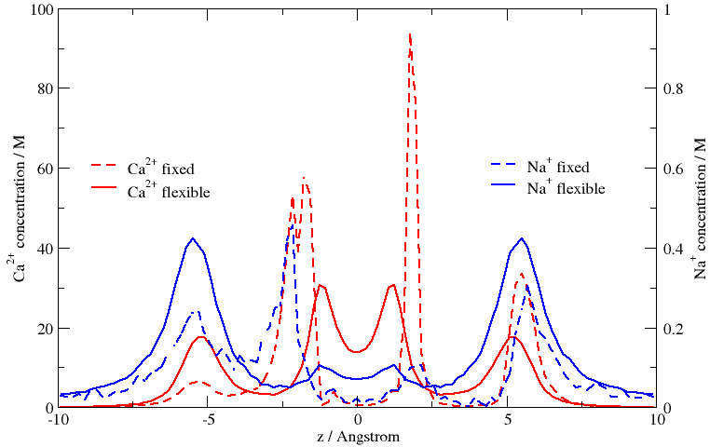
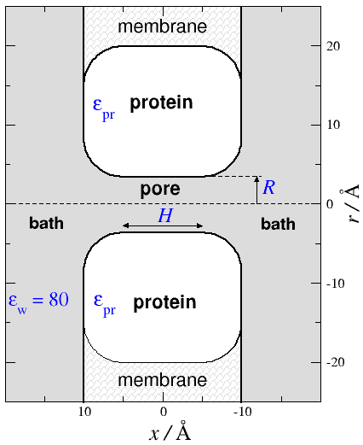
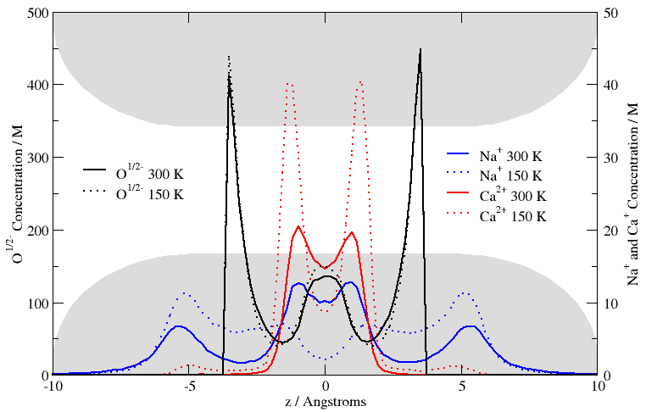
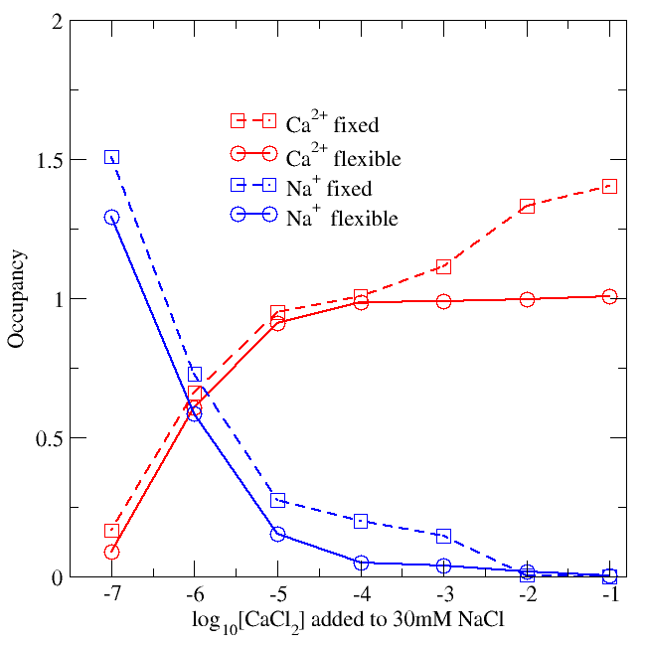
Self-organized Models of Selectivity in Ca and Na Channels
Bob Eisenberg¹, Dezső Boda², Janhavi Giri^{1,3}, James Fonseca¹, Dirk Gillespie¹, Douglas Henderson⁴, Wolfgang Nonner⁵
¹ Rush University Medical Center, Chicago, IL, USA; ² University of Pannonia, Veszprém, Hungary; ³ University of Illinois at Chicago; ⁴ Brigham Young University, Provo, UT , USA; ⁵ Miller School of Medicine, University of Miami, FL , USA
Abstract
Lowest Energy Oxygen Configuration
Location is Sensitive to Flexibility
A simple pillbox model with two adjustable parameters accounts for the selectivity of both DEEA Ca channels and DEKA Na channels in many ionic solutions of different composition and concentration. Only the side chains are different in the model of the Ca and Na channels. Parameters are the same for both channels in all solutions. 'Pauling' radii are used for ions. No information from crystal structures is used in the model. Side chains are grossly approximated as spheres. The predicted properties of the Na and Ca channels are very different. How can such a simple model give such powerful results when chemical intuition says that selectivity depends on the precise relation of ions and side chains? We use Monte Carlo simulations of this model that determine the most stable-lowest free energy-structure of the ions and side chains. Structure is the computed consequence of the forces in this model. The relationship of ions and side chains vary with ionic solution and are very different in simulations of the Na and Ca channels. Selectivity is a consequence of the 'induced fit' of side chains to ions and depends on the flexibility (entropy) of the side chains as well as their location. The model captures the relation of side chains and ions well enough to account for selectivity of both Na channels and Ca channels in the wide range of conditions measured in experiments. Evidently, the structures in the real Na and Ca channels responsible for selectivity are self-organized, at their free energy minimum. Oversimplified models are enough to account for selectivity if the models calculate the 'most stable' structure as it changes from solution to solution, and mutation to mutation.
Cation profiles from simulations with fixed and flexible oxygen configurations:
At 1 μM CaCl₂ and 30 mM NaCl, the channel is occupied equally by Na and Ca. At high Ca concentration [1 mM], the channel is mostly occupied by Ca.
Fixing the oxygen ions perturbs the interactions with cations, which greatly changes the cation distributions.
Ca depletion zones are observed in the fixed oxygen case but not when the oxygen ions are flexible. Depletion zones are an important factor of selectivity.
[CaCl₂] = 1μM
Fixed Oxygen Locations: Predetermined coordinates are unchanged throughout the simulation. The oxygen ions are held in a lowest energy configuration.
Full Oxygen Flexibility: Control case; oxygen atoms are free to move within channel cylinder. The oxygen distribution is an output of the simulation.
[CaCl₂] = 1mM
Model of channel and electrolyte
On the basis of a reduced model using known structural information (amino acid sequences of the selectivity filter) we can explain the selectivity properties of the Ca channel in a wide range of conditions.
The mechanism works on the basis of a competition between electrostatic and excluded volume effects: ions compete for space in the crowded selectivity filter.
Temperature Dependence
Occupancy is Less Sensitive to Flexibility
At 300K, 1 μM CaCl₂, and 30 mM NaCl, the channel is equally occupied by Na and Ca.
Reducing the temperature to 150K greatly affects the cation concentration profiles as well as their occupancies.
The occupancy refers to the average number of various ions (Na⁺ or Ca²⁺) in the selectivity filter.
At low CaCl₂ concentrations, the occupancies are not significantly different for the fixed and flexible cases
Total occupancy depends on the competition between electrical forces and volume exclusion forces arising in a space crowded with ions and side chains
Channel: a doughnut shaped object with a pore in the middle connecting the baths
Parameters: only two parameters. Both held to fixed values in all conditions
  dielectric coefficient ε_{p} = 10
  pore radius R = 3.5 Å
Ions: charged hard spheres with crystal radii,
Solvent is a continuum dielectric (ε_{w} = 80)
Selectivity filter: central pore containing characteristic amino acid side chains
Side chains: hard sphere ions represent the end groups of the side chains
4 Glutamates = eight half charged oxygen atoms (O^{1/2-}) in the model
GCMC Method: Equilibrium Monte Carlo Simulations (Grand Canonical Ensemble)
Conclusions
Concentration profiles of cations depend on the flexibility of side chains
Occupancy is less sensitive to oxygen flexibility
Simulations need to estimate flexibility correctly
Spatial distribution of ions is a sensitive function of the flexibility of side chains and concentrations of ions in the baths
The structure of the binding site must be simulated accurately
Structural charges (O^{1/2-}) move in the flexible case. The filter contains a high density liquid-like structure that minimizes free energy
Structure of the binding site is an OUTPUT of the simulation and depends on conditions.
Only basic physical forces (electrostatic and excluded volume) were used to develop this mechanism. No specific chemical binding forces were assumed.
References
Nonner et al, Binding and selectivity in L-type calcium channels: A mean spherical approximation Biophys. J, 79, 1976 (2000).
Boda et al, Monte Carlo simulations of the mechanism for channel selectivity: The competition between volume exclusion and charge neutrality J. Phys. Chem. B 104, 8903 (2000).
Boda et al, The effect of protein dielectric coefficient on the ionic selectivity of a calcium channel J. Chem. Phys. 125, 034901 (2006).
NIH (Grant GM076013), Hungarian National Research Fund (Grant OTKA K63322), NATO Grant No. PST.CLG.980366, the Rush University Committee on Research the Ira and Marylou Fulton Supercomputing Center of BYU is gratefully acknowledged.

