Slide 1
Hodgkin Huxley Equation Bob Eisenberg Lectures at Illinois Tech and Rush Medical Center October 19, 2018

Slide 2
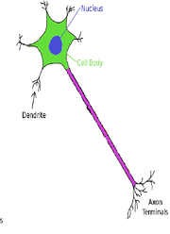
Example:
Real Biological System
A Nerve Cell is a Hierarchy of Devices Cell Body, Dendrites, Axon, Terminals
Structural Complexity of Biology Creates a Hierarchy of Devices
Axon
1 m

Slide 3
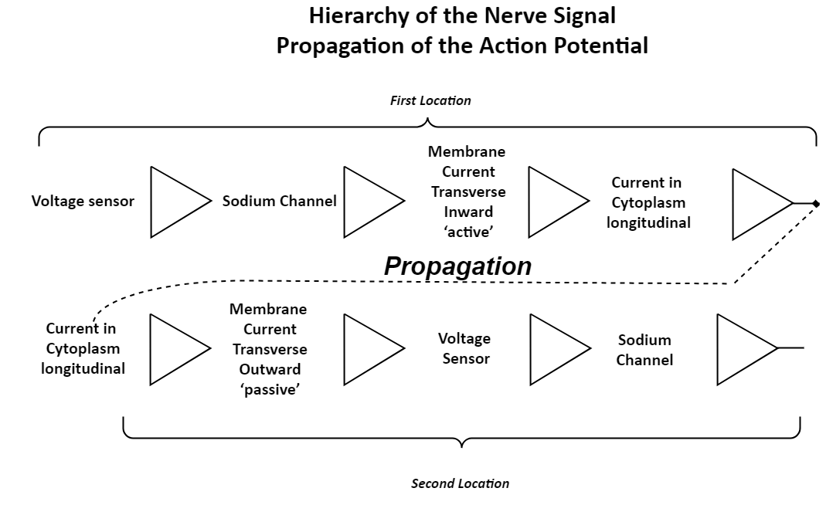

Slide 4
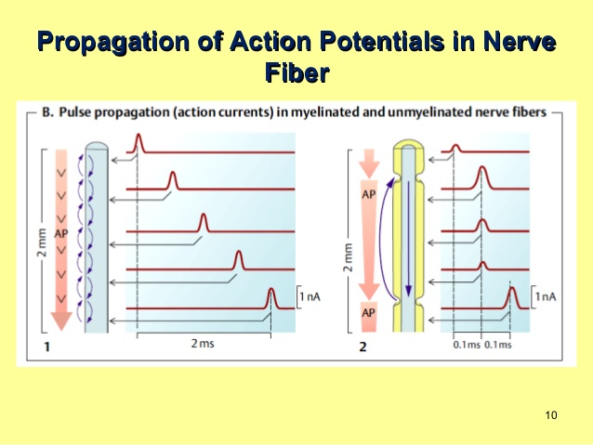
Can never be simulated in atomic detail
Do you see why?
Hint: how many pair-wise interactions? Are interactions in fact just pair-wise or do they involve many more than two particles?

Slide 5
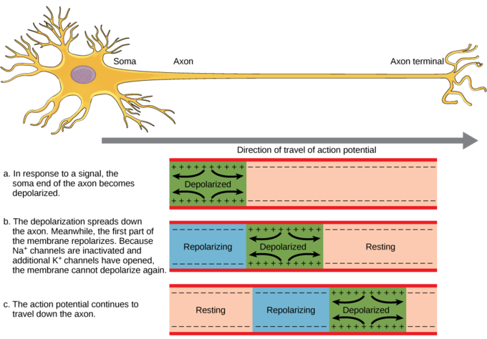
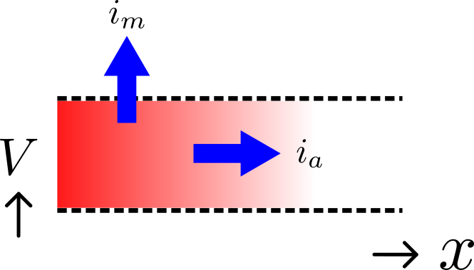
Transverse in out Membrane Current
vs
Longitudinal Cytoplasmic Current
Classical cable theory of transmission lines, telegrapher’s equations, Kelvin, Hodgkin, Noble, extended to 3D-cable theory, ~10 papers, e.g., Barcilon, Cole, Eisenberg. 1971. Singular Perturbation … SIAM J. Appl. Math. 21:339-354.
Another talk, another time!

Slide 6
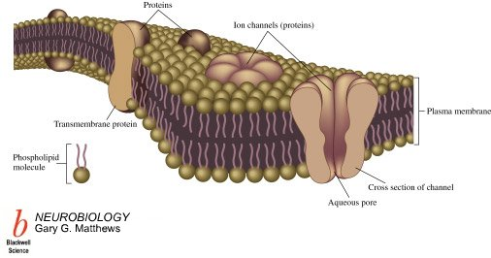
Channels are Energy Source of Signal
2.5 nM
Lipid molecule
Cannot use a theory that assumes zero flow to predict non-zero flow

Slide 7

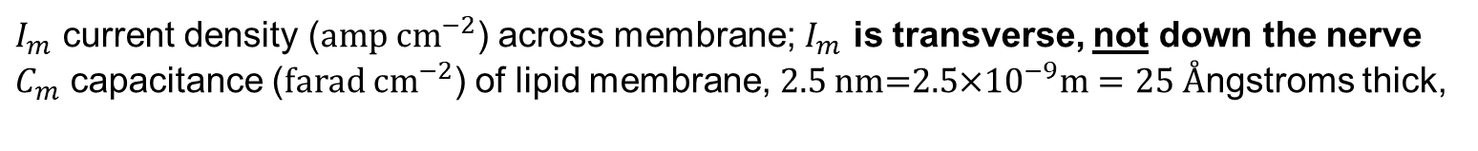
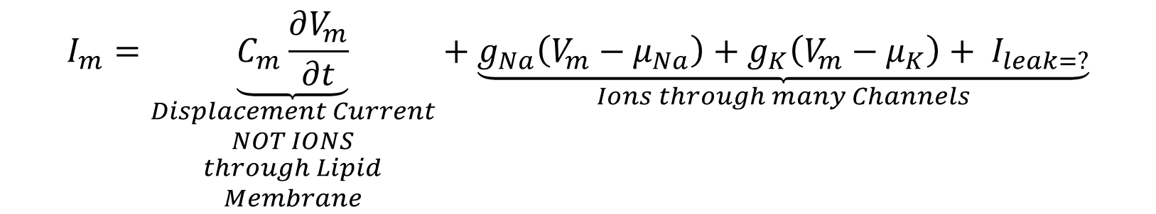
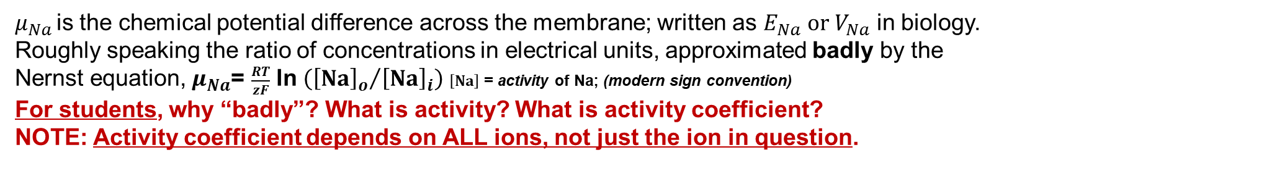
Hodgkin Huxley Equations
For experts mostly Biology as inverse problem, Choose the animal and ‘preparation’ wisely Hodgkin and Huxley chose squid,
Because?
The axon = the nerve fiber (of invertebrates, no myelin insulation)
$$I_{m}$$
$I_{m}$ current density (${amp cm}^{−2}$) across membrane; $I_{m}$ is transverse, not down the nerve
$C_{m}$ capacitance (${farad cm}^{−2}$) of lipid membrane, $2.5$ nm=$2.5$×${10}^{−9}m=25 Å$ngstroms thick,
$$I_{m}=\underset{\begin{aligned}Displacement Current \\ NOT IONS \\ through Lipid \\ Membrane\end{aligned}}{\underbrace{C_{m}\frac{∂V_{m}}{∂t}}}+\underset{Ions through many Channels}{\underbrace{g_{Na}\left(V_{m}−μ_{Na}\right)+g_{K}\left(V_{m}−μ_{K}\right)+ I_{leak=?}}}$$
For students: What is this?
Lipid bilayer is a parallel plate capacitor with dielectric constant $=1.7=\left(0\text{.6 }μ\text{F} {cm}^{−2}\right)×\left(\text{2.5}×{10}^{−9}m\right)$×${\left(8.85{×10}^{−12}F m^{−1}\right)}^{−1}$
F = Farad; $Å$ngstrom = ${10}^{−10}m$; $μ={10}^{−6}$; $n={10}^{−9}$
$μ_{Na }$is the chemical potential difference across the membrane; written as $E_{Na} or V_{Na}$ in biology. Roughly speaking the ratio of concentrations in electrical units, approximated badly by the
Nernst equation, $μ_{Na}$= $\frac{RT}{zF}$ ln$\left({{\left[Na\right]}_{o}}/{{\left[Na\right]}_{i}}\right)$ $\left[Na\right]$ = activity of Na; (modern sign convention)
For students, why “badly”? What is activity? What is activity coefficient? NOTE: Activity coefficient depends on ALL ions, not just the ion in question.

Slide 8
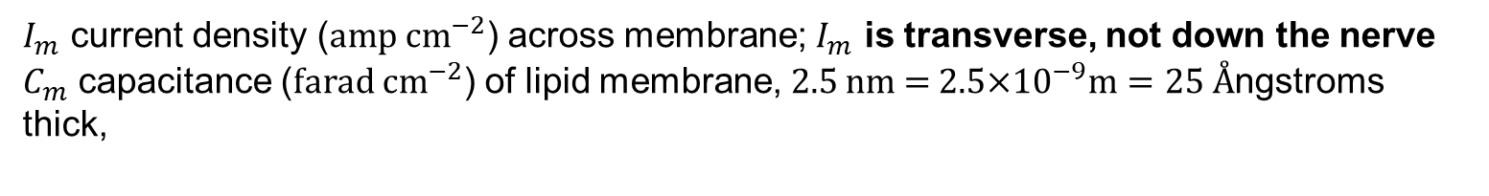

Hodgkin Huxley Equations
$$I_{m}$$
$I_{m}$ current density (${amp cm}^{−2}$) across membrane; $I_{m}$ is transverse, not down the nerve
$C_{m}$ capacitance (${farad cm}^{−2}$) of lipid membrane, $2.5$ nm =$2.5$×${10}^{−9}m=25 Å$ngstroms thick,
$$I_{capacitor}=\underset{\begin{aligned}Displacement Current \\ NOT IONS \\ through Lipid \\ Membrane\end{aligned}}{\underbrace{C_{m}\frac{∂V_{m}}{∂t}}}$$
For students: What is this?
Lipid bilayer is a parallel plate capacitor with dielectric constant $=1.7=\left(0\text{.6 }μ\text{F} {cm}^{−2}\right)×\left(\text{2.5}×{10}^{−9}m\right)$×${\left(8.85{×10}^{−12}F m^{−1}\right)}^{−1}$
F = Farad; $Å$ngstrom = ${10}^{−10}m$; $μ={10}^{−6}$; $n={10}^{−9}$

Slide 9
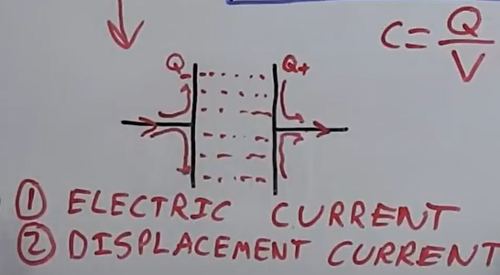


What Current Flows Through a Capacitor?
Super reference: https://www.youtube.com/watch?v=ppWBwZS4e7A
IMPORTANT: when listening, substitute the word VACUUM for the word INSULATOR
The story remains TRUE. Students: HOW CAN CURRENT FLOW THROUGH A VACUUM?
$$I_{capacitor}$$
$$I_{capacitor}=\underset{\begin{aligned}Displacement Current \\ NOT IONS \\ through Lipid \\ Membrane\end{aligned}}{\underbrace{C_{m}\frac{∂V_{m}}{∂t}}}$$
Questions: (1) What DOES carry current THROUGH the capacitor? What mass does it have?
(2) Does the current between the plates of the capacitor produce a magnetic field. WARNING tricky

Slide 10
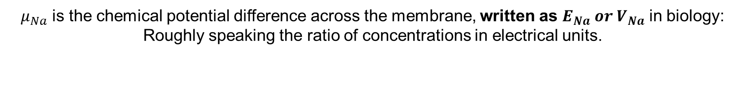

Hodgkin Huxley Equations
For experts mostly Biology as inverse problem, Choose the animal and ‘preparation’ wisely Hodgkin and Huxley chose squid,
Because?
The axon = the nerve fiber (of invertebrates, no myelin insulation)
$$I_{m}$$
$$I_{m}=C_{m}\frac{∂V_{m}}{∂t}+\underset{Ions through many Channels of 2 or 3 types}{\underbrace{g_{Na}\left(V_{m}−μ_{Na}\right)+g_{K}\left(V_{m}−μ_{K}\right)+ I_{leak=?}}}$$
$μ_{Na }$≈ $\frac{RT}{zF}$ log $\frac{{\left[Na\right]}_{out}}{{ \left[Na\right]}_{int}}$ ≈ chemical potential, Nernst potential, equilibrium potential, reversal potential
$μ_{Na}$ is the chemical potential difference across the membrane, written as $E_{Na} or V_{Na}$ in biology: Roughly speaking the ratio of concentrations in electrical units.
Why do I say “or” ?

Slide 11
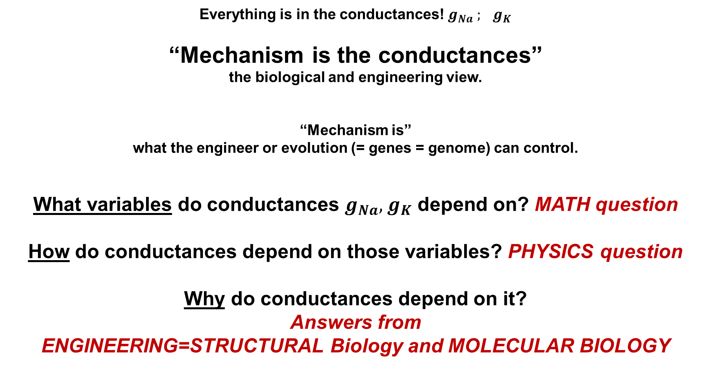
Everything is in the conductances! $g_{Na}{ ; g}_{K}$
“Mechanism is the conductances” the biological and engineering view.
“Mechanism is” what the engineer or evolution (= genes = genome) can control.
What variables do conductances $g_{Na},{ g}_{K}$ depend on? MATH question
How do conductances depend on those variables? PHYSICS question
Why do conductances depend on it? Answers from ENGINEERING=STRUCTURAL Biology and MOLECULAR BIOLOGY

Slide 12
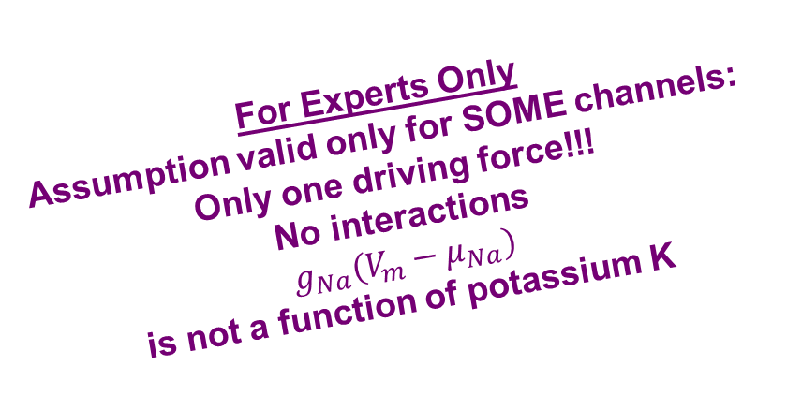
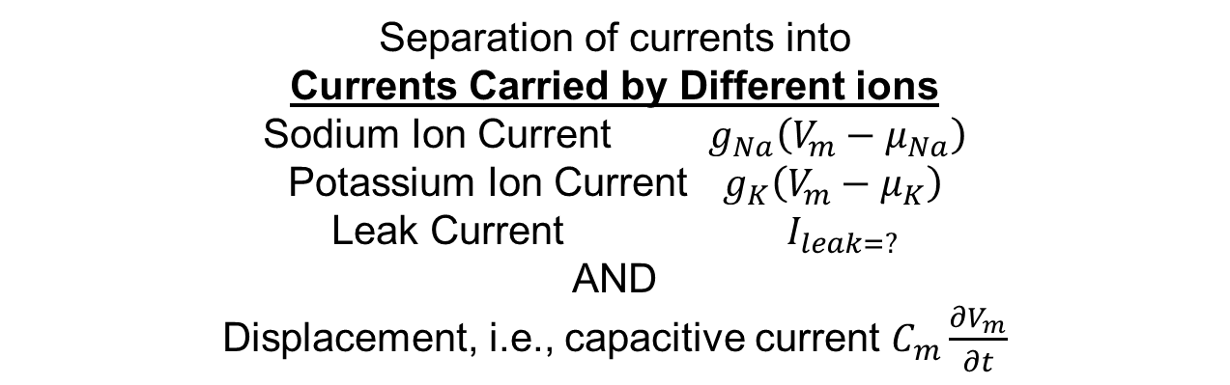
Hodgkin Huxley Equations depend on the Separation of Current
Separation of Pathways = Channels
For Experts Only Assumption valid only for SOME channels: Only one driving force!!! No interactions
$$g_{Na}\left(V_{m}−μ_{Na}\right)$$
is not a function of potassium K
Separation of currents into Currents Carried by Different ions Sodium Ion Current $g_{Na}\left(V_{m}−μ_{Na}\right)$
Potassium Ion Current $g_{K}\left(V_{m}−μ_{K}\right)$
Leak Current $I_{leak=?}$
AND
Displacement, i.e., capacitive current $C_{m}\frac{∂V_{m}}{∂t}$

Slide 13
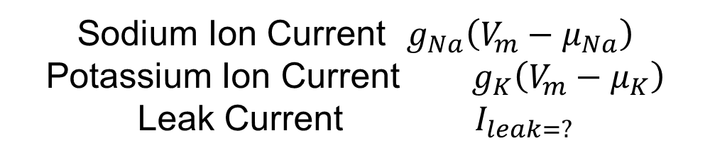
Channels in Hodgkin and Huxley Equation and Formulation are perfectly selective, only allow ONE ION SPECIES to flow
Comments from Students? From Experts?
Sodium Ion Current $g_{Na}\left(V_{m}−μ_{Na}\right)$
Potassium Ion Current $g_{K}\left(V_{m}−μ_{K}\right)$
Leak Current $I_{leak=?}$

Slide 14
Channels in Hodgkin and Huxley Equation and Formulation are perfectly selective, only allow ONE ION to flow
Comments from Students?
Experts How to adapt for channels that are not perfectly selective?
Like Acetylcholine Channel?
Like Ryanodine Receptor?
Like Glutamate Channel?
Etc. etc.

Slide 15
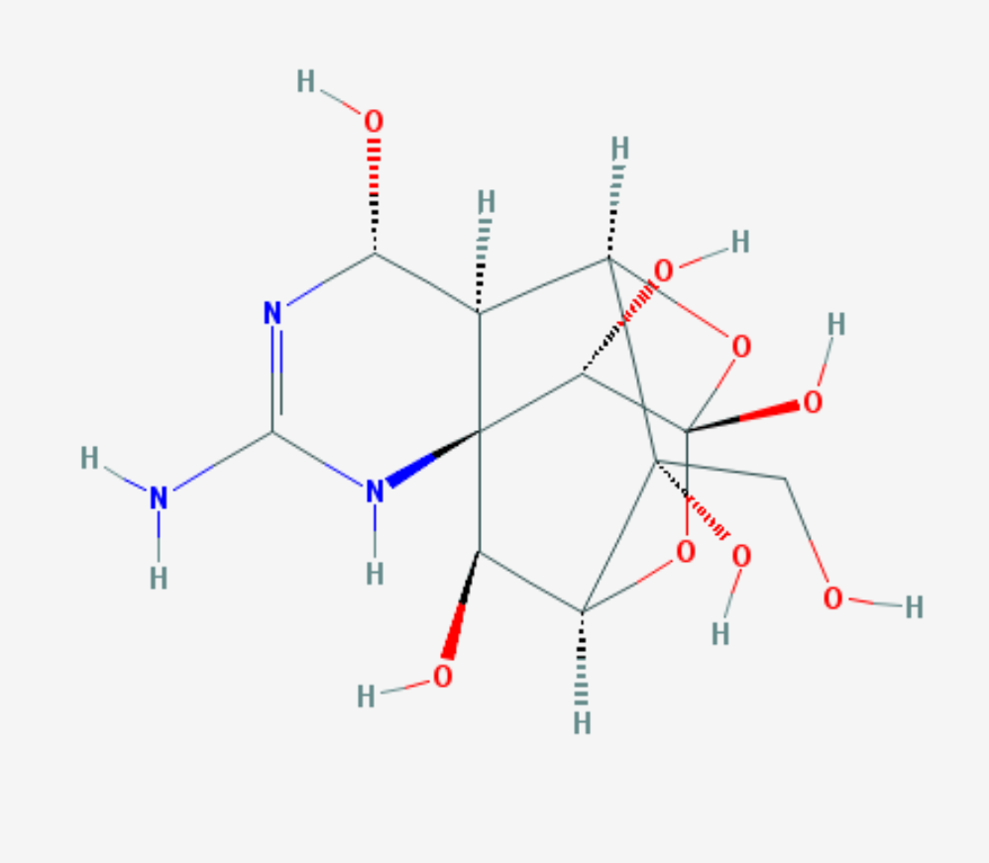
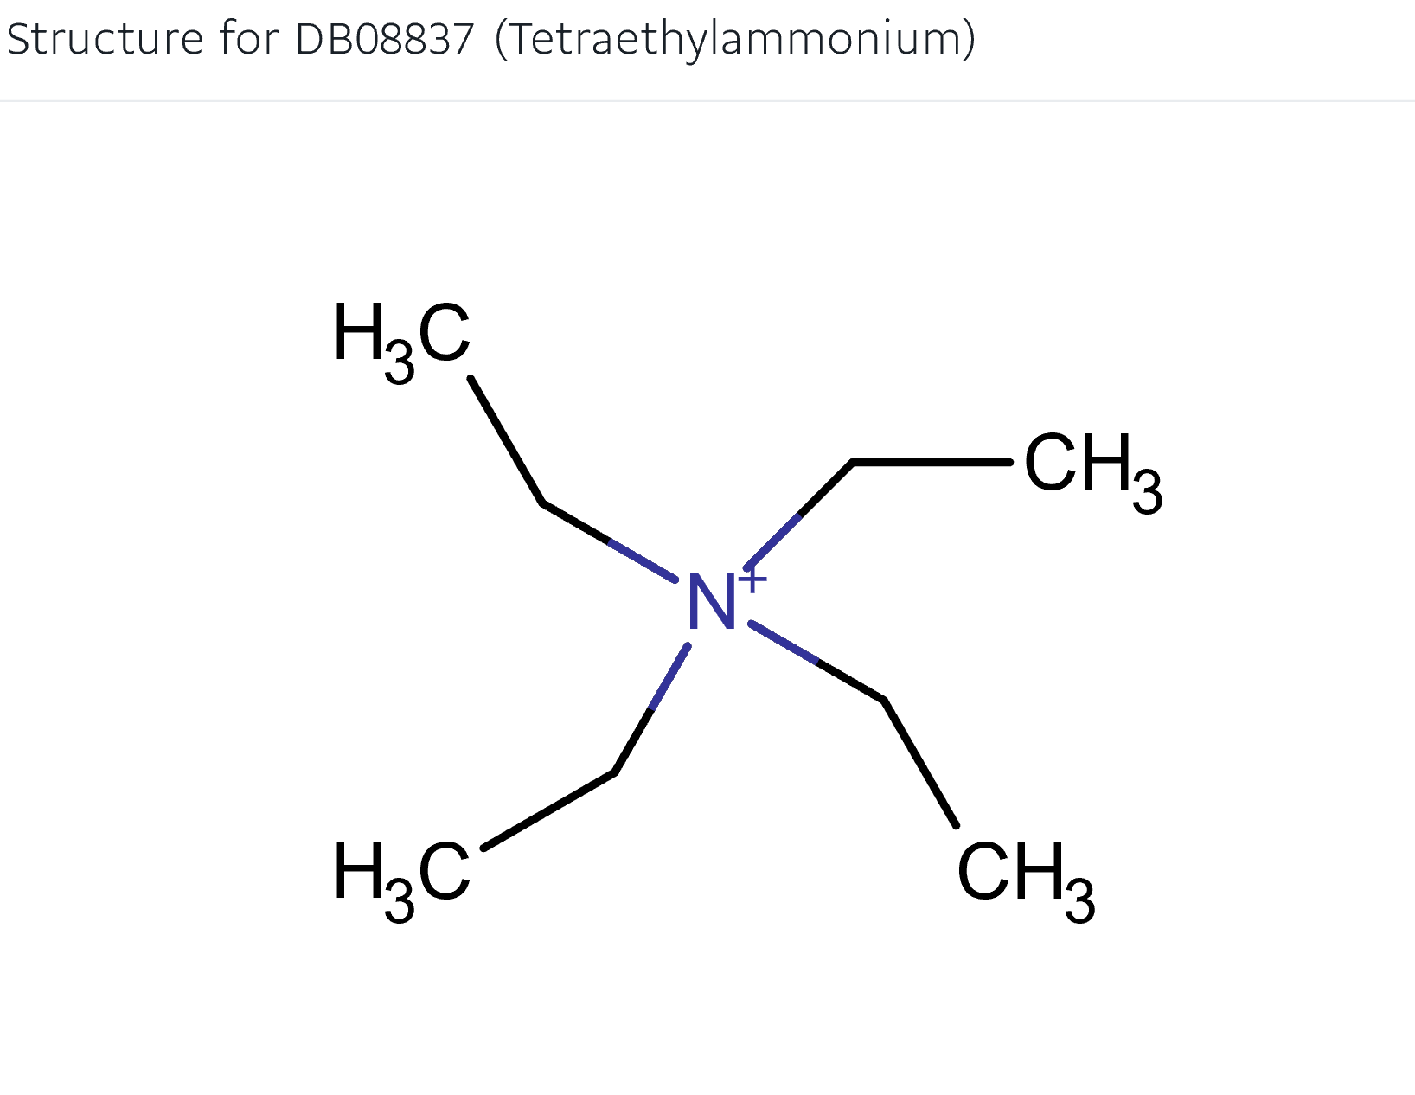
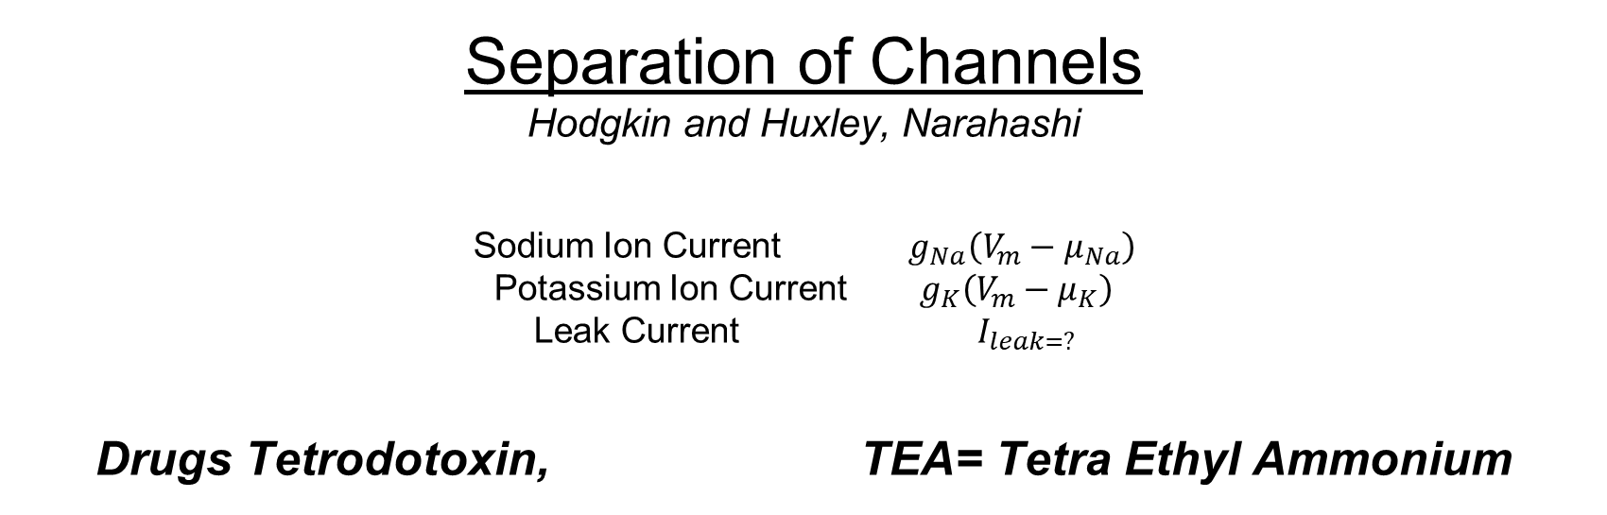
Separation of Channels Hodgkin and Huxley, Narahashi Sodium Ion Current $g_{Na}\left(V_{m}−μ_{Na}\right)$ Potassium Ion Current $g_{K}\left(V_{m}−μ_{K}\right)$ Leak Current $I_{leak=?}$ Drugs Tetrodotoxin, TEA= Tetra Ethyl Ammonium

Slide 16

Hodgkin Huxley Equations
$$I_{m}$$
$$I_{m}=C_{m}\frac{∂V_{m}}{∂t}+\underset{Ions through many Channels}{\underbrace{g_{Na}\left(V_{m}−μ_{Na}\right)+g_{K}\left(V_{m}−μ_{K}\right)+ I_{leak=?}}}$$
$μ_{Na }$= $\frac{RT}{F}$ ln $\frac{{\left[Na\right]}_{out}}{{ \left[Na\right]}_{int}}$ = ideal chemical potential = equilibrium potential = reversal potential = Nernst Potential
Roughly speaking, the ratio of concentrations in electrical units.
$μ_{Na }$is not a function of time in Hodgkin Huxley formulation because concentration of Na is not a function of time

Slide 17
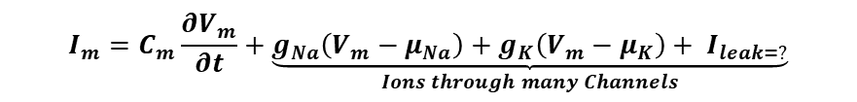
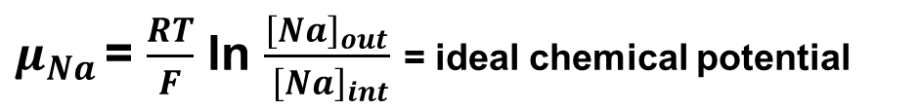
Hodgkin Huxley Equations
$$I_{m}=C_{m}\frac{∂V_{m}}{∂t}+\underset{Ions through many Channels}{\underbrace{g_{Na}\left(V_{m}−μ_{Na}\right)+g_{K}\left(V_{m}−μ_{K}\right)+ I_{leak=?}}}$$
$$I_{m}$$
$μ_{Na }$= $\frac{RT}{F}$ ln $\frac{{\left[Na\right]}_{out}}{{ \left[Na\right]}_{int}}$ = ideal chemical potential
$μ_{Na }$is not a function of time in Hodgkin Huxley formulation because concentration of Na is not a function of time
This is impossible This is an approximation OK sometimes NOT OK others

Slide 18
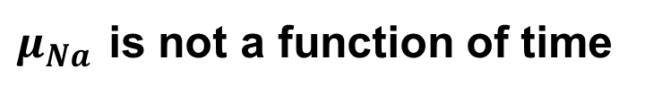
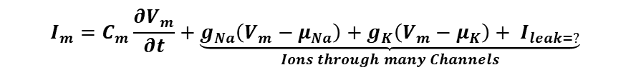
Hodgkin Huxley Equations
$$I_{m}=C_{m}\frac{∂V_{m}}{∂t}+\underset{Ions through many Channels}{\underbrace{g_{Na}\left(V_{m}−μ_{Na}\right)+g_{K}\left(V_{m}−μ_{K}\right)+ I_{leak=?}}}$$
$μ_{Na }$is not a function of time
This is impossible This is an approximation Good approximation sometimes
When concentrations are large compare to flux. When flux is short in duration.
When volumes outside channel are large
Bad Approximation sometimes
When concentrations are small
When flux is prolonged
When volumes outside channel are small

Slide 19
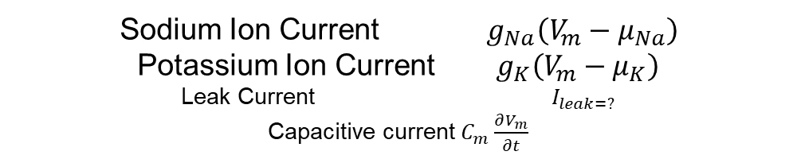
Separation of Currents
Sodium Ion Current $g_{Na}\left(V_{m}−μ_{Na}\right)$
Potassium Ion Current $g_{K}\left(V_{m}−μ_{K}\right)$
Leak Current $I_{leak=?}$ Capacitive current $C_{m}\frac{∂V_{m}}{∂t}$
Questions for Students How did Hodgkin and Huxley separate the currents?
How would YOU separate the currents?
How do biophysicists separate the currents today?

Slide 20
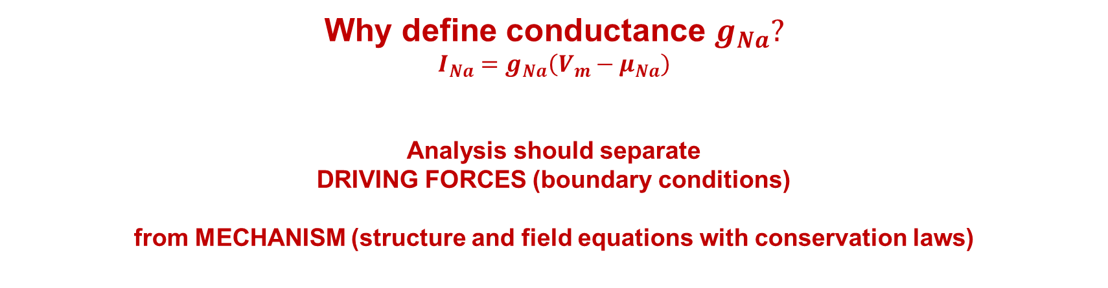
Sodium Na Current and Conductance in Hodgkin and Huxley
Why define conductance $g_{Na}?$
$${I_{Na}=g}_{Na}\left(V_{m}−μ_{Na}\right)$$
Analysis should separate DRIVING FORCES (boundary conditions) from MECHANISM (structure and field equations with conservation laws)
Example of GENERAL THEME in Hodgkin Huxley and BIOLOGY and ENGINEERING

Slide 21
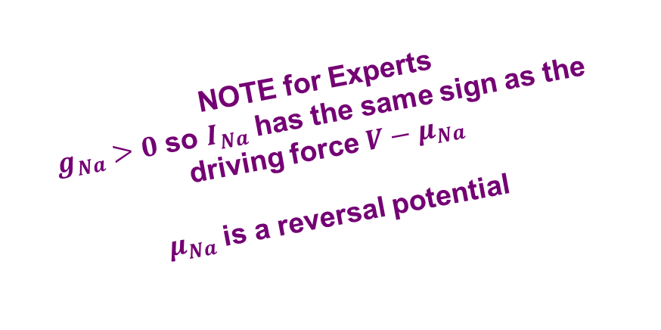
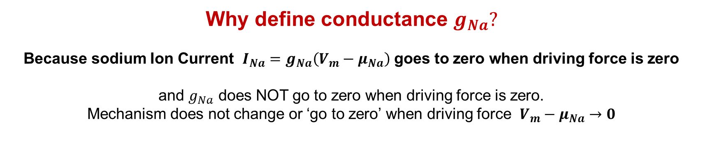
Sodium Na Current and Conductance in Hodgkin and Huxley
Why define conductance $g_{Na}?$
Because sodium Ion Current ${I_{Na}=g}_{Na}\left(V_{m}−μ_{Na}\right)$ goes to zero when driving force is zero
and $g_{Na}$ does NOT go to zero when driving force is zero.
Mechanism does not change or ‘go to zero’ when driving force $V_{m}−μ_{Na}→0$
NOTE for Experts $g_{Na}>0$ so $I_{Na}$ has the same sign as the driving force $V−μ_{Na}$
$μ_{Na}$ is a reversal potential

Slide 22
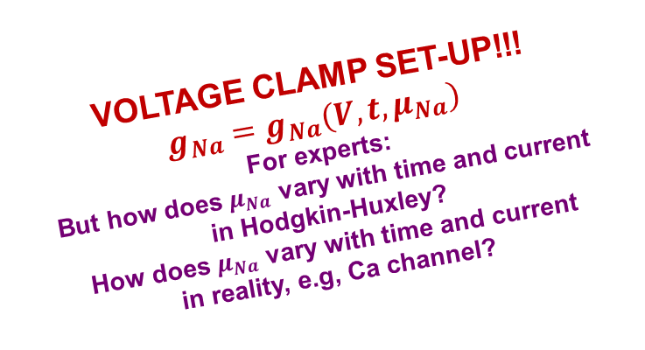
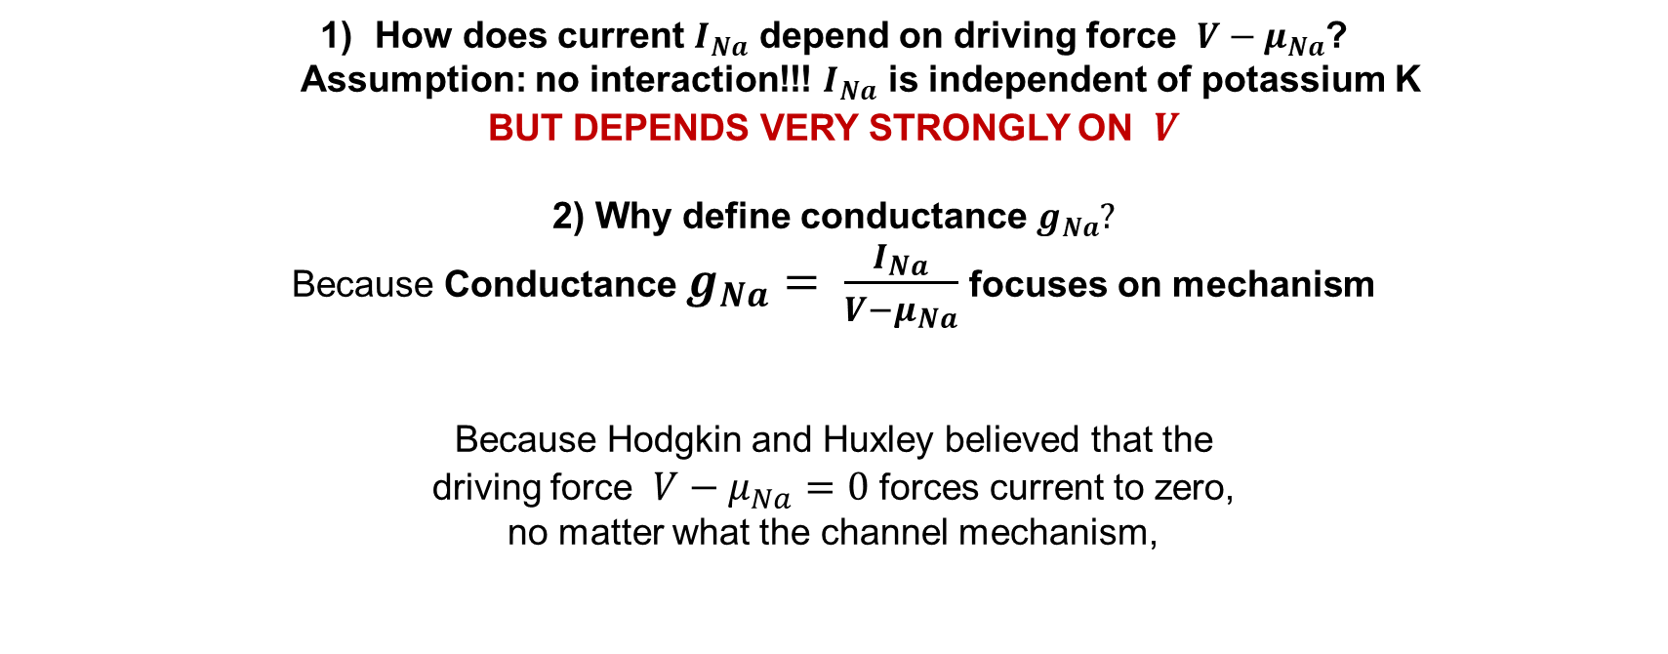
Sodium Na Current and Conductance in Hodgkin and Huxley
How does current $I_{Na}$ depend on driving force $V−μ_{Na}$? Assumption: no interaction!!! $I_{Na}$ is independent of potassium K
BUT DEPENDS VERY STRONGLY ON $V$
2) Why define conductance $g_{Na}?$
Because Conductance $g_{Na}= \frac{I_{Na}}{V−μ_{Na}}$ focuses on mechanism
Because Hodgkin and Huxley believed that the driving force $V−μ_{Na}=0$ forces current to zero, no matter what the channel mechanism,
VOLTAGE CLAMP SET-UP!!!
$$g_{Na}=g_{Na}\left(V,t, μ_{Na}\right)$$
For experts: But how does $μ_{Na}$ vary with time and current
in Hodgkin-Huxley? How does $μ_{Na}$ vary with time and current in reality, e.g, Ca channel?

Slide 23
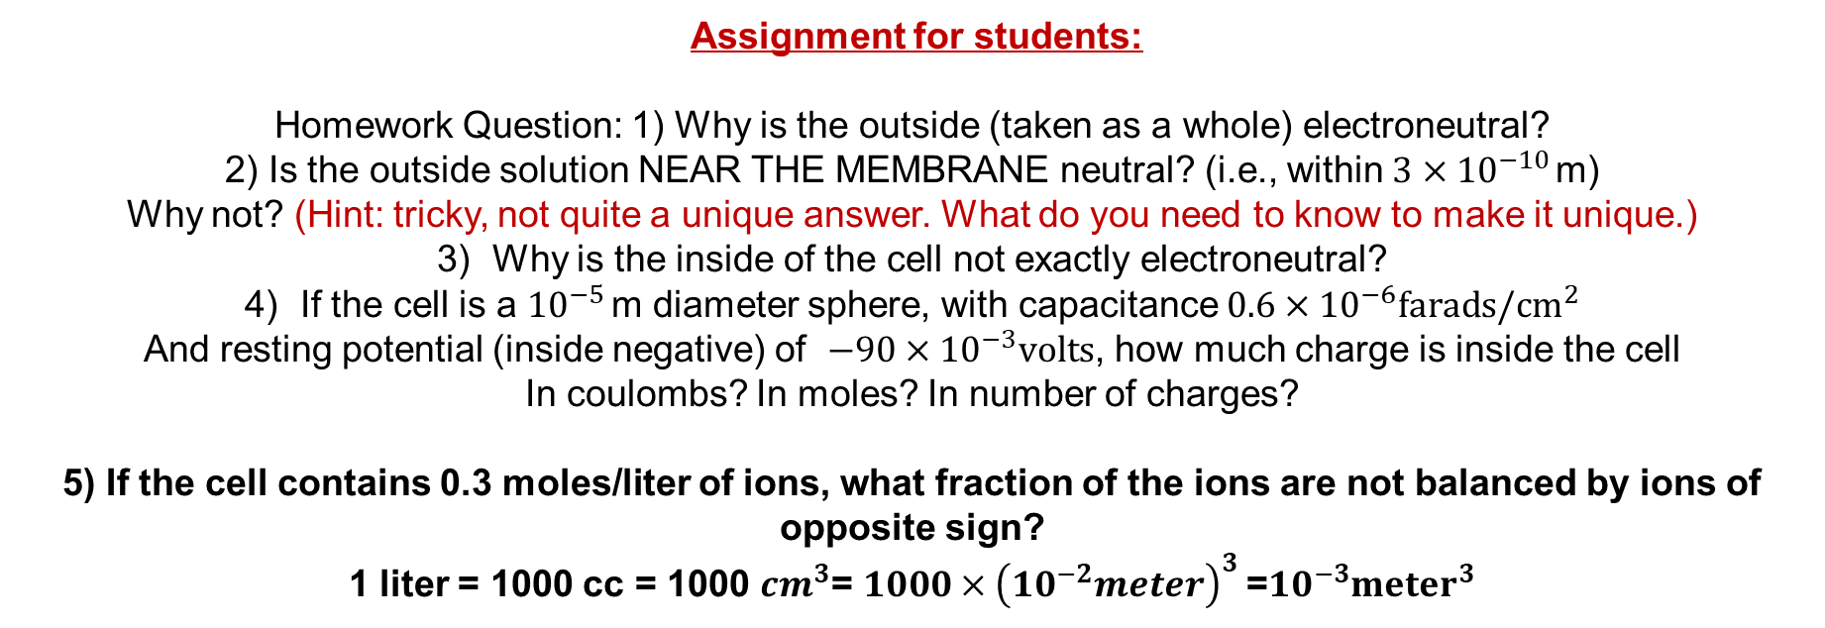
Assignment for students:
Homework Question: 1) Why is the outside (taken as a whole) electroneutral?
2) Is the outside solution NEAR THE MEMBRANE neutral? (i.e., within${ 3×10}^{−10 }$m) Why not? (Hint: tricky, not quite a unique answer. What do you need to know to make it unique.)
Why is the inside of the cell not exactly electroneutral?
If the cell is a ${10}^{−5 }$m diameter sphere, with capacitance ${0.6×10}^{−6}farads/{cm}^{2}$
And resting potential (inside negative) of ${−90×10}^{−3}volts$, how much charge is inside the cell
In coulombs? In moles? In number of charges?
5) If the cell contains 0.3 moles/liter of ions, what fraction of the ions are not balanced by ions of opposite sign?
1 liter = 1000 cc = 1000 ${cm}^{3}$= ${1000×\left({10}^{−2}meter\right)}^{3}$=${10}^{−3}{meter}^{3}$

Slide 24
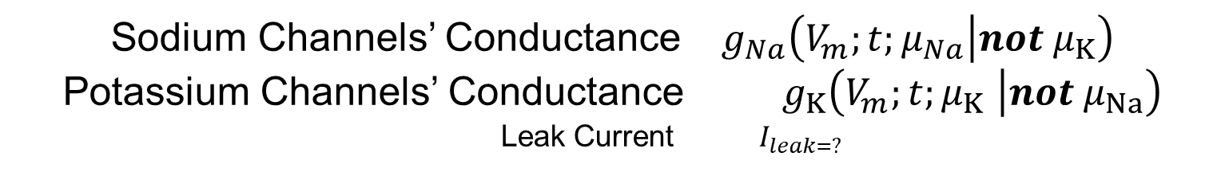
Time Dependence in Hodgkin Huxley Equations
Sodium Channels’ Conductance $g_{Na}\left(V_{m};t;μ_{Na}\left|not μ_{K}\right.\right)$
Potassium Channels’ Conductance $g_{K}\left(V_{m};t;μ_{K} \left|not μ_{Na}\right.\right)$
Leak Current $I_{leak=?}$

Slide 25
Currents are time dependent
1) How does displacement current vary with time?
Displacement currents are zero at steady state “have zero DC component”
2) How does ionic current in salt water around cells vary with time?
3) How does ionic current through channels vary with time?
NOTE CURRENT IS CONSERVED EXACTLY.
CURRENT IS EQUAL IN ONE DIMENSIONAL SYSTEMS NO MATTER WHAT CARRIES THE CURRENT!
Another talk, on eletrodynamics

Slide 26
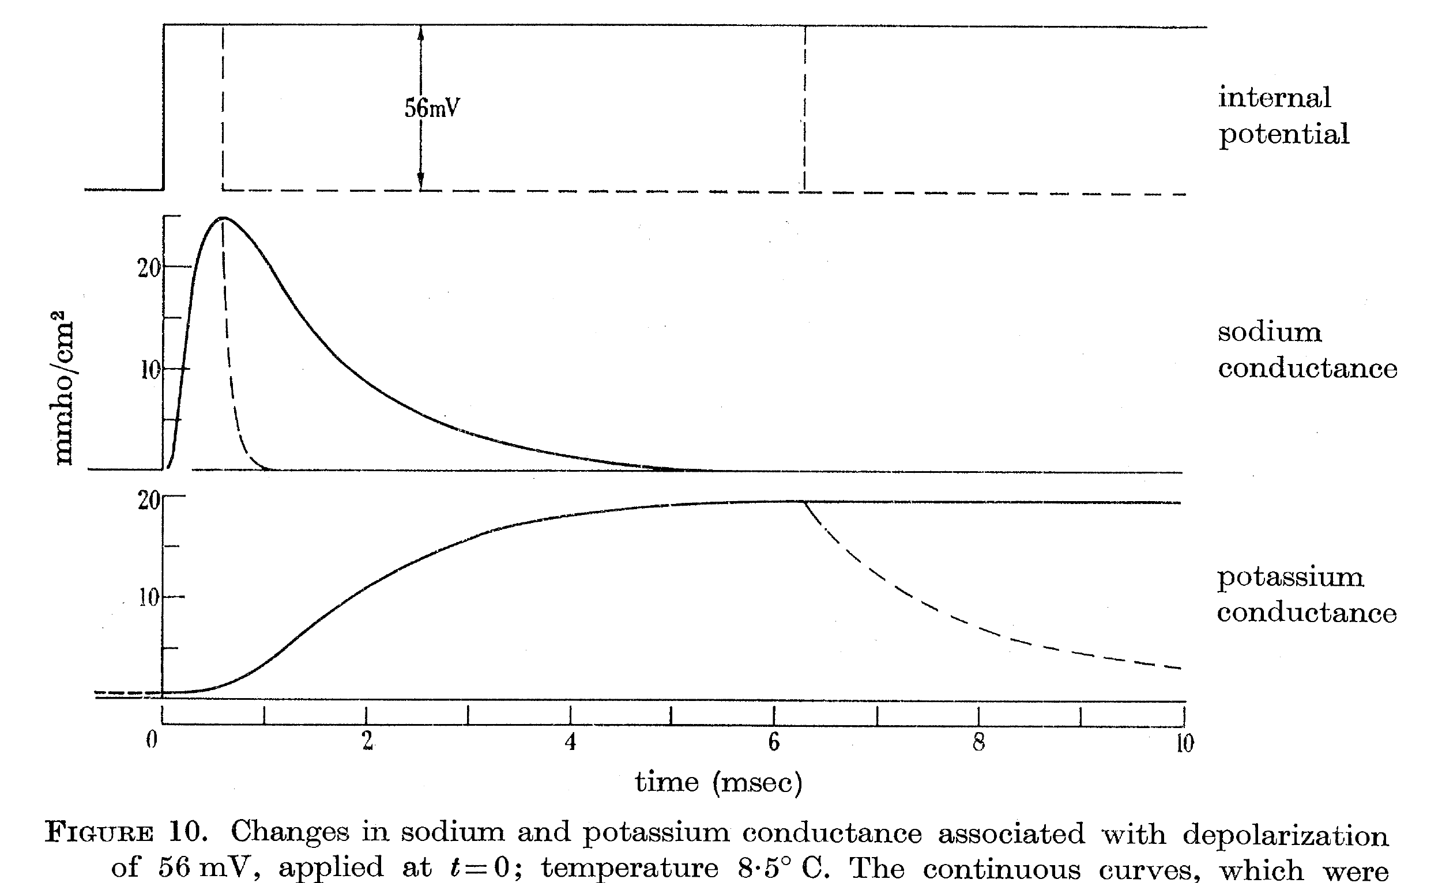
Time Dependent Conductances (of macroscopic number of channels)

Slide 27

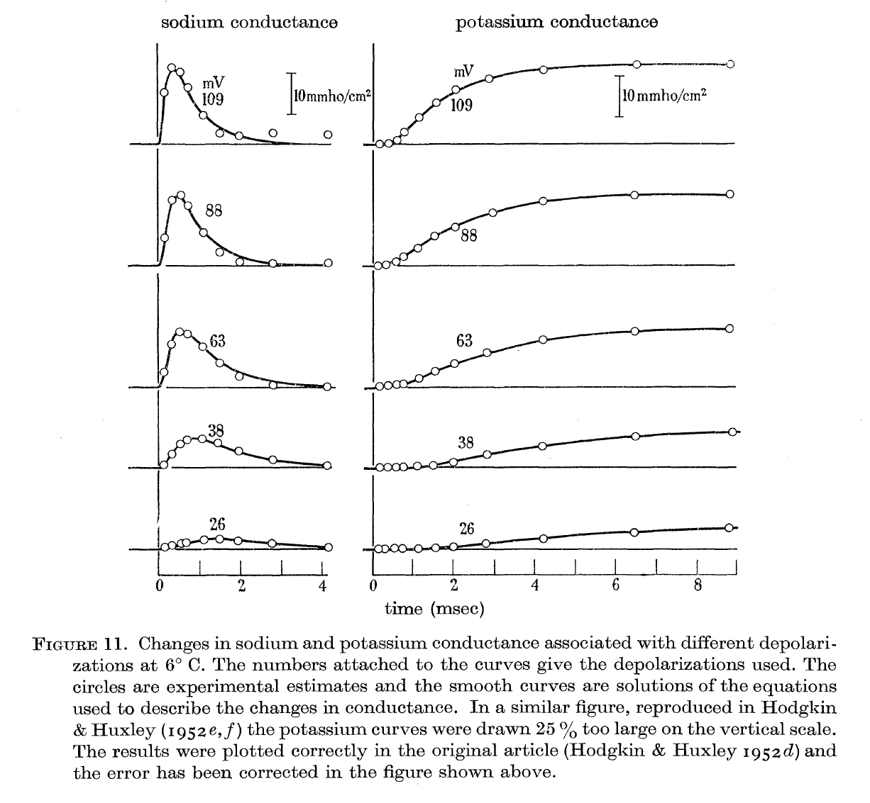



Time AND VOLTAGE Dependence of Conductances (of macroscopic number of channels)
Sodium ${Na}^{+}$
Potassium $K^{+}$

Slide 28
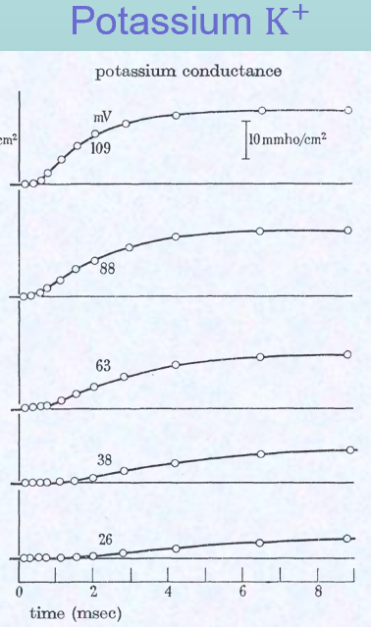
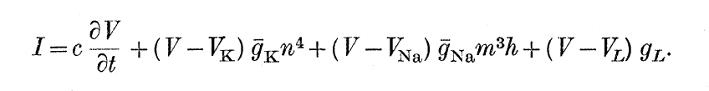
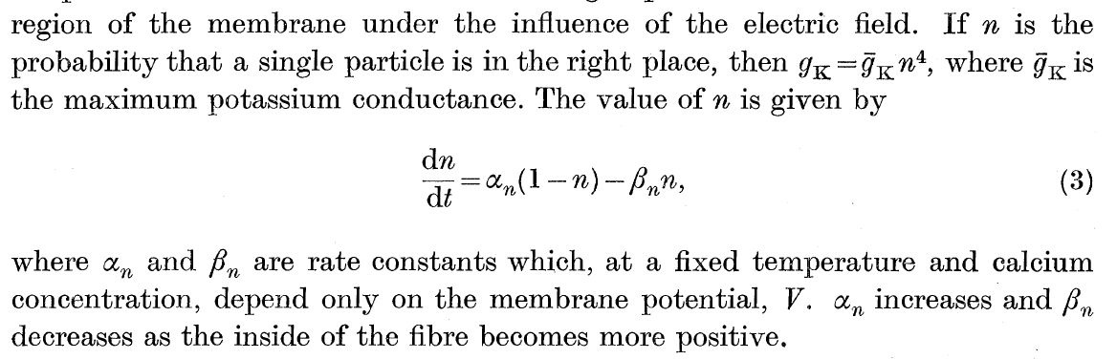
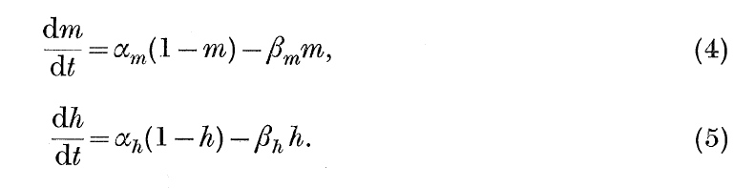
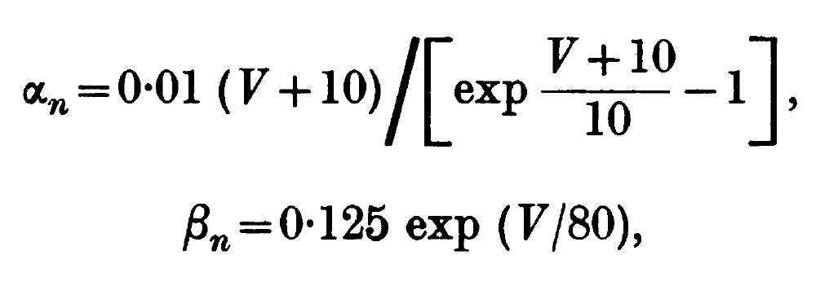


Time AND VOLTAGE Dependence of Conductances (of macroscopic number of channels)
Potassium $K^{+}$ Conductance
Activation $n$

Slide 29
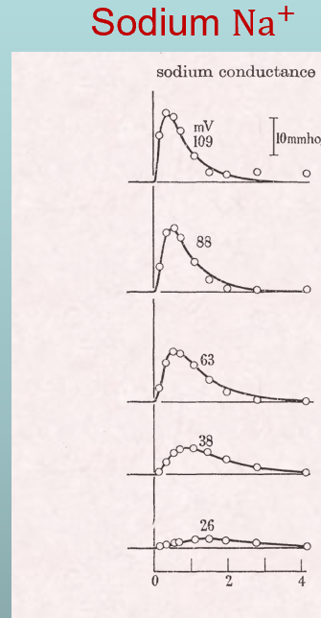
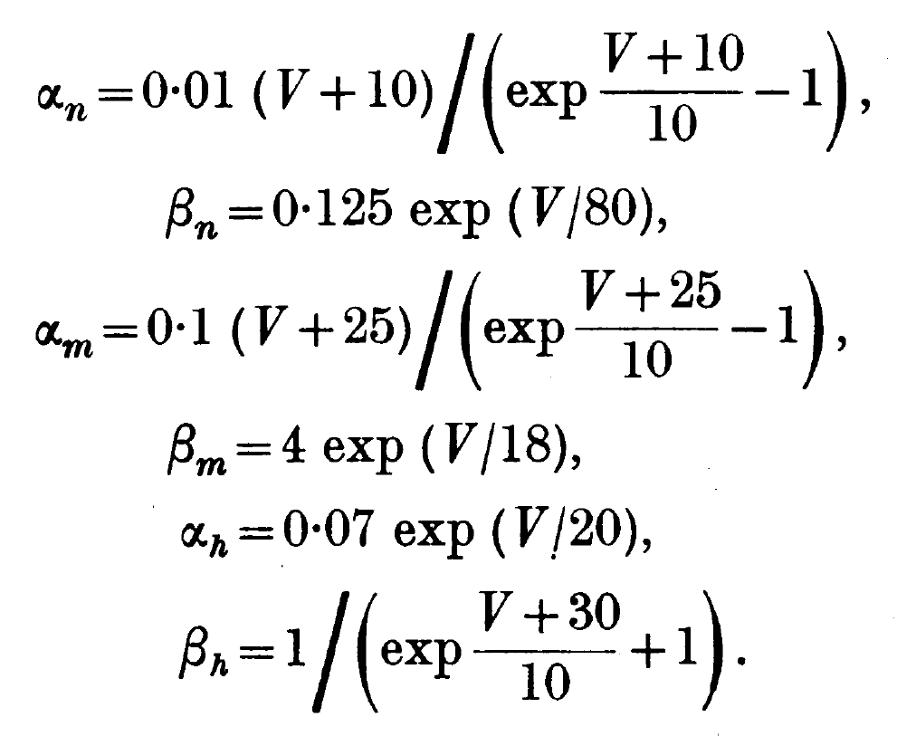
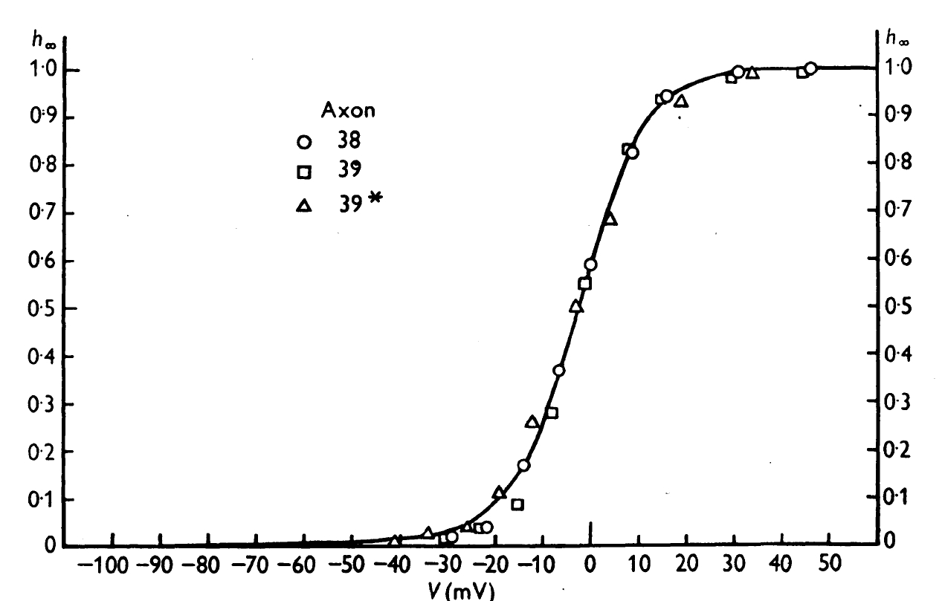


Time AND VOLTAGE Dependence of Conductances (of macroscopic number of channels)
Sodium ${Na}^{+}$ Conductance
Sodium ${Na}^{+}$ Conductance
Steady State Activation Curve in general
Fermi Like
NOT Boltzmann

Slide 30


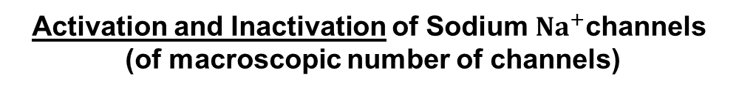

Activation and Inactivation of Sodium ${Na}^{+}$channels (of macroscopic number of channels)
Sodium ${Na}^{+}$ Conductance
Sodium ${Na}^{+}$ Conductance
Activation $m$
INactivation $h$
Fermi Like
NOT Boltzmann
Steady State Activation Curve in general

Slide 31
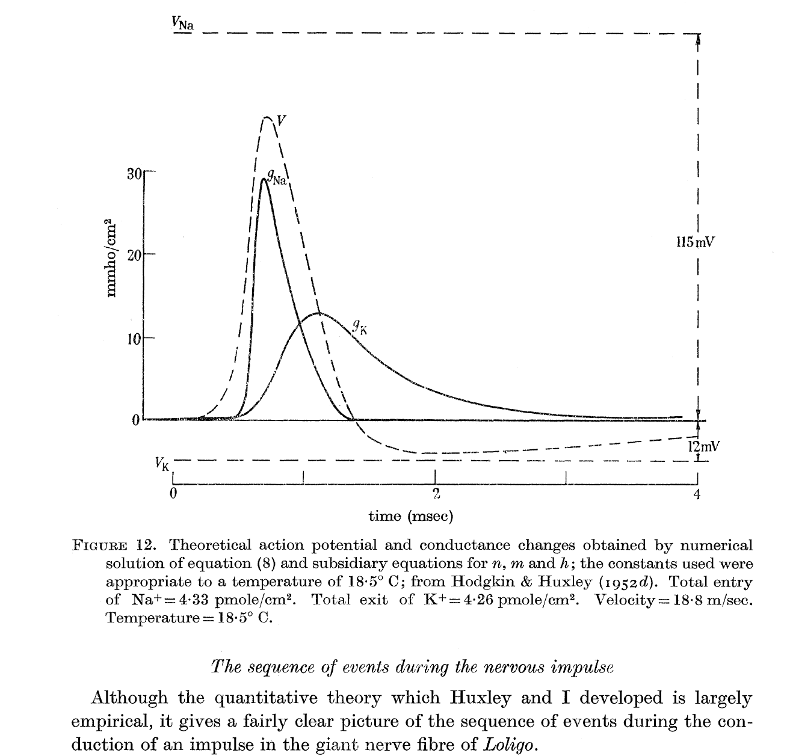
The Sequence of Events During the Action Potential

Slide 32
Voltage Sensor
Conductances in Hodgkin and Huxley equation are functions of transmembrane potential. They are independent of the current through the channel.
The potential within a channel is a strong function of the current through the channel, so the Hodgkin Huxley conductances do not depend on the potential within the channel.
How can the Hodgkin Huxley conductances possibly depend on the transmembrane potential while being independent of the potential in a channel?
Answer: voltage sensor is a separate machine, that senses membrane potential, and is far enough away from the channel to
be insensitive (i.e., ‘shielded from’) to the potential within it.

Slide 33
What have we left out?
1) Why did Hodgkin and Huxley use STEP functions of potential?
What is wrong with that approach?
2) We talked only about transverse membrane current, what about longitudinal current?
3) How did Hodgkin and Huxley implement their plan? What were their challenges? What did they leave untouched? What did they get wrong?
4) For muscle people:
Longitudinal Current: 3-dimensional Cable Theory
Purely resistive DESPITE TIGHT PACKING inside cells
Why?

Slide 34
Any questions ?

