Slide 1
Rockbuster Stealth LLC – Data-Driven Insights & Strategy
A Data-Backed Approach to Maximizing Revenue & Customer Engagement
Presented by: Henry Arkoh Clayman
Date: 28/05/2025

Slide 2
The Challenge
• Rockbuster Stealth LLC is losing market share to streaming services like Netflix and Amazon Prime.
• Leadership wants to launch a video-on-demand service to compete globally.
• Approach: Analyzing rental data to identify key revenue trends, customer behavior, and opportunities for business growth

Slide 3
The Approach
• Combined internal rental and customer data with external demographic insights
• Conducted exploratory data analysis
• Identified high-potential markets and customer segments
• Recommended strategic actions based on insights

Slide 4
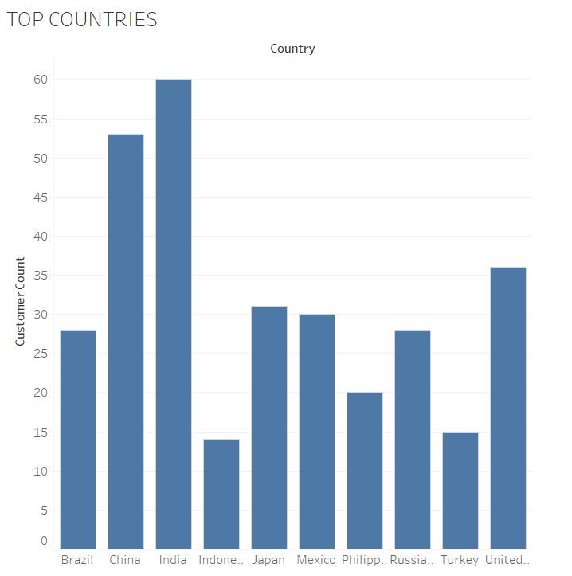
Bar chart of Top 10 Countries by Revenue
Countries with larger populations and stronger economies tend to generate more revenue.
High rental activity correlates with urbanization and digital access.
The presence of major cities within these countries contributes to higher rental demand.

Slide 5
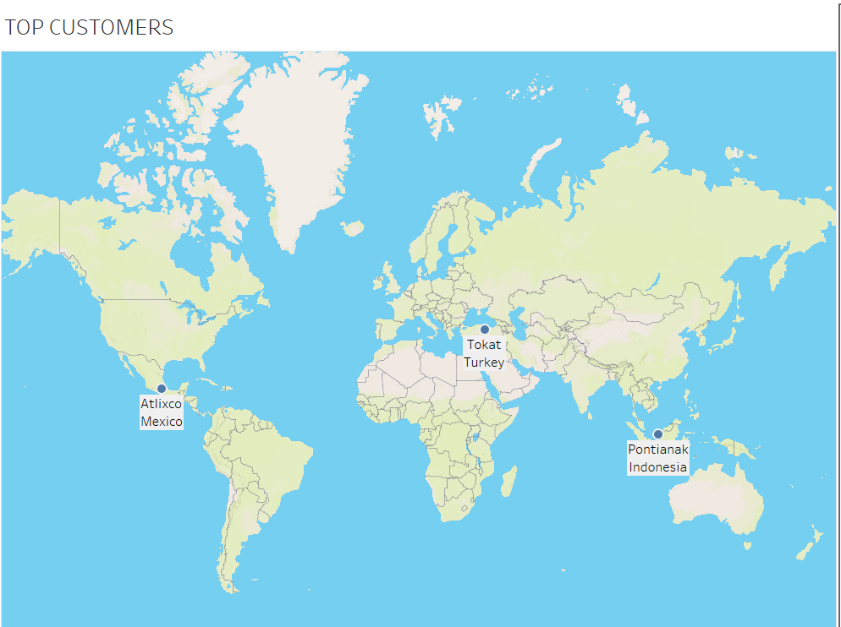
Top 3 Customers by Revenue
While the top countries by revenue are driven by overall market size, individual customer spending patterns do not always align with national trends.
Some high-value customers contribute significantly despite being in countries with lower total revenue.
Mexico, despite ranking 5th, has at least one of Rockbuster’s most valuable customers.

Slide 6
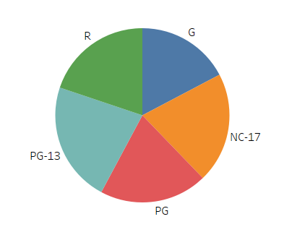
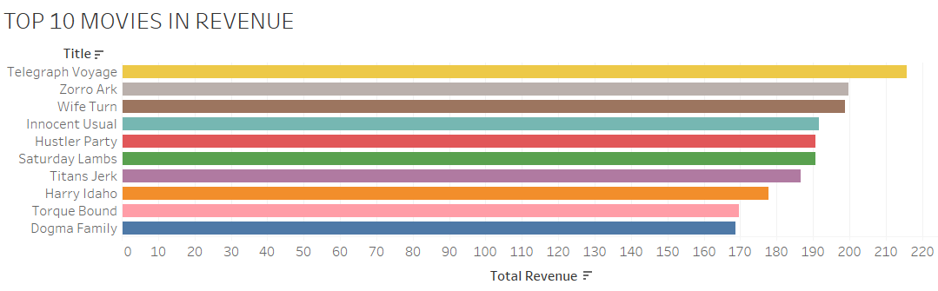
Most Popular Content
17.28%
These movies below contributed the most to Rockbusters revenue
1.These movies like benefited from strong marketing, high-profile actors, or franchise appeal.
Movies PG-13 rated dominates revenue generation.
22.35%

Slide 7

Rental Duration
Most customers rent a movie for around 5 days and pay about $3 per rental.
lowest_rental_duration 3 days
highest_rental_duration 7 days
average_rental_duration 4.985 days
lowest_rental_rate $0.99
highest_rental_rate $4.99
average_rental_rate $2.98

Slide 8
Key Findings
Top Movies by Revenue • A few top movies generate most revenue. • These titles have higher rates and longer rentals.
Viewer Rating • PG-13 movies are most watched.
Country & City Sales • Top-selling countries ≠ top customers. • Mexico ranks 5th but has a top customer. • Top cities drive revenue, not always from top countries.
Rental Duration & Rates • Average: 5 days, $2.98 per rental. • Shorter rentals may boost total volume.

Slide 9
Strategic Recommendations
Focus on Top Markets • Target top countries/cities with marketing. • Investigate why key customers are in lower-sales regions.
1
Refine Pricing • Use premium pricing for top movies. • Offer discounts for shorter rentals.
2
Expand Popular Content • Acquire more PG-13, PG, NC-17 titles. • Promote low-performing categories.
3
Boost Loyalty • Reward repeat customers in key markets. • Use personalized movie suggestions.
4

Slide 10
THANK YOU Email: henryarkohclayman@gmail.com
Tableau Visualization:https://public.tableau.com/app/profile/henry.arkoh.clayman/viz/RockbusterStealthLLCDataAnalysis/ROCKBUSTER?publish=yes

