Slide 1


Corporate PMO Portal
One corporate portal
for investment visibility,
action and control.
A guided walkthrough of registration, login and corporate investment management
Designed for trusted corporate self-service across Unit Trust and Employer Online Portal workflows.
REGISTRATION → LOGIN → MANAGE

Slide 2
CORPORATE PMO PORTAL
THE EXPERIENCE
A controlled path from enrolment to action
The portal creates a clear hand-off between onboarding, secure access and day-to-day investment operations.
01
02
03
Register
→
Verify
→
Manage
Agree to service terms and identify the corporate user.
Set credentials, confirm role context and validate with PAC.
Review holdings, submit requests and authorise transactions.
02

Slide 3
CORPORATE PMO PORTAL
REGISTRATION · STEP 1
Registration begins with a clear service commitment
Corporate PMO Registration
The first screen establishes the terms, mandate and authorised-access context before any user details are collected.
✓
Terms and Conditions accepted
Set the right expectations
The opening makes the service boundaries and account authority explicit.
✓
Corporate mandate acknowledged
✓
Authorised users confirmed
Move forward only when ready
An affirmative “Agree” action advances the user into the registration form.
Disagree
Agree
03

Slide 4
CORPORATE PMO PORTAL
REGISTRATION · STEP 2
Company identity and login credentials are collected together
The portal pairs corporate registration details with secure account setup, keeping the onboarding journey in one place.
Company Registration No.
Full Name & IC No.
Required
Required
Corporate identity
Authorised individual
Mobile & security code
User ID & password
Required
Required
Contact validation
Login credentials
Built-in password rules help the user create a credential that meets the portal’s requirements.
04

Slide 5
CORPORATE PMO PORTAL
REGISTRATION · STEP 3
Security verification confirms access and role context
Before access is granted, the applicant confirms the company, the Unit Trust and EOP role assignments, and a PAC verification method.
Role context
PAC verification
Unit Trust
User & Authoriser
SMS Personal Authentication Code
Employer Online Portal
Admin
Enter 8-digit PAC
COMPLETE
Ativa Studio Solution Sdn Bhd
Result: a verified user is ready to enter the portal with the appropriate operating permissions.
05

Slide 6
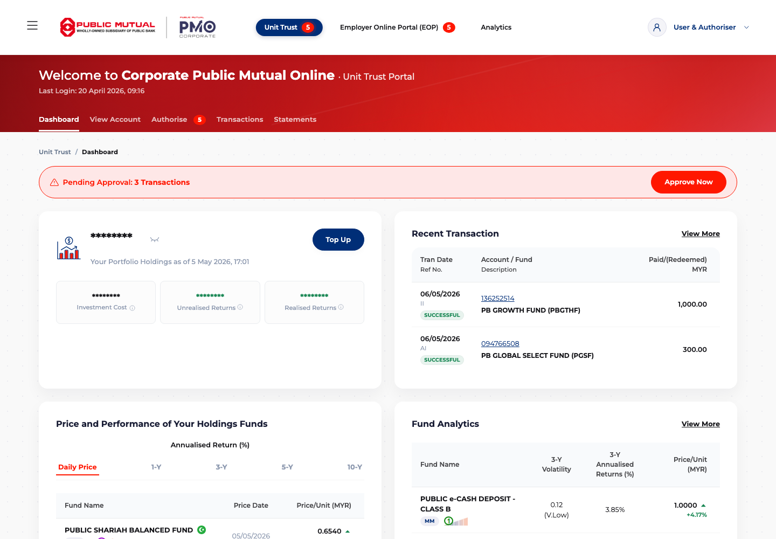
CORPORATE PMO PORTAL
AFTER LOGIN · DASHBOARD
The dashboard puts portfolio health and next actions in view
On login, corporate users land on a consolidated command centre for holdings, transactions, fund performance and analytics.
Portfolio at a glance
Holdings, investment cost and returns are surfaced prominently.
Work that needs attention
Pending approvals are flagged with a direct route to action.
Investment intelligence
Recent transactions, price performance and fund analytics sit together.
06

Slide 7
CORPORATE PMO PORTAL
AFTER LOGIN · WHAT USERS CAN DO
A single portal supports visibility, execution and governance
The logged-in navigation makes routine servicing and control tasks easy to find without losing the high-level portfolio view.
Review accounts
Make investments
View holdings, account details, fund performance and analytics.
Top up and submit investment or redemption requests.
Authorise work
Stay informed
Review and approve pending transactions using role-based controls.
Search transaction history, download statements and view online activities.
Corporate PMO combines a polished onboarding experience with operational tools that help users act confidently after login.
07

