Slide 1
Introduction of Theano

Slide 2
Installation

Slide 3
Install Theano
How to install Theano, Google it!
Supported platforms: Ubuntu, Mac OS, Windows http://deeplearning.net/software/theano/install.html#i nstall

Slide 4
Basic

Slide 5
Review Machine Learning
Define a function set (Model): f(x; w)
x: input
w: model parameters
Define what is the best function: Define a cost
function C(f)
Pick the best function by data: Training
In deep learning, this is usually done by gradient
descent.

Slide 6
Power of Theano
After defining a cost function, Theano can
automatically compute the gradients.
To use Theano in deep learning you only have to
learn
How to define a function
How to compute the gradient
…….. Then that’s it.

Slide 7
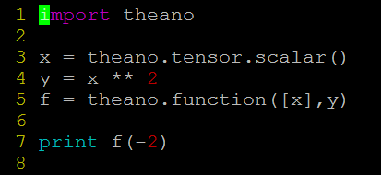
Define function - Overview
E.g. Define a function f(x) = x², then compute f(-2)
Type the left code in a file name “xxx.py”
Execute “python xxx.py”
You should get 4
Step 0. Declare that you want to use Theano (line 1)
Step 1. Define input variable x (line 3) Step 2. Define output variable y (line 4) Step 3. Declare the function as f (line 5) Step 4. Use the function f (line 7)

Slide 8
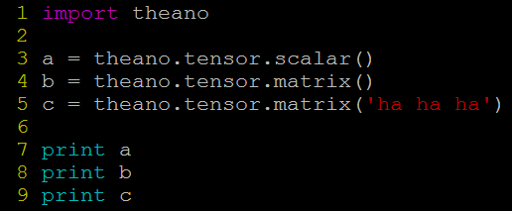
Define function
– Step1. Define Input Variables
A variable can be a scalar, a matrix or a tensor
Line 3: declare a scalar a
Line 4: declare a matrix b
Line 5: declare a matrix c with name “ha ha ha”
The name of a variable only make difference when you try to print the variable.

Slide 9
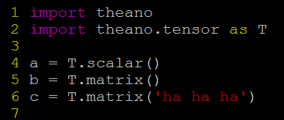
Define function
– Step1. Define Input Variables
A variable can be a scalar or a matrix
=
simplification

Slide 10
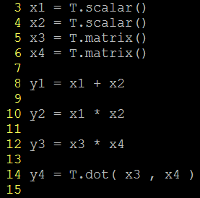
Define function
– Step2. Define Output Variables
Output variables are defined based on their
relations with the input variables
Below are some examples
y1 equals to x1 plus x2
y2 equals to x1 times x2 y3 is the elementwise
multiplication of x3 and x4
y4 is the matrix multiplication of x3 and x4

Slide 11

Define function
– Step 3. Declare Function
Declare the
function as f
Function
input
Function output
Note: the input of a function should be a list.
That is, always put the input in “[ ]”
Define the function input and output explicitly.
(equivalent to the above
usage)

Slide 12
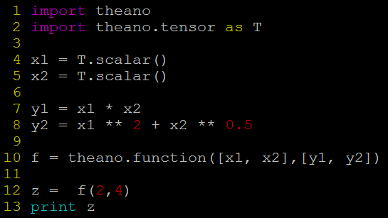
Define function
– Step 3. Declare Function

Slide 13
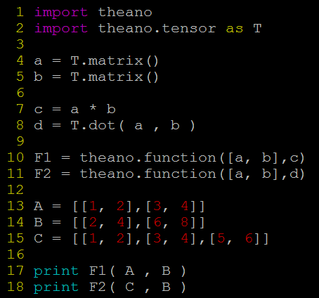
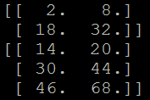
Define function
- Examples for Matrix
Output:
Be careful that the dimensions of the input matrices should be correct.

Slide 14
Compute Gradients
Computing the gradients with respect to a variable
is so simple.
Given a function with input variable x and output
variable y
To compute dy/dx, simply g = T.grad( y , x )
Note: To compute the gradient, y should be a
scalar.
That’s it!

Slide 15
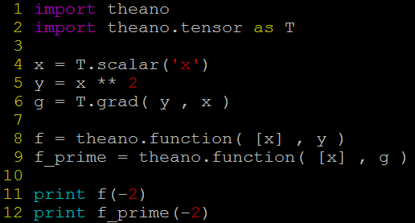


Compute Gradients
- Example 1
g = dy/dx = 2x
output “-4”

Slide 16
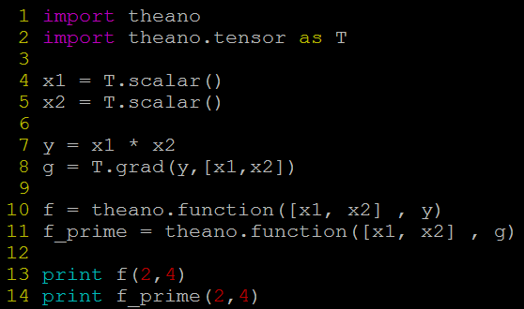


Compute Gradients
- Example 2
compute the gradients with
respect to multiple variables
g = [ 𝜕y/𝜕x1 ,𝜕y/𝜕x2 ]
= [ x2 , x1 ]

Slide 17
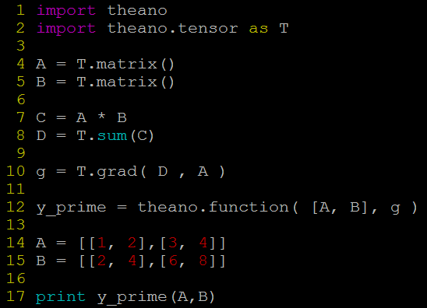
Compute Gradients
- Example 3
.
𝑎₁ 𝑎₂
𝑎₄
𝑏₂
𝑏₃ 𝑏₄
𝐼𝑓 𝐴 = _{𝑎3}
𝐼𝑓 𝐵 = ^{𝑏1}
(Note that the dimensions of A and B is not necessary 2 X 2. Here is just an example.)
_{𝐶 =} 𝑎₁𝑏₁
𝑎₂𝑏₂
𝑎₄𝑏₄
𝑏₂
𝑏₃ 𝑏₄
𝑎₃𝑏₃
𝑔 = ^{𝑏1}
(line 7)
(line 10)
𝐷 = 𝑎₁𝑏₁ + 𝑎₂𝑏₂ + 𝑎₃𝑏₃ + 𝑎₄𝑏₄
(line 8)
You cannot compute the gradients
of C because it is not a scalar

Slide 18
Single Neuron

Slide 19



Single Neuron
First, let’s implement a neuron
x₁
x₂
x_{N}
w₁
Activation function
σ(z)
w₂
w_{N}
z
y
+
…
σ(z)=
1
b
1+ e^{− z}
bias
http://deeplearning.net/software/theano/library/tensor/nnet/nnet.html#theano.tensor.nnet.nnet.sigmoid

Slide 20
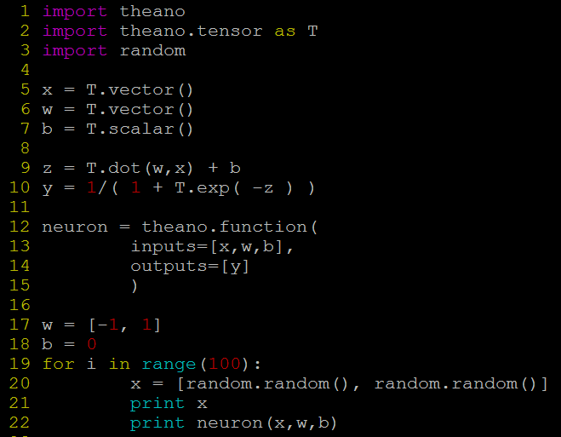



y = neuron(x; w, b)
Logistic Regression

Slide 21
Single Neuron – Shared Variables
In the last example, a neuron is a function with
input x, w and b.
However, we usually only consider x as input. w
and b are model parameters.
It would be more intuitive if we only have to write “neuron(x)” when using a neuron
The model parameters w and b still influence
neuron(.), but in an implicit way.
In Theano, the model parameters are usually stored
as shared variables.

Slide 22
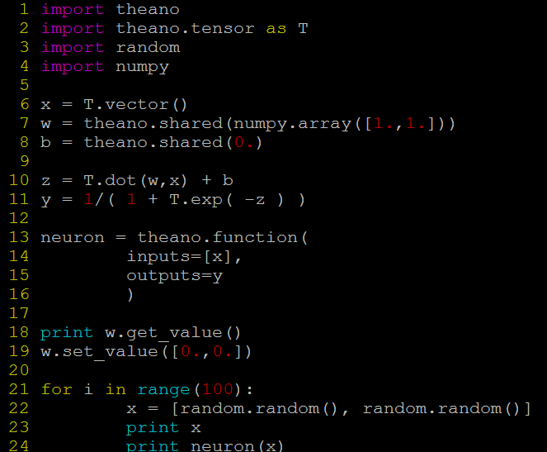



w and b are declared as shared variables.
Initial value
(The shared variables are not symbols.)
x is the only input
The function can access the shared variables.
To get or change the values of the shared variables, you have to use “get_value()” and “set_value()”.

Slide 23
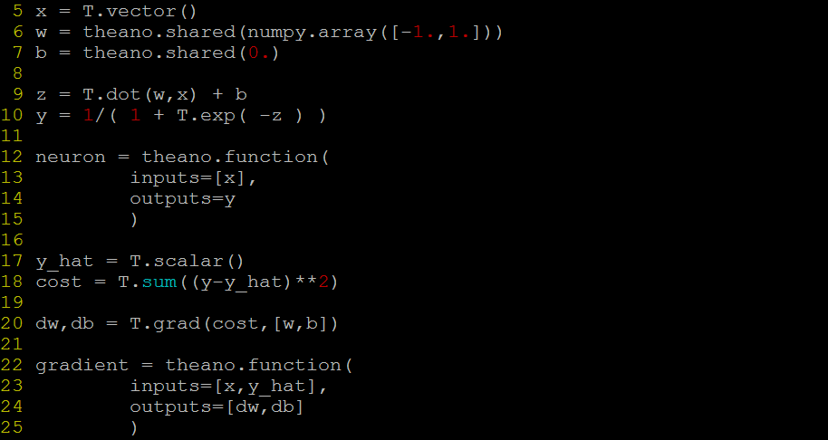




Single Neuron – Training
Define a cost function C
Reference output value
Define Cost
Computing Gradients
Declare the function for computing gradients

Slide 24
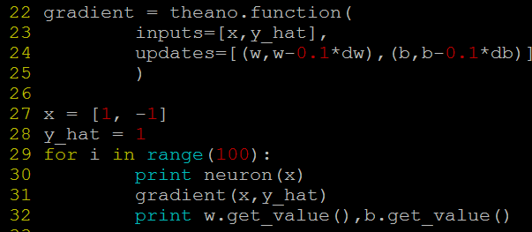
Single Neuron – Gradient Descent
𝑤 ← 𝑤 − 𝜂 ^{𝜕𝐶} , … , 𝑤 ← 𝑤 − 𝜂 ^{𝜕𝐶} , 𝑏 ← 𝑏 − 𝜂 ^{𝜕𝐶}
1 1
𝑁 𝑁
𝜕𝑤₁ 𝜕𝑤_{𝑁} 𝜕𝑏
Effective Way:
Line 24: updates=“a list of pairs”
Each pair is in the form of (shared-variable, an expression). Whenever this function runs, it will replace the value of each shared variable with the result of the expression.

Slide 25
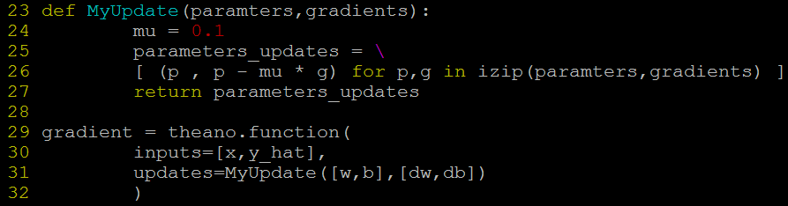
Single Neuron – Gradient Descent
𝑤 ← 𝑤 − 𝜂 ^{𝜕𝐶} , … , 𝑤 ← 𝑤 − 𝜂 ^{𝜕𝐶} , 𝑏 ← 𝑏 − 𝜂 ^{𝜕𝐶}
1 1
𝑁 𝑁
𝜕𝑤₁ 𝜕𝑤_{𝑁} 𝜕𝑏
Effective Way:
In deep learning, usually sophisticated update strategy is needed.
In this case, you may want to use a function to return the pair list for parameter update.
What is izip? https://docs.python.org/2/library/itertools.html#itertools.izip

Slide 26
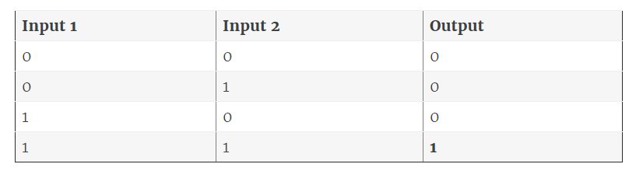
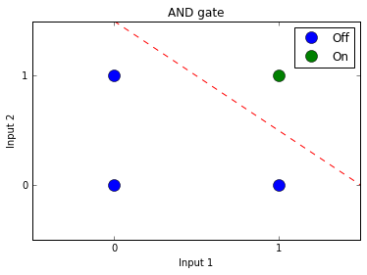
Homework: AND gate
Can you use three neurons to simulate an AND gate?
Hint：
inputs = [[0,0], [1,1], [0,1], [1,0]]
outputs = [0, 1, 0, 0]

