Slide 1
RTLFixer: Automatically Fixing RTL Syntax Errors with Large Language Models
RTL-Repo: A Benchmark for Evaluating LLMs on Large-Scale RTL Design Projects
AIVRIL: AI-DRIVEN RTL GENERATION WITH VERIFICATION IN-THE-LOOP
上週改進部分:
A Multi-Expert Large Language Model Architecture for Verilog Code Generation
ChipNeMo: Domain-Adapted LLMs for Chip Design
Optimizing High-Level Synthesis Designs with Retrieval-Augmented Large Language Models

Slide 2
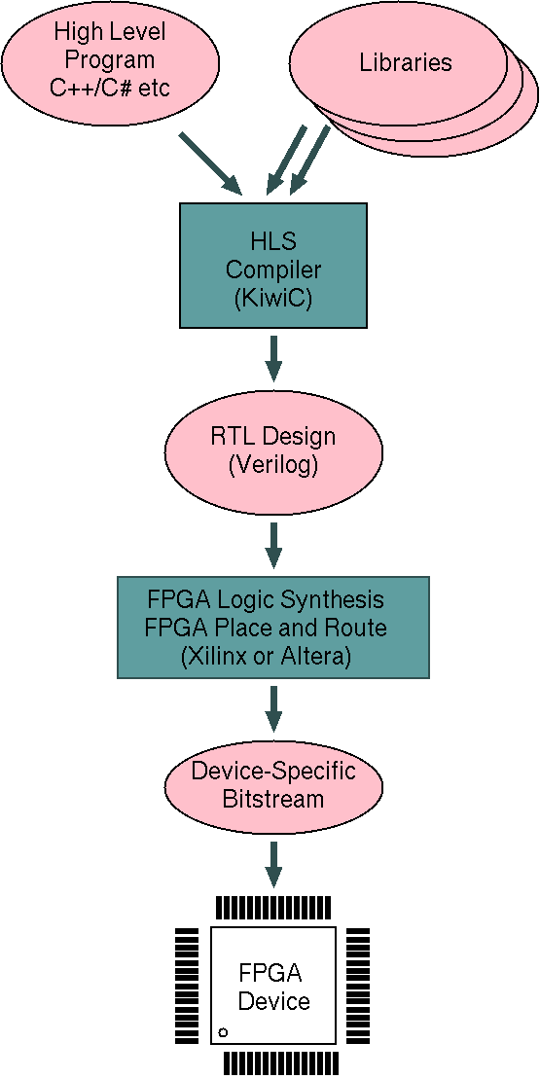
1️⃣ High-Level Program (C++/C#) → Algorithm design (High-Level Programming Language)
2️⃣ Libraries → Pre-built functions for optimization (Reusable Code Modules)
3️⃣ High-Level Synthesis Compiler (KiwiC) → Converts C++ to Register Transfer Level (RTL) Design in Verilog
4️⃣ Register Transfer Level (RTL) Design (Verilog) → Defines hardware logic (Hardware Description Language)
5️⃣ Field-Programmable Gate Array (FPGA) Logic Synthesis & Place and Route (P&R) → Maps RTL to FPGA (Physical Hardware Implementation)
6️⃣ Bitstream Generation → Configures FPGA (Binary Configuration File)
7️⃣ Field-Programmable Gate Array (FPGA) Device → Executes the design (Programmable Hardware Chip) 🚀
Optimizing HLS (RAG)
Multi-Expert LLM
RTLFixer
RTL-Repo
AIVRIL
ChipNeMo
FPGA (Field-Programmable Gate Array) is flexible and good for testing and small projects, but it is slower and uses more power.
ASIC (Application-Specific Integrated Circuit) is very fast and efficient, but it is expensive and cannot be changed after making. 🚀

Slide 3
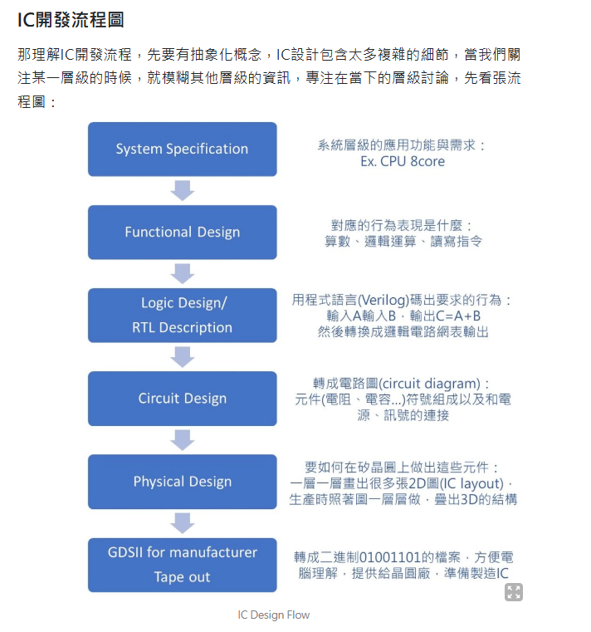
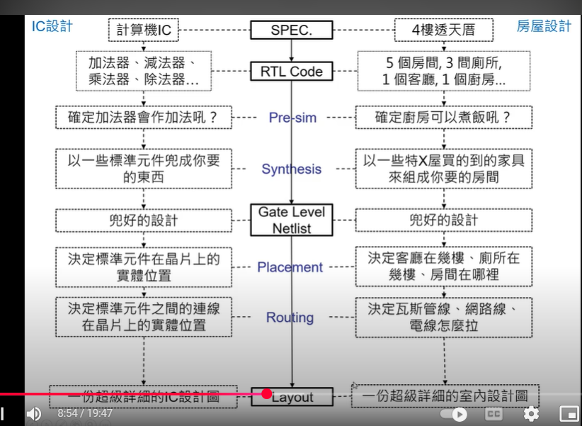

Slide 4
1️⃣ Prompt → Code Llama 生成 HLS C
（工具：Code Llama, GPT-4, Claude, Llama 3, Mistral）
2️⃣ HLS Compiler 轉換為 Verilog（RTL）
（工具：Xilinx Vitis HLS, Vivado HLS, Intel HLS, Catapult HLS, LegUp HLS）
3️⃣ FPGA 綜合（Synthesis）
（工具：Xilinx Vivado, Intel Quartus, Synopsys Synplify, Cadence Genus）
4️⃣ Bitstream 生成
（工具：Xilinx Vivado, Intel Quartus, Lattice Diamond）
5️⃣ 燒錄到 FPGA
（工具：Xilinx Vivado Hardware Manager, Intel Quartus Programmer, OpenOCD）
6️⃣ 測試 FPGA 運行結果
（工具：ILA（Integrated Logic Analyzer）, SignalTap, Oscilloscope, UART/SPI/I2C Debugger）
7️⃣ 量產（FPGA 或轉 ASIC）
（工具：TSMC, GlobalFoundries, Synopsys Design Compiler, Cadence Innovus, Mentor Calibre）

Slide 5

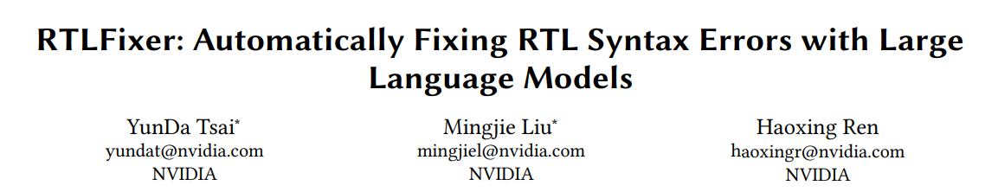

Slide 6
ABSTRACT
Problem:
55% of LLM-generated Verilog code contains syntax errors, causing compilation failures.
Solution:
RTLFixer: A novel debugging framework using Retrieval-Augmented Generation (RAG) and ReAct prompting (Reasoning + Acting).
Allows LLMs to interactively debug Verilog code with feedback.
Results:
Fixes 98.5% of syntax errors in the VerilogEval benchmark dataset (212 samples).
Improves pass@1 success rates by 32.3% (VerilogEval-Machine) and 10.1% (VerilogEval-Human).
Verilog-Machine: ChatGPT-3.5 Turbo converts HDLBits problems with non-text elements into text for better LLM generalization.
Verilog-Human: Manually annotated HDLBits problems ensure high accuracy in Verilog code generation.

Slide 7
syntax errors
module and_gate(input a, input b, output c)
assign c = a & b
endmodule
module and_gate(input a, input b, output c);
assign c = a & b;
endmodule
module simple_module(input a, output b);
assign b = a;
module simple_module(input a, output b);
assign b = a;
endmodule
module compare(input a, input b, output c);
assign c = (a == b;
endmodule
module compare(input a, input b, output c);
assign c = (a == b);
endmodule
module: Defines a hardware module
and_gate: Module name
Inputs and Outputs in parentheses: Define the interface (a, b are inputs; c is output)
assign c = a & b:
assign: Continuous assignment for combinational logic
a & b: Bitwise AND operation; result is continuously assigned to c
Semicolon (;): Ends each statement, signaling the compiler
endmodule: Marks the end of the module definition

Slide 8
module latch(input a, output reg b);
Defines module latch
a is an input; b is an output declared as reg (assigned within an always block)
always @(a b) begin:
Defines an always block triggered when any signal in the sensitivity list changes
Sensitivity list should use commas (correct: @(a, b) or @(*))
b = a;:
When triggered, assigns the value of a to b, making b follow a
end: Ends the always block
endmodule: Ends the module definition
module latch(input a, output reg b);
always @(a b) begin
b = a;
end
endmodule
module latch(input a, output reg b);
always @(a, b) begin
b = a;
end
endmodule

Slide 9
Introduction
Background & Challenges:
LLMs show promise in automating hardware design, generating Verilog code from natural language.
Existing works (e.g., VeriGen, VerilogEval) focus on zero-shot Verilog code generation.
Generating flawless code in one attempt is difficult, requiring multiple debugging iterations.
LLMs struggle with syntax correctness in Verilog:
Fixing syntax errors enhances code accuracy and reduces human debugging effort.
Existing Solutions & Limitations:
ReAct (Reasoning + Acting): Enables LLMs to iteratively refine decisions via interactive feedback.
SelfDebug & SelfEvolve: Allow models to self-identify mistakes but focus on Python, not Verilog.
LLMs suffer from hallucination (factual errors):
Retrieval-Augmented Generation (RAG) helps by integrating external knowledge sources.

Slide 10
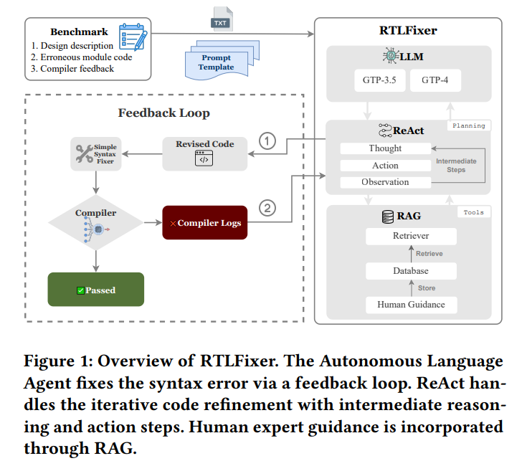
method
LLM (Large Language Model): Uses GPT-3.5 & GPT-4 to analyze and fix Verilog syntax errors.
ReAct (Reasoning + Acting):
Iteratively refines code using Thought → Action → Observation steps.
Enables multi-step adjustments instead of one-shot code generation.
RAG (Retrieval-Augmented Generation):
Retrieves past fixes from a human guidance database.
Enhances Verilog error correction by incorporating expert knowledge.
Feedback Loop (Error Correction Process)
1️⃣ LLM generates initial Verilog code (Revised Code).
2️⃣ Compiler checks syntax:
✅ If correct, code passes.
❌ If errors, compiler logs provide feedback.
3️⃣Uses RAG if additional guidance is needed.
4️⃣ Repeats steps until the code compiles successfully.

Slide 11
proper noun
1. Verilog Benchmarks & Syntax Correction
VerilogEval: A benchmark dataset for Verilog syntax correction.
VerilogEval-syntax: Developed by a research team, includes 174 error samples.
RTLLM benchmark: Evaluates LLMs' ability to correct Verilog syntax.
2. Search & Similarity Techniques
FAISS (Facebook AI Similarity Search): Vector-based similarity search.
Elasticsearch: Full-text search engine for keyword matching.
3. Verilog & FPGA Design Tools
iverilog: Open-source Verilog compiler for basic syntax checks.
Quartus: Intel FPGA design tool for advanced Verilog verification.
Vivado: Xilinx FPGA design tool for FPGA verification.
FPGA (Field-Programmable Gate Array): Reconfigurable logic for AI, 5G signal processing, image processing, and embedded systems; ideal for prototyping and low-volume production.
ASIC (Application-Specific Integrated Circuit): Fixed hardware for SoCs (System-on-Chip), GPUs (Graphics Processing Units), AI chips (TPUs - Tensor Processing Units), and autonomous vehicle processors; optimized for high performance, low power consumption, and mass production.

Slide 12
RTLFIXER: RESOLVING SYNTAX ERROR
WITH LLM AGENTS AND RETRIEVAL
RTLFixer Overview
LLM – Generates and corrects Verilog code.
RAG – Retrieves expert guidance for fixes.
ReAct – Iterative reasoning and action planning.
Workflow:
1️⃣ LLM receives input prompt (benchmark problem).
2️⃣ ReAct + RAG refine code, submitted for compilation.
3️⃣ If errors persist, compiler logs + expert guidance aid further fixes.
4️⃣ Loop until successful compilation.
ReAct: Iterative Debugging
Alternates Thought → Action → Observation.
Queries RAG, adjusts code, resubmits.
Outperforms One-shot correction with multi-round refinement.
RAG: Expert-Guided Fixes
Retrieves real-world debugging solutions.
Prevents hallucinations, ensures accurate corrections.
No retraining needed—adapts with expert insights.

Slide 13
VerilogEval-syntax Error Dataset
Dataset Creation
Extracted Verilog syntax errors from VerilogEval using One-shot & ReAct prompting.
Retained only compilation errors, removing invalid or incomplete samples.
Dataset Composition
✅ 212 Verilog error samples
✅ 7 error categories (30 cases) in Icarus Verilog (iverilog)(開源 Verilog 編譯器 弱)
✅ 11 error categories (45 cases) in Quartus(編譯器 強)

Slide 14
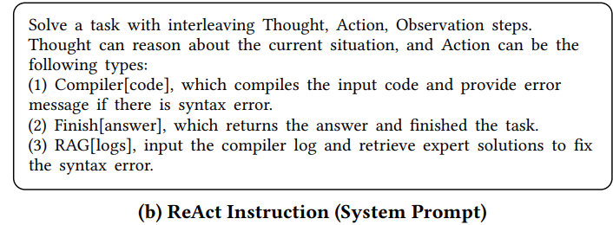
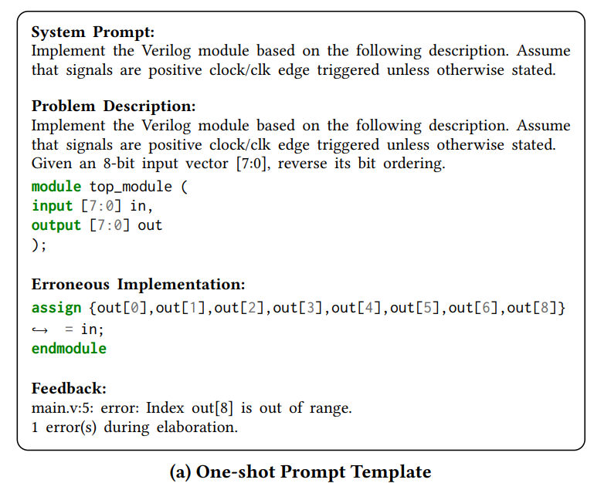
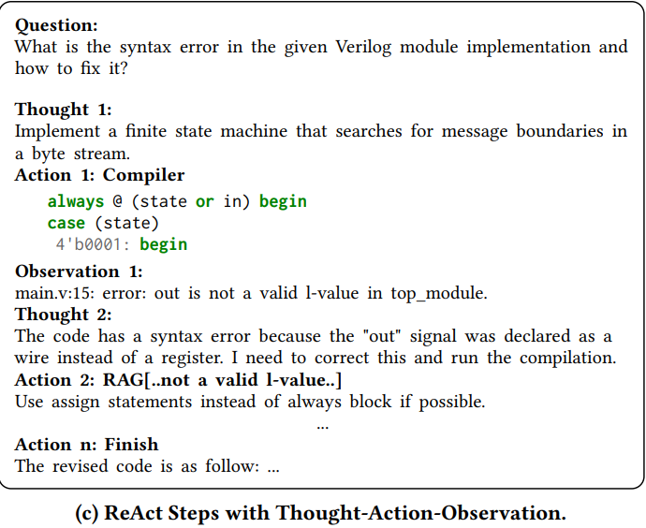
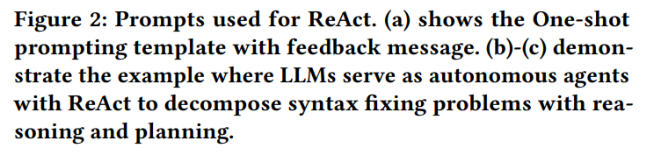

Slide 15
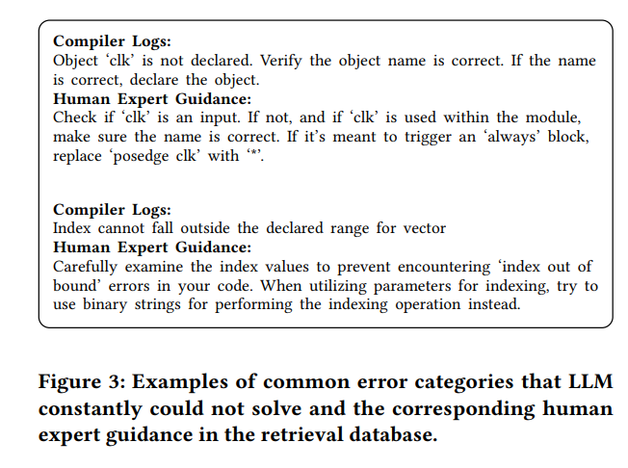

Slide 16
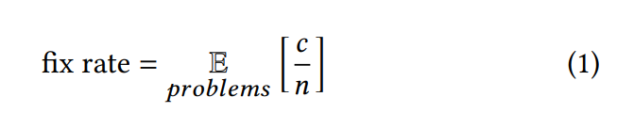
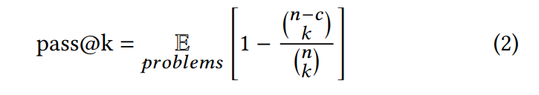
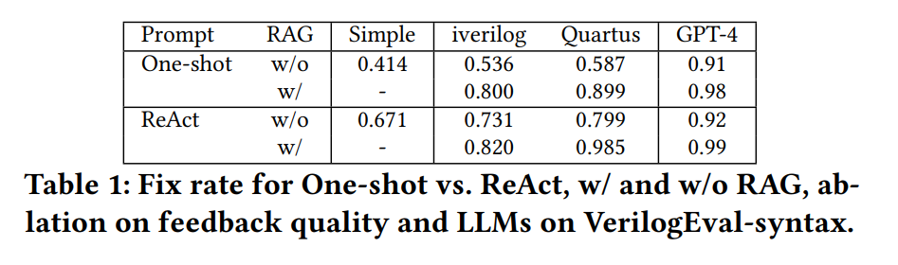
EXPERIMENTS

Slide 17
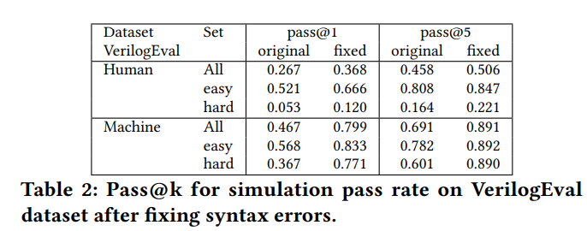
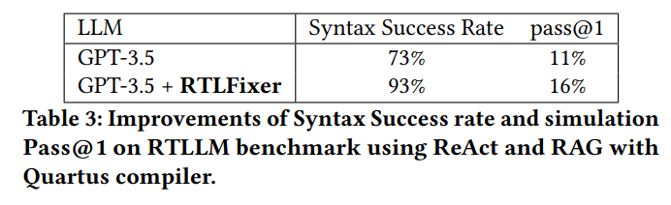
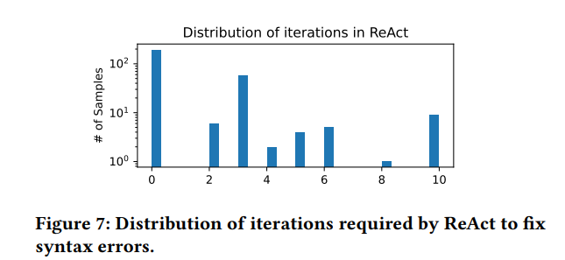

Slide 18
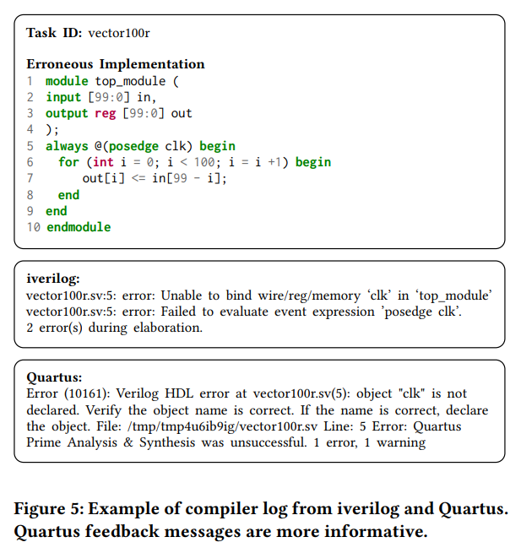
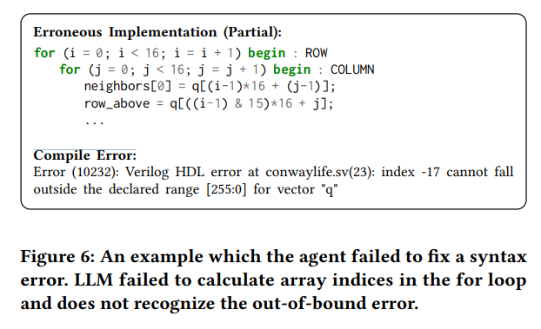
Quartus：

Slide 19
📌 Verilog Compilation Error Analysis (Icarus Verilog vs. Quartus) 處理100bit的問題
✅ 1. iverilog vs. Quartus Error Messages
Error: clk undeclared, posedge clk cannot be resolved.
iverilog: Brief message, only states clk binding failure, no fix suggestion.
Quartus: Detailed message, suggests checking variable name or declaration, more helpful for LLM.
📌 Conclusion: Quartus provides clearer feedback, improving LLM fix success rate.
✅ 2. LLM Failure Case (Out-of-Bounds Index)
Error: q[(i-1)*16 + (j-1)] becomes q[-1] when i=0, j=0, causing an index out-of-bounds error.
Quartus: Clearly marks Index Out of Range, but LLM fails to compute loop indices correctly.
📌 Conclusion: LLM struggles with math-related errors, requiring better numerical reasoning. 🚀

Slide 20
Conclusion
✅ RTLFixer Impact
Integrates RAG + ReAct for Verilog debugging.
Achieves 98.5% syntax error correction success rate.
✅ Key Contributions
Autonomous LLM agent for Verilog debugging.
Comprehensive Verilog debugging dataset for future research.

Slide 21


Repository

Slide 22
Abstract
Overview
Problem: Lack of benchmarks that reflect real-world RTL design complexity.
Solution: RTL-Repo – a benchmark for evaluating LLMs in large-scale RTL projects.
RTL-Repo Dataset
4,000+ Verilog samples from public GitHub repositories.
Each sample includes full project context (multi-file Verilog code).
Models Evaluated
General LLMs: GPT-4, GPT-3.5, Starcoder2.
Verilog-Specific: VeriGen, RTLCoder.
Contributions
Provides a benchmark for assessing LLMs on real RTL design tasks.
Supports model training for Verilog code generation.
Open-source, available on GitHub.

Slide 23
Introduction
RTL modeling is manual, time-consuming, and error-prone.
LLMs improve code generation, but Verilog remains underexplored.
Existing Verilog Models
VeriGen (CodeGen, 16B) – Fine-tuned on GitHub Verilog + textbooks.
RTLCoder (Mistral & DeepSeek, 7B) – Lightweight, better than GPT-3.5.
ChipNeMo (LLaMA-based) – EDA(Electronic Design Automation) scripts & engineering chatbot.
Benchmark Limitations
Existing benchmarks test only single modules.
No evaluation for large-scale, multi-file Verilog projects.
RTL-Repo: A New Benchmark
4,000+ Verilog samples from GitHub.
Tests multi-file understanding & long-range dependencies.
Provides training data for Verilog-specific models.

Slide 24
Related Work
Software Engineering Benchmarks:
CrossCodeEval – Tests LLMs on Python, Java, TypeScript, and C# with cross-file understanding.
RepoBench – Evaluates repository-level code completion in Python and Java.
Limitation – No benchmark exists for Verilog in multi-file, large-scale RTL projects.
Existing Verilog Benchmarks:
RTLLM – 29 RTL tasks, evaluates syntax & functionality.
VerilogEval – 156 Verilog problems from HDLBits, assesses single-module correctness.
Limitations:
Only tests single-file Verilog generation (not real-world large projects).
Limited dataset size – models may memorize solutions rather than generalize.
Need for RTL-Repo:
Realistic multi-file Verilog benchmarking.
Evaluates long-range dependencies in RTL projects.
Ensures models handle complex, large-scale hardware designs.

Slide 25

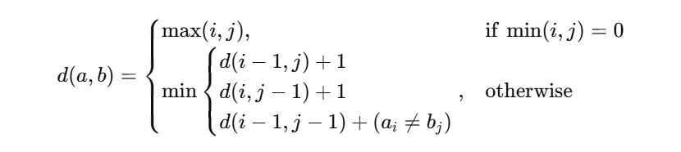

RTL-REPO
Objective
Evaluate LLMs on Verilog code completion and generation in multi-file, large-scale RTL projects.
Assess key abilities: long-context handling, logical consistency, multi-file understanding.
Evaluation Method
Multi-file context + Target line prediction to verify correctness and consistency in Verilog generation.
Metrics:
Exact Match (EM) – Measures the percentage of generated outputs that perfectly match the target line.
Edit Similarity (ES) – Uses Levenshtein distance to evaluate the similarity between the generated and target code.
測量將（模型生成的代碼）轉換成（正確代碼）所需的最少編輯次數（插入、刪除、替換）。

Slide 26
DATASET
RTLLM: Tests single-file Verilog completion, focusing on syntax and single-module logic.(補齊)(底)
VerilogEval: Evaluates single-file Verilog problems (HDLBits-style) for syntax and correctness.(重頭寫)(底)
RTL-Repo:
Supports multi-file, large-scale Verilog projects.
Assesses cross-file dependencies, long-context handling, and logical consistency.
Includes complex RTL designs like CPU architectures, SoCs(System-on-Chip), and hierarchical modules(Hierarchical Modules).
最上層（Top Module）：整合所有子模組，例如 CPU 架構（CPU Architecture）
中間層（Intermediate Modules）：如 算術邏輯單元（Arithmetic Logic Unit, ALU）、控制單元（Control Unit）、寄存器檔（Register File）
最底層（Low-Level Modules）：如 加法器（Adder）、邏輯閘（Logic Gates）

Slide 27
EXPERIMENTAL DESIGN
Data Source
4,098 Verilog samples from 1,361 GitHub repositories.
Real-world projects, ensuring authenticity and diversity.
Data Filtering & Processing
Each sample includes full multi-file context, requiring LLMs to understand entire projects.
4 random files per repository, keeping only valid code (no comments).
Dataset Structure
9 context length categories (ranging from 2K to 128K tokens).
Train set: 2,924, Test set: 1,174, enabling LLM fine-tuning and evaluation.
Purpose
Evaluates LLMs on large-scale, multi-file Verilog projects.
Provides an open-source dataset for Verilog-specific LLM training.
Simulates real RTL design environments, enhancing practical Verilog generation.

Slide 28
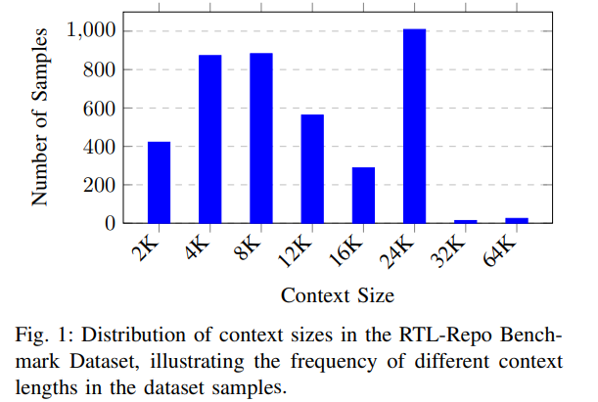

Slide 29
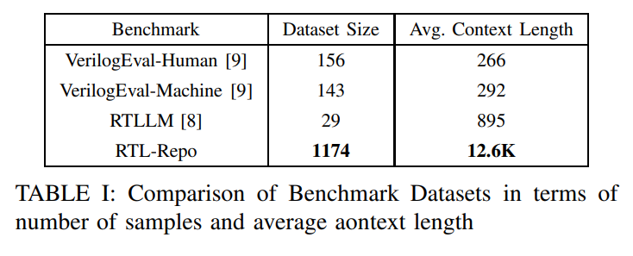

Slide 30
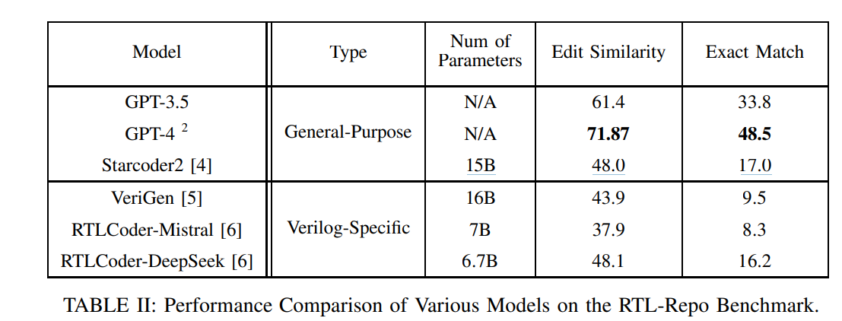
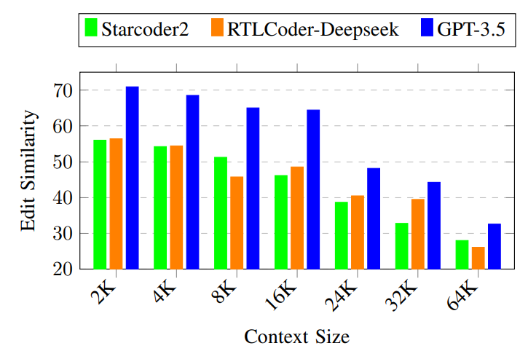

Slide 31
Conclusion
RTL-Repo Contributions
Introduced RTL-Repo, a benchmark with 4,000+ GitHub Verilog samples.
Evaluates LLMs on multi-file, large-scale RTL code generation.
Model Evaluation Results
GPT-4 outperforms all models.
Open-source Verilog models (VeriGen, RTLCoder) struggle with long-range dependencies and multi-file contexts.
Future Research Directions
Fine-tuning open-source models for better Verilog generation.
Developing advanced LLMs to handle large RTL codebases more effectively.

Slide 32
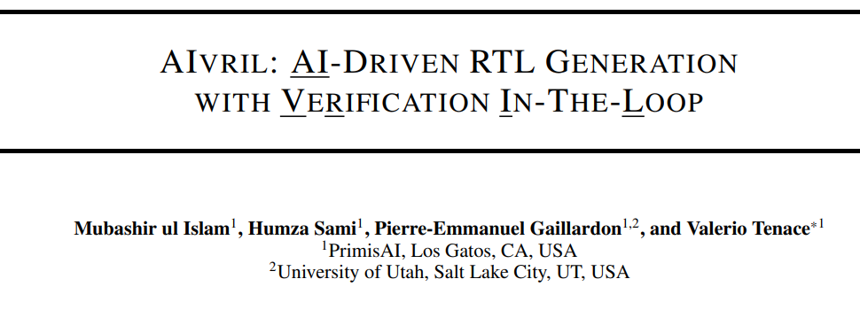


Slide 33
ABSTRACT
AIVRIL: AI-Driven RTL Generation with Verification-In-The-Loop
Objective
✅ Improve LLM-generated RTL code accuracy and reliability.
✅ Address LLM errors in RTL design, where precision is critical.
Key Contributions
✅ AIVRIL Framework: Uses Multi-Agent System + Verification-In-The-Loop (VITL) for automatic syntax correction & functional verification.
✅ Error Reduction: Significantly minimizes incorrect RTL generation.
✅ Performance Boost: 2× code quality improvement, 88.46% verification success rate on VerilogEval-Human dataset.
✅ EDA & AI Integration: Advances LLM applications in RTL automation.
Conclusion
Enhances LLM reliability in RTL design.
Automates RTL generation & verification for error-free code.
Paves the way for AI-powered hardware design automation.

Slide 34
1. Introduction
🔹 Background & Motivation
✅ LLMs revolutionize various fields, including hardware design.
✅ They automate RTL (Register Transfer Level) code generation, enhancing efficiency.
✅ Challenge: LLMs are probabilistic, leading to syntax & logic errors, requiring strict verification.
✅ Issue: While improving code generation speed, verification burden increases.
2 Background & Related Work
🔹 Existing Research & Gaps
✅ Early studies focused on RTL code generation, lacking verification mechanisms.
✅ Recent efforts include syntax error detection & correction, but lack full verification integration.

Slide 35
The AIVRIL Framework
✅ AI-Driven RTL Generation with Verification
AIVRIL uses multiple AI agents to:
Fix syntax errors
Check if the design works (Functional Verification)
✅ Works with EDA Tools to improve RTL code made by AI.
✅ Supports any AI model & tool, making it flexible.
✅ Provides clear verification feedback, unlike black-box models.
Test Results (VerilogEval-Human Dataset)
✅ Better Code Quality:
1.32× better than CodeV
2× better than RTLFixer
✅ 88.46% verification success, ensuring correct & reliable RTL code.
1️⃣ Code Coverage – Makes sure all RTL code runs
Statements Executed: % of Verilog lines tested.
Branches Covered: % of if-else or case statements tested.
Conditions Covered: % of logical conditions (AND, OR) tested.
2️⃣ Functional Coverage – Makes sure all design functions are tested
Reset Condition: Checks if reset works.
Enable Signal: Tests all enable states.
Maximum Count Reached: Ensures the counter reaches its limit.

Slide 36
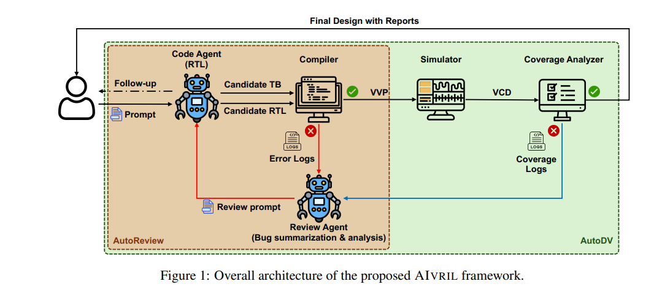
AIVRIL Workflow
1️⃣ AutoReview (Syntax Correction)
User Prompt → Code Agent generates Candidate RTL & TB.
Compiler Check
✅ No errors → Proceed to AutoDV.
❌ Errors → Review Agent analyzes logs, suggests fixes.
Code Agent Refines RTL → Iterates until compilation passes.
2️⃣ AutoDV (Functional Verification)
Simulator (VVP) runs RTL tests.
Coverage Analyzer (VCD) evaluates test coverage.
Verification Check
❌ Low coverage → Review Agent suggests improvements.
✅ Pass → Final RTL + Reports generated.
✅ Automated RTL generation, correction, and verification
✅ Multi-agent system ensures accuracy
✅ Works with various AI models & EDA tools
method
✅ VVP（Verilog Virtual Processor）：用於執行 Verilog RTL 模擬的工具。
✅ VCD（Value Change Dump）：記錄信號變化的波形文件，用於後續分析與覆蓋率計算。
✅ DV（Design Verification）：設計驗證，確保 RTL 代碼在模擬中符合規格。
✅ TB（Testbench）：測試平台，用來驗證 RTL 設計的功能與行為。

Slide 37
AIVRIL Framework – AutoReview & AutoDV
3.1 AutoReview (Syntax Correction)
✅ Ensures LLM-generated RTL code is syntactically correct.
✅ Three Input Types:
Detailed: Complete design, minimal interaction.
Vague: Code Agent asks for clarifications.
Task-Based: Partial RTL, requests verification.
✅ Process: Code Agent → Compiler → Review Agent (error analysis) → Iterates until errors are resolved.
3.2 AutoDV (Functional Verification)
✅ Extends AutoReview with simulation & coverage analysis.
✅ Process: RTL → Simulation → Coverage Check → Review Agent (error fixes) → Iterates until 90%+ coverage.
3.3 EDA & LLM Integration
✅ Tool-agnostic: Works with any EDA(Electronic Design Automation) tools.
✅ LLM-agnostic: Supports multiple LLMs.
✅ Flexible & Scalable: Adapts to different RTL workflows.

Slide 38
🔹 Benchmark & Tools
AIVRIL was tested on 156 VerilogEval-Human benchmarks, using Icarus Verilog for verification and Covered for coverage analysis.
🔹 AutoReview – Syntax Correction & Functional Improvement
✅ GPT-4o & Claude 3.5 Sonnet: Syntax errors completely eliminated.
✅ Llama3 70B: Syntax errors reduced from 124 to 9.
✅ Functional correctness improvement:
GPT-4o: +21.2%
Claude 3.5 Sonnet: +11%
Llama3 70B: +12%
🔹 AutoDV – Functional Verification & Coverage Analysis

Slide 39
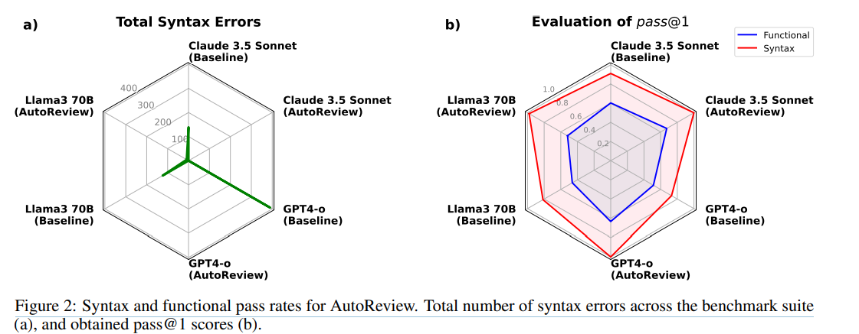
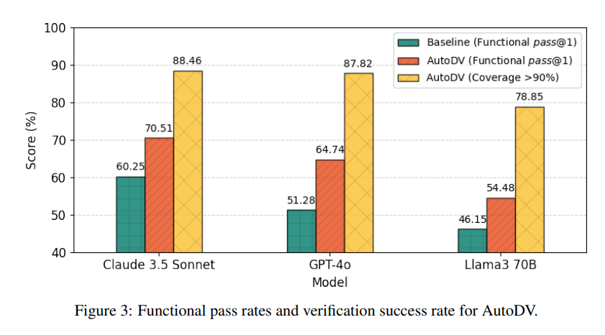
Experimental Results
AIVRIL was tested on 156 VerilogEval-Human

Slide 40
5 Conclusions
AIVRIL: Enhancing GenAI for RTL Design
AIVRIL improves the accuracy and reliability of LLM-generated RTL code through AutoReview (syntax correction) and AutoDV (functional verification). It eliminates syntax errors, enhances functional correctness, and boosts verification success rates without fine-tuning LLMs.
📌 Key Findings:
✅ GPT-4o & Claude 3.5 Sonnet: AutoReview fully eliminated syntax errors and significantly increased pass@k_functional scores.
✅ AutoDV Verification: Improved functional correctness and coverage success, ensuring higher design reliability.
✅ Model Agnostic: Works across LLMs like Claude 3.5, Llama3 70B, demonstrating high adaptability.
📌 Conclusion:
AIVRIL sets a new standard for AI-driven RTL design, offering a scalable, transparent, and efficient approach that seamlessly integrates code generation and verification, paving the way for automated hardware design.

Slide 41
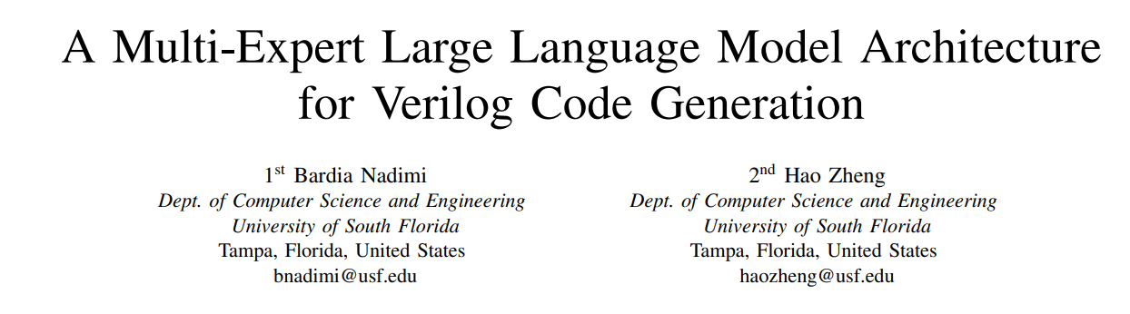


Slide 42

Abstract
Improve Verilog Code Quality
Reduce syntax (comma) and functional (function) errors in LLM-generated Verilog code.
Make the generated code more usable and reliable.
Introduce Multi-Expert LLM (MEV-LLM)
Use different expert models for different design complexities.
Generate more accurate Verilog code for each complexity level.
Develop a Well-Annotated Verilog Dataset
Categorize designs into Basic, Intermediate, Advanced, and Expert levels.
Add detailed descriptions to improve model training.
Enhance LLM Performance for Verilog Generation
Show that MEV-LLM improves accuracy by 23.9% (pass@k) compared to previous methods.
Prove that multi-expert models work better than a single model.
Top-K / Top-P（Nucleus Sampling）
Top-K 限制每次選擇機率最高的前 K 個詞。
Top-P（Nucleus Sampling） 只選擇機率加總超過 P% 的詞（動態 K）。

Slide 43
Input Prompt (設計描述)
│
▼
[Complexity Classifier LLM]
│
├──→ Basic Expert Model (基礎專家)
├──→ Intermediate Expert Model (中級專家)
├──→ Advanced Expert Model (高級專家)
└──→ Expert Expert Model (專家級專家)
│
▼
Generated Verilog Code (生成 Verilog 代碼)
Input: 設計描述
│
▼
[Tokenizer] → [Transformer Encoder] → [Fully Connected Layer] → [Softmax]
│
▼
Output: 設計複雜度（Basic / Intermediate / Advanced / Expert）
Tokenization:
BPE (GPT, LLaMA), WordPiece (BERT), SentencePiece (T5, XLNet).
Transformer Model:
BERT, using token for classification.
Fully Connected Layer:
Maps hidden states to four complexity levels.
Softmax:
Outputs probability distribution over categories.
BPE "hellohello" → ["hello", "hello"]
WordPiece "unhappiness" → ["un", "hap", "pi", "ness"]
SentencePiece "New York" → ["New_York"]

Slide 44
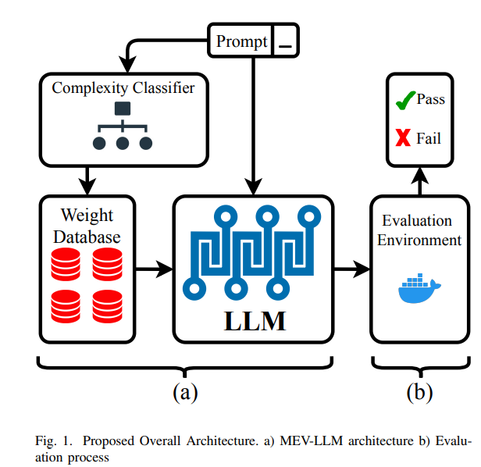
Method
(a) MEV-LLM Architecture
Prompt: User inputs a Verilog code generation request.
Complexity Classifier: Categorizes the request into Basic, Intermediate, Advanced, or Expert to select the best expert model.
Weight Database: Stores fine-tuned expert LLM weights; loads the appropriate weights based on complexity.
LLM: Generates Verilog code using the selected expert model and sends it for evaluation.
(b) Evaluation Process
Evaluation Environment: Runs the generated Verilog code in a testing framework (e.g., Docker-based simulation).
Pass/Fail Check:
✅ Pass: Code meets requirements.
❌ Fail: Code has syntax or functional errors; failed code is fed back for improvement.
HDLBits（156 個 Verilog 設計問題）+ GitHub Verilog 代碼。

Slide 45
Dataset Development Method
Annotation Methods:
Fine-Grained Labeling: Used ChatGPT-3.5-Turbo API to generate detailed descriptions for each Verilog file, enhancing the LLM's understanding of Verilog semantics.
Level (等級) Description (描述)
Basic（基礎） Logic gates, basic wiring. （邏輯閘、基本佈線）
Intermediate（中級） Multiplexers, adders, arithmetic units. （多工器、加法器、算術單元）
Advanced（進階） Sequential circuits, FSMs. （時序電路、有限狀態機）
Expert（專家級） High-level systems integrating multiple modules. （整合多個模組的高階系統）

Slide 46
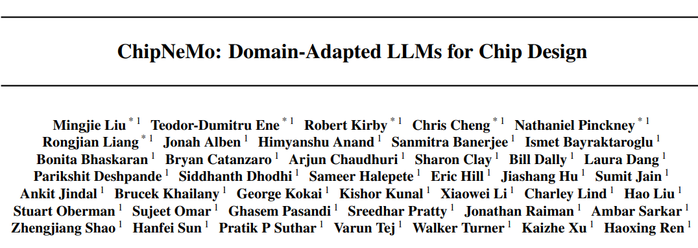


Slide 47
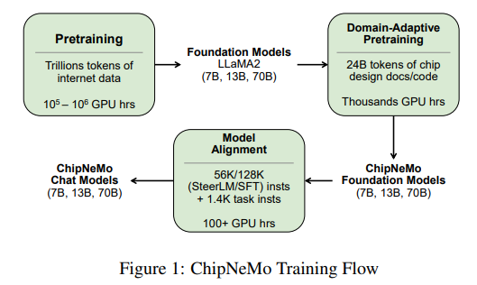
The Pile, Common Crawl, C4, GitHub Code Corpus
Chip Design Docs, RTL Code (Verilog, VHDL), EDA Scripts (Python, Tcl), Verification Testbenches, IEEE/arXiv Papers
1️⃣ Pretraining
Base Model: LLaMA2 (7B, 13B, 70B)
Data: Trillions of tokens from the internet
Compute: 100K – 1M GPU hours
2️⃣ Domain-Adaptive Pretraining
Fine-tunes LLaMA2 with 24B tokens from chip design docs/code
Produces ChipNeMo Foundation Models (7B, 13B, 70B)
Compute: Thousands of GPU hours
3️⃣ Model Alignment
Uses SteerLM/SFT with 56K–128K domain instructions + 1.4K task instructions
Optimizes the model for chip design applications
Compute: 100+ GPU hours
4️⃣ ChipNeMo Chat Models
Final LLM tailored for interactive chip design tasks、e5
Versions: 7B, 13B, 70B
Chip-Specific Instructions (1.4K), General Instruction Data (Alpaca, OASST), RAG from Chip Design Docs

Slide 48
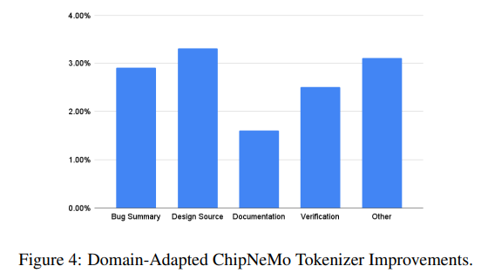
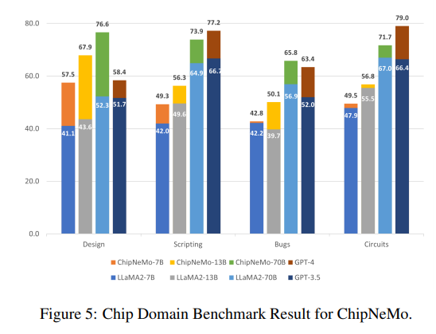
1️⃣ Bug Summary（錯誤摘要）：
2️⃣ Design Source（設計原始碼）：
3️⃣ Documentation（技術文檔）
4️⃣ Verification（驗證）
5️⃣ Other（其他）：

Slide 49
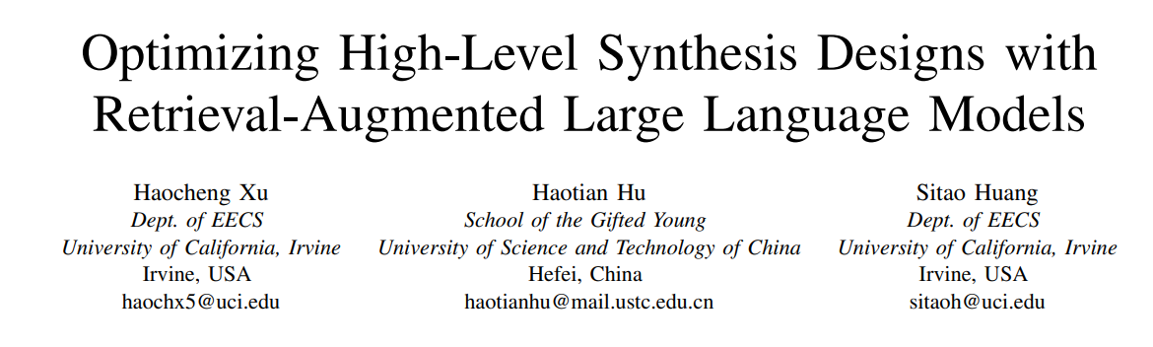


Slide 50
Abstract
Current Challenges in HLS
❌ Manual Code Transformations
Engineers must rewrite code for optimization (loop unrolling, pipelining).
Dataflow & memory structures need manual adjustments.
❌ Manual Optimization Directives
Engineers add #pragma HLS to guide the compiler.
Controls resource usage, parallelism, and memory access.
Requires expert knowledge to get the best performance.
Future Improvements
🔹 AI-powered HLS Optimization – Reduce manual tuning.
🔹 Smarter Compilers – Auto-detect and apply best strategies.
🔹 HLS Code Assistants – AI tools to suggest optimal configurations.

Slide 51
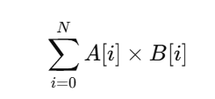
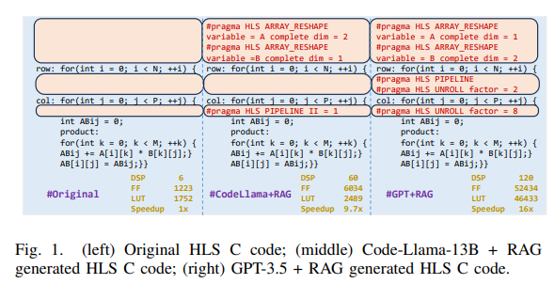



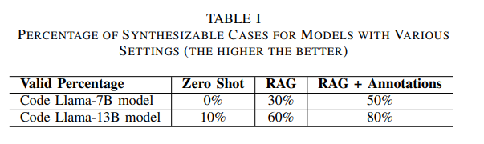
INTRODUCTION
1️⃣ DSP（數位訊號處理單元） - 用於高效執行乘法與點積運算，提升計算效能，但占用較多 FPGA 資源。
2️⃣ FF（觸發器） - 儲存資料的暫存器，提高時序穩定性，增加並行度，但可能提升功耗。
3️⃣ LUT（查找表） - 可編程邏輯元件，決定 FPGA 設計的複雜度，LUT 越少代表設計越高效。
RAG 會在 HLS 代碼庫（如 FPGA 最佳實踐案例、研究論文）

Slide 52
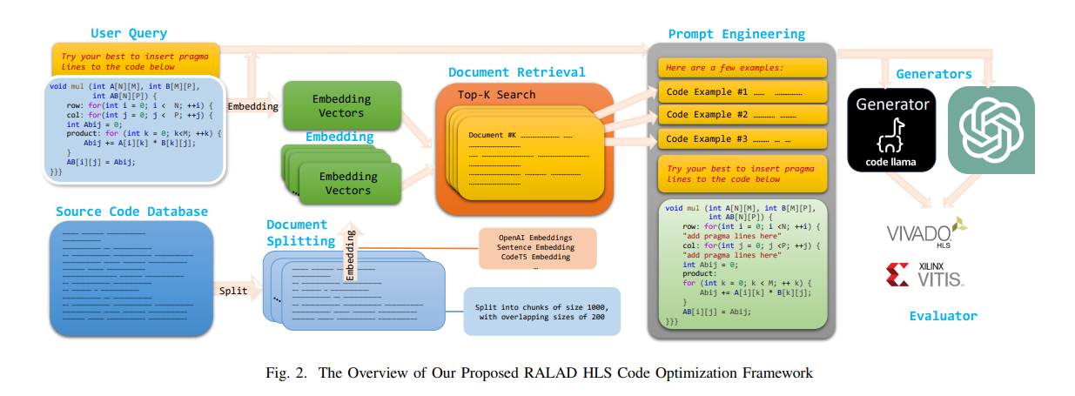

II. METHODOLOGY
Prompt（輸入）-> Code Llama 生成 HLS C -> HLS Compiler 轉換成 Verilog
Parallel Programming for FPGAs" (pp4f)
HLS Benchmark 測試集
開源 HLS 代碼庫

Slide 53
Embedding Methods Comparison
OpenAI Embeddings: General NLP, lacks deep code understanding.
SBERT: Good for Q&A and sentence matching, not for code transformation.
CodeT5 Embedding: Optimized for code retrieval & transformation, requires HLS fine-tuning.
CodeT5 Pretraining Data
CodeSearchNet, BigCode, GitHub Repos – General code understanding.
Hugging Face Code Datasets – Multi-language fine-tuning.
HLS-Specific Code – Tailored for HLS optimization.

Slide 54
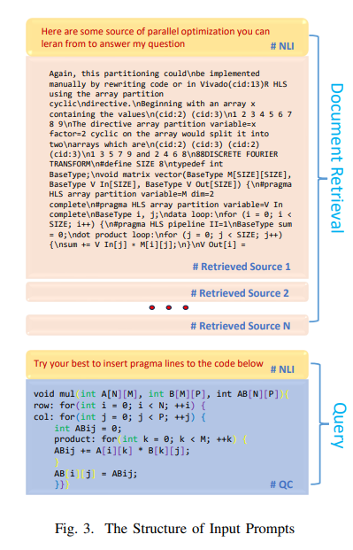
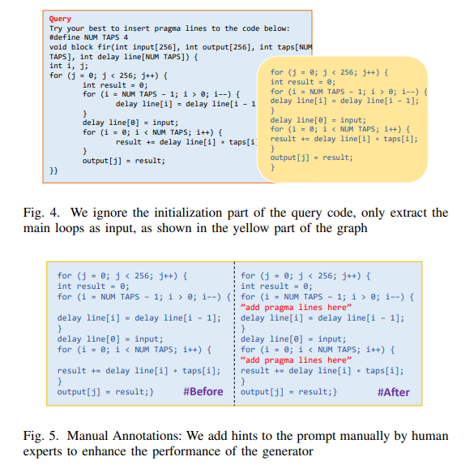
🔹 Retrieval-Augmented Generation (RAG): Retrieves optimization suggestions from a knowledge base to enhance LLM-generated results.
🔹 Semantic Query Matching (NLI (Natural Language Inference)+ Sentence Embedding): Ensures high relevance between retrieved content and the query.
🔹 Manual Annotation: Assists LLM in accurately inserting pragma directives, improving HLS efficiency.

Slide 55
III. EXPERIMENT
These three models play distinct roles in the RALAD HLS framework:
1️⃣ Code Llama – Responsible for code generation, providing HLS code with pragma insertion suggestions.
2️⃣ GPT (e.g., GPT-4) – Focuses on high-level optimization and completion, refining pragma design and improving efficiency.
3️⃣ Vivado/Vitis HLS – Serves as a verification tool, checking synthesizability and hardware resource utilization.
This workflow leverages RAG (Retrieval-Augmented Generation) + Prompt Engineering to enhance the quality of LLM-generated HLS code, ensuring feasibility and optimal performance in FPGA design.

Slide 56
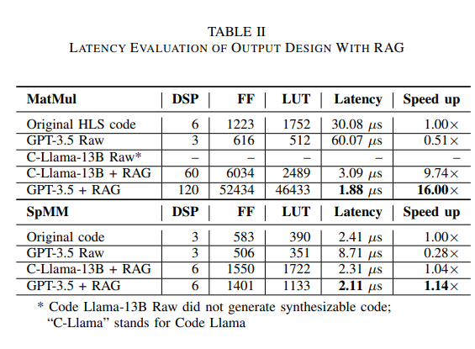
Dense Matrix (dl cv)
Sparse Matrix (gnn)

