Slide 1
Using 100% Open Source technologies, make a mobile app to take a picture, upload the picture onto a cloud Computer Vision library to detect the number of human faces inside the picture. Send response back to the mobile app with the number. Canbuild on Android, iOS, can use React Native, Swift, Objective C++, Java, embedded web HTML5 or any other framework

Slide 2
基本技术
Springboot +jdk11
使用OPENCV 人脸识别
前端使用uniapp 拍照上传

Slide 3
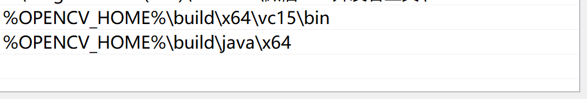
人脸识别
1、下载opencv 4.5.5版本 Releases – OpenCV
2、安装opencv 4.5.5
3、配置环境变量
4、程序基于64位windows下开发。其他平台需要替换相应得jar和库

Slide 4
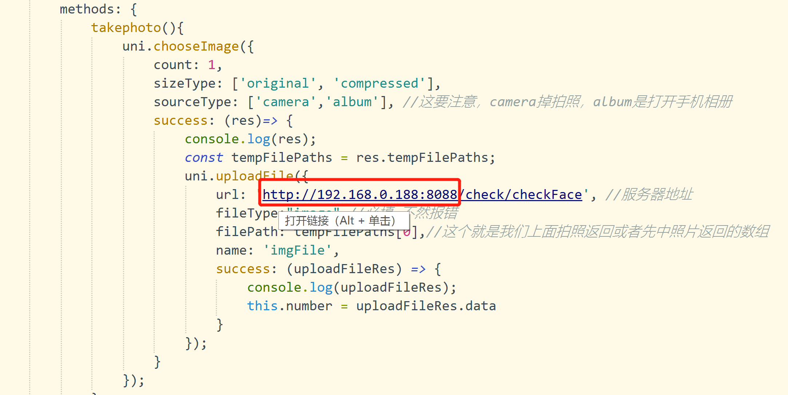
前端
1、修改服务器地址

