Slide 1
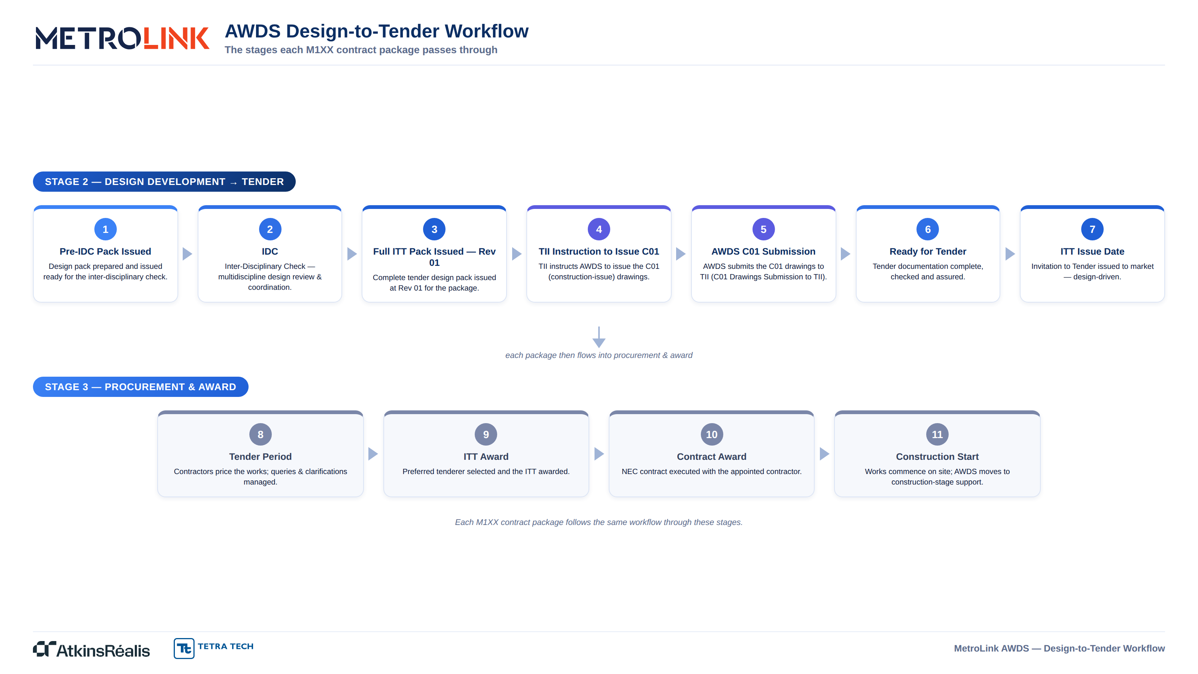

Slide 2



Design-to-Tender Workflow — Pack Status Summary
Current workflow stage of each contract package
Workflow stages: 1 Pre-IDC Pack · 2 IDC · 3 Full ITT Pack — Rev 01 · 4 TII Instruction to Issue C01 · 5 AWDS C01 Submission · 6 Ready for Tender · 7 ITT Issue Date
Contract | Design-to-Tender Workflow Status
M140 | 2 · IDC
M141 | 2 · IDC
M142 | 1 · Pre-IDC Pack
M145 | 1 · Pre-IDC Pack
M146 | 1 · Pre-IDC Pack
M147 | 1 · Pre-IDC Pack
M130 | 1 · Pre-IDC Pack
M135 | 1 · Pre-IDC Pack
Contract | Design-to-Tender Workflow Status
M138 | 1 · Pre-IDC Pack
M160 | 3 · Full ITT Pack — Rev 01
M161 | 1 · Pre-IDC Pack
M190 | 2 · IDC
M111 | 1 · Pre-IDC Pack
Minor Works | 1 · Pre-IDC Pack
Env. Baseline | 1 · Pre-IDC Pack
DAA Works | 1 · Pre-IDC Pack
Status indicative as at 30-Jun-2026 — to be confirmed and maintained against the live P6 integrated programme. Stage numbers correspond to the Design-to-Tender Workflow.

