Slide 1
CSI 3450 Music Venue Database
Group 13
Designed by: Lemuel Cheon, Henry Dare, Alexis Francoeur

Slide 2
Problem Statement
A data repository with an intuitive interface for a user to create an account, reserve tickets under an account, edit account information, and search events by name and date.

Slide 3
Functional Requirements
Non-Authenticated Users:
The system shall allow Non-Authenticated Users to search for Events and Schedules
The system shall allow Non-Authenticated Users to retrieve all Events.
The system shall allow Non-Authenticated Users to retrieve all Schedule information for an Event.
The system shall allow Non-Authenticated Users to retrieve all Availability for any Event’s Schedule.
The system shall allow Non-Authenticated Users to create an Account.
Authenticated Users
The system will use a RMDBS for all persistent data stores.
The system shall allow Authenticated users to…
Log into Accounts on the database
Update Reservations on the database.
Update Account Information on the database.
Delete Accounts from the database

Slide 4
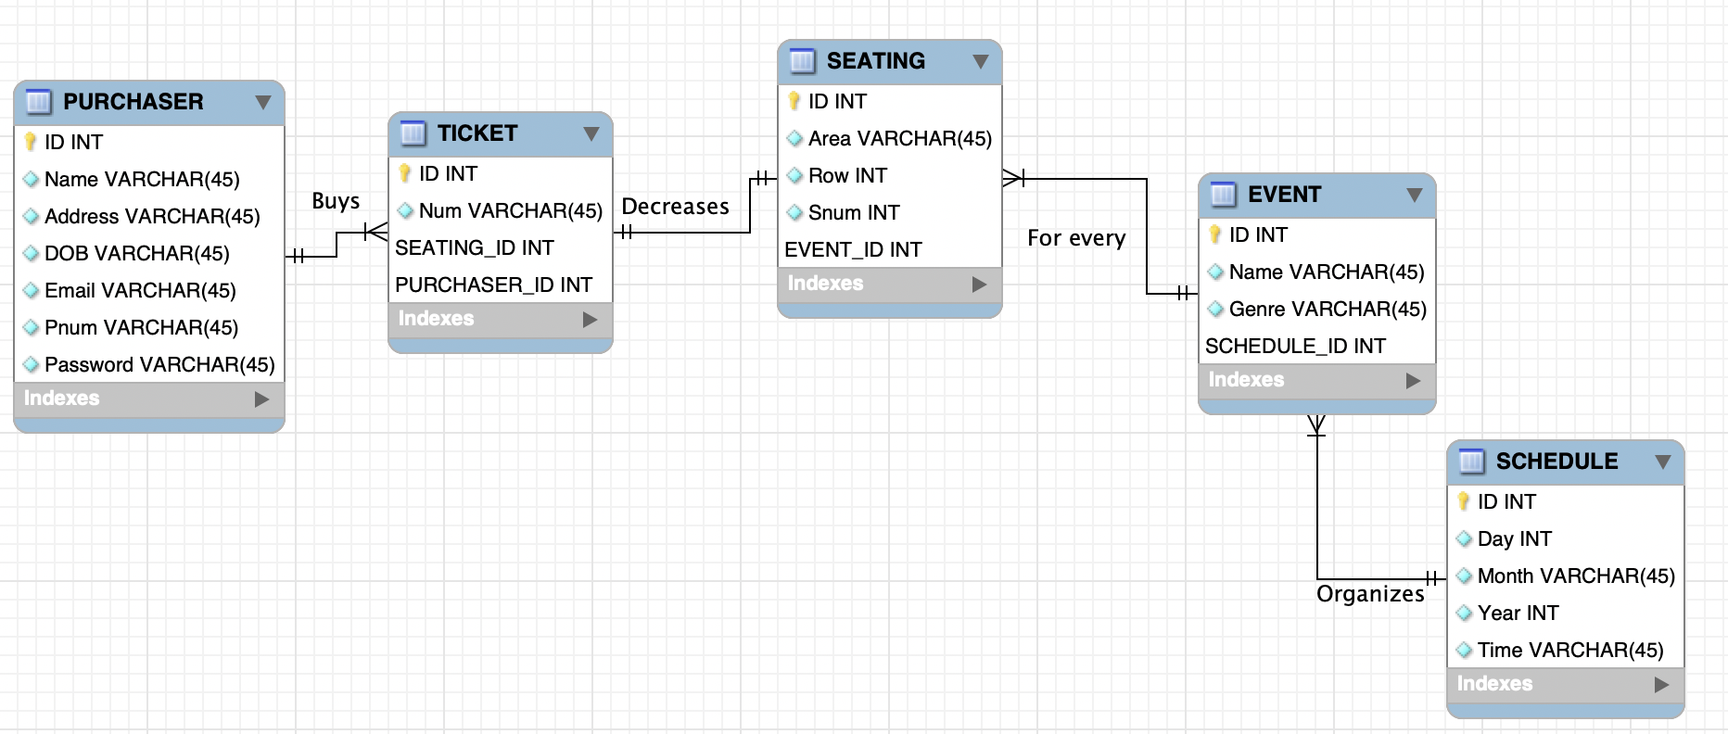
Entity Relationship Diagram

Slide 5
Tools Used
MySQL Server, MySQL Workbench, Visual Studio Code, Github, Internet Browser

