Slide 1

Optimising Stock Market Trading Indicators
Monash FinTech Bootcamp: Project_2_Group_2
Date: 05 - 12 - 2022
Team: Akhil Kavuri, Danny Milson, Dong Ling, Henry Date, Brendan van Maanen

Slide 2
project overview
Our aim was to build a predictive algorithm to outcompete the profitability and risk of the S&P 500.
In doing so wanted to overcome the limitations that a single machine learning model exhibits when trained on a single data set, and is then applied to new data sets.
By using an ensemble machine learning algorithm we could combine several different machine learning models to produce a superior predictive outcome to that of any single model.
For the model to be accuracte we needed to determine the best feature and prediction sets that would maximise the performance indicators, and be able to ensure consistent results when applied to new datasets.
Finally, we wanted to see how AWS and LEX could provide a client interface for the model so that future development of the project would employ a bot to gather customer data, allow selection of an index and report back on the the result.

Slide 3

P2-G2 team roles
DANNY MILSOM
ReadMe
Coding
BRENDAN VAN MAANEN
Project Mgr
QA
HENRY DATE
GitMaster
DEV
DONG LING
AWS/LEX
Coding
AKHIL KAVURI
LEAD DEV

Slide 4
what we set out to do
Build an ensemble model and stacking method of a set of machine learning alogrithms to improve the prediction process - overcoming the limitations of a single model by reducing the occurrence of high variance, low accuracy, noise and bias.
We needed to understand how technical indicators would effect predictions
Test models to maximise indicator performance
Identify feature and prediction sets that would deliver consistent reliable results
Optimisie hyperparameters to maximise neural network accuracy

Slide 5
data techniques
Data sets included: Yahoo Finance, Pandas, Numpy, Pathlib, HvPlot, SkLearn, Ensemble
Stock index data was sourced from Yahoo Finance from 01-01-1980 to current
Stock Indexes tested include S&P500, DOW Jones, S&P/ASX, RUSSEL 2000, NASDAQ 100

Slide 6
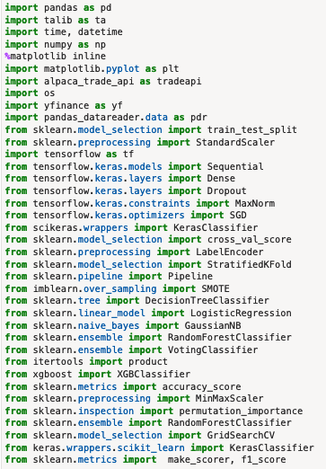
imports + libraries
The project demanded a significant number of imports and libraries

Slide 7
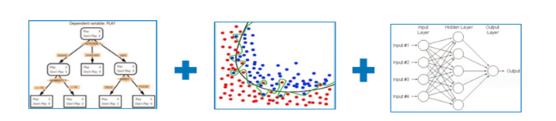

ensemble – what is it?
bagging
boosting
stacking
Ensemble
Ensemble
Ensemble
- Pred
ws1
- Pred
- Pred
ws2
ensemble methods use multiple learning algorithms to obtain better predictive performance than could be obtained from any of the constituent learning algorithms alone

Slide 8
challenges
AWS/LEX: to fully automate LEX required we run the notebook through the LAMBDA function
Ensemble was a complex machine learning model and challenging coding project, but it promised to address the limitations of single algorithm machine learning models experienced in some of the earlier machine learning exercises done in class
For our project to be effective we needed to work out how to find the best features and variables sets that would deliver consistent and accurate prediction outcomes

Slide 9
winners and losers
Using ensemble we were able to consistently predict a higher outcome than any single machine learning alogorithm
The model reliably back tested on datasets and successfully demonstrated higher than market results across all the major stock indices we tested
We were unable to execute LEX using a Lambda function to run the notebook and automate the prediction results to the bot for the user

Slide 10


adding a ‘human touch’
We wanted to ‘humanise’ the front end of the process by creating a bot using AWS and LEX that could harvest initial details and begin the client investment journey
What kind of service are you after: Financial Advice (Green), Investment Management (Blue), or Portfolio Optimisation (Yellow)
Hello, how are you?
Hi, welcome to Group 2 Consulting Firm. Thank you for using our service, can I please have your first name?
Portfolio Optimisation please
Please enter a desired index ticker: SPY (S&P 500), DJI (DOW Jones), AXJO (S&P?ASX200), RUT (Russel 2000) or QQQ (NSADAQ 100)
I’m Alex
Hi, Alex, can I please have your Date of Birth to confirm you are over 18 years old?
AXJO
Thanks Alex. One of our consultants will be in contact to discuss how we apply machine learning, neural networks and apply ensemble to maximise prediction accuracy.
15/01/1990
Thanks Alex. How can I help you today.
Please stand by and we will be back to you shortly…
I was wondering what services you offer

Slide 11
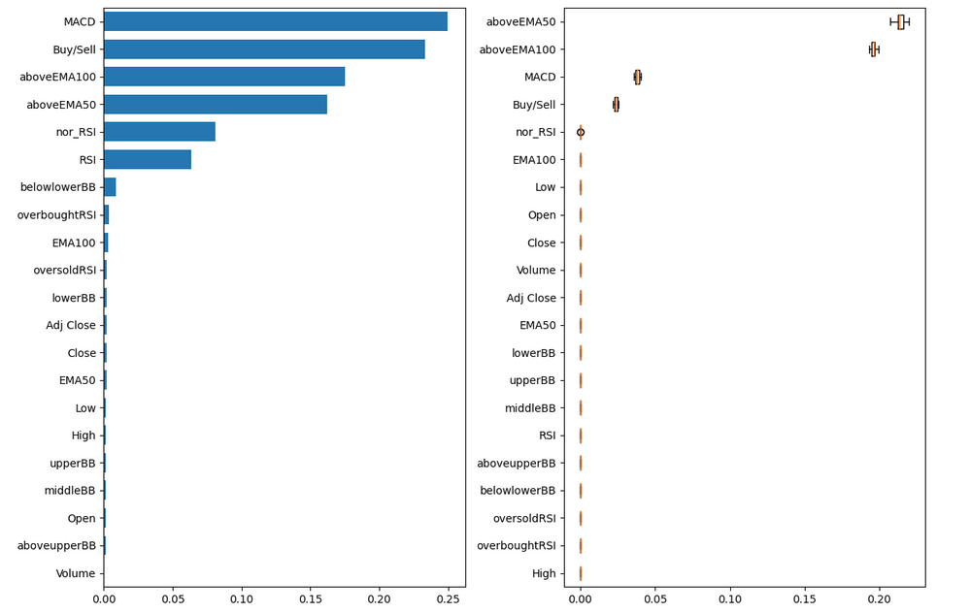
feature selection

Slide 12
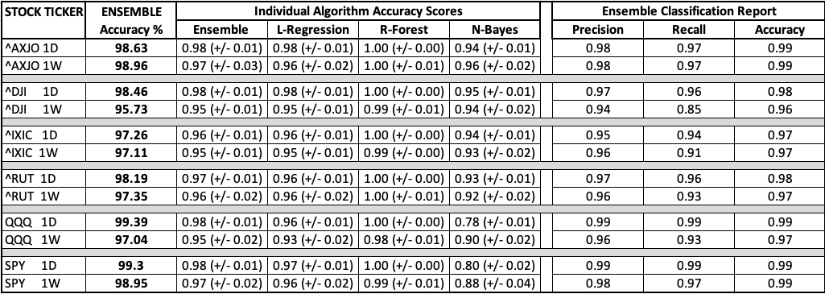
ensemble verfication

Slide 13
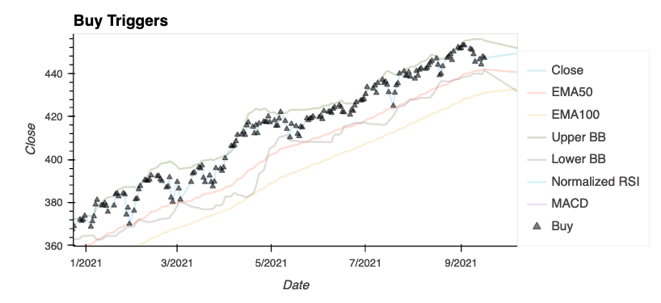

Slide 14
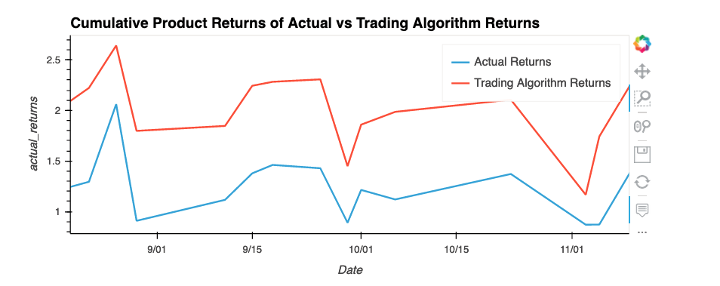

Slide 15
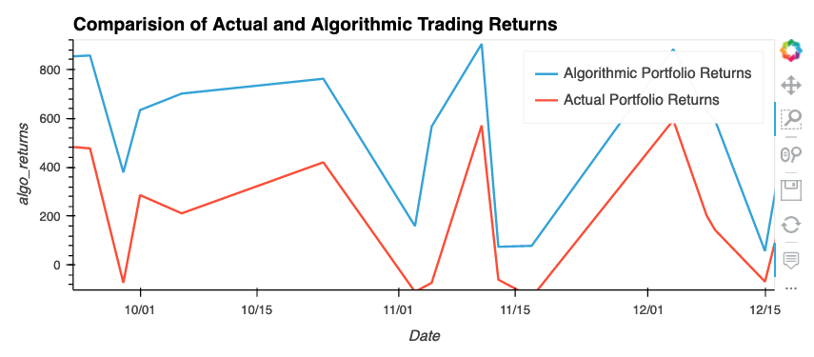

Slide 16
Next Steps
Going forward:
implement a ‘paid for’ API to ‘fully access’ stock data
use lambda to power the notebook and fully activate lex
factor brokerage commissions and trading fees into prediction outcomes
fully optimise the neural network to find global minima
add risk/return analysis with Sharpe and Sortino ratios

Slide 17
Links
Project files can be accessed at:
GitHub: https://github.com/henrydate/Optimising_TA
Notebook: https://github.com/henrydate/Optimising_TA/blob/main/Version_5_1.ipynb
ReadMe: https://github.com/henrydate/Optimising_TA/blob/main/README.md

