Slide 1
Hi???u qu??? ch???n do�n v� di???u tr??? b??? test th???n kinh nh???n th???c
BS.CK2. D??? Thanh Li�m - Don v??? tr� nh??? v� sa s�t tr� tu??? BV 30-4

Slide 2
N???i dung tr�nh b�y
D???t v???n d???
D???i tu???ng v� phuong ph�p nghi�n c???u
K???t qu??? - B�n lu???n
K???t lu???n

Slide 3
C�u h???i NC, m???c ti�u
C�u h???i nghi�n c???u
Gi� tr� ch???n do�n v� di???u tr??? b??? test l� g�?
M???c ti�u
Nghi�n c???u m???i tuong quan c???a thang di???m MMSE v???i c�c test th???n kinh nh???n th???c kh�c trong b??? Test th???n kinh nh???n th???c t???i B???nh vi???n 30-4.
D�nh gi� hi???u qu??? ???ng d???ng c???a b??? Test th???n kinh nh???n th???c trong ch???n do�n v� di???u tr??? Sa s�t tr� tu??? t???i B???nh vi???n 30-4

Slide 4
D???t v???n d???
SSTT l� m???t b???nh l� c???a n�o b???, g�y ra suy gi???m ch???c nang nh???n th???c, h�nh vi v� ho???t d???ng s???ng c???a b???nh nh�n.
T??? nam 2019 d???n nay, Don v??? Tr� nh??? v� Sa s�t tr� tu??? B???nh vi???n 30-4 d� s??? d???ng b??? tr???c nghi???m d�nh gi� ch???c nang th???n kinh nh???n th???c Vi???t Nam (VnCA)
Ph�t hi???n, d�nh gi� d�ng m???c nh???ng thay d???i s???m nh???t v??? h�nh vi v� nh???n th???c c???a b???nh nh�n gi�p c�c nh� l�m s�ng ch???n do�n s???m, t???i uu h�a chi???n lu???c di???u tr???, g�p ph???n gi???m thi???u g�nh n???ng b???nh t???t do SSTT g�y ra

Slide 5
D???i tu???ng v� phuong ph�p nghi�n c�u
Thi???t k??? ngi�n c???u
M� t??? c???t ngang
Ti�u chu???n ch???n
B???nh nh�n d???n kh�m t???i Don v??? tr� nh??? v� SSTT
T??? 40 tu???i tr??? l�n
C� than phi???n v??? tr� nh??? ho???c nh???n th???c
Ti�u chu???n lo???i tr???
Kh�ng h???p t�c
B???nh nh�n dang b??? m� s???ng, l� l???n c???p
Suy gi???m nh???n th???c kh�ng do nguy�n nh�n t�m th???n kinh kh�c

Slide 6
Ti???n d??? l???y m???u
year | n | percentage | 1
2018 | 4 | 1 | 1
2019 | 176 | 39 | 1
2020 | 91 | 20 | 1
2021 | 46 | 10 | 1
2022 | 63 | 14 | 1
2023 | 29 | 6 | 1
2024 | 47 | 10 | 1

Slide 7
Current study
The present study found that there are factors relating to the caregiver and to the person with dementia that affect how resilient a dementia caregiver may be.
It is apparent that caregiver resilience is not solely due to the personal assets and resources of the caregiver but may also be affected by the level of dependence of the person with dementia.
Findings suggest that caregivers with high levels of neuroticism and low subjective caregiver competence

Slide 8
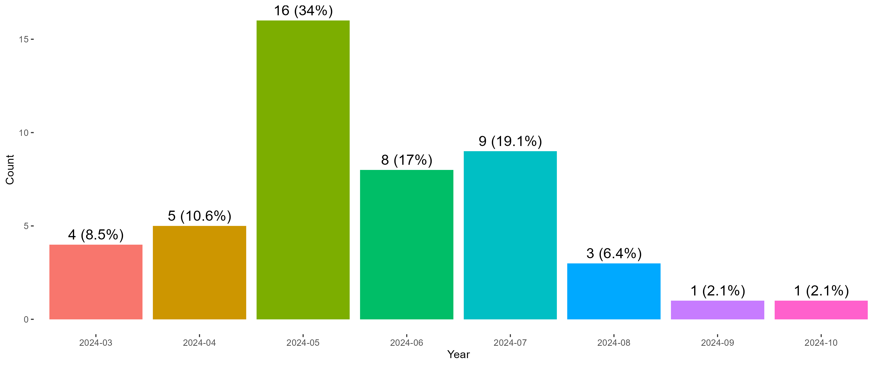
cho ggplot v� body

Slide 9
D???c di???m gi???i t�nh -gi???a
Gi???i t�nh | n | %
Nam gi???i | 171 | 37.5
N??? gi???i | 285 | 62.5

Slide 10
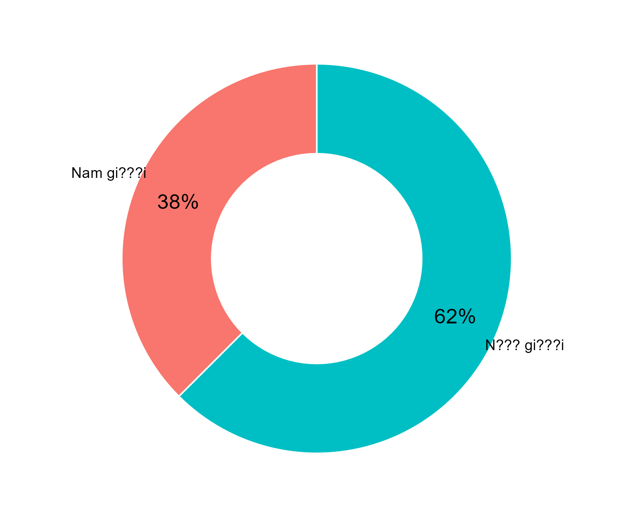
D???c di???m gi???i t�nh (B???n v� bi???u d???)
Gi???i t�nh | n | %
Nam gi???i | 171 | 37.5
N??? gi???i | 285 | 62.5

Slide 11
Th�m b???ng n???a
mpg | cyl | disp | hp | drat | wt | qsec | vs | am | gear | carb
21.0 | 6 | 160 | 110 | 3.90 | 2.620 | 16.46 | 0 | 1 | 4 | 4
21.0 | 6 | 160 | 110 | 3.90 | 2.875 | 17.02 | 0 | 1 | 4 | 4
22.8 | 4 | 108 | 93 | 3.85 | 2.320 | 18.61 | 1 | 1 | 4 | 1
21.4 | 6 | 258 | 110 | 3.08 | 3.215 | 19.44 | 1 | 0 | 3 | 1
18.7 | 8 | 360 | 175 | 3.15 | 3.440 | 17.02 | 0 | 0 | 3 | 2
18.1 | 6 | 225 | 105 | 2.76 | 3.460 | 20.22 | 1 | 0 | 3 | 1

