Slide 1
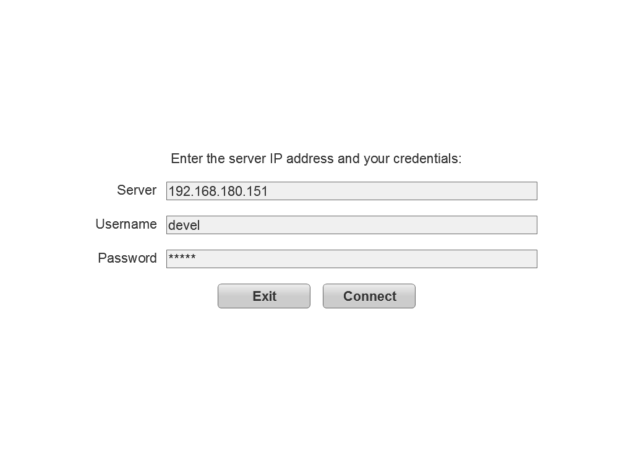
Login

Slide 2
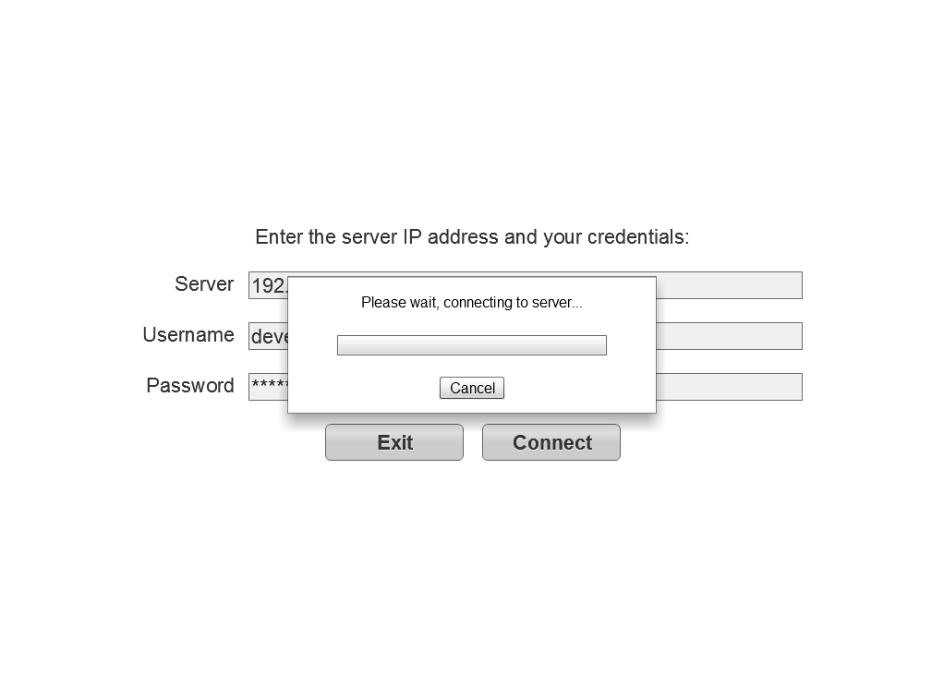
Connecting

Slide 3
Splash
ELIXYS
Automated Radiochemical Synthesis Platform
Designed and developed by the van Dam Lab
California Nanosystems Institute
University of California Los Angeles
Loading

Slide 4
Home
This option will appear when another user is running the system.
Create, view or run a sequence
Watch the run the is currently in progress
Allows users to change their password and personal information.
Manage my account
Manage system users
Functions only available to system administrators.
View and export log data
This option will only be available when running the installed client (AIR).
Log out

Slide 5
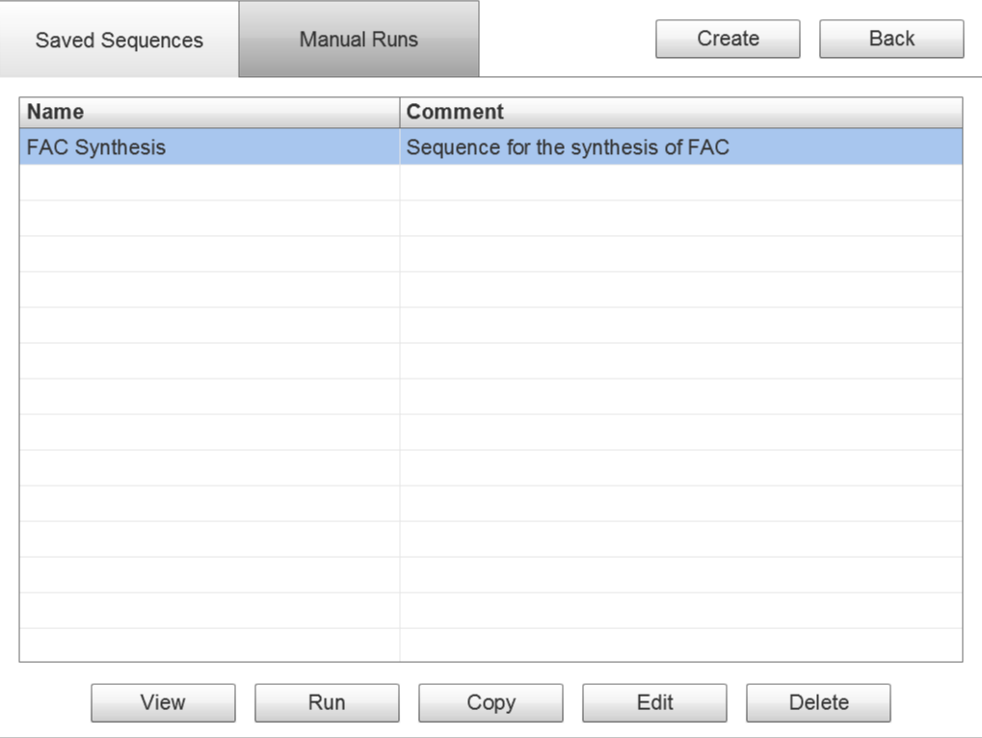
Select
(Sequences)
Sequences
Run History
Choose a saved sequence from this tab and use the buttons below to do one of the following:
View
Run
Edit
Delete
Create a new saved sequence from scratch.

Slide 6
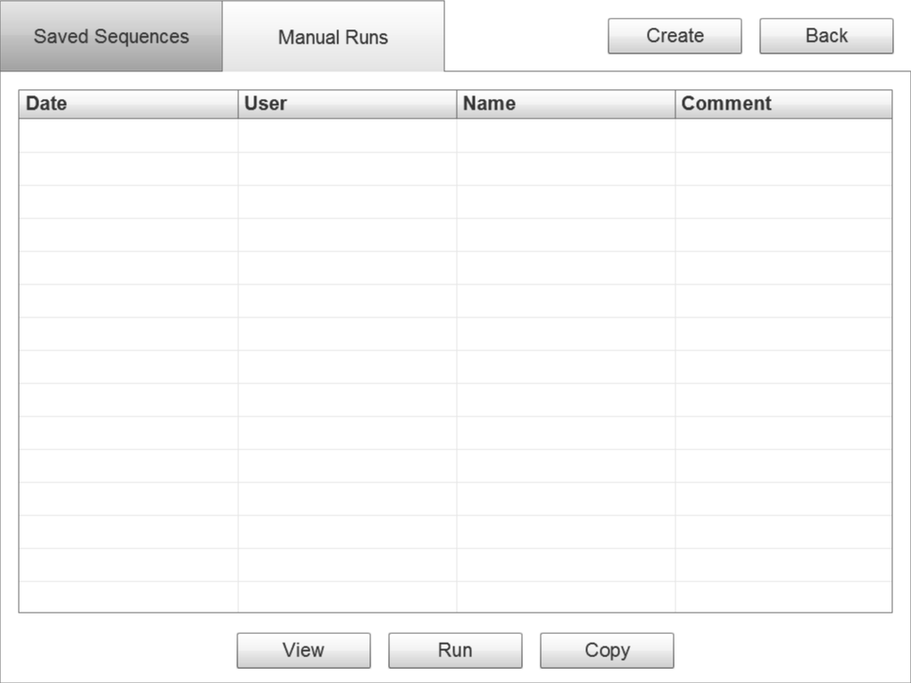
Select
(Run History)
Sequences
Run History
Choose a past run from this tab and either view it or copy it to a saved sequence.
9/21/2011 hsimpson FAC Synthesis 10.4% FAC
9/19/2011 hsimpson FAC Synthesis 14.7% FAC
9/16/2011 hsimpson FAC Synthesis Gasket fell off

Slide 7
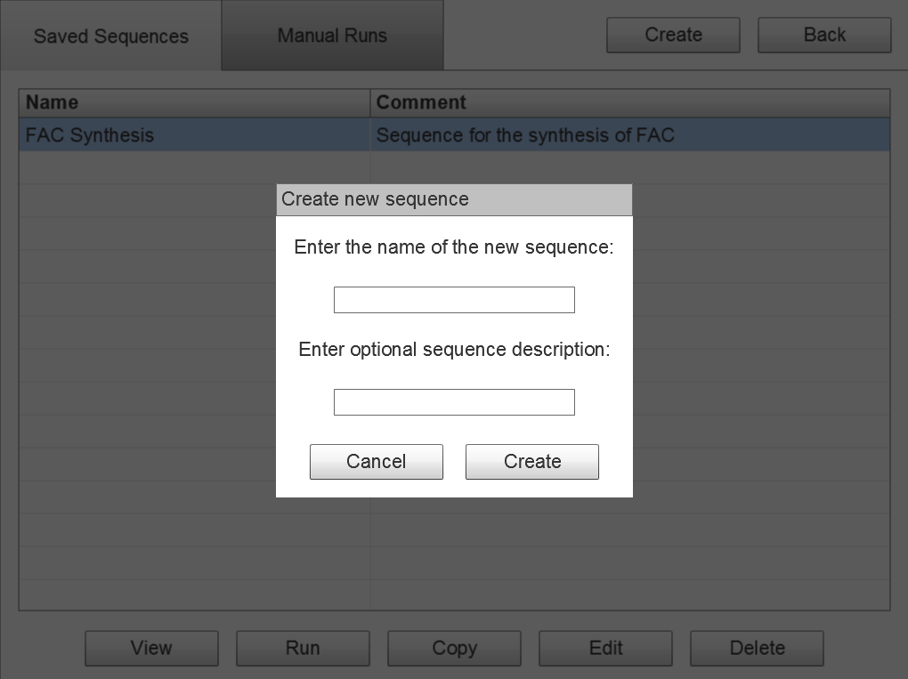
Select Sequence
(Create)

Slide 8
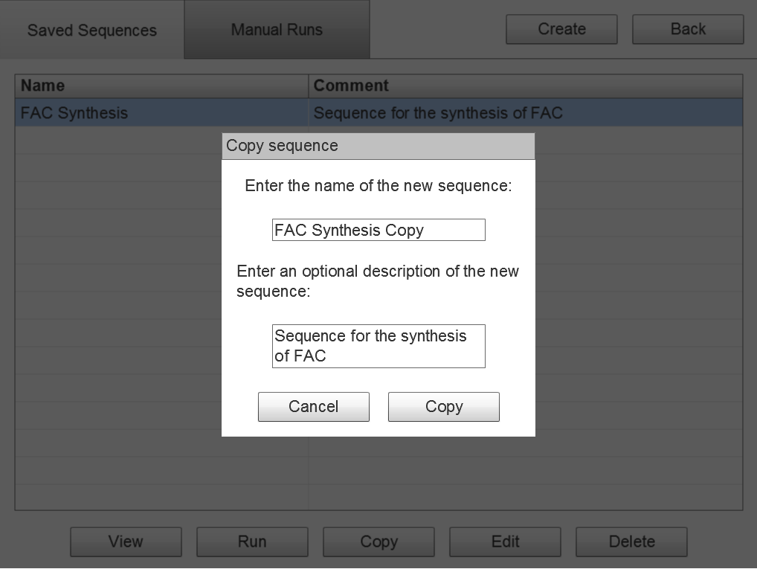
Select Sequence
(Copy)

Slide 9
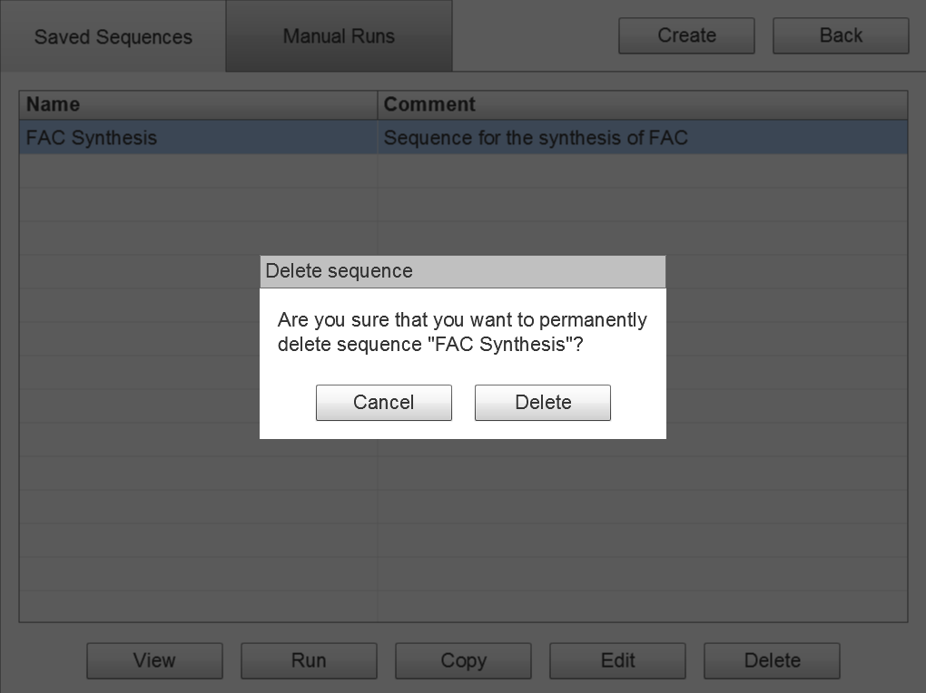
Select Sequence
(Delete)

Slide 10
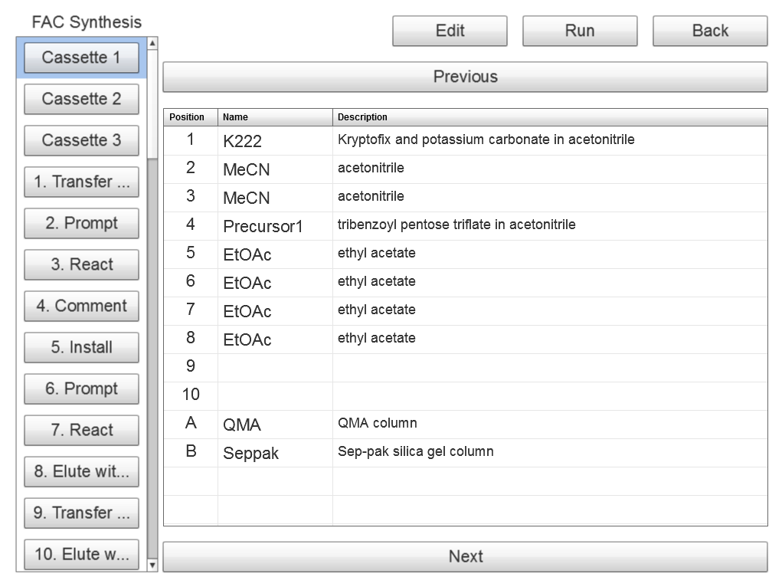
View Sequence
(Cassette)
Click/tap an operation in the left panel to change the contents of the right panel.
Make this column wider to fit more descriptive text.

Slide 11
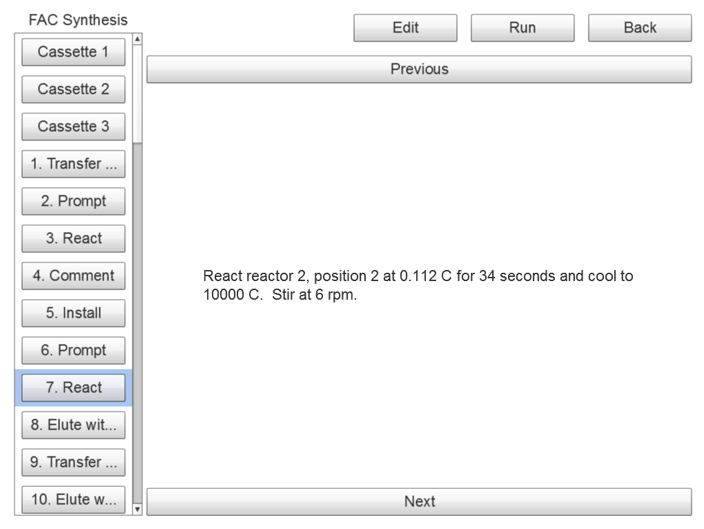
View Sequence
(Unit Operation)

Slide 12
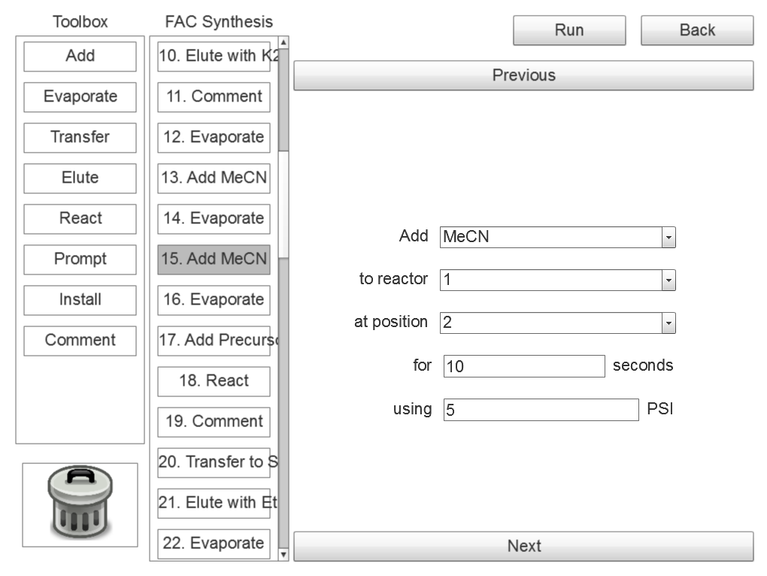
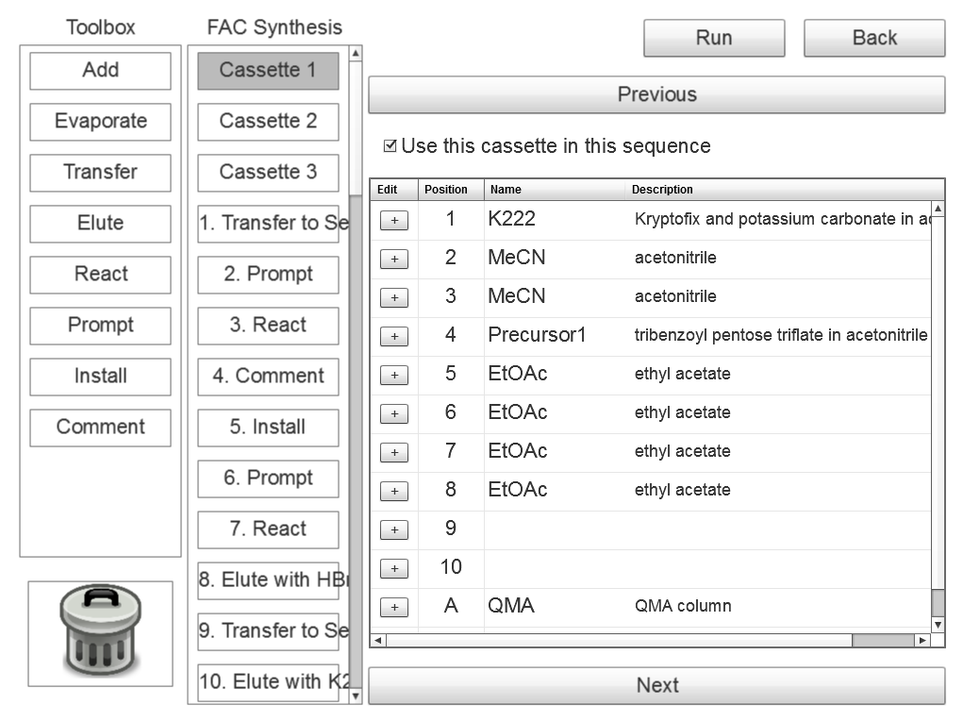
Edit Sequence
(Overview)
Unit Operations
Toolbox contains both unit and hardware operations.
Add Reagent
Click/tap an operation in the middle panel to change the contents of the right panel.
Add
*
*
Reagent to add to the reactor
to reactor
*
*
Reactor where the reagent will be added
at position
Hardware Operations
*
*
Set the operation parameters in the right panel.
Position where the reagent will be added
Move Reactor
Number of seconds to deliver the reagent
Reactor Up
Pressure in to use when delivering the reagent

Slide 13
Edit Sequence
(Cassette)
Unit Operations
Tap/click to enable or disable this cassette.
Tap/click to edit this reagent.
Reagents with the same name are treated as identical by the system.
Hardware Operations
Move Reactor
Reactor Up

Slide 14
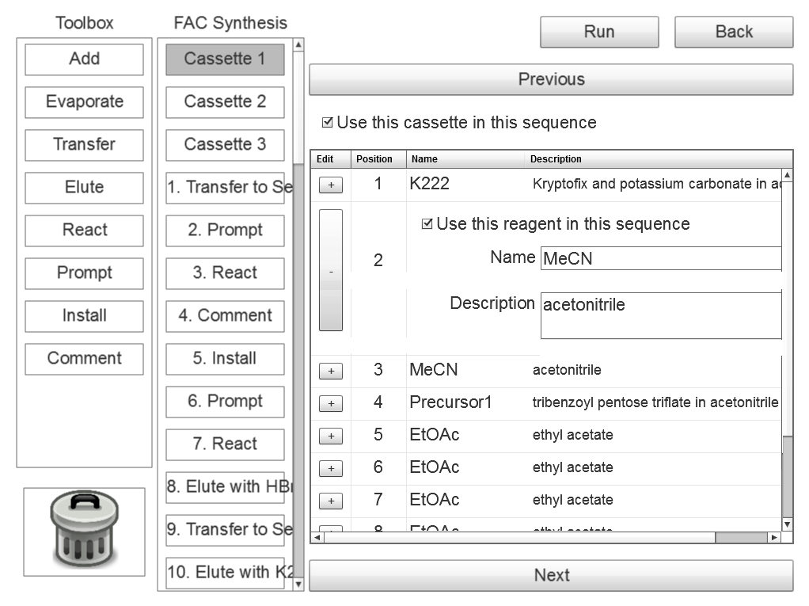
Edit Sequence
(Cassette)
Unit Operations
Tap/click to enable or disable this reagent.
Asterisks indicates required fields.
Name
*
Brief name of this reagent
Strings from the server describe each field.
Hardware Operations
Longer description of this reagent
Move Reactor
Reactor Up

Slide 15
Edit Sequence
(Unit operation)
Unit Operations
Add Reagent
Add
*
*
Reagent to add to the reactor
to reactor
*
*
Reactor where the reagent will be added
at position
Hardware Operations
*
*
Position where the reagent will be added
Server automatically fills in certain fields with default values.
Move Reactor
Number of seconds to deliver the reagent
Reactor Up
Pressure in to use when delivering the reagent

Slide 16
Edit Sequence
(Add, reorder
and delete)
Unit Operations
Drag an operation from the toolbox and drop it in the sequence to add.
Add Reagent
Add
*
*
Drag operation up or down to reorder.
Reagent to add to the reactor
to reactor
*
*
Reactor where the reagent will be added
at position
Hardware Operations
*
*
Position where the reagent will be added
Move Reactor
Number of seconds to deliver the reagent
Reactor Up
Drag operation to trash can to delete.
Pressure in to use when delivering the reagent

Slide 17
Edit Sequence
(Validation)
Unit Operations
Icons used to visually indicate validation errors.
Add Reagent
Add
*
*
!
!
The reagent field is required.
to reactor
*
*
Reactor where the reagent will be added
at position
Hardware Operations
*
*
Position where the reagent will be added
Move Reactor
A description of the validation error is displayed below the field.
Number of seconds to deliver the reagent
Reactor Up
Pressure in to use when delivering the reagent

Slide 18
Edit Sequence
(Validation)
Unit Operations
Validation errors will cause a warning when Back is clicked.
Add Reagent
Add
*
*
The sequence “FAC Synthesis” has validation errors. Are you sure you want to go back to the sequence selection screen?
!
!
The reagent field is required.
to reactor
*
*
Reactor where the reagent will be added
at position
Hardware Operations
*
*
Cancel
Position where the reagent will be added
Back
Move Reactor
Number of seconds to deliver the reagent
Reactor Up
Pressure in to use when delivering the reagent

Slide 19
Edit Sequence
(Validation)
Unit Operations
Validation errors will cause an error when Run is clicked.
Add Reagent
Add
*
The sequence “FAC Synthesis” cannot be run because it contains validation errors.
*
!
!
The reagent field is required.
to reactor
*
*
Reactor where the reagent will be added
at position
Hardware Operations
*
*
OK
Position where the reagent will be added
Move Reactor
Number of seconds to deliver the reagent
Reactor Up
Pressure in to use when delivering the reagent

Slide 20
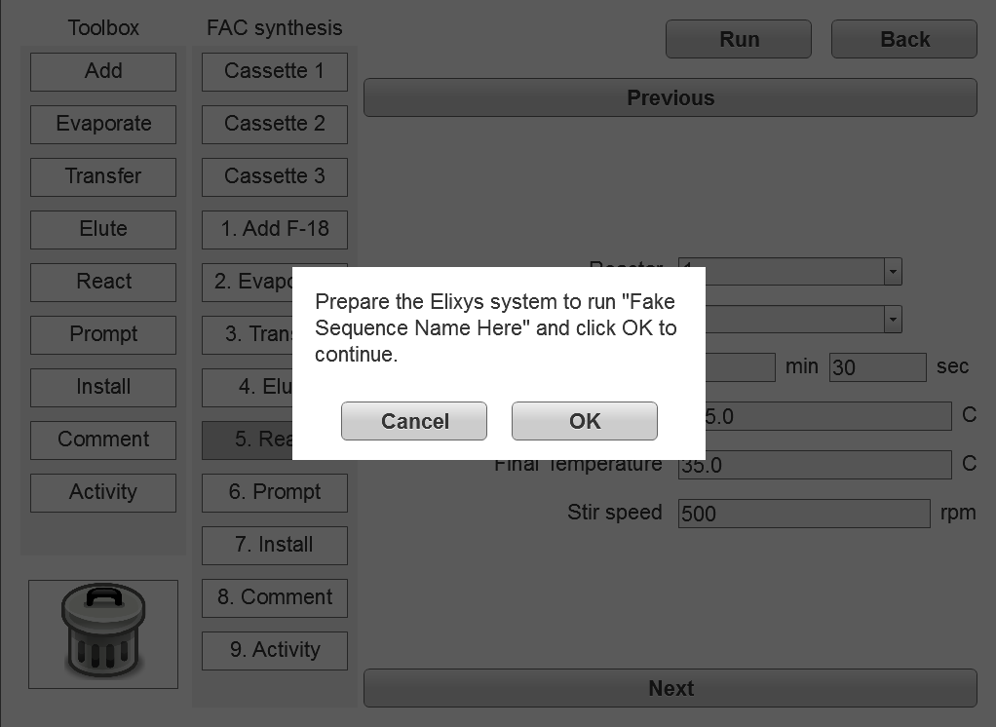
Run Sequence
(Start)

Slide 21
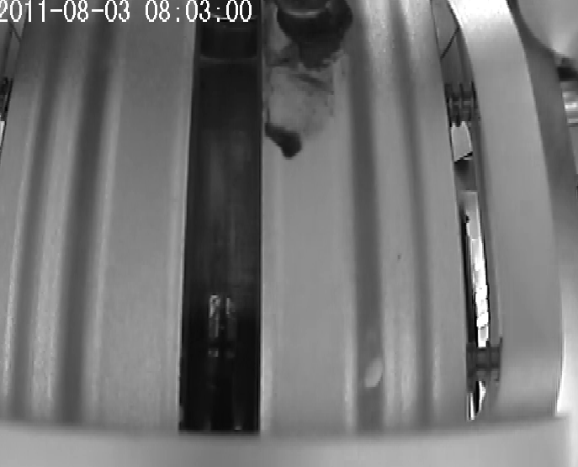
Run Sequence
(Running)
Abort
Unit Operations
Adding Reagent
Adding MeCN to reactor 1 via delivery position 2. Using 5 PSI of nitrogen and delivering for 10 seconds.
Reactor 1
Unit operations that have already passed are grayed out.
Add Reagent
Add
The current unit operation is progress is highlighted.
*
*
Reagent to add to the reactor
to reactor
*
*
Reactor where the reagent will be added
at position
Hardware Operations
*
*
Position where the reagent will be added
Move Reactor
The view will advance automatically with the run if the in-progress unit operation is selected.
Number of seconds to deliver the reagent
Reactor Up
Pressure in to use when delivering the reagent

Slide 22
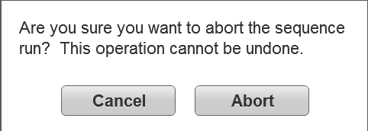
Run Sequence
(Abort)
Abort
Unit Operations
The current run can be completely aborted.
Adding Reagent
Adding MeCN to reactor 1 via delivery position 2. Using 5 PSI of nitrogen and delivering for 10 seconds.
Reactor 1
Add Reagent
Add
*
*
Reagent to add to the reactor
to reactor
*
*
Reactor where the reagent will be added
at position
Hardware Operations
*
*
Position where the reagent will be added
Move Reactor
Number of seconds to deliver the reagent
Reactor Up
Pressure in to use when delivering the reagent

Slide 23
Run Sequence
(Edit)
C`
Abort
Unit Operations
Add Reagent
Unit operations that haven’t occurred yet can be edited while the run is in progress.
Add
*
*
Reagent to add to the reactor
to reactor
*
*
Reactor where the reagent will be added
at position
Hardware Operations
*
*
Reagents that haven’t been used yet can also be editing while the run is in progress.
Position where the reagent will be added
Move Reactor
Number of seconds to deliver the reagent
Reactor Up
Pressure in to use when delivering the reagent
C`

Slide 24
Run Sequence
(View)
C`
Abort
Unit Operations
Unit operations that have already occurred can be viewed but not edited.
Add Reagent
Add Reagent
Add MeCN to reactor 1 via delivery position 1. Use 5 PSI of nitrogen and deliver for 10 seconds.
Add
*
*
Reagent to add to the reactor
to reactor
*
*
Reactor where the reagent will be added
at position
Hardware Operations
*
*
Reagents that have already used can also be viewed but not edited.
Position where the reagent will be added
Move Reactor
Number of seconds to deliver the reagent
Reactor Up
Pressure in to use when delivering the reagent
C`

Slide 25
Run Sequence
(Breakpoints)
C`
Run
Step
Abort
Unit Operations
Tap/click breakpoint area to set or clear breakpoints.
Add Reagent
Add
*
*
Reagent to add to the reactor
to reactor
*
*
Reactor where the reagent will be added
at position
Hardware Operations
*
*
System will pause prior to the step when a breakpoint is encountered.
Position where the reagent will be added
Move Reactor
Number of seconds to deliver the reagent
Reactor Up
Pressure in to use when delivering the reagent
C`

Slide 26
Run Sequence
(Breakpoints)
C`
Run
Step
Abort
Unit Operations
The parameters for the current and future unit operations can be changed.
Add Reagent
Any unit operation inserted before the current position will become the new current unit operation.
Add
*
*
Reagent to add to the reactor
to reactor
*
*
Reactor where the reagent will be added
at position
Hardware Operations
*
*
Position where the reagent will be added
Move Reactor
Number of seconds to deliver the reagent
Reactor Up
Pressure in to use when delivering the reagent
C`

Slide 27
Run Sequence
(Breakpoints)
C`
Run
Step
Abort
Unit Operations
Add Reagent
Run to the next breakpoint or end of the sequence.
Add
*
*
Reagent to add to the reactor
Step to perform the next unit operation and break again.
to reactor
*
*
Reactor where the reagent will be added
at position
Hardware Operations
*
*
Position where the reagent will be added
The system will refuse to continue if any validation errors are encountered.
Move Reactor
Number of seconds to deliver the reagent
Reactor Up
Pressure in to use when delivering the reagent
C`

Slide 28
Run Sequence
(Complete)
Abort
Unit Operations
Adding Reagent
Adding MeCN to reactor 1 via delivery position 2. Using 5 PSI of nitrogen and delivering for 10 seconds.
Reactor 1
Add Reagent
Sequence “FAC Synthesis” completed successfully.
Enter an optional comment for this run:
Add
*
*
Reagent to add to the reactor
to reactor
*
*
35.2% yield
Reactor where the reagent will be added
at position
Hardware Operations
*
*
OK
Position where the reagent will be added
Move Reactor
Number of seconds to deliver the reagent
Reactor Up
Pressure in to use when delivering the reagent

Slide 29
My Account
User:
hsimpson
Role:
Administrator
First:
Homer
Last:
Simpson
Change Password
Cancel
Save

Slide 30
My Account
(Password)
Enter your current password:
User:
hsimpson
Role:
Administrator
********
First:
Homer
Enter your new password and verify:
********
Last:
Simpson
********
Change Password
Cancel
Save
Cancel
Update

