Slide 1
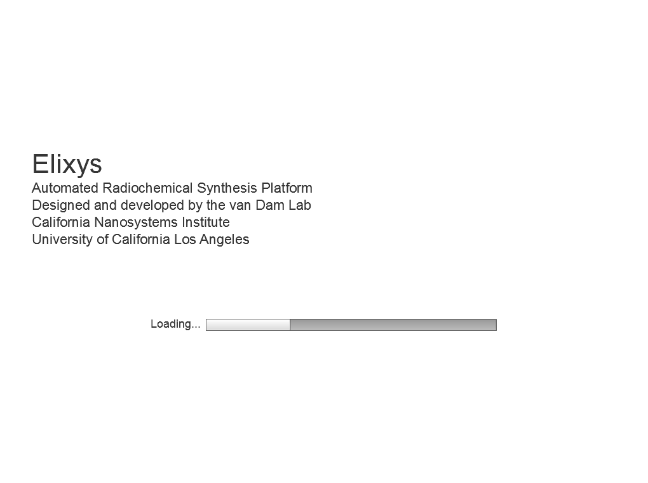
Splash
Radiochemistry Platform

Slide 2
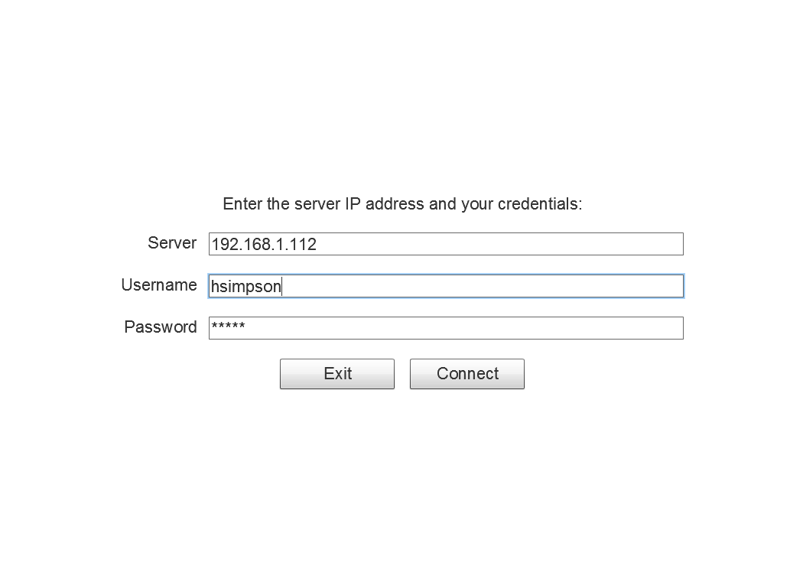
Login

Slide 3
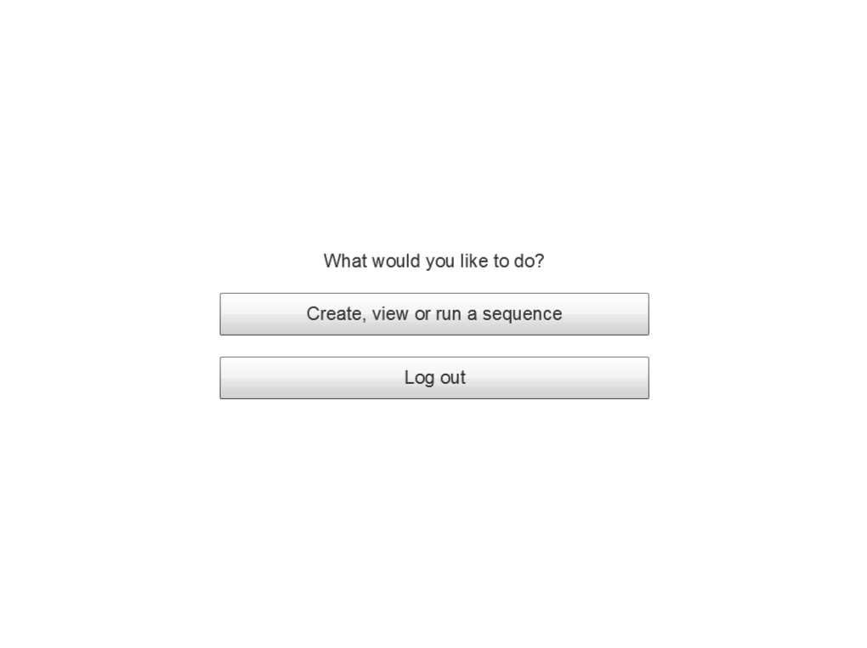
Home
This option will appear when another user is running the system.
Watch the run that is currently in progress
Allows users to change their password and personal information.
Manage my account
Manage system users
Options only available to system administrators.
View and export log data
This option will be available in the AIR client.

Slide 4
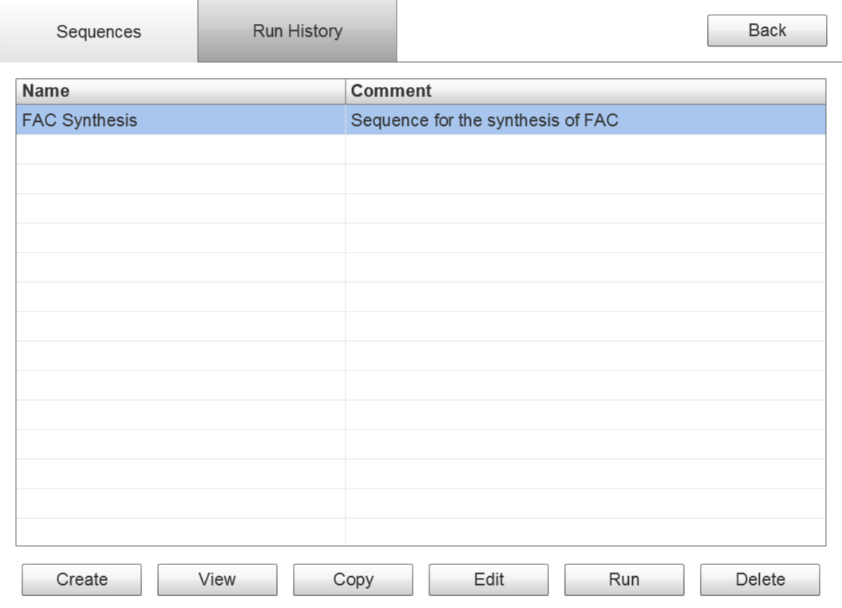
Select
(Sequences)
Sequences
Choose a sequence from this tab and use the buttons below to do one of the following:
View
Copy
Edit
Run
Delete
Design note: we want it to be obvious which of the two tabs is selected.
Create a new sequence from scratch.

Slide 5
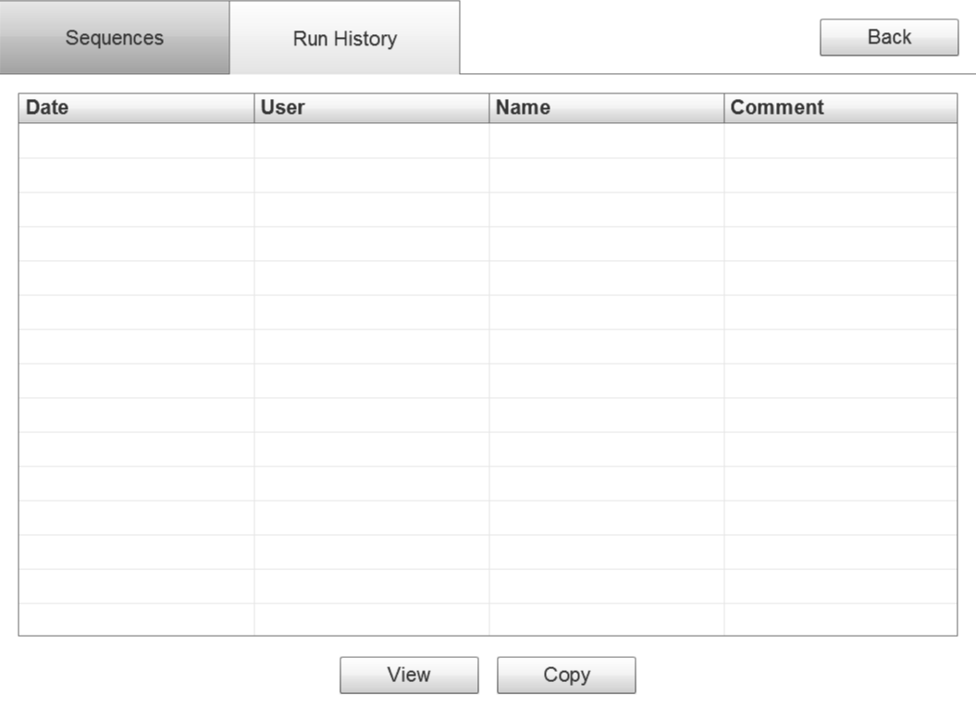
Select
(Run History)
Choose a past run from this tab and either view it or copy it to a saved sequence.
9/21/2011 hsimpson FAC Synthesis 10.4% FAC
9/19/2011 hsimpson FAC Synthesis 14.7% FAC
9/16/2011 hsimpson FAC Synthesis Gasket fell off

Slide 6
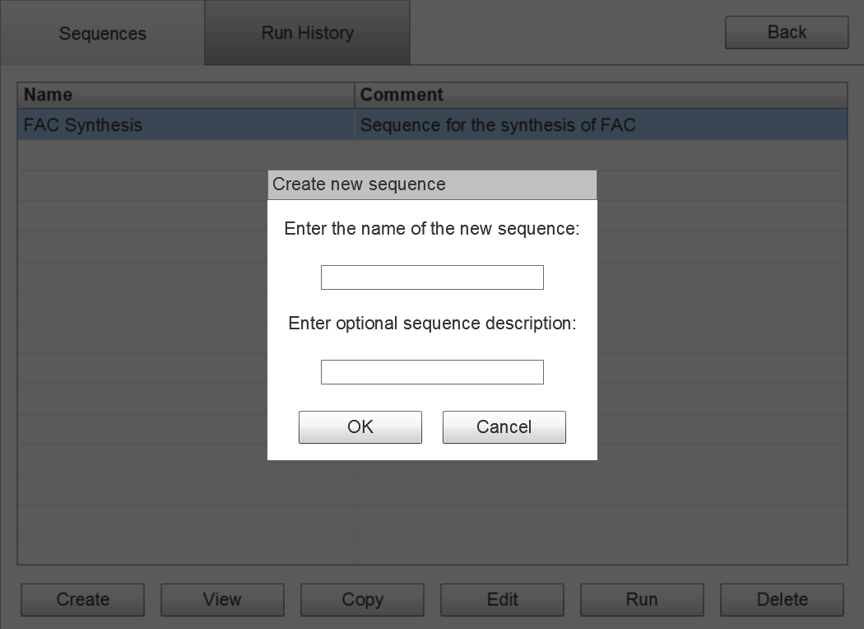
Select Sequence
(Create)

Slide 7
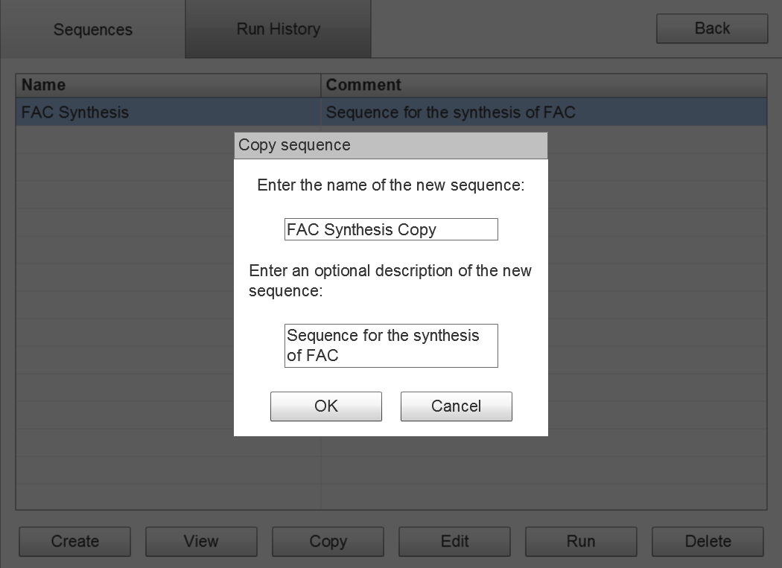
Select Sequence
(Copy)

Slide 8
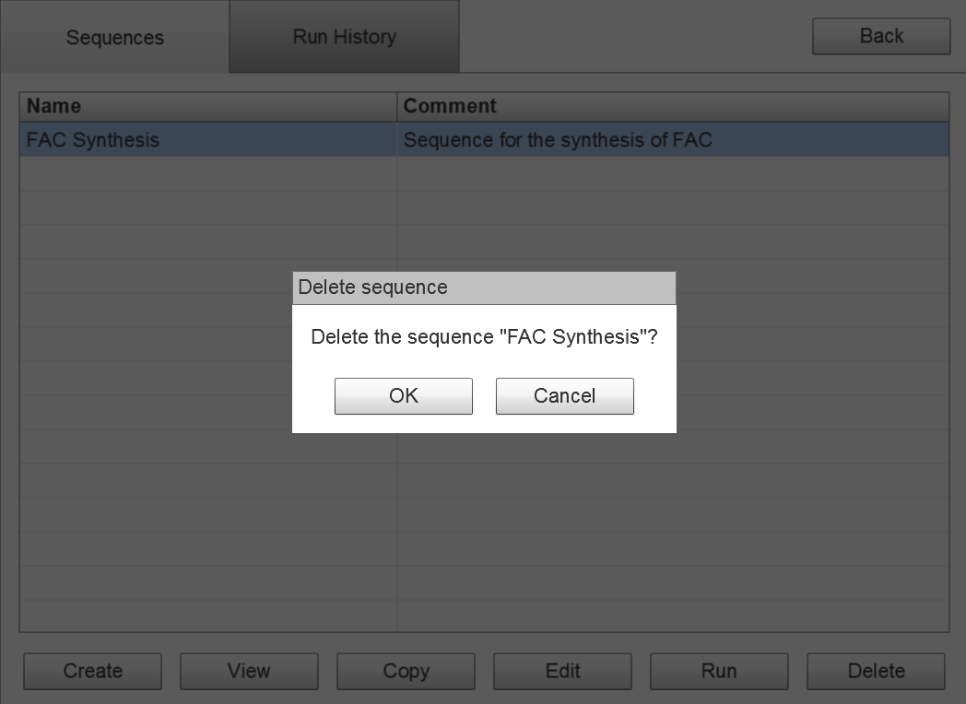
Select Sequence
(Delete)
Yes
No

Slide 9
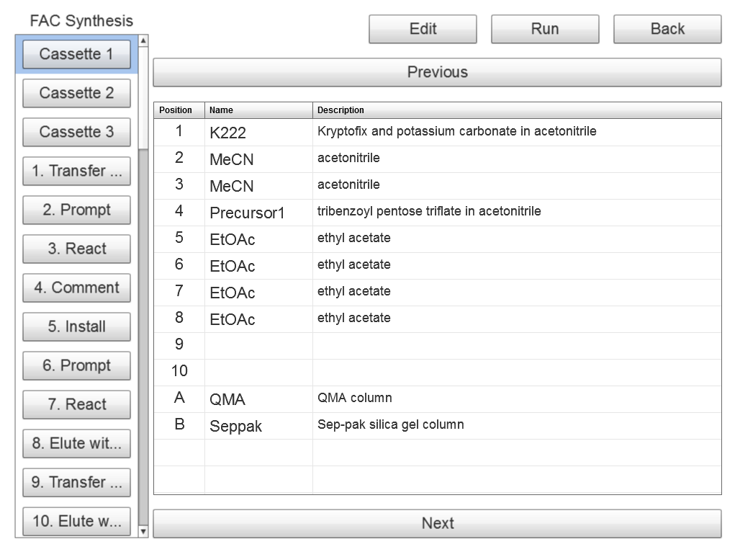
View Sequence
(Cassette)
Click/tap an operation in the left panel to change the contents of the right panel.
Make this column wider to fit more descriptive text.

Slide 10
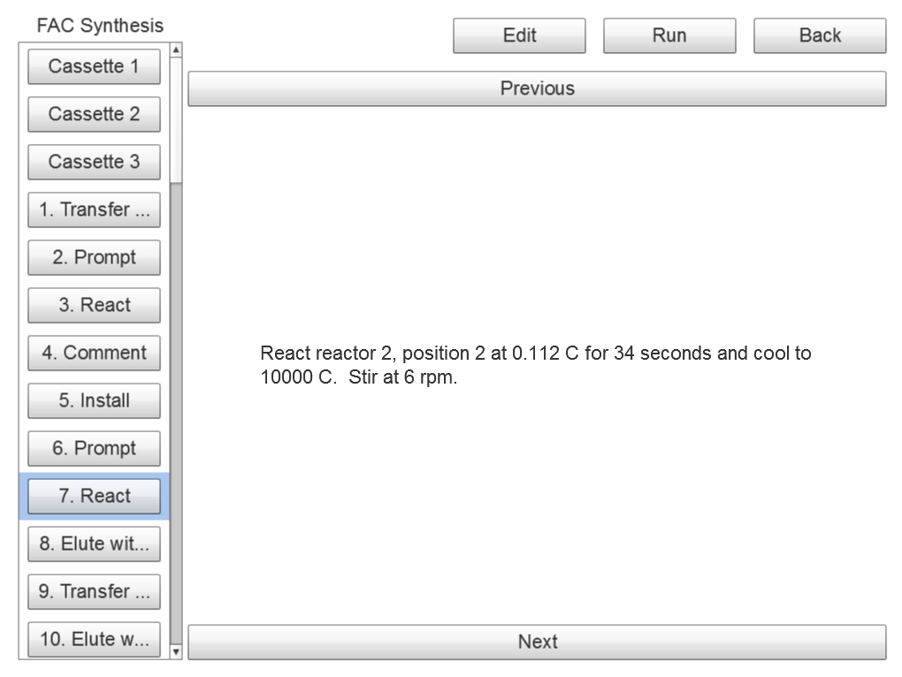
View Sequence
(Unit Operation)

Slide 11
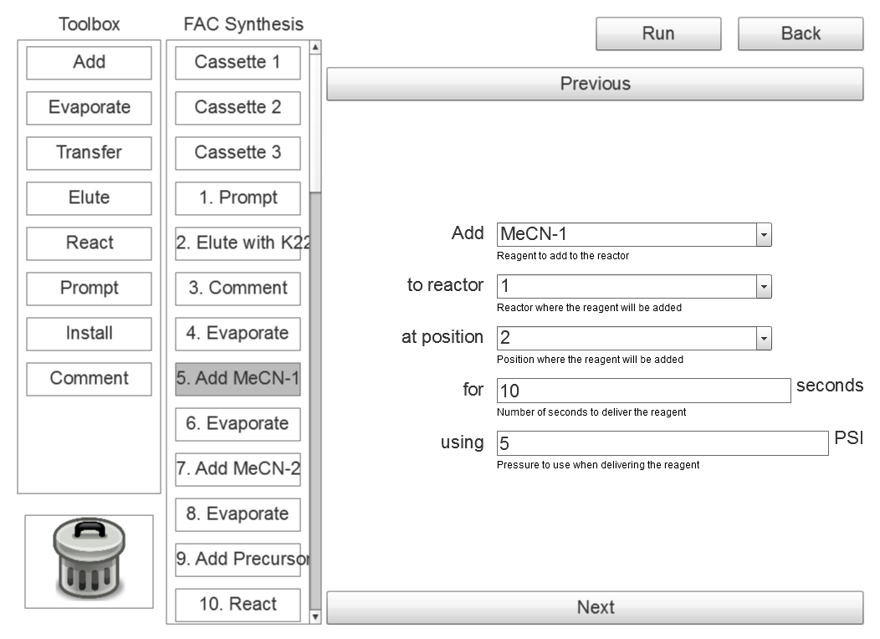
Edit Sequence
(Overview)
Toolbox contains both unit operations.
Click/tap an operation in the middle panel to change the contents of the right panel.
Set the operation parameters in the right panel.

Slide 12
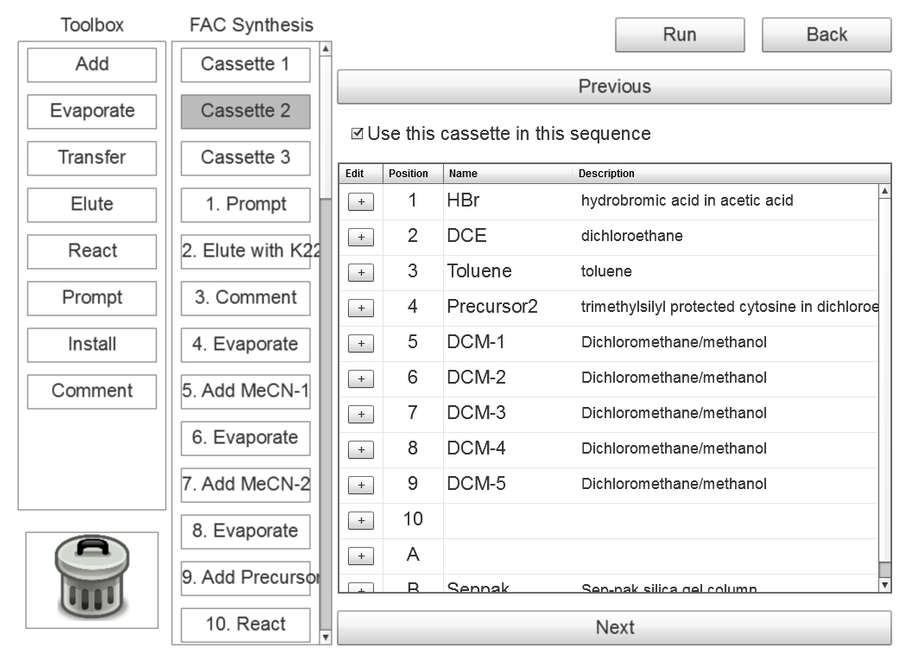
Edit Sequence
(Cassette)
Tap/click to enable or disable this cassette.
Tap/click to edit this reagent.

Slide 13
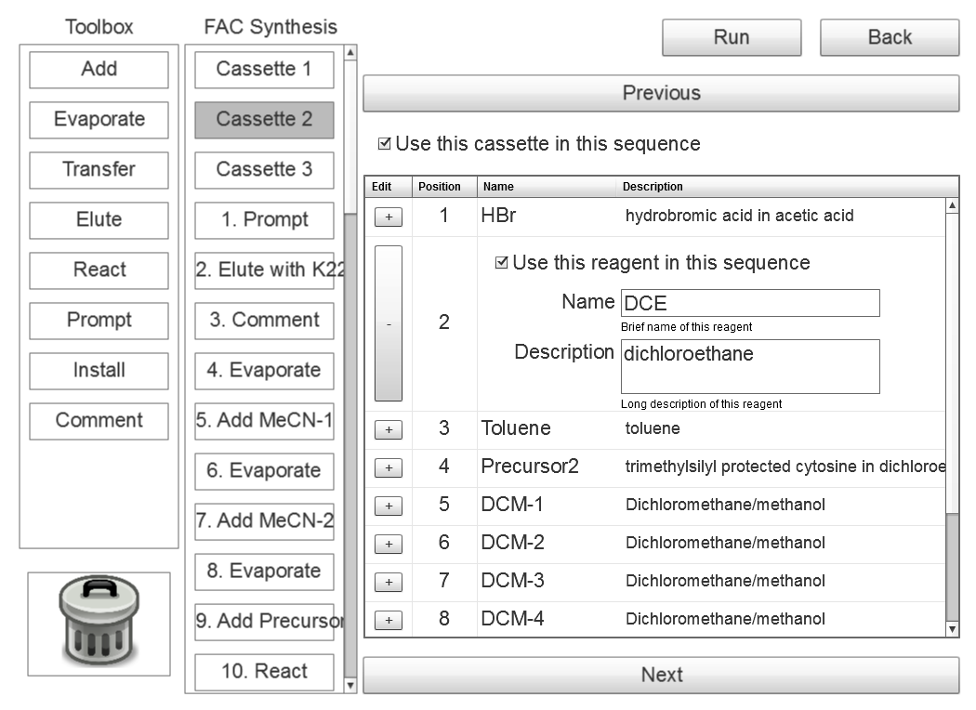
Edit Sequence
(Cassette)
Tap/click to enable or disable this reagent.
Asterisks indicate required fields.
Name
*
Help strings describe each field.

Slide 14
Edit Sequence
(Unit operation)
Server automatically fills in certain fields with default values.

Slide 15
Edit Sequence
(Add, reorder
and delete)
Drag an operation from the toolbox and drop it in the sequence to add.
Drag operation up or down to reorder.
Drag operation to trash can to delete.

Slide 16
Edit Sequence
(Validation)
Icons used to visually indicate validation errors.
!
The reagent field is required.
!
A description of the validation error is displayed below the field.

Slide 17
Edit Sequence
(Validation)
Validation errors will cause a warning when Back is clicked.
!
The reagent field is required.
This sequence contains errors and cannot be run in its current form. Are you sure you want to go back before correcting these errors?
!
Yes
No

Slide 18
Edit Sequence
(Validation)
Validation errors will cause an error when Run is clicked.
!
The reagent field is required.
This sequence cannot be run because it contains errors.
!
OK

Slide 19
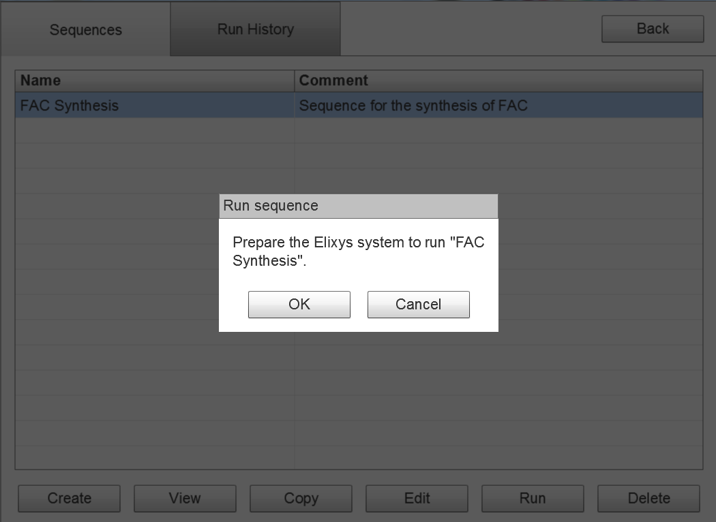
Run Sequence
(Start)

Slide 20
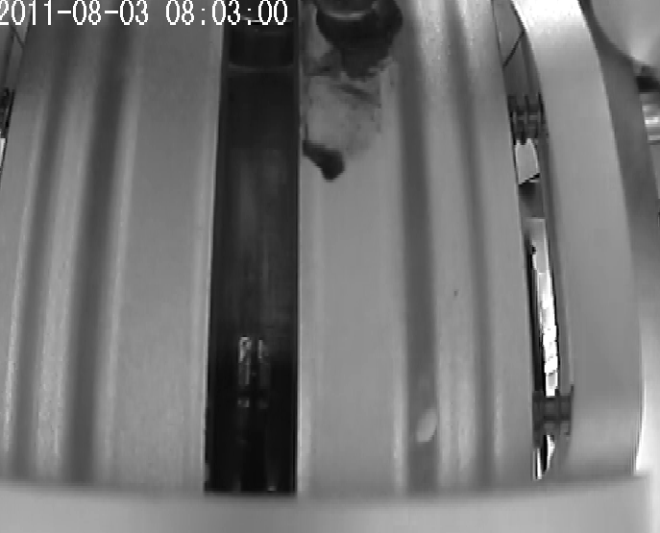
Run Sequence
(Running)
Adding Reagent
Adding MeCN to reactor 1 via delivery position 2. Using 5 PSI of nitrogen and delivering for 10 seconds.
Status: Delivering reagent
Reactor 1
The view will advance automatically with the run.
Unit operations that have already passed are grayed out.
The current unit operation is progress is highlighted.
Pause After This Operation
Abort Run

Slide 21
Run Sequence
(Running)
Adding Reagent
Adding MeCN to reactor 1 via delivery position 2. Using 5 PSI of nitrogen and delivering for 10 seconds.
Status: Delivering reagent
Reactor 1
The status of the unit operation.
Live video from the relevant reactor is shown.
Push-in/out button will flag the system to pause after this unit operation.
Note: this is potentially confusing. Any ideas for a better control to toggle on and off?
Pause After This Operation
Abort Run

Slide 22
Run Sequence
(Timer)
Reacting
Reacting the contents of reactor 1 in position 2 at 160 C for 900 seconds. The vial is being stirred at 500 and will be cooled to 35 C when complete.
Status: Reacting, 3:14 remaining
Reactor 1
Additional buttons will be present for unit operations that include a timer. Note: can we put these closer to the timer so their function is more intuitive? How to prevent accidentally clicking “Skip”? For example, Apple has two step controls for deleting things.
Pause button will stop the timer and change to a Play button which will resume the timer.
Pause timer
Skip to next step
Pause After This Operation
Abort Run
Complete button will cut the timer short.

Slide 23
Run Sequence
(Pause and Edit)
Reagents and cassette positions that haven’t been used yet can be edited.
Unit operations that have already passed are grayed out and cannot be selected.
Unit operations that haven’t occurred yet can be edited.
Continue Run
Abort Run

Slide 24
Run Sequence
(Pause and Edit)
Any unit operation inserted before the current position will become the next unit operation.
The system will refuse to continue if there are any validation errors in the sequence.
Continue Run
Abort Run

Slide 25
Run Sequence
(Abort)
Adding Reagent
Adding MeCN to reactor 1 via delivery position 2. Using 5 PSI of nitrogen and delivering for 10 seconds.
Reactor 1
Are you sure you want to abort the sequence run? This operation cannot be undone.
The current run can be completely aborted.
Yes
No
Pause After This Operation
Abort

Slide 26
Run Sequence
(Complete)
Adding Reagent
Adding MeCN to reactor 1 via delivery position 2. Using 5 PSI of nitrogen and delivering for 10 seconds.
Status: Delivering reagent
Reactor 1
Sequence “FAC Synthesis” completed successfully.
Enter an optional comment for this run:
35.2% yield
OK
Pause After This Operation
Abort Run

Slide 27
My Account
User:
hsimpson
Role:
Administrator
First:
Homer
Last:
Simpson
Change Password
Cancel
Save

Slide 28
My Account
(Password)
Enter your current password:
User:
hsimpson
Role:
Administrator
********
First:
Homer
Enter your new password and verify:
********
Last:
Simpson
********
Change Password
Cancel
Save
Cancel
Update

