Slide 1
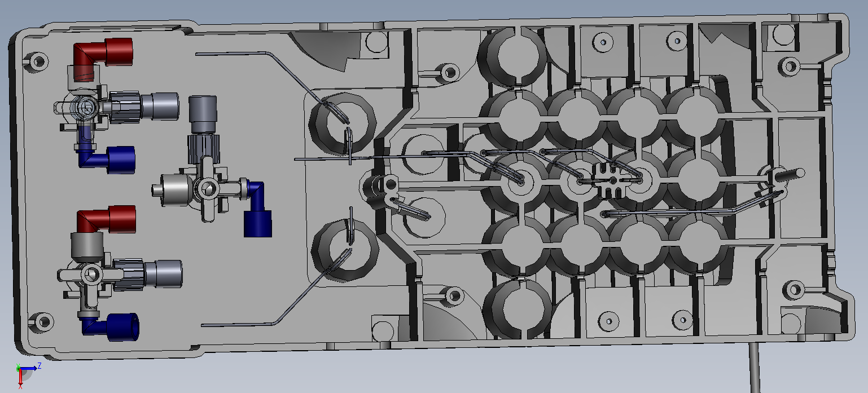
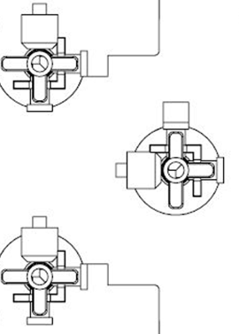
Cassette Plumbing
F18 In
QMA
CW
SC 1
CCW
Default:
Waste
Default:
SC 2
CCW CW
Default:
O18
CW
SC 3
CCW
SP
Out to next cassette
Drawn looking at the bottom of the cassette.

