Slide 1
Delete Sequence
Create Sequence
Key
Screen
Copy Sequence
Delete Operation
Prompt
Select Sequence
View Sequence
Edit Sequence
Validation Warning
Login
Splash
Home
Run Sequence
Error
Abort
Complete
Manual
Run
Abort
Error
Save

Slide 2
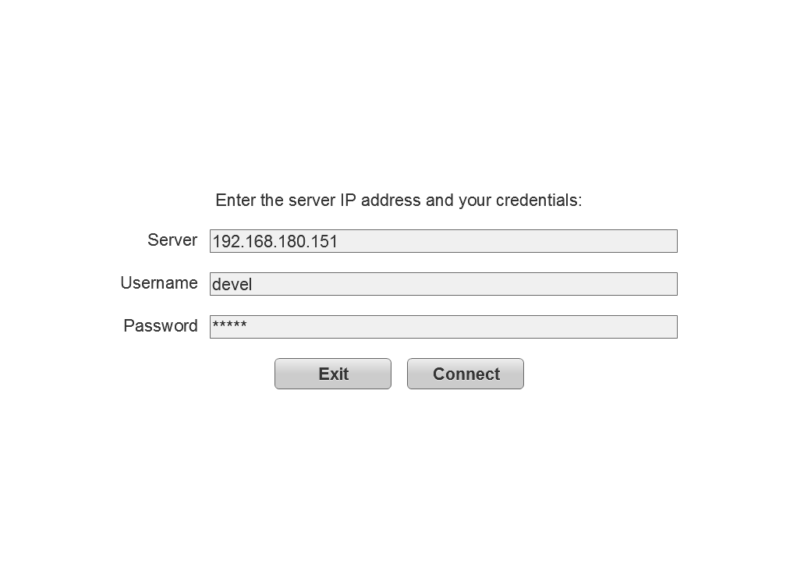
Login

Slide 3
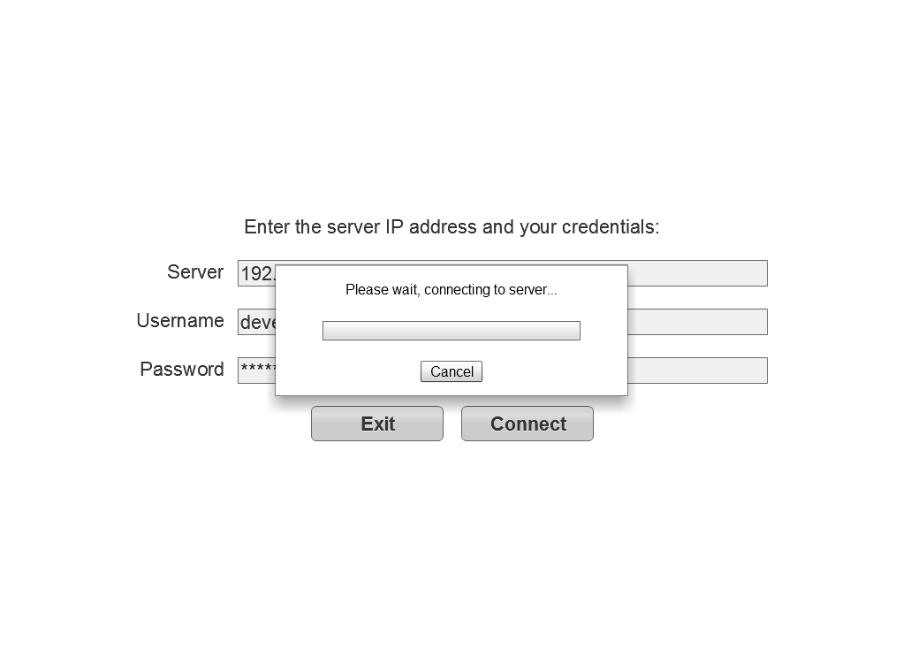
Connecting

Slide 4
Splash
ELIXYS
Automated Radiochemical Synthesis Platform
Designed and developed by the van Dam Lab
California Nanosystems Institute
University of California Los Angeles
Loading

Slide 5
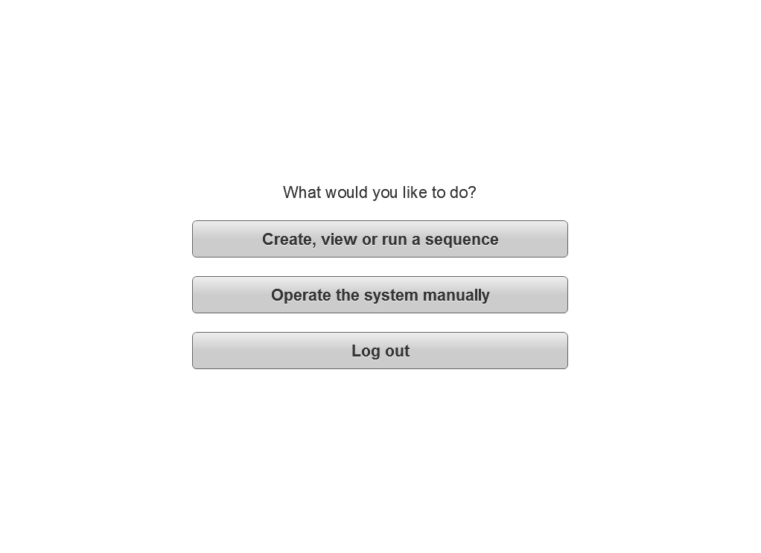
Home
This option will either allow the user to operate the system manually or view the current run when another user is using the system.
Allows users to change their password and personal information.
Manage my account
Manage all system users
Functions only available to system administrators.
View and export log data
This option will only be available when running the installed client (AIR).

Slide 6
My Account
User:
hsimpson
Role:
Administrator
First:
Homer
Last:
Simpson
Change Password
Cancel
Save

Slide 7
My Account
(Password)
Enter your current password:
User:
hsimpson
Role:
Administrator
********
First:
Homer
Enter your new password and verify:
********
Last:
Simpson
********
Change Password
Cancel
Save
Cancel
Update

Slide 8
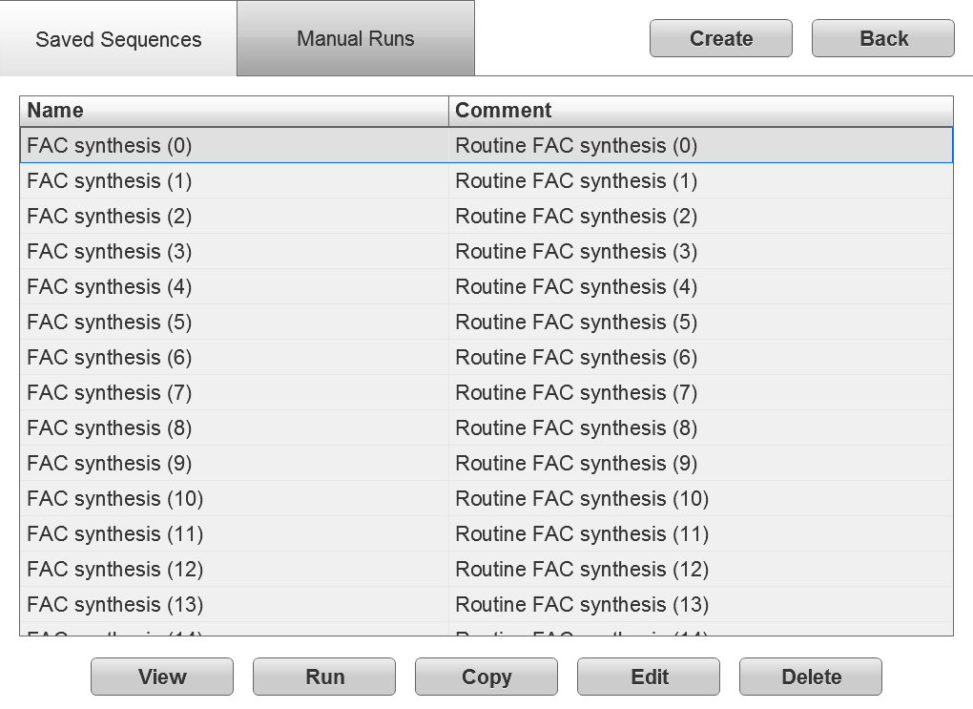
Select Sequence
(Saved)

Slide 9
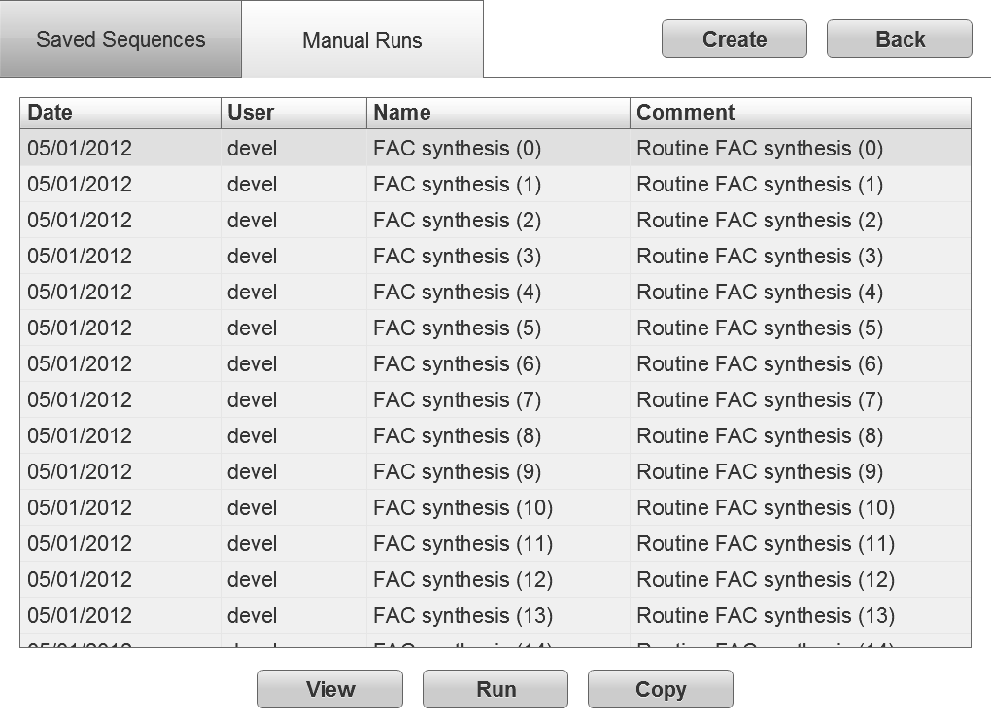
Select Sequence
(Manual)

Slide 10
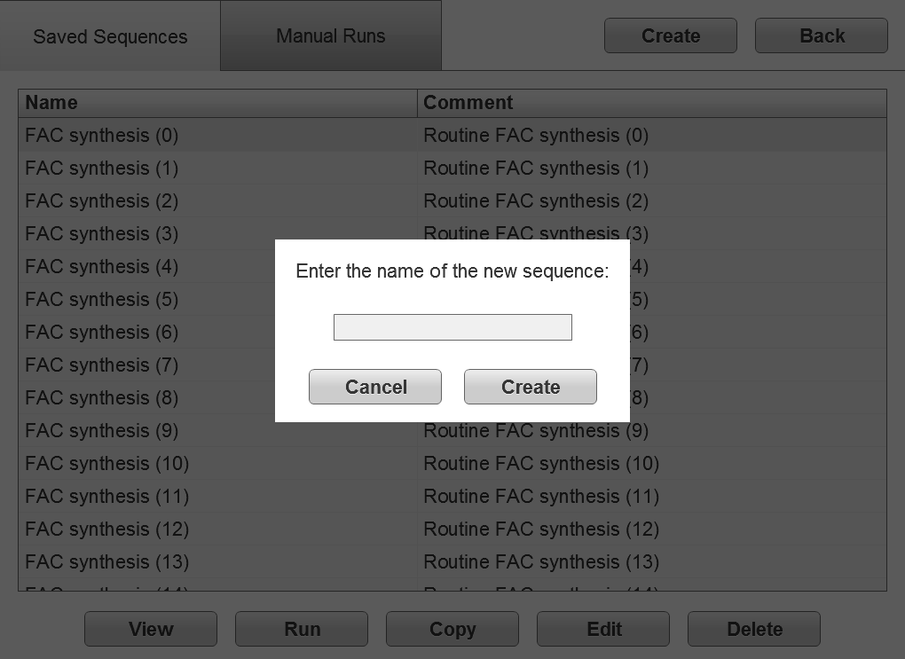
Select Sequence
(Create)

Slide 11
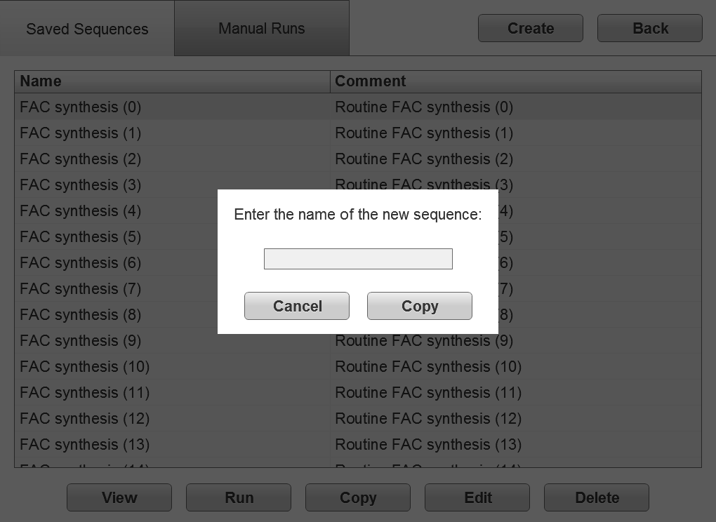
Select Sequence
(Copy)

Slide 12
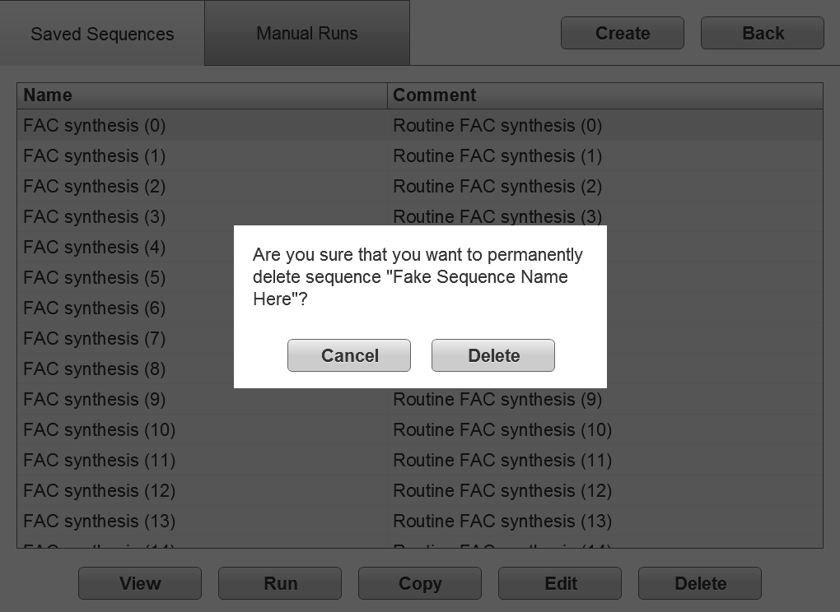
Select Sequence
(Delete)

Slide 13
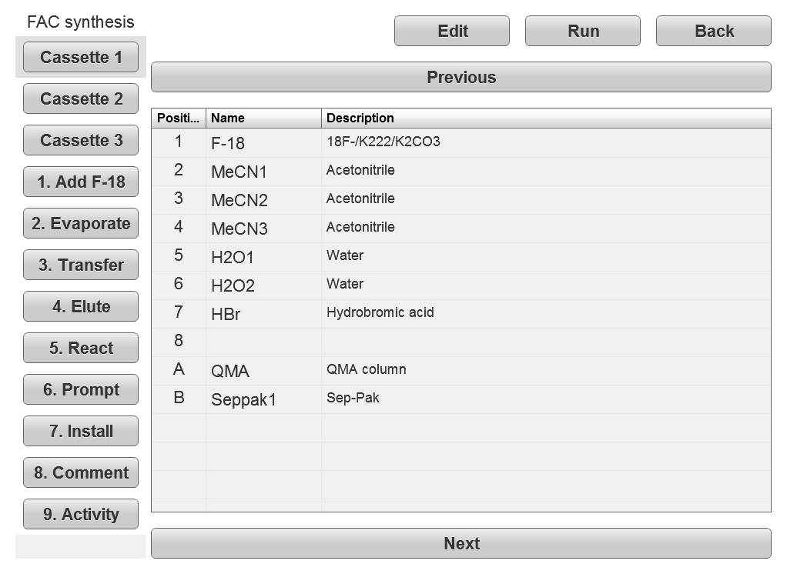
View Sequence
(Cassette)

Slide 14
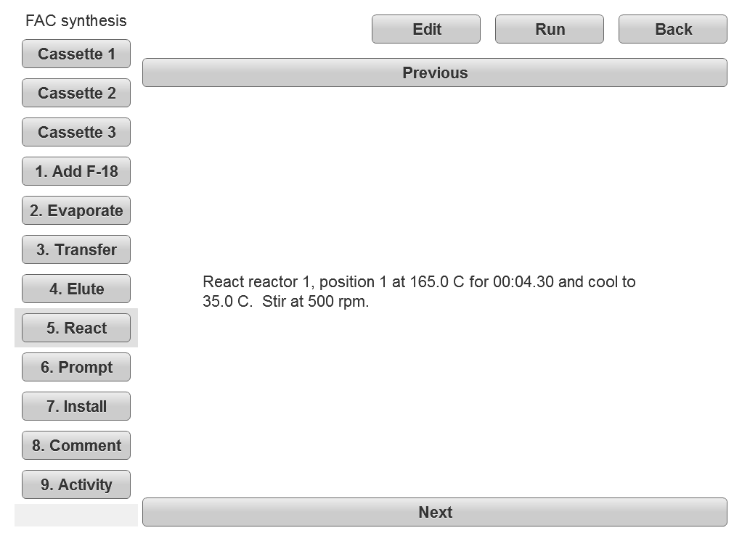
View Sequence
(Unit Operation)

Slide 15
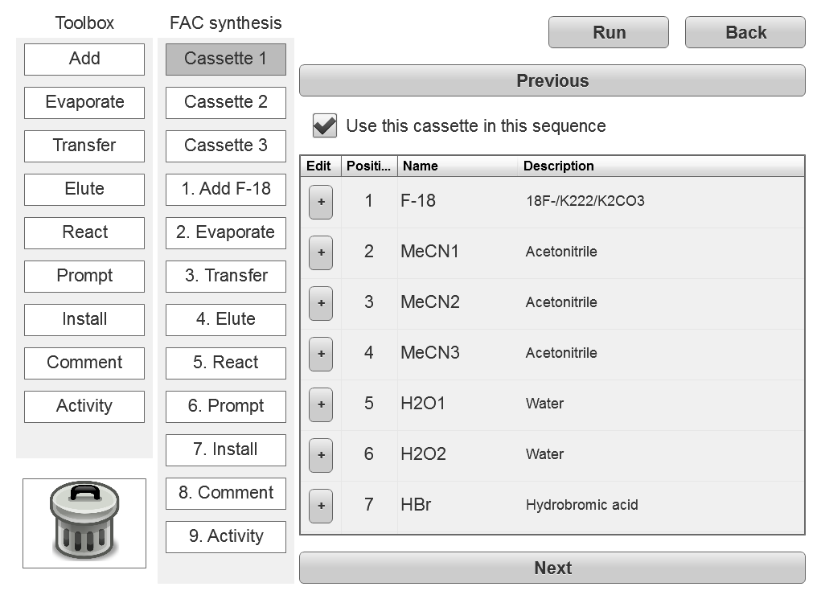
Edit Sequence
(Cassette)
Tap/click to enable or disable this cassette.
Tap/click to edit this reagent.

Slide 16
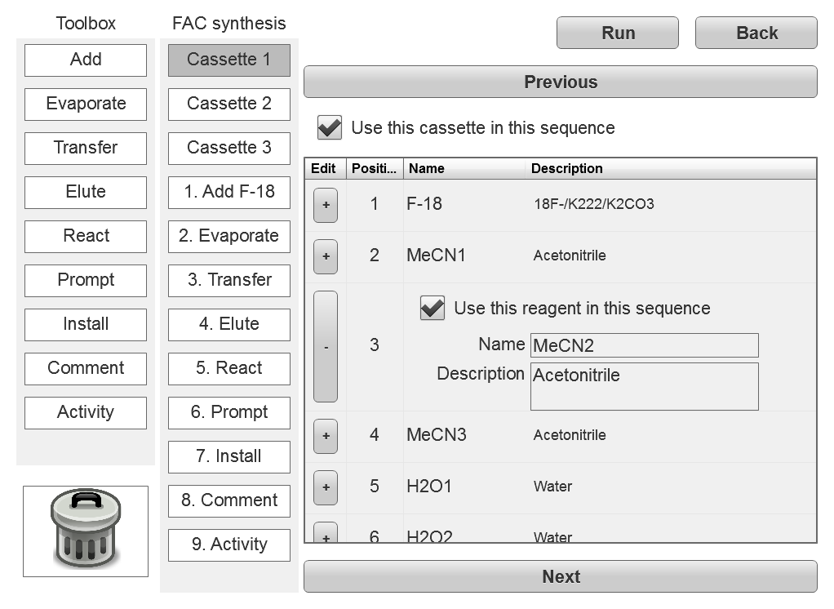
Edit Sequence
(Cassette)
Tap/click to enable or disable this reagent.
Enter unique name (required) and description (optional).

Slide 17
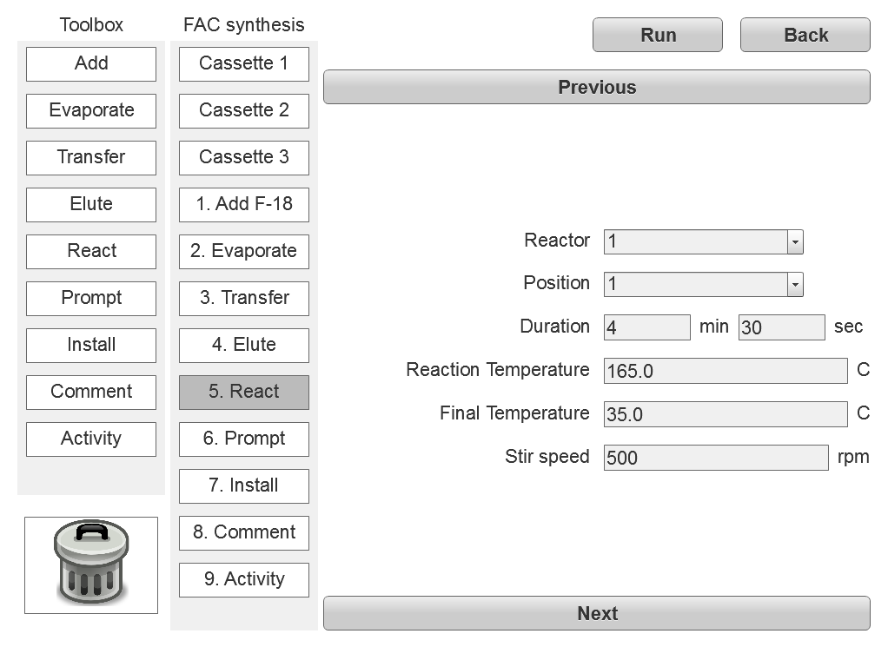
Edit Sequence
(Add/Insert)
Drag operation from toolbox and drop in sequence to add/insert.

Slide 18
Edit Sequence
(Reorder/Delete)
Drag operation up or down to reorder.
Drag operation to trash can to delete.

Slide 19
Edit Sequence
(Set Parameters)
Click/tap an operation in the middle panel to change the contents of the right panel.
Set the operation parameters in the right panel.

Slide 20
Edit Sequence
(Validation 1)
Icons used to visually indicate validation errors. Tap icon to view the error message.
!
!

Slide 21
Edit Sequence
(Validation 2)
Validation error: The reaction temperature must be below 473 K.
!
!
OK

Slide 22
Edit Sequence
(Validation 3)
Validation errors will cause a warning when Back is clicked or an error when Run is clicked.

Slide 23
Edit Sequence
(Validation 4)
The sequence “FAC (high temp)” has validation errors. Are you sure you want to go back to the sequence selection screen?
Cancel
Back

Slide 24
Edit Sequence
(Validation 5)
The sequence “FAC (high temp)” cannot be run because it contains validation errors.
OK

Slide 25
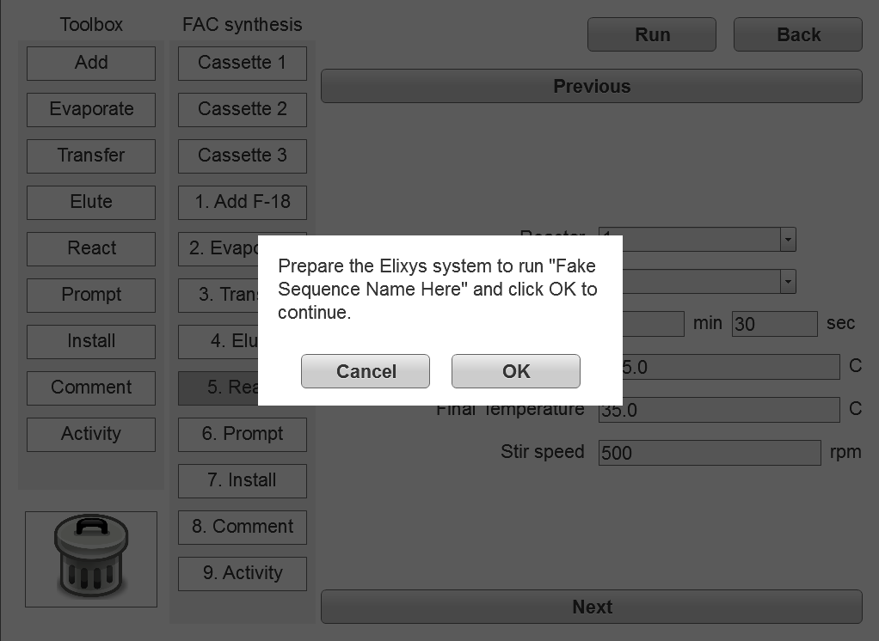
Run Sequence
(Start)

Slide 26
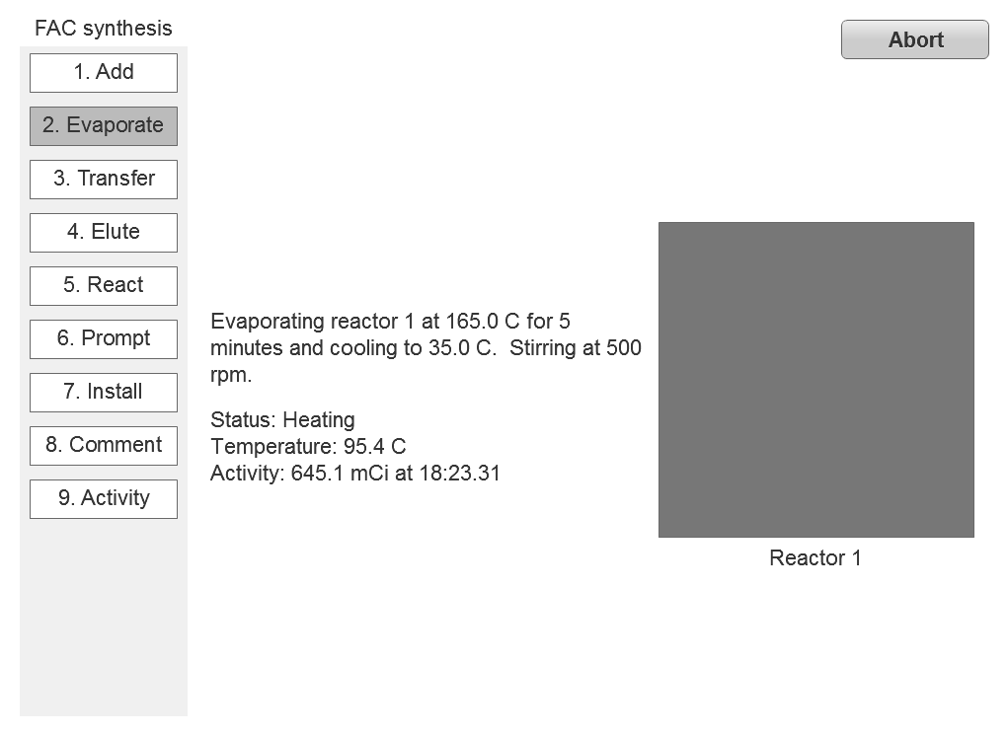
Run Sequence
Advances automatically with the run (scrollable but not selectable).

Slide 27
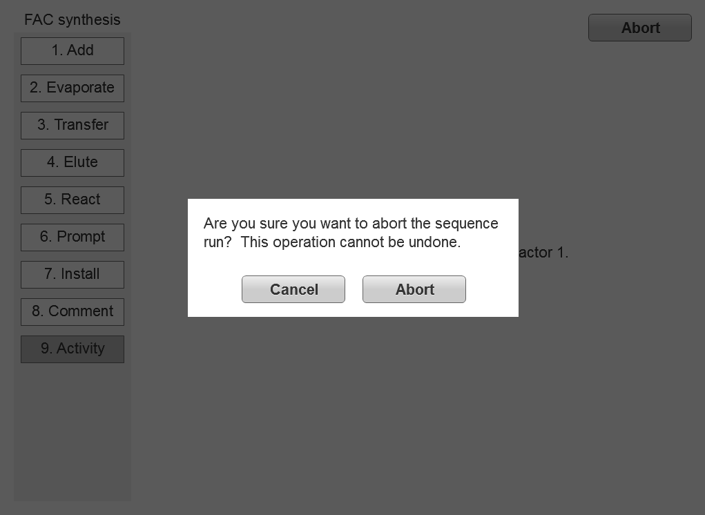
Run Sequence
(Abort)

Slide 28
Run Sequence
(Complete)
Sequence run “FAC (high temp)” completed successfully.
OK

Slide 29
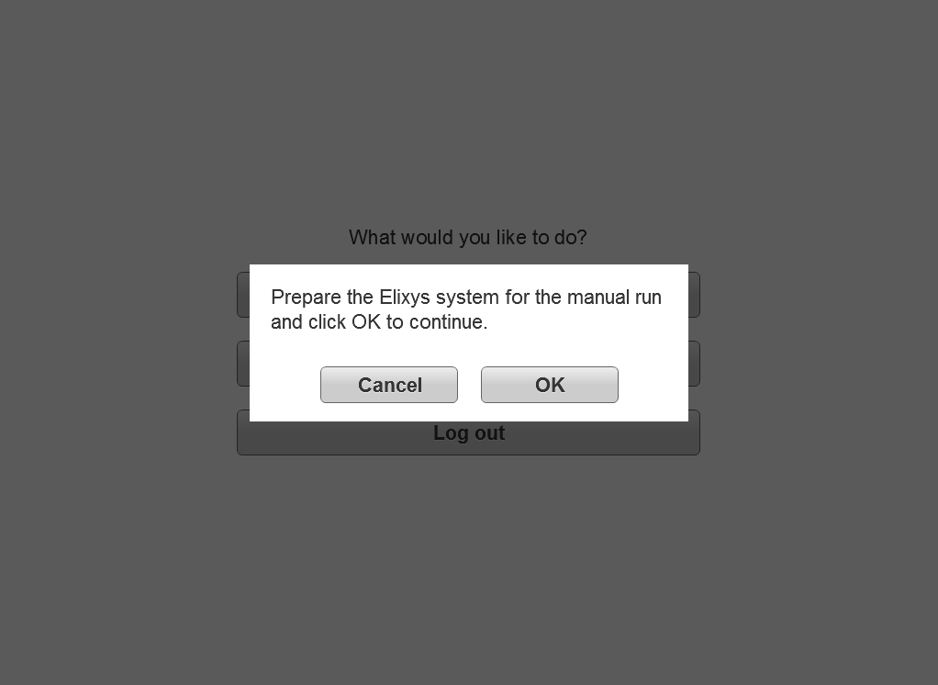
Manual Run
(Start)

Slide 30
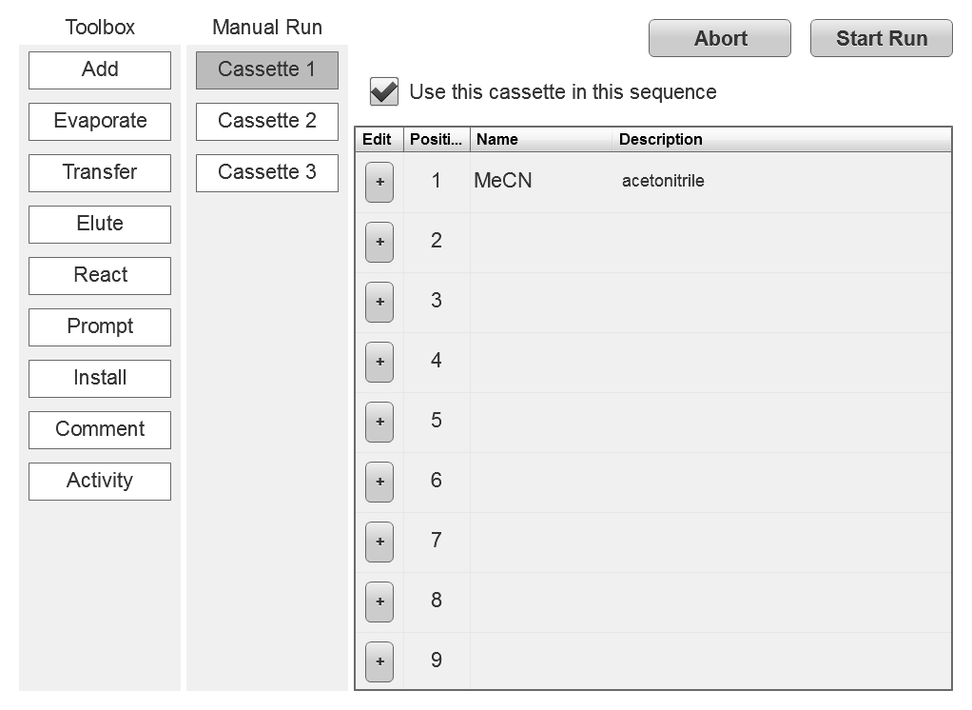
Manual Run
(Cassette)
Abort Run
Click/tap to select cassettes.
Enter the reagents and columns in each cassette.

Slide 31
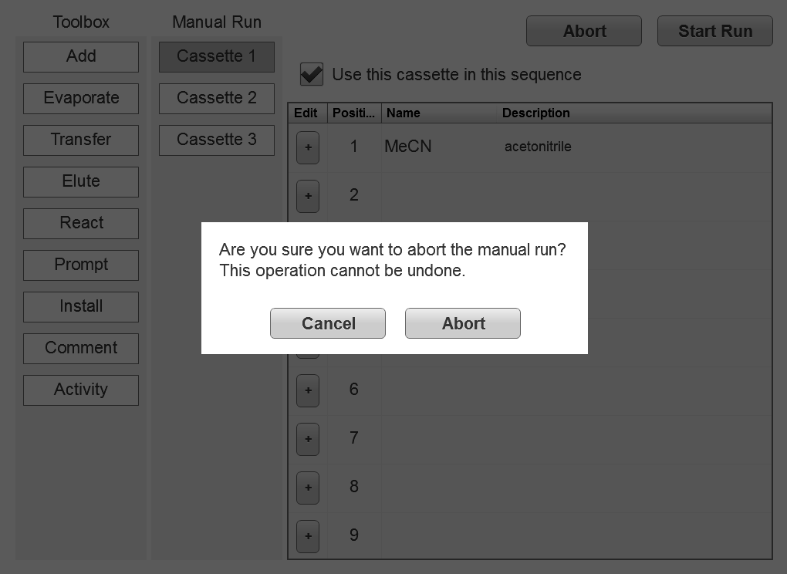
Manual Run
(Cancel)

Slide 32
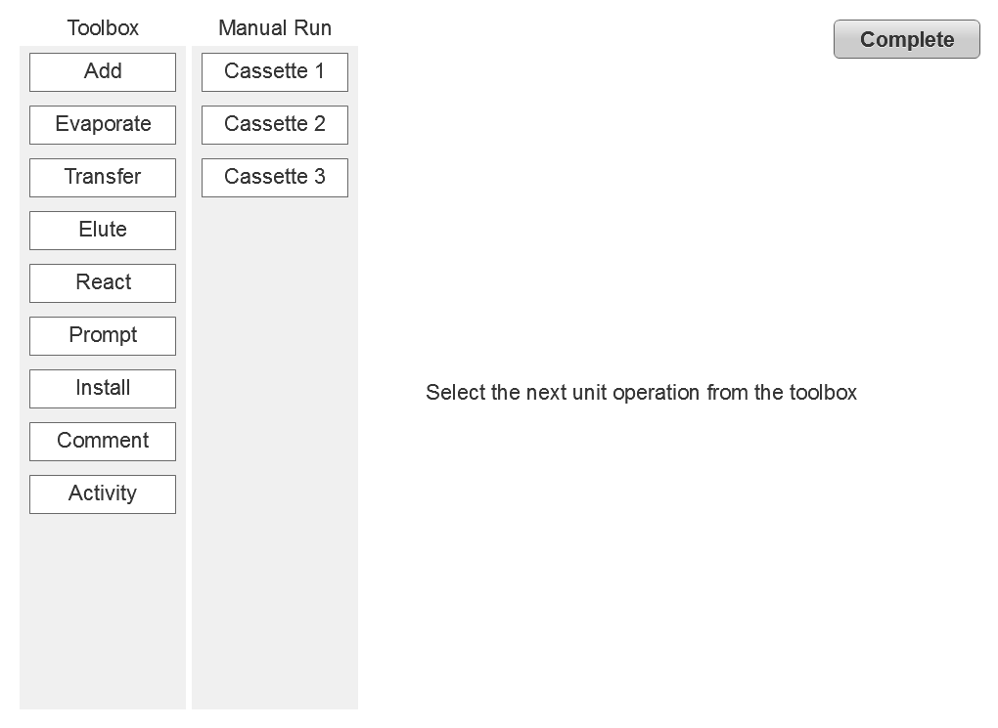
Manual Run
(Select)
Click/tap to select the next unit operation
Select the next unit operation from the toolbox or click the button below if the run is complete.
Manual Run Complete
Read only (scrollable but not selectable)

Slide 33
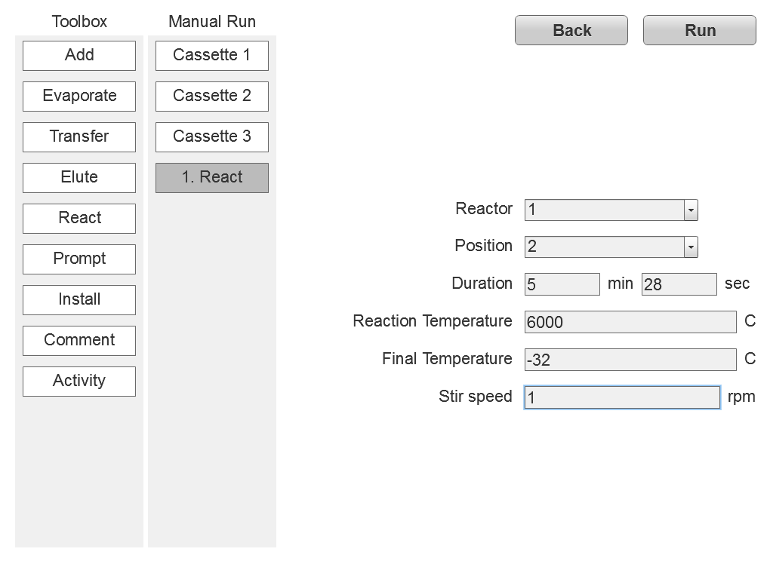
Manual Run
(Configure)
Read only (scrollable but not selectable).
Validate operation parameters when Run is clicked.

Slide 34
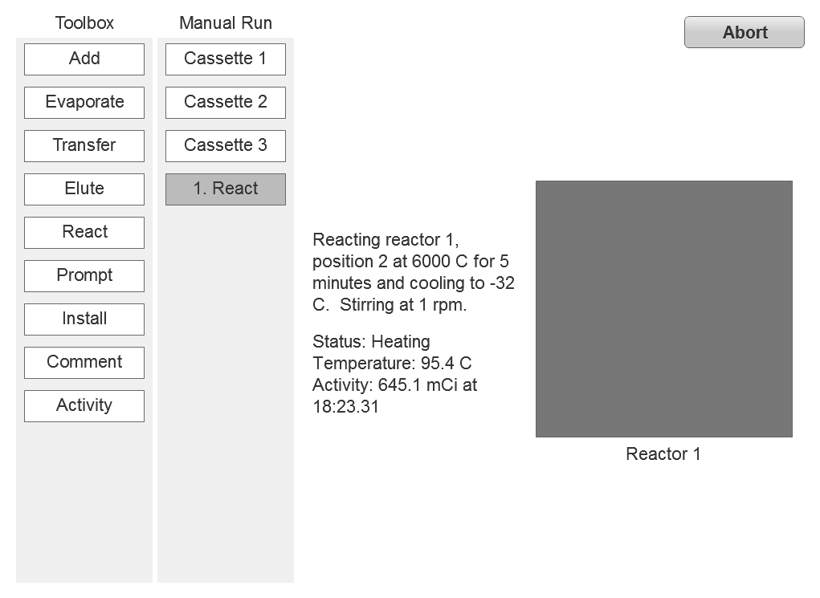
Manual Run
(Run)
Read only (scrollable but not selectable).

Slide 35
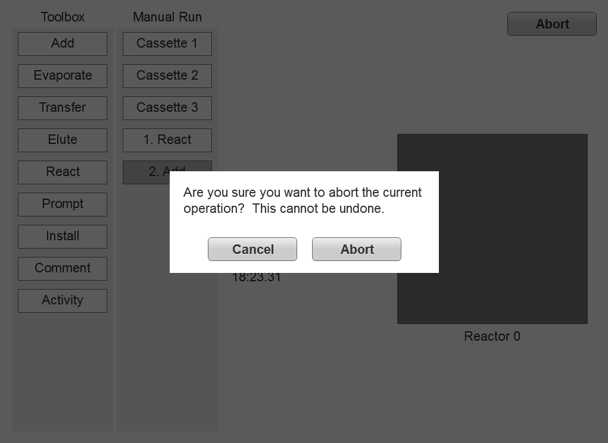
Manual Run
(Abort)

Slide 36
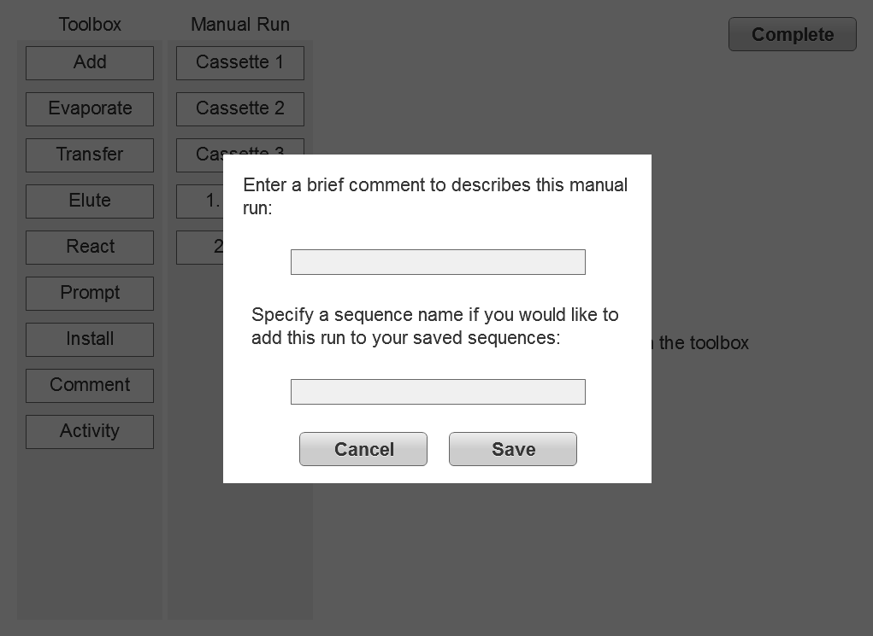
Manual Run
(Complete)

Slide 37
This section describes the details for each unit operation:
View
Edit
Run

Slide 38
Add Operation
This operation is only needed on the new Elixys system.
View:
Add 10 mg tribenzoyl pentose triflate in 0.5 mL acetonitrile to reactor 1.
Edit:
Reactor:
1
Reagent:
Precursor1
Run:
Adding 10 mg tribenzoyl pentose triflate in
0.5 mL acetonitrile (MeCN) to reactor 1.
Temperature: 39.3 ⁰C
Activity: 15 mCi at 4:53 pm
Reactor 1 Video

Slide 39
Evaporate Operation (1)
View:
Evaporate reactor 1 at 105 ⁰C for 3 minutes and cool to 35 ⁰C. Stir at 500 rpm.
Edit:
Reactor:
1
Duration:
3
min
0
sec
Evaporation temperature:
80.0
⁰C
Final temperature:
35.0
⁰C
Stir speed:
500
rpm

Slide 40
Evaporate Operation (2)
Run:
Evaporating reactor 1 at 105 ⁰C for 3 minutes and cooling to 35 ⁰C. Stirring at 500 rpm.
Status: Heating
Temperature: 78.9 ⁰C
Activity: 15 mCi at 4:53 pm
Reactor 1 Video

Slide 41
Transfer Operation
View:
Transfer the contents of reactor 1 to the Silica gel cartridge.
Edit:
Reactor:
1
Target:
Column1
Run:
Transferring the contents of reactor 1 to the Silica gel cartridge.
Temperature: 39.3 ⁰C
Activity: 15 mCi at 4:53 pm
Reactor 1 Video

Slide 42
Elute Operation
View:
Elute the Silica gel cartridge with ethyl acetate into reactor 2.
Edit:
Reactor:
1
Reagent:
MeCN1
Target:
Unit 2
Run:
Eluting the Silica gel cartridge with ethyl acetate into reactor 2.
Temperature: 39.3 ⁰C
Activity: 15 mCi at 4:53 pm
Reactor 1 Video

Slide 43
React Operation (1)
View:
React reactor 1, position 1 at 160 ⁰C for 15 minutes and cool to 35 ⁰C.
Stir at 5000 rpm.
Edit:
Reactor:
1
Position:
1
Duration:
15
min
0
sec
Reaction temperature:
160.0
⁰C
Final temperature:
35.0
⁰C
Stir speed:
5000
rpm

Slide 44
React Operation (2)
Run:
Reacting reactor 1, position 1 at 160 ⁰C for 15 minutes and cooling to 35 ⁰C. Stirring at 5000 rpm.
Status: Reacting, 8:23 minutes elapsed
Temperature: 112.0 ⁰C
Activity: 15 mCi at 4:53 pm
Reactor 1 Video

Slide 45
Prompt Operation (1)
View:
Prompt the user "Please add 1 mL methanol/dichloromethane to
reactor 2 (1 of 5)"
Edit:
Message:
Please add 1 mL methanol/dichloromethane to reactor 2 (1 of 5)

Slide 46
Prompt Operation (2)
Please add 1 mL methanol/
dichloromethane to reactor 2 (1 of 5)
Abort
OK

Slide 47
Move Operation
This operation is only needed on the original ARC-P system.
View:
Move reactor 2 to position 1 and close.
Edit:
Reactor:
2
Position:
1
State:
Close
Run:
Moving reactor 2 to position 1 and closing.
Temperature: 39.3 ⁰C
Activity: 12 mCi at 4:53 pm

Slide 48
Install Operation (1)
This operation is only needed on the new Elixys system.
View:
Move reactor 2 to the install position and prompt the user “Take an
aliquot of the reaction for HPLC analysis.”
Edit:
Reactor:
2
Message:
Take an aliquot of the reaction for HPLC analysis.
Run:
Moving reactor 2 to the install position.
Temperature: 39.3 ⁰C
Activity: 15 mCi at 4:53 pm

Slide 49
Install Operation (2)
This operation is only needed on the new Elixys system.
Take an aliquot of the reaction
for HPLC analysis.
Abort
OK

Slide 50
Comment Operation
View:
This is a comment entered by the user to make a note,
label a section of the synthesis reaction, etc.
Edit:
Comment:
This is a comment entered by the user to make a note, label a section of the synthesis reaction, etc.
Comment operations are ignored during the sequence run.

Slide 51
Read Activity Operation
This operation is only needed on the new Elixys system.
View:
Read the radiation activity level of the vial in reactor 2.
Edit:
Reactor:
2
Run:
Reading the radiation activity level of the vial in reactor 2.
Temperature: 39.3 ⁰C
Activity: 15 mCi at 4:53 pm

