Slide 1
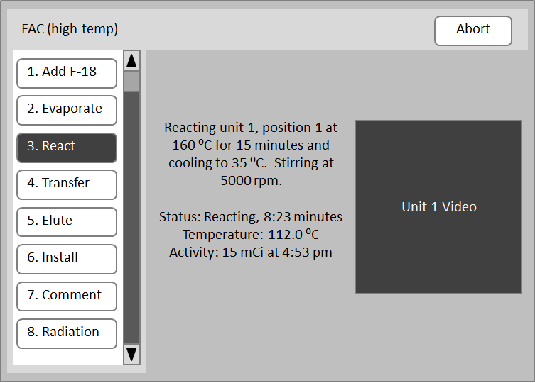
Client
Server
Browser
HTTP GET /
Redirect to HTTPS
HTTPS GET /
401 Not Authorized
HTTPS GET / (+Credentials)
index.html
HTTPS GET /Elixys.swf (+Credentials)
Redirect with client IP added to URL
HTTPS GET /Elixys.swf?clientip=192.168.1.10 (+Credentials)
Elixys.swf
HTTPS GET/POST/DELETE (+Credentials)
JSON
Prompt user
for name and password
Browser

Slide 2
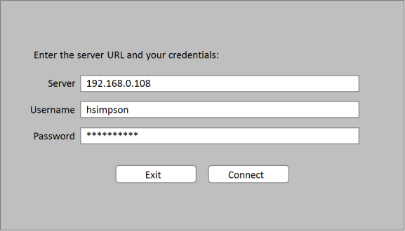
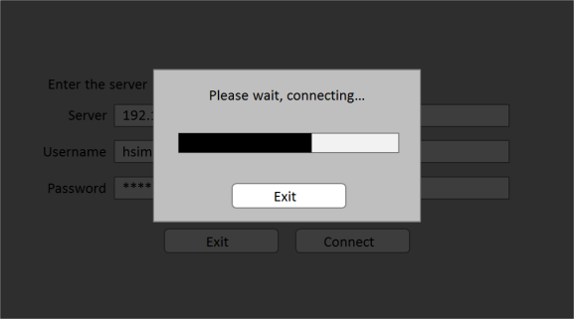
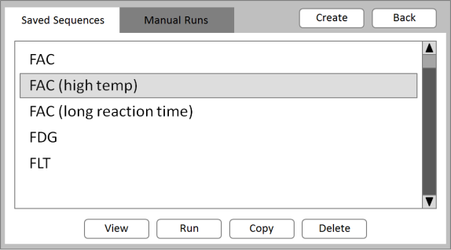
Client
Server
Elixys.exe
Get server IP, user name and password.
Elixys.exe
HTTPS GET /Elixys.swf?donot=redirect (+Credentials)
Elixys.swf
HTTPS GET/POST/DELETE (+Credentials)
JSON
Elixys.exe

Slide 3
Elixys.exe
HTTPS GET/POST/DELETE (+Credentials)
JSON
server.py

