Slide 1


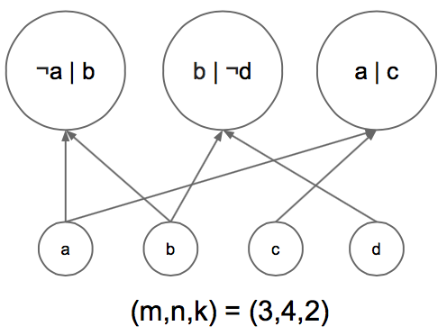
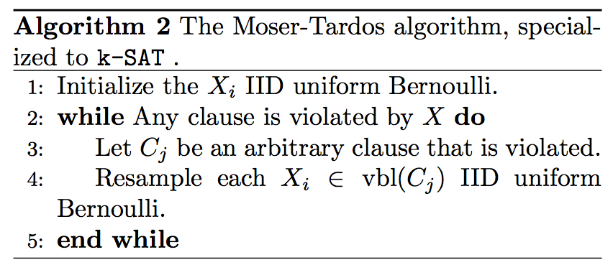
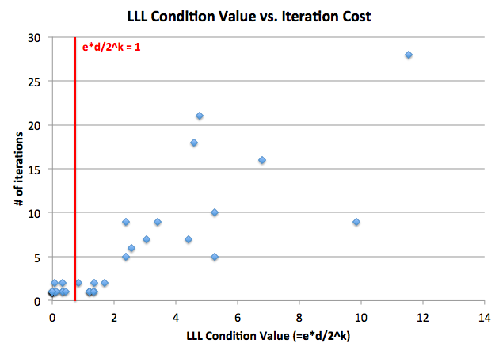
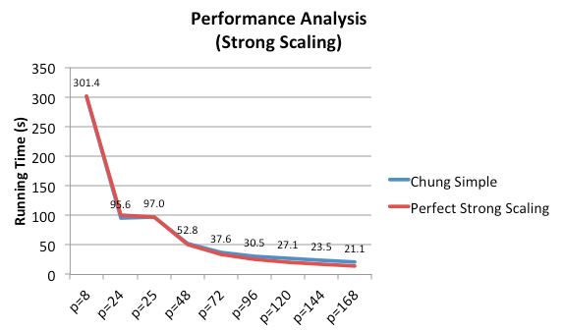
The Algorithmic Lovász Local Lemma:
k-SAT and Beyond
Henry Milner, Derek Kuo, Ion Stoica
EXAMPLE: SOLVING K-SAT
DEPENDENCIES AND PARALLELISM
BEYOND K-SAT
k-SAT: Find solutions for a boolean formula, e.g.:
(!a | b) & (b | !d) & (a | c)
NP-complete for k > 2, but many instances can be solved!
Moser and Tardos: Essentially the same random walk algorithm will work for any problem of finding “flawless” settings of n variables under similar conditions.
Proof (Tao): Each iteration uses k random bits, and to initialize we use n random bits. After t iterations, it has used (n+kt) random bits. But, under the limited-dependence assumption, we can encode the state on each iteration using only (k-C) bits on average and an overhead of (m+n), for a total of (m+n+(k-C)t) bits. Compressing random bits is impossible, so the algorithm must terminate before m/C iterations on average.
The Moser-Tardos theorem applies when our space consists of vectors of variables, but not to, say, spaces of permutations or spaces of infinite dimension. But this novel entropy-compression argument can be applied more broadly as a new way to bound running times of randomized algorithms.
Entropy-compression argument: Say that an algorithm has failed to find a flawless object after t steps, and its state vector has entropy H(Z). If we can write down a deterministic (possibly lossy) function of the state vector, Y, such that H(Z) > H(Y) + H(Z | Y), then we have a contradiction, and the algorithm must terminate before step t in expectation.
Achlioptas and Iliopoulos: Moser-Tardos-like random walk algorithms work for finding flawless objects in arbitrary finite spaces, as long as the space and algorithm satisfy similar conditions. The running time depends on m and log(|Ω|), the encoding length of the state space.
Conjecture: Moser-Tardos-like random walk algorithms work for finding flawless objects in any space, as long as the space and algorithm satisfy similar conditions. The running time depends on the entropy of the state space under the initial sampling distribution of the algorithm.
MOSER-TARDOS ALGORITHM
Challenge: Find a large independent set on each iteration.
EXPERIMENTS
…but the dominant cost is graph construction!
SUFFICIENT CONDITIONS
Theorem (Moser and Tardos): If e*p*(d+1) < 1, the Moser-Tardos algorithm terminates (on average) in O(poly(n, m, k)) time, where:
p = max_{i} P(random assignment does not satisfy clause i)
d = maximum degree of dependency graph for clauses
If the clauses were independent (max degree = 0) then the problem would be trivial. The theorem says a similar thing when the dependence is limited.
REFERENCES
[1] Dimitris Achlioptas and Fotis Iliopoulos. Random walks that find perfect objects and the Lovasz local lemma. In Foundations of Computer Science (FOCS), 2014 IEEE 55th Annual Symposium on, pages 494–503. IEEE, 2014.
[2] Kai-Min Chung, Seth Pettie, and Hsin-Hao Su. Distributed algorithms for the Lovasz local lemma and graph coloring. In Proceedings of the 2014 ACM symposium on Principles of distributed computing, pages 134–143. ACM, 2014.
[3] Robin A. Moser and Gabor Tardos. A constructive proof of the general Lovasz local lemma. J. ACM, 57(2):11:1–11:15, February 2010.
[4] Terence Tao. Moser’s entropy compression argument. https:// terrytao.wordpress.com/2009/08/05/ mosers-entropy-compression-argument/, 2009.

