Slide 1
Microsoft Azure Architect Technologies AZ-300
Dan Lewis

Slide 2
Architecture Style
N-tier application
Web-queue-worker
Microservices
Event-driven architecture

Slide 3
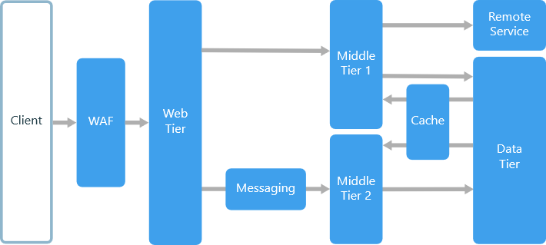
N-tier application

Slide 4
Virtual Machines
Windows Virtual Machines
Linux Virtual Machines
Deploying from custom images
Monitoring
Backup
Migration

Slide 5
Networking
Virtual Networks
DNS
Peering
Routing
Firewalls
Load Balancers
VPN Gateways
ExpressRoute

Slide 6
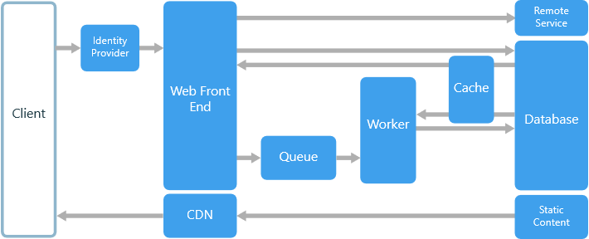
Web-queue-worker

Slide 7
Storage
Blobs
Files
Tables
Queues
Content Delivery Network

Slide 8
Application Services
Web Apps
Functions
Service Bus
Logic Apps

Slide 9
Identity
Azure Active Directory Identities
Securing Azure Active Directory
Hybrid Identity

Slide 10
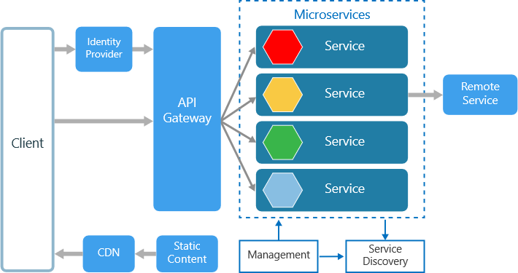
Microservices

Slide 11
Containers
Container Instances
Azure Container Registry
Azure Kubernetes Service
Application Gateway

Slide 12
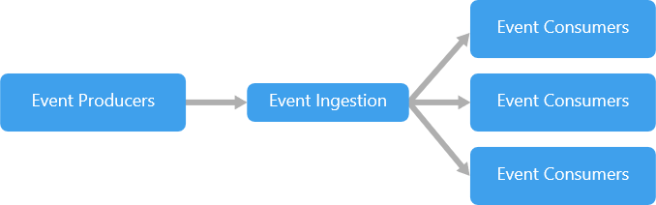
Event-driven architecture

Slide 13
Integration
Service Bus Relay
Event Hubs
Notification Hubs

