Slide 1
AZ-300T02 M 1: Evaluating and Performing Server Migration to Azure
Migrate to Azure
Azure Migrate Process
Overview of Azure Site Recovery (ASR)
Preparing the Infrastructure
Completing the Migration Process

Slide 2
Lesson 1: Migrate to Azure
Video: Migration
Migration Goals
Migration Phases
Azure Migration Service
Video: Azure Migrate
Video: Migrating Applications to the Cloud
Using Azure Migrate: A Look ahead

Slide 3
Video: Migration At the end of this module There will be a full demo for "Migration to Azure"
Migrate on-premises to Azure
Hyper-V
VmWare
P2V
Migrate from IaaS to PaaS
Sql server to Azure DB
IIS to webapp
Migrate from Cloud Services to PaaS
Native app or Migration
Use your own licence
Notes:
Tell about the idea and types of migration..
Assess / Optimise / Migratre
Migrate on-premises to Azure
Hyper-V
VmWare
P2V
Migrate from IaaS to PaaS
Sql server to Azure DB
IIS to webapp
Migrate from Cloud Services to PaaS
Native app or Migration
Use your own licence

Slide 4
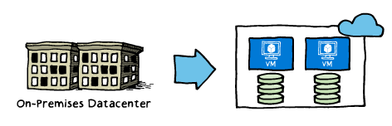
Migration Goals
Technology-focused and business-focused, including:
Addressing the hardware obsolescence cycle
Moving away from the ‘pre-purchase capacity’ model
Lack of IT agility
Desire to re-focus on core competencies
Expense of maintaining a global presence
Enable disaster-recovery scenarios

Slide 5
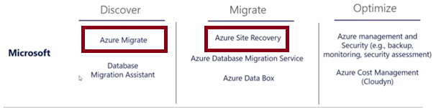
Migration Phases
When planning for migration to Azure, consider the following phases:
Discover: gain better visibility of on-premises workloads and assess the optimal resource level to run them in Microsoft Azure.
Azure Migrate is the primary tool for this, and includes:
Automated server, app, and database discovery.
Intelligent workload right-sizing and costing for maximum ROI.
Workload configuration analyses and recommendations.
Migrate: move selected workloads to Azure.
Azure Site Recovery is the primary tool for this and includes:
Lifting and shifting of servers, apps, databases, and data.
Containerization of existing applications and infrastructure
Modernization options for apps and databases.
Optimize: fine tune your Azure-based workloads and maximize your ROI.
There are many Microsoft partners to help you with backup, monitoring, security assessments, and cost management.

Slide 6
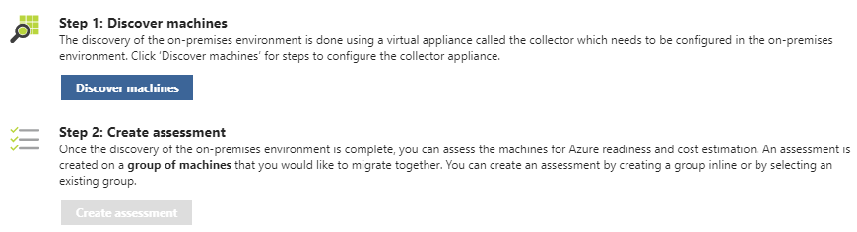
Azure Migration Service
Provides assessment of on-premises workloads for migration to Azure:
migration suitability of on-premises machines
performance-based sizing
cost estimates for running your on-premises machines on Azure VMs
Follows two steps:
Discover machines
Create Assessments

Slide 7
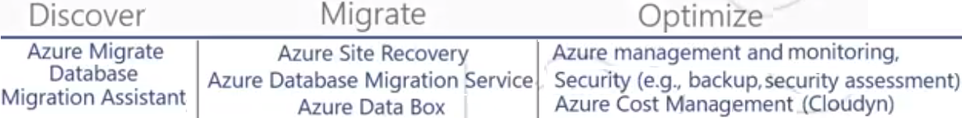
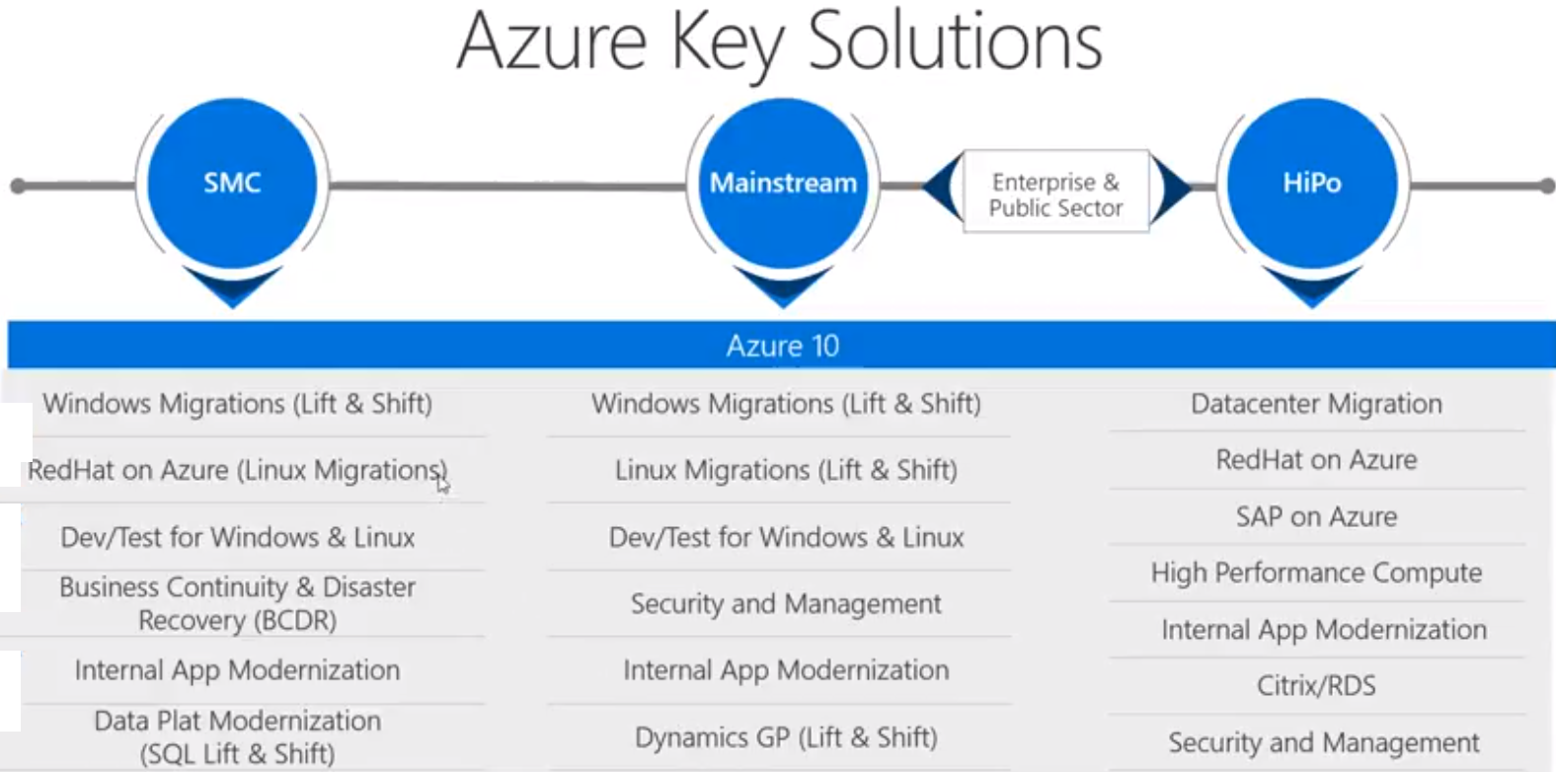
Video: Azure Migrate
Notes:
Azure Migrate
Helps you with discovery and assesment of on prem Applications and VMs
Provides service dependency mapping capability where you can get a Graphical view of all the
different machines and servers that are involved in an application so that you are moving everything up to the cloud in an azure migration. It also involves an delivers worload assessments it can help you to determine right size for your Azure resources.
Looks for your on-prem workload and map that into Azure. What azure vm size you will need for the vm on your on-prem.
Currently Azure migrate only supports VmWare virtualized Windows and Linux VMs.
Free for all customers and partnetrs.
Pricing - https://azure.microsoft.com/en-us/pricing/details/azure-migrate/
Documentation https://docs.microsoft.com/en-us/azure/migrate/migrate-overview
Demo https://azure.microsoft.com/en-us/resources/videos/migration-with-azure-migrate/
Lab - https://aka.ms/azuremigrate_hol ---- https://www.microsoft.com/handsonlabs/selfpacedlabs

Slide 8
Video: Migrating Applications to the Cloud

Slide 9
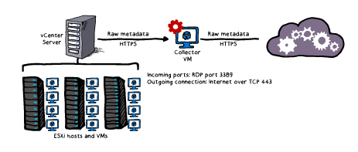
Using Azure Migrate: A Look ahead
Architecture:
Closely integrated with the components of an VMware vCenter environment
Process
Create a project
Discover the machines
Collect the information
Assess the project

Slide 10
Lesson 2: Azure Migrate Process
Creating a Project
Creating a Collector
Assessing Readiness
Assessing VM Sizing
Estimating Cost
Customizing the Assessment
Troubleshooting Azure Migrate
Demonstration: Azure Migrate
Practice: Discover and Assess
Practice: Azure Migrate

Slide 11
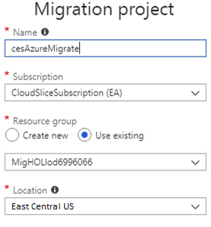
Creating a Project
The initial step of the Azure Migrate
A project contains metadata representing on-premises environment:
Name
Subscription
Resource Group
Location
Discovery records of VMware VMs
Project limits:
Up to 1,500 discovered VMs per project
Up to 1,500 assessed VMs per project
Up to 20 projects per subscription

Slide 12
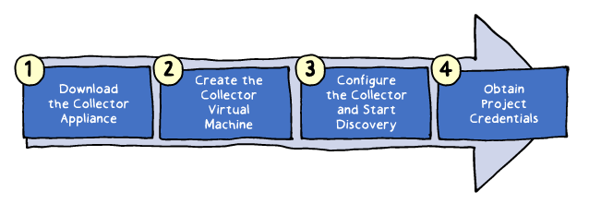
Creating a Collector
A virtual appliance which handles discovery
Implementation consists of four main steps:
Downloading the Collector appliance (an Open Virtualization Appliance (.ova) file downloadable from the Azure Migrate project in the Azure portal)
Creating the Collector virtual machine by importing the .ova file on the vCenter server
Configuring the Collector to initiate discovery
Assigning to the Collector project credentials including Azure Migrate project ID and key

Slide 13
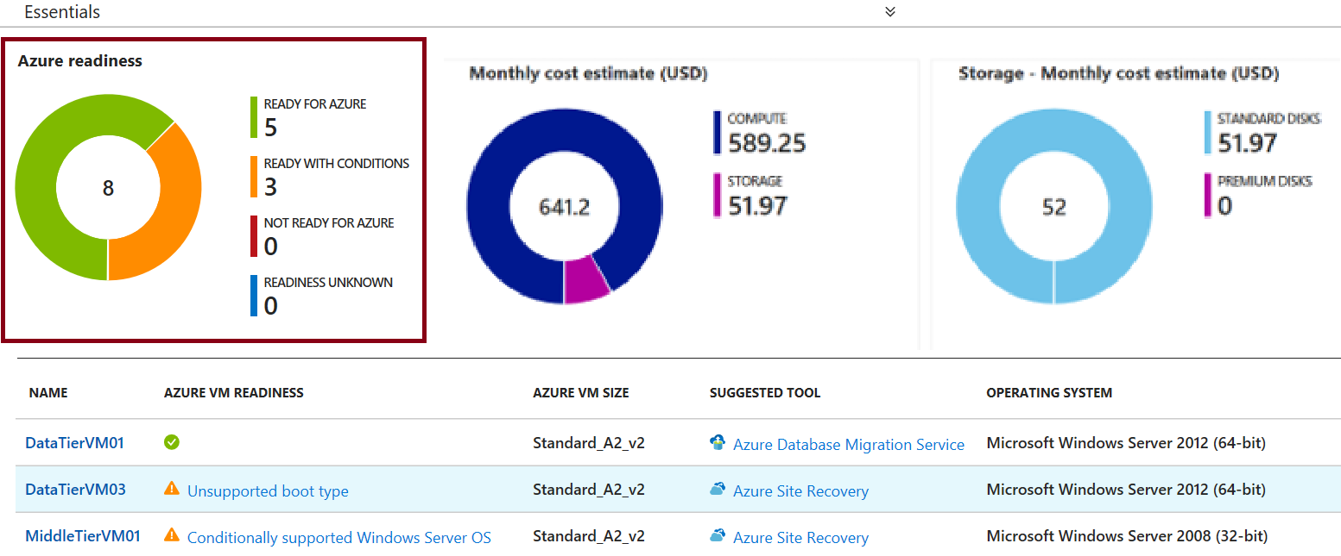
Assessing Readiness
Assessment is based on the readiness status of discovered VMs:
Ready for Azure (green): along with the recommended Azure VM size
Ready with conditions (Orange) and Not ready for Azure (Red): including readiness issues and remediation steps.
Readiness unknown (Blue)

Slide 14
Assessing VM Sizing
Azure Migrate VM assessment offers two types of sizing :
Performance-based sizing (default) which takes into account:
Storage: maps the size and performance of VM disks to Azure VM disks
Network: identifies Azure VM sizes that offer matching number and performance of network adapters
Compute: determines CPU and memory requirements based on performance history of discovered VMs
On-premises sizing:
Matches the size of on-premises VM to an equivalent Azure VM
Does not take into account performance history of discovered VMs

Slide 15
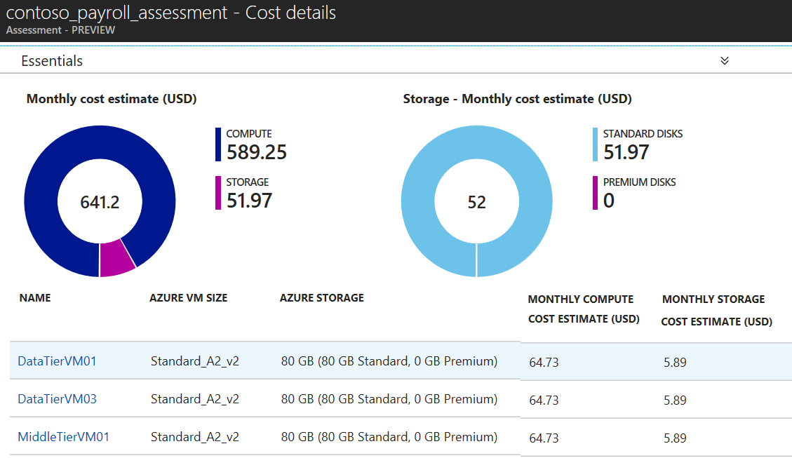
Estimating Cost
Provides the total costs of Azure VMs:
Compute: aggregated monthly cost, which takes into account:
OS type
Software Assurance
Reserved Instances
VM uptime
VM location
currency settings
Storage: aggregated monthly cost.
No offer specific settings

Slide 16
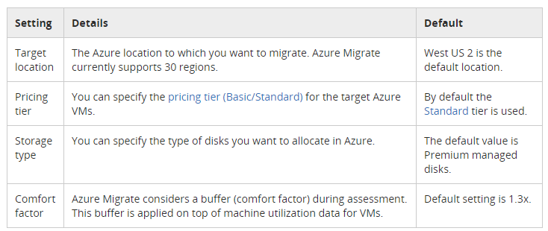
Customizing the Assessment
Customization settings include:
Performance history duration
Target location
Pricing tier
Storage type
Comfort factor
Currency
Discounts
VM uptime

Slide 17
Troubleshooting Azure Migrate
The most common issues include:
Migration project creation failed
No performance data
Collector is not able to connect to the internet
Date and time synchronization error
Error UnableToConnectToServer

Slide 18
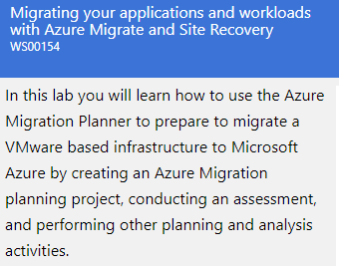
Demonstration: Azure Migrate
https://www.microsoft.com/handsonlabs/selfpacedlabs
Search for Migration
Notes:
You can show the part on the video about the reports.

Slide 19
Practice: Discover and Assess

Slide 20
Practice: Azure Migrate

Slide 21
Lesson 3: Overview of Azure Site Recovery (ASR)
Video: ASR Capabilities
ASR Scenarios
ASR Features
Video: ASR Features
Video: ASR End to End
Using ASR: A Look Ahead

Slide 22
Video: ASR Capabilities

Slide 23
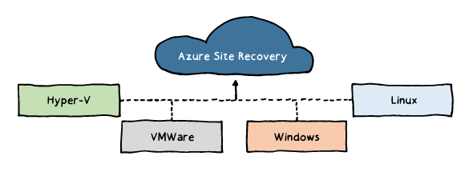
ASR Scenarios
Hyper-V VM replication:
Hyper-V with Virtual Machine Manager (VMM):
Replication to Azure or a secondary datacenter.
Hyper-V without VMM:
Replication to Azure only.
VMware VM replication:
Replication to a secondary site running VMware or to Azure.
Physical Windows and Linux machines:
Replication to a secondary site running VMware or to Azure.

Slide 24
ASR Features
Eliminating the need for disaster recovery sites
Reducing infrastructure costs
Automatically replicating to Azure
Safeguarding against outages of complex workloads
Extending or boosting capacity
Continuous health monitoring

Slide 25
Video: ASR Features

Slide 26
Video: ASR End to End

Slide 27
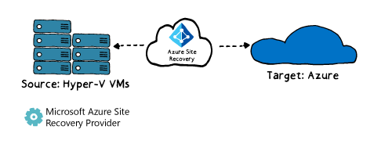
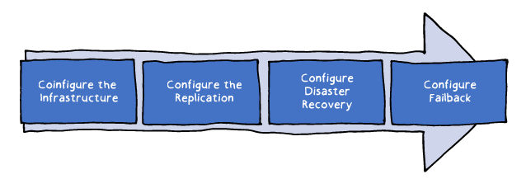
Using ASR: A Look Ahead
Architecture:
The primary and a secondary site
On-premises or in Azure
Process:
Configure the Infrastructure
Configure the Replication
Configure Disaster Recovery
Configure Failback

Slide 28
Lesson 4: Preparing the Infrastructure
Configuring Azure
ASR Deployment Planner
Configure the Infrastructure: Requirements
Configure the Infrastructure: Process
Recovery Services Vault
Video: Configure the Infrastructure
Practice: Preparing the Azure Environment
Practice: Preparing On-premises Hyper-V Servers

Slide 29
Configuring Azure
Delegate permissions within the target Azure subscription:
Virtual Machine Contributor built-in role
Site Recovery Contributor built-in role
Create an Azure Storage account:
General Purpose
Read-access geo-redundant
Secure transfer: Disabled
Create an Azure virtual network:
Ensure sufficient bandwidth for intersite replication

Slide 30
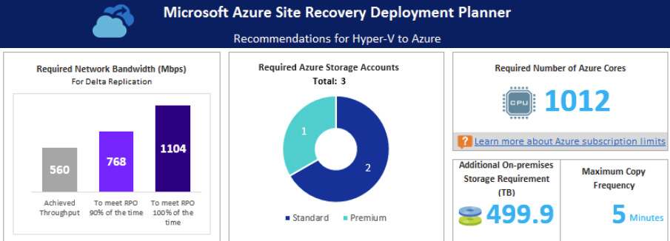
ASR Deployment Planner
A command line tool for profiling Hyper-V VMs to estimate:
Intersite network bandwidth requirements
Azure Storage requirements
Generates a report including:
On-premises summary
Recommendations
VM storage placement
Compatible VMs
Incompatible VMs
Storage requirement
Initial Replication batching
Cost estimate

Slide 31
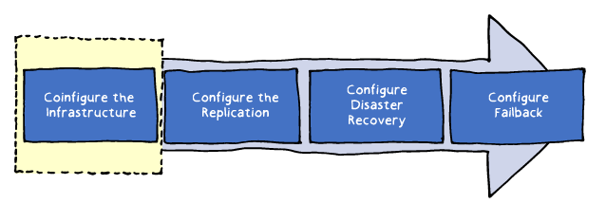
Configure the Infrastructure: Requirements
Verify Hyper-V operating system requirements:
Windows Server 2016 (including server core installation)
Windows Server 2012 R2 with latest updates.
Mixing hosts running Windows Server 2016 and 2012 R2 isn't supported.
Verify Hyper-V host and guest storage requirements:
Hyper-V host storage can include SMB 3.0, SAN (iSCSI), and Multi-path (MPIO).
No support for shared cluster disks and encrypted disks.
Verify internet access:
Hyper-V hosts should have direct access to the internet without using a proxy.
Prepare Windows VMs for access
following a failover (optional)

Slide 32
Configure the Infrastructure: Process
The Azure portal driven sequence:
1. Protection goal (e.g. replicating Hyper-V machines to Azure)
2. Source environment (e.g. Hyper-V site)
3. Target environment (e.g. a resource group in an Azure subscription)
4. Replication settings
5. Deployment planning

Slide 33
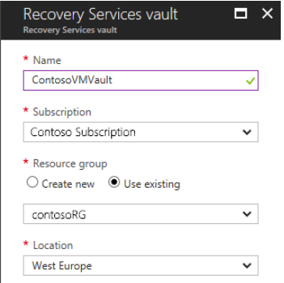
Recovery Services Vault
Hosts ASR metadata and replicated VM disks
Can be created directly from the Azure portal
Serves as the primary configuration interface

Slide 34
Video: Configure the Infrastructure

Slide 35
Practice: Preparing the Azure Environment

Slide 36
Practice: Preparing On-premises Hyper-V Servers

Slide 37
Lesson 5: Completing the Migration Process
Video: Configure Failback
Video: Troubleshoot Hyper-V to Azure Failover
Customize the Recovery Plan
Practice: Using PowerShell to Migrate VMs to Azure
Planned and Unplanned Failovers
Enable Replication
Test Failover
Failback
Virtual Machine Replication
Replication Policy

Slide 38
Video: Configure Failback

Slide 39
Video: Troubleshoot Hyper-V to Azure Failover

Slide 40
Customize the Recovery Plan
Select a replication goal
Set up the source and target environment
Set up a replication policy
Enable replication
Run a test migration to make sure everything's working as expected
Run a one-time failover to Azure

Slide 41
Practice: Using PowerShell to Migrate VMs to Azure

Slide 42
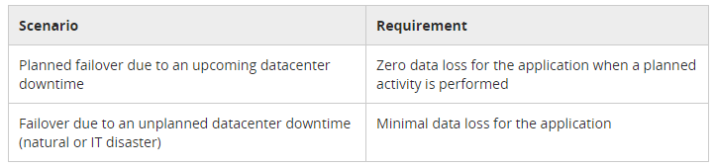
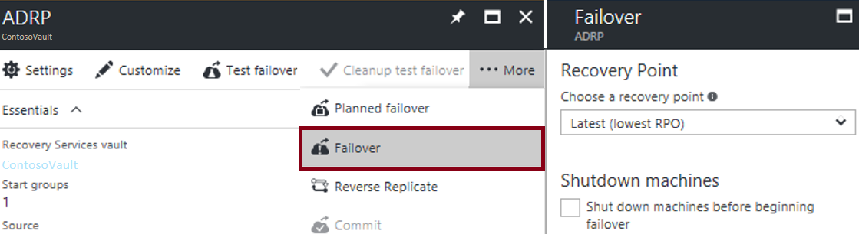
Planned and Unplanned Failovers
ASR facilitates two types of failover:
Planned: guaranteed no data loss
Unplanned: possible data loss
ASR failovers:
are not automatic
can be initiated from the Azure portal

Slide 43
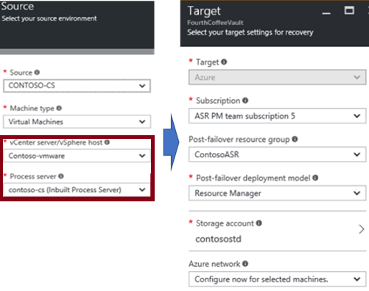
Enable Replication
Start by configuring:
Replication source
Replication target

Slide 44
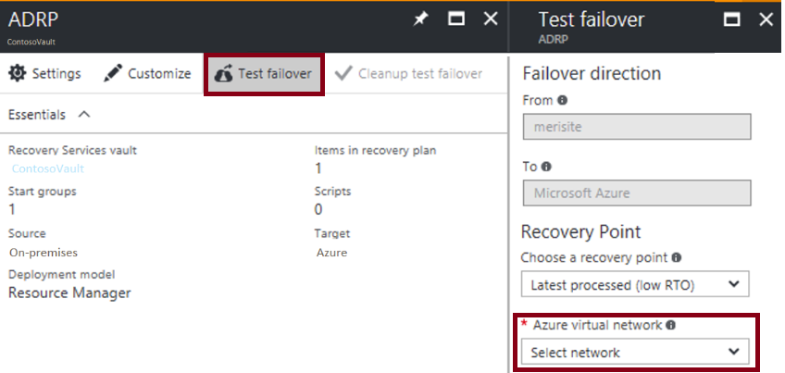
Test Failover
No-impact validation of replication and disaster recovery strategy:
Does not affect ongoing replication and the production environment
Supports single or multiple VMs
Does not require downtime
Does not introduce data loss
Best practices:
Use failover groups
Failover to an isolated network
Integrate with Azure Automation

Slide 45
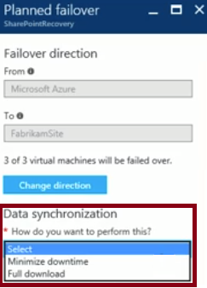
Failback
A planned failover back to the primary site
Offers two data synchronization methods:
Full download:
Faster
Requires VMs to be shut down
Minimize downtime:
Slower
Eliminates the need to shut down VMs

Slide 46
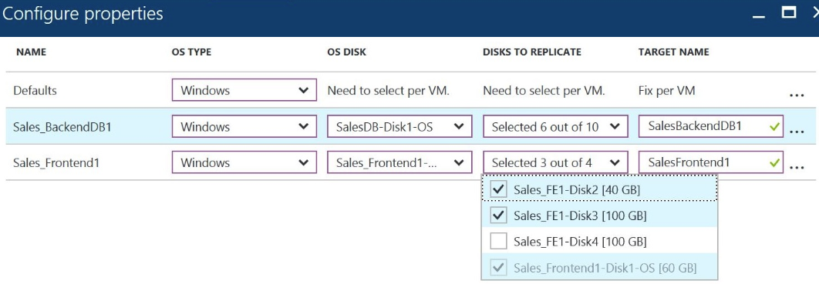
Virtual Machine Replication
To configure:
Select source computers
For each, select the OS type, OS disk, and data disks to replicate
Optionally, exclude disks (e.g. disks hosting a paging file)
For each, specify the name of a target VM

Slide 47
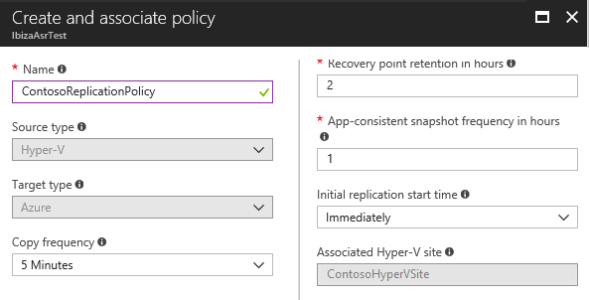
Replication Policy
To configure, specify the following parameters:
Copy frequency:
30 seconds
5 minutes
15 minutes (to be retired)
Recovery point retention
App-consistent snapshot
Initial replication start time

Slide 48
All The Demos
Notes:
Part 1 Configure a Vhost to demonstrate the VM Migration to Azure
Change one of the existing vm's size to D4s_v3
Create an inbound port to your VM on the NSG settings for port 80
Connect to this VM and install Roles and Features.
Hyper-V
Leave switch settings default do not change anything
Select “Allow this server to send and receive live migrations of virtual machines”
Be aware the option set the virtual machine migration set to KERBEROS, do not leave CredSSP...
if you skip this the RDP session will fail, you will need to chose non-secure option...
Remote Access
Routing, Remote Acccess..
Remote Access Install IIS, please stop IIS after the machine is Rebooted for Hyper-V Installation...
Choose the option “Restart the destination server automatically if Required” This will Reboot
After the vm is rebooted
Connect to vm again and download the win 2012 R2 vhd
https://www.microsoft.com/en-us/evalcenter/evaluate-windows-server-2012-r2
While waiting for download configure the Virtual Switch settings on hyper-v
Create an Internal Virtual Switch
Remember to STOP IIS ON VHOST
Configure RRAS
Choose Custom Settting and Choose NAT and Finish
Start the Service
Expand IPv4 and find NAT
Right Click and Add a New Interface
Choose your Network card On Vhost and Choose the option “Public Interface connected to Internet” tick “Enable NAT on this Interface”
Click Services and Ports TAB on the same window and select Web Server HTTP and provide the private IP address as 172.16.0.2 and OK this will be the guest OS ip address.
Right Click and Add a second Interface which is “Internal” connection and OK.
On Vhost configure the network settings, "vEthernet (Internal)" and change the ip adress from empty to 172.16.0.1 and SM:255.255.0.0
Vhost is ready for running the VM
Part 2 Create Vm on the VHost
Open HyperV console
Right click and choose New VM
Choose Generation 1
Give 8 GB Ram (8192)
Connection Internal
Use an Existing Virtual Hard Disk, browse for the one we recently downloaded and FINISH
Part 3 Run the Manage settings on the VM
No Need to change any settings location etc. Click Next
Accept EULA and assign the Administrator Password
Set the ip address 172.16.0.2 -- SM:255.255.0.0 – DG:172.16.0.1 – DNS:8.8.8.8
Ensure you access to internet (ping google.com)
Install IIS onto this vm..
Under C:\inetpub\wwwroot\ find iisstart.png and alter the image
Optional if you want you can rename the guest os to something...
Part 4 Publish this to Internet
Create an NLB
New->Networking –>NLB
Name: Migrated
Type: Public
SKU:Basic
A new Public IP provide a name like Migrate-Pip
Configure a static IP
Choose a RG and Location and set it up... (choose the location which this Hyper-V host is residing on)
Go to your NLB
Choose the option for Backend Pool and click ADD
Name:Migrated-BePool01
Choose the vm-host
Internal ip address of the vm Host
After completed go to "Inbound Nat Rules" click Add
Name:Migrate-80
Choose the front end ip as your Public ip created.
Service HTTP
Leave the rest as default and complete the configuration...
Go to your Public Ip on your browser and Ensure that you see the modified IIS Page
We have designed an environment that has a web page on its Host computer.
It is time to Migrate this to Azure as an asset..
Part 5 Get Prared for the ASR (Azure Site Recover)
Login Azure on VHost better to install chrome to that vm
New->Searhc for the marketplace Backup and Site Recovery
Name:ASR01
RG:Create or use an existing one
Location:Choose the one with your VHost
Open ASR01 and Click Site Recovery
Prepare Infrastructure
1 Protection Goal
On-Premises
Azure
With Hyper-V
No for VMM
2 Deployment Planning
Yes I have done it
3 Source
+ HyperV Site
Provide a Name Like QA-London
+ HyperV Server
3 Download ASR installer
4 Download Vault Registration big blue button
Instal ASR Installer click next until asks for Vault file
Click Register. Browse for the file you downloaded
Complete the installation and click FINISH
On Azure portal close the blades for Add Server and Prepare Source
Click Step 3 again Source
Ensure you see the VHost name and Click OK
4 Target
You will need a storage account to keep your migrated vm’s VHDs
+ Storage Account
Create a new storage account
Provide a unique name like cvaz101803str01
General Purpose 1
Standard
Locally Redundant
Now the storage account is ready
+VNet
Ensure you see the existing VNet which your VHost is member of choose that existing one
Click OK. If OK button does not appear Close this blade only and Click Step 4 again
5 Replication Settings
+ Create and Associate
Provide the name
Leave all the other options with default values
Ensure İnitial replication selected as Immediately
Click OK and Complete
Part 6 Let’s Replicate Click Step 1: Replicate Application
1 Source
On Premises
QA-London
2 Target
Even it allows you to choose different subscription if you have
RG Choose the VMs RG or any other RG you prefer
Storage account Choose the one we created on prior steps
Choose the VNet now
Choose the one with VHost VM residing on
Provide the subnet information
3 Virtual Machines
This will show the available Vms on your HyperV Host, we have only one
Select that one and click OK
4 Properties
Choose windows, because it is a windows OS and click OK
5 Replication Settings
A summary, just click OK
ENABLE REPLICATION --- This may take 5-7 minutes..
Part 7 Time to Failover
Go to ASR01
Click Test Failover
Choose the VNet and click OK
Under Site Recovery On the left down below Click Replicated Items
Click the VM that you replicated.
Ensure the status is Protected and Healthy
Click Failover (normally you should do Test Faiover first but no need to waste time) This will warn you about no tests have been done in past 180 days. Tick the box I understand the risk Skip the test failover and go on...
Click OK with default settings

